Slide 1

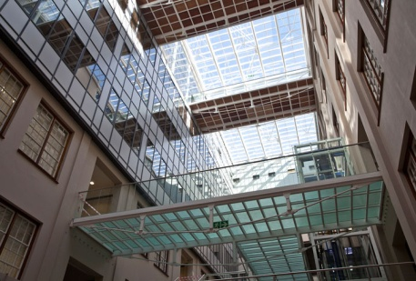
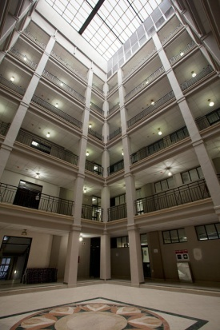
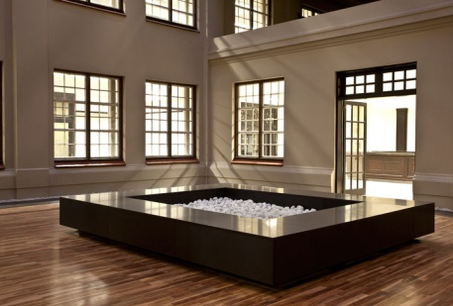
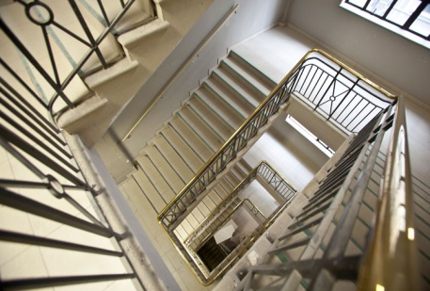
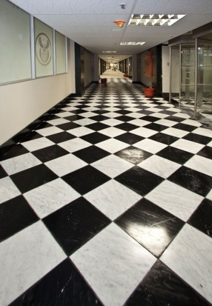
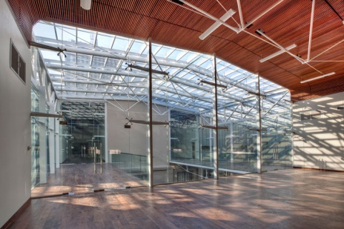
PRESENTATIONS
1:PLANNING AND PRECINCT DEVELOPMENT
2: INVESTMENT ANALYSIS
PROPERTY MANAGEMENT TRADING ENTITY
PRESENTERS: SASA SUBBAN & PETER CHIAPASCO
PRESENTATION TO THE PORTFOLIO COMMITTEE
14 February 2017

Slide 2
CONTENTS
Introduction of Planning and Precinct Development
Follow-up session on PC meeting in September 2016
Strategic Spatial Framework:
  Criteria for Spatial Targeting & Process
  Spatial Targeting Results
Alignment to Sector Departments, Provinces & Municipalities
Planning for Development: The Process
Current projects: lease portfolio, extent of development, project budget, implementation timeframe, job creation
Project Plan

Slide 3
1.INTRODUCTION
Planning and Precinct Development is a division of
PROPERTY MANAGEMENT TRADING ENTITY (PMTE) of DPW
Branch consisting of 7 professionals (town planners and architects)
Since 2014, previously known as the Inner City Regeneration Programme – now known as Planning and Precinct Development (PPD) has expanded its mandate to include other metros, urban areas and rural areas
Our core mandate is to support integrated development and the creation of government precincts in collaboration with national, provincial and municipal counterparts to address the spatial imbalances i.t.o the NDP
Direct government spending and reduce lease cost.

Slide 4
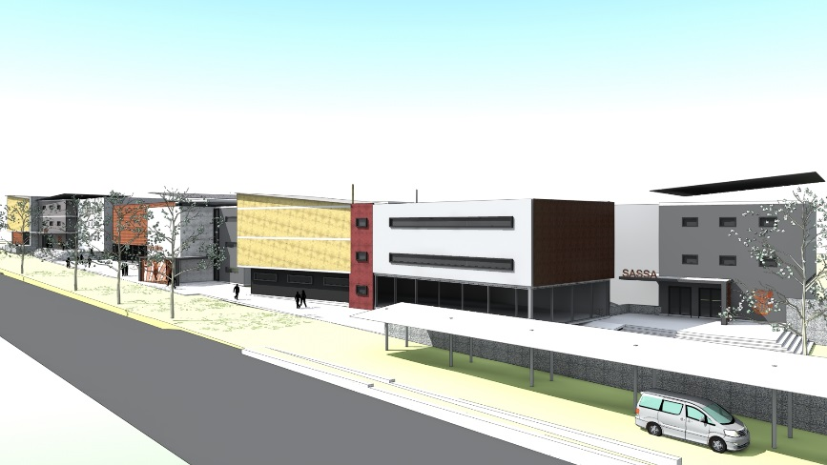
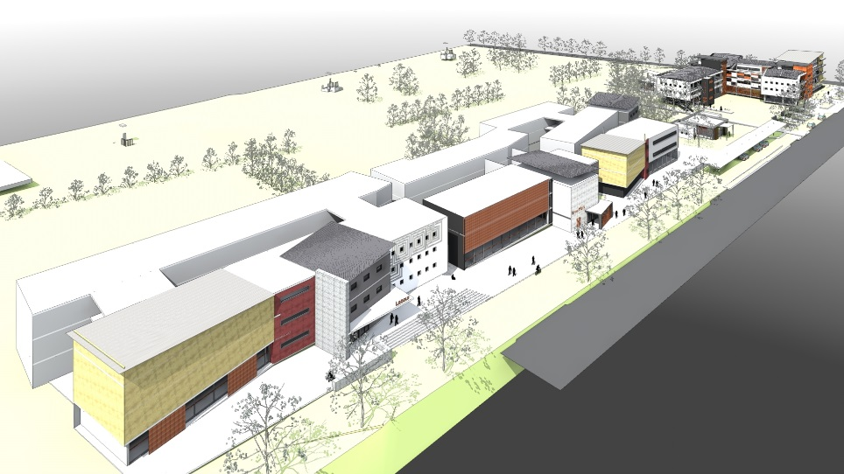
2. FOLLOW-UP SESSION-
Previous Portfolio Committee Meeting September 2016
Need a Strategic Plan with criteria for spatial selection
Clear definitions of urban and rural
Project Plan (Time lines and Expected completion dates)
Projects: lease profile, budgets and potential job creation
Alignment with Sector Departments
Feasibility Studies- methodology

Slide 5
STRATEGIC SPATIAL FRAMEWORK
USER FRAMEWORK
SPATIAL TARGETING
IMPLEMENTATION
User Priorities/UAMP
Camp Assertions
Lease profile reduction
Quantification of needs
Assembly of user needs per Municipality
Areas of Investment
Areas of Intervention
Areas of Deprivation
Alignment to Sector Departments
Defining Urban & Rural
Projects, Programs & Policies
Program/ phasing
Funding/ Budgets
Management guidelines
Planning Process
Packaged Precinct Proposal
Investment Analysis
Level 1
Precinct Selection/ Integration zones
Feasibility & Valuations
LEVEL 5
Precinct Identification
Land availability agreement
Parcel Plan
Volumetric studies
Land Acquisition
Level 4
Signed User Commitment
Level 2
Town Planning & Service Plans
Concept costing
Service installation
Locational Analysis
Urban Design
Precinct Master Plan
T.O.R and budget calculation for appointment of service providers for site clearance
Project Budget, funding options
Level 3

Slide 6
CRITERIA FOR SPATIAL TARGETING (Strategic Spatial Process Cont.)
1. INVESTMENT/ ECONOMIC GROWTH AREAS:
Areas with large government investments in infrastructure and social programs (NDP)
Areas with growth in employment
Municipalities with the highest interment potential
Largest cities and towns/ economic centres
2. INTERVENTION AREAS
Small harbours
Agri-parks initiative
Areas targeted by Sector Departments for development
Small & rural towns that perform as regional service centres
Areas with high population density
Areas experiencing growth in population (Immigration)
Mining towns
3. AREAS OF DEPRIVATION
27 Poorest Municipalities and Districts
DPSA 67 centres with high population density and in-adequate social services
Rural municipalities

Slide 7
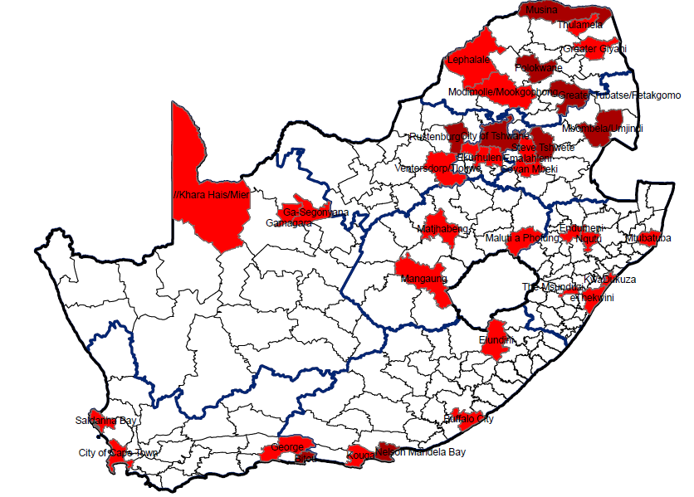
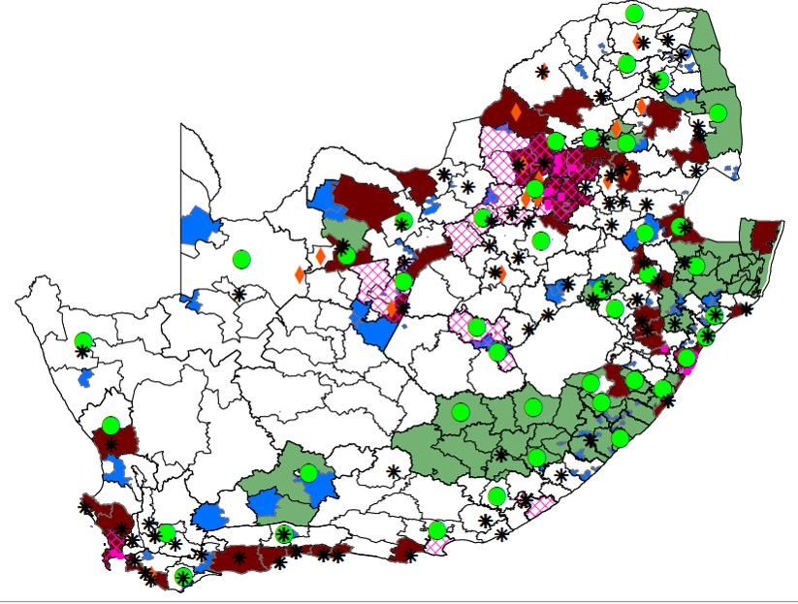
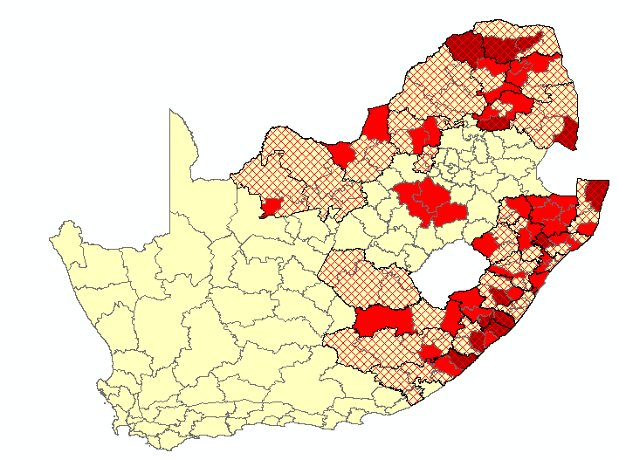
AREAS WITH THE HIGHEST ECONOMIC POTENTIAL
(Strategic Spatial Process Cont.)
AREAS SUBJECT TO GOVERNMENT INTERVENTION
Urban areas are the engine rooms of our economy.
More than 60% of the country’s population depends on social and economic services located in the eight metropolitan centres.
Municipalities benefiting from national projects based on the NDP and other strategies points to integration of government investment
Over a third of South Africa’s population live in the former homelands, and a large proportion of this group is economically marginalised. Many rural areas in the country still face massive service underdevelopment, including poor road infrastructure, a lack of basic services like running water, primary healthcare, sanitation and electricity.
MOST DEPRIVED AREAS

Slide 8
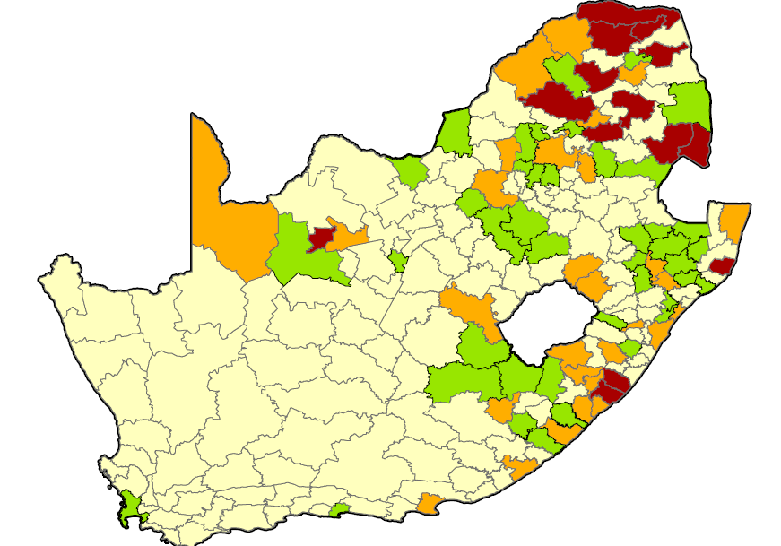
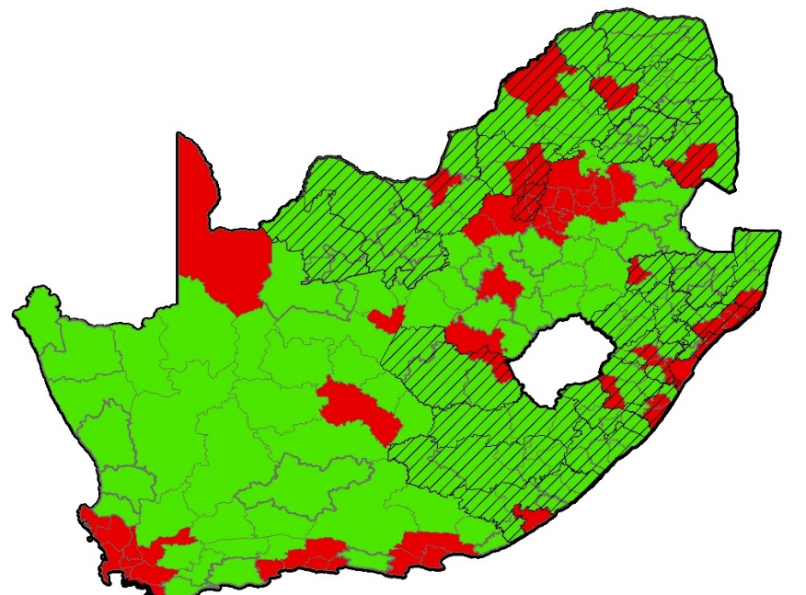
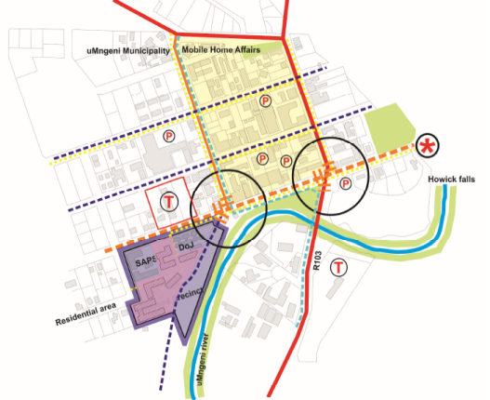
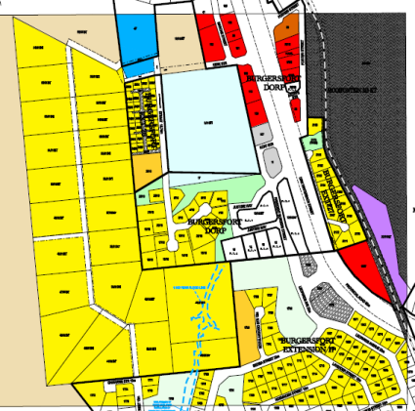
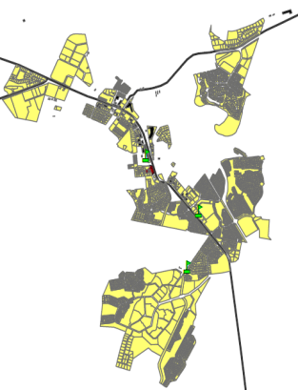
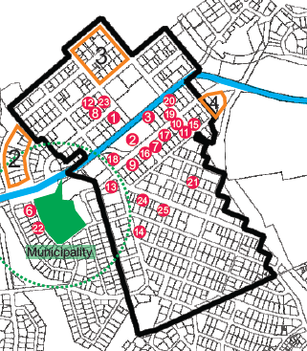
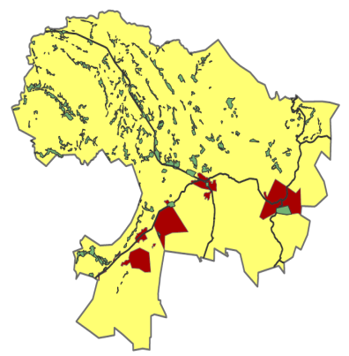
(Strategic Spatial Process Cont.)
URBAN/ RURAL SELECTION
RESULTS of SPATIAL TARGETING
Urban: Metro’s, city region, secondary towns
Municipalities with high
client requirements
FIRST PRIORITY
SECOND PRIORITY
Rural: The rest
Deep rural:
27 Poorest Municipalities
THIRD PRIORITY
INPUTS: GIS, NDP, DPSA, DRDLR
Urban Design & concepts
Site investigations/
Due diligence
ID the precinct/
Confirm land
availability
Map assets & leases
Municipality- ID Intervention areas

Slide 9
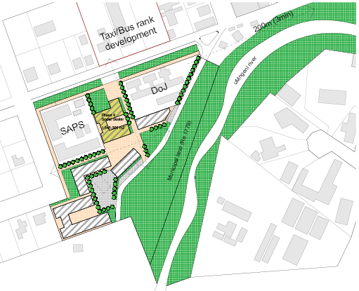
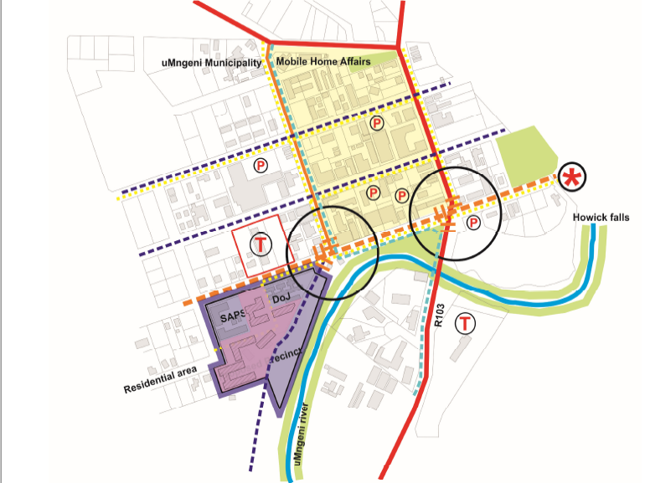
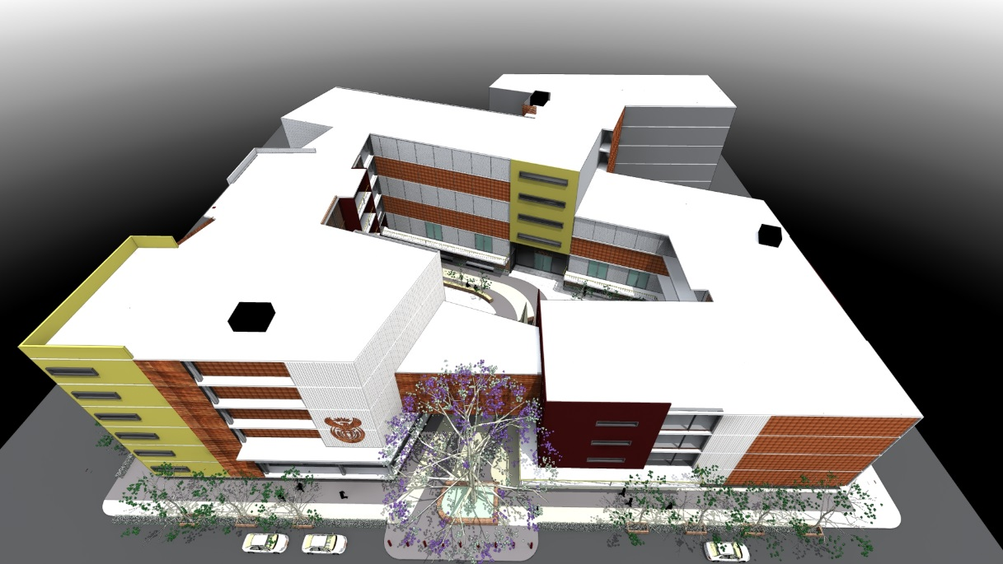
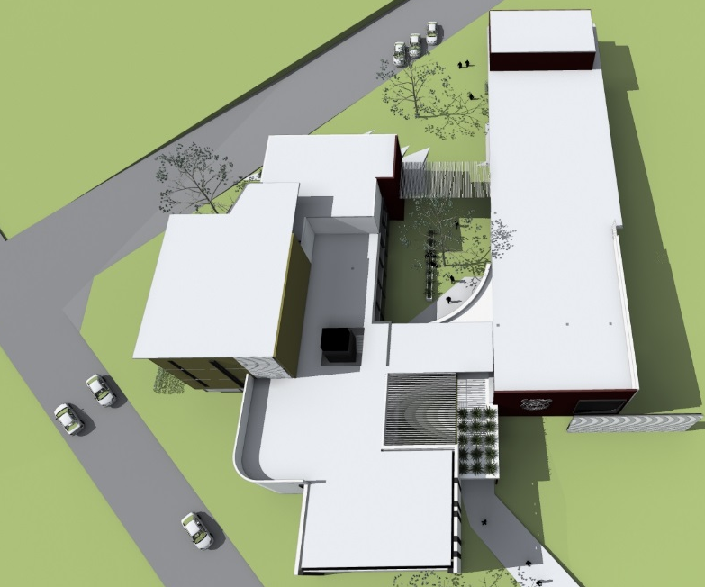
URBAN DESIGN FW
CONCEPT
3-LAYOUT/ VOLUMETRIC STUDY
LOOK & FEEL PROPOSAL

Slide 10
(Strategic Spatial Process Cont.)
  36 large municipalities accommodating 53% of the population where 78% of the economic activity is.
URBAN TARGETS
Queenstown
Grahamstown
Emalahleni (Mp)
City Of Matlosana
//Khara Hais
Uitenhage
Umhlathuze
Matjhabeng
George
Kokstad
Bisho
Drakenstein
Madibeng
Govan Mbeki
Lephalale
Stellenbosch
Johannesburg
Cape Town
Ethekwini
Ekurhuleni Metro
Tshwane
Nelson Mandela
Mangaung
Buffalo City
Polokwane
Mafikeng
Msunduzi
Sol Plaatje
Emfuleni
Mogale City
King Williams Town
Tlokwe
Rustenburg
Newcastle
Steve Tshwete
METROs
MONTHLY LEASE COST
R 175 666 786
36 urban priorities
SECONDARY TOWNs
MONTHLY LEASE COST
R 36 749 780
TOTAL MONTHLY LEASE COST
R 212 416 566

Slide 11
RURAL TARGETS
  100 Rural Municipalities + 14 Precincts currently in planning cycle
1. GREATER TUBATSE
2. ELIAS MOTSEALEDI
3. THULAMELA
4. MUSINA
5. MAKHADO
6. MODIMOLLE
7. GREATER GIYANI
8. NKOMAZI
9. MTUBATUBA
10. NGQUZA HILL
11. MBIZANA
12. GAMAGARA
13. BLOUBERG
14. NQUTO
15. UMZIMKHULU
16. MBHASHE
17. NYANDENI
18. NTABANKULU
19. MATATIELE
20. MHLABUYALINGANA
21. NKANDLA
22. UTHUNGULU
23. NTABANKULU
24. EPHRAIM MOGALE
25. GREATER TZANEEN
26. KWADUKUZA
27. ABAQULUSI
28. OKHALAMBA
29. PORT ST JOHNS
30. UMZIMVUBU
31. GA-SEGONYANA
32. MALUTI A PHOFUNG
33. ENDUMENI
34. NONGOMA
35. MNQUMA
36. INTSIKA YETHU
37. NGWATHE
38. NKETOANA
39. DR JS MOROKA
40. HIBISCUS COAST
41. GREATER LETABA
42. FETAKGOMO
43. ALBERT LUTHULI
44. UPHONGOLA
45. HLABISA
46. EDUMBE
47. EMADLANGENI
48. MSINGA
49. UMTSHEZI
50. MTHONJANENI
MAPHUMULO
NLDWEDWE
IMPENDLE
INGWE
UBUHLOBEZWE
UMUZIVAUNTY
UMZIMVUBU
MALETSWAI
ELUNDINI
MOQHARE
RATLOU
RAMOTSHERE MOILOA
MOGALAKWENA
SENQUE (STERKSPRUIT)
KING SABATA DALINDYEBO
TSANTSABANE
MAGARENG
MORETELE
CAPE AGULHAS
THABAZIMBI
MOOKGOPHONG
MODIMOLLE
PIXLEYE KA SEME
AMAJUBA
MKHUZE
UMLALAZI
KAI ! GARIB
NALEDI
SALDANHA
BELA-BELA
LEPELE-NKUMPI
THABA CHWEU
UTHUKELA
UMNGENI
MTHONJANENI
KOUGA
NKONKOBA
NXUBA
DIKGATLONG
JOE MOROLONG
SIYANCUMA
SETSOTO
MAFUBE
TSWELOPELE
LETSEMENG
KOPANONG
MOHOKARE
PHUMELEYLA SEME
MANTSOPA
14 Current additional precincts:
Mount Fletcher
Howick
Idutywa
Mandeni
KwaMhlanga
Christiana
Carolina
Port St Johns
Barberton
Mdantsane
Mthata
Komatiepoort
Vredenburg
Mamelodi
100 TOWNS

Slide 12
4. ALIGNMENT TO SECTOR DEPARTMENTS, PROVINCES & MUNICIPALITIES
PPD has setup technical forums with Social clients
Department of Home Affairs
Department of Labour
SASSA
Department Of Justice
SAPS
SARS
Relationship with client departments leading to fast tracking accommodation needs
INTEGRATION WITH MUNICIPALITIES
outcome
PPD engaged with
Sector Departments & Public Entities
Treasury (City Support Program)
DPSA
GCIS
COGTA
DRDLR
HUMAN SETTLEMENTS
SALGA
CSIR
Access to research done by Sector Departments
GIS information
Inputs to our Spatial Targeting analysis
Developing a common vocabulary
outcome
PPD engaged with
Provincial Public Works Roads
Western Cape
Eastern Cape
Kwazulu Natal
Mpumalanga
Land exchange
Integration with provincial precincts
Prioritised areas for integrated government precincts
outcome

Slide 13
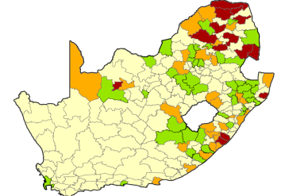

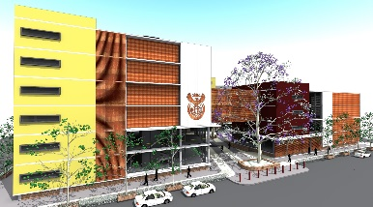
5. Planning for Development: The Process
Input
NDP & other policies
GIS
UAMPS; leases
SDFs, Site visits
Valuations
DPW portfolio
SPLUMA; Service Agreements
Spatial Selection
Areas of Investment
Areas of Intervention
Areas of deprivation
Client priorities
Largest lease portfolio
Id intervention zone
Precinct Identification
Site Identification
Land availability
Client needs
Volumetric study
Due diligence study
Urban design
Investment
Analysis
Feasibility
Client commit.
Concepts & costing
Budget allocation
Procurement of service town planners
Funding models
Site Enablement
Land transfer
Town Planning & legal compliance
Service installation
Tasks
CONSTRUCTION
Outputs
Precinct Mater Plan
Intervention Zone
Procurement approval
Construction
PRECINCT PLANNING AND DEVELOPMENT

Slide 14
6. CURRENT PROJECTS:
TSHWANE: CABINET DIRECTIVE TOWARDS PRECINCT PLANNING
ISLA – established for development of Master Plan ARUP appointment
2011
1997
2001
2004
2005
2013/16
2017
Guide the location of government infrastructure as catalyst for government and private sector investments supporting mixed-used development to advance economic stimulus.
Through Precinct Plans, ensure effective management of precincts that promotes safe, accessible, and environmentally sustainable government facilities aligned to the City’s Vision 2055.
To reduce lease costs, encourage shared services and generate revenue for the PMTE
Cabinet
Memorandum
City of Tshwane and DPW enter into new SLA based on TIRCS Vision 2055
Cabinet Memoranda
All Government Departments to remain within the inner city bounds (CBD) of Pretoria
Establishment of Government Boulevard and proposed SDF nodes
Develop a strategic plan for the accommodation of National Government Departments in the inner city of Tshwane
NDPW/CoT MOU
Establish an institutional framework
Ensure alignment of visions of both parties
Provide a structural mechanism and procedures to facilitate interaction
Notes:
Background to the Government Head Office Accommodation Programme:
The 1997, 2001 and 2004 Cabinet Memoranda
New Government Head Office Accomodation must be implemented to improve service delivery
Government Departments should all be housed in the Tshwane Inner City
Cabinet Memorandum of May 2005 tasked NDPW to collaborate with City of Tshwane to develop new accommodation:
NDPW has role as developer and CoT has role of local authority to manage spatial planning & land use
In November 2005 the NDPW and CoT signed an MOU to work together
In 2011 an “Intergovernmental Service Level Agreement” (ISLA) was signed to define roles, responsibilities and deliverables
From rge 2005 MOU and the 2011 ISLA cooperation between NDPW and CoT is broadly defined on 3 levels: Political, Steering/Management and Techincal
The structure proposal in later slides will cover more detail on the proposed structure for implementation

Slide 15
Tshwane Inner City – NDPW Client Locations & Opportunities
12
USERS IN STATE OWNED LOCATIONS
230,000m²
1.DoL
INNER CITY
2.DTI/DED/SBD
3.Mineral Resources
PTA Zoo
Northern Gateway
6
4.PALAMA
30
5.Presidency
26
7
6.National Archives
23
29
24
7.Environmental Affairs
5
8.DoH
35
9
8
Union Buildings
9.DBE
15
Capital Hill Precinct
10.NT Church Sq.
36
11.Film & Video Found.
25
12.DIRCO outside inner city
Madiba
16
37
Civic Precinct
13.Science & Technology outside
43
52
28
14.GCIS
42
41
31
40
10
39
44
13
15.DPSA Batho Pele House
11
38
Ceremonial Route
Helen Joseph
16.SAPS Ph 1
Dr WF Nkomo
Church Square
17.GPW
32
32
46
45
14
18.StatsSA
48
47
DEFINED LOCATIONS
- Projects in planning Phase 1 Implementation
750,000m²
1
3
Opportunities to be explored
49
50
LEASED
26
27
Nana Sita
2
4
Tshwane Inner City Programme Cabinet Memoranda 1997-2005: All Government Departments to remain within the inner city bounds (CBD) of Pretoria Establishment of Government Boulevard and proposed Government precincts supported by the Tshwane Inner City Regeneration Strategy 2015 (TICRS)
19.DSD, SASSA & NDA
MAJOR OFFICE DEVELOPMENTS
Salvokop:
360 000m²
Northern Gateway: 370 000m²
Capital Hill:
200 000m²
Government Boulevard: accommodation opportunities to be assessed.
Government Boulevard
20.DCS
51
21.DHET
17
22.Transport
Paul Kruger
23.Water & Sanitation
34
24.COGTA
25.DoJ (& Const. Dev)
26.Tourism
Southern Precinct
27.Energy
21
28. DAC
33
LEASE & STATE OWNED
20
19
29.Home Affairs
30.DAFF
31.SAPS Ph 2
Salvokop
22
32.NDPW
18
33.DRD&LR
STATE OWNED
34. Old & New Corporation Buildings
* High degree of commitment from user departments
Freedom Park
Notes:
This slide shows the extent of the Government Estate in the City, as current and envisioned for the future:
Green shows Departments in currently occupies final locations
Orange shows Departments for which a lot of work by PPD has progressed to the point of defined locations that need to be confirmed and implemented (Phase 1)
Yellow show opportunities within the CoT Government and Ceremonial boulevards that has potential for accommodating smaller departments (Phase 2)

Slide 16
CURRENT PROJECTS CONT.
EXISTING URBAN PRECINCTS – TSHWANE
City/Town | Tshwane lease portfolio (m²) | Extent of development potential(m²) | Projected Site enablement Budget | Proposed Service construction start date * | Indicative EPWP Job creation figures (SITE) | Estimated Project budget (R) * | Estimated Project Implementation timeframe
Tshwane :
Southern Gateway Precinct (5) | 1,1million | 360,000 | R350million | 2018 | 2300 | R8,28billion | 2020
Northern Gateway Precinct (3) |  | 370,000 | R100million | 2019 | 660 | R8,51billion | 2021
Capital Hill Precinct (4) |  | 115,000 | R35million | 2019 | 500 | R2,64billion | 2021
Government Boulevard (8) |  | to be assessed | Acquisitions and maximising density |  | 230
* Legalisation process to be finalised prior to construction of services
* Project budget based on Aecom report 2016 and excludes professional fees.
High-rise prestigious office tower R13,400/m² – R16,800/m²
Basement parking R4,000/m² - R6,200/m²
Site enablement= Site acquisition, planning, town planning legal compliance& service installation (2 to 3 years depending on complexity and land ownership)
Service installation = Water, sewer, electricity, roads & stormwater + service contributions (1 to 2 years including building plan development and approvals before construction)
EPWP job figures = 1 job opportunity per R150 000 of the project value.

Slide 17
CURRENT PROJECTS CONT.
EXISTING URBAN PRECINCTS – Metro's
City/Town | Total lease portfolio (m²) | Extent of development (m²) | Site enablement Budget (R ) | Service construction start date | Indicative EPWP Job creation figures (Site) | Project budget (R) | Project Implemen-tation timeframe
Johannesburg | 64 762
Smit Street Precinct |  | 21 000 | R4,6million | 2019 | 30 | R380million | 2021
Mineralia Precinct |  | 11 759 | Acquisition |  |  | PURCHASE
eThekwini | 90 429
Security Precinct |  | 47 409 | R16 million | 2019 | 106 | R853million | 2021
Centrum Precinct |  | 52 460 | R40 million | 2022 | 260 | R944million | 2024
Court |  | 28 526 | R10million | 2019 | 66 | R513million | 2021
Legalisation process to be finalised prior to construction of services
Project budget based on Aecom report 2016 and excludes professional fees.
High-rise prestigious office tower R13,400/m² – R16,800/m²
Basement parking R4,000/m² - R6,200/m²
Site enablement= Site acquisition, planning, town planning legal compliance& service installation (2 to 3 years depending on complexity and land ownership)
Service installation = Water, sewer, electricity, roads & stormwater + service contributions (1 to 2 years including building plan development and approvals before construction)
EPWP job figures = 1 job opportunity per R150 000 of the project value.

Slide 18
CURRENT PROJECTS CONT.
EXISTING URBAN PRECINCTS – Secondary Towns
City/Town | Total lease portfolio (m²) | Extent of development (m²) | Site enablement Budget | Service construction start date | Indicative EPWP Job creation figures (Site) | Project budget (R-Million) | Implemen-tation timeframe
Mbombela | 104 691
Voortrekker Street Precinct |  | 6000 | R10,2million | 2019 | 70 | R108 million | 2021
Polokwane | 58 586
Polokwane Administrative |  | 5236 | R5million | 2018 | 30 | R138 million | 2019
Polokwane Social Precinct |  | 10000 | R5,6million | 2020 | 40 | R180 million | 2021
Secunda | 3000 | 5000 | R5,6million | 2020 | 40 | R90 million | 2021
Vredenburg | 4000 | 6000 | R11,3million | 2019 | 75 | R108 million | 2020
City Of Matlosana | 12000 | 15000 | R4,6million | 2019 | 30 | R270 million | 2020
Legalisation process to be finalised prior to construction of services
Project budget based on Aecom report 2016 and excludes professional fees.
High-rise prestigious office tower R13,400/m² – R16,800/m²
Basement parking R4,000/m² - R6,200/m²
Site enablement= Site acquisition, planning, town planning legal compliance& service installation (2 to 3 years depending on complexity and land ownership)
Service installation = Water, sewer, electricity, roads & stormwater + service contributions (1 to 2 years including building plan development and approvals before construction)
EPWP job figures = 1 job opportunity per R150 000 of the project value.

Slide 19
CURRENT PROJECTS CONT.
EXISTING RURAL PRECINCTS – 7
Town | Total lease portfolio (m²) | Extent of development (m²) | Site enablement Budget | Service construction start date | Indicative EPWP Job creation figures (Site) | Project budget (R-Million) | Implemen-tation timeframe
Mount Fletcher | 556 | 8127 | R3,3million | 2019 | 22 | R146 million | 2020
Howick | 626 | 4635 | R3,5million | 2019 | 23 | R83 million | 2020
Idutywa | 670 | 1200 | R4,1million | 2020 | 27 | R21 million | 2021
Mandeni | 274 | 1500 | R4,1million | 2021 | 27 | R27 million | 2022
KwaMhlanga | 783 | 1200 | R4,7million | 2021 | 31 | R21 million | 2022
Christiana | 1648 | 5000 | R4,6million | 2021 | 30 | R30 million | 2022
Carolina | 726 | 2500 | R4,1million | 2019 | 27 | R45 million | 2020
Legalisation process to be finalised prior to construction of services
Project budget based on Aecom report 2016 and excludes professional fees.
High-rise prestigious office tower R13,400/m² – R16,800/m²
Basement parking R4,000/m² - R6,200/m²
Site enablement= Site acquisition, planning, town planning legal compliance& service installation (2 to 3 years depending on complexity and land ownership)
Service installation = Water, sewer, electricity, roads & stormwater + service contributions (1 to 2 years including building plan development and approvals before construction)
EPWP job figures = 1 job opportunity per R150 000 of the project value.

Slide 21


DDG: Ms Sasa Suban
ACD: Ms Zelmarie van Rooyen
Tel: 012 -4061644
Email: Zelmarie.vanrooyen@dpw.gov.za
National Department of Public Works (NDPW)
Head Office: Public Works
CGO Building
Cnr Bosman and Madiba
Pretoria Central
Private Bag X65
Pretoria
0001
Website: http://www.publicworks.gov.za
  THANK YOU

