Slide 1
Quarters 1 and 2
Programme Performance
2016/2017

Slide 2
Presentation Outline
MDDA Mandate
MDDA Vision, Mission & Values
MDDA Medium Term Strategic Framework
MDDA Legislative Framework
Summary of Performance Q1 & Q2 2016/2017
Programmes
Summary Comparison of Q1 vs Q2 Performance
Core programmes – Programmes 2,3, 4 and 5
Support programme – Programme 1
Financial Performance
6. Issues raised by Portfolio Committee
7. Audit dashboard

Slide 3
MDDA Mandate
Encourage ownership of, and access to, media by HDGs as well as by historically diminished indigenous language and cultural groups.
Encourage the development of human resources and training, and capacity building, within the media industry, especially amongst HDGs.
Encourage the channeling of resources to the community media sectors.
Raise public awareness with regard to media development & diversity issues.
Support initiatives which promote literacy and a culture of reading.
Encourage research regarding media development & diversity.
Liaise with other statutory bodies such as ICASA, USAASA and SALGA
Section 16 & 32 of the Constitution provides for freedom of expression and access to information
MDDA Act 2014 of 2002
.

Slide 4
MDDA Vision, Mission & Values
An accessible, transformed and diversified media
Leading media development, transformation and diversification in South Africa
֍ Integrity ֍ Accountability ֍ Inclusivity ֍ Ubuntu
֍ Professionalism
Vision
Mission
Values

Slide 5
Medium Term Strategic Framework
The National Development Plan - Vision 2030 (NDP) informs the Medium Term Strategic Framework (MTSF) priorities.
Outcome 6 relates to an efficient, competitive and responsive economic infrastructure network. This highlights the role of the MDDA in assisting community media to harness the power of a rapidly changing telecommunications environment.
Outcome 12 relates to an efficient, effective and development orientated public service. This speaks to the character and nature of the MDDA as an institution and the values it should champion.
Outcome 14 relates to nation building and social cohesion as it envisions a society where South Africans will be more conscious of what they have in common than their differences. It directs the MDDA’s approach when supporting and enabling content and production elements.
4

Slide 6
Legislative Environment
Electronic Communication Act no. 35 of 2005
Promotion of Administrative Justice Act.No.3 of 2000 (PAJA)
.
Public Finance Management Act No.1 of 1999 (PFMA)
The Independent Communications Authority of South Africa Act, Act no. 13 of 2000
White Paper on Broadcasting Policy
(1998)
Independent Broadcasting Authority Triple Inquiry Report
(2000)
ICT Policy White Paper (2016)
Community Television Broadcasting Services Position Paper (2004)
Regulations of the Independent Communication Authority of South Africa (2010)
6

Slide 7
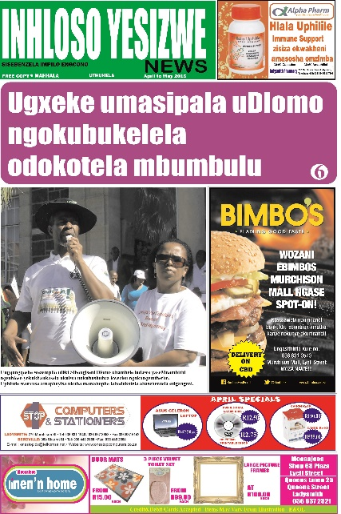
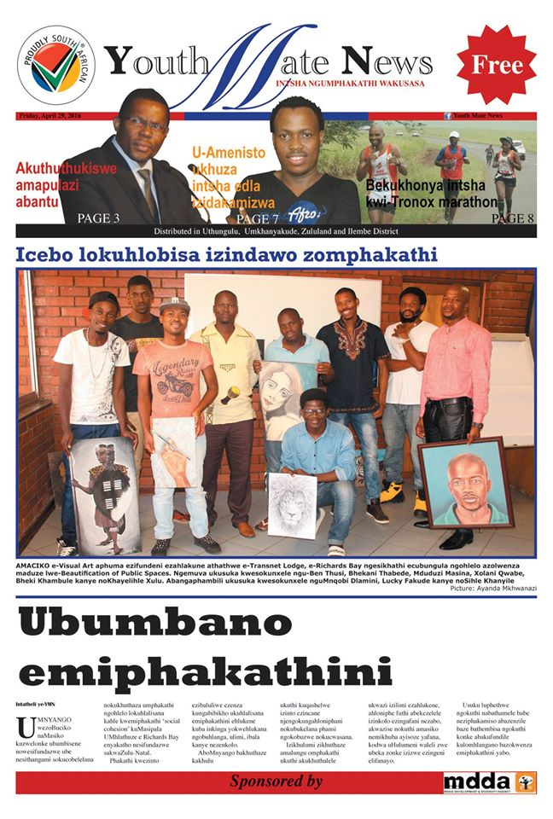
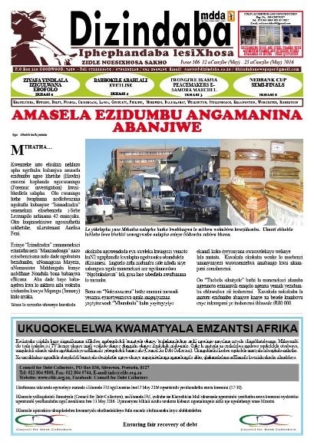
Summary of Performance
Q1 & Q2
2016/2017
7

Slide 8
Programmes
The performance of the Agency is measured and reported for all its programme
areas, which are:
Administration
Human Resources Management
Monitoring and Evaluation
Legal and Regulatory Affairs
Financial and Auxiliary Services
Risk Management and Audit
Information Management and Technology
Grant and Seed Funding
Community Broadcast Media
Print and Digital Media
Advocacy and Lobbying
Strategic Programmes
Stakeholder Management and MDDA Brand Building
Capacity Building
Research and Development
The Agency has 60 performance indicators across its five programmes.

Slide 9
Comparison of Programme Performance Q1 vs Q2 2016/17(1)
Not
Achieved
17%
Partially
Achieved
21%
Achieved
62%
67%
Q2 targets not achieved were mainly in Programme 1 (support activities) and related to capacity limitations. The focus on filling vacancies will enable these targets to be achieved in future.

Slide 10
Comparison of Programme Performance Q1 vs Q2 2016/17(2)
Not
Achieved
17%
Partially
Achieved
21%
Achieved
62%
67%
Q2 shows an improvement in the percentage of targets not achieved. These targets not achieved were mainly in Programme 1 (support activities) and related to capacity limitations. The focus on filling vacancies will enable these targets to be achieved in future.

Slide 11
Programme 2: Performance – Q1 & Q2 2016/17
GRANT AND SEED FUNDING Strategic Objective: Promote media development and diversity through support for community and small commercial media projects. Sub-programme 2.1: Community Broadcast Media
Performance Indicator | Annual Target 2016/17 | Q1 Actual | Q2 Actual Performance against Target July - Sep |  | Cumulative (Q1 and Q2) | Variance for Q2 | Reason for Variance
 |  |  | Target | Actual
Number of community radio stations supported for start-up funding | 8 | 3 | 3 | 5 | 8 | +2 | Additional projects were drawn from backlog of new applications, as there was additional funding available for new projects, due to some Q2 project applications for strengthening not complying. This will not impact on the overall budget for the year.
Number of community radio stations that are supported for strengthening* | 18 | 6 | 5 | 1 | 7 | -4 | A number of applications did not comply. They will be assisted by the MDDA on the compliance issues to enable them to resubmit to the Board in Q3. This will not impact on the overall budget for the year.
Number of community television stations supported for strengthening | 4 | 0 | 1 | 1 | 1 | 0 | Achieved
Number of direct jobs created in the community broadcast sector | 90 | 44 | 0 | 44 | 88 | +44 | Initial APP had not broken down the Annual target per Quarter. Annual target – to be reported on in Q4
Number of indirect jobs created in the community broadcast sector | 160 | 148 | 0 | 128 | 276 | +128 | Initial APP had not broken down the Annual target per Quarter. Annual target – to be reported on in Q4
Percentage of Community Broadcast funds disbursed | 80% | 30% | 0 | 18% | 48% | 18% | Initial APP had not broken down the Annual target per Quarter. The percentage disbursement for Q1 included in Q2
Social engagement strategy for communities using broadcast platform | 1 | 0 | 0 | 1 | 0 | +1 | Annual target – to be reported on in Q4 Poort FM, which provides a shared broadcast platform for the communities of Mamelodi and Eersterus, held its first AGM in Q2. Progress is advanced in developing a similar model for the communities of Khayelitsha and Gugulethu.
*Footnote: Strengthening funds are granted to projects previously funded that require additional support in order to ensure sustainability in the early years of establishment

Slide 12
Programme 2: Performance – Q1 & Q2 2016/17
GRANT AND SEED FUNDING Strategic Objective: Promote media development and diversity through support for community and small commercial media projects. Sub-programme 2.2: Print and Digital Media
Performance Indicator | Annual Target 2016/17 | Q1 Actual | Q2 Actual Performance against Target July - Sep |  | Cumulative (Q1 and Q2) | Variance for Q2 | Reason for Variance
 |  |  | Target | Actual
Number of Small Commercial Media projects funded for strengthening | 5 | 2 | 2 | 2 | 4 | 0 | Achieved
Number of new Small Commercial Media projects funded | 5 | 1 | 2 | 3 | 4 | +1 | One of the projects for submission in Q1 did not comply. The MDDA assisted it with compliance and it was therefore approved in Q2 in addition to the target Q2 projects. This will not impact on the overall budget for the year.
Number of new Community Print projects funded | 4 | 1 | 2 | 1 | 2 | -1 | One project was deferred by the Board due to compliance issues. It will be assisted by the MDDA on the compliance issues to enable them to resubmit in Q3. This will not impact on the overall budget for the year.
Number of Community Print projects funded for strengthening | 4 | 0 | 2 | 2 | 2 | 0 | Achieved
Number of projects assisted and enabled to go digital | 18 | 4 | 8 | 8 | 12 | 0 | Achieved
Disbursement of funds to projects approved** | 70% | 0 | 0 | 68% | 44% | 68% | Initial APP had not broken down the Annual target per Quarter. The percentage disbursement for Q1 included in Q2. Q2 projects approved 30 September 2016; therefore no payments made at end of Q2.
Footnote: *Strengthening funds are granted to projects previously funded that require additional support in order to ensure sustainability in the early years of establishment ; **Refers to percentage of funds disbursed

Slide 13
Programme 2: Q1 Approved Projects
Media Type | Project Name | District Municipality | Province | Amount
Community Radio (New) | Diepsloot Community Radio t/a Sloot FM | City of Johannesburg | Gauteng | R 2, 010,288.94
Community Radio (New) | Vhembe FM | Vhembe District | Limpopo | R 2,179,114.36
Community Radio (New) | Masemola Community Radio t/a MasCom FM | Greater Sekhukhune | Limpopo | R 2,478,669.87
Community Radio (Strengthening) | Radio Zibonele | City of Cape Town | Western Cape | R 2, 453,034.90
Community Radio (Strengthening) | Siyathuthuka FM | ILembe District | KwaZulu-Natal | R 997,000.00
Community Radio (Strengthening) | Brandvlei Correctional Service Radio | Overberg District | Western Cape | R 1,630,000.00
Community Radio (Strengthening) | Poort on Mams | City of Tshwane | Gauteng | R 1,400,000.00
Community Radio (Strengthening) | Makhado FM | Vhembe District | Limpopo | R 975,495.72
Community Radio (Strengthening) | Mohodi FM | Capricorn District | Limpopo | R 1, 468,183.00
TOTAL | R 15,591,786.79
Media Type | Project Name | District Municipality | Province | Amount
SCM Newspaper (New) | KZN Community Newspaper | City of EThekwini | KwaZulu-Natal | R 842,000.00
Community Print (New) | Malatsi Media | City of Tshwane | Gauteng | R 700,000.00
SCM Newspaper (Strengthening) | Winelands Echo | Cape Winelands District | Western Cape | R 731,696.00
SCM (Strengthening) | Nthavela News | Capricorn District | Limpopo | R 765,600.00
TOTAL | R 3,039,296.00
18

Slide 14
Programme 2: Q2 Approved Projects
Media Type | Project Name |  | District Municipality |  | Province |  |  | Amount
Community Broadcast Media (2016/17 GFC)
Community Radio (New) |  | Westside FM |  | Westrand District |  | Gauteng | R2,017,871.90
Community Radio (New) |  | Inakekelo FM |  | Nkangala District |  | Mpumalanga | R2,098,598.21
Community Radio (New) |  | Pongola FM |  | Zululand District |  | KwaZulu-Natal | R2,050,252.47
Community Radio (New) |  | Bojanala FM |  | Bojanala Platinum District |  | Northwest | R2,293,851.74
Community Radio (New) |  | Waterberg FM |  | Waterberg District |  | Limpopo | R2,028,558.76
Community Radio (Strengthening) |  | Sefako Makgatho FM |  | Tshwane |  | Gauteng | R978,520.43
Community TV (Strengthening) |  | 1KZN TV |  | King Cetshwayo District |  | KwaZulu-Natal | R 2,380,000.00
Print and Digital (2014/15 GFC)
Small Commercial (Strengthening) |  | Seipone News |  | Capricorn District |  | Limpopo | R 663,400.00
Small Commercial (Strengthening) |  | Ikhwezi News |  | OR Tambo District |  | Eastern Cape | R557,312.00
Small Commercial (New) |  | Seipone Times |  | Thabo Mofutsanyane District |  | Free State | R659,600.00
Small Commercial (New) |  | Ganyesa News |  | Ngaka Modiri Molema District |  | Northwest | R620,600.00
Small Commercial (New) |  | Glimpse Magazine |  | Ngaka Modiri Molema District |  | Northwest | R414,176.00
Community Print (Strengthening) |  | Disability Magazine |  | Buffalo City |  | Eastern Cape | R427.700.00
Community Print (Strengthening) |  | Amandla Magazine |  | City of Cape Town |  | Western Cape | R547,200.00
Community Print (New) |  | Lekunutu News |  | Waterberg District |  | Limpopo | R467,561.64
Community Print (New) |  | Letlama Foundation |  | Thabo Mofutsanyana District |  | Free State | R0
19

Slide 15
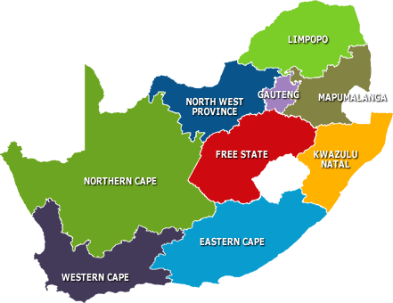
Breakdown of Community Media Projects supported per province
Community Broadcast projects
3
Print & Digital media projects
5
2
1
1
4
1
1
2 projects (broadcast and print) approved for funding in Northern Cape in Q3 - Kurara FM and Kuruman Chronicle
2
3
2
2
2
20

Slide 16
Programme 3: Performance – Q1 & Q2 2016/17
ADVOCACY & LOBBYING Strategic Objective: Position the MDDA as a leading influencer in the community and small commercial media, playing a key role in the national dialogue on the sector. Sub-programme 3.1: Strategic Programmes
Performance Indicator | Annual Target 2016/17 | Q1 Actual | Q2 Actual Performance against Target July - Sep |  | Cumulative (Q1 and Q2) | Variance for Q2 | Reason for Variance
 |  |  | Target | Actual
Concept document on review of MDDA Act submitted | 1 | 0 | 0 | 0 | 0 | 0 | Annual target – to be reported on in Q4
MDDA digital migration strategy approved | 1 | 0 | 0 | 0 | 0 | 0 | Annual target – to be reported on in Q4
Concept document on review of current funding model submitted | 1 | 0 | 0 | 1 | 1 | +1 | Achieved. Annual target. Concept document submitted for Board strategic planning workshop.
21

Slide 17
Programme 3: Performance – Q1 & Q2 2016/17
ADVOCACY & LOBBYING Strategic Objective: Position the MDDA as a leading influencer in the community and small commercial media, playing a key role in the national dialogue on the sector. Sub-programme 3.2: Stakeholder Management and MDDA Brand Building
Performance Indicator | Annual Target 2016/17 | Q1 Actual | Q2 Actual Performance against Target July - Sep |  | Cumulative (Q1 and Q2) | Variance for Q2 | Reason for Variance
 |  |  | Target | Actual
Communications/ Stakeholder Engagement Plan developed | 1 | 1 | 0 | 0 | 1 | 0 | Achieved. Annual target.
Number of newsletters produced | 2 | 0 | 1 | 1 | 1 | 0 | Achieved
Annual Report | 1 | 0 | 1 | 1 | 1 | 0 | Achieved
Number of outreach programmes supported | 15 | 4 | 4 | 4 | 8 | 0 | Achieved. Q2 events: 08/7: Ga-Mothapo Imbizo 23/7: Mphambo Imbizo 03/09: Mtiti Imbizo 19/9: Thusong Public Service Week
Number of joint interventions | 6 | 2 | 2 | 2 | 4 | 0 | Achieved. Q2 events: 5/8: COMSA Conference 20/8: Women’s Dialogue in Media
Number of media awards held | 1 | 0 | 1 | 0 | 0 | -1 | Media awards delayed pending outcome of study on Awards for community-based media. A revamped Media Awards will be launched at the conclusion of the study in February 2017. This will not impact on the overall budget for the year.

Slide 18
Programme 4: Performance – Q1 & Q2 2016/17
CAPACITY BUILDING Strategic Objective: Advance and strengthen community and small commercial media sector through providing media skills and expertise to deliver professional media services to communities served. It further ensures that knowledge and skills provided through training are relevant and accredited.
Performance Indicator | Annual Target 2016/17 | Actual Performance against Target April - June |  | Variance | Reason for Variance
 |  | Target | Actual
Number of partnership agreements with accredited learning Institutions and training institutions per province | 4 | 0
Number of MOUs signed with Partners that enhance our projects’ environment | 4 | 2
Number of training interventions on either Finance, Marketing, Reporting, Governance, learning Forum, Grantee Orientation Workshop etc | 5 | 0
Number of media literacy workshop conducted | 1 | 0
CAPACITY BUILDING Strategic Objective: Advance and strengthen community and small commercial media sector through providing media skills and expertise to deliver professional media services to communities served. It further ensures that knowledge and skills provided through training are relevant and accredited.
Performance Indicator | Annual Target 2016/17 | Q1 Actual | Q2 Actual Performance against Target July - Sep |  | Cumulative (Q1 and Q2) | Variance for Q2 | Reason for Variance
 |  |  | Target | Actual
Number of partnership agreements with accredited learning Institutions and training institutions per province | 4 | 0 | 2 | 1 | 1 | -1 | Partnership proposal from Fray Intermedia – Press Code E-Learning approved by Board Partnership proposal from one training institution deferred by the Board pending identified issues to be addressed . This will not impact on the overall budget for the year.
Number of MOUs signed with Partners that enhance our projects’ environment | 4 | 1 | 0 | 1 | 2 | +1 | Part of Q1 target as signing of SEDA MoU delayed until Q2. Therefore progress on track for annual target to be achieved. This will not impact on the overall budget for the year.
Number of training interventions on Finance, Marketing, Reporting, Governance, Learning Forum, Grantee Orientation Workshop etc | 5 | 0 | 2 | 2 | 2 | 0 | Achieved. The Soul City gender based violence training, which was part of the Q2 target, was implemented at the end of Q1. SAASTA training in Q2..
Number of media literacy workshop conducted | 1 | 0 | 1 | 0 | 0 | -1 | Media literacy workshop delayed due to availability of schools. Negotiations are in progress with schools to carry out the workshop in Q4. This will not impact on the overall budget for the year.
Number of media exchange programmes conducted | 1 | 0 | 0 | 0 | 0 | 0 | Annual target – to be reported on in Q3
23

Slide 19
Programme 5: Performance – Q1 & Q2 2016/17
RESEARCH AND DEVELOPMENT Strategic Objective: Create and enhance a body of knowledge regarding the media landscape.
Performance Indicator | Annual Target 2016/17 | Q1 Actual | Q2 Actual Performance against Target July - Sep |  | Cumulative (Q1 and Q2) | Variance for Q2 | Reason for Variance
 |  |  | Target | Actual
Number content hubs developed | 1 | 0 | 0 | 0 | 0 | 0 | Annual target – to be reported on in Q4.,
Number of research projects undertaken | 2 | 0 | 0 | 1 | 1 | +1 | CDRA Proposal approved by the Board for social engagement strategy between communities of Gugulethu and Khayelitsha, Impact Assessment and Community-based media awards study have commenced. Q3 and Q4 target.

Slide 20
Programme 1: Performance – Q1 & Q2 2016/17
ADMINISTRATION Strategic Objective: Provide efficient, accountable and effective administration. Sub-programme 1.1: Human Resources Management
Performance Indicator | Annual Target 2016/17 | Q1 Actual | Q2 Actual Performance against Target July - Sep |  | Cumulative (Q1 and Q2) | Variance for Q2 | Reason for Variance
 |  |  | Target | Actual
Percentage funded positions filled | 90% | 44% | 90% | 56% | 56% | -34% | A new organogram was approved by the Board in February 2016 to restructure the organogram in line with the new strategy. However, there was uncertainty over the total funding for 2016/2017 and therefore the focus was on only those vacancies in the new organogram that could be covered by the funding already committed. Two major funders have now committed support, and therefore focus is now being placed to fill positions.
Employee Development Programme developed | 1 | 0 | 0 | 0 | 0 | 0 | Annual target – to be reported on in Q4.
Internship Development Programme developed | 1 | 0 | 0 | 0 | 0 | 0 | Annual target – to be reported on in Q4.
Review Performance Management System | 1 | 0 | 0 | 0 | 0 | 0 | Annual target – to be reported on in Q4
Percentage of signed Performance Contracts | 100% | 50% | 100% | 50% | 50% | -50% | 50% (current staff) have signed performance contracts. The performance contracts not signed (50%) are due to the vacancies, the filling of which is an ongoing process.
Number of reviews of MDDA Human Resource Policy & Procedure | 1 | 0 | 0 | 0 | 0 | 0 | Annual target – to be reported on in Q4
10

Slide 21
Programme 1: Performance – Q1 & Q2 2016/17
ADMINISTRATION Strategic Objective: Provide efficient, accountable and effective administration. Sub-programme 1.2: Monitoring and Evaluation
Performance Indicator | Annual Target 2016/17 | Q1 Actual | Q2 Actual Performance against Target July - Sep |  | Cumulative (Q1 and Q2) | Variance for Q2 | Reason for Variance
 |  |  | Target | Actual
Number of projects monitored | 75 | 24 | 25 | 5 | 29 | -20 | Twenty monitoring projects could not be carried out due to capacity limitations. As the Q1 target had been exceeded by 9 projects, 11 additional projects will be monitored in Q3 to ensure that the indicator is on track to achieve the annual target. This will not impact the annual budget for this sub-programme.
Number of projects evaluated | 30 | 10 | 10 | 10 | 20 | 0 | Achieved
Co-ordinate MDDA implementation of Outcome 14 activities | 4 | 1 | 1 | 1 | 2 | 0 | Achieved
Additional to project monitoring activities, the Board requested the compilation of a report reviewing municipal advertising spend on community media across South Africa. This was completed and submitted to the Board during Q2.
Footnote:
Monitoring of a project takes place while the funding of the project is in progress.
Evaluation of a project takes place at the conclusion of the funding of the project.

Slide 22
Programme 1: Performance – Q1 & Q2 2016/17
ADMINISTRATION Strategic Objective: Provide efficient, accountable and effective administration. Sub-programme 1.3: Legal and Regulatory Affairs
Performance Indicator | Annual Target 2016/17 | Q1 Actual | Q2 Actual Performance against Target July - Sep |  | Cumulative (Q1 and Q2) | Variance for Q2 | Reason for Variance
 |  |  | Target | Actual
Contracts Management Strategy developed* | 1 | 0 | 0 | 0 | 0 | 0 | Annual target – to be reported on in Q4
Contracts Register with Grantees and Service Providers** | 1 | 0 | 0 | 0 | 0 | 0 | Annual target – to be reported on in Q4
Turnaround lead time for contract vetting and approval | 2 weeks | 2 weeks | 2 weeks | 2 weeks | 2 weeks | 0 | Achieved
Percentage of litigation cases handled | 100% | 0% | 100% | 0% | 0% | -100% | There were no litigation cases
Percentage of policy development and legislative review contributions | 100% | 0% | 100% | 0% | 0% | -100% | There was no call for policy development and legislative review contributions
Footnote
*A contracts management strategy is in place but, per MDDA procedures, is reviewed on an annual basis.
** A Contracts Register with Grantees and Service Providers is in place but, per MDDA procedures, is reviewed on an annual basis.

Slide 23
Programme 1: Performance – Q1 & Q2 2016/17
ADMINISTRATION Strategic Objective: Provide efficient, accountable and effective administration. Sub-programme 1.4: Financial Administration and Auxiliary Services
Performance Indicator | Annual Target 2016/17 | Q1 Actual | Q2 Actual Performance against Target July - Sep |  | Cumulative (Q1 and Q2) | Variance For Q2 | Reason for Variance
 |  |  | Target | Actual
Percentage of acceptable variance between budget vs expenditure | 8% | 28% | 8% | 30% | 16% | +22% | The positive increase is a result of an improved disbursement policy and procedures implemented in the current year to facilitate access to funds by beneficiary projects . The impact will be much less on the annual budget because MDDA will receive the annual transfers from the two major broadcast funders in Q3
Number of incidents of Irregular, Unauthorised, Fruitless and Wasteful Expenditure | 0 | 0 | 0 | 0 | 0 | 0 | Annual target – to be reported on in Q4
Number of procurement plans submitted to National Treasury | 1 | 0 | 0 | 0 | 0 | 0 | Annual target – to be reported on in Q4
Number of asset counts and verification reports | 2 | 1 | 0 | 0 | 1 | 0 | Achieved – Q2 target completed in Q1. Bi-annual target to be reported in Q2 and Q4.
Unqualified Audit Opinion on the Annual financial statements | 1 | 0 | 1 | 1 | 1 | 0 | Achieved
Quarterly financial reports approved by Accounting Authority | 4 | 1 | 1 | 1 | 2 | 0 | Achieved
Finance policy manual approved* | 1 | 0 | 0 | 0 | 0 | 0 | Annual target – to be reported on in Q4
Footnote
*A Finance Manual is in place but, per MDDA procedures, is reviewed on an annual basis.

Slide 24
Programme 1: Performance – Q1 & Q2 2016/17
ADMINISTRATION Strategic Objective: Provide efficient, accountable and effective administration. Sub-programme 1.5: Risk Management and Internal Audit
Performance Indicator | Annual Target 2016/17 | Q1 Actual | Q2 Actual Performance against Target July - Sep |  | Cumulative (Q1 and Q2) | Variance for Q2 | Reason for Variance
 |  |  | Target | Actual
Reviewed and updated risk management strategy | 1 | 0 | 0 | 0 | 0 | 0 | Annual target – to be reported on in Q3
Annual risk assessment | 1 | 1 | 0 | 0 | 1 | 0 | Achieved Annual target – achieved in Q1
Updated and approved combined assurance plan | 1 | 0 | 0 | 1 | 1 | +1 | Annual target – to be reported on in Q3. The plan was submitted to the Board as part of the internal plan in Q2.
Divisional fraud prevention education events | 2 | 0 | 1 | 0 | 0 | -1 | The Fraud Prevention events have been planned to be carried out after the divisional risk assessments which will be completed in Q3.
Approved internal audit 3-year rolling plan | 1 | 0 | 0 | 1 | 1 | +1 | Achieved Annual target. Internal audit 3-year rolling plan was approved by the Audit & Risk Committee.in August 2016.
Number of risk based internal audit reports | 8 | 0 | 3 | 2 | 2 | -1 | The remainder of the risk based audits are scheduled for Q3 and Q4 as per the internal audit plan approved by the Audit & Risk Committee.

Slide 25
Programme 1: Performance – Q1 & Q2 2016/17
ADMINISTRATION Strategic Objective: Provide efficient, accountable and effective administration. Sub-programme 1.6: Information Management & Technology
Performance Indicator | Annual Target 2016/17 | Q1 Actual | Q2 Actual Performance against Target July - Sep |  | Cumulative (Q1 and Q2) | Variance for Q2 | Reason for Variance
 |  |  | Target | Actual
Approved revised IT Strategy | 1 | 0 | 0 | 1 | 1 | +1 | Achieved Annual target – achieved with support of newly appointed IT Steering Committee.
Revised Business Continuity Disaster Recovery Plan | 1 | 0 | 0 | 1 | 1 | +1 | Achieved Annual target – achieved. With support of newly appointed IT Steering Committee..
Percentage of new users trained in IT Systems/Applications | 100% | 100% | 100% | 100% | 100% | 0 | Achieved
Upgraded and maintained ICT infrastructure | 1 | 0 | 0 | 0 | 0 | 0 | Annual target – to be reported on in Q4. Infrastructure has been purchased but this is an ongoing activity
Updated and/or upgraded Firewall and Antivirus | 1 | 0 | 0 | 1 | 0 | 0 | Annual target – to be reported on in Q4 as it is an ongoing activity

Slide 26
Financial Performance - Income
Description | Budget for the year – R’000 | Adjustments for the year – R’000 | Revised budget for the year – R’000 | Q2 YTD budget – R’000 | Actual YTD (Sept 2016) | Variance R’000 | Reason for variance
DOC Transfer | 23,814 | 0 | 23,814 | 11,907 | 11,907 | 0 | Currently in line with budget
Broadcast funding | 34,387 | 10,527 | 44,914 | 27,720 | 4,345 | -23,375 | Contract funds due in Q3 (6 months after year end. Multichoice committed – R25 million and SABC committed R11 million to be received in Q3)
Interest | 4,291 | 0 | 4,291 | 2,146 | 2,263 | 117 | Currently in line with budget

Slide 27
Financial Performance - Expenses
Description | Budget for year – R’000 | Adjustments for the year – R’000 | Revised budget for the year – R’000 | Q2 YTD budget – R’000 | Actual YTD (Sept 2016) | Variance – R’000 | Reason for variance
Print and Digital | 2,282 | 8,434 | 10,716 | 9,575 | 9,292 | 283 | Currently in line with budget. Release of funds for approved projects in 2015/16 that have submitted signed contracts
Community Broadcast Projects | 29,207 | 11,216 | 40,422 | 25,819 | 13,954 | 11,865 | Project approvals for Q1 submitted in June Board meeting. Disbursements to commence after contract signing. Q2 projects submitted in September Board meeting and contracts currently being signed off
Research , Training and Development | 1,369 | 2,203 | 3,572 | 2,887 | 1,114 | 1,173 | Project approvals for Q1 submitted in June Board meeting. Disbursements to commence after contract signing
Programme administration cost | 7,387 | 0 | 7,387 | 3,694 | 3,589 | 104 | Currently in line with budget
Employee cost support | 9,322 | -4,339 | 4,983 | 1,053 | 4,231 | -3,178 | Budget reprioritisation process conducted in line with needs analysis of other programmes. Variance to be recovered in Q3 and Q4
Operational cost support | 12,924 | 255 | 13,179 | 9,948 | 7,674 | 6,635 | Currently in line with Q2 forecast expenditure
27

Slide 28
Issues raised by Portfolio Committee
The CEO position has been permanently filled as of 1 January 2017
Four other critical positions have been filled as of 1 January 2017: Company Secretary, Risk Specialist, Internal Audit Officer and Supply Chain Management Officer
The Social Impact study is to be completed prior to end of financial year
The MDDA has begun engaging the four mainstream print media houses in an effort to offer community media print an opportunity to operate with minimal interference and direct competition
A meeting has been held with the Competition Commission to address unfair competition
The MDDA is in the progress of drawing up a strategy to intensify its support to Disability projects
The MDDA is piloting an outreach/public campaign in 4 provinces to raise awareness of MDDA, commencing before the end of the current financial year
The MDDA is initiating a partnership with GenderLinks around Women in Media and Violence against Women
A focused training initiative on governance will be launched to enable the community media to participate in the policy discourse in the sector
A partnership has been entered into with SEDA on business enterprise development for the community-based media

Slide 29
Audit dashboard
MDDA has formulated a dashboard to track progress against audit findings raised by the Auditor General in the 2015/2016 financial year.
As at end of Quarter 2 a total of 23 out of 36 (64%) of findings have been addressed.
Progress will be reported in Quarter 3 and Quarter 4 as crucial vacancies are filled during the remaining quarters.
Notes:
Insert the issue of the investment policy to be approved so that we are able to demonstrate a plan to reinvest in viable schemes

Slide 30
Audit Dashboard per section

Slide 31
Thank you

