Slide 1
Brand South Africa 1st and 2nd Quarter Expenditure and Performance Report
2016/17
14 FEBRUARY 2017

Slide 2
TABLE OF CONTENTS
Mandate
Organisational Values
Corporate Governance
Human Capital
Quarter 1 Report
Quarter 2

Slide 3
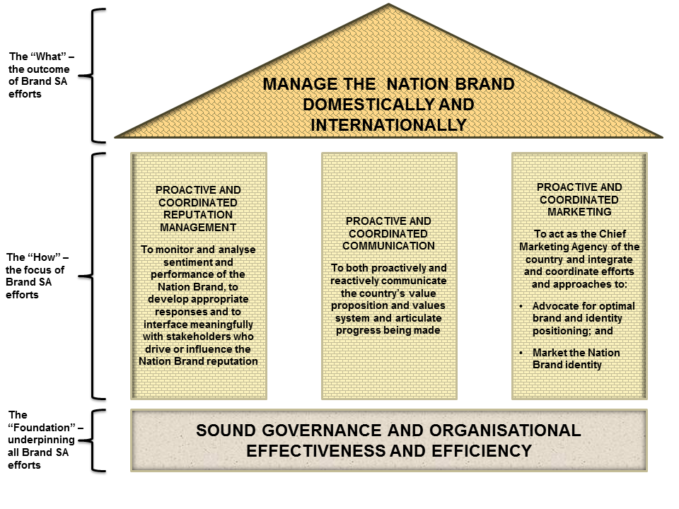
MANDATE (AS PER THE TRUST DEED)

Slide 4
TABLE OF CONTENTS
Mandate
Organisational Values
Corporate Governance
Human Capital
Quarter 1 Report
Quarter 2

Slide 5
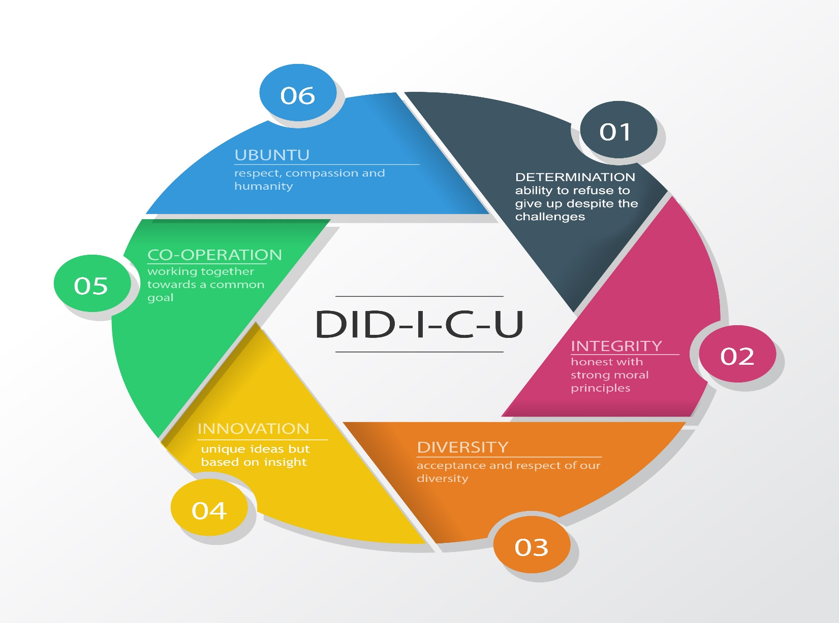
ORGANISATIONAL VALUES

Slide 6
TABLE OF CONTENTS
Mandate
Organisational Values
Corporate Governance
  New Board of Trustees
  Governance Structure
Human Capital
Quarter 1 Report
Quarter 2

Slide 7
NEW BOARD OF TRUSTEES
A new Board was appointed and assumed office on 1 June 2016 after having obtained Letters of Authority as per the Master of High Court, in terms of the Deeds of Trust.
Board Members were appointed in accordance with a new Trust Deed amended in November 2015, which reduced the maximum number of Trustees from 30 to 15.
Three Trustees who served on the previous Board were retained in order to ensure Board continuity.
The new Board was inducted during the first quarter in order to acquaint its members with the new governance environment in accordance with good corporate governance practice.

Slide 8
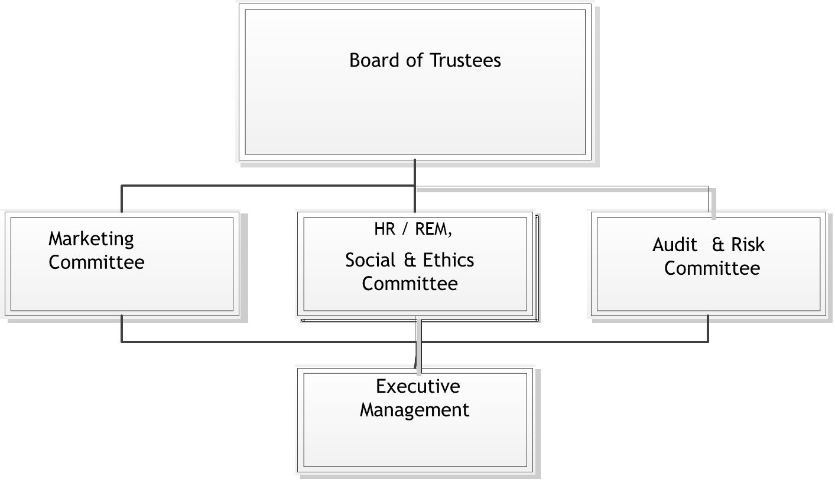
GOVERNANCE STRUCTURE

Slide 9
TABLE OF CONTENTS
Mandate
Organisational Values
Corporate Governance
Human Capital
  Workforce statistics
  Gender Diversity
  Staff Movement
  Organisational Structure
Quarter 1 Report
Quarter 2

Slide 10
WORKFORCE COMPARED TO NATIONAL DEMOGRAPHICS

Slide 11
GENDER DIVERSITY

Slide 12
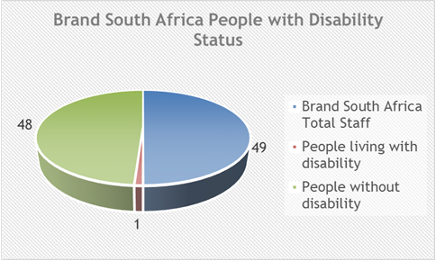
STATUS OF PEOPLE LIVING WITH DISABILTY

Slide 13
STAFF MOVEMENT
Vacancy rate – 4%
Reason for leaving | Voluntary/Involuntary | Number | % voluntary vs Involuntary
Dismissal | Involuntary | 0 | 0%
Retirement |  | 0
Expiry of contract |  | 0
Resignation | Voluntary | 1 | 100%
Other |  | 0
Total |  | 1

Slide 14
ORGANISATIONAL STRUCTURE

Slide 15
TABLE OF CONTENTS
Mandate
Organisational Values
Corporate Governance
Human Capital
Quarter 1 Report
  Performance Information
  Finance
  Performance Results
Quarter 2

Slide 16
Q1 PERFORMANCE INFORMATION
Performance Against Business Plan - Dashboard
Performance Against Pre-determined Objectives

Slide 17
Q1 PERFORMANCE AGAINST BUSINESS PLAN DASHBOARD
 | TARGETS | TOTAL ACHIEVED | NOT ACHIEVED | 87% ACHIEVED | VARIANCE EXPLANATION
PROGRAMME 1 – ADMINISTRATION
STRATEGIC GOAL 1: TO ENSURE A HIGH PERFORMANCE ORGANISATION BOASTING THE CAPABILITIES NEEDED TO DELIVER LOCALLY AND GLOBALLY
PLANNING | 2 | 2 | 0 | 73%
HUMAN CAPITAL | 3 | 2 | 1 |  | For human capital to meet its targets, the HR Plan must be approved by Board. The tenure of the previous Board had expired on the 12/03/2016 and the new Board was appointed on the 12/04/2016. The new Board was registered with the Master of High Court on the 01/06/2016. All the Board meetings will commence during the Q2 period.
INFORMATION TECHNOLOGY | 1 | 0 | 1 |  | The Enterprise Resource Plan contract was finalised towards the end of Q1 due to the process involved in gathering the business requirements from all respective areas. A kick-off meeting has been held and Phase 1 implementation of a single view solution has begun.
FINANCE | 9 | 7 | 2 |  | The target for the business case funding model has been deleted from the business plan during the mid-term review. The quarterly review for the risk assessment could not take place as the target is required to be in alignment with the strategic planning process, therefore the target has been deferred to Q2. A risk workshop is only scheduled for the 11 July 2016 following finalisation of the strategic and annual performance plan.
GOVERNANCE | 4 | 3 | 1
PROGRAMME 2 – BRAND MARKETING & REPUTATION MANAGEMENT
STRATEGIC GOAL 2: TO IMPROVE REPUTATION, PERCEPTIONS AND AWARENESS OF THE NATION BRAND AMONGST TARGETED AUDIENCES
NATION BRAND REPUTATION | 20 | 19 | 1 | 95%
PROGRAMME 3 – STAKEHOLDER RELATIONSHIPS
STRATEGIC GOAL 3: DEVELOP STRATEGIC PARTNERSHIPS AND RELATIONSHIPS WITH TARGETED STAKEHOLDERS TO LEVERAGE OUR REACH AND IMPACT
STAKEHOLDER MANAGEMENT | 7 | 7 | 0 | 100%
TOTAL | 46 | 40 | 6 | 87%

Slide 18

PERFORMANCE AGAINST PRE-DETERMINED OBJECTIVES (PDO)
Achieved 87% of the PDO
7% increase from 2015/16 Q1

Slide 19
TABLE OF CONTENTS
Mandate
Organisational Values
Corporate Governance
Human Capital
Quarter 1 Report
  Performance Information
  Finance
  Performance Results
Quarter 2

Slide 20
FINANCE
Major Cost Drivers
Budget versus Expenditure Q1
Supply Chain Management

Slide 21
MAJOR COST DRIVERS

Slide 22
MAJOR COST DRIVERS
As a result of finalising the appointment of a panel of brand agencies towards the end of the quarter, management had to defer some of the marketing deliverables that were going to be significant cost drivers during this period to the following quarter.
This was the main contributor to the overall budget underspending of 42.45% over and above the field research studies that are currently on-going that have not yet required cash outflows.

Slide 23
BUDGET VERSUS ACTUAL EXPENDITURE: Q1

Slide 24
SUPPLY CHAIN MANAGEMENT
The process of renewing and extending the office lease contract for an additional five years, from July 2016, is at finalisation stage.
Service providers were appointed during this quarter to offer the following services to Brand SA:
  Development and production of the 2015/2016 annual report at R300 127.00;
  Facilitation of strategic planning sessions and production of strategic and annual performance plan ending 2020 at R191 629.00;
  Brand agencies to assist on the execution of approved business plan deliverables as per approved and allocated budget.

Slide 25
TABLE OF CONTENTS
Mandate
Organisational Values
Corporate Governance
Human Capital
Quarter 1 Report
  Performance Information
  Finance
  Performance Results
Quarter 2

Slide 26
PERFORMANCE RESULTS

Slide 27
PERFORMANCE RESULTS
PROGRAMME 1: Administration
Strategy
Ensure a high performance organisation boasting the capabilities needed to deliver locally and globally
Key result area
Develop and manage the organisational capabilities we need, both locally and globally
Achievement:
  Number of targets: 19
  14 targets met
  5 targets not achieved
73% achieved

Slide 28
PERFORMANCE RESULTS
PROGRAMME 1: Administration
 | 4 Targets not met | Variance Explanation
1 | HR Plan approved by Board. | For human capital to meet its targets, the HR Plan must be approved by Board. The tenure of the previous Board has expired on the 12/03/2016 and the new Board was appointed on the 12/04/2016. The new Board was registered with the Master of High Court on the 01/06/2016.
2 | Implementation of the ERP solution. | The Enterprise Resource Plan contract was finalised towards the end of Q1 due to the process involved in gathering the business requirements from all respective areas. A kick-off meeting was held and Phase 1 implementation of a single view solution has begun.

Slide 29
PERFORMANCE RESULTS
PROGRAMME 1: Administration
 | 4 Targets not met | Variance Explanation
3 | A business case to secure funding. | The target has been removed from the 2016/17 business plan during the mid-term review. The application to amend the business plan has been sent to the Minister for submission to Parliament.
4 | Strategic risk register reviewed quarterly to mitigate risks. | The quarterly review for the risk assessment could not take place as the target is required to be in alignment with the strategic planning process, therefore, the target has been deferred to Q2. A risk workshop is scheduled for the 11/07/2016 following finalisation of the strategic and annual performance plan.

Slide 30
PERFORMANCE RESULTS
PROGRAMME 2: Brand Marketing & Reputation Management
Strategy
To improve reputation, perceptions and awareness of the Nation Brand amongst targeted audience
Key Result Area
Brand marketing and reputation management
Achievement:
  Number of targets: 20
  19 targets met
  1 targets not achieved
95% achieved

Slide 31
PERFORMANCE RESULTS
PROGRAMME 2: Brand Marketing & Reputation Management
 | 1 target partially met
1 | Implementation of online knowledge hub. | Implementation dependent on new website architecture implementation which is due for completion during the third quarter.

Slide 32
PERFORMANCE RESULTS
PROGRAMME 3: Stakeholder Relationships
Strategy
Develop strategic partnerships and relationships with targeted stakeholders to leverage our reach and impact
Key Result Area
Stakeholder relationships management
Achievement:
  Number of targets: 7
  7 targets met
100% achieved

Slide 33
TABLE OF CONTENTS
Mandate
Organisational Values
Corporate Governance
Human Capital
Quarter 1 Report
Quarter 2
  Performance Information
  Finance
  Performance Results

Slide 34
Q2 PERFORMANCE INFORMATION
Performance Against Business Plan - Dashboard
Performance Against Pre-determined Objectives

Slide 35
Q2 PERFORMANCE AGAINST BUSINESS PLAN DASHBOARD
TARGETS | TOTAL ACHIEVED | NOT ACHIEVED | 84% ACHIEVED |  | VARIANCE EXPLANATION
PROGRAMME 1 – ADMINISTRATION
STRATEGIC GOAL 1: TO ENSURE A HIGH PERFORMANCE ORGANISATION BOASTING THE CAPABILITIES NEEDED TO DELIVER LOCALLY AND GLOBALLY
17 | 13 | 4 | 68%
 |  | A business case approved by Board | Target not met | The target required the appointment of a service provider for the business case funding model. The board has since reviewed this target to allow the organisation to engage in partnerships as a matter of course without necessarily diversifying its revenue stream by asking for donations from the public sector. The target has since been removed from the Business Plan and communicated to the department.
 |  | 1% budget variance as per materiality framework. | Annual target | This target is annual target and has been revised as such during the mid-term review. The variance is supposed to be 5% which includes a contingency for the following months.
 |  | HR plan 2017/2022 approved by Board | Annual target | The target is subject to the mid-term proposed review. This is an annual target that should be aligned with the strategic plan process. The HR Plan will be submitted for Board approval once the 2017/2022 Strategic Plan has been approved in February 2017.
 |  | Workplace skills plan (WSP) implemented and training report submitted. | Target met | WSP: training implemented and the training report submission is due April 2017.
 |  | Submit an application for establishment of foreign offices in China | Target not met | Management to engage DIRCO to assist with the Government to Government approach once the new Country Manager: China has been appointed.
 |  | Phase 2 implementation of the Enterprise Resource Plan (ERP) solution. | Target not met | Development of software requirements and project plan completed. The implementation is ongoing and is expected to be completed by the end of Financial Year.
 |  | 100% legal compliance per compliance checklist | Target not met | Compliance currently 98.3% instead of 100% of an annual target. The outstanding issues were the development of a Succession Plan as recommended in the Protocol on Corporate Governance in the Public Sector as well as IT Governance Policies. With regard to the Succession Plan, the need for a Succession Plan in a public entity like Brand South Africa is negated by the Government policy that all posts have to be advertised. Regarding IT policies, all requisite policies will be finalised by financial year-end.
PROGRAMME 2 – BRAND MARKETING & REPUTATION MANAGEMENT
STRATEGIC GOAL 2: TO IMPROVE REPUTATION, PERCEPTIONS AND AWARENESS OF THE NATION BRAND AMONGST TARGETED AUDIENCES
20 | 19 | 1 | 95%
 |  | Management of GSA digital content on Brand South Africa website | Target partially met |  | Developed framework for GSA website redesign. Deferred to Q3.
PROGRAMME 3 – STAKEHOLDER RELATIONSHIPS
STRATEGIC GOAL 3: DEVELOP STRATEGIC PARTNERSHIPS AND RELATIONSHIPS WITH TARGETED STAKEHOLDERS TO LEVERAGE OUR REACH AND IMPACT
7 | 7 | 0 | 100%
TOTAL
46 | 39 | 7 | 84%

Slide 36
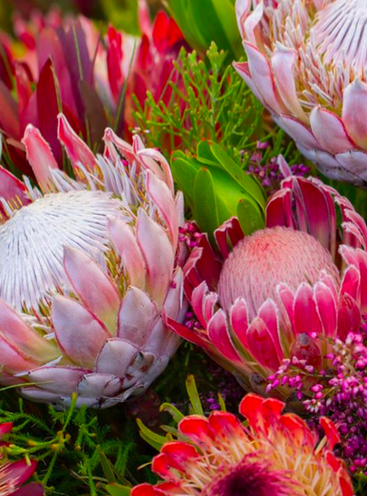
PERFORMANCE AGAINST PRE-DETERMINED OBJECTIVES (PDO)
Achieved 83% of the PDO
0% increase from 2015/16 Q2

Slide 37
TABLE OF CONTENTS
Mandate
Organisational Values
Corporate Governance
Human Capital
  Workforce statistics
  Gender Diversity
  Staff Movement
  Organisational Structure
Quarter 1 Report
Quarter 2 Report

Slide 38
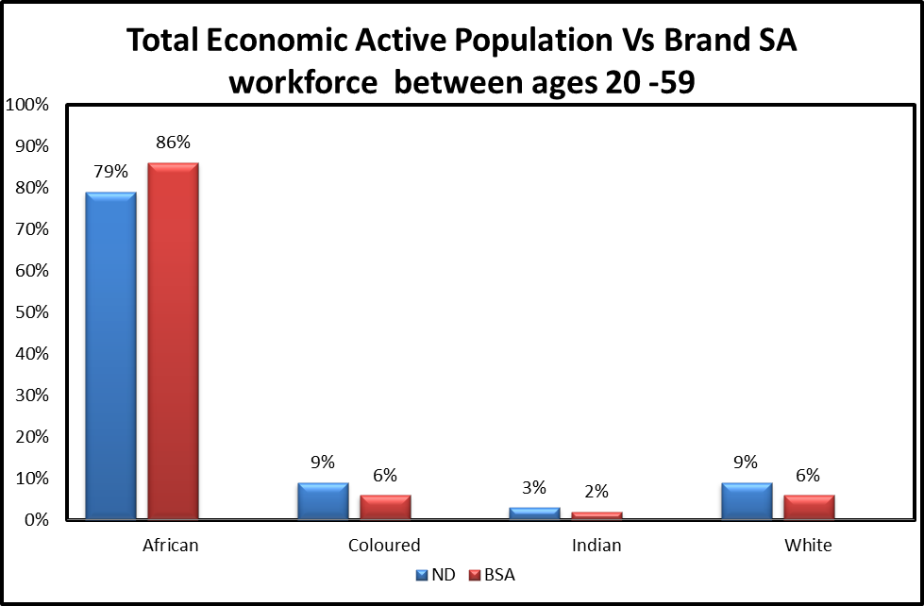
WORKFORCE COMPARED TO NATIONAL DEMOGRAPHICS

Slide 39
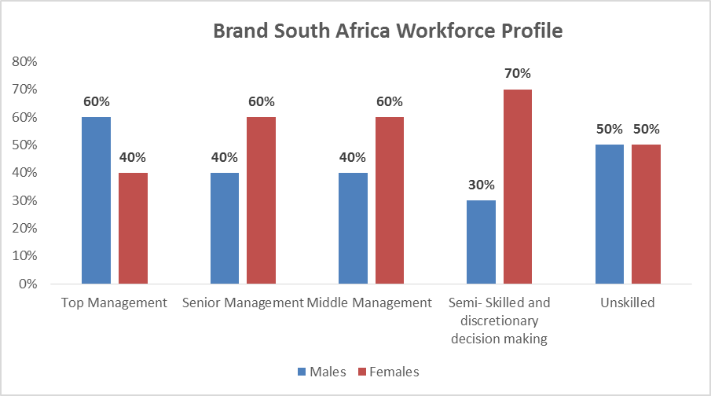
GENDER DIVERSITY

Slide 40
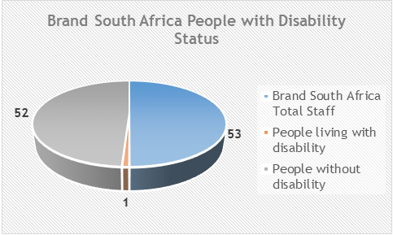
STATUS OF PEOPLE LIVING WITH DISABILTY

Slide 41
STAFF MOVEMENT
Vacancy rate – 5.88%
Reason for leaving | Voluntary/Involuntary | Number | % voluntary vs Involuntary
Dismissal | Involuntary | 0 | 0%
Retirement |  | 0
Expiry of contract |  | 0
Resignation | Voluntary | 2 | 100%
Other |  | 0
Total |  | 2

Slide 42
FINANCE
Monthly income versus expenditure
Year to date Cost Centre expenditure
Major Cost Drivers
Quarterly budget versus expenditure
Accumulated quarterly budget versus expenditure
Supply Chain Management

Slide 43
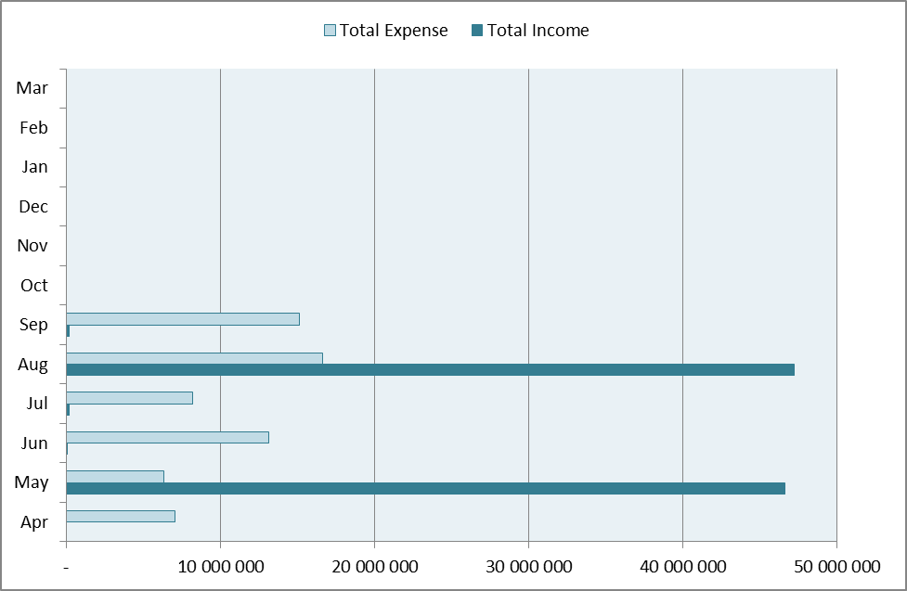
MONTHLY INCOME VERSUS EXPENDITURE

Slide 44
YEAR TO DATE COST CENTRES PERFORMANCE

Slide 45
MAJOR COST DRIVERS
The Q1 targets were deferred to Q2 due to delayed conclusion of suppliers contracts

Slide 46
QUARTERLY BUDGET VERSUS EXPENDITURE

Slide 47
ACCUMULATED QUARTERLY BUDGET VERSUS EXPENDITURE

Slide 48
SUPPLY CHAIN MANAGEMENT
Base Media (Pty) Ltd was awarded a three-month contract through a deviation process for media monitoring and analysis services for the total value of R373 863.99 inclusive of VAT. A tender process is currently underway for a three-year contract.
No irregular expenses have been incurred during the quarter under review.
Implementation of recommendations from AGSA is continuous. In particular, the update of the entity’s supplier database and the planned verification of declarations of interest.

Slide 49
TABLE OF CONTENTS
Mandate
Organisational Values
Corporate Governance
Human Capital
Quarter 1 Report
Quarter 2
  Performance Information
  Finance
  Performance Results

Slide 50
PERFORMANCE RESULTS

Slide 51
PERFORMANCE RESULTS
PROGRAMME 1: Administration
Strategy
Ensure a high performance organisation boasting the capabilities needed to deliver locally and globally
Key result area
Develop and manage the organisational capabilities we need, both locally and globally
Achievement:
  Number of targets: 19
  13 targets met
  4 targets not achieved
68% achieved

Slide 52
PERFORMANCE RESULTS
PROGRAMME 1: Administration
 | 4 Targets not met | Variance Explanation
1 | A business case approved by Board | The target required the appointment of a service provider for the business case funding model to be appointed. The Board has since reviewed the target as communicated in the Q2 Management Report.
2 | Phase 2 implementation of the Enterprise Resource Plan (ERP) solution. | Development of software requirements and project plan completed. The implementation is ongoing is expected to be completed by the end of Financial Year.
3 | 100% legal compliance per compliance checklist | Compliance currently 98.3% instead of 100% of an annual target.
4 | Submit an application for establishment of foreign offices in China | The Minister of Communications and the Board of Trustees will assist management and engage DIRCO to assist with the Government to Government approach once the new Country Manager: China has been appointed.

Slide 53
PERFORMANCE RESULTS
PROGRAMME 2: Brand Marketing & Reputation Management
Strategy
To improve reputation, perceptions and awareness of the Nation Brand amongst targeted audience
Key Result Area
Brand marketing and reputation management
Achievement:
  Number of targets: 20
  19 targets met,
  1 target not achieved
95% achieved

Slide 54
PERFORMANCE RESULTS
PROGRAMME 2: Brand Marketing & Reputation Management
 | 1 target not met | Variance Explanation
1 | Management of GSA digital content on Brand South Africa website | Developed framework for GSA website redesign. Deferred to Q3.

Slide 55
PERFORMANCE RESULTS
PROGRAMME 3: Stakeholder Relationships
Strategy
Develop strategic partnerships and relationships with targeted stakeholders to leverage our reach and impact
Key Result Area
Stakeholder relationships management
Achievement:
Number of targets: 7
7 targets met
100% achieved

Slide 56


