Slide 1
SECOND AND THIRD QUARTER PERFORMANCE REPORT PRESENTATION
FOR 2016-2017
Presentation to the Portfolio Committee on DPSA and DPME
Date: 8 February 2017
Mr. Tshediso Matona: Acting Director General

Slide 2
Introduction
The main focus of DPME’s work is monitoring the implementation of the National Development Plan (NDP) though the Medium Term Strategic Framework (MTSF)
In this regard, we seek to:
Enhance the quality of planning and implementation across government as a whole
Institutionalise evidence based planning drawing on monitoring and evaluation and other data sources
ensuring that planning sets the priorities that inform the allocation of resources
Work is proceeding in implementing the different elements of institutionalising planning. This will converge into an overarching national framework on the policy and regulation of planning in government

Slide 3
Background 3
The work of the DPME is organised according to the following programmes:
Programme | Programme Goals
Programme 1 : Administration | An efficient and effective department that complies with legislation, policy and good corporate governance principles
Programme 2 : Outcomes Monitoring and Evaluation | To advance the strategic and developmental agenda of government through monitoring, reporting and recommending corrective measures on the implementation of the NDP and the MTSF targets and evaluating key government programmes
Programme 3: IPME | To strengthen institutional performance through regular monitoring, evaluation and support
Programme 4: Planning | To facilitate integrated short, medium to long-term planning and policy coherence in support of the implementation of the National Development Plan and government programme
Programme 5 : Youth | To promote youth development and empowerment

Slide 4
Monitoring the NDP Implementation
The MTSF 2014-2019 is the framework through which the implementation of the NDP is monitored
MTSF is government’s first five year implementation plan of the NDP 2030 - covering the period 2014 – 2019
The monitoring focuses on targets and indicators towards 14 identified outcomes

Slide 5
Implementing NDP 2030: MTSF 2014-2019
Quality basic education A long and healthy life for all All people in South Africa are, and feel safe Decent employment through inclusive economic growth Skilled and capable workforce to support an inclusive growth path An efficient, competitive and responsive economic infrastructure network Comprehensive rural development and food security | Sustainable human settlements and improved quality of household life Responsive, accountable, effective and efficient local government system Environmental assets and natural resources that are valued, protected and continually enhanced Create a better South Africa, a better Africa and a better world An efficient, effective and development-oriented public service Social protection Nation building and social cohesion

Slide 6
Levers for implementing the NDP 2030
ECONOMIC
SERVICES:
Corresponding Outcomes
4. Decent employment through inclusive economic growth
5. Skilled and capable workforce to support an inclusive growth path
6. An efficient, competitive and responsive economic infrastructure network
7. Comprehensive rural development and food security
10. Environmental assets and natural resources that are valued, protected, and continually enhanced
CAPABLE
STATE & ACTIVE CITIZENRY:
Corresponding Outcomes
3. All people in South Africa are
and feel safe
9. Responsive, accountable, system-effective, and efficient local government
11. Create a better South Africa, a better Africa and a better world
12. An efficient, effective and development-oriented public service
14. Nation building and social cohesion
CAPABILITIES
OF SOUTH AFRICANS:
Corresponding Outcomes
Quality basic education
A long and healthy life for all
Sustainable human settlements and improved quality of household life
13. Social protection

Slide 7
High level progress at midpoint of the MTSF 2014-2019
Higher Education and Training: Number of qualifying TVET students obtaining financial assistance annually has increased from 188 182 in 2012 to 235 988 in 2015
Number of students enrolled in public higher education studies at universities has increased from 950 000 in 2012 to 985 212 in 2015
Human Settlements: From 2014 to 2016, access to Housing has improved:
Housing delivered by the state has increased by 273000 additional units
200000 households in informal settlements have been upgraded
163000 title deeds have been transferred to homeowners, thereby reducing the previous backlog of 820000
217000 loans have been issued into the gap market by the DFIs and the Banks (40% of target at a 4:1 ratio)

Slide 8
High level progress at midpoint of the MTSF 2014-2019 (2)
Basic Service Delivery has improved. Since 2014:
628 061 additional HHs have been connected to electricity grid
40 569 additional HHs are connected to non-grid
401794 additional HHs had access to refuse removal
283,200 additional HHs have received access to water
425000 additional HHs have been given access to sanitation
International Relations and Trade: A cumulative total tourism spend has reached R39,3 billion as at September 2016
Social Protection
16 853 828 million beneficiaries have access to social grants, which is 91% of eligible beneficiaries

Slide 9
Fighting corruption in the public service
Anti-Corruption Inter-Ministerial Committee and Anti-Corruption Task Team established and functional
Legislation to protect whistle blowers developed and approved by cabinet and tabled in parliament
Office of Chief Procurement Officer has developed the Public Procurement Bill (PPB) which aims to modernise the public procurement and Supply Chain Management function
Some successful prosecutions of high priority corruption cases
Public Service Regulations 2016 published – they govern the receipt of gifts, financial disclosures, performance of other remunerative work by civil servants, the doing business with an Organ of State and ethics infrastructure
National Anti-Corruption Strategy Discussion Document developed in conjunction with other spheres of government and civil society – further public consultation to take place in early 2017
Public Consultations will culminate in the adoption of the National Anti-Corruption Strategy that brings together government, business and civil society
However, there is still a long way to go in the fight against corruption, including in the private sector.
There is a need to strengthen prosecutorial, investigative and forensic capacity as well as to strengthen anti-corruption legislation

Slide 10
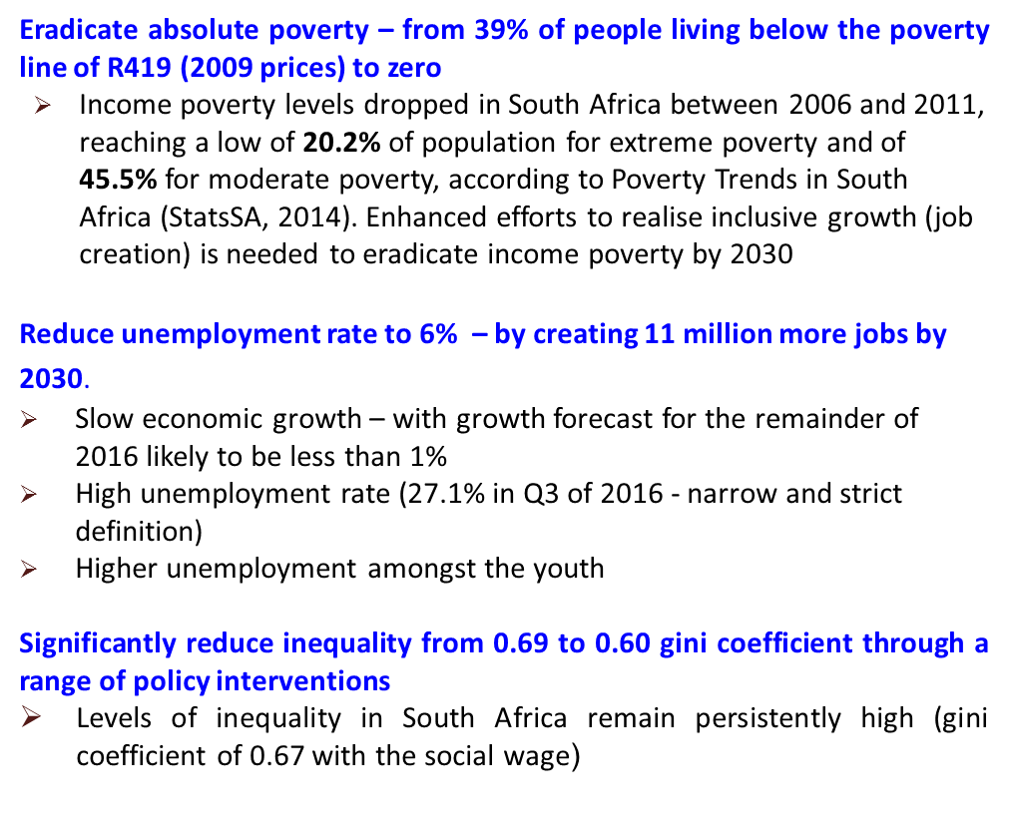
NDP 2030 goals and status
Our future - make it work

Slide 11
Observations
There is a need to accelerate implementation in the remainder of the MTSF 2014-2019
It will be also imperative to sharpen focus and deploy resources to priority areas of high impact
Also, accountability for performance needs to be enhanced across the board

Slide 12
2016-17 APP PERFOMANCE HIGHLIGHTS

Slide 13
Highlight of progress against 2016-17 commitments
Alignment of Plans and Budgets with NDP
A framework for Strategic Plans and APPs is under review. Completion of the framework is planned for 2017
Draft framework for long term planning has been developed
Assessed budgets allocation against priorities to improve alignment of National Development Plan and Budget. This culminated in a proposal on alignment of budget to NDP priorities which was adopted by the Cabinet Lekgotla in August 2016
Providing continued support to the National Planning Commission

Slide 14
Highlight of progress against 2016-17 commitments (2)
30 days payment of legitimate invoices
DPME is continuing to monitor the payments of suppliers and producing reports . The reports indicate that some progress is being made but more needs to be done. The table below indicate progress in the first two quarters of the financial year.
As of 03 February 2017, the total amount paid to suppliers as a result of DPME intervention amounts to R273, 5 m
1. INVOICES PAID AFTER 30 DAYS: As at September 2016
2. INVOICES OLDER THAN 30 DAYS AND NOT PAID: As at September 2016
 | Number of Invoices | Rand Value
National Departments | 11 951 | R84 775 891
Provincial Departments | 50 785 | R3 900 976 102
 | Number of Invoices | Rand Value
National Departments | 14 889 | R201 735 303
Provincial Departments | 23 511 | R2 212 803 125

Slide 15
Highlight of progress against 2016-17 commitments (3)
Operation Phakisa Methodology
Progress is being made through the methodology in regard to South Africa’s ocean economy, and the Health, Education and Mining sectors
Operation Phakisa Ocean Economy has since 2014, unlocked R7 billion in investments and created 6,903 jobs
The health component of Operation Phakisa has contributed to efforts to improve the quality of care in public sector facilities.
A total of 322 Primary Health Care (PHC) facilities were transformed into ideal clinics in 2015, while a further 138 achieved this status in 2016/17, culminating in a total of 460 ideal facilities. Government is committed to make 2,823 PHC facilities ideal by 2019
Operation Phakisa in the Basic Education Sector was launched in October 2015
A total of 54% of the targeted 24 000 public schools have been connected. Progress is constrained by the exorbitant costs of broadband . Government continues to engage with service providers around this matter

Slide 16
Highlight of progress against 2016-17 commitments (4)
Operation Phakisa in the Mining has been finalised in December 2015, and some of strategies and programmes are being implemented to stem the negative tide in the mining sector
Operation Phakisa on Biodiversity was completed in May 2016, and included Bioprospecting, promoting Marine and Coastal Tourism; protecting our Wildlife
Operation Phakisa on Agriculture, Land Reform and Rural Development was completed at the end of October 2016

Slide 17
Revitalising mining communities: progress and challenges
DPME is coordinating a multi-departmental and multi-stakeholder IMC. The following work streams are in progress:
Partnerships between government and mining companies in the delivery of decent housing and living conditions for mine workers and community members are being implemented
A review of mining companies additional infrastructure capacity (water treatment plants) is being conducted to assess the possibility of infrastructure partnerships between municipalities and the mining companies
The development of mining towns spatial transformation plans has been finalised for all the prioritised municipalities by the Housing Development Agency

Slide 18
Revitalising mining communities: progress and challenges (2)
Catalytic economic development projects with an emphasis on the advancement of the agriculture sector in mining communities are being implemented in both the mining towns and the labour sending areas
Increased access to medical assessments for ex-mineworkers, community members and current mineworkers is being fast tracked
Some challenges:
Delay in informal settlements upgrading. NDoH is addressing the this.
Inadequate capacity in municipalities to drive catalytic economic projects in labour sending areas.

Slide 19
Highlight of progress against 2016-17 commitments (5)
Frontline Service Delivery Monitoring (FSDM) and Support
97 new facilities were monitored. 39 Improvements Monitoring Visits were conducted in the past quarter
Implementation of CBM has taken place in 3 facilities (Amangwe Police Station, Kopanong Police Station and Alexandra Police Station)
A report has been prepared on FSDM findings under four themes: (i) buildings; (ii) equipment; (iii) staffing and (iv) coordination
The findings emphasise the need for proper management and resourcing of frontline facilities to ensure quality public services
Implementation of evaluation
The system has now resulted in 55 national evaluations covering around R90 billion of government expenditure, as well as around 55 provincial evaluations
Currently there are 27 approved reports and 18 Improvement Plans being implemented
2017-18 National Evaluation Plan approved by Cabinet

Slide 20
Highlight of progress against 2016-17 commitments (4)
Supported 4 provincial departments to develop provincial evaluation plans. 6 evaluation reports were produced and 8 evaluation improvement plans were developed with the aim of improving programme performance during the 2015/16 financial year
LGMIM and MPAT
LGMIM and MPAT are programmes to assess management and leadership capabilities in municipalities and national and provincial departments. The LGMIM programme has enrolled 30 municipalities across six provinces in the past financial year. Similarly, MPAT secured 100% participation (155 national and provincial departments) on the assessment of management practices
Youth
President established the Presidential Working Group on Youth comprising of Deputy Ministers to monitor and drive the implementation of the NYP 2020. Work streams, comprising of business, civil society, and government departments were set up in each of the five priority areas to monitor NYP 2020

Slide 21
Planning and Budgeting for 2017-18
The strategy review exercise was concluded. The purpose of the review is to enhance the effectiveness of the department and create synergies across the programmes
The process resulted in the development of a limited number of strategic objectives and outputs, and revised organisational and budget structure

Slide 22
OVERALL PERFORMANCE FOR QUARTER 02 & 03
YEAR 2016/17
 | QUARTER 02 | QUARTER 03
Number of targets | 45 | 37
Targets Exceeded | 13 | 07
Targets Achieved | 22 | 16
Target Partially Achieved | 5 | 05
Targets not Achieved | 5 | 09

Slide 23
Overall view of the performance
There are no major changes in the performance environment in relation to the APP targets
Most of the targets will be achieved by the end of the financial year
Targets not achieved under programme 1 relate to non-submission of 1st and 2nd draft APP and Strategic Plan and maintaining a vacancy rate of 10%. The former was due to the strategy review exercise which took longer than anticipated and the latter was due to the fact that most posts were filled by internal candidates (vacancy rate is currently at 11%)

Slide 24
FINANCIAL PERFORMANCE FOR 2016-17

Slide 25
2016/17 Budget Overview
# | PROGRAMME | PURPOSE | BUDGET (R000)
1 | Administration | Provide strategic leadership, management and support services to the department. Including Ministry, Office of the DG, Office of the CIO, Internal Audit and Corporate & financial Services | 141 052
2 | Outcomes Monitoring & Evaluation | Further the strategic agenda of government by advancing and implementing the outcomes approach, monitoring and reporting on its progress, and evaluating its impact. | 91 751
3 | Institutional Performance Monitoring & Evaluation | Promote good monitoring and evaluation practices and processes in government through: management performance assessment and support; frontline service delivery monitoring and support; and capacity development. | 61 955
4 | National Planning | Develop the country’s long term vision and national strategic plan, and contribute towards better outcomes in government through better planning, better long term plans, greater policy coherence and the clear articulation of long term goals and aspirations. | 91 508
5 | National Youth Development Agency | Provide oversight on youth development policy and its implementation, and facilitate the transfer of funds to the National Youth Development Agency. | 411 396
 | TOTAL |  | 797 662

Slide 26
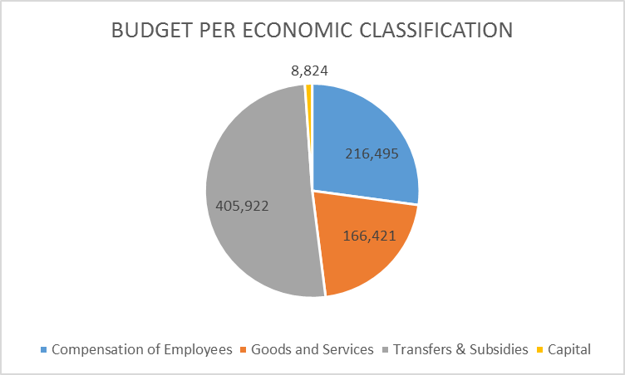
2016/17 Budget Overview

Slide 27
2016/17 Financial Performance

Slide 28
2016/17 Budget Performance
DPME was allocated additional funding to enhance capacity to support its growing mandate
R30 million savings on Compensation of Employees declared in Adjustments Budget due to the approval of the new organisational structure taking longer than anticipated
Treasury has classified these funds as “specifically and exclusively appropriated” and therefore it cannot be utilized for any other purpose
The Department projects around 97% expenditure for 2016/17

Slide 29
Conclusion
The existing tools and methodologies of DPME are now well established
The strategy and organisational review is shifting focus to areas of priority and high impact
This will inform DPME’s capacity- building and resource allocation plans from the additional funding

Slide 30
Ke a leboha Ke ya leboga Ke a leboga Ngiyabonga Ndiyabulela Ngiyathokoza Ngiyabonga Inkomu Ndi khou livhuha Thank you Dankie

Slide 31
ADDITIONAL SLIDES DETAILED PERFORMANCE PER PROGRAMME AS PER APP TARGETS

Slide 32
PERFORMANCE INFORMATION PER APP PROGRAMMES

Slide 33
OVERALL PERFORMANCE FOR QUARTER 02 & 03
YEAR 2016/17
 | QUARTER 02 |  | QUARTER 03
Number of targets | 45 | 78% | 37 | 62%
Targets Exceeded | 13 | 29% | 07 | 19%
Targets Achieved | 22 | 49% | 16 | 43%
Target Partially Achieved | 05 | 11% | 05 | 14%
Targets not Achieved | 05 | 11% | 09 | 24%

Slide 34
PERFORMANCE INFORMATION PROGRAMME 01: ADMINISTRATION

Slide 35
OVERALL PERFORMANCE FOR QUARTER 02 & 03
PROGRAMME 01
 | QUARTER 02 |  | QUARTER 03
Number of targets | 13 | 61% | 12 | 50%
Targets Exceeded | 3 | 23% | 03 | 25%
Targets Achieved | 5 | 38% | 03 | 25%
Target Partially Achieved | 4 | 31% | 02 | 17%
Targets not Achieved | 1 | 08% | 04 | 33%

Slide 36
Planned Annual Target 2016/17 | 2nd Quarter Targets | 3rd Quarter Targets | Actual Achievement/ Narration
Conduct annual review of strategic plans and APP as prescribed by the relevant planning framework | Review and produce 1st draft of strategic plan and APP and submit to NT and DPME | Review and produce 2nd draft of strategic plan and APP and submit to NT and DPME | Target not Achieved Both 1st and 2nd draft were not produced due to the strategy review process which took longer that anticipated
Quarterly reports submitted to the Executive Authority, National Treasury and DPME within 30 days from the end of the quarter | 1st quarter performance report for 2016- 17 produced and approved by the Minister and submitted to NT | 2nd quarter performance report for 2016- 17 produced and approved by the Minister and submitted to NT | Target partially achieved Both reports were produced but approved after due dates

Slide 37
Planned Annual Target 2016/17 | 2nd Quarter Targets | 3rd Quarter Targets | Actual Achievement/ Narration
Produce AR and Submit AGSA for audit and to NT and Parliament by due date | Audited Annual Report produced and submitted to National Treasury and Parliament by due date | - | Target Achieved Audited Annual Report was produced and submitted to National Treasury and Parliament by due date
Produce a communication plan annually and report on its implementation within 30 days of end of each quarter of the financial year | Implement 40% of activities and produce quarterly report | Implement 50% of activities and produce quarterly report | Target Achieved 52% of planned targets are implemented

Slide 38
Planned Annual Target 2016/17 | 2nd Quarter Targets | 3rd Quarter Targets | Actual Achievement/ Narration
100% of valid invoices paid within 30 days or disciplinary action taken in 100% of cases where invoices are not paid within 30 days | 100% of valid invoices paid within 30 days or disciplinary action taken in 100% of cases where invoices are not paid within 30 days | 100% of valid invoices paid within 30 days or disciplinary action taken in 100% of cases where invoices are not paid within 30 days | Target Achieved 100% of valid invoices were paid within 30 days
Maintain a vacancy rate of less than 10% annually | 10% or less on average over the quarter | 10% or less on average over the quarter | Target Not Achieved 11.4% average vacancy rate over the quarter (40/350*100=11.4%)
Achieve 90% submissions of performance agreements, reviews and assessments by due dates | 90% of mid-term performance reviews concluded by 30 September 2016 | 90% of mid-term performance reviews concluded by 31 October 2016 | Target Exceeded 248 out of 264 employees submitted the midterm reviews. This represents 94%.

Slide 39
Planned Annual Target 2016/17 | 2nd Quarter Targets | 3rd Quarter Targets | Actual Achievement/ Narration
WSP approved by DG by 30 April 2016 Achieve 80% of targets in the WSP by the end of the financial year | 30% | 60% | Target exceeded 330 training interventions were organized which represents 132%. (330/250*100=132%)
Produce quarterly reports indicating 85% achievement of ICT systems standards | 1 | 1 | Target Achieved 85% of ICT standards where achieved
Business applications produced and approved by the CIO | Produce a report indicating 60% achievement of targets in the business applications plan | Produce a report indicating 60% achievement of targets in the business applications plan | Target not Achieved 5 of 16 project are achieved 5/16*100 = 31 %

Slide 40
Planned Annual Target 2016/17 | 2nd Quarter Targets | 3rd Quarter Targets | Actual Achievement/ Narration
Produce annual risk plan and quarterly progress reports | 1st quarter risk progress report submitted to Risk and Audit Committee by 30 September 2016 | 2nd quarter risk progress report submitted to Risk and Audit Committee by 30 December 2016 | Target Partially achieved 2nd Quarter risk management progress report was presented only to Audit Committee and not Risk Committee meeting
Produce a 3 year rolling strategic internal audit plan and submit to the Audit Committee for approval by 30 June 2016 | 1st quarter internal audit progress report submitted to Audit Committee by 30 September 2016 | 2nd quarter internal audit progress report submitted to Audit Committee by 30 December 2016 | Target Achieved Quarter Internal Audit progress report was submitted to Audit Committee

Slide 41
Planned Annual Target 2016/17 | 2nd Quarter Targets | 3rd Quarter Targets | Actual Achievement/ Narration
Produce as executive support plan and produce quarterly reports on performance against the plan | Produce report against the plan for 1st quarter | Produce report against the plan for 2nd quarter | Target Not Achieved The quarterly report to support executive both political and administrative was not produced

Slide 42
PERFORMANCE INFORMATION PROGRAMME 02: OUTCOME MONITORING AND EVALUATION

Slide 43
OVERALL PERFORMANCE FOR QUARTER 02 & 03
PROGRAMME 02
 | QUARTER 02 |  | QUARTER 03
Number of targets | 13 | 77% | 07 | 58%
Targets Exceeded | 3 | 23% | 02 | 29%
Targets Achieved | 7 | 54% | 02 | 29%
Target Partially Achieved | 1 | 8% | 01 | 14%
Targets not Achieved | 2 | 15% | 02 | 29%

Slide 44
Planned Annual Target 2016/17 | 2nd Quarter Targets | 3rd Quarter Targets | Actual Achievement/ Narration
MTSF and or Delivery Agreements reviewed when necessary | Draft MTSF finalised and submitted to Cabinet Lekgotla | MTSF finalised | Target Not Achieved The 14 Chapters of the MTSF are reviewed when necessary. To date, 8 Chapters have cumulatively been revised and submitted to Cabinet for approval
Produce 3 consolidated reports for each of the 14 outcomes | 1 | - | Target Not Achieved The submitted draft consolidated report is for quarter 01

Slide 45
Planned Annual Target 2016/17 | 2nd Quarter Targets | 3rd Quarter Targets | Actual Achievement/ Narration
Produce 1 summary report on the implementation of the 14 outcomes by 31 March 2017 and submit to Cabinet | - | 1 | Target Not Achieved Summary report on the implementation of the 14 outcomes was not produced
3 reports for each outcome on the POA systems (excluding outcomes for which the reports are classified by 31 March 2017) | One report for each outcome for which the reports are classified | - | Target Achieved 13 outcomes reports were displayed to the public on POA website. Outcome 11 was classified
Develop a concept document | Produce 2nd draft concept document and project plan in consultation with StatsSA | Implement the project plan and report on progress | Target Achieved Progress report has been prepared. The concept document including project plan was submitted

Slide 46
Planned Annual Target 2016/17 | 2nd Quarter Targets | 3rd Quarter Targets | Actual Achievement/ Narration
Produce 2 Operation Phakisa interactive dashboard reports per lab and publish on Operation Phakisa website by 31 March 2017 | 1 | - | Target Achieved Dashboard reports for Ocean Economy and Ideal Clinic labs published on the Phakisa Website.
Provide quality advice to political principals by preparing briefing notes on 75% of Cabinet memoranda and 100% of requests from political principals | Produce 75% of briefing notes on Cabinet memoranda and 100% of briefing notes or reports on specific requests received | Produce 75% of briefing notes on Cabinet memoranda and 100% of briefing notes or reports on specific requests received | Target Exceeded 67 of 81 briefing notes for Cabinet memoranda (67/81*100=83%) completed.

Slide 47
Planned Annual Target 2016/17 | 2nd Quarter Targets | 3rd Quarter Targets | Actual Achievement/ Narration
Produce an average of 80% of briefing notes on executive visits throughout the quarters of the financial year | Produce an average of 80% of briefing notes on executive visits | Produce an average of 80% of briefing notes on executive visits | Target Exceeded 15 of 16 Briefing notes on executive visits were produced (15/16*100=94%)
Produce 3 briefing notes on the status of mining towns and labour sending areas submitted to Minister to update him on progress | 1 | - | Target Achieved 1 Briefing note on the status of mining towns and labour sending areas was produced
LGMIM updated and approved by DG by the end of September 2016 | Approved LGMIM | - | Target Achieved LGMIM was approved by DG on the 17 May 2016

Slide 48
Planned Annual Target 2016/17 | 2nd Quarter Targets | 3rd Quarter Targets | Actual Achievement/ Narration
Produce and Submit 1 LGMIM report by July 2016 | 1 | - | Target Achieved 1 LGMIM report was produce and submitted by July 2016
Produce annual report showing support for 80% requested impact assessments | Report on percentage of request/ submissions received and support provided/ responses sent to departments within 30 days | Report on percentage of request/ submissions received and support provided/ responses sent to departments within 30 days | Target Achieved 88 of 96 Socio Economic Impact Assessment Study (SEIAS) submissions received and responded to the department with 30 days
2017-18 National Evaluation Plan approved by Cabinet by March 2017 | Evaluations recommended for 2017/18 to 2019/202 plan | - | Target Achieved Five letters of acceptance from the DG have been produced.

Slide 49
Planned Annual Target 2016/17 | 2nd Quarter Targets | 3rd Quarter Targets | Actual Achievement/ Narration
8 (Number of improvement plans produced | 2 | 2 | Target Partially Achieved 2 improvement plan for design evaluation of draft policy on community was produced.

Slide 50
PERFORMANCE INFORMATION PROGRAMME 03: INSTITUTIONAL PERFORMANCE MONITORING AND EVALUATION

Slide 51
OVERALL PERFORMANCE FOR QUARTER 02 & 03
PROGRAMME 03
 | QUARTER 02 |  | QUARTER 03
Number of targets | 13 | 85% | 13 | 62%
Targets Exceeded | 6 | 46% | 06 | 47%
Targets Achieved | 5 | 39% | 02 | 15%
Target Partially Achieved | 0 | 0% | 02 | 15%
Targets not Achieved | 2 | 15% | 03 | 23%

Slide 52
Planned Annual Target 2016/17 | 2nd Quarter Targets | 3rd Quarter Targets | Actual Achievement/ Narration
MPAT updated and approve by Director General and launched by the end of August 2016 | MPAT and submit to DG for approval by end of August 2016 | - | Target Achieved MPAT standards were updated and approve by Director General and launched by the end of August 2016
95% MPAT assessment conducted to national and provincial departments | Facilitate self-assessment at all national and provincial departments | Moderation completed for all national and provincial department | Target Achieved 612 of 634 MPAT Self-assessment conducted to both national and provincial departments (612/634*100=97%) and all were moderated

Slide 53
Planned Annual Target 2016/17 | 2nd Quarter Targets | 3rd Quarter Targets | Actual Achievement/ Narration
80% feedback given to Director General within 30 days of receipt of the performance agreement | 80 Performance Agreement filed by the due date | Feedback letters circulated to HoDs | Target Not Achieved 47/111 Feedback Letters were circulated to HODs (47/111=42%)
90% Capacity development of newly appointment DG’s within 3 months after appointment | Capacity development to DGs appointed in the previous 3 months | Capacity development to DGs appointed in the previous 3 months | Target Not Achieved Capacity development provided to DG’s appointed in the previous 3 months did not take place because OPSC cancelled the session at last minute

Slide 54
Planned Annual Target 2016/17 | 2nd Quarter Targets | 3rd Quarter Targets | Actual Achievement/ Narration
Revised FSDM Operational Guide Framework placed on DPME website | First draft produced and saved on M-drive | Second draft of FSDM Operational Guidelines | Target Achieved Second draft of FSDM Operational Guidelines was produced
63 new facilities monitored and passed quality assurance with site monitoring reports captured on the M-Drive by 31 March 2017 | 21 | 21 | Target Achieved 80 new facilities monitored and passed quality assurance with site monitoring reports
27 New frontline service delivery monitoring visits to be directly focused on indicators in the M&E framework for the National Youth Policy | 9 | 9 | Target Exceeded 20 Youth Facilities were monitored

Slide 55
Planned Annual Target 2016/17 | 2nd Quarter Targets | 3rd Quarter Targets | Actual Achievement/ Narration
100 Improvement monitoring visits | 25 | 25 | Target Exceeded Improvements Monitoring Visits were conducted
20 unscheduled monitoring interventions as a result of reported service delivery challenges | 5 | 5 | Target Exceeded 19 unscheduled visits were undertaken
Performance reports to G&A Cluster once per year Performance report to PCC once per year | - | Hotline performance reports to G&A and PCC | Target Achieved Reports have been submitted to G&A and PCC
Produce customer satisfaction survey reports by end of each quarter | Produce 1 customer satisfaction report by 30 September 2016 | Produce 1 customer satisfaction report by 31 December 2016 | Target Achieved Customer satisfaction reports were produced

Slide 56
Planned Annual Target 2016/17 | 2nd Quarter Targets | 3rd Quarter Targets | Actual Achievement/ Narration
Citizen-based monitoring implemented in 10 new facilities to support capacity building in service delivery departments | Implement CBM in 2 Facilities | Implement CBM in 4 Facilities | Target Partially Achieved Implementation of CBM has taken place in 5 facilities
2 integrated intervention plans submitted to relevant clusters | Submit first plan to relevant cluster by September 30, 2016 | Planning with stakeholders on second intervention plan | Target Achieved First plan was submitted to G&A Cluster System on September 29, 2016 Two planning meetings were held

Slide 57
Planned Annual Target 2016/17 | 2nd Quarter Targets | 3rd Quarter Targets | Actual Achievement/ Narration
Achieved 80% of targets in the Capacity Development Implemented Plan | Produce 1 progress report showing 40% achievement of targets in the implementation plan | Produce 1 progress report showing 60% achievement of targets in the implementation plan | Target Achieved Produced quarterly report showing achievement of 79% of target in the Capacity Development Implementation plan

Slide 58
PERFORMANCE INFORMATION PROGRAMME 04: PLANNING

Slide 59
OVERALL PERFORMANCE FOR QUARTER 02 & 03
PROGRAMME 04
 | QUARTER 02 |  | QUARTER 03
Number of targets | 04 | 100% | 03 | 100%
Targets Exceeded | 1 | 25% | 0 | 0%
Targets Achieved | 3 | 75% | 03 | 100%
Target Partially Achieved | 0 | 0% | 0 | 0%
Targets not Achieved | 0 | 0% | 0 | 0%

Slide 60
Planned Annual Target 2016/17 | 2nd Quarter Targets | 3rd Quarter Targets | Actual Achievement/ Narration
3 research projects commissioned/ commenced by end of financial year | Terms of reference for 1 research study compiled | Terms of reference for 1 research study compiled | Target Achieved Terms of reference for research study were compiled
Participation in the budget review and planning prioritisation for key government departments | Participate in the budget review and produce report on support provided during the first 2 quarters | - | Target Achieved Ongoing process of internal consultation and working with National Treasury on analysis to assess budgets and priorities and to improve alignment of National Development Plan and Budget.

Slide 61
Planned Annual Target 2016/17 | 2nd Quarter Targets | 3rd Quarter Targets | Actual Achievement/ Narration
Produce Annual Report on stakeholder engagements and the work of the NPC on the NDP and submit to the NPC by end of March 2017 | Produce quarterly activity report on support provided to the NPC | Produce quarterly activity report on support provided to the NPC | Target Achieved 27 NPC activities were recorded in both quarters

Slide 62
Planned Annual Target 2016/17 | 2nd Quarter Targets | 3rd Quarter Targets | Actual Achievement/ Narration
Consultation with government departments on a discussion document on approached to institutionalisation of long term planning incorporating framework for spatial planning | Consultation of stakeholders Commence with implementation of legal and administrative process for re-assignment of the responsibility for the NSDF | Consolidation of consultation process and implication of inputs received | Target Achieved A report on consultations on the Planning discussion document with government departments and implications for planning reform in South Africa was compiled.

Slide 63
PERFORMANCE INFORMATION PROGRAMME 05: NATIONAL YOUTH DEVELOPMENT PROGRAMMES

Slide 64
OVERALL PERFORMANCE FOR QUARTER 02 & 03
PROGRAMME 05
 | QUARTER 02 |  | QUARTER 03
Number of targets | 02 | 100% | 02 | 100%
Targets Exceeded | 0 | 0% | 0 | 0%
Targets Achieved | 2 | 100% | 02 | 100%
Target Partially Achieved | 0 | 0% | 0 | 0%
Targets not Achieved | 0 | 0% | 0 | 0%

Slide 65
Planned Annual Target 2016/17 | 2nd Quarter Targets | 3rd Quarter Targets | Actual Achievement/ Narration
Submit reports on the status of implementing the youth policy | 1 Implementation report | 1 Implementation report | Target Achieved Quarter reports on the status of implementing the youth policy was produced
Produce Tranche approval and NYDA quarterly reports | Tranche approval Quarter 2 NYDA report | Tranche approval Quarter 3 NYDA report | Target Achieved NYDA Tranche approved and Quarter Performance Information report

