Slide 1
Presentation by SANParks on Strategies to curb wildlife crime (Rhino poaching)
31 January 2017
Presented by Mr Fundisile Mketeni: CEO SANParks

Slide 2
Maj Gen (ret) Johan Jooste

Slide 3
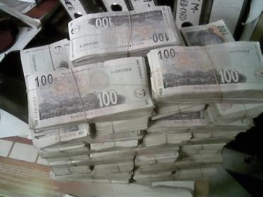
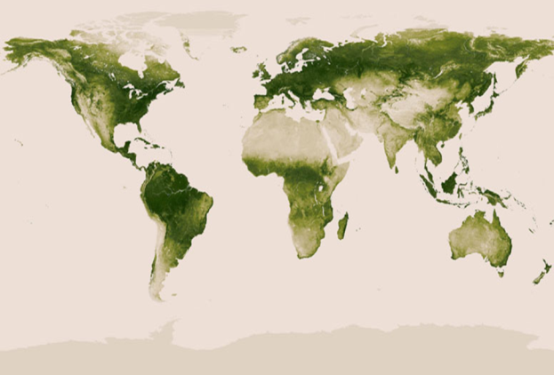
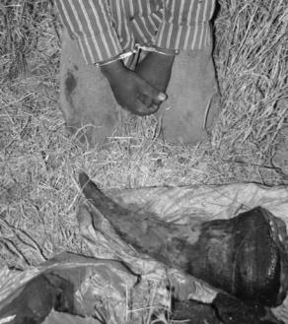
IWT global challenge
Greed
End users market not within African control
Supply sourced largely from Africa
Poverty
Notes:
Only through collaborative global action that reinforces national, regional and international interventions will we be able to effectively combat this transnational organised crime.
Holistic, integrated and multidimensional responses, involving all relevant government departments, including conservation authorities, enforcement and intelligence agencies, customs, the prosecuting authorities and other national, regional and international organisations and stakeholders should be implemented by all countries.

Slide 4
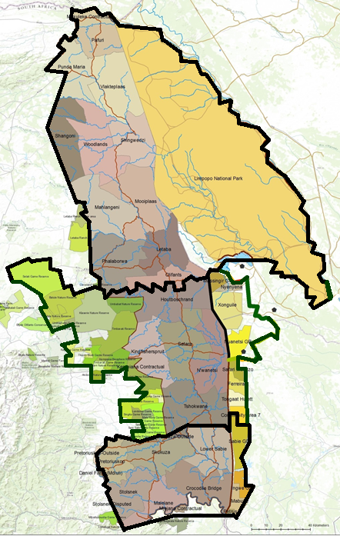
The reality: Kruger National Park
2,000,000ha
380km x 60km 1.9 million tourists PA
20,000 Elephant
8,000 Rhino
MANY Allies
186 km
221 km
Wales 21,000km²
Israel 20,000km²
KRUGER PARK 19,000km²
282 km
1000 km
167 km

Slide 5
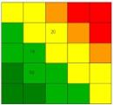
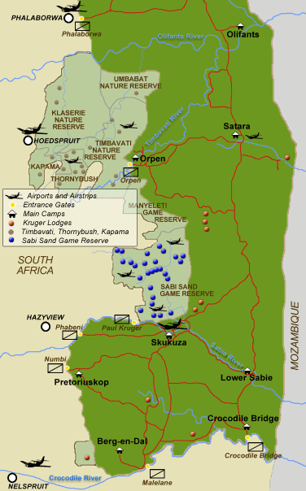
Whole-of-Society approach
Operating concept
Foresight
Scenarios
& Risks
With what
capabilities?
Security Chain
What tasks?
Who?
DEA
Analysis
Private
Security
Prevention
NGOs
Business
Response
Public
Measures of
Effectiveness
Evaluation
Communities

Slide 6
An integrated approach for South Africa
Compulsory interventions
Pro-active anti-poaching
Actionable intelligence
Responsive legislative framework
Interventions to increase rhino numbers
Strategic removals
Sanctuaries, conservancies, strongholds
Conservation husbandry
International collaboration
Long-term sustainability interventions
Creating sustainable demand
Supply options
Alternative economic choices for communities
Game-changing interventions
Disruption of organized crime
Technology

Slide 7
The elusive victory
Are we winning? Not YET
Why ? Doctoring only the symptoms of wild life crime
When will we win? When a whole-of-government (WOG) approach is implemented
Good success rate
5
Poaching down to an “acceptable number”
WHAT WE NEED
INTERNATIONAL CONSUMER
4
NATIONAL EXPORTER
3
NATIONAL COURIER
2
LOCAL COURIER OR TRANSITO
1
THE POACHER IN THE PARK
WHAT WE CAN DO INSIDE THE PARK

Slide 8
Removing the cause
A small number of brokers or coordinators manage the chain
Source end of the supply chain where rhinos are poached and their horns removed
Distribution and retail end of supply chain, where rhino-horn goods are sold
Due to the structure of the illicit wildlife supply chain,
the best target for intervention is the central stakeholder group

Slide 9
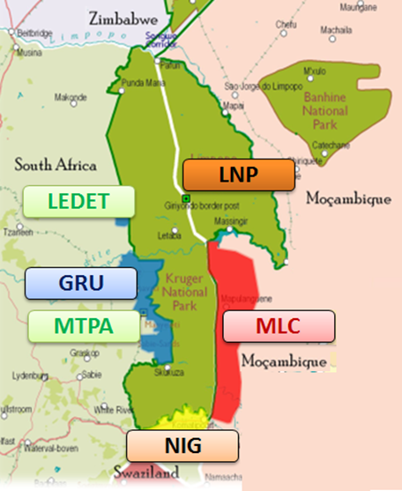
Inclusive Approach
Surrounded by Strategic Partners
Urban & Rural Communities
Private & Provincial Reserves
Hotels, Lodges & Resorts
Informal Settlements
Farms & Businesses
at
KNP can only be cleared
from the outside

Slide 10
Alliances
By choice:
CSIR
SA Wildlife College
Peace Parks Foundation
SHR
Donors
Through design:
NATJOINT structures
Mozambique institutions

Slide 11
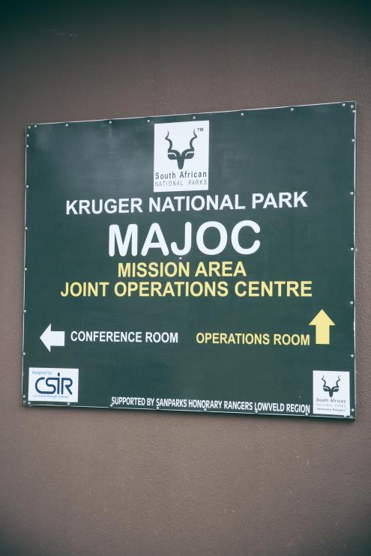
Kruger National Park Mission Area
JOINT OPERATIONS CENTRE
SANDF
SAPS
BFS
STF
NIU
Infantry
Canine
SAAF ASCO
Detectives
Air Wing
Military Police
Field Rangers
HQ support teams
Special Rangers
Protection Services

Slide 12
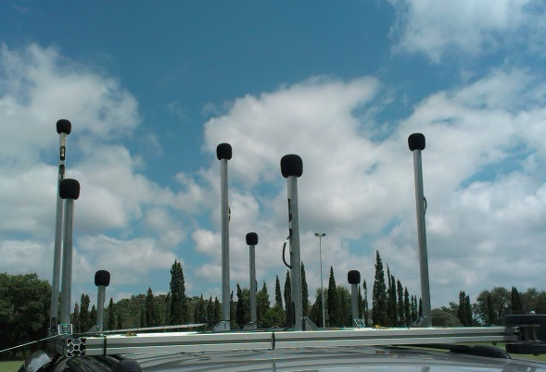
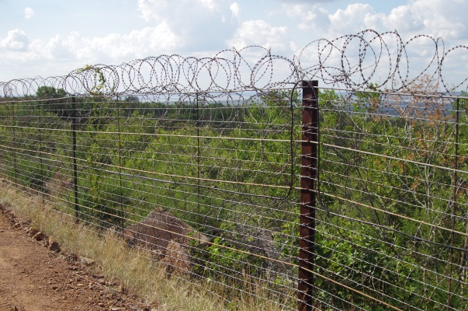
Surveillance, Early Warning, Detection and Tracking (SEDT) Technology
Area Surveillance
Radar & Electro-optic Technology
Acoustic Surveillance Technology
Magnetic Surveillance Technology
Seismic Surveillance Technology
Perimeter Surveillance
… enabling Superior Situational Awareness

Slide 13
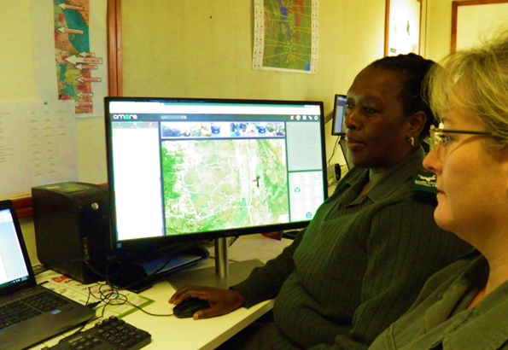
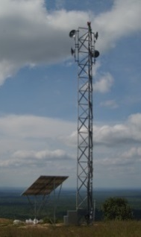
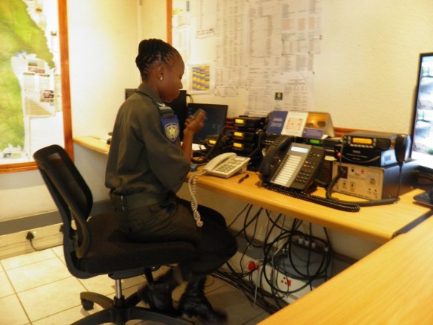
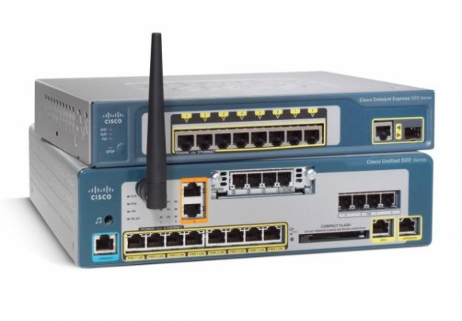
System Integration Technology
Collaboration Platform
High Speed Data Network
Voice Communication
Communication Integration
… enabling Superior Situational Awareness

Slide 14
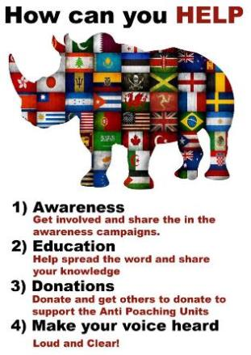
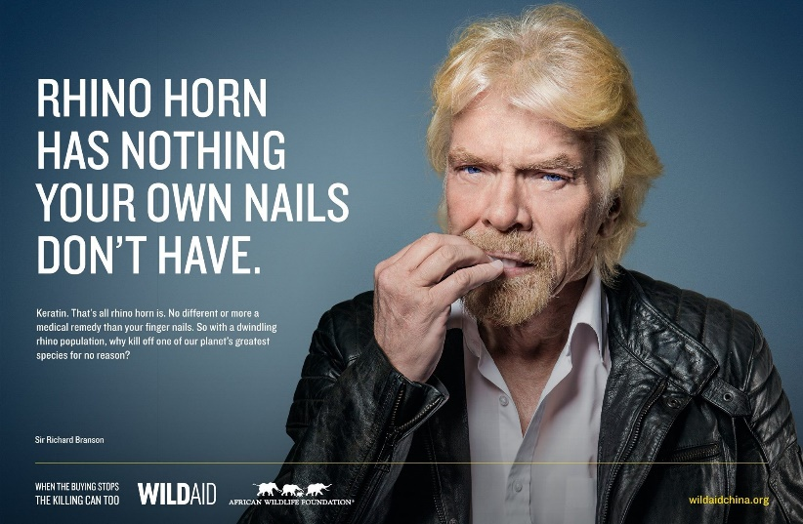
Wildlife crime combatting coordinating Centre
Wildlife crime approach
Extended investigative capacity
Alliances (internal and external)
Mozambique as key partner
Technology and research (“think tank”)
Strategic communication (social media)
Resource mobilization

Slide 15
Chief Ranger Nicolus Funda

Slide 16
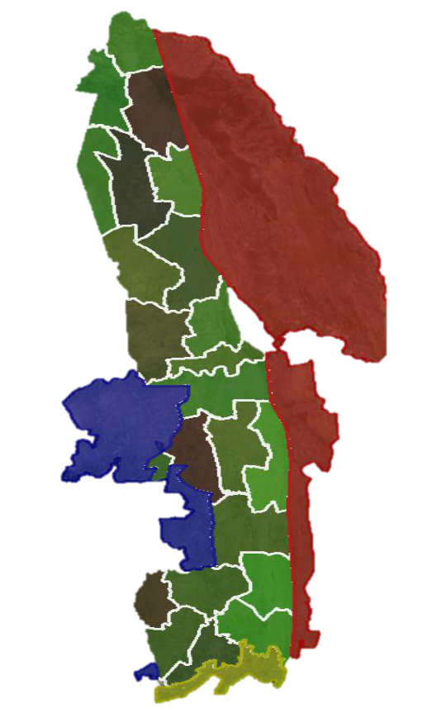
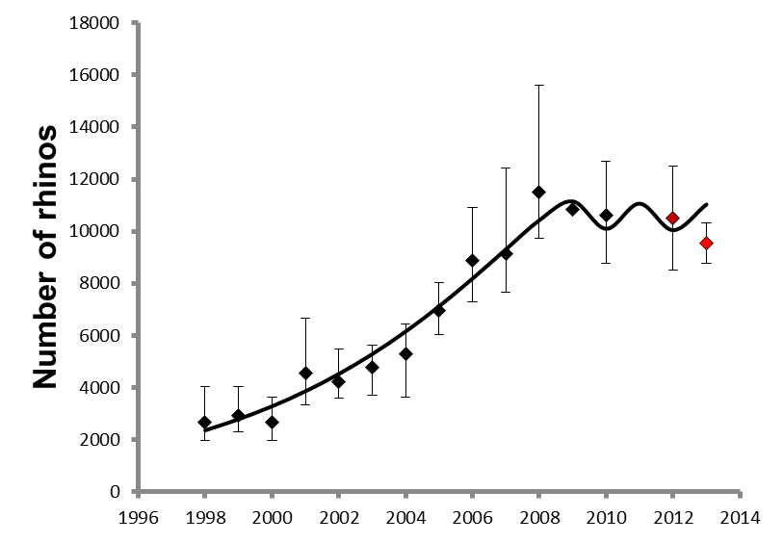
The zoning approach
Nxanatseni North & South
CPZ
Composite Protection Zone
Cross-border co-operation and local community involvement
Rhino guardian approaches
Other Parks and Protected Areas
Marula North
JPZ
Joint Protection Zone
Depend on human intelligence and partner communication
Marula South
IPZ
Intensive Protection Zone
Use of various Integrated technology/intelligence enablers
16

Slide 17
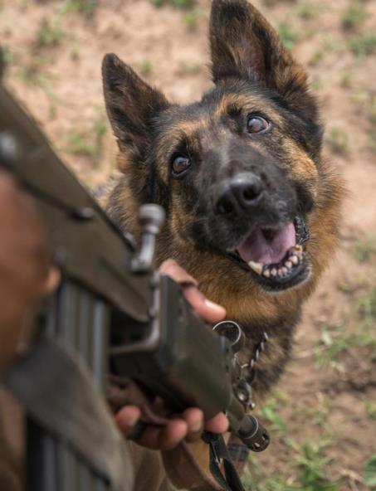
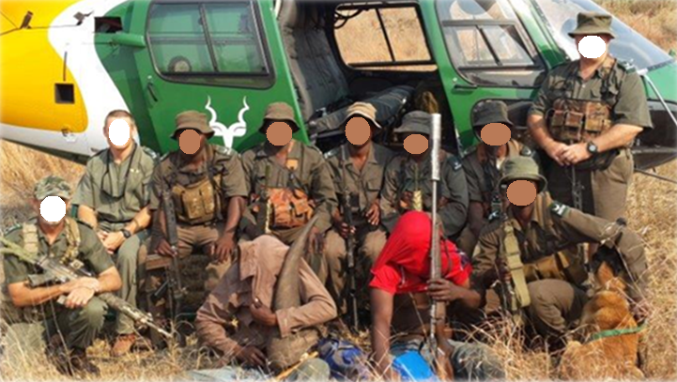
Tactical capabilities
Expand air services
Special rangers
Canine capability
Night enhancement
PERSISTANT AND UNPREDICTABLE

Slide 18
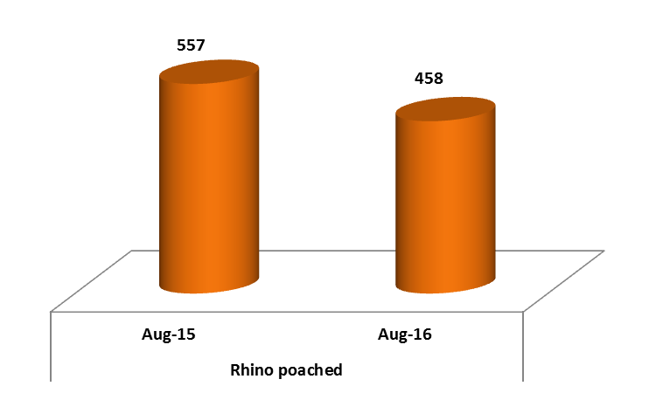
Wildlife crime Stats…cont

Slide 19
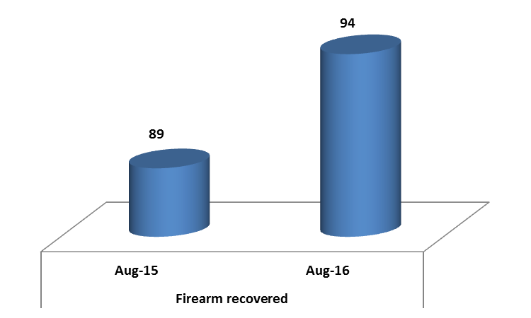
Wildlife crime Stats…cont

Slide 20
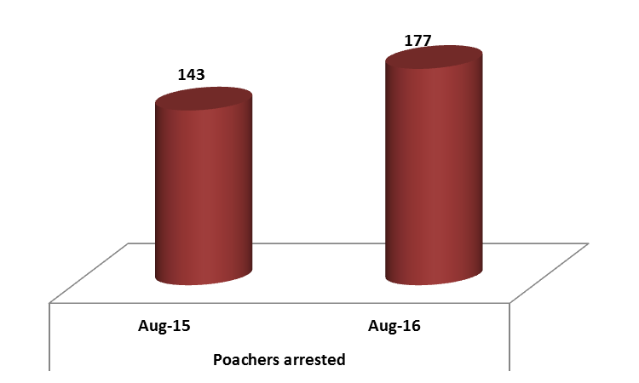
Wildlife crime Stats…cont

Slide 21
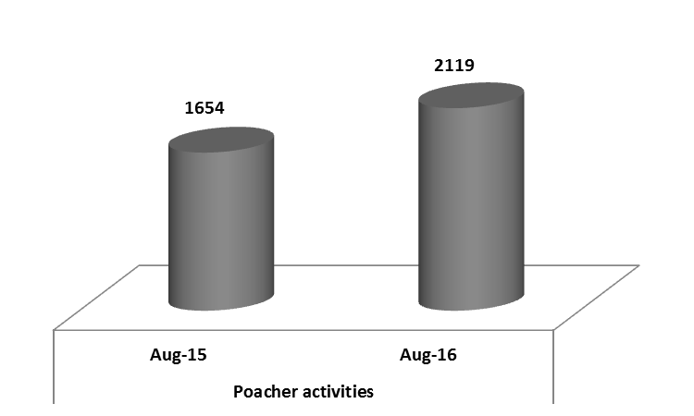
Wildlife crime Stats…cont

Slide 22
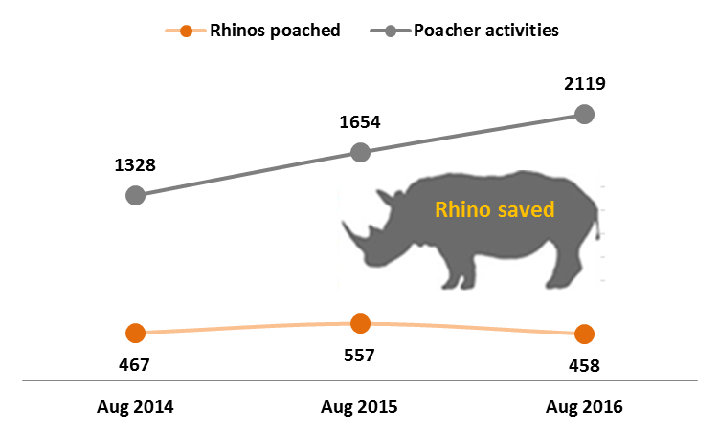
Wildlife crime Stats…cont

Slide 23
Beyond enforcement
A Global Problem with Severe Regional Implications
and Catastrophic Local Impact

