Slide 1
SA Post Office Corporate Plan progress report & future prospects for quarter 3 (2016/2017)

Slide 2
Executive summary
Postbank is profitable, well capitalised and Corporatization process is on track.
ICASA relationship regularised - postal services reserved area and tariff increases
Early signs of customer confidence & trust returning to SAPO
Payment of creditors
Settlement of historical labour matters
JIMC cleanup
Key areas of focus for 2017 calendar year
SASSA grants
Postbank licence
Branch network and operational efficiency
Launch a competitive courier business
Invest to become the e-commerce hub of choice for Africa
Become government’s delivery partner of choice
On a net basis, SAPO is expected to meet its Corporate Plan target of R1.146 billion net loss
2

Slide 3
Mail revenue ….. declining business
Mail YTD revenue of R2.4 billion
YoY decline of R166m (6%) and below budget by R701m (23%)
Explanation
Corporate customers going to online & courier solutions
Hybrid mail – reduced mailings
Historical delay in the payment of critical suppliers (paid in October 2016)
120 Corporate customer engagements from July to December 2016
Comprehensive client solution replaced disparate systems
Postbox renewed at 50%
JIMC backlog reduced despite high volumes during seasonal peak
Hybrid mail contract signed for printing services
Sales staffing structure completed
Current
Actions
R200m additional revenue in pipeline (25% contracted)
Parcel solution for major corporates that integrates into SAPO systems (4 customers)
Bids for 11 Government tenders submitted
3

Slide 4
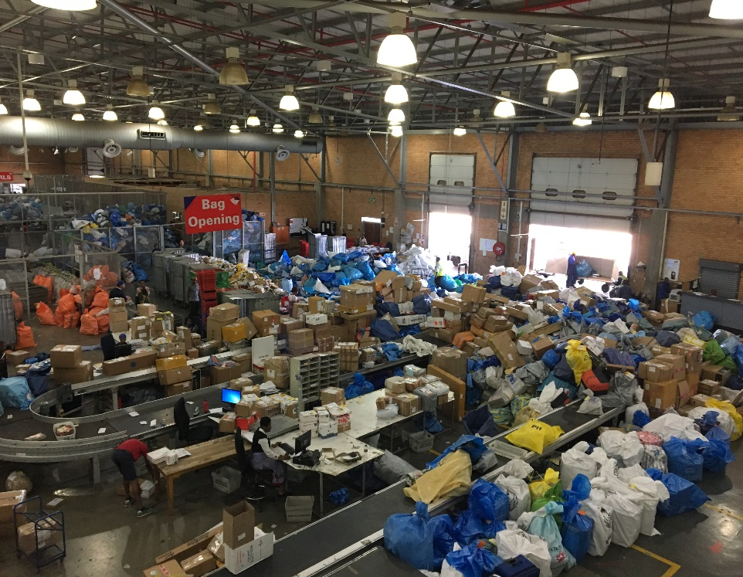
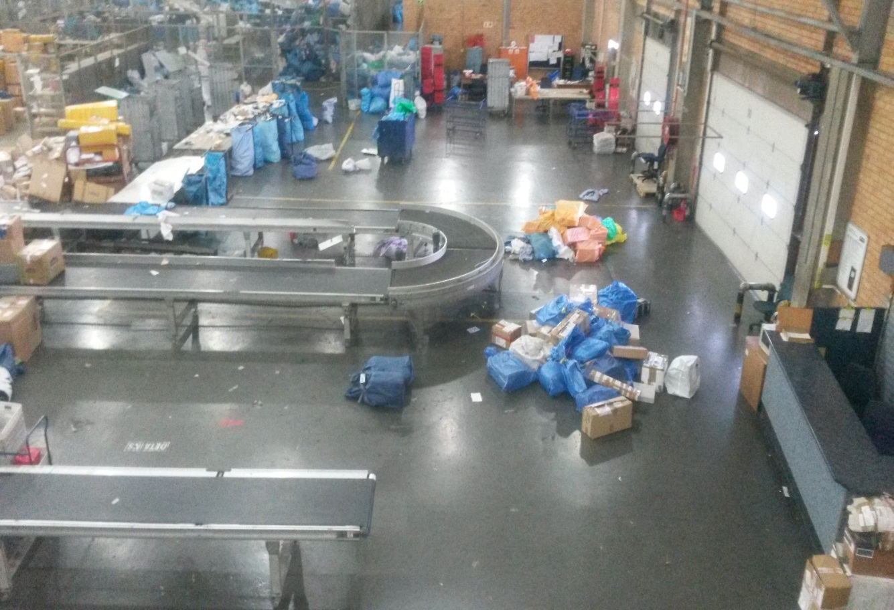
JIMC ….. backlog cleared
Before
After
4

Slide 5
Retail revenue
Retail YTD revenue of R349 million
YoY increase of R66m (15%) and below budget by R303m (46%)
Non availability of stock at branches
Aging infrastructure
Fax and photocopiers
Point of sale equipment
State of repair of the branches
DTT project revenue of R47m
MVL revenue increased by 7%
Explanation
Current
Stock availability improving
Shortage of government stationery for MVL (Government Printing Works)
Network stability and capacity not optimal
Optimal staffing model for Retail in progress
Fax & photo copiers service: re-launch planned
EMV compliant pinpads by 31 March 2017 to increase transactions & revenue
Address aging infrastructure
Awareness campaigns for DTT underway to increase uptake
Investigating expansion of footprint – fuel retailers, etc.
Actions
5

Slide 6
Property revenue
Property YTD revenue of R53 million
YoY increase of R28m (107%) and below budget by R225m (81%)
Explanation
R17m proceeds from sale of property
Increased rental from existing tenants
Leasing out unutilized space
Current
Sale of properties on hold
Valued 98 properties
Refurbishing and redesign of buildings to attract potential tenants
Valuation of properties to improve balance sheet
Expansion of space at ORT by 71% to support E-Commerce
Head office alternatives being investigated
Actions
6

Slide 7
Staff expenses ….. labour stability
Staff expenses (includes VSP & staff liabilities) of R2.8 billion
YoY increase of R28m (1%) and below budget by R720m (19%)
Explanation
Employee headcount reduced by 1 794 to 18 987 [Nov 2014 headcount 23 591]
Voluntary severance packages (VSP) approved for 768 employees
VSP cost of R125m contributed to YoY increase
CFO appointed in December 2016
SETA approved the funding of 250 learners to obtain a National Diploma in Customer Management (NQF Level 5)
Historical labour disputes settled:
Conversion of part time and casual employees
Salary increases for 2014/15, 2015/16 & 2016/17 settled
Equal pay for work of equal value - Branch Managers
Current
New recognition agreement currently with organized labour & substantive negotiations to commence in Feb 2017
Top structure to be presented at the Board meeting of 6 Feb 2017
Recruitment process for critical positions currently underway including COO and E-Commerce
Actions

Slide 8
Transport expenses ….. some real savings achieved
Transport expenses of R239 million
YoY decrease of R97m (29%) & below budget by R250m (51%)
Explanation
Reduction in line haul costs
Route optimisation due to lower volumes
Reduction in fleet and fuel cost despite price increases
Current
Procurement process for line haul service providers, fleet services and fuel cards soon to be finalised
Delivery standards improving
Continue with further route optimization initiatives
Actions
Additional vehicles acquired for strategic projects
Optimising usage and mix of container types
Optimising fleet size and composition to support revenue growth
8

Slide 9
Corporate plan forecast
Revenue expected to be R1.81 billion below corporate plan targets
Mitigated by reduction of budgeted expenditure and non ops costs of R1.85 billion
On a net basis SAPO is expected to meet its Corporate Plan target

Slide 10
Balance sheet ….. liquid & solvent
Total assets of R12 billion
Recapitalisation & term loans
R650 million recapitalization funds received in April 2016
R3.7 billion long term loans acquired against government guarantees (cost to service debt is high)
Postbank depositors funds
Depositors funds of R4.9 billion increased by R128m
Postbank investments of R7.3 billion
Liquidity & solvency
Trade payables reduced by R531m (now at normal operational levels)
SAPO Group meets liquidity & solvency requirements
SAPO debt / equity structure not optimal
R1.1 billion available from term loans
Overdraft facility (R270m) repaid
10

Slide 11
Postbank corporatisation update
Section 13 Approval to Establish the Bank granted by the SA Reserve Bank in July 2016
Approved Postbank Board nominees enable next step in registration of company
Preparations are underway to register the South African Postbank Limited entity with the CIPC
Postbank staff, operations and balance sheet will transfer from the Postbank division to the new entity after the incorporation process
Systems and compliance implementation are on track for the Section 16 Application to Register a Bank to be submitted before the 3 of July 2017
Bank controlling and capital adequacy to be addressed
11

Slide 12
SASSA grants
SAPO/Postbank is uniquely positioned to pay social grants:
2400 points of presence (+-5000 counters) in even the most remotest parts of the country
Previous experience in SASSA disbursements
Postbank implemented an upgraded core banking platform that is “best of breed”
Postbank is a full member of the Payment Association of South Africa and participates in the NPS
VISA and MasterCard membership with a large active card base
In excess of 5.7 million customer accounts with R5 billion in deposits
SAPO/Postbank will make a submission to the SASSA RFI which is closing on the 10 of February 2017
If awarded all or part of the contract, SAPO will fast track investment and implementation of all required capabilities
SAPO will not require additional funding from NT for these investments but require certainty of revenue to justify making these significant investments
12

Slide 13
E-commerce …. SAPO as hub for Africa?
SAPO has in excess of 2 400 points of presence across the country giving it the largest “footprint” to facilitate collections and deliveries. The network rests on 26 hubs that are strategically placed to ensure speed of connection for items and delivery with SAPO controlling the entire distribution network with a fleet of 1 317 vehicles.
The JIMC facility offers access to the ORT international airports apron enabling a faster turn- around of the items through the processes for mail entering or leaving the country
In process of increasing floor space by 71% (7 944 m² from 11 130 m² ) at the OR Tambo airport
SARS is co-located at JIMC for forwarding and clearing
Engagements progressing to secure online payment options to supplement cash on delivery service
SAPO will offer two types of online malls one focused on South Africa in the next year and the other on the SADC region in the second year
South African mall will consist largely of SMEs in South Africa who will be provided an online platform to promote and sell their products within South Africa, with SAPO providing backend fulfilment
Invest in E-commerce with appropriate partners including the ports
13

Slide 14
Investments for revenue
22 significant projects approved
9 projects in implementation stage
4 projects in procurement phase
7 projects in detail design & testing phase
2 project in feasibility
Potential annulised revenue of R420m
14

