Slide 1
DEPARTMENT OF PLANNING, MONITORING
AND EVALUATION
MPAT Lessons Learnt and Support

Slide 2


Purpose
To present Portfolio Committee on PSA and PM&E with MPAT results for 2015 as well as a report on the consolidated lessons learnt from good management practice case studies between 2011 and 2015.
To also present proposed initiatives to support transformation of the Public Service in the managerial leadership practices,

Slide 3


Summary
MPAT has been implemented to facilitate reforms in management practices in government departments. MPAT has over the years acknowledged that whilst there are pockets of improvements, these have not reached the desired levels.
The lessons learnt from MPAT case studies show that managerial leadership weaknesses still persist in the public service and highlight the need for a holistic approach towards managerial leadership to improve performance in service delivery.

Slide 4


Key Findings
Two key issues coming out of the performance assessments and case studies are as follows :-
There are pockets of excellence with regards to management practises throughout government.
Weak managerial leadership practises remain a major challenge and contribute to administrative failures in government. Good management practices are crucial and at the centre as enablers for service delivery and have to be established throughout government institutions.
Management practices combined with good leadership are key to success of any organisation.

Slide 5


Pockets of Excellence
National Department of Trade and Industry
National Department of Environmental Affairs South African Police Services
Western Cape Department of Transport
Western Cape Department of Health
KwaZulu Natal Treasury
Gauteng Department of Social Development
Free State Department of Education

Slide 6
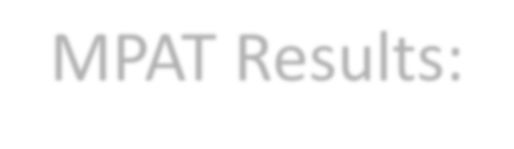



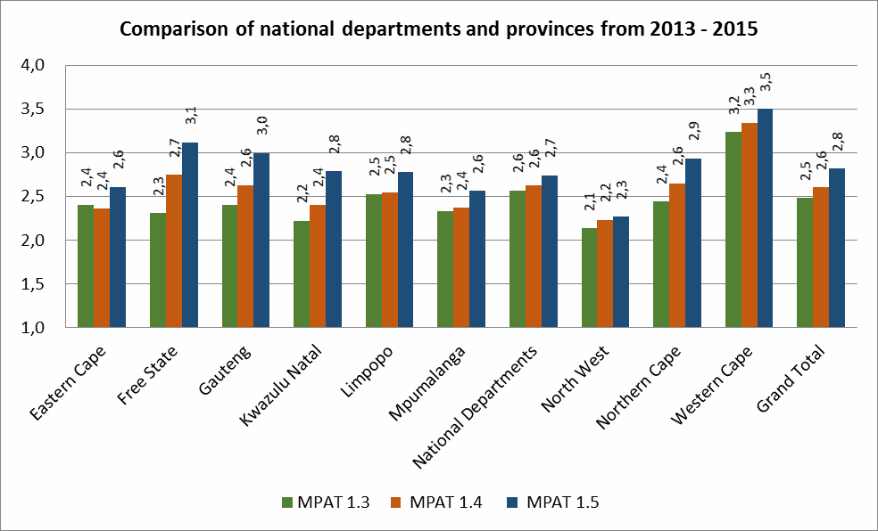




MPAT Results:
Comparison of National and Provinces from 2013-2015
NB! Top 3 Scoring Provinces: Western Cape, Free State, Gauteng
3 Lowest scoring provinces: North West, Eastern Cape, Mpumalanga

Slide 7
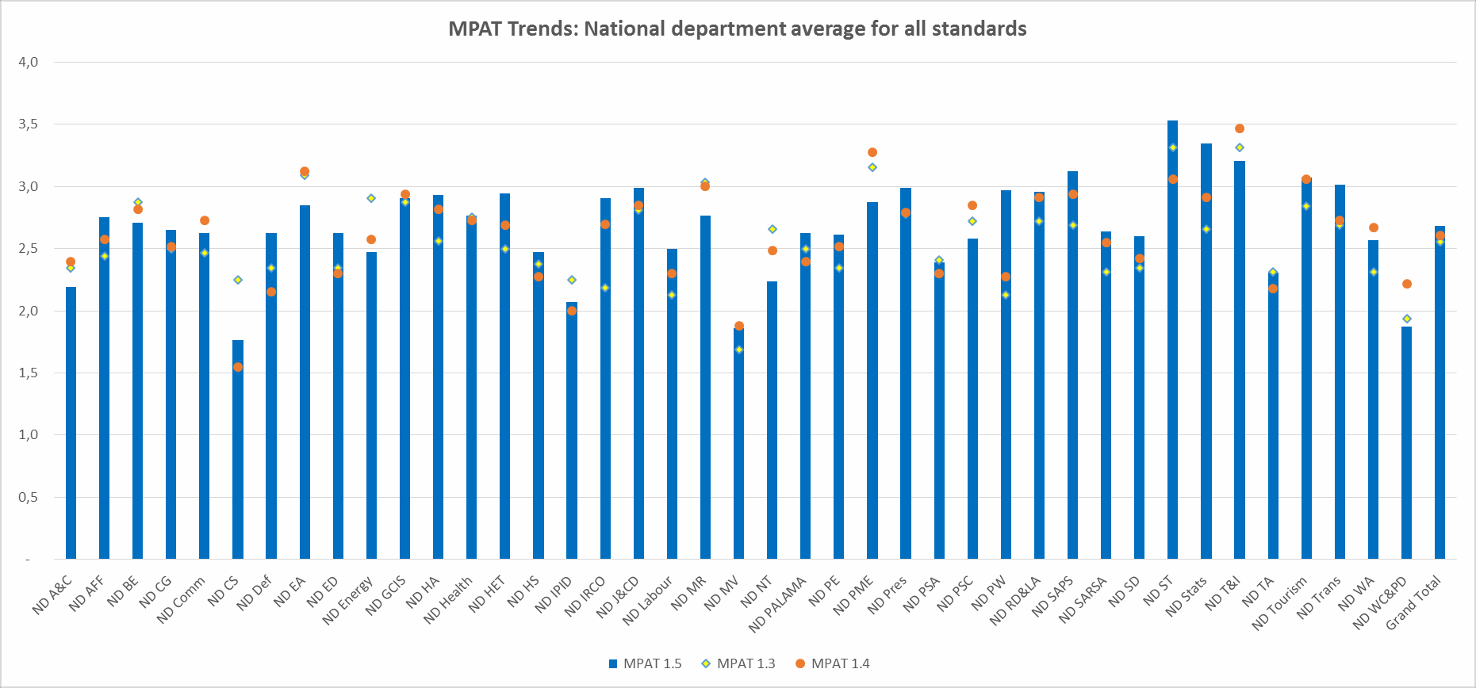


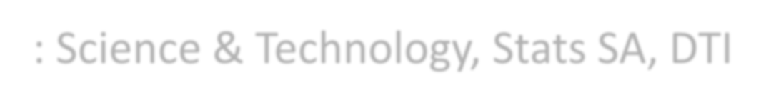



MPAT Trends: National Departments from 2013 2015
Top 3 scoring dept’s: Science & Technology, Stats SA, DTI
Lowest 3 scoring dept’s: Military Vets, Women , Correctional Services

Slide 8



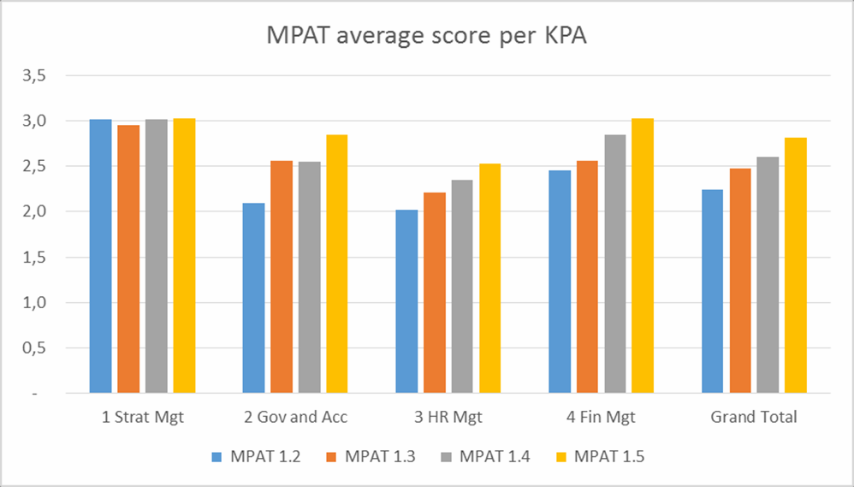


Trends for Key Performance Areas 2012-2015
HR Management KPA remains lowest performing in more
than 80 % Nationally and provincially.

Slide 9
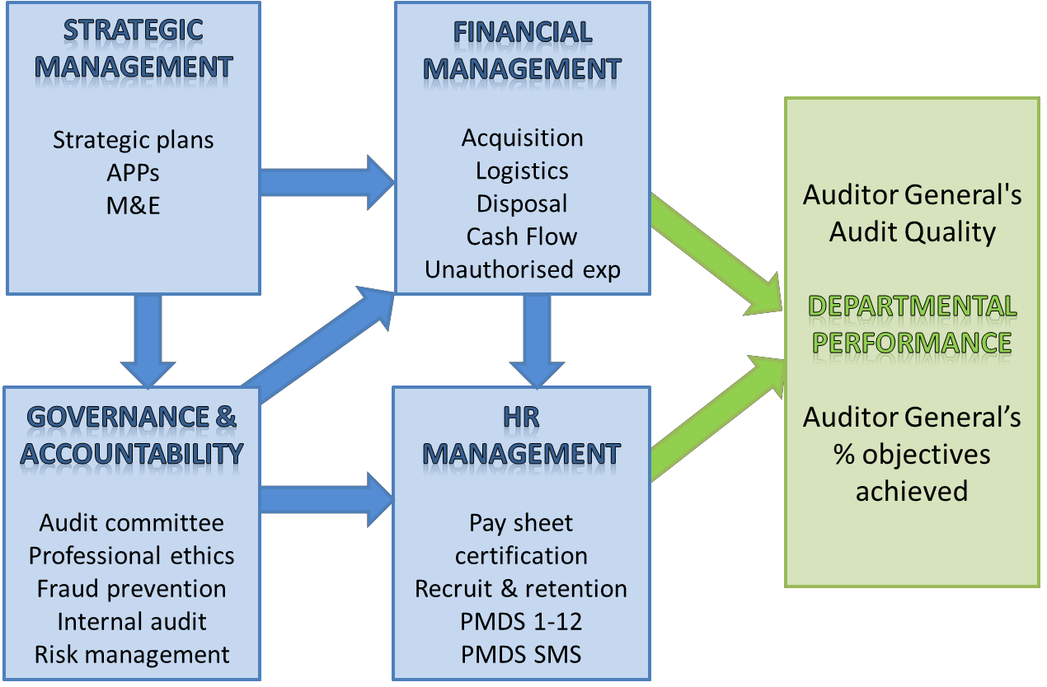
Comparative analysis of KPAs to the achievement of APP targets through the centrality of HR and financial management
No relation between Strategic Management and HRM

Slide 10





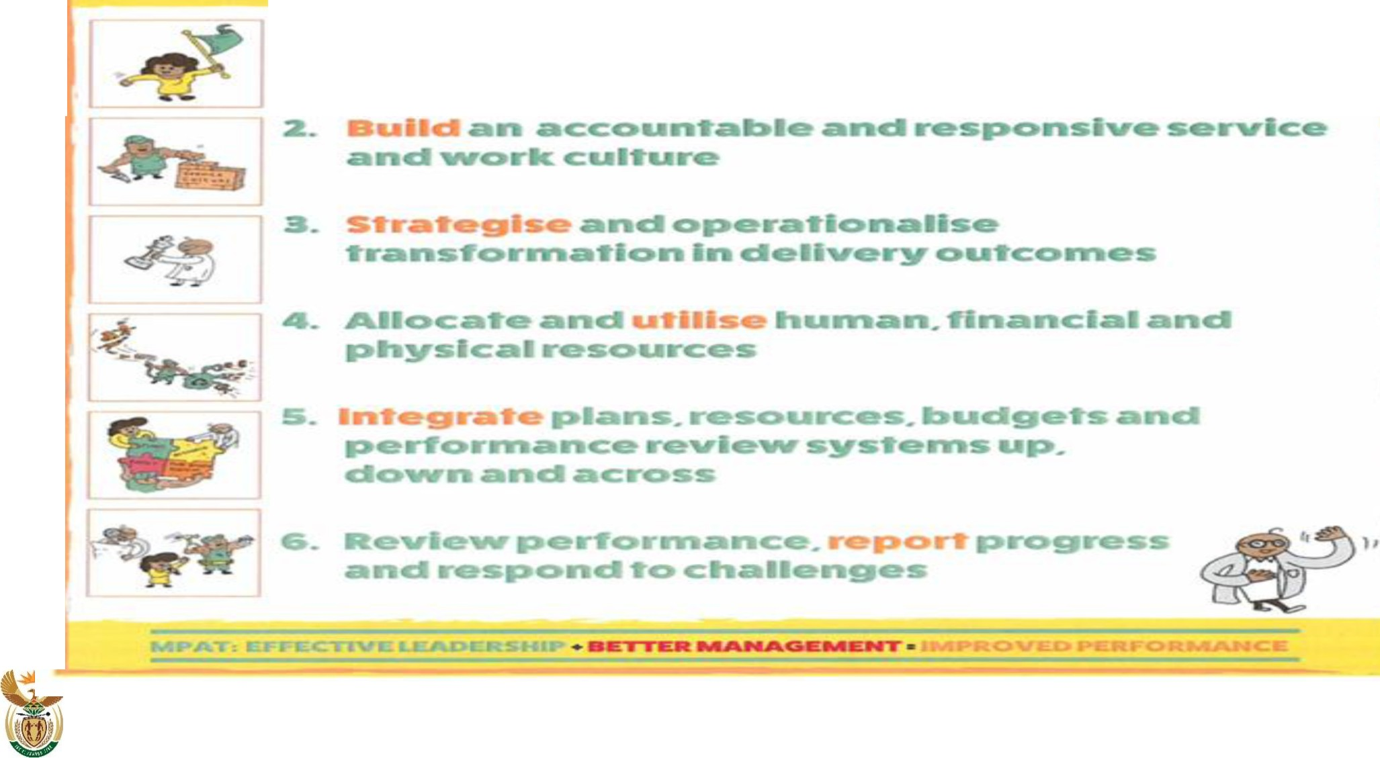
OVED
SERV CE
'1.
c::
2030
& evaluation
lENT
Department:
Planning, Monitoring and Evaluation
REPUBLIC OF SOUTH AFRICA
10

Slide 11
Ke ya leboga
Ke a leboha
Ke a leboga
Ngiyabonga
Ndiyabulela
Ngiyathokoza
Ngiyabonga
Inkomu
Ndi khou livhuha
Dankie
Thank you
11

