Slide 1

Financial statistics of higher education institutions 2015
To : The Portfolio Committee on Higher Education
By: Dr Pali Lehohla (Statistician-General)
16 November 2016

Slide 2
Sources of higher education data in Statistics South Africa
Household surveys
National accounts
Prices
Higher education
Government finances
Population data

Slide 3
Background and concepts
The reference period (HEI financial year): 1 Jan – 31 Dec 2015
Information obtained from audited / draft financial statements
Financials:
  Receipts: (actual cash received, irrespective for which period):
  * Grants from national government
  * Tuition fees
  * Donations
  Payments: (actual cash paid, irrespective for which period):
  * Compensation of employees
  * Goods and services
  * Capital expenditure
Scope:
* 26 HEIs (20 universities; 6 universities of technology)
* Excludes private institutions
Time series: Data for last 10 years (2006-2015)
Unit data available on request
Forms part of the consolidated government financials; adjusted from accrual to cash for consolidation purposes

Slide 4
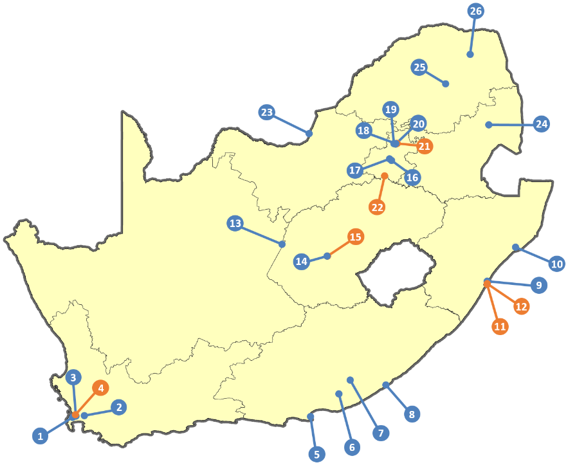
Scope: where are our Higher Education Institutions?
University
University of Technology

Slide 5

Enrolment

Slide 6
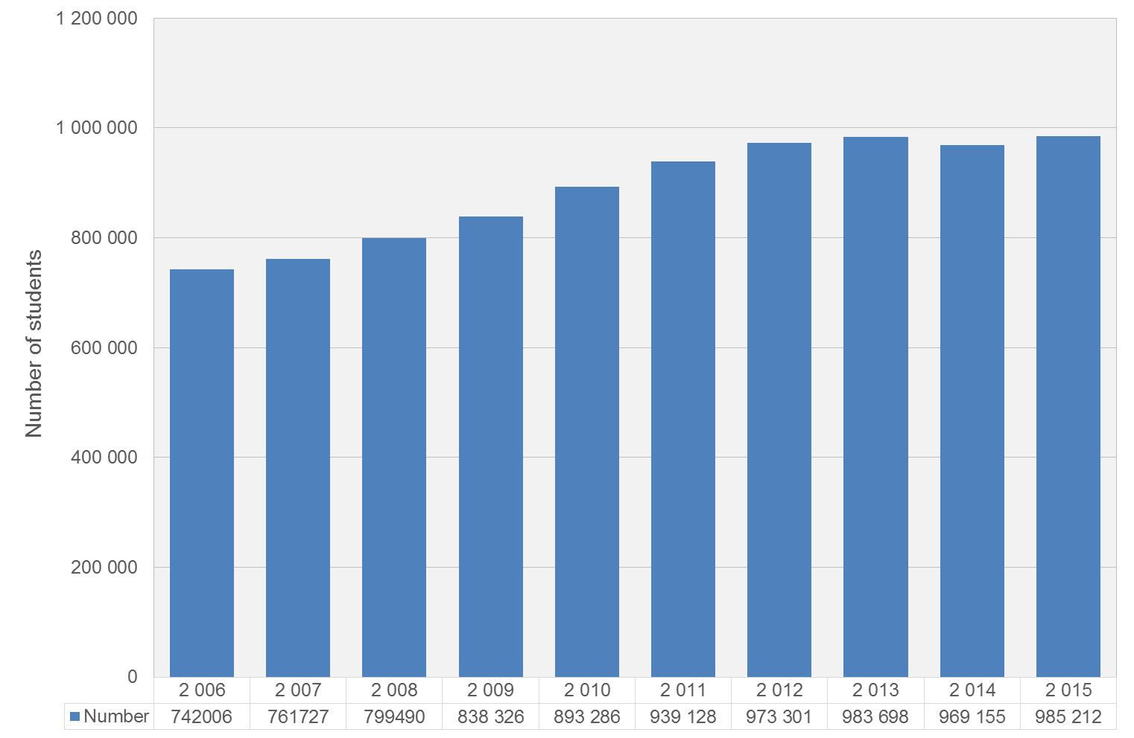
Higher education student enrolment
Source: Department of Higher Education. 2015: preliminary results

Slide 7
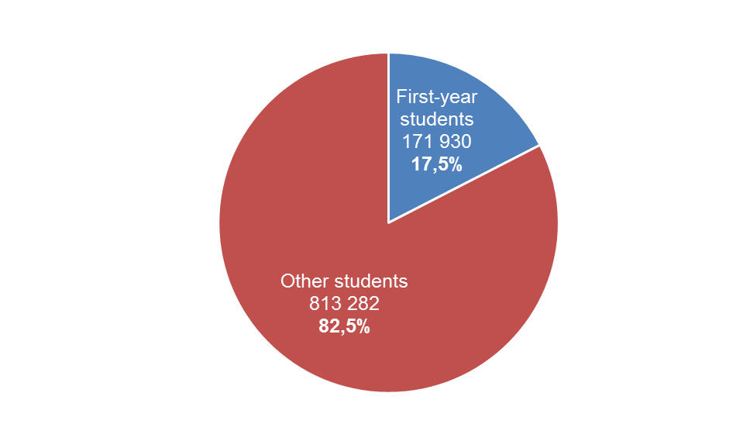
Contribution of first-year students to 2015 enrolment
171 930 (17,5%) students who enrolled in higher education institutions in 2015 were first-year students
Source: Department of Higher Education. Preliminary results

Slide 8
Proportion completing grade 12 after completing grade 9

Slide 9
Proportion completing bachelor’s degree after completing grade 12
White
The alarming evidence points to regressive proportions in Bachelor’s completion rates amongst Blacks
Indian/Asian
Black African
Coloured

Slide 10
Student enrolment: 2015
There were
985 212
students enrolled in higher education in 2015
Source: Department of Higher Education

Slide 11
Growth in student numbers: 2006–2015
The number of students in higher education grew by
32,8%
from 2006 to 2015
Source: Department of Higher Education
Notes:
North West (2006:38708) (2015: 64070); Zululand (2006: 10591) (2015: 16891); Fort Hare (2006: 8526) (2015: 13458)

Slide 12
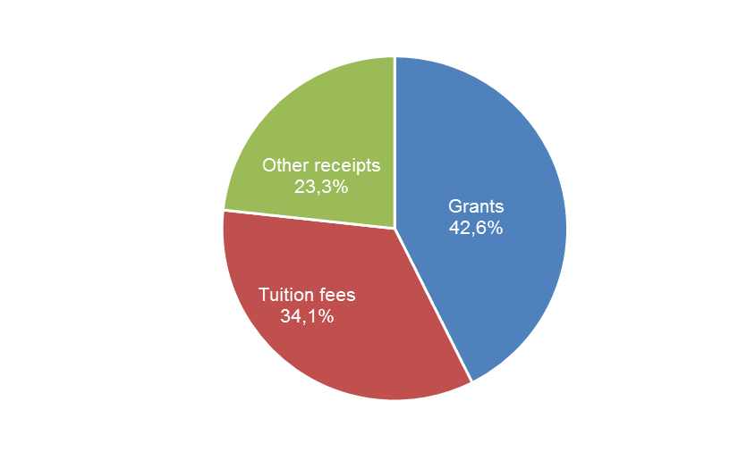
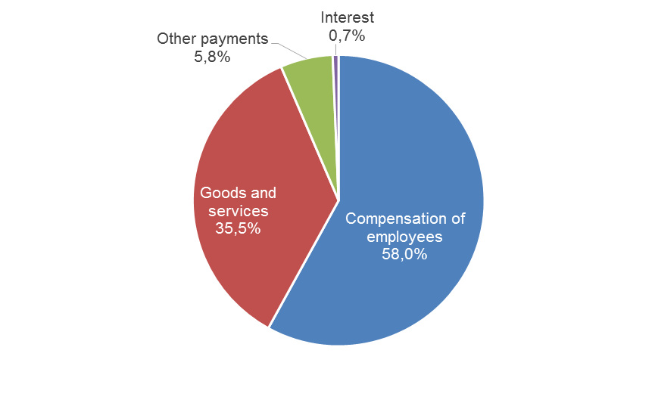
HEIs receipts and payments (2015)
Receipts
(R63,1 billion)
Payments
(R54,1 billion)

Slide 13

Receipts

Slide 14
Revenue per institution: 2015
* Other includes sales of goods & services, research contracts, interest and donations

Slide 15
Tuition fees received per HEI for the 2015 financial year (Rm)
Higher education institutions received
R21,5 billion
in the form of tuition fees in 2015

Slide 16
Tuition fees as a percentage of HEI total income: 2015
Tuition fees contributed
34,1%
of total income in 2015

Slide 17
Grants received per HEI in 2015 (Rm)
Higher education institutions received
R26,8 billion
in the form of grants in 2015

Slide 18
Main contributors to grants received by HEIs: 2011-2015 (Rm)
New university project grants for Sol Plaatje and Univ. of Mpumalanga

Slide 19
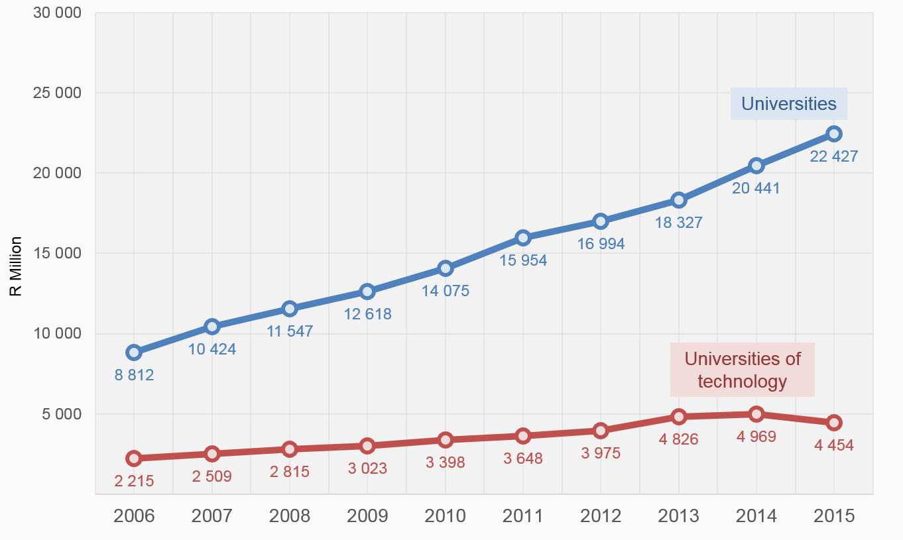
Grants from national government: 2006–2015 (Rm)

Slide 20
Donations to HEIs: 2015 (Rm)
Higher education institutions received
R4 billion
in the form of donations in 2015
Stellenbosch: The figure of R1,2 billion was obtained from their audited financial statements, and did not distinguish between the different forms donations and other awards (so the whole amounts was treated as donations). The university informed Statistics SA that they received R220m in donations (after the data was published).

Slide 21
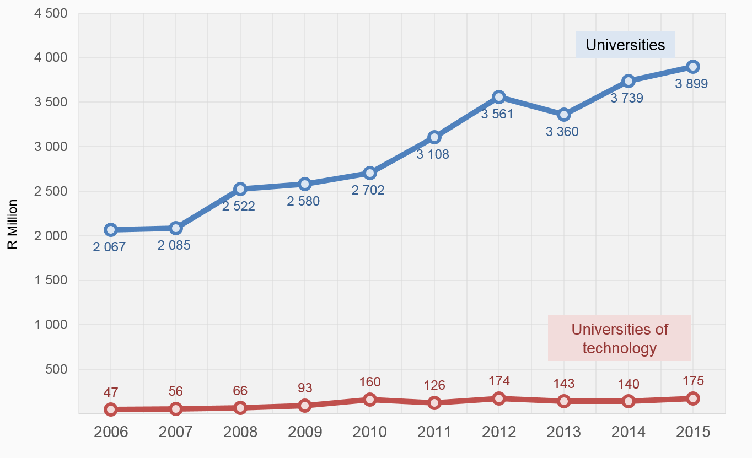
Donations to HEIs (Rm)

Slide 22

Payments

Slide 23
Cash payments per institution: 2015
* Other payments includes mainly interest paid & bursaries

Slide 24
Compensation of employees per HEI for 2015 (Rm)
Higher education institutions spent
R31,4 billion
on employees in 2015

Slide 25
HEIs purchases of goods and services: 2015 (Rm)
Higher education institutions spent
R19,2 billion
on goods and services in 2015

Slide 26
Bursaries per HEI for 2015 (Rm)
Higher education institutions spent
R3,1 billion
on bursaries in 2015

Slide 27
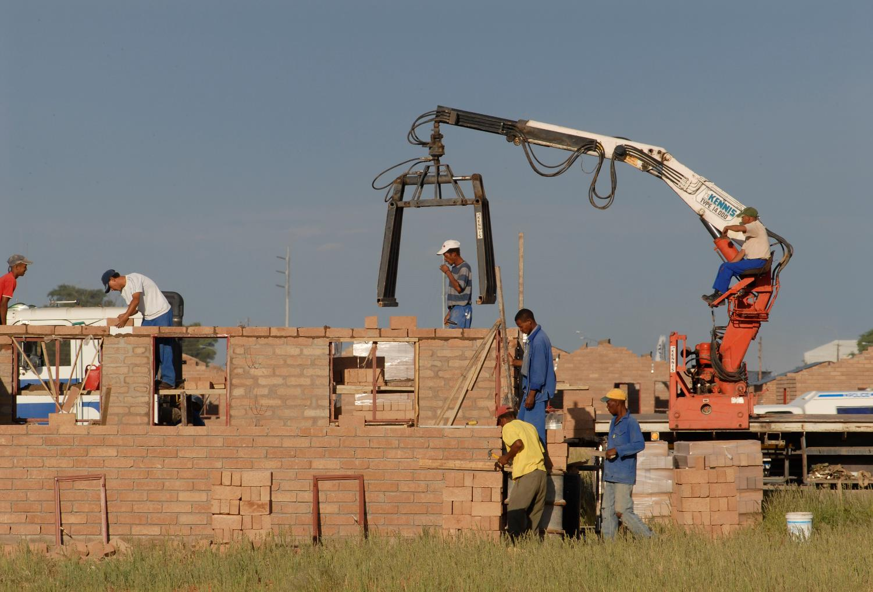
Capital expenditure by HEIs
Photo: Graeme Williams http://www.mediaclubsouthafrica.com/

Slide 28
Capex per HEI for 2015 (Rm)
Higher education institutions spent
R7,2 billion
on capital expenditure in 2015

Slide 29
Statement of sources and uses of cash
Net cash flow from operating activities = receipts¹ – payments² = A
Net cash flow from investment in non-financial assets = sales¹ – purchases² = B
Surplus (net inflow) before net financing activities = A + B = C
Net cash flow from financing = borrowing¹ – purchases of financial assets² = D
Net change in the stock of cash = C + D
¹ inflow
² outflow

Slide 30
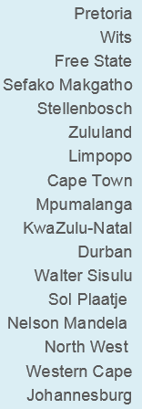
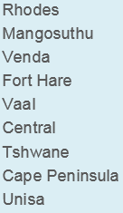
Surplus (net inflow) before net financing activities [C]: 2015 (Rm)
In 2015 HEIs
had a surplus (net inflow) [C] of
R2 billion

Slide 31
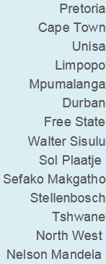
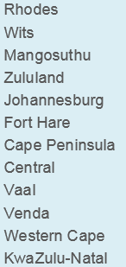
Net change in the stock of cash (movement of bank balance during the year) (Rm)
In 2015 HEIs had a net change in the stock of cash of
R821 million

Slide 32
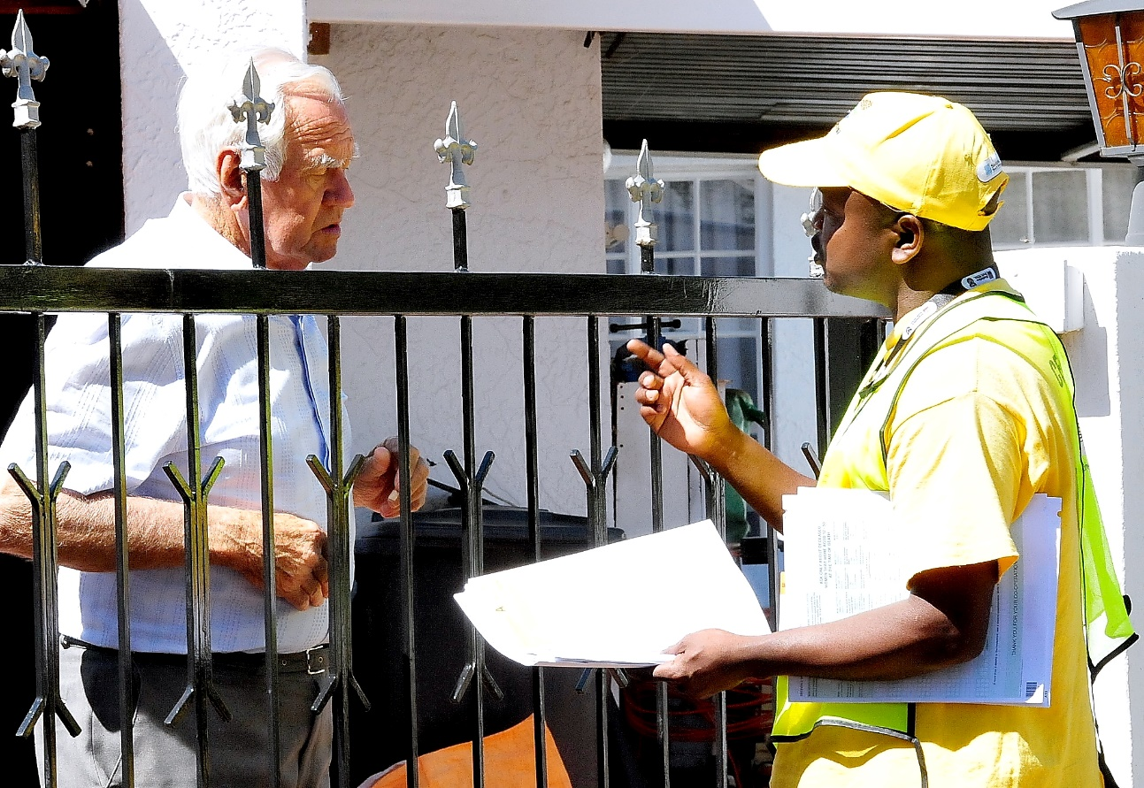
Prices, GDP and population data

Slide 33
Annual percentage change in tertiary education fees and headline CPI
Higher education fees did not increase in 2016

Slide 34
Annual percentage change in household expenditure on education
Source: Gross domestic product (GDP), 2nd quarter 2016.
Notes:
From GPE

Slide 35
Percentage of persons aged 5–24 attending an educational institution by type of institution
Institution | 2001 | 2011 | 2016
School | 92% | 93% | 93%
University / University of Technology | 2% | 3% | 5%
College | 1% | 3% | 1%
Other | 5% | 2% | 1%
Total | 100% | 100% | 100%
Source: Census 2001, Census 2011 and Community Survey 2016; percentages are rounded off

Slide 36
Closing remarks
The number of students enrolled in higher education grew by 32,8% from 2006 to 2015
First-year students constitute 17,5% of total HEI student intake in 2015. This percentage indicates challenges within the system
Grants by national government to HEIs increased by 144% over the ten-year period 2006 to 2015
Salaries comprise about 58% of total current HEI expenditure over the ten-year period 2006 to 2015
On average, income from tuition fees increased by 12,7% p.a. over the ten-year period 2006 to 2015
Annual rise in tuition fees for tertiary education (CPI) in 2015 was 9,8%. In 2016 is was 0%. In 2017 it has been set to no more than 8%
This publication only reports on the cash transactions of HEIs, adapted from the annual statements provided by the respondents
Information on HEI disaggregated tables available on the Stats SA website: http://www.statssa.gov.za

Slide 37
Thank you

