Slide 1
INTERNATIONAL NETWORK OF CONGOLESE LAWYERS (INCL)
PUBLIC HEARING ON THE REFUGEES AMENDMENT BILL B12-2016
15 NOVEMBER 2016
PORTOFOLIO COMMITTEE ON HOME AFFAIRS
PARLEMENT OF SOUTH AFRICA
CAPE TOWN
JEAN CLAUDE KAZAKU AND KIZITO KABENGELE
INCL

Slide 2
REFUGEE ACT 130 1998
Content of the Presentation
Overview and Purpose
Proposed vision and principles
Policy areas and proposals
Way forward

Slide 3
OVERVIEW AND PURPOSE
In parliamentary procedure, a motion is a proposal to do something. The wording of such a proposal could be changed using the motion to amend. Amendments can remove words, add words, or change words in motions. All main motions and some secondary motions can be amended. An amendment can be amended. However, an amendment to an amendment of an amendment is not allowed.

Slide 4
PROPOSED VISION AND PRINCIPLES
What is a refugee ?
What is the RAB 2015
Applying for an Asylum seeker Visa (ASV)
Cessation of Refugee status
Who is a dependant ?
Refugee Camps and places of Detention

Slide 5
POLICY AREAS AND PROPOSALS
Visa is a conditional authorization granted by a country (typically to a foreigner) to enter and temporarily remain within, or to leave that country. Discriminatory and stigmatization, Human Rights ???
Delay and removal of a right to apply for PR on the grounds of year spent by a refugee in the country. Quid of backlog ? Quid of corruption .

Slide 6
WAY FORWARD
Backlog and transitional provisions
Issuing dignify, secure and recognissable ID/travelling Docs
Review of existing bilateral labour agreement
Introduction of a regional special work
The Right to work and to study were acquired in Court of Law in South Africa
Integration with accompanying honorable refugees to SA culture heritage, language, Labor for development and national priorities, educate them about their civic rights constitution
Capacitated the Department in terms of workforce and expertise

Slide 7
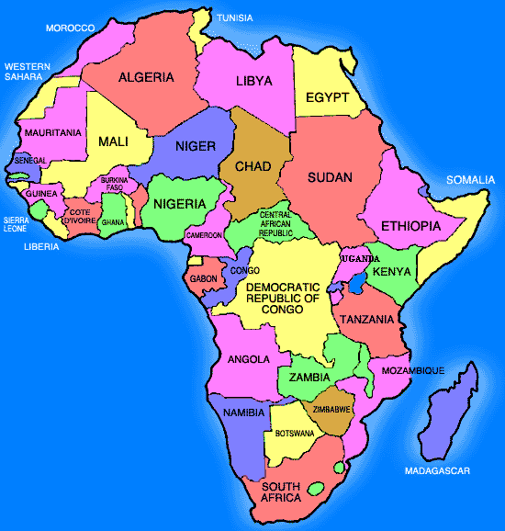
END !
THANK YOU…
DANKIE…
NDIYABULELA…
KE A LEBOHA…
KE YA LEBOGA…
INKOMU…
NGIYABONGA…
NDI KHOU LIVHUHA…
NGIYATHOKOZA…
MERCI…
OBRIGADO…
SHUKRAAN…
XIÈXIÈ…
GRACIAS…
ASANTE…

