Slide 1
DEPARTMENT OF LABOUR
UNEMPLOYMENT INSURANCE FUND
PORTFOLIO COMMITTEE PRESENTATION
2016-11-09

Slide 2
CONTENTS
1. INTRODUCTION
2. PROPOSED AMENDMENT – NEDLAC
3. VALUATION REPORT BY ACTUARIES
4. RECOMMENDATIONS
5. QUESTIONS/ COMMENTS
2

Slide 3
1. INTRODUCTION
NEDLAC partners agreed to consider further amendments to the UI Act 18 months after the promulgation of the current Bill.
NEDLAC partners Further proposed that further amendments be tabled for consideration (although the current Bill is not promulgated).
3

Slide 4
2. PROPOSED AMENDMENTS
PROPOSED AMENDMENTS | RESPONSE
Short time employment | Included in the Bill
Fixed term and Seasonal employment | Included in the Bill covering employers who worked for more than 24 hours
Asylum seekers | Included in Bill provided they have the required documentations
Informally & Self employed | A new proposal that is currently under consideration. The Actuaries have conducted a research however it was found that there is little data to provide a comprehensive outcome.
Parental benefits/ Paternity leave- | Proposal is introduced by the Private Member’s Bill which is before Parliament
Resignation | A new proposal that is currently under consideration. The Actuaries have conducted a research however inputs from Management is still to be incorporated by Actuaries.

Slide 5
3. PROPOSED CHANGES
Amendment Bill 2013
Part 1: Extension of benefits to 365 days with a flat rate of 20% after 238 days, and adjustment of benefit accrual at rate of 1 day for every 5 days worked
Part 2: Maternity and Illness benefit changes
Part 3: Unemployment benefit cycle changes
Part 4: Extension of Death claims submission period from 6 to 18 months
Part 5: Extension of Unemployment claims submission period from 6 to 12 months
Part 6: Death claims to allow for nominated beneficiary
Part 7: Inclusion of persons on learnership contracts and migrant workers

Slide 6
4. PROPOSED CHANGES
Amendment Bill 2015
Part 8: Payment of benefits in the case of reduced salary
Part 9: Extension of Maternity claims submission period from 8 weeks prior to birth to 12 months after child birth
NEDLAC
Part 10: Inclusion of persons employed in the informal sector
Part 11: Payment of 12 days of paternity leave to fathers
Part 12: Payment of benefits to persons who have resigned
This presentation only considers the proposed changes which have a financial impact on the Fund

Slide 8
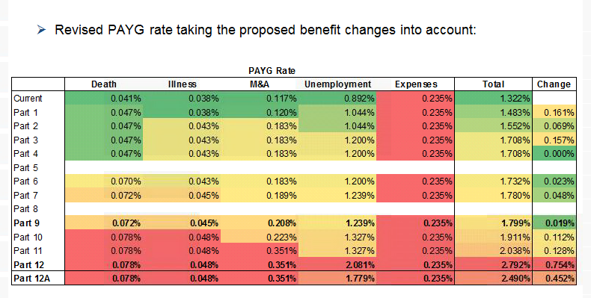
6. IMPACT ON PAYG RATE

Slide 9
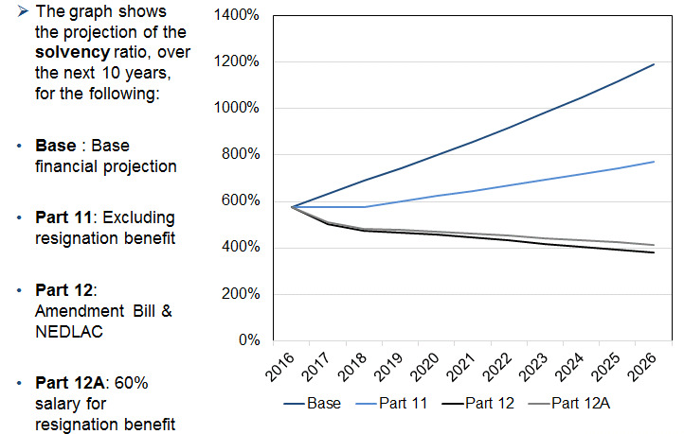
10 YEAR PROJECTIONS

Slide 10
9. EVALUATION OUTCOME
The Actuarial report indicates that;
The Fund is in a position to cover all amendments in the current Bill
The Fund will spend more than the 2% of contribution if the Bill and new proposed amendments are all implemented (benefits will be paid from investments)
Resignation appears to be the more expensive proposal
10

Slide 11
10. RECOMMENDATIONS
It is recommended that:
The proposed amendments may be considered
Proposals be ranked and rationalised for implementation
Implementation be staggered due to financial implications.
Identify proposal that can be considered later
11

Slide 12
Ndo livhuwa/ Thank You…
Questions/ Comments
12

