Slide 1
SECOND QUARTERLY REPORT ON THE PERFORMANCE OF THE DEPARTMENT IN MEETING ITS STRATEGIC OBJECTIVES FOR 2016/17
Portfolio Committee on Basic Education
8 NOVEMBER 2016

Slide 2
PRESENTATION OUTLINE
PART A
Performance Indicators and Targets
PART B:
Financial Report: Second Quarter Expenditure

Slide 3
PURPOSE
To report on the second quarter outputs of the Department against the planned targets of the pre-determined objectives in the Annual Performance Plan for financial year 2016/17.
To report on the Department’s expenditure for the second quarter of the financial year 2016/17.

Slide 4
PART A
Performance Indicators and Targets

Slide 5
PROGRAMMES OF THE DBE
The ANNUAL PERFORMANCE PLAN summarises the priorities of the DBE as aligned to the Delivery Agreement of OUTCOME 1: Improving the quality of Basic Education and the Action Plan to 2014: Towards the Realisation of Schooling 2025.
The activities of the DBE have been structured into five programmes as elaborated in the Annual Performance Plan:
  PROGRAMME 1: ADMINISTRATION
  PROGRAMME 2: CURRICULUM POLICY, SUPPORT AND MONITORING
  PROGRAMME 3: TEACHERS, EDUCATION HUMAN RESOURCES AND
  INSTITUTIONAL DEVELOPMENT
  PROGRAMME 4: PLANNING, INFORMATION AND ASSESSMENT
  PROGRAMME 5: EDUCATIONAL ENRICHMENT SERVICES

Slide 6
STATUS BAR FOR INDICATORS
The status of all Annual Targets not yet achieved is White.
Where 50% of the target has not been achieved, the status will be reflected as red.
Where 50% or more of the target has been realised, supported by credible evidence, the status will be reflected as amber.
Green will be reflected when the target has been fully achieved.

Slide 7
PROGRAMME ONE: ADMINISTRATION
The purpose of Programme 1 is to manage the Department and provide strategic and administrative support services.

Slide 8
INDICATOR TABLE- PROGRAMME 1
# | PERFORMANCE INDICATORS | TARGET FOR 2016/17 AS PER APP | ACTUAL OUTPUT AS AT END OF 2nd QUARTER OF 2016/17 | DEVIATION FROM PLANNED TARGET FOR 2016/17 | STATUS
1.1.1 | Percentage of Service providers within the procurement unit paid within 30 days. | 100% Quarterly | Q1: 100.84% (359/356) Q2: 98.13% (105/107) | -1.87%
1.1.2 | Percentage of received misconduct cases resolved within 90 days | 80% Quarterly | Q1: No cases received Q2: 100% (2/2) | 20%
1.1.3 | Percentage of received grievances cases resolved within 30 days | 75% Quarterly | Q1: 100% 2 cases received 2 cases resolved Q2: 33.33% 6 cases received 2 cases resolved 1 case referred to Public Service Commission for a ruling 3 cases referred to GPSSBC for conciliation and the department is awaiting a date on the matter | -41.67%

Slide 9
PROGRAMME 1
Human Resource Management and Development
The 22 posts were advertised, 12 interns had been appointed.
Two disciplinary hearings were held where final written warning was issued.
Six formal grievances were lodged during this period.
All meetings were held.
All quarter reports, outcomes 1, 7, 13, 14 reports were compiled and submitted to DPME, National Treasury and Parliament.
Annual Report tabled in Parliament on the 30th September 2016.
Communications publication and media liaisons through the website, intranet, Facebook, Twitter and YouTube was strengthened in the past quarter.

Slide 10
PROGRAMME 1
Internal Audit verified all MPAT evidence before final upload.
Submitted final Annual Performance Evaluation Report on Conditional Grants to National Treasury on 4 August 2016
Under the UNESCO wing, the department attended several meetings:
  the SDG4 meeting for the continent
  ROSA Education Sector
  IAJ Seminar: Racism, Censorship & Freedom of Expression,
International relations have seen the following bilateral sealed, in the form of MOU or MOA.
  Cuba
  South Korea

Slide 11
PROGRAMME 2
PROGRAMME TWO: CURRICULUM POLICY, SUPPORT AND MONITORING
The purpose of Programme 2 is to develop curriculum and assessment policies and monitor and support their implementation.

Slide 12
INDICATOR TABLE: PROGRAMME 2
# | PERFORMANCE INDICATORS | TARGET FOR 2016/17 AS PER APP | ACTUAL OUTPUT AS AT END OF 2nd QUARTER OF 2016/17 | DEVIATION FROM PLANNED TARGET FOR 2016/17 | STATUS
2.1.1 | Number of off-line digital content packaged and distributed to provinces | 10: Annually | Q1:10 Q2: indicator achieved in Q1. | 0 | Annual
2.1.2 | Number of schools per province monitored for utilisation of ICT resources | 27: Quarterly Q1: 9 Q2: 9 Q3: - Q4: 9 | Q1:13 Q2: Delays in school visit due to late nomination of schools by one province. Remaining visits confirmed for Q3. | -14
2.1.3 | Number of off-line digital content resources developed annually | 4: Annually | Q1: The writing process was completed in both English and Afrikaans versions Q2:The materials were screened and quality assured | -4 | Annual
2.2.1 | Percentage of public schools with Home Language workbooks for learners in Grades 1-6 | 100% Annually | Q1: 14 283 480 Workbooks printed Q2: 56.5% (13 809 schools received deliveries | -43.5% | Annual

Slide 13
INDICATOR TABLE: PROGRAMME 2
# | PERFORMANCE INDICATORS | TARGET FOR 2016/17 AS PER APP | ACTUAL OUTPUT AS AT END OF 1ST QUARTER OF 2016/17 | DEVIATION FROM PLANNED TARGET FOR 2016/17 | STATUS
2.2.2 | Percentage of public schools with Mathematics workbooks for learners in Grades 1-9 | 100%: Annually | Q1: 14 283 480 Workbooks printed. Q2: 56.5% (13 809 schools delivered) | -43.5% | Annual
2.2.3 | Percentage of public schools with workbooks for Grade R | 100%: Annually | Q1: 3 878 970 Workbooks printed. Q2: 55% (9 708 schools with Grade R received deliveries) | -45% | Annual
2.3.1 | Number of underperforming schools monitored on the implementation of the Early Grade Reading Assessment (EGRA). | 20: Annually | Q1: 5 Q2: 15 | 0 | Annual
2.3.2 | Number of schools monitored on the implementation of the reading norms | 20 Annually | Q1: Monitoring tool developed. Terms of reference for subject advisory committee developed. Processes initiated to develop African languages norms. Q2: 5 site visits and launched reading advisory committee | -15 | Annual

Slide 14
INDICATOR TABLE: PROGRAMME 2
# | PERFORMANCE INDICATORS | TARGET FOR 2016/17 AS PER APP | ACTUAL OUTPUT AS AT END OF 1ST QUARTER OF 2016/17 | DEVIATION FROM PLANNED TARGET FOR 2016/17 | STATUS
2.3.3 | Number of schools monitored on the implementation of the Incremental Introduction to African languages (IIAL) nationally | 20: Annually | Q1: 9 PEDs reported implementation Q2: 20 Schools The 9 PED’ reports on the implementation of IIAL were analysed. 20 schools were identified for monitoring. PEDs reported on progress and challenges with implementation of IIAL during interprovincial committee meetings/ telecon where remediation was provided | -20. Desktop monitoring to be completed for 20 schools in Q3 | Annual
2.4.1 | Mathematics, Science and Technology lesson plans developed for the Senior and FET Phases | Mathematics and Science lesson plans developed for the Senior and FET: Annually | Q1: Natural Science Gr 7 lessons plans developed. Q2: Annual Teaching Plans (ATPs) were developed for Maths, Natural Science and Physics and Chemistry | Annual. Mathematics Grade 7 and Physical Science Gr10-12 ATPs to be adapted into lesson plans and completed by Q4. | Annual
2.4.2 | Mathematics, Science and Technology teacher guides developed for the Senior and FET Phases | Mathematics and Science teacher guides developed for Senior and FET phase: Annually | Q1:Planning was completed on areas to be covered, scope and design for both subjects in the Senior and FET phases respectively Q2: Annual Teaching Plans (ATPs) were developed for Maths, Natural Science and Physics and Chemistry to be adapted into teacher guides | -Mathematics and Science teacher guides developed for the Senior and FET phase. ATPs to be adapted into teacher guides and completed by Q4. | Annual

Slide 15
INDICATOR TABLE: PROGRAMME 2
# | PERFORMANCE INDICATORS | TARGET FOR 2016/17 AS PER APP | ACTUAL OUTPUT AS AT END OF 1ST QUARTER OF 2016/17 | DEVIATION FROM PLANNED TARGET FOR 2016/17 | STATUS
2.4.3 | Number of districts visited for monitoring the 1+4 strategy | 9 Bi-annually Q2: 6 Q4: 3 | Q1: 4 clusters from 3 districts visited on 11/04/2016 and 09/05/2016. (Documentation verified in Q2) Q2: Developed Teaching Plans for Grade 7. | - 6 . 50% delivery in the quarter under review. Planned visits reorganised for Q3 and Q4 based on monitoring in three clusters. | Bi-annual
2.4.4 | Number of training centres of CAPS for Technical subjects visited during a training session | 14 Bi-annually Q1: 7 Q2: 7 | Q1:4 Q2: 9 Total: 13 | -1. | Bi-annual
2.4.5 | Number of schools visited for monitoring CAPS implementation in technical schools | 27: Quarterly Q1: 9 Q2: 9 Q3: - Q4: 9 | Q1:0 Q2: 12 Total: 12 | -15.

Slide 16
INDICATOR TABLE: PROGRAMME 2
# | PERFORMANCE INDICATORS | TARGET FOR 2016/17 AS PER APP | ACTUAL OUTPUT AS AT END OF 2nd QUARTER OF 2016/17 | DEVIATION FROM PLANNED TARGET FOR 2016/17 | STATUS
2.5.1 | Number of learners enrolling for the Kha Ri Gude Literacy Campaign in 2016/17 | 561 722: Annually | Q1: Printing of 982 255 workbooks Preliminary recruitment of 14 00 volunteers Q2: 162 802 Appointment of Service Providers (stationery and delivery/warehousing) | -398 920 | Annual
2.5.2 | Number of learners obtaining a NSC through the Second Chance Programme | 10 000 Annually | Q1: Printed 125 400 mind the gap study guides and 10 000 past question papers 750 Teachers appointed for the face to face classes 36 venues were finalised Q2 Face-to-face classes (19 824 learners) , digital (PH I 4 724 and PH II 6 323 internet hits) and broadcasting support provided via HD OpenView and DSTV to 36 centres | -10 000 | Annual

Slide 17
PROGRAMME 2
Curriculum Implementation and Monitoring
Early Childhood Education (ECD)
The Department co-hosted the Play Conference in July 2016
The South African National Curriculum Framework for Children from Birth to 4 (NCF) was versioned into all official languages.
A management guide for the in-service training of ECD practitioners has been finalized.
The Department finalised 26 draft subjects for Technical Occupational pathway and 22 draft subjects for learners with Severe Intellectual Disability.
Consultative meetings on the Development of the Rural Education Policy were held in three provinces namely, Eastern Cape, KwaZulu-Natal and Limpopo. – the engagements with these stakeholders were necessary and they ensured that the development of the Rural Education Policy is done from a well-informed position.

Slide 18
PROGRAMME 2
RURAL EDUCATION: The DBE and the Department of Science and Technology have partnered with Hydrogen South Africa, to install Energy Fuel Cell technology for the provision of power at the rural schools.
LTSM: The printing of 3 878 970 Grade R workbooks, for 2017 academic year, has been completed- a total number of 2 191 820 (55%) Grade R workbooks were delivered to schools.
A total number of 28 566 960 Grades 1-9 workbooks, for the 2017 academic year, was printed. As at 30 September 2016 a total number of 15 943 815 (56.5%) Grades 1-9 workbooks for Home Language and Mathematics were delivered to schools.
MST: A total of 229 schools were supplied with resources, 4 557 teachers trained and 8 754 learners supported during the first quarter of 2016/17.

Slide 19
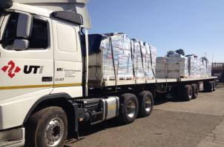
DELIVERY OF WORKBOOKS TO PROVINCES

Slide 20
PROGRAMME 2
The DBE-JICA Project completed Phase 2 of the pilot project in 192 schools in North West and Eastern Cape.
ICT: The Department provided connectivity to 278 schools through the Universal Service and Access Obligation (USAO).
Department has engaged with all the stakeholders, - ICASA, Vodacom, MTN and Neotel to discuss future rollouts.
A total of 1 380 digital offline content packs were distributed to 10 districts in all provinces.

Slide 21
PROGRAMME 2
Kha Ri Gude Literacy Project
Orders for workbooks and admin documents were ordered from Government Printers for the 2016 Campaign.
298 000 Learner Assessment Portfolios were collected and submitted to South African Qualifications Authority (SAQA)
The classes for the 2016/17 Campaign will start on 01 November 2016.
Second Chance Matric Programme
Access to the content was made available via the 74 Vodacom Centres, schools with Telematics and (Internet Broadcasting Programme.
Four venues per province (36 nationally) were identified for face-to-face classes.

Slide 22
WINTER/SPRING CAMPS MONITORED
BY THE DIRECTOR-GENERAL
DATE VISITED | PROVINCE
7 July 2016 | Western Cape
8 July 2016 | Kwa Zulu-Natal
11 July 2016 | Gauteng
12 July 2016 | Mpumalanga
13 July 2016 | Northern Cape
14 July 2016 | North West
18 July 2016 | Limpopo

Slide 23
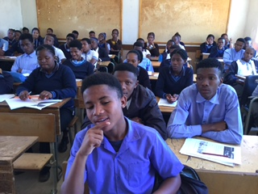
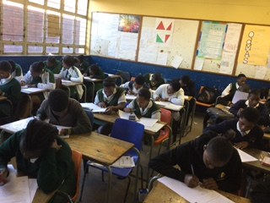
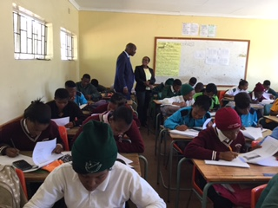
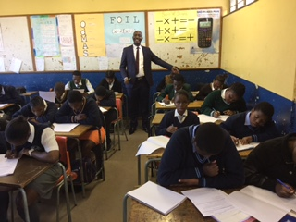

Slide 24
DBE OVERSIGHT VISITS
DATE | PROVINCE
29 and 30 August 2016 | Gauteng
05 and 06 September 2016 | KwaZulu-Natal
05 and 06 September 2016 | Mpumalanga
05 and 06 September 2016 | Free State
07 and 08 September 2016 | Western Cape
07 and 08 September 2016 | Limpopo
07 and 08 September 2016 | Northern Cape
12 and 13 September 2016 | Eastern Cape
12 and 13 September 2016 | North West

Slide 25
PROGRAMME 3
PROGRAMME THREE : TEACHERS, EDUCATION HUMAN RESOURCES AND INSTITUTIONAL DEVELOPMENT
The purpose of Programme 3 is to promote quality teaching and institutional performance through the effective supply, development and utilisation of human resources.

Slide 26
INDICATOR TABLE –PROGRAMME 3
# | PERFORMANCE INDICATORS | TARGET FOR 2016/17 AS PER APP | ACTUAL OUTPUT AS AT END OF 1ST QUARTER OF 2016/17 | DEVIATION FROM PLANNED TARGET FOR 2016/17 | STATUS
3.1.1 | Percentage of SGBs that meet minimum criteria in terms of effectiveness (in sampled schools) | 50% of sampled SGBs: Annually | Q1: None Q2 A total of 800 tools from Western Cape, KwaZulu-Natal, Eastern Cape and North West have been received and captured. | -50% of sampled SGBs. Capturing on going. | Annual
3.1.2 | Percentage of schools producing the minimum set of management documents at a required standard. | 70% of sampled schools: Annually | Q1: None Q2: Data capturing tool has been updated and sent to provinces. As this is an annual target, the survey is conducted during Q3. | -70% of sampled schools. Survey in Q3. | Annual
3.2.1 | Number of Funza Lushaka bursaries awarded to students enrolled for initial teacher education. | 14 000: Annually | Q1: 13 725 Q2:14 343 | 343 | Annual

Slide 27
INDICATOR TABLE –PROGRAMME 3
# | PERFORMANCE INDICATORS | TARGET FOR 2016/17 AS PER APP | ACTUAL OUTPUT AS AT END OF 1ST QUARTER OF 2016/17 | DEVIATION FROM PLANNED TARGET FOR 2016/17 | STATUS
3.3.1 | Number of teachers participating in the EFAL diagnostic tests | 10 000 Annually | Q1: Development of specifications Q2 Processes are in place to advertise the tender, a service provider will be appointed in January 2017 and actual testing will take place in February/March 2017. | -10 000. | Annual
3.3.2 | Number of teachers participating in the Mathematics diagnostic tests | 10 000: Annually | Q1: Development of specifications Q2: Processes are in place to advertise the tender, a service provider will be appointed in January 2017 and actual testing will take place in February/March 2017. | -10 000 . | Annual
3.4.1 | Number of schools per PEDs monitored on the implementation of IQMS | Monitor 18 schools in 6 PEDs: Quarterly Q1: 6 Q2: 6 Q3: 3 Q4: 3 | Q1: 6 schools monitored in 2 PEDs (Northern Cape and Limpopo) Q2: 6 schools monitored in 2 PEDs (North West and KwaZulu-Natal) | - 6

Slide 28
INDICATOR TABLE – PROGRAMME 3
# | PERFORMANCE INDICATORS | TARGET FOR 2016/17 AS PER APP | ACTUAL OUTPUT AS AT END OF 1ST QUARTER OF 2016/17 | DEVIATION FROM PLANNED TARGET FOR 2016/17 | STATUS
3.4.2 | Number of PEDs monitored on the implementation of PMDS | 6 PEDS monitored Quarterly Q1: 2 Q2: 2 Q3: 1 Q4: 1 | Q1: 1 PED monitored (Kwazulu-Natal) Q2: 3 PEDs monitored (Free State, Eastern Cape and Northern Cape) | -2
3.5.1 | Number of PEDs that had their post provisioning process assessed for compliance with the post provisioning Norms and Standards | All Nine (9) PEDs: Annually | Q1: Officials in 3 (three) PEDs trained on the implementation of the post provisioning policy. Q2: All 9 PEDs provided their management plan for the declaration and implementation of staff establishments for 2017 in August 2016. 7 of the 9 PEDs have provided staff establishments to schools by 30 September 2016. KZN and LMP committed to send out the staff establishments in October 2016. | -9. Annual target. Training and preparations for post declaration finalised. Detailed reporting to be done in Q3 . | Annual

Slide 29
PROGRAMME 3
Teacher and Professional Development
The Department monitors and supports the implementation of the post provisioning norms.
Officials have been trained in KwaZulu-Natal, Eastern Cape and Limpopo on the implementation of the post provisioning norms.
DBE provides a monitoring and supporting role for the placement of Funza Lushaka graduates in PEDs.
As a result, 87% (4 021 of 4 637) graduates were placed as at the end of September 2016.
Initial Teacher Education : The Funza Lushaka bursary allocation from National Treasury for 2016/17 is R 1, 043, 611, 000 which translates into about 14,000 bursaries that can be awarded to students in 2016.
Preliminary data from the consolidated 2016 awards list shows that 14 343 Funza Lushaka bursaries have been awarded for initial teacher education by 30 September 2016.
This number exceeds the target of 14 000 by 343. This over-achievement is mainly attributed to university fees that were lower than projected.

Slide 30
PROGRAMME 3
Labour Relations & Conditions of Service: Collective Agreements in the sector were negotiated and successfully concluded and they are:
  ELRC COLLECTIVE AGREEMENT 2 of 2016: Amendments to the threshold requirements for trade unions requiring to obtain organisational rights and admission to the ELRC.
  ELRC COLLECTIVE AGREEMENT 3 of 2016: ELRC Guidelines: Promotion arbitrations
  ELRC COLLECTIVE AGREEMENT 4 of 2016 about the amendments to COLLECTIVE AGREEMENT 2 of 2003 regarding the transfer of educators in terms of operational requirements
  ELRC COLLECTIVE AGREEMENT 5 of 2016: Levy increase
  Collective Bargaining in the PSCBC: Salary negotiation
  Draft COLLECTIVE AGREEMENT on amendments to paragraph B.8.5 of Chapter B and the repeal of paragraph H.17 of Chapter H of the Personnel Administrative Measures:

Slide 31
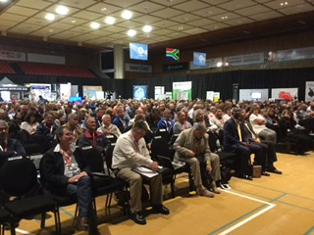
DG MEETING WITH UNIONS

Slide 32
PROGRAMME 3
    EDUCATION HUMAN RESOURCES DEVELOPMENT
    Human Resource Development:
    156 Teacher Centre Managers and E- Learning specialists have been trained through an on-line university accredited course.
    The department provided three-day training for 1 316 Grade 12 Mathematics and Physical Science Teachers in 10 districts on critical topics identified through the Diagnostic Report.
    The Department has also provided oversight and support to provinces in relation to Reading Promotion and Library and Information Services’ (RLIS) programmes implementation.
    Oversee the training of 11 666 SGM Members on Financial Management in collaboration with ABSA. Training happened in Free State, Gauteng, KZN and North West.

Slide 33
PROGRAMME 3
Curriculum and Professional Development Institute
Training on ICT integration into teaching and learning is underway in provinces.
166 Teacher Centre Managers and E-Learning Specialists have attended the Course for the Managing and Leading Education Change with Digital Technologies
A final draft report of the evaluation of Ukufunda Virtual School has been produced.
166 Teacher Centre Managers and E-Learning Specialist have attended the Course for the Managing and Leading Education Change with Digital Technologies.
Additional 10 Teacher Centres identified and ready for Vodacom expansion.
Draft instrument for the evaluation of impact assessment for PTD programmes has been finalised in collaboration with CPUT.
.

Slide 34
PROGRAMME 3
Continuing Professional Teacher Development
The Department supported and facilitated the sign up, registration and participation of 32 924 principals & deputies against a target of 34 764 which shows an increase of 1840 SMTs compared to the previous quarter.
This brings the total of sign-ups to 143 761 and 15 000 plus participants in programmes.
There has been an increase of educators participating in teacher professional development.
With regards to English First Additional Language (EFAL), there has been a strengthening of subject advisor skills with 195 master trainers trained

Slide 35
PROGRAMME 3
EDUCATOR PERFORMANCE MANAGEMENT AND DEVELOPMENT AND WHOLE SCHOOL EVALUATION
The Department has overseen the implementation and administration of the IQMS in the provinces.
Total number of 8 061 new entrants in the profession attended workshops/ information sessions on the implementation of the IQMS.
Gauteng and Western Cape are implementing an efficient data driven system to manage the analysis of IQMS scores.
The Department has also completed an analysis of quarterly reports on IQMS implementation in the provinces.
Total of 341 326 of 375 157 (91%) educators were evaluated in terms of the IQMS in all provinces.
Total of 61 275 educators were beneficiaries of development and support on areas identified in their Personal Growth Plans (PGPs) and School Improvement Plans (SIPs).
As a result, DBE produced the 2015/16 IQMS Annual Report.

Slide 36
PROGRAMME 3
Teacher Development Implementation (TDI) :The Department designed programmes for supporting NSC in partnership with the National Education Collaboration Trust with a total of 160 Mathematics and Physical Science Teachers having been trained.
Curriculum Research : The Department has developed a diagnostic self-assessment in EFAL and Mathematics.
Programme has been designed to strengthen Provincial Teacher Development Institutes and District Teacher development centers to act as hubs of teacher professional development.
A total number of 1 316 teachers were trained in 10 districts of 7 provinces for Grade 12 Mathematics and Physical Science on content and pedagogy.
The Department developed Training Manuals for grade 11 Technical Subjects. Trained 229 Technical Mathematics and Science subject advisors.
Further trained 1170 subject advisors and teachers on the 9 Specialisation: Mechanical; Civil and Electrical subjects.
Completed the textbook development of Grade 4-6 Mathematics and Natural Science & Technology.

Slide 37
PROGRAMME 4
PROGRAMME FOUR: PLANNING, INFORMATION AND ASSESSMENT
The purpose of Programme 4 is to promote quality and effective service delivery in the basic education system through planning, implementation and assessment.

Slide 38
INDICATOR TABLE: PROGRAMME 4
# | PERFORMANCE INDICATORS | TARGET FOR 2016/17 AS PER APP | ACTUAL OUTPUT AS AT END OF 1ST QUARTER OF 2016/17 | DEVIATION FROM PLANNED TARGET FOR 2016/17 | STATUS
4.1.1 | Number of ANA reports produced. | 2: Annually | ANA reports will not be produced in 2016/17 due to the re-modelling of National Assessments (NA). | -2. Proposals on the re-design of NA and beyond were developed. | Annual
4.1.2 | A bank of Language and Mathematics test items for Grade 3,6 and 9 developed | 100: Annually | Q1: Appointment of Language and Mathematics panel members to develop exemplar tests for Grades 3, 6 and 9 Q2: 701 Grade 3: 113 Grade 6: 311 Grade 9: 277 Total: 701 | 601 | Annual

Slide 39
INDICATOR TABLE: PROGRAMME 4
# | PERFORMANCE INDICATORS | TARGET FOR 2016/17 AS PER APP | ACTUAL OUTPUT AS AT END OF 1ST QUARTER OF 2016/17 | DEVIATION FROM PLANNED TARGET FOR 2016/17 | STATUS
4.2.1 | Number of NSC and SC reports produced | 5: Annually | Milestones toward achieving the annual indicator on 5 Reports Q1:NSC Registration Q2: Conducted the review and support to the three PEDs. Monitored, supported and evaluated the level of preparedness of the 9 PEDs to administer the 2016 NSC Exams. Audited district offices, QP storage points, nodal points and distribution points in all provinces | -5 (The reports will be produced end of 3rd quarter with the release of NSC results) | Annual
4.2.2 | Number of question papers set annually for NSC and SC | 358: Annually | Q1: 176 Q2: 82 NSC question papers were set, moderated, quality assured and approved by Umalusi. In total 268 NSC papers. 90 SC question papers for 2017 exam will be finalised in quarter 3/4 | -100 (Senior Certificate question papers for 2017 exam will be finalised in Q3 and 4) | Annual

Slide 40
INDICATOR TABLE: PROGRAMME 4
# | PERFORMANCE INDICATORS | TARGET FOR 2016/17 AS PER APP | ACTUAL OUTPUT AS AT END OF 1ST QUARTER OF 2016/17 | DEVIATION FROM PLANNED TARGET FOR 2016/17 | STATUS
4.3.1 | Number of new schools built and completed through ASIDI | 59 Annually | Q1: 4 Q2: 3 170 in total | -52. Records for delivery are being verified and validated with delivery agents | Annual
4.3.2 | Number of schools provided with sanitation facilities through ASIDI | 265 Annually | Q1: 2 Q2: 7 425 in total | -256. Records for delivery are being verified and validated with delivery agents | Annual
4.3.3 | Number of schools provided with water through ASIDI | 280 Annually | Q1: 10 Q2: 0 615 in total | -270. Records for delivery are being verified and validated with delivery agents | Annual
4.3.4 | Number of schools provided with electricity through ASIDI | 620 Bi-annually Q1: 310 Q2: 310 | Q1: 0 Q2: 0 306 in total | -620. Records for delivery are being verified and validated with delivery agents

Slide 41
INDICATOR TABLE: PROGRAMME 4
# | PERFORMANCE INDICATORS | TARGET FOR 2016/17 AS PER APP | ACTUAL OUTPUT AS AT END OF 1ST QUARTER OF 2016/17 | DEVIATION FROM PLANNED TARGET FOR 2016/17 | STATUS
4.4.1 | Percentage of public schools using the standardized school administration system, SA-SAMS for reporting | 98% Quarterly Q1: 96% Q2: 97% Q3: 98% Q4: 98% | Q1: 86.86% 22 563/25 975 Q2 95.34% 24 752/25 961 | -1.66%
4.4.2 | Percentage of learners from public schools that are successfully uploaded on to LURITS | 99% Quarterly Q1: 96% Q2: 97% Q3: 98% Q4: 99% | Q1: 80.86% 9 643 397/ 11 925 479 Q2: 90.34% 10 773 372/ 11 925 479 | -6.66% DBE has communicated to PEDs about the outstanding schools. PEDs to implement mop up plans to recover the outstanding records that will be closely monitored by DBE for better Q3. Mainly in GP & KZN

Slide 42
INDICATOR TABLE: PROGRAMME 4
# | PERFORMANCE INDICATORS | TARGET FOR 2016/17 AS PER APP | ACTUAL OUTPUT AS AT END OF 1ST QUARTER OF 2016/17 | DEVIATION FROM PLANNED TARGET FOR 2016/17 | STATUS
4.5.1 | Number of officials from districts that achieved below the national benchmark in the NSC participating in a mentoring programme | 30: Annually | Q1: 36 Q2: indicator achieved in Q1 | 6. Ongoing monitoring and support | Annual
4.5.2 | Percentage of principals rating the support of district offices as satisfactory. | 63%: Annually | Q1: Report of the 2015 survey produced and reviewed the survey design and instrument for the 2016 administration. Q2: Disseminated findings of the 2015 survey widely in the sector (provinces and districts) for action. Revised data collection instrument for 2016. | Annual | Annual

Slide 43
INDICATOR TABLE: PROGRAMME 4
# | PERFORMANCE INDICATORS | TARGET FOR 2016/17 AS PER APP | ACTUAL OUTPUT AS AT END OF 1ST QUARTER OF 2016/17 | DEVIATION FROM PLANNED TARGET FOR 2016/17 | STATUS
4.5.3 | Percentage of district assessed against developed criteria. | 75%: Annually | Q1: Developed plan to monitor implementation of the competency assessments by provinces for newly appointed district directors. Q2: Tool developed and sent to provinces to track district appointments made in the first half of the financial year and compliance with policy on competency assessments. | Annual

Slide 44
PROGRAMME 4
National Assessment and Public Examinations
National Assessment:
ANA programme is currently under review and there has been extensive consultation on its design with teacher unions to establish suitable models .
A concept document with proposals for re-design of ANA in 2016 and beyond has been developed and a proposed National Integrated Assessment Framework (NAIF) consisting of 3 distinct, yet complementary assessment programmes have been developed.
The NIAF comprises of
  Systemic evaluation: It will be administered once in 3 years to a sample of learners at Grade 3,6,and 9.
  Diagnostic tests: Phase focused test administered to Grade 3,6 and 9 – they will not be reported on but to assist the teacher to diagnose learner challenges. They are currently being prepared for offering end of the year 2016.
  Summative evaluation: which is proposed to be administer in 2017 to Grade 6 only and will continue to be administered in Grade 9 only from 2018 every year.
Discussions have been on-going with teacher unions and academic experts to refine the proposals for the re-design of ANA.

Slide 45
PROGRAMME 4
INTERNATIONAL ASSSESSMENTS
The TIMSS study was completed in August 2015 at the Grade 9 level a TIMSS Numeracy study was completed at the Grade 5 level.
Results will be finalised in the next quarter.
The PIRLS study was completed with Grade 5 learners in 2016. The administration of the study is managed by the Centre for Evaluation and Assessment (CEA) at the University of Pretoria.
Preliminary results for the PIRLS will be available in the 2nd quarter of 2017.
Africa has received the preliminary results of the SACMEQ IV Study from the SACMEQ Coordinating Centre (SCC). The study was conducted in 2013 and tested learner competencies at a Grade 6 level on Reading, Mathematics and Health Knowledge. The preliminary shows an improvement in the performance of our learners.

Slide 46
PROGRAMME 4
Public Examinations: NSC and SC
The second quarter of the financial year is a time used for the readiness of the examination sitting.
In preparation for the November 2016 NSC examinations, all PEDs have collected their 130 question papers and 41 non -official language question papers for printing in their respective provinces.
A total of 46 papers have been adapted for deaf leaners, these too have been released to PEDs.
For the learners with visual disability, a total of 50 Braille papers have been submitted to braille houses for printing.
All examinations papers for 2016 were set, moderated, quality assured and approved by Umalusi.
To strengthen the national examination systems so as to ensure that the National examinations are administered with credibility and integrity the Department goes through a rigorous monitoring process.
DBE conducted a series of checks and audits, for example, audit of examination centres, audit of marker appointments and the overall state of readiness of provinces

Slide 47
PROGRAMME 4
Information Management Systems
Educational Management Information Systems (EMIS):
The Department embarked on the maintenance of the SA SAMS Version 16.1- to update, latest policies and correct information.
Identification and reporting on learners at risk, correcting NW Curriculum settings, URS for 16.2.0 signed.
SA-SAMS has developed a help desk and it has till end of quarter resolved 450 online queries and fixed 156 databases.
Financial Planning, Economic Analysis and Provincial Budget Monitoring
The 2016 signed off “No Fee” schools lists from PEDs were received from Western Cape, Mpumalanga, Northern Cape, KwaZulu-Natal provinces, while North West, Free State, Limpopo and Gauteng provinces submitted unsigned lists, Eastern Cape is still outstanding.
The DBE together with Limpopo Treasury were assigned to support the Limpopo Department of Education to help develop a strategy to assist them to get closer to the targeted minimum threshold amounts for their school allocation.

Slide 48
PROGRAMME 4
The DBE produced a report on the analysis of the 2016 Medium Term Expenditure Framework (MTEF) for Provincial Education Budget
The intention of the report is to provide a snapshot of the budgetary situation in the current MTEF against the previous MTEF cycle.
A report on monitoring the implementation of the National Norms and Standards for Funding Grade R was produced and the following conclusions and recommendations were highlighted in the report:
  The availability and use of accurate enrolment data for Grade R
  Grade R coverage
  Funding and communication around allocations for Grade R
  The use of the budget programme structure including SCOA
  Availability of classrooms for Grade R
  Employment and remuneration of Grade R teaching staff

Slide 49
PROGRAMME 4
Physical Planning
Education Infrastructure Grant (EIG): The Department’s first and second trench tranche of the EIG allocation for 2016/17 financial year have been transferred to provinces on 15 April 2016 and the 30 May 2016 respectively.
The second transfer was dependent upon the submission of March 2016 Infrastructure reports, NEIMS assessment forms, quarterly performance reports on disaster allocations, amongst others.
To date, a total of R 3, 605 billion or 37.5% of R 9, 614 billion allocated to the sector has been transferred to respective PEDs.
The DBE has delivered 13 229 desks to 103 schools in Eastern Cape and Limpopo to the value of R 8 340 705.
A total of 73 056 units of furniture were delivered to 752 schools has already been delivered to schools for 2016/17.
A total of 524 662 learners were identified in need of transport for the 2016/47 financial year.

Slide 50
PROGRAMME 4
Accelerated Schools Infrastructure Development Initiative (ASIDI)
Replacement of Inappropriate schools: 7 schools have been completed at the end of 2nd quarter bringing it to a total of 170 schools completed since the start of the project
Sanitation : 9 schools completed at the end of 2nd quarter, bringing it to a total of 425 schools provided with sanitation since the start of the project.
Water: 10 schools completed at the end of 2nd quarter, bringing it to a total of 615 schools provided with water since the start of the project.
Electricity: No new schools were electrified at the end of 2nd quarter, bringing it to a total of 306 schools have been provided with electricity since the start of the project.
Socio-Economic Development: No new jobs were created and the figures still stands at 32 681 Job Opportunities since inception of the programme.

Slide 51
PROGRAMME 4
District Planning and Support
District Level Planning and Implementation Support:
A proposed minimum Norms and Standards for Staffing of Districts has been approved by HEDCOM and CEM.
The department has successfully run competency training course for selected district officials.
160 district managers have been identified nationally to benefit from the Induction and Orientation programme for district managers. The programme design has been completed.
Training of 48 officials on data management , processing and utilisation
56 district front line officials were trained on office management
School Level Planning and Implementation Support
The Department worked with 187 Circuit Managers to support 1 684 schools. The process has cascaded and Circuit Managers are working with schools in order to address the challenges that emerged from the school profiling exercise, as part of their circuit improvement activities.

Slide 52
PROGRAMME 4
NATIONAL AND PROVINCIAL COORDINATION
The Department adopted a proposed 2018 School Calendar, and developed a plan for School Readiness monitoring over the four quarters of the academic year.
CUSTOMER RELATIONS MANAGEMENT AND NATIONAL COORDINATION
In preparation for the approval of the 2018 and publication of the 2019 school calendars, the Chief Directorate conducted a research to assess the impact of the single calendars to road fatalities between 2006 and 2015.
CEM meeting of 21-22 July 2016 raised a concern that single calendars might have effect on the high rate of road crashes and fatalities in the country.
RAPID RESPONSE AND CALL CENTRE MANAGEMENT
The average resolution rate for the DBE during the Second quarter was 99.91%.
From July to September 2016 performance increased by 0.06% from previous quarter for the Presidential Hotline

Slide 53
MINISTER’S OVERSIGHT VISITS
Province | District | Date
KwaZulu-Natal | Pinetown, Umgungundlovu, Ilembe, Umlazi, Harry Gwala, Umzinyathi, Zululand, Uthukela and Amajuba | 7 – 8 September 2016
Limpopo | Vhembe | 12 September 2016
Gauteng | Johannesburg Central | 16 September 2016
Limpopo | Waterberg and Mogalakwena | 13 October 2016

Slide 54
PRESENTED THE NATIONAL DEVELOPMENT PLAN (NDP) VISION 2030 TO PROVINCIAL AND DISTRICT OFFICIALS
DATE VISITED | PROVINCE
2 & 4 August 2016 | Northern Cape
8 August 2016 | KwaZulu Natal
10 August 2016 | Mpumalanga
30 August 2016 | North West
31 August 2016 | Western Cape
29 & 31 August and 05 September 2016 | Eastern Cape
14 September 2016 | Free State
16 September 2016 | Gauteng
20, 23, 26 & 28 September 2016 | Limpopo

Slide 55
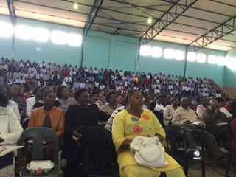
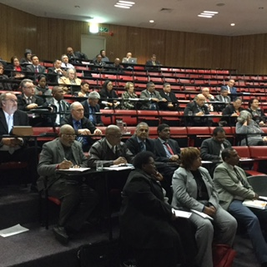
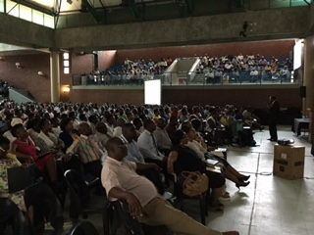
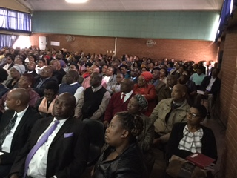

Slide 56
SCHEDULE OF MINISTER’S and DG’s VISTS TO PROVINCES IN THE 2ND QUARTER
PROVINCE | DATE | VENUE
Eastern Cape Cluster A | 29 August 2016 | Mthatha
Cluster C | 31 August 2016 | Grahamstown
Cluster B | 05 September | Queenstown
Free State Cluster 1 | 12 September 2016 | Bloemfontein
Cluster 2 | 14 September 2016 | Welkom
Gauteng | 16 September 2016 | Katlehong
KwaZulu-Natal Cluster 1 | 7 September 2016 | Pietermaritzburg
Cluster 2 | 8 September 2016 | Newcastle
Limpopo – Capricorn District | 20 September 2016 | Seshego
Sekhukhune District | 23 September 2016 | Burgersfort
Vhembe District | 26 September 2016 | Thohoyandou
Mopani District | 28 September 2016 | Giyani
Waterberg District | 13 October 2016 | Bela Bela
Mpumalanga | 10 August 2016 | Middleburg
Northern Cape Cluster 1 | 02 August 2016 | Kimberley
Cluster 2 | 04 August 2016 | Upington
North West | 30 August 2016 | Mahikeng
Western Cape | 01 September 2016 | Cape Town

Slide 57
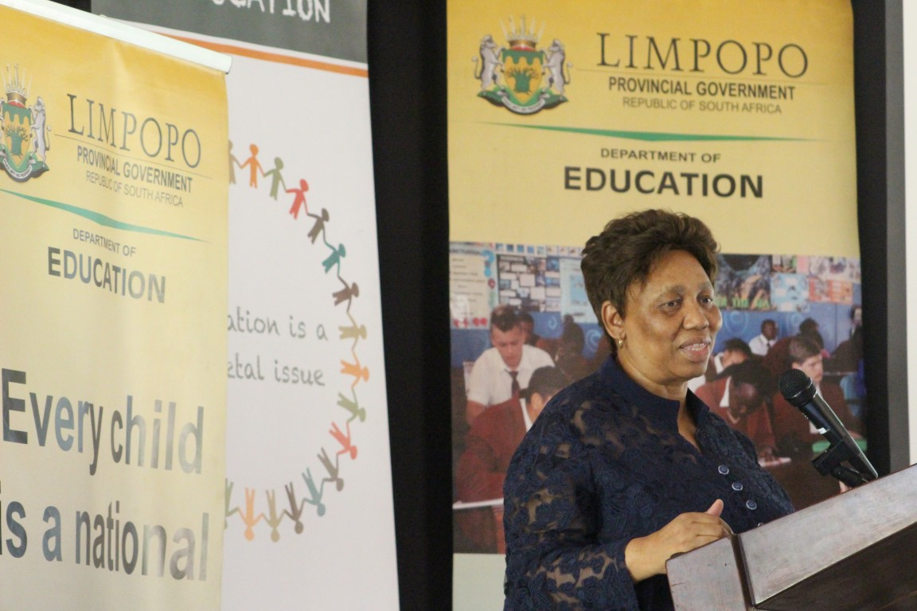
PROGRAMME 4: MINISTER’S ROADSHOW

Slide 58
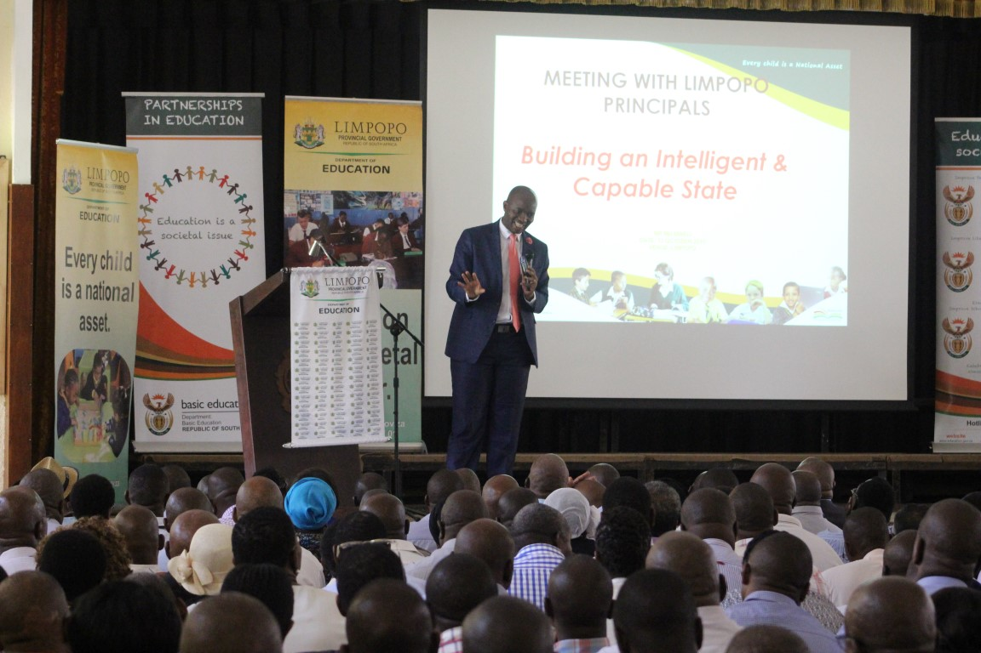
PROGRAMME 4: MINISTER’S ROADSHOW

Slide 59
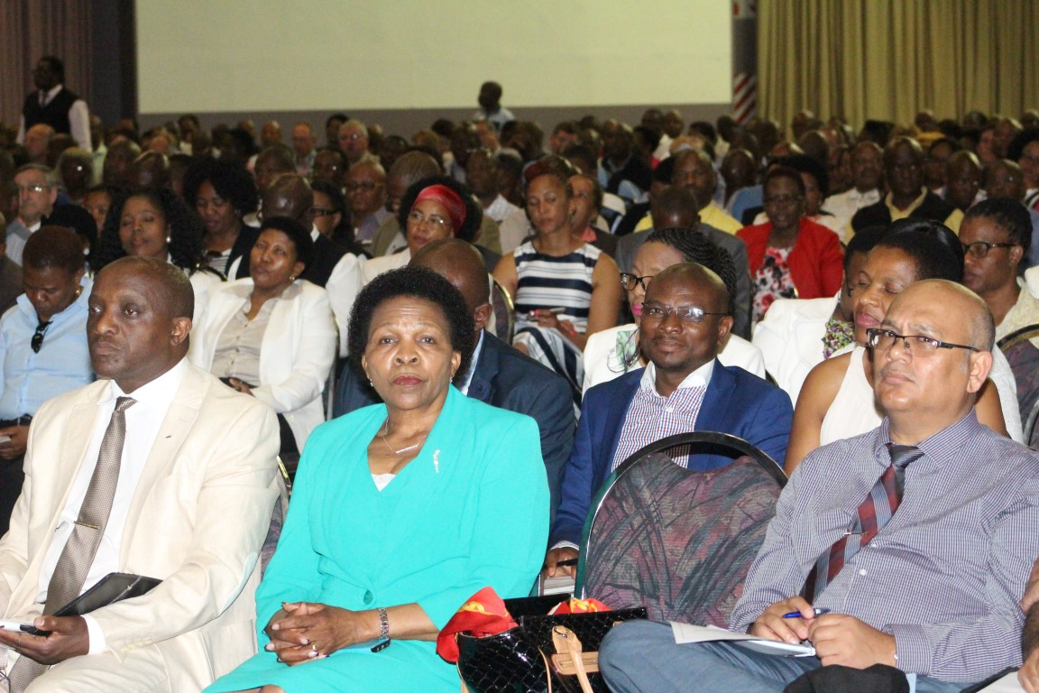
PROGRAMME 4: MINISTER’S ROADSHOWS
DG Roadshows: Limpopo Province Sekhukhune District

Slide 60
PROGRAMME 4
SCHOOL READINESS ASSESSMENT
School readiness to support for 2017 focuses on:
  Pre-closure assessment supports and assesses schools to prepare for the following year;
  Conduct assessment visits during the first two weeks of the opening of schools to ensure that all the schools start with teaching and learning on the first week of school
  Support visits to schools where challenges were identified during the first two visits.
Preparations are underway to dispatch officials to take up this responsibility.

Slide 61
PROGRAMME 5
PROGRAMME FIVE : EDUCATIONAL ENRICHMENT SERVICES
The purpose of Programme 5 is to develop policies and programmes to improve the quality of learning in schools.

Slide 62
INDICATOR TABLE: PROGRAMME 5
# | PERFORMANCE INDICATORS | TARGET FOR 2016/17 AS PER APP | ACTUAL OUTPUT AS AT END OF 2ND QUARTER OF 2016/17 | DEVIATION FROM PLANNED TARGET FOR 2016/17 | STATUS
5.1.1 | Number of schools monitored for the provision of nutritious meals | 150: Quarterly Q1: 30 Q2: 60 Q3: 50 Q4: 20 | Q1: 11 Q2: 90 Total: 101 | -49
5.2.1 | Number of adjudicators, data capturers and Farm school conductors trained in SASCE programmes | 900: Annually | Q1: Training materials being developed Q2: Training in process | -900
5.2.2 | Number of learners participating in Social cohesion programmes. | 6000: Annually | Q1: 447 Q2: 563 | -4990
5.3.1 | Number of Hot Spot Schools monitored towards Implementation of the NSSF | 46: Annually | Q1:12 Q2: 12 | -22

Slide 63
PROGRAMME 5
Care and Support
National School Nutrition Programme (NSNP)
School Feeding: For the 2016/17 financial year, the programme has provided nutritious meals to all the targeted 19 800 schools nationally.
A total of 90 schools have been monitored in 23 districts of 8 provinces. This is used to see if schools are feeding, if the meals are compliant .
85% of the schools monitored were found to be compliant.
Nutrition education is coupled with all the monitoring visits that are held.
A concept document which will guide the DBE to develop and sustain a procurement system that will ensure prioritisation of smallholder farmers as suppliers for certain food commodities for the NSNP has been finalised and submitted to Director for approval.
De worming Programme: Noting the low coverage in deworming learners during the February to March 2016 launch, some provinces were requested to do a mop-up in August 2016.

Slide 64
PROGRAMME 5
PSYCHOSOCIAL SUPPORT
The Psychosocial Support Strategy:
The DBE had planned the training of trainer’s material on assisting traumatised learners followed by printing and distribution to provinces.
The material has been contextualised with the support of the Chicago school of Psychology. As a result the following South African specific content has now been inserted in both the trainer and participant manuals:
    South African legislation for children;
    The Children’s Act form 22 for reporting of abuse or deliberate neglect of children; and
    The Department of Basic Education’s Speak Out booklet for assisting learners to understand abuse, this booklet also contains call centre details of some national organisations.
The provinces are now cascading the training to districts and further down to school.

Slide 65
PROGRAMME 5
HIV and AIDS Life Skills Education Programme
Upon submission to National Treasury, the first tranche of provincial allocation was transferred to all nine provinces on 15 April 2016 for the HIV and AIDS conditional grant.
Monitor and support educator training on sexual and reproductive health for learners: The target for the second quarter was to reach 8 250 educators through training.
Provinces reached 6 059educators through training.
All provinces contributed to the reach of this focal area.
Monitor provinces to expand the appointment of Learner Support Agents to support vulnerable learners: The plan for the period under review was to collect the baseline on the LSAs that have been appointed in provinces.
The target of 1 819 LSAs have been appointed and placed in schools.
Provinces have established systems to appoint more Learner Support Agents (LSAs) over the next quarters.

Slide 66
PROGRAMME 5
School Safety
Operation Val’gontjie in collaboration with SAPS on the closure of illegal taverns/shebeens in close proximity of school is in full swing and the operations were performed in the Limpopo in August 2016 and in the Free State in September 2016. The main aim of the project is to combatting alcohol and illegal drugs amongst learners in schools.
NSSF implementation provincial orientation workshops conducted in the Northern Cape. The purpose of the workshops was to provide orientation on the NSSF as well as unpack the monitoring tool for the implementation of the NSSF.

Slide 67
PROGRAMME 5
ENRICHMENT AND SPORT IN EDUCATION
ABC Motsepe Schools Eisteddfod: The National Eisteddfod was successfully held from 28 June to 01 July 2016 at the Rhema Ministries, Randburg under the theme: “Commemoration of the 1976 Youth Uprisings Through Music”.
A total number of 8 200 schools registered and participated from the first level of competition. A total of 153 schools managed to proceed up the levels (i.e. school, circuit, district and provincial) and reached the National Eisteddfod.
School Sport :The Winter Games were successfully held on 10 to 16 July 2016 in Durban, KwaZulu-Natal.
Spelling Bee South Africa and Reading Clubs: All provinces have conducted their Spelling Bee championships.
Only one (Gauteng) province completed their selection of provincial champions by August 2016 which was the target month according to the time-line and management plan.

Slide 68
PROGRAMME 5
Social Cohesion
Moot Court: The provincial oral argument rounds took place from 01– 24 September 2016. The national finals were held at Constitutional Hill from the 5-9 October.
The iNkosi Albert Luthuli Oral History Programme: Provincial elimination rounds took place in the month of August and September in all provinces except Limpopo.
The national finals were held at Freedom Park from 4-7 October 2016.
Youth Citizens Action Programme: The 2016 Y-CAP national finals took place at Roodevalei, Pretoria from 22-24 July 2016. A total of 99 of Grade 7 (primary category) and 10 (Secondary category) learners participated in the 2016 YCAP national finals.

Slide 69
PROGRAMME 5
Commemoration of Historical and Significant events
60th year commemoration of 1956 Women's March
  This was in a form of a dialogue for girls learners and the minister held on the 27th August 2016.
  A total of 249 girl learners attended the dialogue which was held in Welkom, Free state Province.
Draft protocol on discrimination
  Developed to guide schools on how to deal with cases that relates to discrimination.
  A visit was made Pretoria Girls High School after the incident of discrimination arose at the school.

Slide 70
SUMMARY AREAS OF UNDER-PERFORMANCE ON QUARTERLY AND BI- ANNUAL TARGETS
Indicator | Reasons for Under-performance | Remedial Action | Time Frame | Responsibility
Number of districts visited for monitoring the 1+4 strategy | Delays in logistics related to districts were aggravated by resource constraints. | Planned visits reorganised for Q3 and Q4 based on findings of the monitoring in three clusters in Q1. | Visits currently under way and will be reported in Q3. | Programme 2 : Branch C
Number of schools provided with electricity through ASIDI | Documentation and evidence being verified on the electrification projects completed. | Credibility of the evidence from delivery and provincial mechanisms activated to improve turn around time for the same. | Documentation and evidence being verified on the electrification projects completed. Verified reports will be produced for completed projects in Q3 and Q4. | Programme 4: Branch I

Slide 71
PART B
Second Quarter Expenditure Report

Slide 72
INTRODUCTION
The total Appropriation budget of the Department for the 2016/17 financial year amounts to R22.269 billion
78% of the budget amounting to R17.465 billion is allocated to transfer payments as follows:
  Conditional Grants: R16.213 billion
  Transfers to Public Entities: R1.162 billion
  Other Transfers: R89.492 million
The remainder of the budget (R4.805 billion) is allocated to the following:
  Compensation of Employees: R402.112 million
  Examiners and Moderators: R21.794 million
  Earmarked Funds: R1.172 billion
  Office Accommodation: R174.922 million
  Specifically and Exclusively Appropriated: R2.375 billion
  Departmental Operations: R67.226 million
  Departmental Projects: R592.096 million (including Kha Ri Gude and Annual National Assessment)

Slide 73
INTRODUCTION (cont.)
The total actual expenditure of the Department for the 2016/17 financial year second quarter amounts to R11.712 billion
Expenditure amounting to R10.607 billion is made up of transfer payments as follows:
  Conditional Grants: R9.598 billion
  Transfers to Public Entities: R968.920 million
  Other Transfers: R40.907 million
The remainder of the expenditure (R1.104 billion) is made up as follows:
  Compensation of Employees: R197.179 million
  Examiners and Moderators: R5.636 million
  Earmarked Funds: R72.291 million
  Office Accommodation: R86.763 million
  Specifically and Exclusively Appropriated: R396.872 million
  Departmental Operations: R70.711 million
  Departmental Projects: R274.769 million

Slide 74
ALLOCATION AGAINST ACTUAL EXPENDITURE PER PROGRAMME FOR THE 2016/17 FINANCIAL YEAR
Programmes | 2016/17 |  |  | Expenditure as % of Appropria-tion
 | Appropriation | Actual Expenditure | Variance
 | R’000 | R’000 | R’000
Administration | 377 893 | 205 858 | 172 035 | 54.48%
Curriculum Policy, Support and Monitoring | 1 936 100 | 488 959 | 1 447 141 | 25.25%
Teachers, Education Human Resources Development and Institutional Development | 1 163 742 | 987 642 | 176 100 | 84.87%
Planning, Information and Assessment | 12 500 176 | 6 399 176 | 6 101 000 | 51.19%
Educational Enrichment Services | 6 291 684 | 3 630 066 | 2 661 618 | 57.70%
Total | 22 269 595 | 11 711 701 | 10 557 894 | 52.59%

Slide 75
DEVIATIONS AND REASONS
Deviations | Reasons
Programme 2: Curriculum Policy, Support and Monitoring The bulk of the allocation in these programme is in respect of Workbooks, Second Chance programme and Kha Rii Gude programme. | The printing of Workbooks volume 1 has been completed. The Department receive invoices for the printing and were paid in October 2016. The expenditure on this programme will therefore increase in the third quarter of the financial year. The Second Chance project is currently at planning stage for the implementation in 2017. The printing of past matric question papers, Mind the Gap study guide, Maths and Science textbooks are currently underway. Other processes for the Digital programme, radio broadcasts, television broadcasts are being planned for third and fourth quarter.

Slide 76
DEVIATIONS AND REASONS
Deviations | Reasons
Programme 3: Teachers, Education Human Resources Development and Institutional Development The high spending in this programme is mainly due to the transfer of the Funza Lushaka Bursary Scheme made in the beginning of the financial year to NSFAS which take the bulk of the allocation of the programme. | 90% of the allocation for Funza Lushaka Bursary Scheme has been transferred to NSFAS, the remaining 10 % will be transferred made during January 2017 to cover for the registration fees of the 2017 academic year.
Programme 5: Educational Enrichment Services The high spending on this programme is due to the NSNP Conditional grant. | The projections on this grant are normally high in the first two quarters of the financial year as they include the cooking and eating utensils allocation. The transfers of the conditional grant were made to the provinces as scheduled .

Slide 77
ALLOCATION AGAINST ACTUAL EXPENDITURE PER ECONOMIC CLASSIFICATION FOR THE 2016/17 FINANCIAL YEAR
Economic Classification | 2016/17 |  |  | Expenditure as % of Appropriation
 | Appropriation | Actual Expenditure | Variance
 | R’000 | R’000 | R’000
Compensation of Employees | 472 143 | 223 864 | 248 279 | 47.41%
Goods and Services | 2 076 354 | 576 518 | 1 499 836 | 27.77%
Transfers and Subsidies | 17 464 973 | 10 607 481 | 6 857 492 | 60.74%
Payment for Capital Assets | 2 256 125 | 303 838 | 1 952 287 | 13.47%
Total | 22 269 595 | 11 711 701 | 10 557 894 | 52.59%

Slide 78
DEVIATION AND REASONS
Deviations | Reasons
Compensation of Employees: The underspending on this item is mainly due to the expenditure on Earmarked funds (MST Oversight and Examiners and Moderators). | The allocation on these item for MST is in respect of MST Oversight posts for monitoring the implementation of the conditional grant. The vacant posts were advertised in July 2016. The process of shortlisting is currently underway. The spending on Examiners and Moderators will be realized after the NSC examinations are concluded and the results are released, that is in quarter 4.

Slide 79
DEVIATION AND REASONS
Deviations | Reasons
Goods and Services: The printing of workbooks volume 1 has been completed and delivery is expected to be completed during the third quarter of the financial year. The printing of Workbooks Volume 2 is currently underway. | The spending on Examiners and Moderators will be realized after the NSC examinations are concluded and the results are released, that is in quarter 4.
Payments for Capital Assets: The deviation is due payments in respect of ASIDI projects. | Due to the mergers and rationalisation processes undertaken by the Eastern Cape PED, the allocation of almost 217 schools within the ASIDI Programme could not be allocated to the Implementing Agents and thus no activities took place. These process has now been finalised and it envisaged that at most 61 isolated schools will be completed by the end of the 2016/17 financial year. The Department was put in untenable position of having to reduce scope of work previously allocated to the non performing Implementing Agents and is currently in the process of appointing replacement implementing agents through the Framework Agreement.

Slide 80
ALLOCATION AGAINST ACTUAL EXPENDITURE FOR THE 2016/17 FINANCIAL YEAR
Economic Classifications | 2016/17 |  |  | Expenditure as % of Appropriation
 | Appropriation | Actual Expenditure | Variance
 | R’000 | R’000 | R’000
Compensation of Employees | 402 112 | 197 179 | 204 933 | 49.04%
Examiners and Moderators | 21 794 | 5 636 | 16 158 | 25.86%
Transfers to Public Entities | 1 162 484 | 968 920 | 193 564 | 83.35%
Other Transfers | 89 492 | 40 907 | 48 585 | 45 71%
Conditional Grants | 16 212 997 | 9 597 654 | 6 615 343 | 59.20%
Schools Infrastructure Backlogs Indirect Grant | 2 374 867 | 396 872 | 1 977 995 | 16.71%
Earmarked Funds | 1 171 605 | 72 291 | 1 099 314 | 6.17%
Departmental Operations | 67 226 | 70 711 | (3 485) | 105.18%
Office Accommodation | 174 922 | 86 763 | 88 159 | 49.60%
Projects | 592 096 | 274 769 | 317 327 | 46.41%
Total | 22 202 369 | 11 711 701 | 10 557 894 | 52.59%

Slide 81
DEVIATIONS AND REASONS
Deviations | Reasons
Examiner and Moderators The expenditure on examiners and moderators will reach its peak during the year end examination. | The spending on examiners and moderators is influenced by the Grade 12 examinations which are scheduled to start on 24 October 2016.
School Infrastructure Backlog grant The deviation is due payments in respect of ASIDI projects. The process of rationalisation for schools had an impact on the spending trends for the ASIDI project. | The consultation on rationalisation of schools has been completed in some areas. The Department is in the process of allocating projects to Implementing Agencies.
Earmarked Funds The workbooks volume 1 has been delivered to different provinces. Furthermore, printing of workbooks volume 2 is currently in progress. | To date a total of 10 244 schools in different provinces have received their 2017 Workbooks volume 1 consignments. The expenditure will improve in the third and fourth quarter of the financial year.

Slide 82
DEVIATIONS AND REASONS
Deviations | Reasons
Departmental Operations The overspending on this item are in respect of computer services and audit fees venues and facilities. | The Department is in a process of reviewing the half yearly allocation. The 2016/17 operational budget is lower than the 2015/16 financial year due to the budget cuts implemented by National Treasury.
Projects The bulk of the remaining allocation on this item is in respect of the Annual National Assessment and Kha Ri Gude project. These projects were previously earmarked projects. | With regard to ANA, the Department appointed examiners that will develop the diagnostic assessment tools. The roll out of the assessment tools will be in January 2017. These assessment tools will also be linked to the development of appropriate ICT platforms. The Kha Ri Gude classes will start in 1 November 2016. The payments of stipend to volunteers will also influence the spending on projects.

Slide 83
DETAILS OF EARMARKED ALLOCATIONS/CONDITIONAL GRANT FOR THE
2016/17 FINANCIAL YEAR
Service |  |  |  | Expenditure as % of Appropriation
 | Appropriation | Actual Expenditure | Variance
 | R’000 | R’000 | R’000
Earmarked Funds: | 1 171 605 | 72 291 | 1 099 314 | 6.17%
Workbooks | 1 008 441 | 43 875 | 964 566 | 4.35%
NEEDU | 22 330 | 12 749 | 9 581 | 57.09%
MST | 5 271 | 1 241 | 4 030 | 23.54%
NSNP | 17 014 | 8 086 | 8 928 | 47.53%
EPWP: KHA RI GUDE | 68 549 | - | 68 549 | 0.00%
MATRIC SECOND CHANCE | 50 000 | 6 340 | 43 660 | 12.68%
Conditional Grants: | 16 212 997 | 9 597 654 | 6 615 343 | 59.20%
EDUCATION INFRASTRUCTURE GRANT | 9 613 692 | 5 811 520 | 3 802 172 | 60 45%
HIV&AIDS (LIFE SKILLS EDU) GRANT | 230 849 | 92 338 | 138 511 | 40.00%
MATHS,SCIENCE&TECHNOLOGY GRANT | 362 444 | 181 221 | 181 223 | 50.00%
NAT SCHOOL NUTRITION PROG GRANT | 6 006 012 | 3 512 575 | 2 493 437 | 58.48%

Slide 84
DEVIATIONS AND REASONS
Deviations | Reasons
Workbooks The workbooks volume 1 has been delivered to different provinces. Furthermore, printing of workbooks volume 2 is currently in progress. | To date a total of 10 244 schools in different provinces have received their 2017 Workbooks volume 1 consignments. The expenditure will improve in the third and fourth quarter of the financial year.
EPWP: Kha Ri Gude The Kha Ri Gude classes resume in October 2016. The application form for volunteers to meet the categories required by the EPWP electronic system has been amended. | Although the EPWP allocation for the 2016/17 amounts to R68,5 million, the Expanded Public Works Programme (EPWP) has indicated that an upfront transfer will be made when the Implementation Plan and the revised Incentive Model has been finalised and signed by both DGs of the Department of Basic Education and the Department of Public Works.

Slide 85
DEVIATIONS AND REASONS
Deviations | Reasons
Matric Second Chance The pilot started in the 2016/17 financial year, offering direct tuition in 2 districts per province at 2 schools per district. Part of the allocation on this project is earmarked for the advocacy and procurement of study materials in preparation for the 2017 supplementary examinations. | The Second Chance project is currently at planning stage for the implementation in 2017. The printing of past matric question papers, Mind the Gap study guide, Maths and Science textbooks are currently underway. Other processes for the Digital programme, radio broadcasts, television broadcasts are being planned for third and fourth quarter.
Conditional grants The transfers on conditional grants was made as schedule. | The transfers on the conditional grants is based on the approved payment schedule communicated to province.

Slide 86
DETAILS OF TRANSFERS AGAINST ACTUAL EXPENDITURE FOR THE 2016/17 FINANCIAL YEAR
Service |  |  |  | Expenditure as % of Appropriation
 | Appropriation | Actual Expenditure | Variance
 | R’000 | R’000 | R’000
Transfers to Public Entities | 1 162 484 | 968 920 | 193 564 | 83.35%
NSFAS: Fundza Lushaka Bursaries | 1 043 611 | 939 250 | 104 361 | 90.00%
Umalusi | 118 678 | 29 670 | 89 008 | 25.00%
ETDP SETA | 195 | 0 | 195 | 0.0%
Other Transfers | 89 492 | 40 907 | 48 585 | 55.46%
UNESCO Membership Fees | 13 890 | 0 | 13 890 | 0.0%
ADEA | 35 | 0 | 35 | 0.0%
Childline South Africa | 58 | 0 | 58 | 0.0%
Guidance Counseling & Youth Development Centre: Malawi | 124 | 0 | 124 | 0.0%
SACMEQ | 3 265 | 0 | 3 625 | 0.0%
Households¹ | - | 907 | (907) | -100.0%
National Education Collaboration Framework | 72 120 | 40 000 | 32 120 | 55.46%

Slide 87
DEVIATIONS AND PROGRESS
Deviations | Reasons
Other Transfers The bulk of the transfers are made to foreign/international organisations which are made in Dollars and EUROs. | The bulk of these transfers are normally made during January/February of the financial year.
Households The expenditure for this item is in respect of leave gratuity for officials who exit Government. | The item is not allocated a budget since resignations of officials cannot be pre-determined. The household expenditure is normally covered from the compensation of employees.

Slide 88
RECOMMENDATIONS
To request the Portfolio Committee to:
  accept the Quarter 2 Report outputs of the Department of Basic Education against planned targets of the pre-determined objectives in the Annual Performance Plan of 2016/17.
  accept the second quarter expenditure report of the Department of Basic Education for the financial year 2016/17.

Slide 89


