Slide 1

CORRECTIONAL SUPERVISION AND PAROLE
PRESENTATION TO PORTFOLIO COMMITTEE ON JUSTICE AND CORRECTIONAL SERVICES
25 OCTOBER 2016

Slide 2
Purpose
To provide a brief overview on the administration of parole, medical parole and correctional supervision.
Outline of presentation
Parole and medical parole
Community Corrections

Slide 3
    Correctional Supervision and Parole
    Mandates
    History
    Establishment of Parole Boards
    Function of Parole Boards
    Parole
    Review of Parole Board decisions
    Victim participation
    Lifers Van Vuuren and Van Wyk
    Seat of Parole Boards
    Vacancies in Parole Boards
    Cases considered 2013/14 – 2015/16
    Training of Parole Boards/CMC for 2016
    Addressing of challenges

Slide 4
    Medical Parole
    Background
    Correctional Services Regulations
    Medical Parole Policy Principles
    Medical Parole Process
    Delegated Authority

Slide 5
Mandates
Correctional Services Act, 111 of 1998 (Act No 111 of 1998), as amended
Correctional Services Act , 8 of 1959 (Act 8 1959)
Criminal Procedure Act, 1977 (Act 51 of 1977)
White Paper on Corrections

Slide 6
History
Until 1 October 2004, the Parole Board consisted of members of the Department of Correctional Services (DCS) who only made recommendations on the possible placement of offenders.
Decisions to place offenders out was delegated to members of the DCS on various levels.
Due to criticism from all fronts including the SA Police Service, the Judiciary and the public against the decisions of the DCS, the placement process was revised.
In the new concept (which came into operation 1 October 2004) , the decision-making authority was effectively removed from the DCS and placed in the hands of the community.
In this manner the responsibility for corrections has also been extended to the society and this should improve the reintegration of offenders back into the society.

Slide 7
History cont…
The 1998 legislation allows for the establishment of a transparent and fair parole system with the inclusion of key stakeholders outside of the Department in the decision making process.

Slide 8
Establishment of Correctional Supervision and Parole Boards
53 Parole Boards were established in terms of section 74 of the Correctional Services Act, 111 of 1998 on 1 October 2004.
Consist of:
Chairperson – Community member
Vice Chairperson – Community member
DCS Representative – also act as secretary
2x part time Community members
Co-option of SAPS (DOJ)
Quorum – 3 members
Parole Boards contracts have been extended to 31 March 2017.

Slide 9
Functions of the Correctional Supervision and Parole Boards
The primary task of the Parole Board is the responsible consideration and approval/disapproval of placement of offenders:
  under correctional supervision
  on day parole
  parole and
  medical parole.
The granting of special remission of sentence to offenders for meritorious conduct.
Making recommendations to the Minister regarding offenders sentenced to life imprisonment.
Making recommendations to Courts on offenders declared as dangerous criminals as well as conversions of sentence.

Slide 10
What is parole?
Parole is an internationally accepted mechanism that allows for the conditional release of offenders from a correctional centre into the community before expiry of their sentence of imprisonment.
This means that the offender is released from a correctional centre before the expiry of his or her sentence of imprisonment to serve the remainder of the sentence in the community subject to specific conditions that must be complied with.
This allows the offender to return to normal community life albeit under controlled conditions under the supervision of correctional officials. The process facilitate reintegration into society under controlled circumstances.

Slide 11
Principles for parole consideration
The protection of the community on the short term should be fundamental i.e. the release of the offender should not affect the community negatively.
On the longer term, the protection of the community should be addressed by means of reducing the risk of re-offending by having identified offending behavior and having addressed it sufficiently to consider any risk of placement to be acceptable and manageable once placed into the system of community corrections.
Supervised placement increases the likelihood of successful reintegration and on the long run contributes to the protection of the community.
Conditions should be appropriate and proportional to facilitate the protection of the community and should promote social reintegration.

Slide 12
Review of Parole Board decisions
The Correctional Services Act 111 of 1998 makes provision that a decision of a Parole Board may be reviewed.
Once a Parole Board has taken a decision, it cannot review its decision except if new information which was not previously at its disposal came to its attention after the decision was taken.
A Parole Board decision is final and may be referred to the Review Board by the Minister, Inspecting Judge or the National Commissioner.
In practical terms anybody including an offender may request (based on motivated grounds) any of the abovementioned to refer a decision to the Review Board.
The Review Board may confirm the decision of a Parole Board or may substitute the decision with any other decision which the Parole Board ought to have made.

Slide 13
Victim participation in Parole Board
The participation of victims has increased over the years.
Financial Year | Number of victims
2010/11 | 253
2011/12 | 684
2012/13 | 1215
2013/14 | 1543
2014/15 | 1695
2015/16 | 2279

Slide 14
Status: Van Vuuren Judgement Cases
On 30 September 2010 the Constitutional Court delivered a ruling in the case of offender Van Vuuren to the effect that all lifers sentenced prior to 1 March 1994 had to be considered for placement after they have completed 15 years of their sentences.
A total of 369 offenders qualified and were considered. Since 1 March 2011 up to 22 August 2016 the following decisions were taken by the Minister:
All qualifying cases were considered by 14 March 2012
Offenders who were given further profile dates continue to be considered on dates approved by the Minister
Deportation | Parole | Day Parole | Further Profile | Parole with- drawn | Day Parole Withdrawn
5 | 118 | 149 | 92 | 2 | 3

Slide 15
Status : Van Wyk Judgement Cases
Offenders sentenced to life incarceration before 1 October 2004 had to serve a minimum detention period of 20 years before being eligible for consideration for placement on parole according to the 1998 Correctional Services Act.
On 15 July 2011 the North Gauteng High Court handed down a judgment in the Van Wyk case which had the effect to change the minimum detention period for offenders sentenced to life before 1 October 2004 prior to them being eligible for consideration for placement on parole.
The implication was that the previous credit system is also applicable to those offenders sentenced to life sentences from 1 March 1993 up to 30 September 2004 and after allocation of the maximum number of credits advanced their consideration dates from 20 years to 13 years and 4 months. The minimum detention period was further reduced to 12 years and 4 months as a result of 2005 and 2012 special remission by the President.

Slide 16
Seat of Parole Boards
REGION | NUMBER OF PAROLE BOARDS | MANAGEMENT AREAS
FSNC | 7 | Bizzah Makhate, Colesburg, Goedemood, Groentpunt, Grootvlei, Kimberley and Upington
EC | 9 | Mthatha, Lusikisiki, Sada, Amathole, East London, Cradock, Kirkwood, St Albansx2
GP | 11 | Baviaanspoort, Boksburg, Johannesburg x2, Kgosi Mampuru II x2, Krugersdorp, Leeuwkop x2, Modderbee and Zonderwater
KZN | 8 | Durban x2, Empangeni, Glencoe, Kokstad, Ncome, Pietermariztburg and Waterval
WC | 10 | Allendale, Brandvlei, Breederiver, Drakenstein, Goodwood, Overburg, Pollsmoor, Southern Cape, Voorberg and West Coast
LMN | 8 | Barberton, Bethal, Klerksdorp, Polokwane, Rooigrond, Rustenburg, Thohoyandou and Witbank
Total | 53

Slide 17
Seat of Parole Boards
Free State/ Northern Cape
Grootvlei - Brandfort, Boshof, Ladybrand, Winburg, Wepener, Mangaung (APOPS).
Colesberg - De Aar, Richmond, Victoria West, Hopetown.
Groenpunt - Vereeniging, Sasolburg, Frankfort, Parys, Heilbron.
Goedemoed - Edenburg, Fauresmith, Bethuli, Zastron
Upington - Springbok, Kuruman.
Kroonstad - Ventersburg, Senekal, Bethlehem, Lindley, Harrismith, Hennenman, Hoopstad, Odendaalsrus, Virginia, Ficksburg
Kimberley - Barkley-West, Douglas

Slide 18
Seat of Parole Boards
Eastern Cape
Lusikisiki - Bizana, Mt Ayliff, Mt Fletcher, Mt Frere, Flaggstaff, Tabankulu, Umzimkulu
Amathole (Middledrift) - Fort Beaufort, King Williams Town, Grahamstown, Stutterheim
East London - Mdantsane
Umtata - Ngqeleni, Mqanduli
Cradock - Burgersdorp, Middelburg, Somerset East, Graaff Reinet
Kirkwood
St Albans (1)
St Albans (2)- Port Elizabeth, Patensie
Sada - Queenstown, Barkley East, Sterkspruit, Butterworth, Idutywa, Willowvale, Lady Frere, Elliotdale, Nqamakwe, Cofimvaba, Engcobo, Dordrecht

Slide 19
Seat of Parole Boards
Gauteng
Baviaanspoort
Boksburg - Heidelberg
Johannesburg(2)
Krugersdorp
Leeuwkop(2)
Modderbee - Nigel, Devon
Pretoria(2) - Atteridgeville, Odi
Zonderwater

Slide 20
Seat of Parole Boards
KwaZulu/ Natal
Pietermaritzburg - Sevontein, Ixopo, New Hanover
Durban(2) - Umzinto
Kokstad - Matatiële, Port Shepstone
Ncome - Vryheid, Nongome, Melmoth, Nkandla
Empangeni - Qulakabushe, Mtunzini, Maphumulo, Stanger, Eshowe, Ingwavuma
Waterval - Utrecht, Ekuseni, Newcastle
Glencoe - Dundee, Bergville, Ladysmith, Estcourt, Greytown, Kranskop, Pomeroy

Slide 21
Seat of Parole Boards
Western Cape
Allandale - Staart van Paardeberg, Obiqua, Hawequa
Brandvlei
Drakenstein - Stellenbosch
George - Oudtshoorn, Beaufort Wes, Ladismith, Prince Albert, Uniondale, Mossel Bay, Knysna
Helderstroom - Caledon, Buffeljagsrivier, Swellendam
Malmesbury - Riebeeck West
Pollsmoor
Goodwood
Voorberg - Calvinia, Van Rhynsdorp
Worcester - Dwarsrivier, Robertson, Warmbokkeveld

Slide 22
Seat of Parole Boards
Mpumalanga/ North West/ Limpopo
Barberton – Lydenburg, Nelspruit
Bethal - Geluk, Standerton, Ermelo, Piet Retief, Volksrust
Witbank - Belfast, Middelburg, Carolina
Klerksdorp - Christiana, Wolmeranstad, Potchefstroom
Rooigrond - Lichtenburg, Zeerust
Rustenburg - Brits, Losperfontein, Mogwase
Polokwane - Modimolle, Tzaneen
Thohoyandou - Louis Trichardt, Kutama Sinthumule (APOPS)

Slide 23
Vacancies in Parole Boards
Vacancies | Chairpersons | Vice-Chairpersons | Secretaries
FSNC | 0/7 | 5/7 | 3/7
EC | 1/9 | 2/9 | 0/9
GP | 2/11 | 4/11 | 0/11
KZN | 2/8 | 6/8 | 4/8
WC | 1/10 | 6/10 | 0/10
LMN | 1/8 | 4/8 | 0/8
Total vacancies | 7 | 27 | 7
Total posts filled | 46 | 26 | 46

Slide 24
APP – Cases considered by CSPB
Percentage of offenders' profiles submitted by CMC that were considered by CSPBs.
REGION | 2013/14 | 2014/15 | 2015/16
NATIONAL | 84.83% (35666/42044) | 94% (41519/44367) | 96.52% (41942/43454)
FS/NC | 77.04% (6156/7990) | 89% (6703/7507) | 90.08% (7466/8288)
KZN | 84.86% (4662/5485) | 95% (5361/5650) | 95.40% (5148/5396)
LMN | 69.63% (4781/6866 | 87% (5833/6686) | 96.52% (5830/6040)
WC | 94.58% (9051/9569) | 96% (9817/10193) | 97.13% (9753/10041)
EC | 92.84% (3898/4138) | 99% (4296/4341) | 99.87% (4528/4534)
GP | 89.01% (7118/7996) | 95% (9509/9990 | 100.68% (9217/9155)

Slide 25
Summary of Key Performance Indicator 2015/16
BREAK DOWN OF CASES CONSIDERED BY CSPBs
 | National
 | CSPB
Parole | 45.20%
Correctional Supervision | 6.17%
Medical Parole | 0.21%
Day parole | 0.29%
Sentence Expiry Date | 4.50%
Further Profile | 43.63%
Total | 100%

Slide 26
Consideration of offenders who maintain that they have not committed offences for which they were sentenced (Wits Justice Project, p2)
  A number of factors are considered by Parole Boards which include the following:
the completion of the legislatively required minimum detention period;
positive report on conduct and behaviour (including relevant interventions and programmes where applicable);
proof that rehabilitation/ development took place;
risk posed to the community/ victim must be assessed and must have been reduced/ managed appropriately;
Participation in compulsory risk and needs assessments and completion of required programmes and interventions including restorative justice orientation programme;

Slide 27
Consideration of offenders who maintain that they have not committed offences for which they were sentenced (Wits Justice Project, p2)
proof of a monitorable and appropriate support system; and
acceptance of the conditions for placement by the offender
As indicated a number of factors are considered, not only participation in RJ or failure to apologise to victims
This issues was dealt with extensively during the CMC/CSPB training held between June and September 2016.

Slide 28
Addressing Challenges
  Training
  Training sessions were held between June and September 2016.
  Case Management Committees (CMCs), Parole Boards, Heads of Community Corrections and Regional Coordinators Social Reintegration and Corrections are currently being trained – training includes the following issues which were identified as some of the challenges:
    Compilation of the profile report, quality and format
    Conversions of sentence into correctional supervision, 276(1)(i) and 276A(3) cases
    Promotion of Administrative Justice Act - PAJA
    Court judgments relating to parole
    Decision making and formulation of motivation/reasons for decision
    Submission of Lifers

Slide 29
Addressing Challenges
    Performance indicators
    Setting of placement conditions
    Relations between CMC, Parole Boards and Community Corrections, etc.
    Separate training sessions for Heads of Centres are also being held.

Slide 30
Training of CSPB/ CMC for 2016
Parole Board and CMC Training
Region | Dates | Venue
Gauteng | 7-10 June 2016 | Gauteng –Baviaanspoort
Western Cape | 21-24 June 2016 | WC- Brandvlei
Eastern Cape | 19-22 July 2016 | EC- St Albans
FS/NC | 23-26 August 2016 | FS/NC –Grootvlei
KZN | 13-16 September 2016 | KZN- Durban
LMN | 27-30 September 2016 | LMN- Witbank

Slide 31
Addressing Challenges …
  2. Quality Control on Profiles
  A new compliance checklist and cover page to the G326 has been introduced and was implemented.
  Profile reports of lifers which did not comply with the basic requirements were taken back to Regions and were discussed with Regional Heads, Heads of Centre, Chairpersons of CMCs and Parole Boards during workshops.
  A revised cover page for all other profile reports were also introduced.
  These documents were also presented during the mentioned training sessions and was dealt with during practical group work sessions.

Slide 32
Addressing Challenges …
  2. Quality Control on Profiles
A one-day workshop was held with Free State and Northern Cape(FS/NC) and Limpopo, Mpumalanga and North West (LMN) Regions to work through issues of non-compliance on the quality of profile reports. Regional Head Corrections, Regional Coordinator Corrections, Heads of Centre, Chairpersons of Case Management Committees (CMC) and Parole Boards attended the workshop. The Same matter was again dealt with during training with other Regions. Following such workshops, all profile reports received thereafter which do not comply with the required standards, are being sent back to Regional Commissioners with requests for steps to be taken against the responsible officials.
The National Commissioner has issued a communication signed on 17 March 2016 reference no 16/1/1/P to this effect.

Slide 33
Addressing Challenges …
  2. Review of the Parole System
  A task team was appointed to make recommendations to the Minister on the review of the parole system.
  Preliminary recommendations have been submitted to the Minister and once the Minister’s inputs have been received and reworked, the Committee will be briefed comprehensively.
  In the meantime, the new tools are being developed and tested and will be compulsory for utilization by CMCs, CSPBs and Supervision Committees (where applicable)

Slide 34
Addressing Challenges …
  2. Review of the Parole System …
  Re-Offending Risk Tool – statistically based risk indicator. The indicator must be used as a guidance for indicating risk and for identifying interventions/ actions/ conditions to manage the risk,
  Decision Making Matrix – a tool to ensure that a standard consideration thought processes are used by all CMCs and CSPBs to evaluate the risks and to assist them in making properly considered and fully motivated recommendations/ decisions,
  Parole Revocation Tool – a tool to ensure that parole revocations comply with a uniform approach to consider parole revocations by standardizing the criteria used during the recommendation and decision making processes. It is intended to ensure that there is consistency amongst Supervision Committees and CSPBs when parole revocation is considered.

Slide 35
Addressing Challenges …
  3. Filling of Vacancies/ Extension of Contracts
  The Minister has approved the extension of contracts of the Parole Board members to 31 March 2017.
  In addition, the Minister has approved that current vacancies be advertised and be filled as a matter of urgency.

Slide 36
Medical Parole: Background
Previously in South Africa, medical parole was dealt with in accordance with Section 79 of the Correctional Services Act, Act 111 of 1998, which stipulated: “Any person serving any sentence in a prison and who, based on the written evidence of the medical practitioner treating that person, is diagnosed as being in the final phase of any terminal disease or condition may be considered for placement under correctional supervision or on parole, by the National Commissioner, Correctional Supervision and Parole Board or the court, as the case may be, to die a consolatory and dignified death”. The above process was initiated by professional nurses, and the offender would be assessed by two separate medical practitioners. The one medical practitioner would be the treating the applicant, and the other would preferably be a relevant specialist so that a second opinion is provided into the inmate’s medical condition.
These completed health reports, together with other prescribed reports, would be submitted to the National Commissioner of Correctional Services, the Correctional Supervision and Parole Board or the Court, as the case may be, for consideration for placement under correctional supervision or parole.

Slide 37
Background
  There were instances where requests for placement on medical parole were not submitted on time, eligible offenders would die before their applications could be completed. At other times if submitted on time, terminally ill offenders could live longer.
  Legislation did not make provision for medical parole of terminally ill remand detainees since they are not yet sentenced. Based on the medical condition of the remand detainee, medical reports would be submitted with recommendations to the courts to consider withdrawing the cases or granting of bail.
  Based on the above, a need was therefore identified to review legislation and develop new policy and procedures in order to provide a framework within which all releases on medical parole will be managed and standardize implementation.

Slide 38
Background
Due to the inconsistent implementation of Section 79 of the Correctional Services Act, Act 111 of 1998 as amended and relevant policies and procedures, it was necessary to review this section of the Act.
Section 79 of Act 111 of 1998, as amended by Section 55 of Act 25 of 2008, was reviewed and substituted by Section 79 of the Correctional Matters Amendment Act, Act 5 of 2011, as follows:
Section 79(1)(a), (b) & (c) stipulates conditions for applying for medical parole;
Section 79(2)(a), (b) & (c) stipulates a new process for the application for medical parole;
Section 79(3)(a) & (b) stipulates the establishment of a medical advisory board to provide an independent medical report to the National Commissioner, Correctional Supervision and Parole Board or the Minister as the case may be; and
Sections 79(4) (a) & (b) and (5) (a) stipulates considerations for placement on medical parole.

Slide 39
Correctional Services Regulations
Amendments to Correctional Services Regulations 29A and 29B, (2004), detail the following:
management of medical parole, which includes medical conditions under which an applicant can be considered for medical parole; and
the appointment as well as composition of the Medical Parole Advisory Board (MPAB).
The previous MPAB comprised of ten (10) independent medical practitioners, who were appointed in February 2012 by the then Minister of Correctional Services, Ms. NN Mapisa-Nqakula (MP), for a period of three (3) years starting from 1st March 2012.
The current MPAB consists of thirteen (13) members of whom some are specialists and were appointed by the Honorable Minister Adv. M Masutha (MP) in June 2015.
The MPAB meets on a monthly basis to review applications for medical parole as received from the country’s 243 Correctional Centers.

Slide 40
Medical Parole
The new medical parole system differs from the previous one in that an offender or someone acting on the offender’s behalf will, from 1 March 2012, be able to bring an application for release on medical parole. Before 1 March 2012, only the medical practitioner treating the offender could apply.
Furthermore, the placement of an offender on medical parole is no longer limited to offenders in the final phase of a terminal disease or medical condition. Apart from terminally ill inmates, the net is thrown wider to include physically incapacitated inmates and those suffering from an illness that severely limits their daily activity or self-care.
  The MPAB is expected to provide an independent medical report to the National Commissioner, the Correctional Supervision and Parole Board or the Minister as the case may be on offenders who have applied for medical parole, suffering from any of the medical condition(s) as listed in the Amendment of the Correctional Services Regulations, 2004.

Slide 41
Amendment of Correctional Services Regulations, Section 29 A
Section 29 A
Infectious Conditions
  WHO Stage 4 of Acquired Immunodeficiency Syndrome despite good compliance and optimal treatment with ARV’s
  Severe Cerebral Malaria
  Methicilin resistance staph aureas despite optimal treatment
  MDR or XDR tuberculosis despite optimal treatment
Non- infectious Conditions
  Malignant Cancer Stage 4 with metastasis being inoperable or with both radiotherapy and chemotherapy failure
  Ischaemic Heart Disease with more than two ischaemic events in a period of one year with proven cardiac enzyme abnormalities
  Chronic Obstructive Airways Disease with grade 3- 4 dyspnoea

Slide 42
Amendment of Correctional Services Regulations, Section 29 A
Continued
  Cor – pulmonale
  Cardiac disease with multiple organ failure
  Pancytopaenia
  End Stage Renal Disease
  Liver cirrhosis with evidence of liver failure
  Space occupying lesions in the brain
  Severe head injury with altered level of consciousness
  Multi- system organ failure
  Chronic inflammatory demyelinating Polyradiculoneuropathy
  Neurological sequelae of infectious diseases with a Karnofsky score of 30% and less

Slide 43
Amendment of Correctional Services Regulations, Section 29 A
Continued
  Tetanus
  Dementia
  Severe disabling Rheumatoid Arthritis , and whether such condition constitutes a terminal disease or condition; or the offender is rendered physically incapacitated as a result of injury , disease or illness so as to severely limit daily activity or inmate self-care
  The MPAB may consider any other condition not listed in sub-regulation 5a or 5b if it complies with the principles contained in Section 79 of the Act.

Slide 44
Medical Parole Principles
All staff, offenders, remand detainees, and stakeholders shall be provided with information on the Medical Parole (MP) process.
Any eligible offender shall be considered for placement/ release on MP.
MP shall only be considered after completion of the prescribed areas in the approved MP application form and submission of all relevant and latest clinical reports, x-rays, etc.
All MP applications shall be subject to review by the Medical Parole Advisory Board (MPAB).
Discharge plan shall be developed and implemented for each terminally ill offender who is identified as eligible for MP
All approved applications of terminally ill offenders shall be properly transported, accompanied and handed over to the next party.
The HCC or Head of Remand Detention Facility (HRDF) shall refer a terminally ill or severely incapacitated remand detainee to court for a decision.

Slide 45
Medical Parole Process
1. | IDENTIFICATION OF ELLIGIBLE OFFENDER BY APPLICANT (as prescribed by the Act) | CASE MANAGEMENT COMMITTEE COMMENCES WITH RELEVANT PROCESSES E.G. IDENTIFICATION OF FAMILY MEMBERS, CONFIRMATION OF ADDRESS
2. | GRANTING OF INFORMED CONSENT BY PATIENT FOR DISCLOSURE OF HEALTH INFORMATION
3. | COMPLETION OF THE MEDICAL APPLICATION FORM BY THE PATIENT OR APPLICANT
4. | COMPLETION OF THE MEDICAL APPLICATION FORM BY THE TREATING MEDICAL PRACTITIONER
DISCHARGE PLAN PREPARED AND IMPLEMENTED

Slide 46
Medical Parole Process
5. | SUBMISSION OF APPLICATION FORM AND ALL RELEVANT CLINICAL RECORDS TO THE MPAB
6. | CONSULTATION OF PATIENT BY MEMBER OF THE MPAB WHERE NECESSARY
7. | MEDICAL PAROLE ADVISORY BOARD (MPAB) SITTING OR MEETING
8. | REFERRAL OF PATIENT FOR SPECIALIST’S CONSULTATION IF NECESSARY
9. | RECOMMENDATION/S OF MPAB TO NATIONAL COMMISSIONER, CORRECTIONAL SUPERVISION AND PAROLE BOARD OR THE MINISTER DEPENDING ON THE CASE
10. | DECISION TAKEN BY THE DELEGATED AUTHORITY
11. | DECISION IMPLEMENTED BY CMC

Slide 47
Delegated Authority
Prior to taking a decision the following are considered:
that the risk of re-offending is low;
whether appropriate arrangements for the inmate's supervision, care and treatment are available within the inmate’s community;
whether at the time of sentencing the presiding officer was aware of the medical condition;
any sentencing remarks of the trial judge or magistrate;
the type of offence and the length of the sentence outstanding;
the previous criminal record of such offender; and
the conduct, disciplinary record, adaptation, training, aptitude, industry, physical and mental state of such offender.

Slide 48
COMMUNITY CORRECTIONS

Slide 49
Community Corrections
Community Corrections’ mean all non-custodial measures and forms of supervision applicable to persons who are subject to such measures and supervision in the community and who are under the control of the Department (inclusive of Community Liaison and Outreach)
Community corrections include activities such as supervision, community-based sanctions and services (partnerships) directed at offenders who have committed crimes and have been placed under supervision by the Court / Correctional Supervision and Parole Board / Commissioner (Probationers, Parolees, ATP’s)

Slide 50
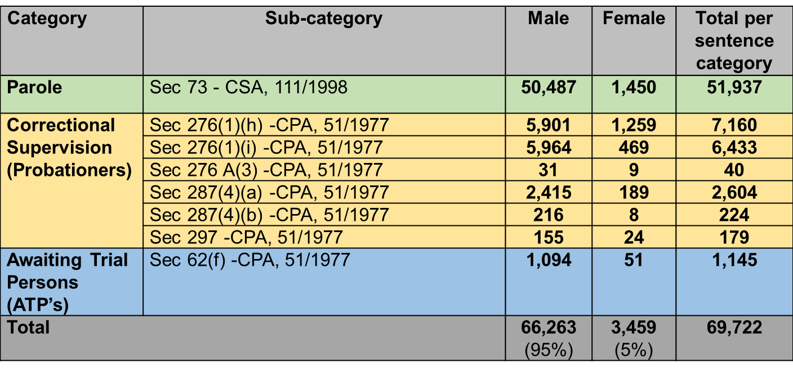
Number of offenders under the Community Corrections System

Slide 51
Key Activities/Projects
Monitoring of offenders (Probationers, Parolees & Awaiting Trail Persons) under the system of Community Corrections
Electronic Monitoring (EM) Programme
Halfway Houses
Employability of Probationers / Parolees
Restorative Justice (VOD’s / VOM)
Formalization of Partnerships
Promotion of alternative / non-custodial sentencing
Establishment of Community Safety Forums
Community Profiling
Establishment of Offender Desks

Slide 52
Restorative Justice
The purpose of this programme is to orientate and exposed offenders to the Restorative Justice Programme.
The programme is meant to assist the offender to have an understanding of the basic concepts in Restorative Justice.
To empower the offender in understanding the effects and impact of crime to themselves, their families, victims and communities.
The Restorative Justice orientation programme becomes compulsory if it is scheduled in the offender’s Sentence Plan.
To promote healing and restoration of relationships amongst offenders, families, victims and communities, whilst at the same time correcting offending behaviour.
The Department since 2012 has committed itself in reviewing its approach on RJ by introducing VOD with the aim of placing victims at the centre of its activities.
The victim is afforded an opportunity to express voluntary desire to engage the offender and seek answers like how and why crime happened
In addressing the participation of victims in our activities the Department have contracted 63 Auxiliary Social Workers to trace and prepare victims.
We have seen an increase in victim participation hence to date 3956 victims and 2595 offenders have participated in the RJ programme.

Slide 53
Family Involvement
During the Confirmation of address and undertaking for care, families / relatives / friends / employer of the offender must be consulted with regard to the address confirmation and undertaking for care. The reintegration case official must:
visit the family/relatives/friends/employer of offender physically to confirm the existence of the address and verify the stability factors;
get consent from the owner of the property e.g. farmer/ employer;
clarify roles and responsibilities of the family/relatives/ friends/employer with regard to the undertaking for care;
procure written undertaking from family/relatives/friends who will take care for the offender and also include the identity number (including Section 114 of the Correctional Services Act, Act 111 of 1998).
supply the family/relatives/friends of the offender with brochures on release preparation and correctional and/ or parole supervision.

Slide 54
Orientation and confirmation of conditions
Upon admission at community corrections, the Head of Community Corrections or the delegate must orientate and induct offenders by explaining the following:
The Offender Rehabilitation Path (ORP)
Orientation / Reorientation in terms of the correctional sentence plan
The correctional supervision and / or parole supervision conditions
Consequences of non-compliance with set conditions
Involvement of family / relatives / friends / care giver
Referral to service providers for employability and skills training
Information about services available
Complaints and request procedure
Provide a copy of the orientation booklet to the offender (probationer / parolee.
The offenders must sign on the G444-form (acknowledgement of conditions) for receipt of the booklet and orientation received.

Slide 55
Case Management in Community Corrections
Section 58 of the Correctional Services Act, 1998 (Act 111/1998) makes provision for the establishment of a Supervision Committee at each community corrections office
The Supervision Committee must review, evaluate and update the correctional sentence plan at least every six months / or more frequently depending on the length of sentence
There are 218 Community Corrections offices Nationally

Slide 56
Stages 8 & 9 of the Offender Rehabilitation Path (ORP) in Community Corrections
1. Pre-Admission (8) / Pre-sentence (9)
12. Release
CASE MANAGEMENT
2. Admission at community corrections
11.Effecting instructions/recommendations by Head Community Corrections
Process during which the progress of the offender ito CSP is monitored and ammended
Offender
3. Assessment / Re-assessment and risk classification / profiling
10. Review of CSP
4. Development / Implementation of Correctional Sentence Plan
9 Progress review
8. Supervision Committee evaluation (6 monthly progress & reclassification)
7. Execution of CSP. Monitoring and evaluation
6. Implementation of correctional sentence plan supervision
5. Head of community corrections approves CSP

Slide 57
Legislative Mandates for Electronic Monitoring
The system of Electronic Monitoring is considered as a condition for correctional supervision not as alternative sentence.
As a condition or in lieu of bail.
As a condition of early release from incarceration
As a risk mitigation for parolees and probationers posing significant risk
Implementation of Electronic Monitoring is mandated by the following legislations:
The Correctional Services Act, 1998 (Act 111 of 1998),
  Section 52 (1) (p) – Monitoring
  Section 68 (1) – Electronic Monitoring
DCS Regulation 28 – Electronic Monitoring

Slide 58
Legislative Mandates for Electronic Monitoring cont…
Section 52(1)(p) of the Correctional Services Act, 1998 (Act 111 of 1998) authorises the Department of Correctional Services to subject a person to monitoring.
Section 68 of the Correctional Services Act, 1998 (Act 111 of 1998) reads as follows:
  (1) Where a condition of monitoring is set in terms of section 52 (1)(p) , it must specify the form of monitoring .
  (2) If such monitoring involves the use of electronic monitoring
  The Correctional Services Regulation (Regulation 28) states: “The Electronic Monitoring device must be compact, unobstructive (obscured, covered and hidden) and allow persons under community corrections as far as possible to carry out normal activities. The Electronic Monitoring device must be fitted to the ankle or wrist without causing a risk to the person’s health” .
  Such devices must to conform to the Independent Communications Authority of South Africa (ICASA) standards and a valid Equipment Type Approval Certificate(s) must be provided to the DCS.

Slide 59
Progress On Electronic Monitoring Programme
Electronic Monitoring Pilot Project ( EMPP) was introduced to assist in mitigating the risk posed by the release of the so called ‘Van Vuuren’ Lifers.
DCS introduced Electronic Monitoring Pilot Project for the lifers over a period of twelve (12) months, with the intention to roll-out the intervention as a permanent solution. EM programme for offenders was piloted on the 28 March 2012
DCS targeted 150 offenders during EMPP and the total number of 288 offenders were tagged during the pilot project. Electronic Monitoring Programme was rolled out on the 01July 2014.
The total number of 511 offenders were tagged and all categories eligible for EM were targeted.
DCS entered into a supplier contract agreement with Engineered Systems Solutions (ESS) for the acquisition, storage, distribution, installation, commissioning; inspection management and maintenance of EM equipment, software and services for a period of twelfth (12) months
EM is currently available to the courts , particularly remand detainees and parolees.
  Setting of placement conditions of EM by relevant authorities ( i.e Court/CSPB / Minister) is discussed in consultation with CMC and Community Corrections to ensure availability of tags
Currently, a total number of 774 persons are actively tagged as at 05 October 2016 and 2278 were cumulatively tagged since inception
114 spare tags are in the Regions for re-use, 48 buffer stock available at Services Provider and 64 sent for repairs.

Slide 60
Assistance with obtaining work (Employability of Parolees and Probationers)
The Department of Correctional Services has made some inroads though not sufficient.
The Department engaged the following institutions:
- Department of Environment Affairs
- Department of Public Works
- Kishugi group ( Implementing agent for Working on Fire)
- Nunnovation Foundation for Africa
- New Life after Prison
-Fear Free Life

Slide 61
Partnerships with Stakeholders
Department of Correctional Services has formalised partnerships with relevant stakeholders such as NPOs, Institutions of Higher learning and other government departments for the employability and successful reintegration of parolees and probationers.
The DCS has also entered into agreement with institutions of higher learning to utilise students to conduct community profiling within communities.

Slide 62
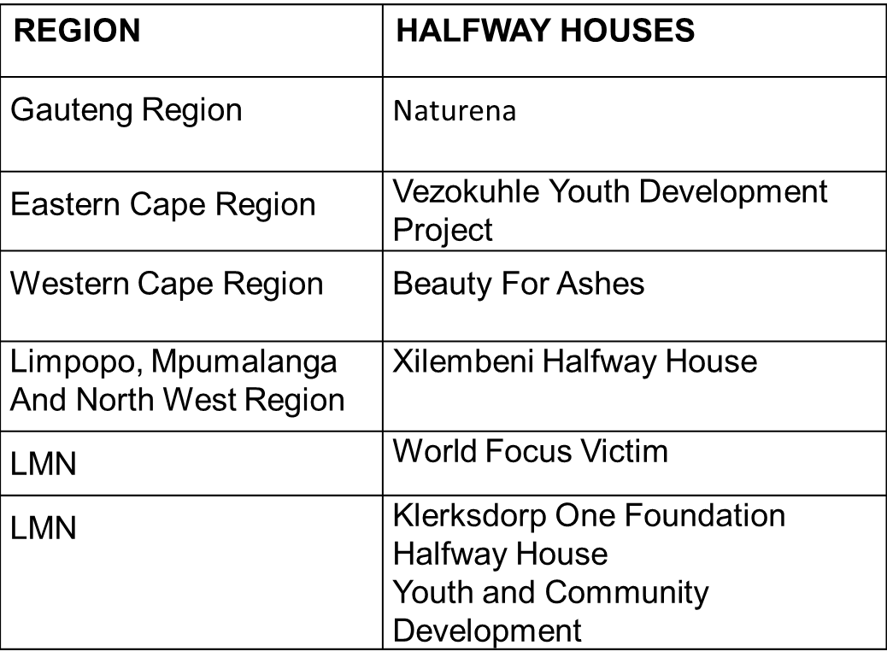
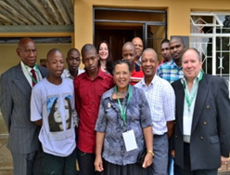
Halfway Houses

Slide 63
Service Points
According to Batho Pele principles, access to information should be made available to the people.
Department has established service points in order to bring community corrections services closer to the communities where the offenders are residing.
Since the establishment of service points, the number of violations have significantly decreased resulting in adherence to parole conditions by offenders.
It has been evident by seeing 98% of probationers without violations against the target of 96% and 98% of parolees without violations against the target of 97%.
By the end of August 2016 the Department managed to establish 105 new Service Points nationally.

Slide 64
Community Profiling
To draw a full picture of communities where offenders come from.
This is done in order to identify resources and opportunities that are available within various communities.
To expand the base for community support for offenders that return to the community to enhance smooth reintegration (e.g job opportunities and employment).
The department has entered into agreement with Institutions of Higher learning to assist in profiling communities.

Slide 65

Thank You
Thank You

