Slide 1
Support given to community radio stations
Presentation to Portfolio Committee on Communications
2 November 2016

Slide 2
MDDA Mandate
.

Slide 3
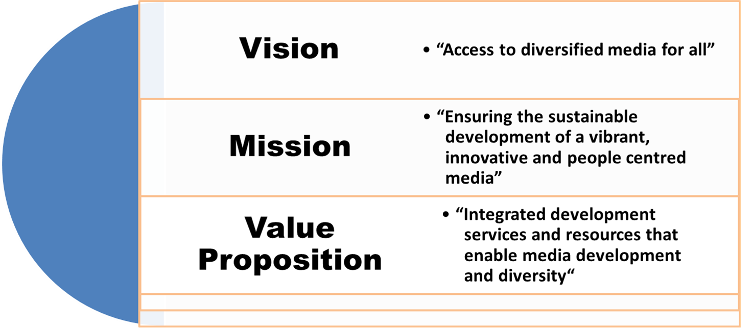
MDDA Vision, Mission and Values

Slide 4
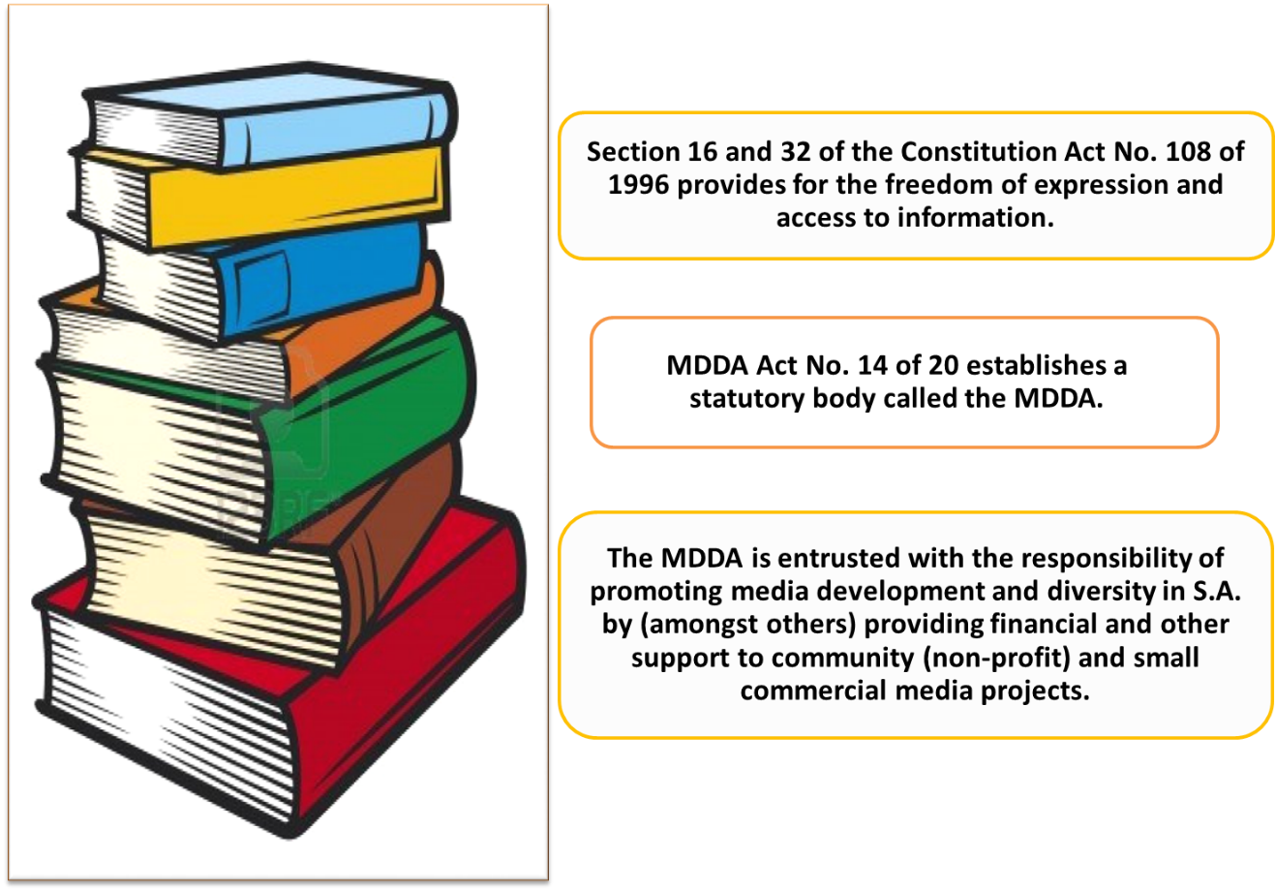
MDDA Regulatory & Legislative Framework
MDDA ACT No. 14 of 2002 establishes a statutory body called the MDDA

Slide 5
MDDA vs ICASA Mandate
The Media Development and Diversity Agency Act, 2002, no. 14 of 2002, stipulates that the nature of support provided by the Agency to community broadcast projects may be, inter alia, in the form of
(a) financial support;
(b) training opportunities and capacity development in all areas of media.
The Independent Communications Authority of South Africa Act, Act no. 13 of 2000, as amended gives ICASA the power to grant; renew; amend; transfer; and revoke licences.

Slide 6
Breakdown of community radio stations funded by the MDDA per province

Slide 7
Breakdown of community radio stations funded by the MDDA per province
20
16
13
13
8
19
5
12
18

Slide 8
MDDA Projects per District Municipality
FREE STATE
* | Name of Project | District / Metro
1 | Motheo FM | Motheo
2 | Qwa Qwa CR | Thabo Mofutsanyana
3 | The Rock CR | Lejweleputswa
4 | Setsoto CR | Thabo Mofutsanyane
5 | Karabo FM | Fezile Dabi
6 | Naledi FM | Thabo Mofutsanyana
7 | Koepel Stereo | Fezile Dabi
8 | Mozolo FM | Fezile Dabi DM
EASTERN CAPE
# | Name of Project | District / Metro
1 | Takalani CR | UKhahlamba
2 | Lukhanji CR | Chris-Hani
3 | Alfred Nzo CR | Alfred Nzo
4 | Ekhephini CR | Joe. Gqabi
5 | Forte CR | O.R Tambo
6 | Radio Unique | UKhahlamba
7 | Vukani CR | Chris Hani
8 | Radio Graaff Reinett | Cacadu
9 | Bay FM | Nelson Mandela
10 | Inkonjane CR | O.R Tambo
11 | Kouga FM | Cacadu
12 | Izwi Lethemba Christian Community Radio | Buffalo
13 | Lathi-Thaa CR | Joe Gqabi
14 | Kumkani FM | Buffalo City
15 | Mdantsane CR | Buffalo City
16 | Rhodes Music Radio | Cacadu
17 | Ngqushwa CR | Amathole DM
18 | Isajonisi Y Radio | OR Tambo DM

Slide 9
MDDA Projects per District Municipality
GAUTENG
# | Name of Project | District / Metro
1 | Thetha FM | City of JHB
2 | Voice of Thembisa CR | Ekurhuleni
3 | Alex FM | City of JHB
4 | Kasie FM | Ekurhuleni
5 | Eldos FM | City of JHB
6 | Ekasi Konexion | Ekurhuleni
7 | Hweletsa Hope FM | Greater Sedibeng
8 | Tshwane University of Technology | City of Tshwane
9 | Tshwane Community TV | City of Tshwane
10 | Bagaka | City of Thswane
11 | Mams FM | City of Tswane
12 | Poort FM | City of Tshwane
13 | West Side FM | West Rand DM
14 | Mogale FM | West Rand
15 | VUT | Sedibeng DM
16 | Sefako Magkatho | City of Tshwane
LIMPOPO
# | Name of Project | District / Metro
1 | Mokopane CR | Waterberg
2 | Sekhukhune CR | Greater Sekhukhune
3 | Botlokwa CR | Capricorn
4 | Makhado CR | Vhembe
5 | Greater Lebowakgomo CR | Lepelle Nkumpi
6 | Tubatse CR | Sekhukhune
7 | Thabazimbi Community Media Resource | Waterberg
8 | Greater Tzaneen CR | Greater Tzaneen
9 | Phalaborwa CR | Mopani
10 | Blouberg CR | Capricorn
11 | Moletjie CR | Capricon
12 | Malamulele CR | Vhembe
13 | Sekgosese CR | Mopani
14 | Moutse CR | Capricon
15 | Mohodi CR | Molemole
16 | Radio Turf | Capricon
17 | Radio Zebediela | Capricon
18 | Greater Giyani CR | Greater Giyani
19 | Waterberg Stereo | Waterberg DM
20 | Masemola CR | Greater Sekhukhune

Slide 10
MDDA Projects per District Municipality
KWAZULU-NATAL
# | Name of Project | District / Metro
1 | Newcastle CR | Amajuba
2 | Maputaland CR | Umkhanyakude
3 | Inanda CR | EThekwini Metro
4 | Vibe FM | EThekwini Metro
5 | ICORA | King Cetshwayo DM
6 | Radio Sunny South | Ugu DM
7 | Zululand CR | Zululand DM
8 | Shine FM | King Cetshwayo DM
9 | UMgungundlovu CR | Umgungundlovu DM
10 | Highway Radio | EThekwini Metro
11 | Ugu Youth Radio | Ugu DM
12. | Radio Khwezi | Umzinyathi DM
13 | Nquthu FM | Umzinyathi DM
14 | Siyathuthuka CR | Illembe DM
15 | Nongoma CR | Zululand
16 | KZN Capital | Umgungundlovu
17 | One KZN formerly Bay TV | King Cetshwayo DM
18 | Nqubeko CR | Uthukela DM
19 | Pongola CR | Zululand DM
MPUMALANGA
# | Name of Project | District / Metro
1 | Bushbuckridge CR | Ehlanzane
2 | Barberton CR | Ehlanzane
3 | Kanyamazane CR | Mbombela
4 | Emalahleni FM | Nkangala
5 | Greater Middleburg FM | Nkgangala
6 | Mkhondo CR | Gert Sibande
7 | Nkomazi FM | Ehlanzeni
8. | Kangala CR | Enkangala
9 | Mash FM | Ehlanzeni
10 | Ikuthani FM | Engangala DM
11 | Inakekelo FM | Enkangala DM
12 | Hope FM | Nkangala DM
13 | Ermelo CR | Gert Sibande

Slide 11
MDDA Projects per District Municipality
NORTH WEST
# | Name of Project | District / Metro
1 | Aganang CR | Dr Kenneth Kaunda
2 | Star FM | Dr Kenneth Kaunda
3 | Radio Mafisa | Bojanala Platinum
4 | Kopanong CR | Ngaka Modiri Molema
5 | Letlhabile CR | Bojanala
6 | Modiri FM | Ngaka Modiri Molema
7 | Motsitle CR | Bojanala
8. | Mmabatho CR | Ngaka Modiri Molema
9 | Vaaltar CR | Dr. Ruth Segomotsi Mompati
10 | Village FM | Bojanala
11 | Bojanala FM | Bojanala DM
12 | Kgatleng CR | Moses Kotane DM
13 | Madibogo CR | Ngaka Modiri Molema DM
WESTERN CAPE
# | Name of Project | District / Metro
1 | Bush Radio | City of Cape Town
2 | Franschhoek FM | Cape Winelads
3 | Radio Atlantis | Blaauwberg
4 | Whale Coast FM | Overstrand
5 | Gamkaland CR | Beauforf West
6 | Eden FM | George
7 | Radio Kaapse Punt | City of Cape Town
8 | Cape Town TV | City of Cape Town
9 | MFM | Cape Winelands
10 | Radio Namakwaland | West Coast
11 | Radio Zibonele | City of Cape Town
12 | Brandvlei Correctional Centre | Winelands DM
NORTHERN CAPE
# | Name of Project | District / Metro
1 | NFM | Namakwa
2 | Kurara FM | John Taolo Gaetsewe
3 | Radio Teemaneng | Frances Baard
4 | Radio Riverside | ZF Mgcawu DM
5 | Revival FM | Frances Baard

Slide 12
Stakeholders and Partners
Strategic partnerships with stakeholders targeted at implementing MDDA mandate:
Sector Industry bodies
National Community Radio Forum (NCRF) – Partner on National Policy Conference
Association of Community Televisions of South Africa (ACTSA) – Empowerment, capacity building, lobbying and advocacy
Association of Independent Publishers (AIP) - Empowerment, capacity building, lobbying and advocacy
National Association of Broadcasters (NAB) - Empowerment, capacity building, lobbying and advocacy
.
Regulatory Bodies
Independent Communications Authority of South Africa (ICASA) – Liaise/partner on regulatory issues regarding community broadcasting

Slide 13
Stakeholders and Partners
Signal Distributor
SENTECH – MoU in progress on affordable signal distribution costs for community broadcasting
Skills Development Agencies
SETAs - Media Information and Communication Technologies Sector Education and Training Authority (MICT-SETA) and The Fibre Processing and Manufacturing SETA (FP&M SETA) – Accredited and quality training
SEDA - Small Enterprise Development Agency
Soul City
Tertiary Institutions – Accredited and quality training
Institute of Advanced Journalism ( IAJ) – Accredited and quality training
South African Agency for Science and Technology Advancement (SAASTA ) - MoUs with Limpopo Small Commercial Media and Community Radio on pilot project on science reporting in indigenous languages and science education content

Slide 14
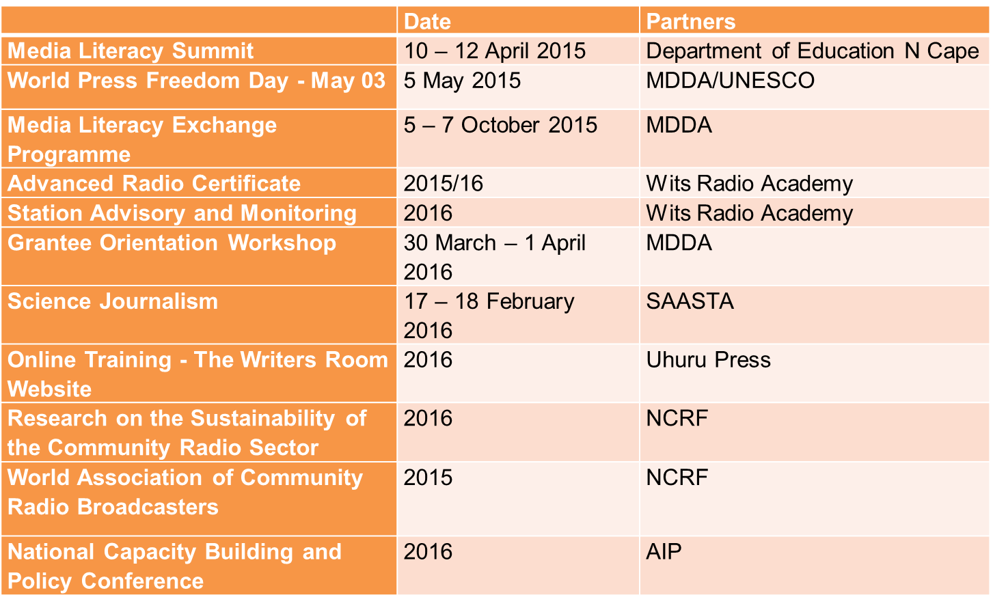
Overview of Research, Training and Development – 2015/2016

Slide 15
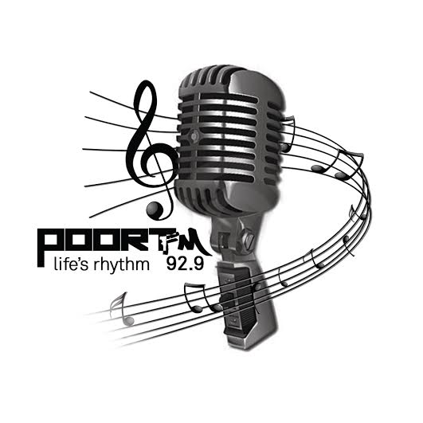
Thank you

