Slide 1
PRESENTATION TO THE PORTFOLIO COMMITTEE ON PUBLIC WORKS
CBE ANNUAL REPORT 2015/16
Priscilla Mdlalose (Acting CEO)
01 November 2016

Slide 2
CBE Delegation
Mr Isaac Nkosi – CBE Chairperson
Ms Priscilla Mdlalose– Acting Chief Executive Officer
Mr Clifton Changfoot – Chief Financial Officer

Slide 3
Presentation Structure
Purpose of the Presentation
Vision and Mission of CBE
Contextual Overview
  Legislative Mandate
  Background to Strategic and Annual Planning Processes
  Strategic Goals of the CBE
  Description of Programmes
Performance Report
Governance Review
Financial and Audit report
Report on Activities of Professional Councils
Conclusion

Slide 4
Purpose of the Presentation
To account to the Portfolio Committee of the CBE and the six Built Environment Professional Councils (BEPCs) Performance during the 2015/16 financial year as per the commitments made in the 2014-2019 CBE Strategic Plan and 2015/16 Annual Performance Plan.

Slide 5
  Vision and Mission of CBE
Vision
An environment built to meet people’s needs and aspirations.
Mission
Implementing projects and programmes that address built environment issues and add value to the built environment professions, Government and the general public.

Slide 6
Contextual Overview

Slide 7
Legislative Mandate
The CBE and Professional Councils have 13 concurrent functions delegated to them by the Council for the Built Environment Act (Act No. 43 of 2000), these are:
Identification of Work
Guideline Professional Fees
Continuous Professional Development
Accreditation of Built Environment Programmes
Code of Conduct for the Professions
Professional Registration
Recognition of Voluntary Associations
Recognition of New Professions
International Agreements
Recognition of Prior Learning
Standard Generating
Appeals and Tribunals
Competency Standards for Registrations

Slide 8
Other Legislation
Constitution of the Republic of South Africa of 1996 (Act No. 108 of 1996)
Consumer Protection Act, 2011
Construction Industry Development Board Act, 2000
Council for the Built Environment Act, 2000; Architectural Profession Act, 2000; Landscape Architectural Professional Act, 2000; Engineering Profession Act of South Africa, 2000; Project and Construction Management Profession Act, 2000; Quantity Surveying Profession Act, 2000; and Property Valuers Profession Act, 2000
Public Finance Management Act, 1999
Skills Development Act (No. 97 of 1998)
Employment Equity Act, 1998
Promotion of Administrative Justice Act, 2000
Promotion of Access to Information Act, 2000
Minimum Information Security Standards
Occupational Health and Safety Act, 1993
National Treasury Regulations
National Archives of South Africa Act, 1996
Construction Charter
Property Charter

Slide 9
  Background to Strategic and Annual Planning Processes
The CBE 2014-19 Strategic Plan was informed by the Strategic Review Session held by the CBE Council in October 2014
The following key policy documents and stakeholder engagements informed discussions:
  CBE’s mandate derived from the CBE Act of 2000,
  National Development Plan (Vision 2030)
  Updated Government’s medium-term strategic framework document
  2015 State of the Nation Address,
  Outline of the Dept of Public Works Minister’s key priorities
  The 2015 National Budget and appropriation for 2015/16
  Inputs from the Built Environment Professional Councils

Slide 10
Strategic goals of the CBE
A Built Environment that is responsive to the developmental and economic priorities of Government;
A transformed Built Environment with appropriate, adequate skills and competencies, responsive to the country’s infrastructure delivery, operation and maintenance needs;
An optimally functioning Built Environment, with a responsive and relevant policy and legislative framework, based on informed and researched positions; and
Built Environment Professionals that operate within a regulated policy and legislative framework.

Slide 11
Description of programmes
Programme | Programme objectives
1. Government Policies and Priorities | To ensure that the CBE has necessary capacity and capability to support Government’s development priorities within the built environment, including infrastructure delivery programme, health and safety in construction, environmental sustainability and job creation.
2. Skills for Infrastructure Delivery | Drive and facilitate skills development and transformation within the built environment.
3.BE Research, Information and Advisory | To provide research, knowledge and information on BE issues pertinent to BE professionals, DPW, and BE issues impacting on service delivery and the economy.
4. Regulation and Oversight of six BEPCs | To act as an appeals body on matters of law referred to CBE in terms of legislation regulating the BE professions, and to promote and ensure high standards of professional ethics and conduct within the built environment.

Slide 12
Performance Report

Slide 13
CBE Performance Highlights
The 2015/16 APP had 22 deliverables
73% of the targets were achieved
23% were partially achieved,
4% was not achieved.
The partial and non-achievement of targets were due to the dependency on external stakeholder endorsement.
Achievement of an unqualified audit opinion for 2015/16

Slide 14
PROGRAMME 1 – Government Policies and Priorities
Programme 1 had five targets, of which four were partially achieved and one was achieved.
The partial achievement of the targets were as a result of the Council of Higher Education (CHE) not endorsing the framework, citing that it was outside their mandate to do so.
The highlight of Programme 1 was the development of the framework on modalities to incorporate health and safety in construction, environmental sustainability, job creation through labour intensive construction and the IDMS in BE curricula
Engagements were held with the Office of the Chief Procurement Officer to formalise partnerships on IDMS training, as well as on roll out of the new Standards for Infrastructure Procurement and Delivery Management (SIPDM).

Slide 15
PROGRAMME 2 – Skills for Infrastructure Delivery
Programme 2 achieved all five of its planned targets
150 Grade 10-12 students were assisted with a Maths and Science support programme in Kimberley. Mobile Science Lab was donated for the learners and teachers in the Northern Cape Department of Education
60 candidates and 154 interns were placed in Workplace Integrated Learning
CBE participated in 12 accreditation visits to ensure consistent application of Accreditation policy by professional councils and to assess the gaps amongst the BE educational institutions
Establishment of a Transformation Steering Committee to drive Transformation initiatives within the BE

Slide 16
PROGRAMME 3 – BE Research, Information and Advisory
Programme 3 had five targets, of which four were achieved and one was partially achieved.
The partial achievement of the one target was due to the delayed appointment of the technical expert
The highlight of this Programme was the development of the following:
A report on the existing Maths and Science support programmes within the Built Environment Professional Councils (BEPCs);
The final research report on the profile of the BE technical professionals employed at National and Provincial departments as well as state owned entities;
The formulation of recommendations and an advisory report to the Department of Public Service and Administration (DPSA) on the Occupational Specific Dispensation (OSD); and
A report on the first phase research on the viability of a Government infrastructure agency.

Slide 17
PROGRAMME 4 – Regulation and Oversight of six BEPCs
Programme 4 achieved six targets out of seven that were planned for the year
The reason for the non-achievement of the one target was that the professional councils did not submit their Strategic Plans and APPs on time, to allow for their evaluation by the CBE.
The highlights of Programme 4:
Research on international benchmarking of the identification of work (IDoW).
Monitoring and evaluation of the BEPCs’ compliance with CBE’s Corporate Governance Framework was done
Workshop with the BEPCs and the Department of Public Works (DPW’s) Policy Unit on the Ministerial approved policy frameworks was successful
Appeals were concluded within the statutory required time limit.

Slide 18
Governance Review

Slide 19
Governance Review
The CBE Council is the Accounting Authority as per section 49 of the Public Finance Management Act, (no. 1 0f 1999) (PFMA)
The CBE Council reports to the Minister of Public Works (who is the Executive Authority)
The Accounting Authority assumes responsibilities as mandated by the CBE Act.
The Accounting Authority also discharges this responsibility in line with provisions of section 51 of the PFMA In line with good governance (as per the King III Report) and in ensuring the Accounting Authority fulfills its roles as mandated, the following statutory and governance committees were established:

Slide 20
Governance cont.
Executive Committee (Exco)
A Council Working Committee constituted in terms of section 12 of the CBE Act with a responsibility of ensuring that all Council resolutions are carried out
Finance, Human Resources and Legal Committee (FHLC)
Responsible for the human resources issues and accordingly plays the role of Human Resource Committee
Audit and Risk Committee
The audit committee was constituted in line with requirements of the PFMA and Treasury Regulations, with 2 of the 4 members being external members. The key focus areas of the committee were internal control and Risk Management. Performs the function of the audit committee as set out in the PFMA and the Treasury Regulations.

Slide 21
Governance cont…
Council received two resignations from Ms AA Steyn (representing SACLAP on the Council) and Ms NF Sithole on 02 February 2016 and 10 February 2016 respectively.
Ms NF Sithole resigned as Deputy Chairperson of Council, but will stay on as a Council member.
The Council received nominations from SACLAP, as required by the Act, which were recommended to the Minister.

Slide 22
Committees Composition and meetings

Slide 23
Financial and Audit Report

Slide 24
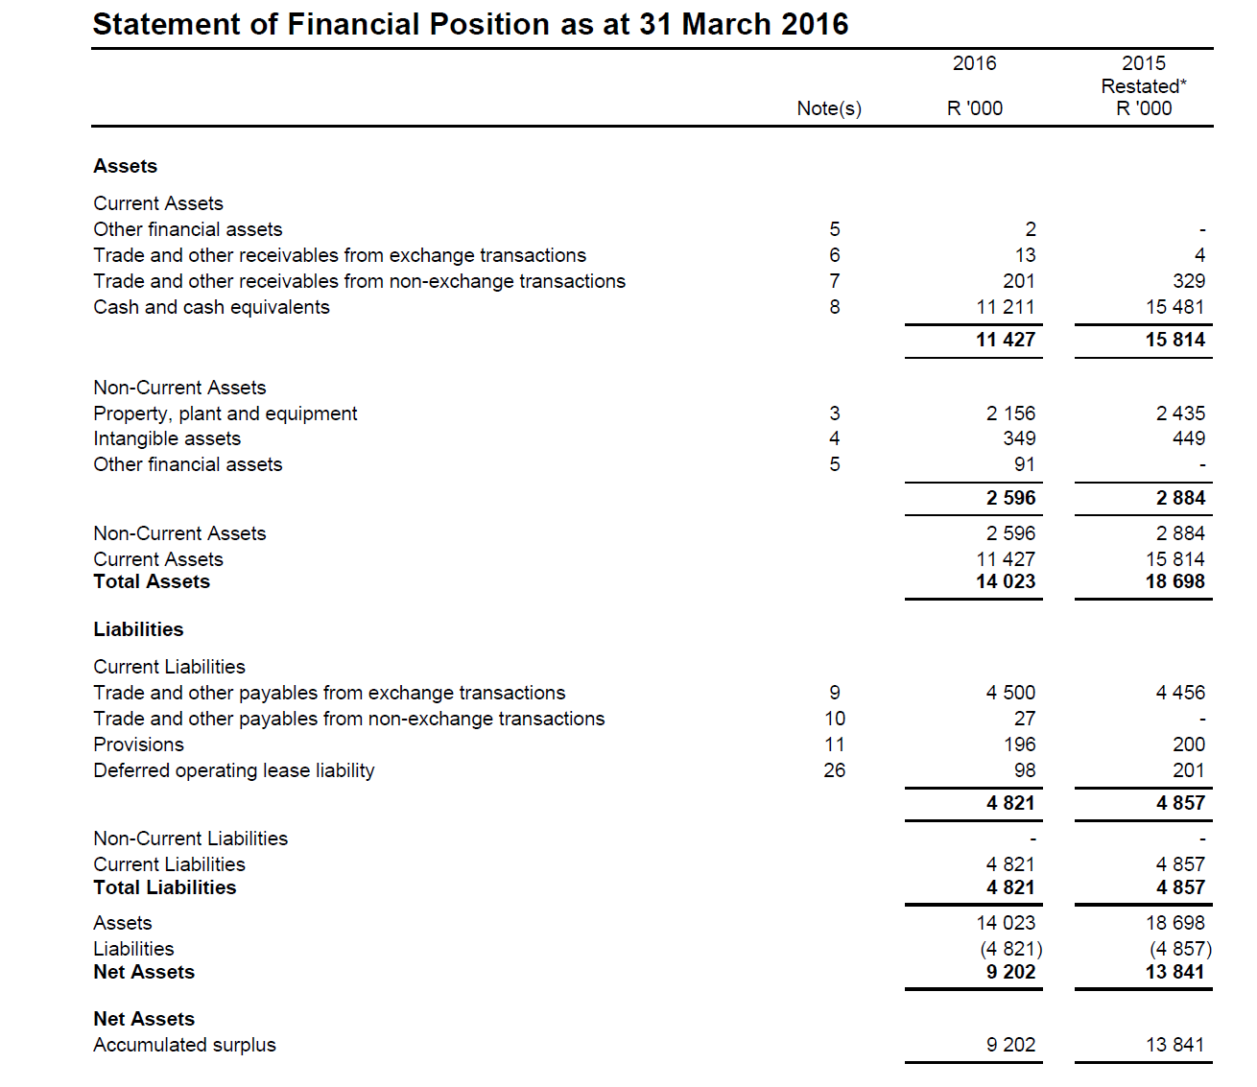
Analysis of Financial Statements

Slide 25
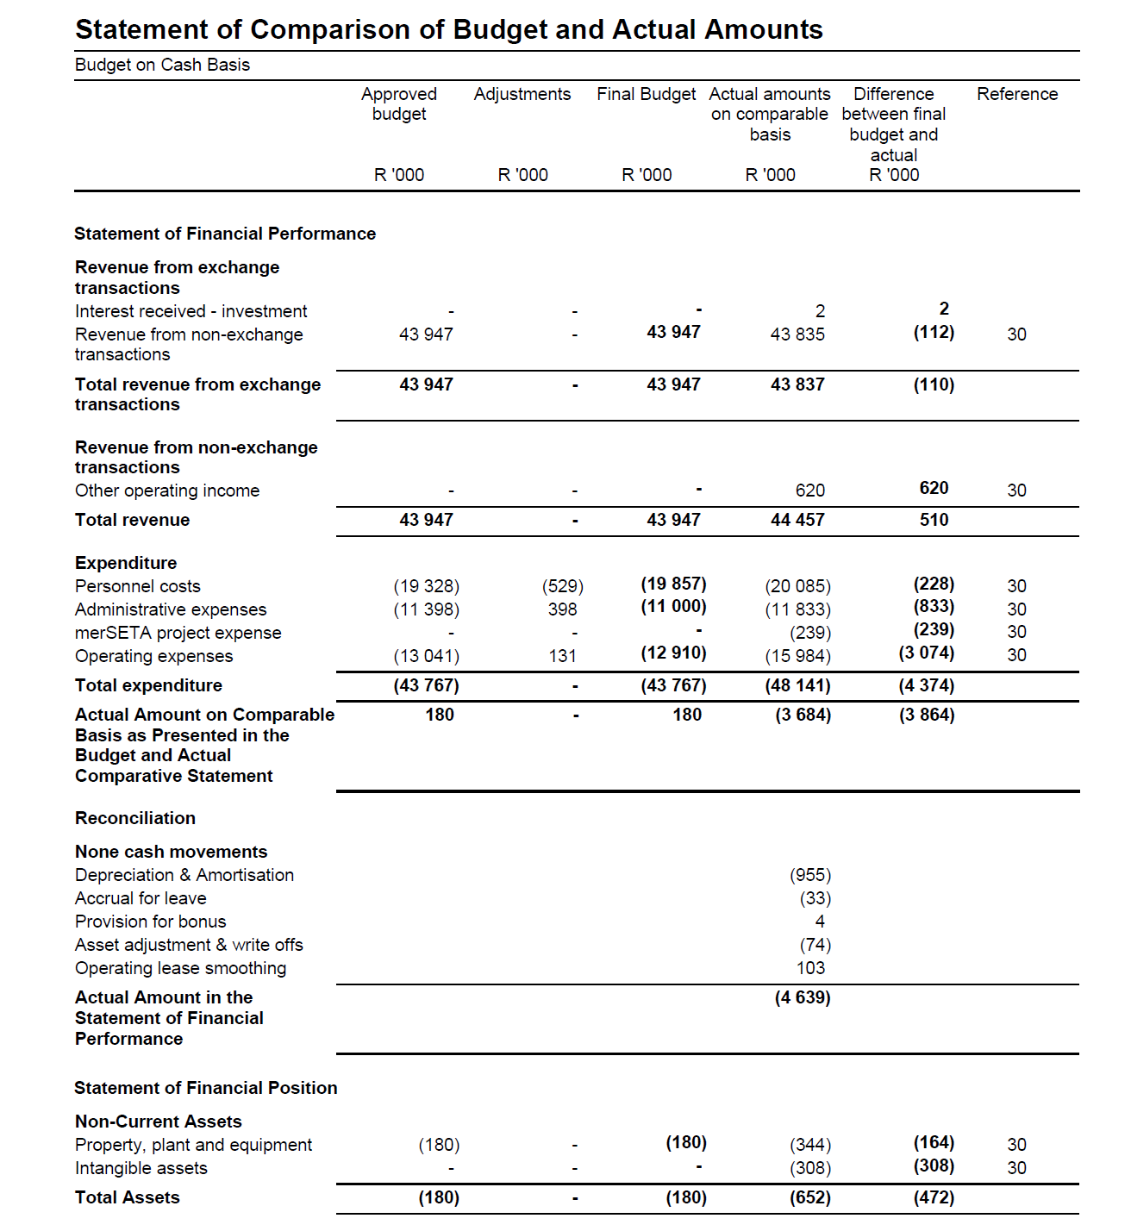
Comparison of Budget & Actual amounts for year ending 31 March 2016

Slide 26
AUDITORS REPORTS
2015/16

Slide 27
Audit Report – 2015/16
Performance Report issues
Achievement of planned targets
Adjustment of material misstatements

Slide 28
Compliance with Legislation
Annual Financial Statements
Material misstatements of non-current assets, current liabilities and disclosure items identified by the auditors in the submitted financial statement were subsequently corrected, resulting in the financial statements receiving an unqualified audit opinion.
Expenditure Management
The accounting authority did not take effective steps to prevent irregular expenditure
Internal Control
Management did not have adequate review and monitoring processes in place in certain instances

Slide 29
Compliance cont…
Investigations
A disciplinary process against the CEO is in progress
A disciplinary process was instituted against the former supply chain management. A criminal case has been opened and was still on-going at the time of the Audit report

Slide 30
Human Resource Report

Slide 31
Personnel cost by salary band

Slide 32
Equity Target and Employment Equity Status
All demographic areas have been fulfilled with the exception of the Coloured female, African male staff and disabled persons representation.

Slide 33
Equity cont…

Slide 34
Report on Activities of Professional Councils

Slide 35
South African Council for the Landscape Architectural Profession (SACLAP)
SACLAP is the smallest of the BEPCs with a total of about 260 registered persons.
SACLAP, with this limited base of registered persons, strives to meet the same mandates, set out in the BEPC Acts, as the bigger councils with the limited resources available.
SACLAP, in terms of the Landscape Professions Act, Act 45 of 2000, appoints a Council of ten (10) members. Due to the fact that a replacement member could not be appointed on time, it operated with nine (9) members in the 2015–2016 financial year.

Slide 36

Performance Highlights - SACLAP
Registration
  The Professional Registration Assessment process was successfully undertaken.
  The Recognition of Prior Learning (RPL) process was embarked upon and concluded.
  The five year Continuing Professional Development (CPD) review of individuals, who needed to renew their registration was undertaken with a 100% compliance being attained.
Education
  The review of the Higher Education Policy, Education Standards and Accreditation Procedure commenced and was finalised.
  Preparations began for the CPUT accreditation visit.
  The Self Evaluation Report template was reviewed.
  The Checklist for the Education Standards was generated.
  The list of programmes earmarked as potential future feeder programmes was expanded and the institutions engaged with.
  The Academic Forum was established to improve the synergy between SACLAP and higher education institutions that offer feeder programmes to the professional registration categories.

Slide 37
Performance cont…SACLAP
Professional Practice
  SACLAP continued to participate in the deliberations with the Competition Commission regarding Identification of Work (IDOW) and the publishing of Guideline Professional Fees.
  The Voluntary Association Policy went through a successful review process.
  The CPD Policy was also reviewed and aligned with the DPW framework.
  The new registration category process for the Landscape Management Profession continued and progress was made in terms of the Registration Procedure, the required core competencies and the weighting of such upon graduation and professional registration. It will be gazetted for public comment early in the next financial year. Implementation is also anticipated in 2016 – 2017.
Finance committee
  SACLAP established a Procurement Policy.
  Updated the rates applicable to the services that SACLAP renders and followed the procedure in terms of implementing such.

Slide 38
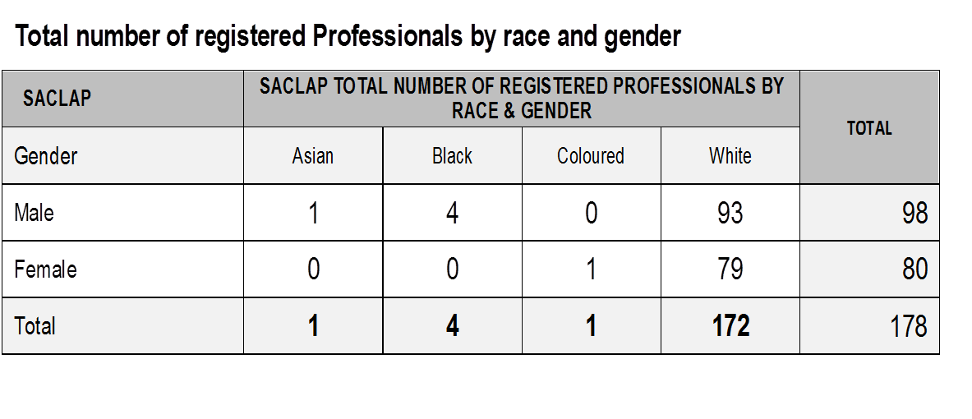
Professional Registration- SACLAP

Slide 39
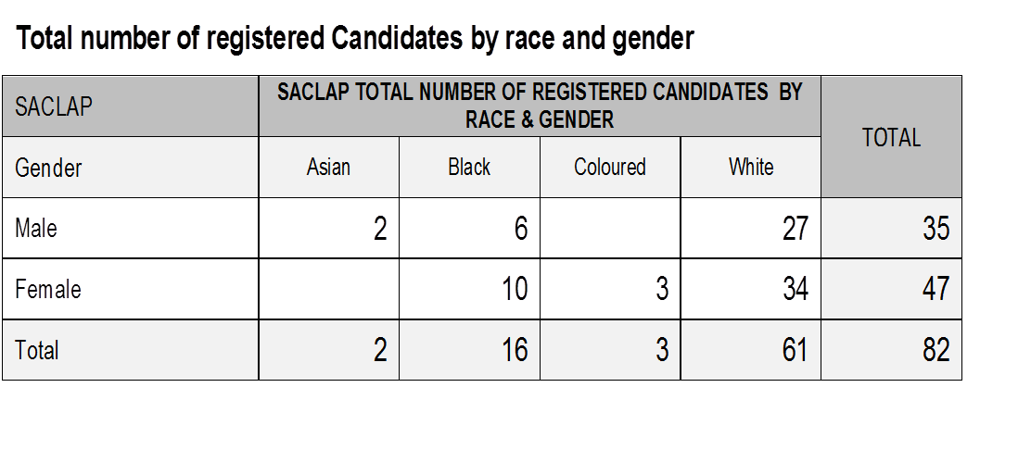
Candidates- SACLAP

Slide 40
SOUTH AFRICAN COUNCIL FOR THE PROPERTY VALUERS PROFESSION (SACPVP)
Council’s composition: Six registered persons; Two professionals working for the State; and two members of public nominated through an open process

Slide 41
Performance Highlights-SACPVP
During the 2015/16 financial year SACPVP almost concluded the development of municipal valuation standards
The standards are now being tested against the standards of the International Association of Assessing Officers (IAAO)
The standards will be rolled out to metros and local governments or municipal districts after securing appropriate budget from Local Government SETA (LGSETA)
LGSETA also assisted SACPVP with the development of a Municipal Property Assessor qualification to assist in the implementation of the Local Government: Municipal Property Rating Act, 2004 (Act No. 6 of 2004). National CoGTA and KZN CoGTA were the main partners in this initiative
Quality Council for Trades and Occupations (QCTO) recently published the qualification for public comment
Service providers to be nominated to offer the qualification (SACPVP and LGSETA)

Slide 42

Professional Registration-SACPVP

Slide 43

Candidates-SACPVP

Slide 44
ENGINEERING COUNCIL OF SOUTH AFRICA (ECSA)
Council consists of 50 members as follows:
Section 3(1)(a) – thirty (30) registered persons.
Section 3(1)(b) – ten (10) persons in state service.
Section 3(1) (c ) - ten (10) members of the public
ECSA Council has 44 committees with delegated functions to enable the execution of ECSA mandate.

Slide 45
Performance Highlights-ECSA
6 accreditation visits conducted
100% compliance with the requirements for the international accords and standards
Host Africa Engineering Week according to plan and support the international Event
Revised Voluntary Association recognition framework
15 000 learners reached through Engenius information session

Slide 46

Professional Registration -ECSA

Slide 47
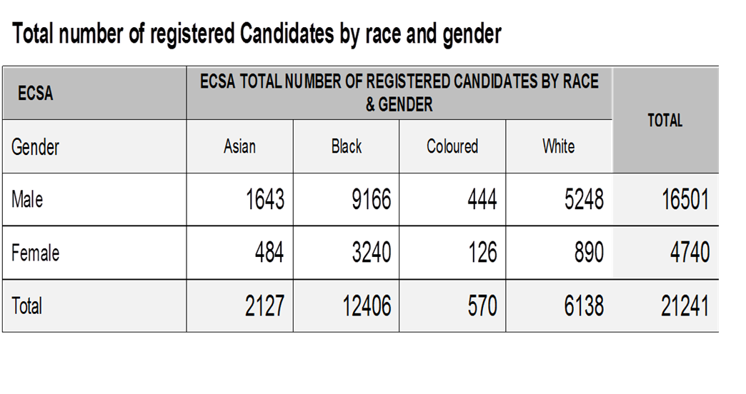
Candidates -ECSA

Slide 48
SOUTH AFRICAN COUNCIL FOR THE QUANTITY SURVEYOR PROFESSION (SACQSP)
17 members appointed by the Minister of Public Works
Committees
EXCO members
Finance Committee (FINCOM); Education, Standards and Research Committee (ESR);
Registration Committee (REGCOM), Fees Committee (FEECOM), Investigation Committee (IC), Human Resources
Committee (HRC), SACQSP Annual Research Conference Local Organising Committee (LOC) and Continuous
Development Programmes Committee (CPD). Two additional committees were appointed during the current year:
Audit Committee (AUDCOM) and Publicity Committee (PUBCOM).

Slide 49
Performance Highlights - SACQSP
The annual heads of departments meeting of all accredited QS programme providers was held in October 2015 in Bloemfontein. Some of the critical items discussed:
The Re-Curriculation of Academic Programmes by Universities of Technology
Promotion of a Learned Profession in terms of MSc / MTech / PhD
Lecture Staff Recruitment at Higher Education Institutions
Research outputs for Universities of Technology
Synergy between Courses offered at University and University of Technology
Revision of the QS Unit Standards
The introduction of additional tiers of professional registration.

Slide 50
Performance cont…
The 2015 Guideline Tariff of Professional fees was published as Board Notice 170 of 2015 in Government Gazette No 39134 of 28 August 2015 and became effective on the 01 September 2015.
Notwithstanding the above, the Competition Commission in correspondence dated 10 February 2016 conveyed its decision not to grant SACQSP an exemption to publish fee guidelines on the ground that fee guidelines amount to price-fixing and are not in line with international best practice.

Slide 51
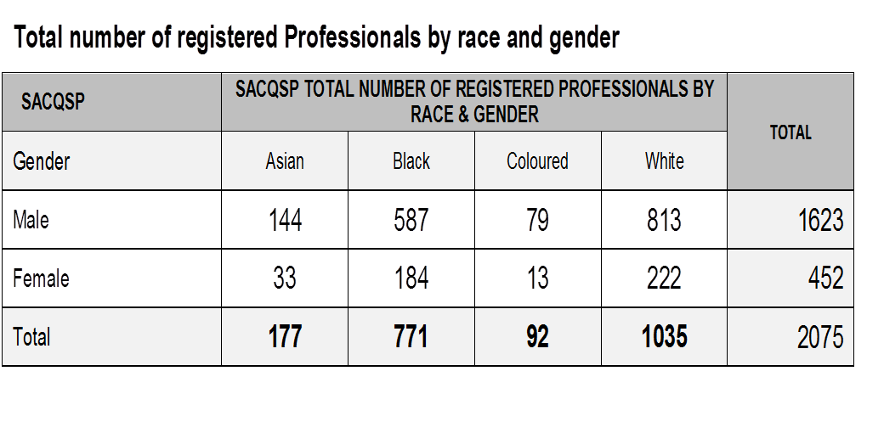
Professional Registration-SACQSP

Slide 52

Candidates - SACQSP

Slide 53
SOUTH AFRICAN COUNCIL FOR THE ARCHITECTURAL PROFESSION (SACAP)
Council Committees
  Audit & Risk
  Stakeholder Relations
  Education Committee
  Continuing Professional Development
  Finance Committee
  HR & Remuneration Committee
  Investigation Committee
  Professional Fees
  Recognition of Prior Learning (RPL)
  Identification of Work (IDoW)
  Heads of Schools (HOS)

Slide 54
Performance Highlights - SACAP
The Women in Architecture South Africa (WiASA) programme was launched by SACAP in response to the identified severe and dire need for transformation; and structured just for women.
The Architectural Learning Sites (ALSs) are meeting the transformation objectives, and exciting new programmes are in place to meet the needs of disadvantaged students.
Some of the ALSs offer a bridging year to support learners who have demonstrated potential however do not have the requisite skills.
Council resolved to directly engage with all of its recognised Voluntary Associations (VAs) on all of the draft board notices that we publish for comment
SACAP has entered into a memorandum of understanding with the South African Police Service (SAPS) in 2014 to ensure that all reported cases received from the public against unregistered professionals are investigated and that perpetrators are brought to book.

Slide 55
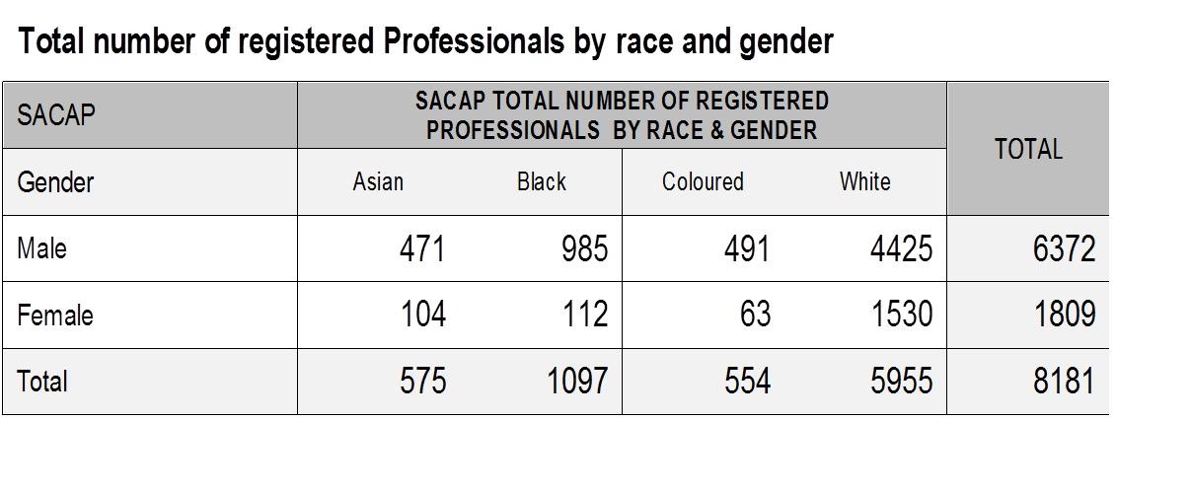
Professional Registration -SACAP

Slide 56

Candidates - SACAP

Slide 57
South African Council for Project and Construction Management Professions (SACPCMP)
The composition of the SACPCMP Council is in terms of the provisions of section 3 of the Project and Construction Management Professions Act (Act No 48 of 2000). It consists of ten (10) members appointed by the Minister.
Council is formed by six (6) registered persons as per categories of the Act, excluding candidates, of whom at least four must actively practise in the Professions and nominated by Voluntary Associations and any registered persons;
Two (2) professionals in the service of the State, nominated by any sphere of government, of whom at least one must be nominated by the Department
Section 3(c):Public and two (2) members of the public nominated through an open process of public participation.
There are 13 established Committees of the Council.

Slide 58
Performance Highlights - SACPCMP
Strategic engagements were through the following platforms:
4th Construction Management Summit in collaboration with various stakeholders
Inaugural Construction Mentorship Seminar in collaboration with CIDB and University of Pretoria
3rd Project and Construction Management Professions Conference
SACPCMP and National Home Builders Registration Council (NHBRC) Signing of Memorandum
Construction Health and Safety Registration Workshops in partnership with the Department of Labour
Participation at various Annual General Meetings of Voluntary Associations (VAs)
Department of Labour (DOL) Construction Seminar to inform the industry of the exemptions granted regarding the phased-in implementation of the Construction Regulations 2014
The fourth (4th) year into the implementation of the Programme Accreditation Policy Framework is a milestone for both Council and the accredited institutions.

Slide 59
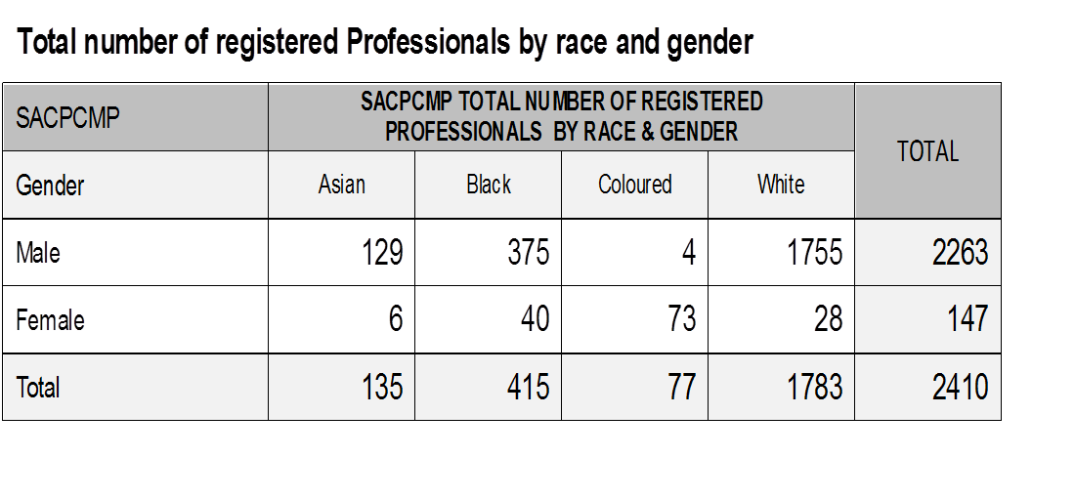
Professional Registration – SACPCMP

Slide 60

Candidates-SACPCMP

Slide 61
Conclusion
The CBE and the six BEPCs are strengthening their partnerships and their relations with the BE industry to benefit learners, students and candidates.
Doors need to be opened for students to do their practical training, candidates need exposure to work that would be relevant to the learning outcomes excepted by their Professional Councils.
Government as a key client for infrastructure development need to enforce skills training through construction projects undertaken by consultants.
The CBE and the BEPCs in partnership with DPW and other entities have a commitment to increase skills pipeline throughput from high school to tertiary, to candidacy until registration level.

Slide 62
Thank You

