Slide 1
Just transition to a low carbon economy
Presentation to Parliamentary Colloquium
28 October 2016
Tasneem Essop

Slide 2
Context in NDP
Recent international and domestic context
Vision & Plan for Transition to Low Carbon Economy
Challenges
Process ahead

Slide 3
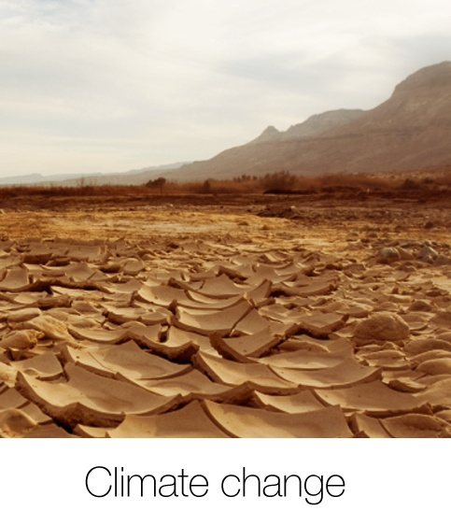
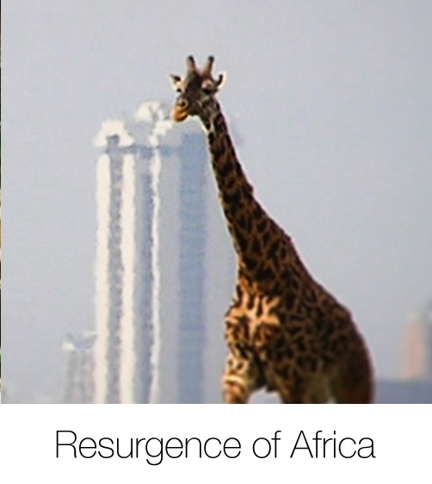

Slide 4
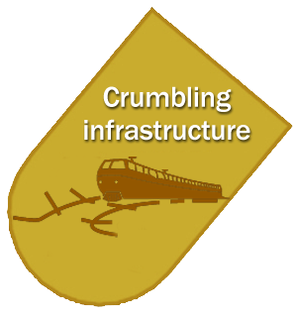
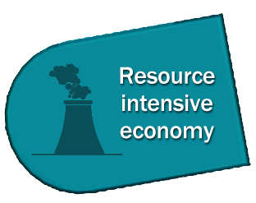
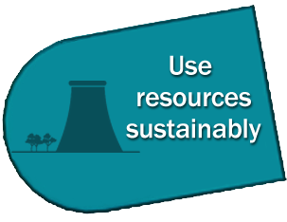

Slide 5
INTERNATIONAL CONTEXT
Paris Agreement at COP21 – will enter into force 4 November
IPCC Special Report on 1.5°C
Sustainable Development Goals agreement – Sept 2015
Energy Market Shifts
DOMESTIC CONTEXT
National Climate Change Response Strategy
Submission on national INDC
5

Slide 6
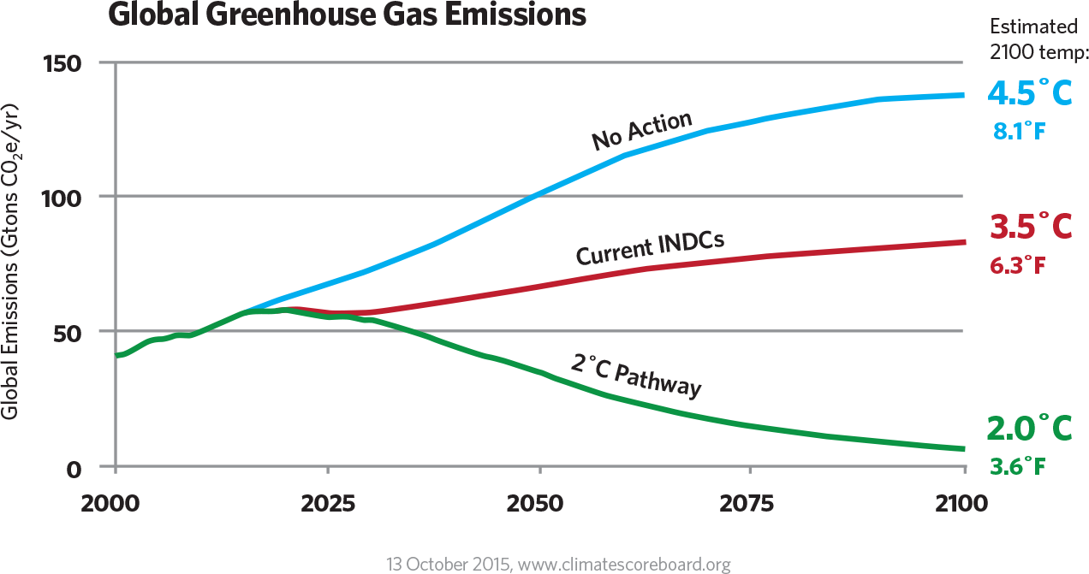
6

Slide 7
Vision for 2030
By 2030 – An environmentally sustainable society, expanded low-carbon economy and reducing emissions
South Africa has reduced poverty and unemployment to socially sustainable levels, as emissions reach a plateau.
Thriving rural communities are providing an economic and social base for a significant number of people.
Urban development is more compact and energy efficient.
Growing public awareness of the consequences of climate change and unconstrained consumption of our natural resources leads to a refocusing of political priorities towards the protection and rehabilitation of the region’s natural assets.
Investment in low-carbon and climate-resilient infrastructure has enabled South Africa to export and profit from its technologies and skills, and benefit sectors that deliver enhanced energy, food and water security, new high-quality job opportunities, and improved quality of life.
The state is well capacitated and comfortably manages its policy, regulatory and support functions.
The transition has been aligned with South Africa’s efforts to address poverty and inequality.
The benefits of building resilience are evident in the strides towards a flourishing and prosperous nation. Various incentive frameworks and a suite of comprehensive carbon-pricing policies have catalysed high levels of private investment in mitigation and adaptation activities, and generated public resources for reducing emissions.

Slide 8
The transition to a low-carbon economy is complex
We have high levels of CO2 emissions
Our economic development is hugely dependent on fossil fuels
We have significant coal resources
We have unacceptably high levels of poverty and inequality
The process of transitioning to a low carbon and climate resilient economy has to place eradicating poverty and reducing inequality at the centre
This requires commitment to
an expanded renewable energy programme;
appropriate policy instruments;
proactive government actions;
better and effective regulation around carbon pricing, building and construction standards, transport; and
robust M&E

Slide 9
ADOPTION OF A CARBON BUDGET APPROACH
How this budget gets used and shared cannot be left to govt alone
Nation has to be engaged – about what we prioritise, trade off – losers and winners
Public good vs private interests

Slide 10
Challenges
Development vs environment discourse – climate change viewed as an environmental issue
Stakeholder vested interests – negotiation stance
Lack of integration and synergy – policy and implementation – eg. Energy and Infrastructure investment
Trade offs and lock-ins

Slide 11
Largely unresolved issues
Transition costs – how much, who pays, who bears the costs
• Role of energy efficiency – ambition, scale, instruments
• Energy Mix - Role of coal, nuclear, gas
How to build resilience – communities, economic sectors, eg. Drought and other extreme weather events
• Role of taxes, trading schemes
• Types of incentives
• When, where and how do you cushion the poor?
• When, where and how do we cushion “losing” sectors?
• Shape and structure of the energy industry
• Competitiveness – short term versus long term

Slide 12
The NDP was a high level first round of recommendations – peg in the ground
It will be followed by a year long Pathways planning process bringing together a group of social partners at high level and experts as well as public engagements
Plotting the different paths to transition to low carbon society that maximises development co-benefits – reducing poverty and inequality
Potential to use this consesus as basis for a social contract in the country

Slide 13
Role of Portfolio Committee
Important nexus between executive and the public – ensure transparent and participatory decision-making
Cross-cutting view across all departments accountability – domestic and international commitments
Initiate Public discourse on transition, priorities, trade offs, resourcing etc
Keep issue alive politically and in the public domain – start with Energy choices

Slide 14
Thank you Tasneem Essop tasessop@gmail.com

