Slide 1
Presentation to Parliamentary Portfolio Committee on Education and Training
26 October 2016
Nireen Naidoo
Director: Office of CEO

Slide 3
Structure of Report
General Information
Performance Information
Sustainability & Stakeholders
Human Resource Information
Financial Information
Governance
Notes:
Cover details of each of the sections

Slide 5
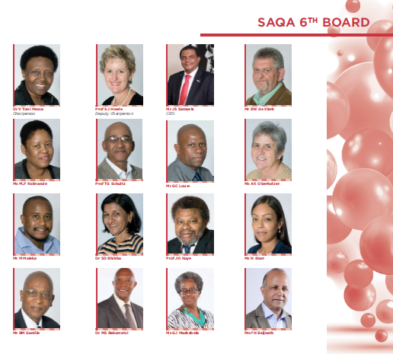
SAQA Board
Dr V. Toni Penxa Chairperson
Prof S. Howie Deputy Chairperson

Slide 6
Composition of Board
Education & Training Sector, professional bodies, organised business and the community
10 members appointed by Minister in their individual capacities
Organised Labour
2 members appointed by Minister in their personal capacities
CEOs
3 QCs and SAQA CEOs appointed by virtue of their positions

Slide 7
Committee Structure
9 Committees
Minimum of 2 board members per committee
Additional specialist expertise
Terms of Reference
Reviewed and approved annually by Board
Chairpersons report progress to Board
Assessment
Annual self-assessment
Reporting
Appointed for 5 years

Slide 8
Board Profile
81%
19%
GENDER REPRESENTATION
44%
56%

Slide 9
Structure of Report
Notes:
Cover details of each of the sections

Slide 10
Legislative and Policy Frameworks
NQF Act, No. 67 of 2008
Ministerial Guidelines
White Paper on Post-school Education and Training, 2013
PFMA, No. 1 of 1999

Slide 11
Objectives of the NQF and SAQA
Create a single integrated national framework
Facilitate access, mobility and progression
Enhance equality of education and training
Accelerate redress of past unfair discrimination
Contribute to the full personal development of each learner and the social and economic development of the nation at large

Slide 12
SAQA and the Quality Councils focus on…
Developing, fostering and maintaining an integrated and transparent framework for the recognition of learning achievements
Ensuring that South African Qualifications meet appropriate criteria, determined by the Minister and are internationally comparable
Ensuring that South African Qualifications are of an acceptable quality

Slide 13
NQF Architecture
National Qualifications Framework
Level | Sub-Framework and qualification types
10 | Doctoral Degree Doctoral Degree (Professional) | *
9 | Master’s Degree Master’s Degree (Professional) | *
8 | Bachelor Honours Degree Postgraduate Diploma Bachelor’s Degree | Occupational Certificate (Level 8)
7 | Bachelor’s Degree Advanced Diploma | Occupational Certificate (Level 7)
6 | Diploma Advanced Certificate | Occupational Certificate (Level 6)
5 | Higher Certificate | Occupational Certificate (Level 5)
4 | National Certificate | Occupational Certificate (Level 4)
3 | Intermediate Certificate | Occupational Certificate (Level 3)
2 | Elementary Certificate | Occupational Certificate (Level 2)
1 | General Certificate | Occupational Certificate (Level 1)
Higher Education Qualifications Sub-Framework
Occupational Qualifications Sub-Framework
General and Further Education and Training Qualifications Sub-Framework
* Qualification types beyond Level 8 on the OQSF have not been determined.

Slide 14
Foundation for performance
A world class NQF for SA
Oversee further development & implementation of NQF & advance objectives which contribute to full development of learner and socio-economic development of nation

Slide 15
Strategic Goals

Slide 16
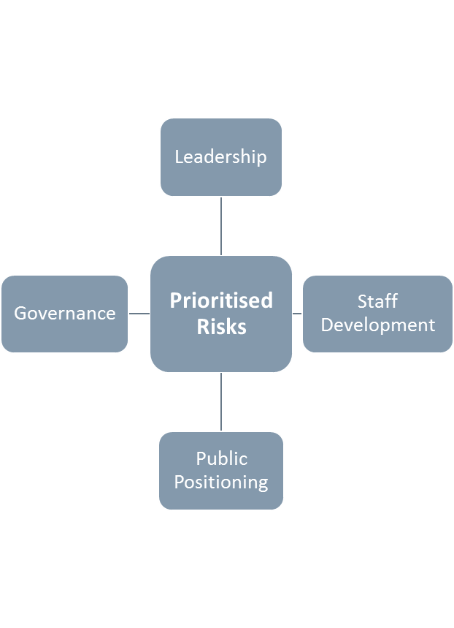
Levels of Managing Risk
Assurance : Internal & External Auditors
Oversight: governance structures
Operational: line managers

Slide 17
Structure of Report
Notes:
Cover details of each of the sections

Slide 18
Overall performance
Performance audit: 50 annual targets
Unqualified audit report
Financial audit
2
1
Exceeded expectation on 6 targets
Partially achieved 4 targets

Slide 19
For 2015/16…
Focused on policy implementation
Developed draft policy on Misrepresented Qualifications
Provided information of misrepresented qualifications
Simplified the NQF by de-registering qualifications with no uptake 2 years after registration
Completed initial work on establishing SAQA in ombuds role
Inducted new Board
Published Policy and Criteria for evaluating Foreign Qualifications in the SA NQF
Promoted better understanding of Articulation through research and advocacy
Planned international events to mark SAQA’s 20th birthday

Slide 20
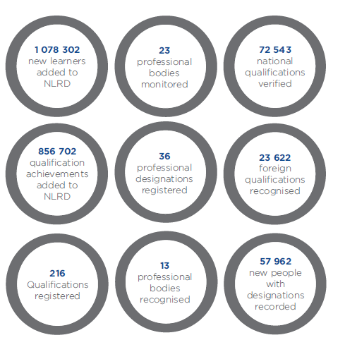
Some key achievements for the 2015/16 financial year

Slide 21
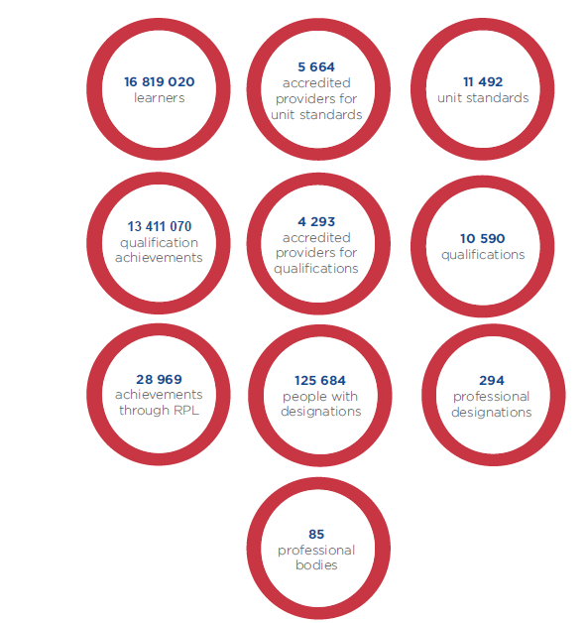
A snapshot of the NLRD as at 31 March 2016

Slide 22
Zimbabwe
18.7%
India
12%
Nigeria
9.6%
United Kingdom
9.1%
Lesotho
6.1%
DRC
3.7%
Thailand
USA
3.3%
2.4%
Swaziland
2.3%
Pakistan
2.1%
More than two-thirds (69%) of qualifications that were compared and recognised, originated from 10 of 154 countries.
Chart showing top 10 countries from where qualifications that were compared and recognised originated

Slide 23
Zimbabwe
8
Nigeria
7
Lesotho
5
Cameroon
Swaziland
5
Pakistan
4
DRC
Rest of Africa
Ghana
5
Angola
Other countries (excl, Africa)
India
Bangladesh
3
3
5
5
40
12
9
111 misrepresented foreign qualifications = 0.5% of total verified
41% on NQF level 4
23% on NQF level 7
Chart showing countries/regions whose qualifications are being misrepresented

Slide 24
National Qualifications
72 543 qualifications verified
92 misrepresented national qualifications = 0.1% of total verified

Slide 25
International Initiatives
World Reference Levels
Technical assistance to Namibia
Groningen Declaration Network
Addis Convention
Validation of teacher professional standards
African Qualifications Verification Network
Notes:
Cover details of each of the sections

Slide 26
Structure of Report
Sustainability Report & Stakeholders
Notes:
Cover details of each of the sections

Slide 27
Sustainability
Economic Viability
Cost recovery plus 5% margin model
Environmental Sustainability
Energy efficiency and saving
Recycling and eco-friendly waste management
Social and Transformation Matters
SAQA supports the Tshwaraganang Orphanage
Committed to transformation in the workplace
Funding for priority projects

Slide 28
Communication with Stakeholders
Engaging in strategic conversations
Creating a platform for intellectual debates
Seeking public comment
Participating in forums
Learning from and contributing to international initiatives
Collaborating with partners to reach policy makers, implementers and beneficiaries

Slide 29
Structure of Report
Human resource management
Notes:
Cover details of each of the sections

Slide 30
Staff Count
2012
171
2013
182
2014
214
2015
2016
148
167

Slide 31
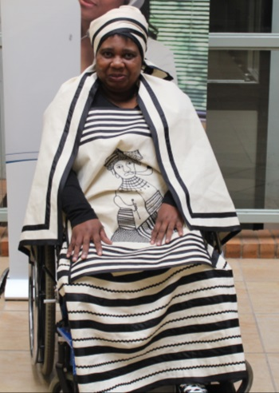
Staff Composition
89% of staff is Black
63% are women
1.8% of staff are disabled
167 staff
33 appointments
16 resignations
Notes:
Cover details of each of the sections

Slide 32
Staff Development
Strategic conversations | 160
Leadership development | 126
Diversity awareness | 67
Understanding the NQF | 64
Toastmasters speechcraft | 21
Advanced computer skills | 15
Coaching & mentoring | 9
Training expenditure = R 1,65 m

Slide 33
Structure of Report
Notes:
Cover details of each of the sections

Slide 34
Financial Management
19th consecutive unqualified audit report

Slide 35
Budget vs Expenditure

Slide 36
Savings
Staff | R 4 650 000
Consulting & Project Fees | R 1 730 000
Training & Recruitment | R 1 160 000
Research, Legal & Verification Fees | R 550 000
Print & Photocopies | R 500 000
Conferences | R 490 000
R 8 035 000 savings

Slide 37
Expenditure over Budget
Advertising | R 470 000
IT | R 460 000
PPE & Intangible Assets | R 282 000
Loss (foreign exchange, disposal of PPE) | R 21 000

Slide 38
Revenue Received
Government Grant | 59.60%
R 54 757 000
Foreign Qualification Evaluation | 23.80%
R 21 852 000
National Qualification Verification | 9.20%
R 8 485 000
Sundry Income | 3.80%
R 3 523 000
Interest Received | 2.20%
R 1 981 000
Rental Income | 1.40%
R 1 259 000
Total Revenue: R 91 857 000

Slide 39
Structure of Report
Questions from previous meetings
Notes:
Cover details of each of the sections

Slide 40
Questions from previous meeting
The Portfolio Committee requested a further breakdown of the number of artisans who obtained qualifications through RPL
Of the 28 565 learners who obtained at least one qualification via RPL, 62 were artisans
Likely to be more, but the information is not available

Slide 41
Questions from previous meeting
Issue of performance information reported by AG to Portfolio Committee

Slide 42
Structure of Report
Concluding Remarks
Notes:
Cover details of each of the sections

Slide 43
In summary
Successful transition from 5th to 6th Board
From Policy Development to Policy Implementation
Implemented a list of misrepresented qualifications
Project on Digitisation of learner records
19th unqualified audit report
Financial audit
Performance audit
50 targets
Fully achieved 92% of targets
Partially achieved the 8%
Spent 92% of the budget

Slide 44
STRATEGIC IMPERATIVES 2016/17
Decisive leadership and co-ordination
Facilitate and support NQF implementation
Public positioning
Publicly position the NQF through its positive impact and structured advocacy and communications
Facilitate and support the implementation of NQF Policies in a simple, coherent and integrated manner across education, training, development and work
Provide decisive and coherent leadership to coordinate, simplify, and monitor and evaluate the implementation of an effectively articulated NQF
Valuing staff
Optimise capacity, encourage and value the contributions of staff towards organisational effectiveness and excellence in service delivery

Slide 45
FOCUS AREAS
RPL
Simplification
NQF Advisory Service
Articulation
RASA

Slide 46
Presentation to Parliamentary Portfolio Committee on Education and Training
26 October 2016
Nireen Naidoo
Director: Office of CEO

