Slide 1


Portfolio Committee
25th October 2016
Presented by:
Bryan Chaplog
(Chief Executive Officer)
Silence Mmotong
(Chief Financial Officer)
Estate Agency Affairs Board

Slide 2

STRATEGIC OVERVIEW
THE MANDATE OF THE EAAB
The primary mandate of the EAAB
Regulate, maintain and promote the standard of conduct of estate agents having due regard to the public interest;
Issue fidelity fund certificates to qualifying applicants;
Prescribe the standard of training of estate agents;
Investigate complaints against estate agents and institute disciplinary proceedings against offending estate agents where required; and
Manage and control the Estate Agents Fidelity Fund.

Slide 3
STRATEGIC OVERVIEW Cont/…
Secondary mandate of the EAAB
The EAAB is the Supervisory Body of the estate agency profession pursuant to the Financial Intelligence Centre Act, and is obliged to take all steps required to prevent, alternatively identify, and report on anti-money laundering and terrorist financing activities.

Slide 4
Additional to the primary mandate
of the EAAB
Financial Intelligence Centre
The EAAB is the Supervisory Body of the estate agency profession pursuant to the Financial Intelligence Centre Act and is obliged to take all steps required to prevent, alternatively, identify and report on, money laundering and terrorist financing activities in the estate agents’ sector.

Slide 5
Government-wide priorities
Based on this governmental strategic priority, the EAAB recognises its role in supporting the following:
Intensify homeownership induction programmes for the affordable housing market;
Establish transactional support for the affordable housing market;
Monitor and reporting transactions in the secondary housing subsidy market;
Conduct analysis and disseminate information on property trends and values in the affordable housing market;
Facilitate the regular backlog of title deeds to form part of the housing development;

Slide 6
Government-wide priorities
The expanded mandate of the EAAB in respect of the National Development Plan 2030 Vision and Trajectory is reflected in outcome no. 8, which refers to sustainable and improved quality of household life.
With respect to MTSF sub-outcome 2, the Department of Human Settlements is required to ensure a sustainable residential property market.

Slide 7
VISION
To be a sound and trusted world class regulator that is responsive to and surpasses its stakeholder expectations.
MISSION
Our mission is to ensure that the integrity of the transaction between the estate agent and consumer is of a high standard by regulating, protecting, guiding and enhancing the conduct of the real estate agents’ profession in South Africa.

Slide 8
VALUES
After comprehensive consultation and interaction with relevant stakeholders, both internal and external, within the estate agency environment, it was agreed that the following values will underscore the Board’s behaviour as it strives to achieve the ideals encapsulated in its vision and mission, namely:
Integrity: the quality of adhering to the highest moral principles and professional standards;
Responsibility: the authority to make decisions independently and to be accountable for actions taken;
Excellence in service delivery: to exceed client expectations in service delivery;
Communication: the effective exchange of information in such a manner that there is a mutual understanding;
Participation: the involvement of all relevant stakeholders in what the EAAB does;
Transparency: to remove all barriers to and the facilitation of free and easy stakeholder access to the boards operations.
Professionalism: maintaining performance standards and expectations within the industry; and
Target driven: to have an operational bias toward tangible delivery.

Slide 9
LEGISLATIVE MANDATES
The EAAB is a schedule 3A public entity in terms of the Public Finance Management Act, 1 of 1999. The EAAB must always remain aware of, and comply with, legislation impacting on its functioning. Other relevant legislation includes, but is not limited to:
The South African Constitution;
The Estate Agency Affairs Act, 112 of 1976;
The Public Finance Management Act, 1 of 1999;
The Preferential Procurement Framework Act of 2000;
The Financial Intelligence Centre Act, 38 of 2001;
The Labour Relations Act, 66 of 1995;
The SA Qualifications Authority Act, 58 of 1995;
The Skills Development Act, 97 of 1998;
The Promotion of Administrative Justice Act,3 of 2000
The Promotion of Access to Information Act, 2 of 2000
The National Credit Act, 34 of 2005; and
The Consumer Protection Act,68 of 2008.

Slide 10
Section 32A of the Estate Agency Affairs Act was replaced as unconstitutional on the 26th February 2016.
There were no further changes to the legislative mandates.
It should, however, be noted that the EAAB, along with the Department of Settlements, are in the process of preparing the Property Practitioners Bill for promulgation which, when concluded, will repeal the current Estate Agency Affairs Act.

Slide 11
EAAB Organogram
Executive Authority
MINISTER
Department of Human Settlements
Accounting Authority
Estate Agency Affairs Board
Board Members
Chief Executive Officer
Bryan Chaplog
Legal Technical Analyst
Adv Jan Tladi
Executive: Operations
Anton Arendse
Company Secretary
Nkululeko Ndebele
Chief Risk Officer
Nikita Sigaba
Internal audit (Outsourced)
Special Projects
Khwezi Ngwenya
Executive Manager:
Compliance
Jimmy Baloyi
Executive Manager: Inspections
Dineo Mphahlele
Executive Manager: Education & Training
Clive Ashpol
Executive Manager: Corporate Services (CFO)
Silence Mmotong
Legal Manager
Deli Nkambule
Inspectors
Marketing, Publications & Consumer Awareness Manager
Margie Campbell
HOD: Finance & Administration
Aubrey Mokwena
Claims & Section 27 Applications Manager
Adv Debra Vial
Information Technology Manager
Thembelani Mbolekwana
Education & Training Manager
Nomsa Mokoena
Audit Compliance Manager
Thomas Makupo
Human Resources Manager
Mafiki Duma
Knowledge Centre and library
Registrations Manager
(Vacant)
Customer Relations Manager
Thokozani Khumalo
Litigation & Recoveries
(Vacant)
Professional Body
CPD Manage(Vacant)

Slide 12
Chief Executive Officer’s Report
The Estate Agency Affairs Board (“EAAB”) and the Department of Human Settlements;
The term of office of the Board Members of the EAAB;
Ensuring that the EAAB becomes a sound and trusted world class regulator;
The evolution and expansion of the property sector;
South African residential property stock;
Utilisation of immovable property as an economic enabler;
Notes:
The term of office of the Board members of the EAAB
Sight should, moreover, not be lost of the substantial contribution made to the EAAB as an organisation by its erudite and knowledgeable Board members during the period 1 April to 31 December 2015, when their three-year term of office expired. I would record, in this respect, that the Minister of Human Settlements had duly commenced the process of appointing new Board members, as required by section 3(2) of the Estate Agency Affairs Act, 112 of 1976, as early as April 2015. This necessarily comprehensive and multifaceted process had, however, not yet been finalised by 31 December 2015. The new Board was subsequently appointed by the Minister of Human Settlements on 6 July 2016 in compliance with the provisions of the Estate Agency Affairs Act
Ensuring that the EAAB becomes a sound and trusted world class regulator
It is to be underscored that Board members had collectively focused significant effort on ensuring that the EAAB consistently remained on track to reach its ultimate target of becoming a sound and trusted world class regulator. I wish to extend my sincere gratitude and appreciation to the EAAB Board members for having so willingly and generously provided the necessary leadership, competencies and skills not only to the activities of the EAAB Board but also to the various sub-committees upon which they served. Board members, in so doing, undoubtedly made a vital contribution to enabling the EAAB better to serve its stakeholders, property consumers in general and the property profession in particular. I am especially appreciative of the valuable contributions consistently made to the functions and work of the EAAB by Professor Kwandiwe Kondlo, the Board Chairman, and Ms. Maletsatsi Wotini, the Deputy Chairman, both of whom were re-elected to these respective positions.
The evolution and expansion of the property sector
It seems trite, yet true, to state that the property sector in general, and the estate agency environment in particular, continued both to evolve and to expand during the period under review as it sought to identify and accommodate the on-going demands of a rapidly changing socio-political-economic environment and property landscape.
South African residential property stock
While it should never be overlooked that the residential property stock constitutes but one aspect of the entire multi-differentiated South African property environment, all of which falls under the regulatory purview of the EAAB, I believe that it nevertheless of significance, at this juncture, to have regard to the composition of the South African residential property stock as it pertained during the 2015/16 financial year. Doing so provides a powerful reference point for purposes of future research, investigation and development. Such an analysis, indeed, also suffices to provide a more meaningful insight into the regulated estate agency sector, which contributes so significantly to the South African Gross Domestic Product, especially when it is considered that the total value of residential property stock was R4,5 trillion.
Utilisation of immovable property as an economic enabler
It is self-evident that as South Africans become increasingly more aware of the inherent value of property as an economic enabler they will progressively begin to focus more on property ownership as a key investment goal and opportunity rather than simply viewing property as only a means of shelter as was previously the position. This will have substantial ramifications for the regulated sector as secondary immovable property markets are created in areas where they hitherto did not exist.

Slide 13
Chief Executive Officer’s Report Cont/…
Issues which received the attention of the EAAB during the period under review;
Playing a more responsive role in the South African economic landscape;
Making more effective use of available technology;
Professionalising the real estate sector – Continuing Professional Development;
Countering acts of racism, discrimination and intolerance;
The Equity Pledge;
Notes:
Issues which received the attention of the EAAB during the period under review
It can be more fully appreciated, therefore, that it was necessary for the EAAB during the period under review to have regard, amongst others, to such pertinent issues as:
the imperative of transforming the property and estate agency sectors to ensure that they speedily conformed to the demographic realities of a democratic South Africa;
the continuing professionalisation of estate agency as a career of choice with all that this broad objective necessarily entailed;
the development and implementation of enhanced and ‘fit for purpose’ query management systems to provide better and more efficient customer relations services to stakeholders;
a substantial investment in modern IT systems;
the implementation of appropriate and goal-directed consumer awareness campaigns;
the establishment of regional offices to enable the EAAB more fully to meet the needs of all estate agency practitioners;
making Information Technology and other resources available to estate agency practitioners from previously disadvantaged communities to ensure that they were able to achieve reputational and financial success in a relatively new sector where they are concerned; and
encouraging an awareness of, and the introduction of appropriate steps and measures to eliminate, any residue aspects of racism, discrimination or acts of intolerance, of whatsoever nature, that might occur within the sector.
It may be stated that the effective and successful implementation of these specific programmes, which are more fully dealt with elsewhere in this Annual Report, inevitably required significantly enhanced resources, both financial and human, where the EAAB was concerned. The acknowledged success of these programmes, moreover, clearly redounded to the benefit of all sector stakeholders, specifically including estate agency professionals and the consumers with whom they daily interact.
Playing a more responsive role in the South African economic landscape
The EAAB also continued to dedicate itself not only to playing a more responsive role in the South African economic landscape but also in positively impacting the property sector for the benefit of both the consumers and property practitioners. During the period under review, for instance, the EAAB steadfastly focused on improving its operational environment through the more effective use of technology and technological innovations in its service offering to estate agents and stakeholders. Additional services were, thus, provided through the increased use of online solutions notwithstanding that the EAAB yet remained flexible in the adjustment of these solutions as it proceeded to navigate the usual introduction and implementation challenges that inevitably arise.
Making more effective use of available technology
The EAAB has, over the years, resolutely endeavoured to make the submission of the mandatory annual auditor’s reports in respect of estate agency enterprises as user-friendly as possible. In pursuance of its stated modernisation and optimisation programme it became mandatory, during the period under review, for such reports to be submitted by auditors to the EAAB online. The ever-increasing levels of co-operation and support that the EAAB received from estate agency principals and their auditors in this respect are to be greatly commended. This innovation also had the positive effect of significantly expediting the assessment and updating of such reports by the EAAB. It was, furthermore, noted that the number of non-compliant estate agencies who had failed timeously to submit auditor’s reports had, conversely, showed a marked decline. It is apparent that the impressive improvement in auditor’s report processes and procedures adopted by the EAAB was keenly appreciated by stakeholders and, moreover, that this bodes extremely well for the future of the sustainability of the sector as a whole.
Professionalising the real estate sector – Continuing Professional Development
The EAAB continued, in addition, to focus on professionalising the real estate sector. In its joint capacity as statutory regulator and, also, as the SA Qualifications Authority recognised professional body of the estate agency sector, the EAAB successfully launched a Continuing Professional Development Programme (“CPD”) for practicing professional estate agents during the year under review. Only intern estate agents were exempted from compliance with peremptory CPD requirements.
It is gratifying to record that during the 2015 calendar year the EAAB delivered over 176 CPD contact sessions nationally. It is also pleasing to note that well over 13 000 qualifying estate agents enrolled for, and completed, the first year of the three-year CPD rolling cycle. To facilitate participation in the mandatory CPD programme the EAAB also introduced an e-learning CPD intervention to supplement the one-on-one contact sessions. Empirical data indicates that in excess of 1 500 estate agents completed the first year of the CPD programme through e-learning. It does seem that significantly more estate agents will seek to complete the mandatory CPD requirement through the e-learning process in future years and the EAAB will ensure that they are able to do so.
The annual seminars previously presented countrywide by the EAAB were incorporated into the CPD programme under the rubric of ‘Integrated Real Estate Dialogues’. Estate agents are, thus, now able to accrue verifiable CPD points through attendance at these popular events. As the feedback received from persons attending these events was overwhelmingly positive it may be accepted that this innovation has been well received by the general body of professional estate agents.
With the successful introduction and implementation of the CPD programme property consumers, for their part, are able to rest assured that registered estate agents who comply with the CPD requirements will be in a far better position consistently to provide professional estate agency services of the highest calibre. Property practitioners who have complied with EAAB educational requirements can, indeed, be accepted as persons who are knowledgeable, and keep abreast of, relevant property-related issues, legalities and processes.
Countering acts of racism, discrimination and intolerance
Acts of racism, discrimination and intolerance committed by estate agents were, unfortunately, not only prevalent during the period under review but also received significant press and public attention. Such reprehensible acts are not only contrary to the integrity of estate agents in general but also bring the estate agency profession as a whole into disrepute. The EAAB, therefore, unequivocally distanced itself from any instances of discrimination on the grounds of race, gender, religion, nationality, or any other factors. The EAAB, furthermore, acted resolutely within its regulatory and authoritative powers to remove all vestiges of racism and discrimination wherever they may occur within the estate agency sector. The EAAB is determined not to tolerate the manifestation of any form racism, discrimination or acts of intolerance and it will certainly not permit odious acts of this nature to take place within the regulated sector.
The Equity Pledge
The EAAB, acting in concert with the estate agency sector, created and circulated an Equity Pledge form pursuant to which all estate agents are required to pledge their commitment to non-racism and absolute equality in the rendering of estate agency services to property consumers. The response from the estate agency sector has, thus far, been quite encouraging while the position will continue to be monitored during the ensuing financial year.

Slide 14
Chief Executive Officer’s Report Cont/…
Establishment of the Multi-Stakeholder Group;
Transformation of the estate agency sector – the “One Learner - One Estate Agency” Your Brigade Empowerment Programme;
Legislative review;
Registrations and renewals of fidelity fund certificates;
Education and Training;
Disciplinary Inquiries;
Notes:
Establishment of the Multi-Stakeholder Group
I am pleased to report that my concerted efforts to establish a formally structured Multi-Stakeholder Group, comprising both the EAAB and estate agency sector representative organisations, finally came to fruition during the period under review. The underlying objective of creating the Multi-Stakeholder Group, which met on a monthly basis, was to identify, discuss and, of course, hopefully resolve the many pertinent concerns, issues and challenges which members of the estate agency profession, in its many differentiated spheres, generally encountered. The MSG meetings have created the much needed forum for the discussion and ventilation of pertinent matters affecting the interests of the real estate sector and for ensuring that such matters are suitably addressed. Due to the activities of the Multi-Stakeholder Group significant successes in this respect have already been achieved.
During the period under review the Multi-Stakeholder Group comprised representatives at the highest level of:
the EAAB;
the Institute of Estate Agents of South Africa (IEASA);
the National Association of Managing Agents (NAMA);
the National Property Forum (NPF);
the Real Estate Business Owners of South Africa (REBOSA);
the South African Property Owners Association (SAPOA);
the South African Institute of Auctioneers (SAIA); and
the South African Business Brokers Association (SABBA).
Transformation of the estate agency sector - the “One Learner - One Estate Agency Youth Brigade Empowerment” programme
It is pleasing, therefore, to report that the ‘One Learner – One Estate Agency Youth Brigade Empowerment” programme (“the programme”), which aims at placing intern estate agents from previously disadvantaged communities in the service of registered estate agency enterprises so that they may act under the supervision and control of a suitably qualified mentor for a period of twelve months, proved to be most successful during the 2015/16 financial year.
It remains unfortunately true that the transformation of the property sector so as to reflect the demographics of a democratic South Africa is still not as advanced as it ought to be. The EAAB is consequently determined to continue to emphasise transformation in light of the fact that changes in the spatial demographics of the South African property landscape require the full cooperation and support not only of estate agents but, indeed, of all South African property buyers, sellers, landlords and tenants.
A major underlying objective of the programme is to increase the level of representation and participation of the youth, previously disadvantaged persons and persons with disability within the property sector in general and the estate agency environment in particular. The programme is intended to accelerate the much needed transformation of the real estate sector, which is presently heavily skewed in favour of white South Africans, to reflect the demographic realities of a democratic South Africa.
Participation in the programme is open to matriculants, TVET college graduates, university and university of technology graduates as well as persons with disability. The programme aims, in particular, at placing intern estate agents from the identified groups into the service of registered estate agency enterprises. Such intern estate agents are required to complete the compulsory twelve-month internship period acting under the supervision and control of an appointed mentor estate agent while they simultaneously seek to be certificated against the Further Education and Training Certificate: Real Estate (NQF Level 4). Both the intern estate agents and their mentors are required to maintain and complete an intern logbook. This requirement ensures that the intern estate agents are able to gain relevant practical work experience and that they are not relegated to the fringes of estate agency practice.
After they have completed the twelve-month internship period and been certificated against the Further Education and Training Certificate: Real Estate, the intern estate agents must enrol for, and pass, the Professional Designation Examination for non-principal estate agents (PDE 4). The PDE 4 represents the final summative assessment of the ability of the intern estate agents to integrate their theoretical learning with the practical on-the-job experience acquired during the internship period. Successful PDE 4 candidates are also awarded the designation ‘PPRE’ (Professional Practitioner in Real Estate) which is registered on the National Learner Registration Database (“NLRD”) maintained by the SA Qualifications Authority.
Having met these educational requirements intern estate agents obtain a status upgrade to full status professional practitioner in real estate. Persons wishing to become real estate business owners are required, thereafter, to be certificated against the National Certificate: Real Estate (NQF Level 5) and subsequently to pass the Professional Designation Examination for principal estate agents (PDE 5). This results in the award of the “MPRE” (Master Practitioner in Real Estate) designation which is, similarly registered on the NLRD.
The programme, thus, essentially equips the intern estate agents with the required property market experiential learning while they obtain the necessary real estate qualifications. It aims at retaining such persons within the sector and at enabling them to achieve financial and reputational success as they continue to work as estate agents and, hopefully, become the business owners of the future.
The EAAB is most grateful for the support that it continues to receive from the Services SETA as a key funding partner of the programme.
It is intended that the programme be significantly accelerated during the next financial year. Following the conclusion of a partnership agreement between the EAAB and the South African Graduates Development Agency (“SAGDA”), it is envisaged that a further 3 000 intern estate agents will be accepted into the programme.
I remain hopeful that the EAAB will continue to receive the active co-operation of stakeholders in the furtherance of this important endeavour for, without their commitment, cooperation and support, the imperative of effecting the radical transformational change, which the real estate sector so urgently requires if it is to safeguard its continued sustainability, may be hindered.
Legislative review
The legislative review of the Estate Agency Affairs Act, 112 of 1976, made significant progress during the financial year in question as it was presented to various forums as part of the legislative process. It is envisaged that valuable and well considered inputs on the proposed Property Practitioners Bill will be forthcoming from stakeholders once the Bill is duly published for public comment in due course.
Registrations and renewals of fidelity fund certificates
While it is pleasing to note that the turnaround time for the issue and renewal of fidelity fund certificates was significantly reduced during the period under review the EAAB remains determined not to rest on its laurels. I am, thus, presently exploring all other feasible and available avenues that may facilitate the further reduction of turnaround times. As will be more fully apparent from the content of the Annual Report, it is pleasing to note that the EAAB successfully issued a total of 36 390 fidelity fund certificates to individuals and 6 420 fidelity find certificates to estate agency firms during the period under review.
Education and training
The Education and Training Department was again tasked with ensuring both the professionalisation and the transformation of the estate agency sector by fully implementing the educational dispensation for estate agents as established by the Standard of Training of Estate Agents Regulations promulgated on 4 June 2008. In terms of the Education Regulations, all registered estate agents are required to be certificated against the appropriate NQF Real Estate qualifications. The quality assurance of these qualifications, however, vests in the Services SETA. Estate agents are also required to pass a Professional Designation Examination for both principal and non-principal estate agents respectively and to participate in the CPD programme.
Disciplinary Inquiries
The EAAB continued to receive and investigate complaints against estate agents from members of the public. The intensive consumer awareness initiatives conducted by the EAAB during the period under review, using all available means of communication including community radio stations, has resulted more knowledgeable and empowered consumers who are increasingly aware of their rights and obligations when engaging in property transactions. The need to reach even more consumers remains a challenge that the EAAB is determined to address.

Slide 15
Chief Executive Officer’s Report Cont/…
Management and control of the Estate Agents Fidelity Fund;
Stakeholder Management;
Consumer Awareness and education
New consumer protection initiative launched;
Title Deed Restoration Programme;
Customer Relations;
Conclusion;
Notes:
Management and control of the Estate Agents Fidelity Fund
The management and control of the Estate Agents Fidelity Fund, as prescribed by the Estate Agency Affairs Act, is a function integral to the activities of the EAAB. It will be seen from the Annual report that, during the financial year under review, the liquidity and solvency of the Fund remained sound.
Stakeholder management
Pursuant to the modernisation and optimisation programme implemented by the EAAB, two online communication portals, namely the “MyEAAB” and “MyCPD” portals respectively, were made available to stakeholders on the EAAB website. These portals have proved to be particularly beneficial as they have not only enabled the EAAB to update the contact details of registered estate agents but have also increased its capacity to reach specifically identified stakeholder segments. Most registered estate agents can, consequently, now be electronically accessed by the EAAB.
Consumer education
As a constituent part of its consumer awareness programmes during the period under review the EAAB successfully conducted various consumer awareness workshops in all provinces. The reach of the EAAB’s consumer awareness programmes was, furthermore, routinely enhanced through the increased use of all available and relevant communications media platforms with special emphasis on radio as a medium of mass communication. This has significantly increased the EAAB’s footprint, thereby empowering more consumers with the knowledge that they may previously have lacked.
An integral aspect of the EAAB consumer awareness programme is to both engage with and educate consumers by informing them of the EAAB, as the statutory regulator of the property sector, as well as the many consumer protection services that the EAAB is able to offer. Consumers are, for instance, made aware of the importance of using only registered estate agents for the rendering of real estate transactions and are apprised of the significant difference between engaging the services of persons who purport to be estate agents, but who are not registered with the EAAB, as against the estate agency services of professional, fully complaint and registered estate agents. It is emphasised to consumers that, in instances where the services of illegally trading operators are utilised, there is an exponentially increased risk of unprofessional conduct which may even result in the theft or misappropriation of trust moneys.
A further important element of the consumer awareness initiative is the provision of knowledge enabling consumers to utilise immovable property as a store of wealth. To achieve this end it is essential that the property owner be provided with the title deed of the property concerned. In furtherance of this consideration the Department of Human Settlements recently instituted a far-reaching transformation programme aimed at providing title deeds to all property owners. This laudable objective aligns with the mandate of the EAAB and, also, with the mandate and priorities of the Department of Human Settlements.
As part of its consumer awareness programmes for the year under review, the EAAB successfully conducted workshops in all provinces. The EAAB’s consumer awareness programmes also assists in carrying all relevant messages through its radio platforms which has increased significantly during the year under review.
The EAAB’s consumer awareness includes both engaging with consumers and educating them on who the EAAB is as well as its duties and obligations as the statutory regulator of the real estate profession. It is imperative that consumers should be made aware of the importance of using only duly registered estate agents for all property transactions and be apprised of the significant difference between engaging the services of persons who purport to be estate agents but who are not registered with the EAAB. In most instances, in this latter respect, the unfortunate result is a fraudulent transaction with the consequent loss of the consumer’s money.
New Consumer protection initiative launched
The EAAB successfully launched a new consumer protection initiative to enable consumers to distinguish between illegal operators and legitimate professional estate agents.
Estate agents are now required to make use of a digital seal in all electronic media which confirms their current registration status. Accessing that seal enables consumers to check that the person that they are dealing with is a registered and qualified estate agent.
This seal, in addition, incentivises estate agents to ensure their contact details are always updated with the EAAB so as to provide the correct information and enhance awareness of the EAAB and its consumer protection funcations where the public is concerned.
The title deed backlog elimination programme
It is essential that all recipients and beneficiaries of subsidised and affordable housing be furnished with the title deed to their properties, whether the houses in question were acquired before or after the transition to democracy in 1994. Housing beneficiaries who have received the title deed to their properties are legally acknowledged as being the owners of those homes and are able to deal with them accordingly. Home owners may utilise their homes as collateral to secure mortgage finance thereby enabling them, for example, to establish a business undertaking or to upgrade the property. Having a title deed also facilitates the sale of the property concerned which contributes to the creation of a much needed secondary housing market in previously overlooked areas. Home owners are able, furthermore, to bequeath that property to their designated heirs. Possession of a title deed avoids the burdensome complications that otherwise may arise in the case of death. It is self-evident that homeowners having the title deeds to their properties are able fully to benefit from the undisputed advantages of property ownership and thereby more meaningfully participate in the economy.
The EAAB is fully mindful of the importance attached to the speedy eradication of the current backlog in the issue of title deeds to home owners and of the fundamental value of facilitating the issue of title deeds to persons in, particularly, the Reconstruction and Development Programme (“RDP”), the Breaking New Ground programme (“BNG”) and gap markets. This is presently being facilitated by leveraging on existing strategic alliances concluded between the EAAB and the Ministry of Human Settlements, the national and provincial Departments of Human Settlements, local authorities and the various deeds offices. The EAAB wishes to record its gratitude for the much valued support that it has consistently received from the Black Conveyancers Association (“BCA”) to this end.
There can be little doubt that significant additional value has been created in the affordable housing market segment which has also accelerated and stimulated the creation of a secondary housing market in these areas. This has had the desired effect of increasing the number of property practitioners rendering estate agency services in the affordable housing market and, more especially, in the gap market sectors. The gap market sector, where the income of a prospective property owner while sufficient to disqualify that person from benefitting from economic housing is yet insufficient to obtain mortgage finance through the usual channels, has benefitted immeasurably.
The issue of title deeds to property owners has served as a vital wealth creator, hitherto absent, which has had the positive effect of both alleviating poverty and providing an added stimulus to the ownership of immovable property.
Customer relations
I am pleased to report that, during the period under review, significant attention and resources, both human and financial, were again devoted to further improving the effective regulation of the estate agency sector. Priority was also given to making the use of EAAB information and technology systems more effective and ‘user friendly’ to enable estate agents fully to comply with their various legislative obligations on-line. While it must be conceded that this concerted modernisation and optimisation drive was not without its fair share of problems and challenges, both expected and unanticipated, it ultimately has proved to be extremely successful in meeting the increased expectations of stakeholders and was, accordingly, well received.
Of cardinal importance, in addition, was the identified need for the EAAB carefully to consider and analyse the nature and type of the queries that were generally received from stakeholders; the frequency of receipt of those queries; and, most importantly, the turnaround times for not only dealing with but also satisfactorily resolving all queries. It was essential, furthermore, to consider and highlight problematic gaps in service delivery to stakeholders. After the conclusion of this exercise the EAAB was able to effect all necessary improvements to its customer relations systems to expedite excellent service delivery.
Areas of investigation in this respect necessarily included, but were not limited to:
the creation of a decentralised query management process;
more effective use of online query management systems and techniques;
the introduction of standardised professional query resolution processes; and
an investigation into ways of improving turnaround times for the speedy and effective resolution of queries.
There can be little doubt that the EAAB call centre is frequently the initial point of contact between stakeholders and the EAAB. It was felt, thus, to be of critical importance that the call centre be empowered more fully to support the functional and operational departments of the organisation by efficiently dealing with routine queries and, also, communicating accurate and reliable information to stakeholders. It was hoped, and indeed this proved to be the case, that the vast majority of general queries would be satisfactorily resolved during this first interaction without any further wastage of time, or cause of irritation, to stakeholders.
During the period under review, therefore, much attention was focused on:
analysing the number of queries that were immediately resolved by call centre operators by using a manual of “Frequently Asked Questions” that was specifically compiled for this purpose;
managing the turnaround times for the answering of telephone calls;
managing the quality of information provided to callers by call centre operators; and
managing a seamless system for the transfer of telephone calls between, and from, call centre operators and EAAB operational and functional departments.
As will more fully appear elsewhere in this Annual Report, during the period under review 141 926 telephone calls were distributed by the EAAB call centre while 24 620 telephone calls were, for a multiplicity of reasons, abandoned. It appeared that, of these calls, 139 103 (or 84%) were satisfactorily answered and dealt with. While there is, no doubt, still room for further improvement, I am most gratified at this impressive result.
Conclusion
As Chief Executive Officer of the EAAB I dedicated myself to making the 2015/2016 financial period the year in which the full resources of the EAAB, both human and financial, would be effectively applied towards maximising and optimising the regulatory and professional body activities entrusted to the EAAB in the joint interest of both the consumers and property practitioners that the EAAB serves. I believe that I largely succeeded in fulfilling this objective. The result is that the EAAB has been able considerably to improve its systems, processes and procedures thereby making them more ‘user-friendly’. This has both facilitated and encouraged improved legislative compliance by the regulated sector. The EAAB has, in addition, profoundly enhanced estate agency as a viable and financially rewarding career of choice for, particularly, members of previously disadvantaged communities, women, the youth and persons with disability, thereby inevitably leading to the necessary and speedy transformation of the sector in the interests of all South Africans.
I am immensely proud of the fact that the EAAB has made impressive gains in the exemplary execution of its regulatory functions and that the optimisation and modernisation projects that I have initiated are starting to yield the desired results. The success of these various projects emphasises the fact that the EAAB is definitely moving in the right direction and that it has become a regulatory force to be reckoned with.
The ongoing support of the Executive Authority and the EAAB Board is indispensable in ensuring that the EAAB continues to achieve success and makes necessary operational advances and breakthroughs. I remain confident that ever increasing optimisation and modernisation programmes will result in consistently improving operational efficiency and effectiveness. I am also satisfied that the current excellent co-operation and liaison with sector stakeholders, through such mechanisms as the Multi-Stakeholder Group, has created the necessary collaborative problem-solving mechanisms adequate to collectively addressing common problems, threats and challenges, whether perceived or real. I wish to thank industry stakeholders for their much valued inputs and commitment to advancing the professionalism of the sector. This has undeniably resulted in increased operational productivity and efficiencies where the EAAB is concerned.
I wish, finally, to express my sincere gratitude to EAAB executives, management and staff for their dedication and commitment both to the EAAB and to the economic sector which it regulates and serves. Their strong support for my assiduous and frequently protracted efforts exponentially to optimise the service offerings of the EAAB is valued. They will, however, also be sharply aware that I do not countenance mediocrity or the commonplace and that I insist on commitment, willingness, performance, continuous innovation, improvement and, most of all, results.

Slide 16
Consumer protection lies at the heart of the
Estate Agency Affairs Board mandate
Registration by estate agents to obtain the required seal of authenticity is a relatively straightforward process as outlined below.

Slide 17
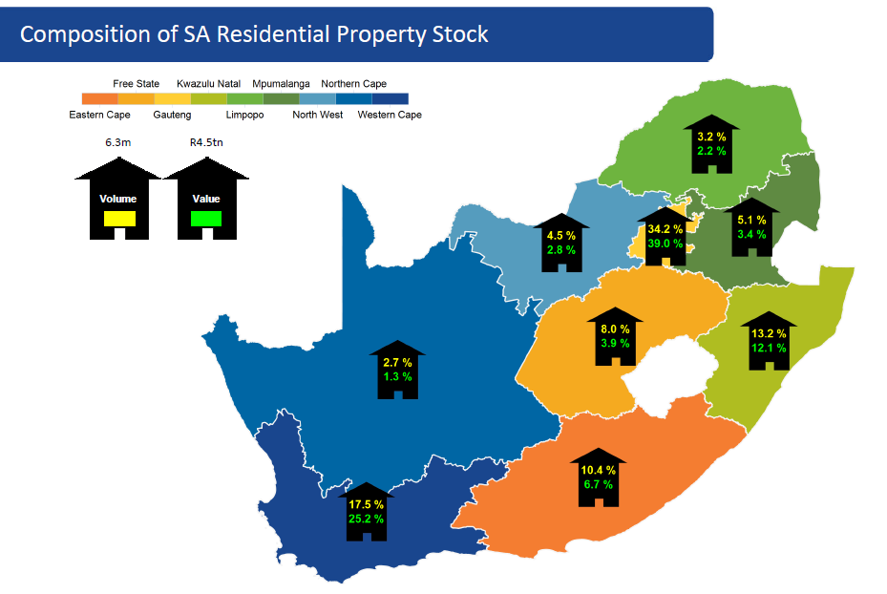

Slide 18
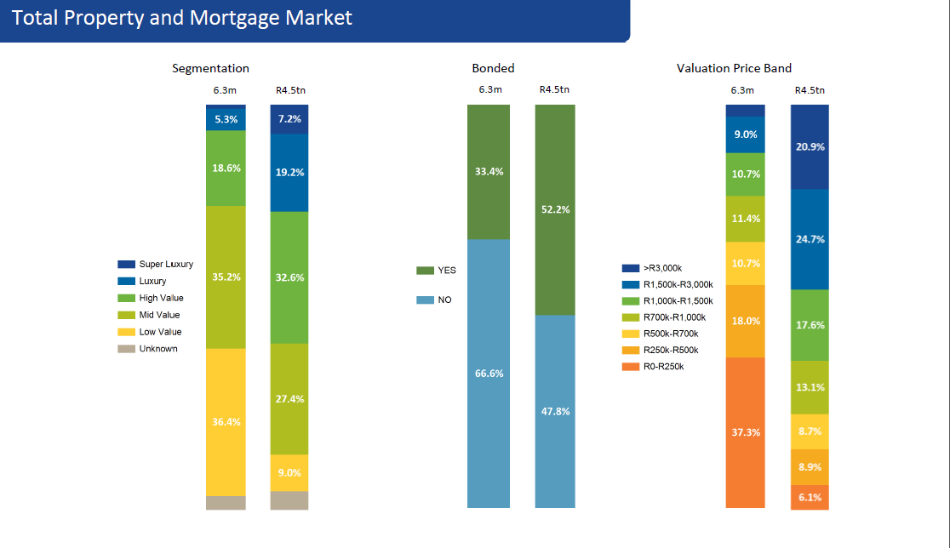

Slide 19
 | 31 March 2016 | 31 March 2015
Principal estate agents | 8 163 | 7 094
Non-principal estate agents | 11 261 | 10 274
Intern estate agents | 18 892 | 16 224
Firms | 5 226 | 5 057
Attorneys | 187 | 104
Total | 43 729 | 38 753

Slide 20
FIDELITY FUND CERTIFICATES BY - GENDER
The numbers relating to the gender of registered estate agents for the 2015/2016 financial year are indicated in the graph below.
 | 31 March 2016 | 31 March 2015
Male | 16 675 | 13 986
Female | 21 828 | 19 710
Total | 38 503 | 33 696

Slide 21
FIDELITY FUND CERTIFICATE – BY PROVINCE
The numbers of registered estate agents in each province for the 2015/2016 financial year are depicted in the chart below.
 | 31 March 2016 | 31 March 2015
Kwa-Zulu Natal | 5 129 | 4 257
Mpumalanga | 1 378 | 1 116
Limpopo | 587 | 634
North West | 1 198 | 925
Free State | 1 120 | 939
Northern Cape | 336 | 304
Eastern Cape | 1 986 | 1 699
Western Cape | 9 082 | 7 629
Gauteng | 17 687 | 16 193
TOTAL | 38 503 | 33 696

Slide 22
FIDELITY FUND CERTIFICATE – BY RACE
The racial distribution of registered estate agents for the 2015/2016 financial year is indicated below:
 | 31 March 2016 | 31 March 2015
White | 31 794 | 28 689
African | 3 944 | 2 955
Coloured | 781 | 600
Indian | 1 984 | 1 452
Total | 38 503 | 33 696

Slide 24
New Registrations
CATEGORY | 31 March 2016 | 31 March 2015
Attorney | 76 | 34
Close Corporations | 69 | 66
Partnerships | 1 | 18
Companies | 357 | 240
Full Status Estate Agents | 30 | 1
Intern Estate Agents | 6 614 | 6 074
Principal Estate Agents | 21 | 7
TOTAL | 7 168 | 6 440

Slide 25
EDUCATION AND TRAINING
The Education and Training Department is tasked with ensuring both the professionalisation and the transformation of the estate agency sector by fully implementing the educational dispensation for estate agents as established by the Standard of Training of Estate Agents Regulations promulgated on 4 June 2008.
Education and training regulatory and prescribed qualifications for estate agents
In terms of regulation 4(1)(a) of the Education Regulations no person may perform the functions and activities of a non-principal estate agent unless that person has completed the Further Education and Training Certificate: Real Estate (SAQA QUAL ID 59097). The regulation also prescribes that no person may perform the functions and activities of a principal estate agent unless that person has completed the National Certificate: Real Estate (SAQA QUAL ID 20188).

Slide 26
EDUCATION AND TRAINING Cont/…
These qualifications, which are presently quality assured by the Services Sector Education and Training Authority (SSETA), are designed to enhance the provision of entry level service within the property and real estate professions and also seek to provide the broad knowledge, skills and values that are needed by estate agency practitioners in the property and real estate environment.
The mode of delivery for these qualifications is formal training, recognition of prior learning, age-based and equivalency exemptions.

Slide 27
The following is a table illustrating the number of estate agents who qualified against these prescribed qualifications during the year under review, as compared to the previous financial year:
Compliance with prescribed qualifications | 31 March 2016 | 31 March 2015
Estate agents who qualified at NQF 4 (FETC: Real Estate) | 16 371 | 1 297
Estate agents who qualified at NQF 5 (National Certificate: Real Estate) | 6 464 | 600
TOTAL | 22 835 | 1 897

Slide 28
Equivalency Exemption based on academic achievements
Equivalency exemption applications assessed and granted | 31 March 2016 | 31 March 2015
Equivalency exemptions at NQF Level 4 (FETC: Real Estate) only | 34 | 51
Equivalency exemption at NQF Level 5 (NC: Real Estate) only | 14 | 13
Equivalency exemptions at both NQF Levels 4 (FETC: Real Estate) and NQF Level 5 (NC: Real Estate) | 464 | 381
TOTAL | 512 | 445

Slide 29
Study Material issued to Estate Agents
Study materials issued | 31 March 2016 | 31 March 2015
PDE 4 Study Guides | 647 | 646
PDE 5 Study Guides | 300 | 430
TOTAL | 947 | 1 076

Slide 30
The Professional Designation Examination (PDE)
Professional Designation Examination conducted | 31 March 2016 |  | 31 March 2015
 | PDE 4 | PDE 5 | PDE 4 | PDE 5
Candidates who wrote the examination | 1 526 | 324 | 614 | 463
Candidates who passed the examination | 1 121 | 235 | 467 | 352
Candidates who failed the examination | 405 | 89 | 147 | 100
Pass rate | 73% | 73% | 76% | 76%

Slide 31
Statutory exemptions granted | 31 March 2016 | 31 March 2015
Principal Estate Agent | 128 | 370
Non- Principal Estate Agent | 175 | 350
Total | 303 | 720

Slide 32
Status upgrade granted and the issue of amended fidelity fund certificates to qualifying estate agents
Status Upgrades granted | 31 March 2016 | 31 March 2015
From Intern to Full Status Agent | 182 | 116
From Full Status to Principal Estate Agent | 103 | 64
Total | 285 | 180

Slide 33
COMPLIANCE
The mandate of the EAAB is two-fold. It is divided into the primary and secondary mandates.
The primary mandate of the EAAB as outlined in the Act, 112 of 1976 is to maintain and promote the standard of conduct of estate agents and to regulate the activities of estate agents in the interest of the public.
The secondary mandate is stipulated in the Financial Centre Intelligence Act which on the EAAB to ensure compliance with the FIC Act by estate agents. Therefore the Enforcement & Compliance Department is tasked with carrying out this core mandate of the EAAB.
The Department receives and investigates complaints from members of the public and follow through with disciplinary proceedings where the evidence received establishes incidents of wrong doing on the part of estate agents.

Slide 34
COMPLIANCE Cont/…
The mandate of the EAAB is two-fold. It is divided into the primary and secondary mandates. The activities of the Department are informed by the number of complaints the Board receives from members of the public against estate agents.
The Department is also responsible for giving guidance and legal advice to Consumers and estate agents on the provisions of the Estate Agency Affairs Board and for providing necessary guidance to complainant’s regarding the correct forum to submit their complaints where the complaints fall outside of the jurisdiction of the EAAB.
The various sources from which the Board receives complaints are as follows:
1. Post / Mail
2. Email/
3. On-line
4. Fax
5. Walk-in clients
6. Whistle Blower
7. Inspections

Slide 35
COMPLIANCE Cont/…
The consumer awareness initiatives that the Board has undertaken through various means including community radio stations, has resulted in more and more consumers becoming aware of their rights and this is evidence from the nature of the complaints received as consumers seem to be aware of the provisions that have been transgressed by the estate agent.
However, the need to reach more consumers and provide awareness regarding the importance of dealing with registered estate agents remains a challenge that the Board needs to continuously deal with.

Slide 36
 | 31 March 2016 | 31 March 2015
Complaints received | 4 821 | 2 888
Complaints investigated & finalised | 3 131 | 1 076
No jurisdiction | 1 031 | 1 812
Pending finalization | 659 | 736

Slide 37
Disciplinary Hearings
 | 31 March 2016 | 31 March 2015
Cases enrolled | 167 | 1 076
Convictions | 67 | 1 072
Acquittals | 23 | 4
Postponed/ withdrawn | 32 | 0
Appeals | 1 | 0

Slide 38
INSPECTIONS
 |  | 31 March 2016 |  | 31 March 2015
 | Province | Total | Coverage | Total | Coverage
1 | Eastern Cape | 39 | 6% | 24 | 2%
2 | Free State | 22 | 4% | 10 | 1%
3 | Gauteng | 253 | 41% | 365 | 36%
4 | KwaZulu Natal | 77 | 12% | 81 | 8%
5 | Limpopo | 33 | 5% | 66 | 6%
6 | Mpumalanga | 18 | 3% | 149 | 15%
7 | North West | 22 | 4% | 84 | 8%
8 | Northern Cape | 5 | 1% | 32 | 3%
9 | Western Cape | 151 | 24% | 214 | 21%
 | TOTAL | 620 | 100% | 1025 | 100%

Slide 39
EAA Act 112, of 1976 Contraventions per province
 | PROVINCE | S 26 – FFC | S 32(1) – Trust account(s) | S 32(2)(a) – Trust Investment account(s) | S 32(2) (c) - Interest on trust monies | S 32(2)(e) – Retention of trust monies | S 32(3) – Trust accounting records | S 32 (7) - Cessation of practice | S 29(b) – Audited accounting records | Contracts - regulation 4.1.2 | contracts - sole mandates | S 34A - Invalid FFC's & Remuneration | S 34B – Contracts sign off by interns | Not available for inspection | Unannounced Inspection - Supporting documents not submitted
1 | Eastern Cape | 10 | 7 | 1 | - | 1 | 3 | - | 3 | - | - | 2 | 11 | - | -
2 | Free State | 9 | 12 | 3 | 1 | 1 | 6 | 2 | 7 | - | - | 6 | 9 | 1 | -
3 | Gauteng | 50 | 107 | 28 | 8 | 7 | 52 | 2 | 50 | 1 | - | 9 | 57 | 4 | 4
4 | KwaZulu Natal | 11 | 22 | 3 | - | 1 | 13 | - | 11 | - | - | 3 | 12 | - | -
5 | Limpopo | 9 | 17 | - | - | - | 9 | - | 7 | - | - | 2 | 9 | - | 1
6 | Mpumalanga | 7 | 10 | 4 | 2 | - | 7 | - | 4 | - | - | - | 3 | - | -
7 | North West | 8 | 12 | 5 | - | - | 2 | 4 | 3 | - | - | 5 | 1 | 1 | -
8 | Northern Cape | - | - | - | - | - | - | - | - | - | - | - | - | - | -
9 | Western Cape | 45 | 56 | 16 | 2 | 3 | 27 | 3 | 30 | 2 | - | 13 | 25 | 1 | -
 | TOTAL | 149 | 243 | 60 | 13 | 13 | 119 | 11 | 115 | 3 | - | 40 | 127 | 7 | 5

Slide 42
FIC Act 38, of 2001 Contraventions per province
 | PROVINCE | S 43B & Reg 27A - Registration | S 43(b) - Duty to appoint a compliance officer | S 21 Duty to identify clients | S 22 - Duty to keep records | S 23 - Period for which records are kept | S 24 & Reg 20 - Records kept by third party | S 28 Regs 22B, 22C & 24 - Cash transaction above threshold R25 000 | S 29 & Regs 23 & 24 - Suspicious and unusual transactions | S 42 & Regs 25,26&27 - Internal rules
1 | Eastern Cape | 5 | 0 | 0 | 17 | 1 | 0 | 0 | 0 | 9
2 | Free State | 4 | 5 | 1 | 10 | 2 | 1 | 1 | 2 | 9
3 | Gauteng | 45 | 47 | 20 | 66 | 10 | 3 | 5 | 16 | 110
4 | KwaZulu Natal | 9 | 6 | 1 | 15 | 1 | 0 | 0 | 1 | 14
5 | Limpopo | 9 | 9 | 1 | 14 | 5 | 0 | 1 | 0 | 13
6 | Mpumalanga | 5 | 9 | 2 | 5 | 0 | 0 | 0 | 0 | 11
7 | North West | 6 | 2 | 1 | 7 | 0 | 0 | 0 | 0 | 8
8 | Northern Cape | 1 | 0 | 0 | 1 | 0 | 0 | 0 | 0 | 0
9 | Western Cape | 35 | 30 | 4 | 47 | 2 | 0 | 0 | 7 | 63
 | TOTAL | 119 | 108 | 30 | 182 | 21 | 4 | 7 | 26 | 237

Slide 44
AUDIT COMPLIANCE
Improvement in compliance levels relating to the submission of audit reports within the four months prescribed time.
 | 2012/2013 | 2013/2014 | 2014/2015 | 2015/2016
Received within prescribed four months | 29% | 51% | 90% | 85%
Received outside prescribed four months | 71% | 49% | 10% | 15%

Slide 45
Audit reports in the 2015/2016 financial year
2016 | 2015 | 2014 | 2013 and prior | Total
41 | 6396 | 674 | 1403 | 8514

Slide 46
CLAIMS AND SECTION 27 APPLICATIONS
Claims
STATISTICS OF NEW CLAIMS AGAINST THE FUND | 2016 | 2015 | 2014 | 2013 | 2012
Number of claims received | 282 | 53 | 60 | 67 | 225

Slide 47
Claims processed against the fidelity fund for the period 2015/2016
Claims Statistics (Rand) | 31-Mar-16 | 31-Mar-15 | 31-Mar-14 | 31-Mar-13 | 31-Mar-12
Value of claims lodged | 20 564 502 | 5 947 783 | 10 447 320 | 2 352 209 | 10 461 075
Value of claims approved | 7 249 818 | 3 516 964 | 4 866 526 | 288 600 | 3 849 910
Value of claims rejected | 197 349 | 2 151 043 | 4 077 829 | 389 004 | 2 588 299
Value of claims pending | 13 117 335 | 870 728 | 2 049 284 | 1 674 605 | 4 022 935

Slide 48
FORMAL SECTION 27 APPLICATIONS (NON BOARD RESOLUTION)
NO | DESCRIPTION | 2012 | 2013 | 2014 | 2015 | 2016
1 | Applications Received | 21 | 22 | 10 | 11 | 32
2 | Applications Approved | 20 | 22 | 10 | 11 | 29
3 | Applications Rejected | 1 | 0 | 0 | 0 | 3

Slide 49
Applications by persons disqualified in terms of section 27 for late submission of audit reports
NO. | Description | 31 March 2014 | 31 March 2015 | 31 March 2016
1 | Applications Received | 1718 | 11200 | 5463
2 | Applications Approved | 570 | 8974 | 3000
3 | Applications Rejected | 1512 | 2226 | 2463

Slide 50
Title Deed Restoration Project
Outstanding Transfers
14%
Title Deeds Issued Transfers
86%

Slide 51
Integrated Human Capital
HUMAN RESOURCE OVERSIGHT STATISTICS
Personnel costs per programme
Programme | Total expenditure (R'000) | Total personnel per costs (R'000) | Personnel expenditure as a % of Total expenditure | No. of employees | Average personnel costs per employee (R'000)
CEO's office | 23,182 | 16,085 | 69% | 15 | 1 072
Compliance | 29,686 | 26,879 | 91% | 43 | 625
Education & Training | 24,870 | 7,009 | 28% | 13 | 539
Corporate services | 37 692 | 16548 | 445 | 32 | 517
 | 115,430 | 66,521 |  | 104

Slide 52
Integrated Human Capital
HUMAN RESOURCE OVERSIGHT STATISTICS
Personnel costs per salary band
Programme | Total personnel per costs (R'000) | Personnel expenditure as a % of Total expenditure | No. of employees | Average personnel costs per employee (R'000)
Top Management | 17687 | 27% | 10 | 1768
Senior Management | 11002 | 17% | 9 | 1222
Professional qualified | 10706 | 16% | 11 | 973
Skilled | 8830 | 13% | 12 | 736
Semi-skilled | 17380 | 26% | 58 | 411
Unskilled | 916 | 1% | 4 | 229
TOTAL | 66521

Slide 53
Integrated Human Capital
HUMAN RESOURCE OVERSIGHT STATISTICS
Training Costs
Programme | Total personnel per costs (R'000) | Personnel expenditure as a % of Total expenditure | No. of employees | No. of employees trained | Average personnel costs per employee (R'000)
CEO & Strategy | 16085 | 258 | 2% | 13 | 20
Compliance | 26879 | 459 | 2% | 38 | 12
Education and Training | 7009 | 43 | 1% | 10 | 4
Corporate Services | 16548 | 729 | 4% | 26 | 28
TOTAL | 66521 | 1490 |  | 87 | 18

Slide 54
Integrated Human Capital
HUMAN RESOURCE OVERSIGHT STATISTICS
Salary Bands
Salary Bands | 2015/2015 No. of Employees | 2015/2016 Approved Posts | 2015/2016 No. of employees | 2015/2016 Vacancies | % of Vacancies
Top Management | 8 | 10 | 10 | - | 0%
Senior Management | 10 | 13 | 9 | 4 | 31%
Professional qualified | 9 | 11 | 11 | 0 | 0%
Skilled | 9 | 14 | 12 | 2 | 14%
Semi-skilled | 55 | 68 | 58 | 10 | 15%
Unskilled | 4 | 4 | 4 | 0 | 0%
TOTAL | 95 | 120 | 104 | 16 | 13%

Slide 55
Integrated Human Capital
HUMAN RESOURCE OVERSIGHT STATISTICS
Employment Changes
Salary Bands | Employment at the beginning of the period | Appointments | Terminations | Employment at the end of the period
Top Management | 8 | 2 | 0 | 10
Senior Management | 10 | 1 | 2 | 9
Professional qualified | 9 | 2 | 0 | 11
Skilled | 9 | 3 | 0 | 12
Semi-skilled | 55 | 5 | 2 | 58
Unskilled | 4 | 0 | 0 | 4
TOTAL | 95 | 13 | 4 | 104

Slide 56
Integrated Human Capital
HUMAN RESOURCE OVERSIGHT STATISTICS
Reasons for leaving EAAB employment
Reason | Number | % of staff leaving
Death | 0 | 0
Resignation | 3 | 3%
Dismissal | 0 | 0%
Retirement | 1 | 1%
Ill Health | 0 | 0%
Expiry of contract | 0 | 0%
Promoted to higher position | 0 | 0%
Total | 4 | 4%

Slide 57
Integrated Human Capital
HUMAN RESOURCE OVERSIGHT STATISTICS
Labour Relations: Misconduct and Disciplinary
Reason | Number
Verbal warning | 2
Written warning | 3
Final written warning | 0
Dismissal | 0
Total | 55

Slide 58
Integrated Human Capital
HUMAN RESOURCE OVERSIGHT STATISTICS
Employment Equity status - MALE
Salary Bands | AFRICAN MALE |  | COLOURED MALE |  | INDIAN MALE |  | WHITE MALE
 | EAAB Staff | EE Target | EAAB Staff | EE Target | EAAB Staff | EE Target | EAAB Staff | EE Target
Top Management | 6 | 5 | 2 | 2 | 0 | 0 | 1 | 0
Senior Management | 3 | 4 | 0 | 0 | 0 | 0 | 0 | 0
Professional qualified | 5 | 3 | 0 | 0 | 0 | 0 | 0 | 0
Skilled | 4 | 3 | 0 | 1 | 1 | 2 | 0 | 1
Semi-skilled | 16 | 18 | 0 | 1 | 0 | 1 | 0 | 0
Unskilled | 2 | 0 | 0 | 0 | 0 | 0 | 0 | 0
TOTAL | 36 | 33 | 2 | 4 | 1 | 2 | 1 | 1

Slide 59
Integrated Human Capital
HUMAN RESOURCE OVERSIGHT STATISTICS
Employment Equity status - FEMALE
Salary Bands | AFRICAN FEMALE |  | COLOURED FEMALE |  | INDIAN FEMALE |  | WHITE FEMALE
 | EAAB Staff | EE Target | EAAB Staff | EE Target | EAAB Staff | EE Target | EAAB Staff | EE Target
Top Management | 1 | 2 | 0 | 0 | 0 | 0 | 0 | 0
Senior Management | 4 | 7 | 0 | 0 | 0 | 0 | 2 | 2
Professional qualified | 5 | 6 | 0 | 0 | 1 | 1 | 0 | 1
Skilled | 7 | 8 | 0 | 0 | 0 | 0 | 0 | 0
Semi-skilled | 39 | 41 | 1 | 2 | 1 | 2 | 1 | 2
Unskilled | 2 | 0 | 0 | 0 | 0 | 0 | 0 | 0
TOTAL | 58 | 64 | 1 | 2 | 2 | 3 | 3 | 5

Slide 60
EAAB BOARD AND BOARD CHAIRMAN’S COMMITTEE
 | Chairman’s Committee: (7 members)
 | Members | Date of Appointment | Total Number of Meetings | Total Attended
1 | Kwandiwe Kondlo | 01 January 2013 | 3 | 3
2 | Maletsatsi Maceba-Wotini | 01 January 2013 | 3 | 2
3 | Jill Corfield | 01 January 2013 | 3 | 2
4 | Mputumi Damane | 01 January 2013 | 3 | 2
5 | Sikander Kajee | 01 January 2013 | 3 | 1
6 | Patricia Lebenya | 01 January 2013 | 3 | 3
7 | Tshepo Maake | 01 January 2013 | 3 | 1
8 | Jabhile Mbele | 01 January 2013 | 3 | 1
9 | Bethuel Nsibande | 01 January 2013 | 3 | 1
10 | Fazel Randera | 01 January 2013 | 3 | 2

Slide 61
EAAB BOARD AND BOARD COMMITTEE MEETINGS
Board meetings: (7 Members)
No. | Name | Date of Appointment | Total Number of Meetings | Total Attended
1 | Kwandiwe Kondlo | 01 February 2013 | 3 | 3
2 | Maletsatsi Maceba-Wotini | 01 February 2013 | 3 | 2
3 | Mputumi Damane | 01 February 2013 | 3 | 2
4 | Sikander Kajee | 01 February 2013 | 3 | 0
5 | Patricia Lebenya | 01 February 2013 | 3 | 2
6 | Tshepo Maake | 01 February 2013 | 3 | 2
7 | Fazel Randera | 01 February 2013 | 3 | 2

Slide 62
AUDIT, RISK AND FINANCE COMMITTEE
 | Audit, Risk and Finance Committee: (7 members)
 | Members | Date of Appointment | Total Number of Meetings | Total Attended
1 | Kyansambo Vundla (Chairman) | 01 Feb 2013 | 5 | 4
2 | Sikander 'Sikkie' Kajee | 10 May 2013 | 4 | 3
3 | Moope Mphahlele | 01 Feb 2013 | 5 | 2
4 | David Bosa | 24 Mar 2011 | 4 | 4
5 | Mputumi Damane | 10 May 2013 | 4 | 4
6 | Jabhile Mbele | 10 May 2013 | 4 | 1
7 | Tendai Mapenda | 01 Feb 2016 | 1 | 1

Slide 63
CLAIMS COMPLIANCE AND ENFORCEMENT COMMITTEE
 | Claims Compliance and Enforcement Committee 2015/2016: (4 members)
 | Members | Date of Appointment | Total Number of Meetings | Total Attended
1 | Tshepo Maake (Chairman) | 10 May 2013 | 3 | 3
2 | Sikander 'Sikkie' Kajee | 10 May 2013 | 3 | 3
3 | Patricia Lebenya | 10 May 2013 | 3 | 1
4 | Jill Corfield | 10 May 2013 | 3 | 3

Slide 64
EDUCATION AND TRAINING COMMITTEE
 | Education and Training Committee: (4 members)
 | Members | Date of Appointment | Total Number of Meetings | Total Attended
1 | Fazel Randera (Chairman) | 10 May 2013 | 2 | 2
2 | Patricia Lebenya | 10 May 2013 | 2 | 1
3 | Mputumi Damane | 10 May 2013 | 2 | 2
4 | Maletsatsi Maceba-Wotini | 10 May 2013 | 2 | 1

Slide 65
HUMAN RESOURCES AND REMUNERATION COMMITTEE
 | Human Resources and Remuneration Committee: (4 members)
 | Members | Date of Appointment | Total Number of Meetings | Total Attended
1 | Patricia Lebenya (Chairman) | 10 May 2013 | 3 | 3
2 | Bethuel Nsibande | 10 May 2013 | 3 | 3
3 | Maletsatsi Maceba-Wotini | 10 May 2013 | 3 | 1
4 | Tshepo Maake | 10 May 2013 | 3 | 3

Slide 66
Committee of Inquiry into Racism in the Property Sector
 | Committee of Inquiry into Racism in the Property Sector
 | Members | Organisation Represented | Number of Meetings Held | Total Attended
1 | B Chaplog | Estate Agency Affairs Board | 1 | 1
2 | T Moloi | Department of Human Settlements | 1 | 1
3 | S Letele | Department of Human Settlements | 1 | 1
4 | I Padayachy | Ministry of Human Settlements | 1 | 1
5 | N Ndebele | Estate Agency Affairs Board | 1 | 1
6 | K Mlotha | Estate Agency Affairs Board | 1 | 1
7 | N Matibe | Department of Justice & Constitutional Development | 1 | 1
8 | Z McLaren | Gauteng Rental Housing Tribunal | 1 | 1
9 | M Menye | Community Scheme Ombud Service | 1 | 1
10 | J Tladi | Estate Agency Affairs Board | 1 | 1
11 | K Ngwenya | Estate Agency Affairs Board | 1 | 1
12 | D Dube | Community Scheme Ombud Service | 1 | 1

Slide 67

Estate Agency Affairs Board
ANNUAL REPORT AND
FINANCIAL STATEMENTS - 2015/2016

Slide 68
The Estate Agency Affairs Board and its controlled entity
Consolidated and Separate Financial Statements
for the year ended 31 March 2016

Slide 69

INDEPENDENT AUDITORS REPORT
^{Opinion}
In our opinion, the consolidated and separate financial statements present fairly, in all material respects, the financial position of the Estate Agency Affairs Board as at 31 March 2016 and financial performance and cash flows for the year then ended, in accordance with Generally Recognised Accounting Practices and the requirements of the Public Finance Management Act, 1 of 1999 of South Africa.

Slide 70
INDEPENDENT AUDITORS REPORT
^{Other matters}
We draw attention to the matter below. Our opinion is not modified in respect of this matter below:
We note that the previous board term of office expired on the 31st of December 2015. The new board was appointed on the 6th of July 2016, subsequent to year end as per note 26 in the financial statements

Slide 71
INDEPENDENT AUDITORS REPORT
^{Other reports}
As part of our audit of the financial statements for the year ended 31 March 2016, we have read the Director’s Report, the Audit Committee’s Report and the Company Secretary’s Certificate for the purpose of identifying whether there are material inconsistencies between these reports and the audited financial statements. These reports are the responsibility of the respective preparers. Based on reading these reports we have not identified material inconsistencies between the reports and the audited financials. We have not audited the reports and accordingly do not express an opinion on them.

Slide 72
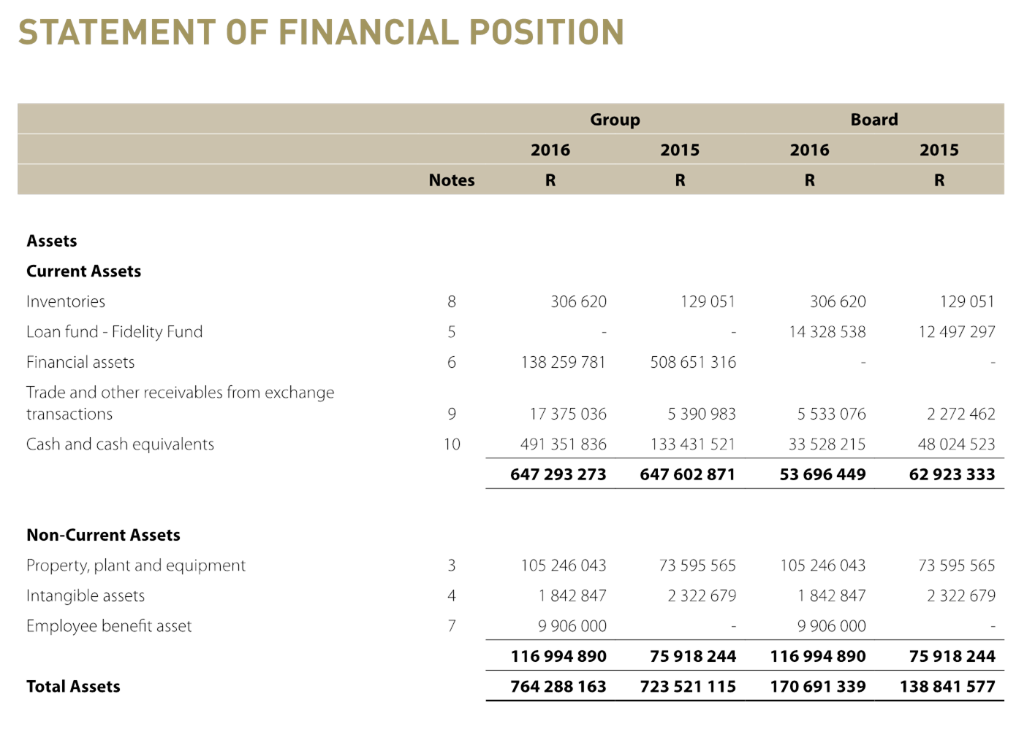
STATEMENT OF FINANCIAL POSITION

Slide 73
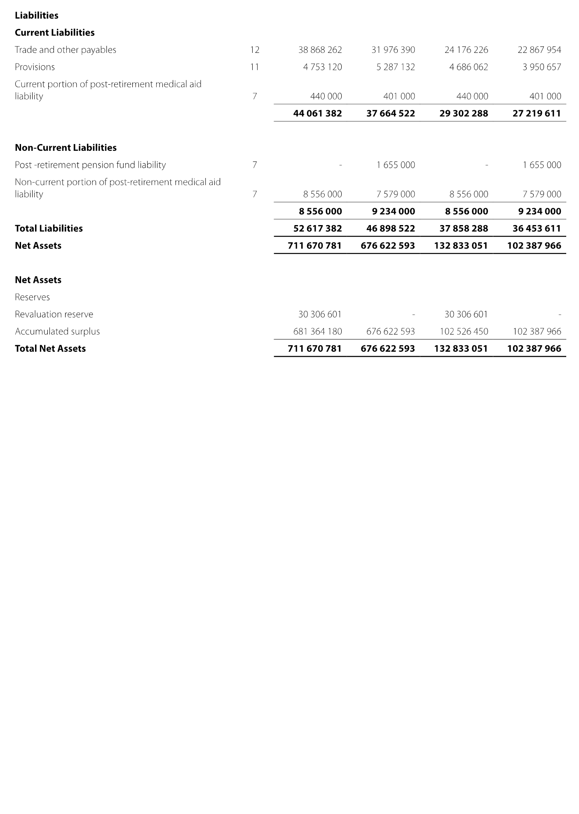
STATEMENT OF FINANCIAL POSITION

Slide 74
FINANCIAL OVERVIEW
THE ESTATE AGENCY AFFAIRS BOARD (EAAB)
A financial overview of the five (5) year period ended 31 March 2016 reveals the following key achievements:
(a) Total assets grew by 30% from R102,388 million to R132,833 million;

Slide 75
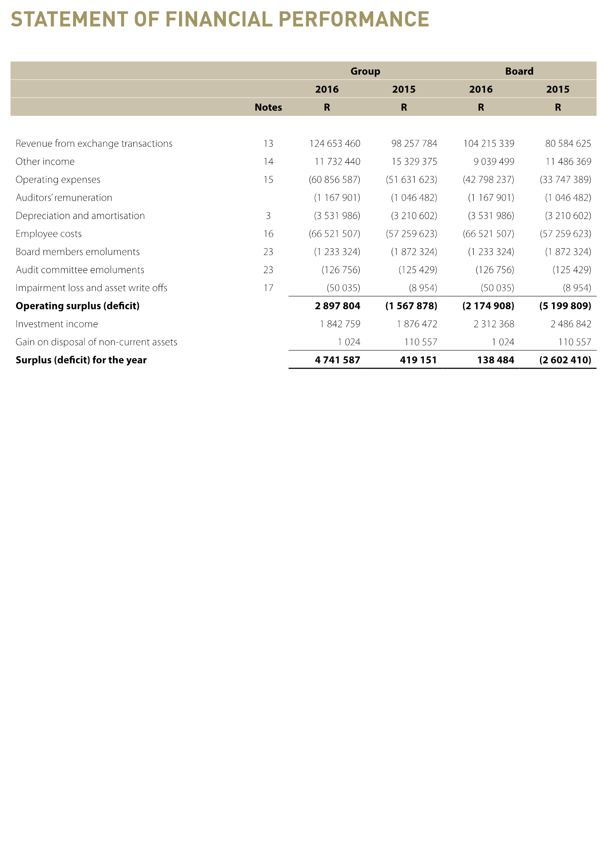
STATEMENT OF FINANCIAL PERFORMANCE

Slide 76
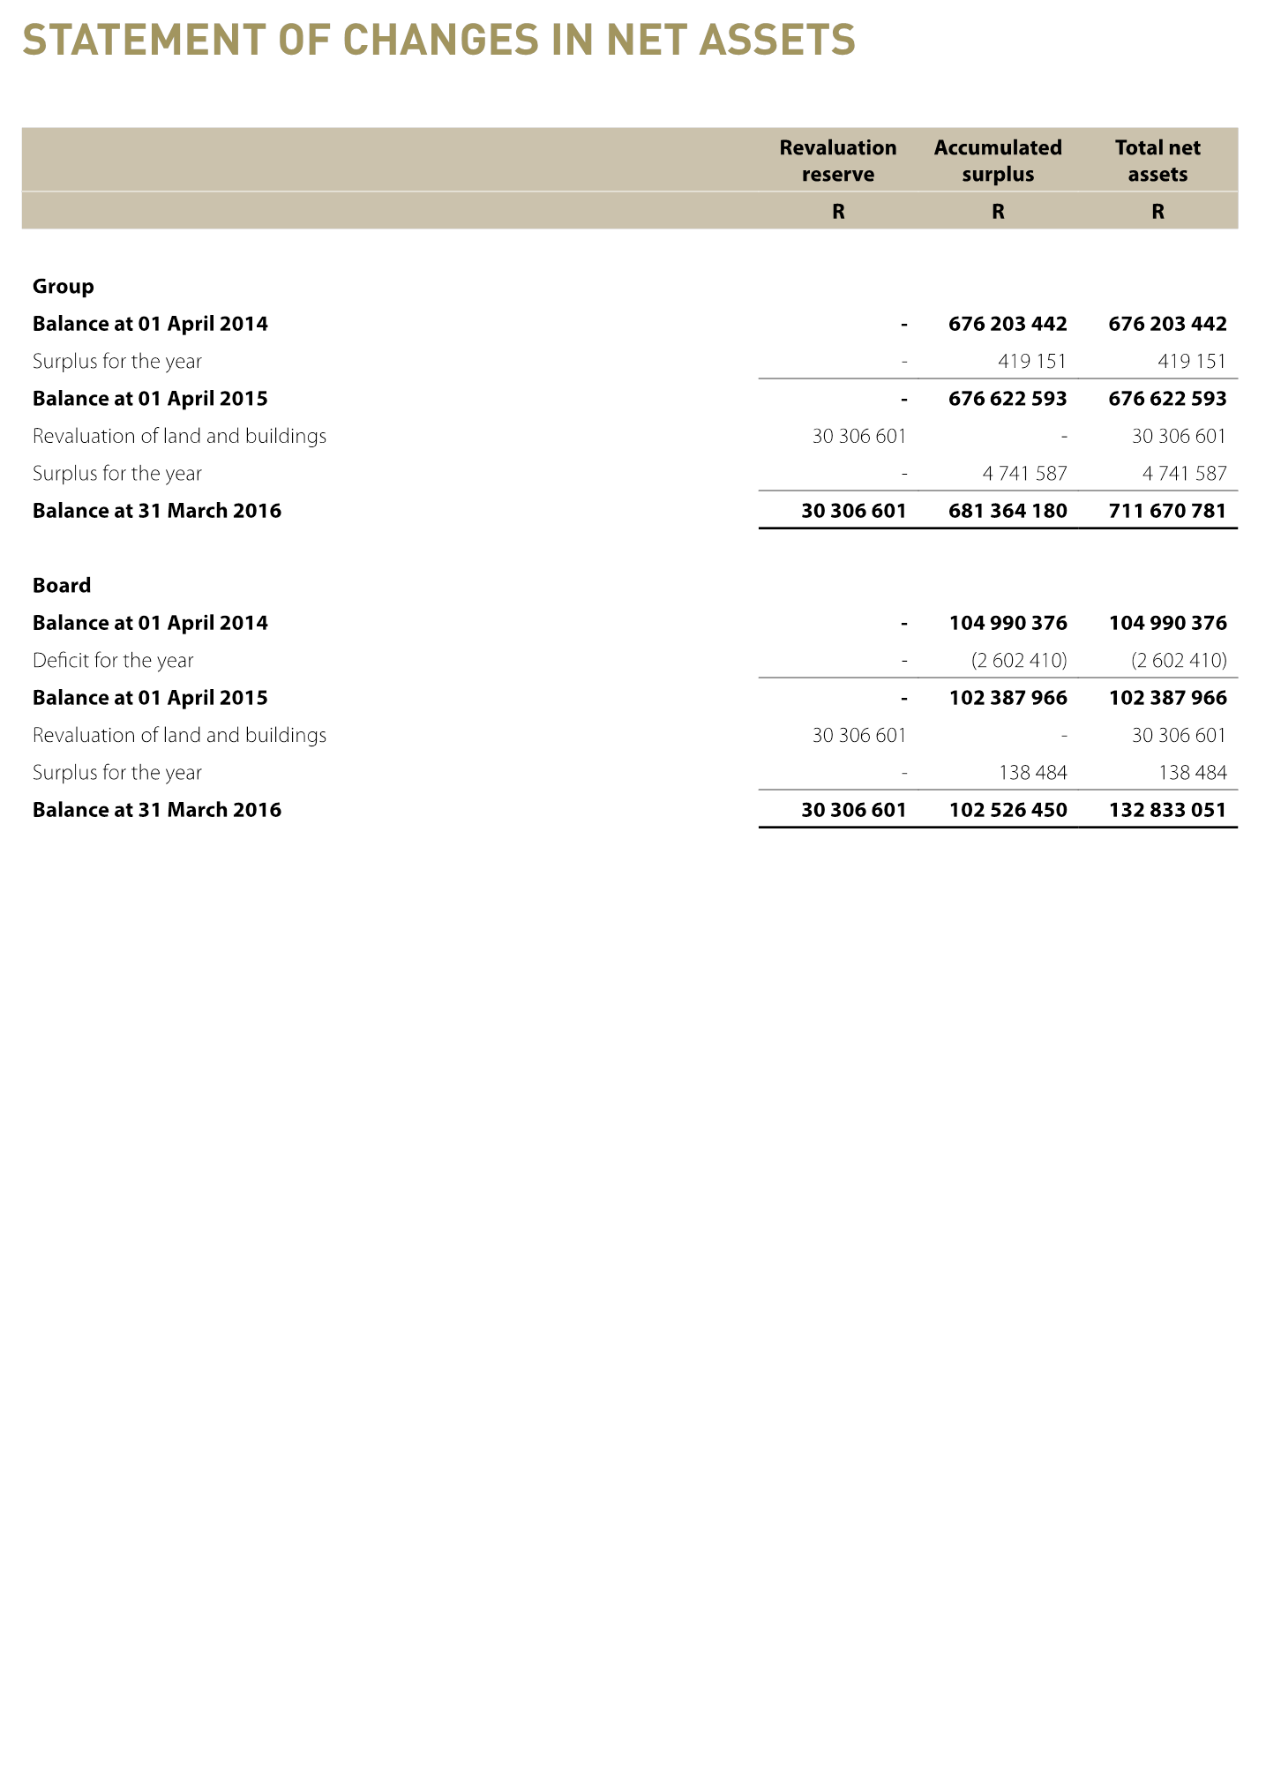
STATEMENT OF CHANGES IN NET ASSETS

Slide 77
^{ESTATE AGENTS FIDELITY FUND}
^{Annual Financial Statements}
for the year ended 31 March 2016

Slide 78
INDEPENDENT AUDITOR’S REPORT
^{Opinion}
In our opinion, the separate financial statements present fairly, in all material respects, the financial position of the Estate Agents Fidelity Fund as at 31 March 2016 and financial performance and cash flows for the year then ended, in accordance with Generally Recognised Accounting Practices and the requirements of the Public Finance Management Act, 1 of 1999 of South Africa.

Slide 79
INDEPENDENT AUDITORS REPORT
^{Other matters}
We draw attention to the matter below. Our opinion is not modified in respect of this matter below:
We note that the previous board term of office expired on the 31st of December 2015. The new board was appointed on the 6th of July 2016, subsequent to year end as per note 26 in the financial statements

Slide 80
INDEPENDENT AUDITORS REPORT
^{Other reports}
As part of our audit of the financial statements for the year ended 31 March 2016, we have read the Director’s Report, the Audit Committee’s Report and the Company Secretary’s Certificate for the purpose of identifying whether there are material inconsistencies between these reports and the audited financial statements. These reports are the responsibility of the respective preparers. Based on reading these reports we have not identified material inconsistencies between the reports and the audited financials. We have not audited the reports and accordingly do not express an opinion on them.

Slide 81
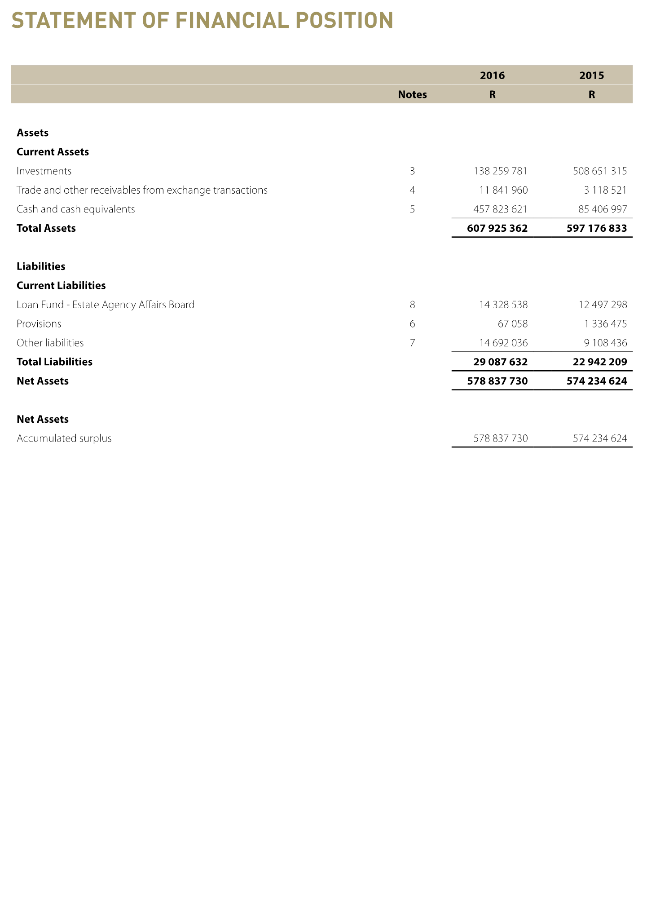
STATEMENT OF FINANCIAL POSITION

Slide 82
FINANCIAL OVERVIEW
THE ESTATE AGENTS FIDELITY FUND (EAFF)
A financial overview of the five (5) year period ended 31 March 2016 reveals the following key achievements:
(a) Capital and reserves grew by 0.80% from R574,235 million to R578,837 million

Slide 83

STATEMENT OF FINANCIAL PERFORMANCE

Slide 84
THANK YOU

