Slide 1
Presentation to Portfolio Committee on Water and Sanitation on TCTA Integrated Annual Report 2015/16
Ms Monhla Hlahla
CHAIRPERSON
2016

Slide 2
Outline
Strategic Overview
Annual Performance Report (2015-16)
Expenditure 2015-16
Discussion & Clarifications

Slide 3
Strategic Overview

Slide 4
TCTA Vision & Mission
Vision
To be the Leader in the Sustainable Supply of Water in the Southern Africa Region
Mission
To facilitate water security through the planning, financing and implementation of bulk raw water infrastructure, in the most cost-effective manner that benefits water users

Slide 5
TCTA, the Organization
Who is TCTA?
State-owned Water Infrastructure Entity (SPV)
Established in 1986 to fund and implement RSA portion of LHWP
Mandate expanded to undertake liability management on LHWP
Now a multi-project entity, to fund & implement bulk raw water infrastructure
Reports to Minister of Water & Sanitation
Shareholder’s Compact: agreement with Minister on the expected performance targets
Quarterly Reports to the Minister from Board
What do we do?
Project structuring
Project funding
Project implementation
Liability management
Tariff setting
Advisory services
Knowledge management

Slide 6
Strategic Goals
Deliver to Ministerial directives relating to the planning, financing & implementation of water infrastructure, in accordance with specifications & within agreed timelines & budget.
Ensure that all project activities facilitate social transformation & build sustainable communities by providing jobs & empowering women, youth & the disabled.
Operate the business & its projects & processes in a cost-effective manner, conscious of the imperatives of public fin mgt.
Build the knowledge & capability of the organization to support other water institutions, in pursuit of greater efficiencies in overall water management & water services delivery.
Ensure the continuous availability of high-calibre human capital for delivering on organisational mission into the future.

Slide 7
Contribution to Government Outcomes
Out- come | Government outcomes | TCTA contribution
4 | Decent employment through inclusive economic growth | Providing cost-effective water infrastructure as an enabler of economic growth & jobs
5 | A skilled and capable workforce | Developing entrepreneurship in small businesses and up-skilling the workforce to enable South Africa to compete in world markets
6 | Efficient, competitive and responsive economic infrastructure network | Providing a comprehensive financial and implementation package to ensure the most cost-effective solution
7 | Vibrant, equitable and sustainable rural communities with food security for all | Supporting other water sector institutions to enable them to deliver on their mandate

Slide 8
Contribution to Government Outcomes
Out-come | Government outcomes | TCTA contribution
8 | Sustainable human settlements and improved quality of household life | Providing affordable infrastructure
9 | A responsive, accountable, effective and efficient local government system | Supporting other water sector institutions to enable them to deliver on their mandate
10 | Environmental assets and natural resources that are well protected and continually enhanced | Contributing to the development of knowledge in the sector (desalination, water re-use)
12 | An efficient, effective and development-orientated public | A comprehensive internal training programme to enable TCTA to deliver quality products in the most efficient manner.

Slide 9
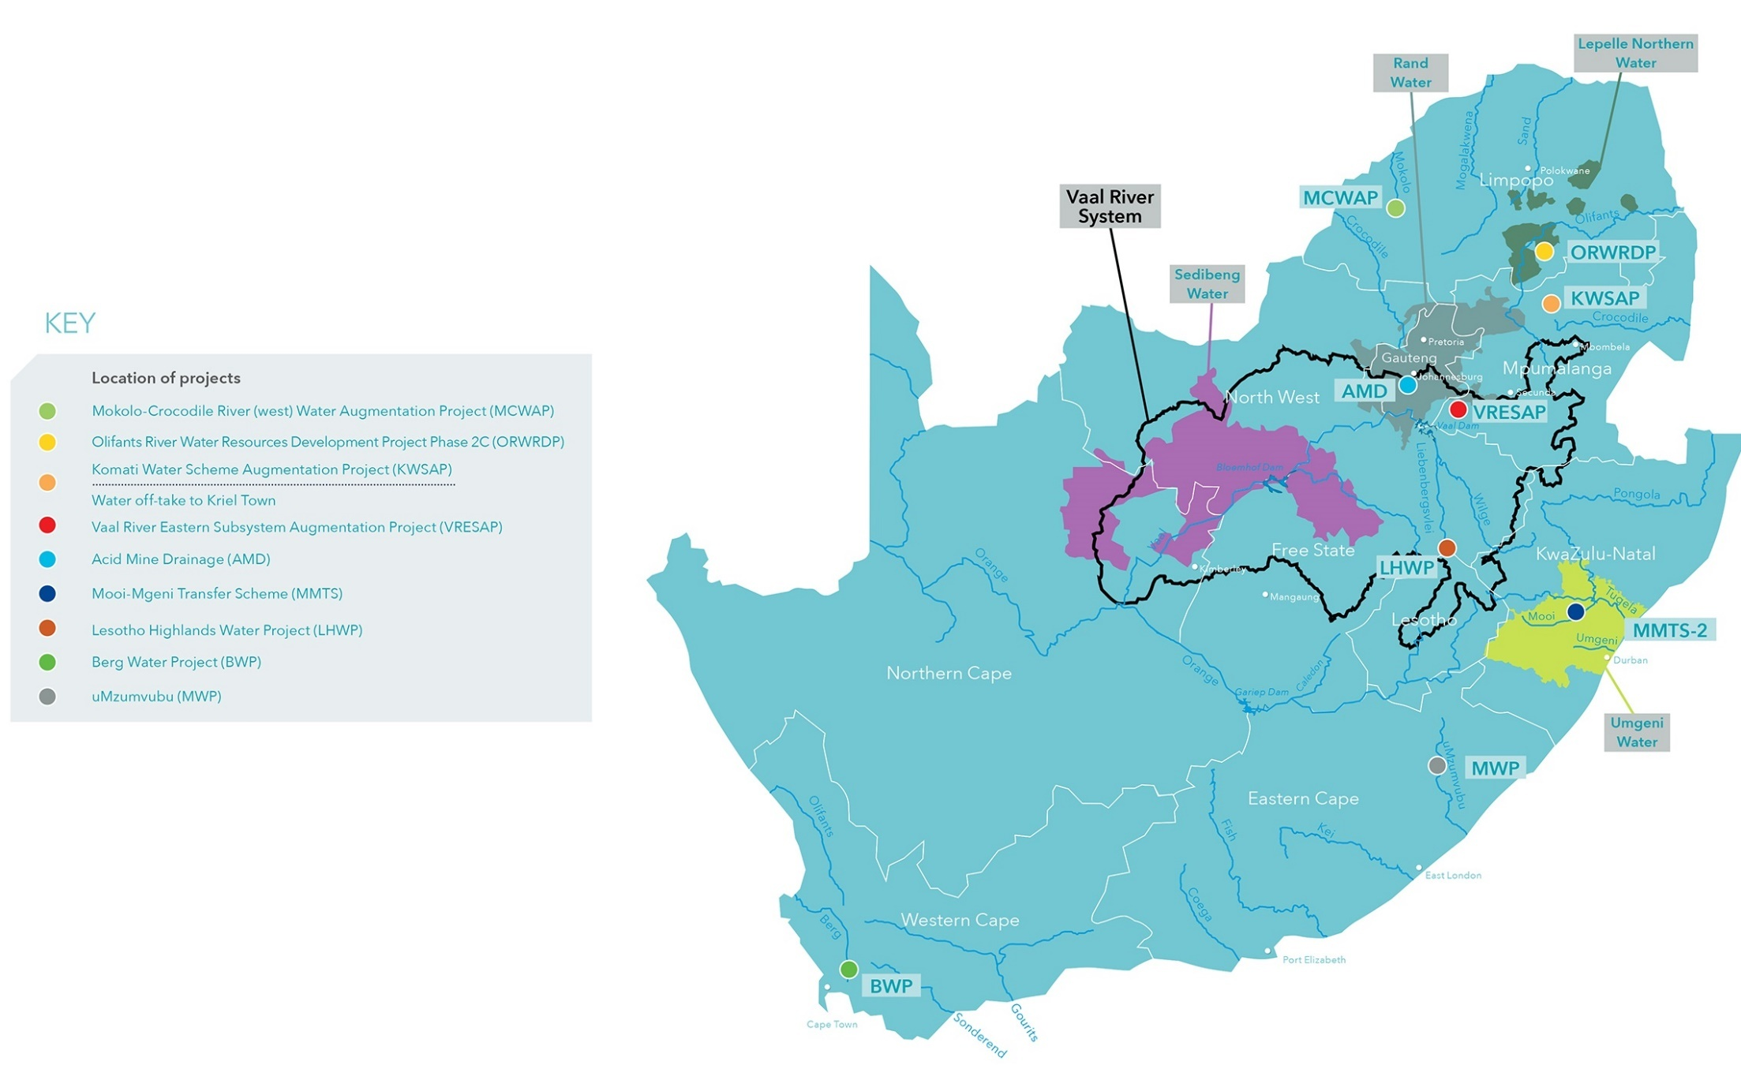
Location of TCTA Projects

Slide 10
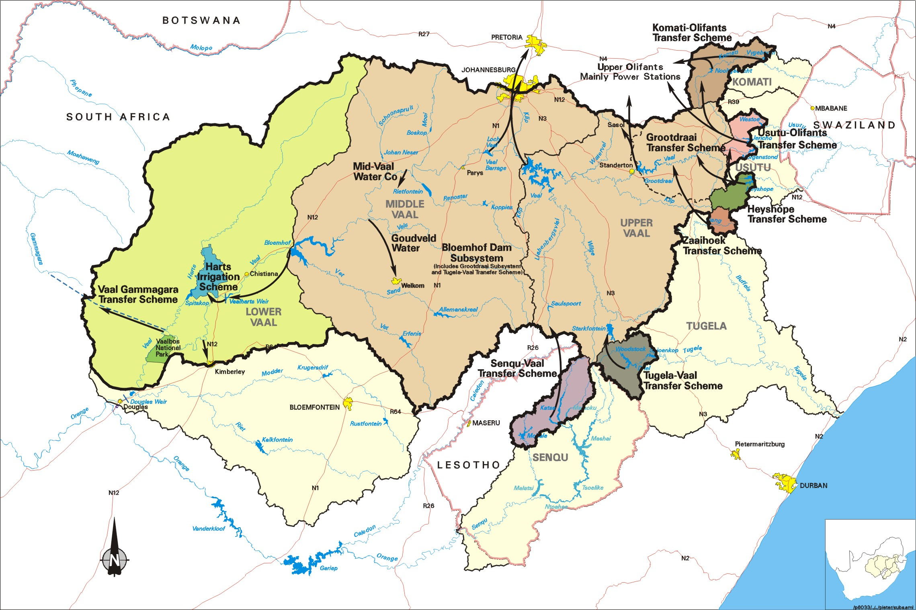
RUSTENBURG
Vaal Barrage
Vaal Dam
Bloemhof Dam
Proposed
Jana Dam
Proposed
Mielietuin Dam
Katse
Proposed Polihali Dam
Mohale
Vaal/Orange River System
10
Notes:
Quantity Issues
Resources of the Vaal exceeded in the early 1970’s so water transferred in from other catchments
The system covers the whole of Gauteng, but also the important areas in Mpumalanga (mines and industries (Sasol’s coal to liquid fuel) and bulk of Eskom’s coal fired power stations ), North West and Free State Gold Fields (supplied by Midvaal Water and Sedibeng Water respectively), Northern Cape (Kimberley and the mines and towns from the Vaal Gamagara Transfer Scheme), large irrigation schemes of which Vaalharts is the biggest in the country, and soon to the important developments near Lephalale (Eskom and Sasol) in Limpopo.
Numerous dams, pipeline etc. all owned and operated directly by DWA or through one of its entities such as a water board or a water user association
Problem is not just water quantity but water quality
Although good quality water from Vaal Dam is supplied to Gauteng, return flows (with pollutants added by users) and mine discharge flows into Barrage.
The salinity problem was shown to have the biggest impact on the future security of water in the VRS, and is therefore highlighted here.
This water is not fit for users downstream and we have being releasing water from Vaal Dam to dilute the Barrage to 600mg/l for many years now.
Although the studies suggested a long term strategy to deal with the salinity problem, we will have to continue with these releases for the short and medium term.
We have to ultimately implement source control.
We have ti implement and upgrade a monitoring programme.
The polluted return flows will increase in future as a result of population growth, with the effect that the releases from Vaal dam will increase. This will ultimately lead to loss of water out of the system.
The utilisation of the return flows must be studied and possible re-use schemes identified.
The re-use of the Acid Mine Drainage (AMD) must be seen as the first step.
Where does TCTA fit into this picture?
10

Slide 11
Annual Performance Report (2015-16)
Achievement of Predetermined Objectives

Slide 12
Objective1:
Manage the funding and debt on the infrastructure projects, in the Vaal River System, in a manner that achieves cost-effective funding, taking into account current and projected market conditions as well as managing risks
Achievements | Impact
Loan facilities were effective at the time when required Regulatory limits not breached | No failed disbursements Payment of interest and capital on required date No default declared

Slide 13
Objective 2:
Construct infrastructure on time, within budget, to the appropriate standards and in a sustainable socio environmental manner
Achievements | Impact
Augmentation of the Water Transfer Component of the Mooi Mgeni Transfer Scheme: Water delivery commenced in February 2016. Augmentation of the Mokolo Crocodile River water Augmentation Project: Water delivery commenced in June 2015 Olifants River Water Resources development Project: Construction of the last 30 km still in progress. Acid Mine Drainage: Eastern Basin, Construction still in progress. The projected date for the commencement of treatment is May 2016 | The full yield of the Mooi River can now be transferred into the Mgeni system to alleviate the stress caused by the drought The project has been completed well before the additional needs caused by the construction of Medupi Power Station and the associated mining activities The first 10 km has been able to deliver water to the water treatment works at Steelbrug since January 2014. Delays in the completion of the remainder of the project have not had a service delivery impact as the infrastructure necessary to take the water is not in place. No discharge of untreated AMD has occurred and there have been no reports of pollution to groundwater (outside of the mine void)

Slide 14
Objective 3:
Acid mine drainage is treated to the correct standard before discharge to the environment
Achievements | Impact
The concentrations of heavy metals have been reduced to within safe limits and the effluent is now alkaline Some reduction in the salt load has been achieved | The Department is now able to control the level of water in the mine void, by pumping and treating and reduced the risk to human health from heavy metals and high salt concentrations,
Objective 4:
Participation in the Key Water Sector initiatives, which are focused on the sustainability of the water sector
Achievements | Impact
Five water sector institutions were advised | Recognition of TCTA’s expertise in the sector

Slide 15
Acknowledgement of the Audit Report on other Matters
EY assessed the reliability of the reported performance information to determine whether it was valid, accurate and complete.
EY did not identify any material findings on the usefulness and reliability of the reported performance information for the selected objectives.

Slide 16
Contribution to Transformation and Employment in the Construction Sector

Slide 17
Projects Completed in 2015-16
Category | MMTS2-WTS |  | MCWAP1
 | Target | Expenditure | Target | Expenditure
Preferential Procurement | R100 mil | R440 mil | R67 mil | R128 mil
Enterprise Development | R142 mil | R137 mil | R56 mil | R64 mil
Skills Development | R2.34 mil | R2.35 mil | R1.82 mil | R2.29 mil

Slide 18
Projects Still under construction in 2015-16
Category | ORWRDP-2C |  | AMD-Eastern Basin
 | Target | Expenditure | Target | Expenditure
Preferential Procurement | R302 mil | R436 mil | R163 mil | R263 mil
Enterprise Development | R143 mil | R257 mil | R73 mil | R75 mil
Skills Development | R12.47 mil | R14.25 mil | R4.07 mil | R3.37 mil

Slide 19
Employment

Slide 20
Expenditure 2015-16

Slide 21

Performance Against Budget
 | Actual 2015/16 | Budget 2015/16 | Variance
Tariff Billed | ( 5 399,20) | ( 4 736,05) | 663,15
Running Expenditure | 1 287,75 | 1 624,91 | (337,16)
Total Finance Charges | 2 733,22 | 3 046,93 | (313,71)
Fixed Assets | 4,25 | 31,23 | (26,98)
Capital Expenditure | 1 615,46 | 2 677,48 | (1 062,02)
TOTAL FUNDING REQUIREMENT | 2 424,73 | 4 369,85 | (1 945,12)

Slide 22
Acknowledgement of External Auditors Opinion
In our opinion as EY, the financial statements present fairly, in all material respects, the financial position of Trans-Caledon Tunnel Authority as at 31 March 2016, and its financial performance and cash flows for the year then ended in accordance with International Financial Reporting Standards and the requirements of the Public Finance Management Act of South Africa.

Slide 23
Thank You
…Discussion & Clarifications…

