Slide 1
Briefing to the Portfolio Committee on Tourism Department of Tourism Annual Report 2015/16 Financial Year 21 October 2016
Department of Tourism
www.tourism.gov.za

Slide 2
Contents
Performance Information.
Financial Performance Information.
Human Resource Information.

Slide 3
1. Programme Performance Information

Slide 4
2015/16 DEPARTMENTAL ANNUAL PERFORMANCE
Achieved
Not achieved
Not achieved; however significant work done
Insufficient information to express opinion

Slide 5
BRANCHES ANNUAL PERFORMANCE OVERVIEW
Achieved
Not achieved
Not achieved; however significant work done
Insufficient information to express opinion

Slide 6
PROGRAMME 1
ADMINISTRATION : PERFORMANCE HIGHLIGHTS

Slide 7
Programme 1: Performance highlights
Strategic Objective: To ensure economic, efficient and effective use of departmental resources.
Clean Audit (performance and financial). Achieved 5.75% vacancy rate against a stretched target of 8%. Achieved 49% of women at Senior Management level against a 50% target (Top Management at 67%). Achieved 5% for people with disability (against a stretch target of 5%, with national target being 2%) – the total number is about 24 people. Achieved 100% departmental procurement from BBBEE compliant.

Slide 8
Programme 1: Performance highlights
Service Delivery Information
One Tourist Guide appeal received and resolved in accordance with the Tourism Act, 2014 requirements. Information Gateway (OR Tambo) operational with personal contact support and self help service daily from 06h00 am to 22h00 and self- help service only, through touch screens between 22h00 and 06h00 am. A total of 34 complaints lodged with the Tourism Complaints Officer, of which 26 were finalised and 8 in process (all within the required timeframes) – see statistics in the following slides.

Slide 10
NATURE OF COMPLAINT

Slide 11
RESOLVED COMPLAINTS

Slide 12
Programme 1: Challenges, lessons learnt and proposed solutions
Increase in consultancy services – driven by advisory services for the energy efficiency programme (most of these are non-recurring medium-term contracts that are unavoidable due the technical nature of the required expertise). Need for realignment of the organisational structure to strategy and consolidation of common areas (e.g. capacity building, Local Government support, product development etc.) – The department has commenced with this process with a view to implement in 2017/18 financial year.

Slide 13
PROGRAMME 2
POLICY AND KNOWLEDGE SERVICES

Slide 14
Programme 2: Performance highlights
Strategic Objective: To create an enabling legislative and regulatory environment for tourism development and growth.
New regulations for tourist guides was developed. Draft review NTSS was completed but not published for comments due to extensive consultations with affected and interested stakeholders (however, a subsequent decision has been taken to revisit that draft review). Tourism BBBEE codes were promulgate (20 November 2015).
Strategic Objective: To accelerate the transformation of the tourism sector.
Enterprise and supplier development programme to accelerate SMMEs’ empowerment in the tourism sector was developed (the focus is on procurement facilitation through a portal).

Slide 15
Programme 2: Performance Highlights
Strategic Objective: To facilitate tourism capacity-building programmes.
Executive Development (ED) Programme to capacitate black women managers developed in association with UNISA – 20 students have since been placed on this programme. The participants are active employees in industry with recommendations from Industry Employers. Capacity-building on tourist information conducted at the eight world heritage sites – inline with the National Visitor Information Framework. Programme to capacitate tourist guides was implemented at two World Heritage Sites, namely: Robben Island Museum: Twenty five (25), Vredefort Dome: a group of five (5) guides from the Vredefort Dome - up-skilling was further provided in areas of business and entrepreneurial skills, communication and presentation as well as content training to other already qualified Tourist Guides. Training was provided to 81 tourism practitioners from 49 municipalities and 77 policy makers from 27 municipalities. UA stakeholder awareness and training of staff was conducted at all 9 government-owned provincial parks
Strategic Objective: To diversify and enhance tourism offerings.
Universal accessibity assessments were conducted for Blyde River Canyon Nature Reserve and Pilanesberg Provincial Park in North West.

Slide 16
Programme 2: Performance Highlights
Strategic Objective: To diversify and enhance tourism offerings.
Tourism Incentive Programme: Pilot phase Market access: 145 applications received of which 80 were approved for International Market Access support (for ten different international marketing platforms) – of which 53 claims were processed. These were approved for eleven international trade platforms (business and leisure platforms). A further 70 enterprises were approved for market access through Indaba platform – hence the transfer of funds to SAT in 2015/16. Tourism grading: 206 applications received for grading support, with 139 approved - 99 accommodation establishments’ claims were processed. Energy-efficiency: Partnership with IDC to implement a private sector energy efficiency programme, with seed funding of R30 million and IDC making available instruments for access to finance for those requiring loans in this regard. Concluded procurement processes for the public sector owned facilities energy efficiency programme. Destination development plans for the following sites were completed: Robben Island Museum and Walter Sisulu National Botanical Gardens. Other destination development plans include: Phalaborwa Wild Activity Hub, Shangoni Gate, Tsitsikama Big Tree Gateway, Maropeng Expansion, National Heritage Monument.

Slide 17
Programme 2: Performance Highlights
Strategic Objective: To provide knowledge services to inform policy, planning and decision-making.
OR Tambo International Airport - National Tourism Information Gateway (NTIG) is optimally operational with adequate capacity. Added the King Shaka International Airport (KSIA) NTIG Increase online information provision and self-help services/assessment tools through the Tourism Portal in areas such as Responsible Tourism, Local Government Needs Analysis, Visitor Information Centres and Services, Tourist Guiding Services, Service Excellence and events. Impact evaluation report conducted on completed operational projects under Social Responsibility Implementation (SRI) indicates that the is a need for a review of the model. Whilst a number of projects are successful (mainly those with operating partners and/or with Municipalities), there are those which are not working optimally – these lessons will inform the SRI policy/strategy review as well. Four research studies were conducted in collaboration with universities in the following areas: Local Economic Development, Community participation, Regional tourism competitiveness and Service Excellence. NTSS implementation and State of Tourism reports were also completed.

Slide 18
Programme 2: Challenges, lessons learnt and proposed solutions
Strategic Objective: To provide knowledge services to inform policy, planning and decision-making.
Limited capacity of some of the Universities to fulfill the requirements of the research partnerships – (the department uses contractual instruments to provide for strategic interventions that may include introduction of another university or collaborations). Very low uptake of the tourism grading incentive despite industry confirmations of the need for it – (integration of the incentive in the overall grading system and use of the grading council to implement that incentive component – with initial seed funding provided). Unavoidable process delays (contract negotiations) in the implementation of large capital projects, particularly around destination development and energy efficiency – (To overcome this, a large pipeline of projects must be in place, with detailed existing plans and not just concepts) – this will ensure that there is complete readiness at the beginning of each financial year) – It will also ensure that most of the applicable expenditure is evenly or proportionately spread over the financial year (this explains why most of the expenditure in the Tourism Incentive Programme (TIP) was in the later part of the year – plans and contracting were completed at that stage). Universities programmes start at the beginning of a calendar year and require funding shortly before that period upon complete planning for the year – hence the transfers to take place before the commencement of the academic year.

Slide 19
Programme 2: Challenges, lessons learnt and proposed solutions
Strategic Objective: To provide knowledge services to inform policy, planning and decision-making.
General slow uptake of new incentives by industry – (to overcome this, various incentives should be developed and scaled up progressively in areas that show a significant market appetite and uptake with visible impact). Processing of claims for supported enterprises has a lagging period of two months after the event and in some cases approval and part payment happens way before the event to secure the space – (risk is accepted by the department). On international market access support - it does appear that for some small enterprises, they struggle with cash flow issues, leading difficulty in paying for their flights and accommodation – (need to strengthen the domestic and regional market access component to build the capacity for future international market).

Slide 20
PROGRAMME 3
INTERNATIONAL TOURISM MANAGEMENT

Slide 21
Programme 3: Performance highlights
Strategic Objective: To facilitate tourism capacity-building programmes.
Chefs trainer’s skilling workshop/training was confirmed with the partners (the French), with the confirmed dates of actual training falling outside the reporting period (starting 18 April 2016). Capacity-building programme (knowledge, insights and tools) for SA missions abroad, was implemented in the form of training provided to 37 officials to be posted abroad on the requests from DIRCO) – officials were posted at various missions in the Americas, Africa, Middle East, Middle East and Asia.
Strategic Objective: To develop new source markets.
Tourism source market development plans implemented in the following regions: Indonesia, Malaysia, Singapore (South-east Asia), Russia, Poland, Portugal, Turkey, Saudi Arabia, Egypt, Senegal, Sweden, Norway, Denmark, Mexico, Argentina, Chile) – 15 markets instead of 20. Used of official and or state visits to also do a trade mission (additional 9) – making it a total of 24. The following engagements / exhibitions were not done: Canada, Finland, Senegal, Ireland and Zambia. The Department took a strategic decision to have all trade related interventions in markets to be driven by South African Tourism – with support from the department on areas of diplomatic interface for strategic unlocking of relations. The overall international tourism strategy is under review.

Slide 22
Programme 3: Performance Highlights
Strategic Objective: To enhance regional tourism integration.
Hosted Africa Tourism Ministerial Dialogue session – coinciding with Indaba (This session allows for strategic reflects and policy dialogue on matters of positioning tourism in the continent in a less diplomatic format) – the focus was on travel facilitation and better connectivity across the continent. Other interventions: Strategic support for the reorganisation of Regional Tourism Organisation of Southern Africa (RETOSA). Hosted sharing of best practices workshop for African countries focusing statistics, grading, tourism policy formulation, business and mega events. Facilitated exchange programme with Seychelles in relation to working models of international resort hotels in the Island and the hospitality schools models. The participants Mahikeng Hotel School, CPUT and FEDHASA. Seychelles Tourism Academy and CPUT have signed collaboration agreement as a result.

Slide 23
Programme 3: Challenges, lessons learnt and proposed solutions
Third party dependency must be limited by confining the targets to what is within the departmental control (to be effected in future planning). Strategic reorganisation of the department and review of areas of harmonisation collaboration with South African Tourism, DIRCO, BrandSA, Provinces and others. Establish mechanisms to ensure that other routine and adhoc strategic functions within the international domain are lifted for reporting (e.g. implementation of bilateral instruments, engagements at multilateral fora etc.) as they take a bulk of resources and time.

Slide 24
PROGRAMME 4
DOMESTIC TOURISM MANAGEMENT

Slide 25
Programme 4: Performance highlights
Strategic Objective: To enhance understanding and awareness of the value of tourism and its opportunities.
Hosted National Tourism Careers Expo (NTCE) in Free State Province - attended by 461 educators, 7384 learners and 42 exhibitors. Tourism Month outreach to Limpopo Province – “one billion tourist – one billion opportunities” Educator Exposure Programme - Through partnership with FEDHASA, Basic Education Department and UNISA (across all nine provinces) Service Excellence awareness across nine provinces and the Department of Home Affairs (both private and public organisation in the tourism value chain) – targeting small enterprises within the private sector.
Strategic Objective: To accelerate the transformation of the tourism sector.
101 rural enterprises supported for development against a target of 100 in partnership with the Tourism Enterprise Partnership – Across 31 municipalities. The areas of support are: Mentorship, Access to Information Market Access, Training and Quality Assurance.

Slide 26
Programme 4: Performance highlights
Strategic Objective: To facilitate tourism capacity-building programmes.
Local government tourism induction programme (direct interaction with municipalities, traditional leaders and private sector), with a focus on rural areas with tourism potential (six district municipalities) conducted, these were: Bushbuckridge Local Municipality – Mpumalanga – 86 people. Harry Gwala District Municipality - KZN – 49 people. Ngaka Modiri Molema District Municipality – North West – 78 people. Vhembe District Municipality – Limpopo – 60 people. ZF Mgcawu District Municipality - Northern Cape; 80 people. Dr RS Mompati District Municipality - North West; 62 people. Leading to establishment of Local Tourism Organisation (Public-Private sector) in Bushbuckridge Local and Dr RS Mompati District Municipalities. Strategic Objective: To diversify and enhance tourism offerings. Implemented Service Excellence Standards at Manyane Game Reserve (next to Pilanesberg) and Robben Island Museum (RIM) – resulting in recorded improvement in service levels for RIM and effective process changes for Manyane. Interpretative Tourism Signage erected at Cradle of Humankind and iSimangaliso Wetland Park.

Slide 27
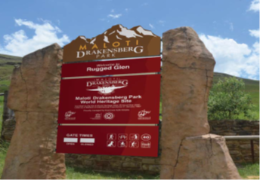
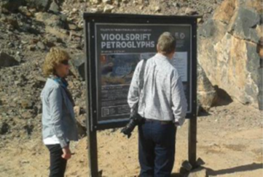
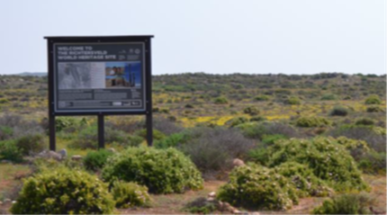
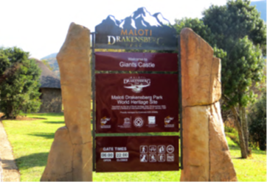
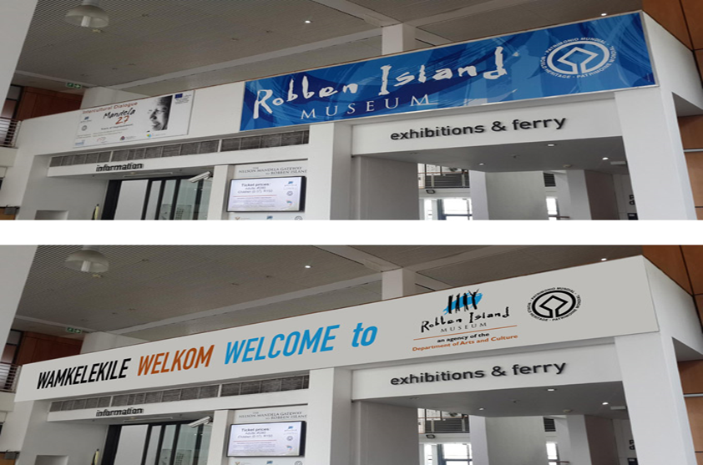
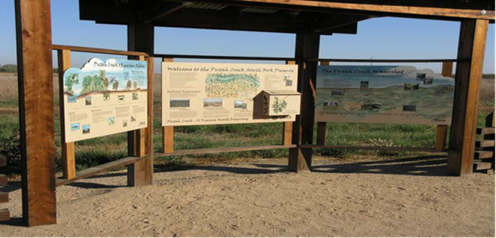
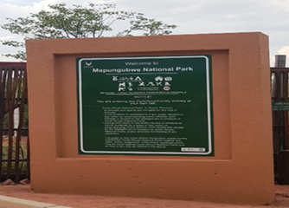
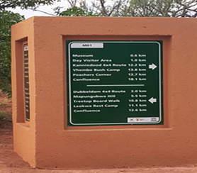

Slide 28
Programme 4: Performance Highlights
Strategic Objective: To create employment opportunities by implementing tourism projects.
3059 full-time equivalent (FTE) jobs created through the Department’s Expanded Public Works Programme against a target of 3 008. Completed eleven (11) product assets received by beneficiaries amounting to R166,560,462. These include attractions, information centres, heritage tourism facilities, accommodation as well as food and beverage facilities. Achieved accredited training associated with delivery of infrastructure for 207 beneficiaries (skills areas include –construction and hospitality related areas). 4081 youth trained in areas such as Chefs, Hospitality (buddies) and Wine appreciation. Of these, 2688 youth (66%) are women. 19 of the trained youth are employed as Chefs in the USA and Dubai.

Slide 29
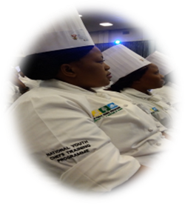
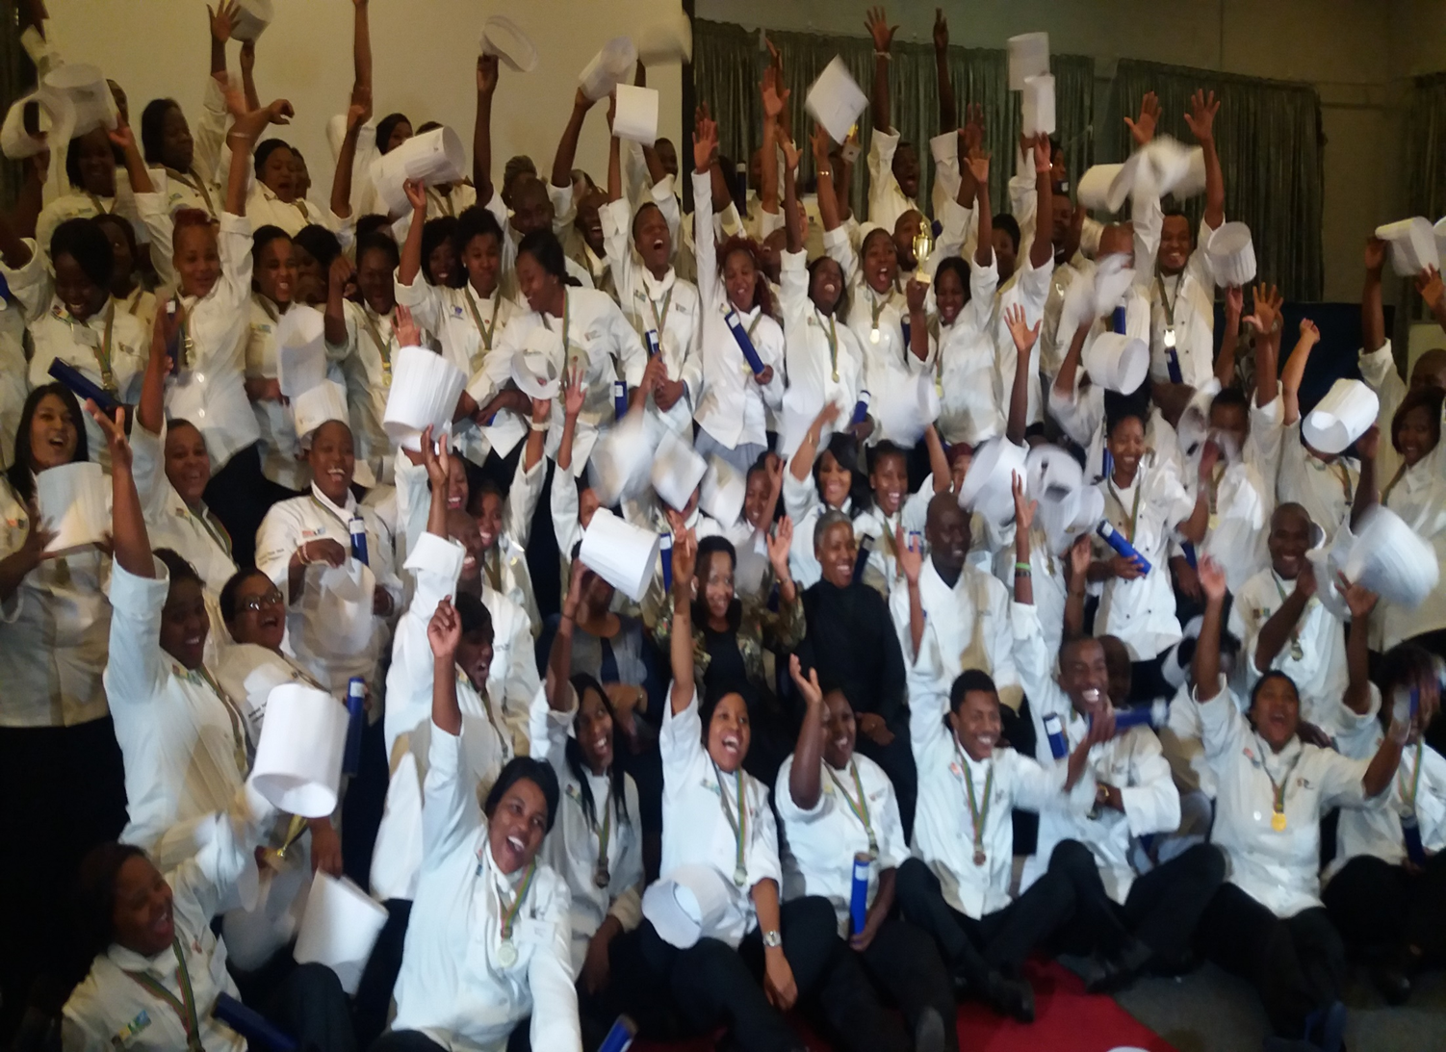
KZN Chefs Graduation

Slide 30
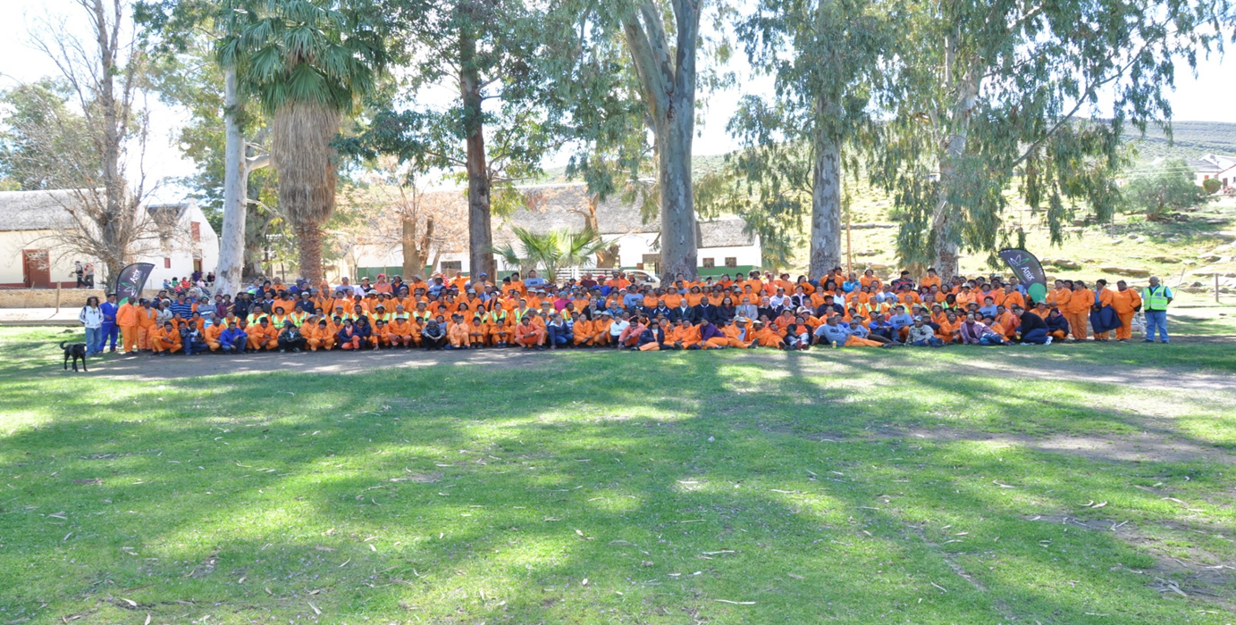
EPWP WORKERS – FALSE BAY

Slide 31
Programme 4: Challenges, lessons learnt and proposed solutions
EPWP Projects: Limitations in capacity by owning agencies to operate the facilities (provision of support for identification of operating or management companies ). Future interventions include facilitation of targeted hospitality training for the local beneficiary communities. The department is also ensuring that provinces are involved in the sustainability mechanisms. Projects not reaching completion on time and within budget. The department has sourced technical support from Government Technical Advisory Centre (GTAC) – to provide technical support for planning and implementation for the finalisation of the projects – including sustainability tests. Process is also underway for full review of internal processes, systems and policies (with the assistance of KPMG) Suspected improper conduct on the part of project implementers as found in the outcomes of the forensic audit - (the department has opened cases against these implementers with the SAPS). Disciplinary action taken against officials whose duty it was to ensure effective management of the implementers. Inadequate internal professional capacity for planning and implementation of Infrastructure projects (Department is undertaking an institutional review). GTAC will revisit all outstanding projects, the concepts, plans and actual sites

Slide 32
Programme 4: Challenges, lessons learnt and proposed solutions
The department is also reviewing the overall Social Responsibility Initiative policy/strategy to ensure that it is effective – given the tensions between delivery of quality infrastructure and labour intensity. Other Challenges: Whilst recruitment of food safety trainee officers was completed the placement did not take place due to contract negotiations resulting delays in the sourcing of training provider. The Tourism Human Resources Development Strategy Review – Sector Skills Audit could not be completed due to delays in the contracting associated with leadership changes of the partner agency. These delays affected the timelines for implementation – hence the work was not concluded. The outcome of this process will also deal with role clarification amongst the players in skills development in the sector. Interpretive signage at Vredefort Dome – The erection the signage in partnership with Free State was not completed on time – hence the department did not disburse of the funds (R250,000) to the Province. Need to revisit the partnership with TEP to ensure that the principles of equitability, competitiveness, cost effectiveness are applied – (a panel of service providers has been appointed).

Slide 33
2. Financial Information

Slide 34
BUDGET AND EXPENDITURE FOR 2015/16
Programme | Final Appropriation (R’000) | Expenditure (R’000) | Expenditure as per % of Final Appropriation
Administration | 227 378 | 224 811 | 98.9%
2. Policy and Knowledge Services | 1 205 699 | 1 195 525 | 99.2%
3. International Tourism Management | 50 500 | 49 928 | 98.9%
4. Domestic Tourism Management | 310 601 | 307 130 | 98.9%
Total | 1 794 178 | 1 777 394 | 99.1%

Slide 35
ACTUAL EXPENDITURE PER PROGRAMME

Slide 36
EXPENDITURE PER ECONOMICAL CLASSIFICATION (SUMMARY)
Economical Classification | Final Appropriation R’000 | Expenditure R’000 | Variance R’000
Current Payments | 463 980 | 452 618 | 11 362
- Compensation of Employees | 253 059 | 252 906 | 153
- Goods and Services | 210 921 | 199 712 | 11 209
Transfers and Subsidies | 1 236 203 | 1 230 784 | 5 419
- Departmental Agencies and Accounts | 1 050 536 | 1 045 570 | 4 966
- Higher Education Institutions | 3 809 | 3 800 | 9
- Public Corporations and Private Enterprises | 72 916 | 72 915 | 1
- Foreign Governments and International Organisations | 6 004 | 5 810 | 194
- Non-Profit Institutions | 24 450 | 24 200 | 250
Households | 78 488 | 78 489 | (1)
Capital Assets | 93 415 | 93 413 | 2
- Buildings and other fixed structures | 87 160 | 87 160 | -
- Machinery and Equipment | 6 213 | 6 211 | 2
- Software and other intangible Assets | 42 | 42 | -
Payment for Financial Assets | 580 | 579 | 1
Total | 1 794 178 | 1 777 394 | 16 784

Slide 37
ACTUAL EXPENDITURE PER HIGH LEVEL ITEM

Slide 38
DETAILS OF VARIANCE
Details | Amount | Action
 | R'000
Current Payments Cost containment measures Accruals | 11 362 | Returned to National Treasury.
Transfer Payments Departmental Agencies and Accounts Foreign Governments and International Organisations | 5 419 | Returned to National Treasury.
Payments for Capital Assets - Machinery and Equipment | 2 | Returned to National Treasury.
Payment for Financial Assets | 1 | Returned to National Treasury.
TOTAL | 16 784

Slide 39
3. Human Resource Information

Slide 40
EMPLOYEE RELATIONS CASES
Total number of Reported Misconduct Cases | Finalised cases | Pending Cases
14 | 9 | 5
Number of Grievances Reported | Grievances Resolved | Grievances Pending
10 | 7 | 3

Slide 41
WORKFORCE REPRESENTATIVITY AS END OF 31 MARCH 2016
TOTAL ESTABLISHMENT
Race | Number | Percentage
Africans | 449 | 87.2
Coloureds | 27 | 5.3
Indians | 16 | 3.1
White | 23 | 4.5
TOTAL | 515 | 100
Persons with Disabilities | 24 | 4.7

Slide 42
EMPLOYEES PER OCCUPATIONAL BANDS: MARCH 2016
OCCUPATIONAL BAND | MALE |  |  |  | FEMALE |  |  |  | TOTAL
 | African | Coloured | Indian | White | African | Coloured | Indian | White
Top Management | 1 | 0 | 0 | 2 | 2 | 0 | 0 | 1 | 6
Senior Management. | 22 | 3 | 3 | 1 | 22 | 1 | 3 | 2 | 57
Professionally qualified and experienced specialists and mid-management. | 94 | 2 | 5 | 6 | 95 | 7 | 3 | 6 | 218
Skilled technical and academically qualified workers, junior management, supervisors, foreman and superintendents. | 69 | 5 | 0 | 0 | 104 | 8 | 2 | 5 | 193
Semi-skilled and discretionary decision making. | 19 | 0 | 0 | 0 | 12 | 1 | 0 | 0 | 32
Unskilled and defined decision making. | 4 | 0 | 0 | 0 | 5 | 0 | 0 | 0 | 9
TOTAL | 209 | 10 | 8 | 9 | 240 | 17 | 8 | 14 | 515

Slide 43
Thank You

