Slide 1
Presentation to the Portfolio Committee on Justice and Correctional Services
Annual Report 2015/16
18 October 2016

Slide 2
Presentation Outline
Annual Performance Information
Update on Investigations
Civil Matters
Human Resources
Financial Overview
Key Operational Challenges
Situational Analysis
Overview of Improvement Focus Areas

Slide 3
1. ANNUAL PERFORMANCE INFORMATION

Slide 4
Key Performance Highlights
Key Performance Highlights
Number / Value | Description
20 | The number of final investigation reports submitted to the Presidency between 1 April 2015 and 31 March 2016
5 | The number of proclamations published between 1 April 2015 and 31 March 2016
73 million | The potential value of money that may be recovered for the State. For Example Preservation order or acknowledgement of debt that could lead to actual recovery in a future reporting period.
52 million | The actual value of money and/or assets that has been recovered for the State. For example final forfeiture orders or cash paid into trust account following acknowledgements of debt.
583 million | The value of the five civil matters that were instituted by the SIU between 1 April 2015 and 31 March 2016. One of the matters to the value of R139. 4m has since been finalised
6.8 billion | The value of the 307 matters that have been referred to the NPA for prosecution and the AFU for forfeiture orders
717 million | The value of three contracts that were set aside as a result of the SIU’s intervention(s)
310 million | The value of payments that were not made in two matters as a result of the SIU’s intervention(s)

Slide 5
Annual Performance
Information 2015/16
Final Estimate for National Expenditure Financial Report - 2015/2016 Financial Year
SIU Business Operations | ACTUAL PERFORMANCE
Core Mandate Combatting Corruption | 2015/2016
Key Performance Indicator | Actuals | Annual Target
Number of Proclamations Issued | 5 | 12
Percentage of Issued Proclamations Finalised | 0% | 60%
Potential Value of Cash and/or Assets Recoverable | R73 m | R220 m
Actual Value of Cash and/or Assets Recovered | R52 m | R120m
Number of Civil Matters Instituted in Court or the Special Tribunal. (one matter has since been finalised) | 5 | 15
Number of Referrals made to the National Prosecuting Authority (NPA) | 307 | 45
Number of instances where potential disciplinary matters were bought to the attention of the relevant State Institution | 68 | 60

Slide 6
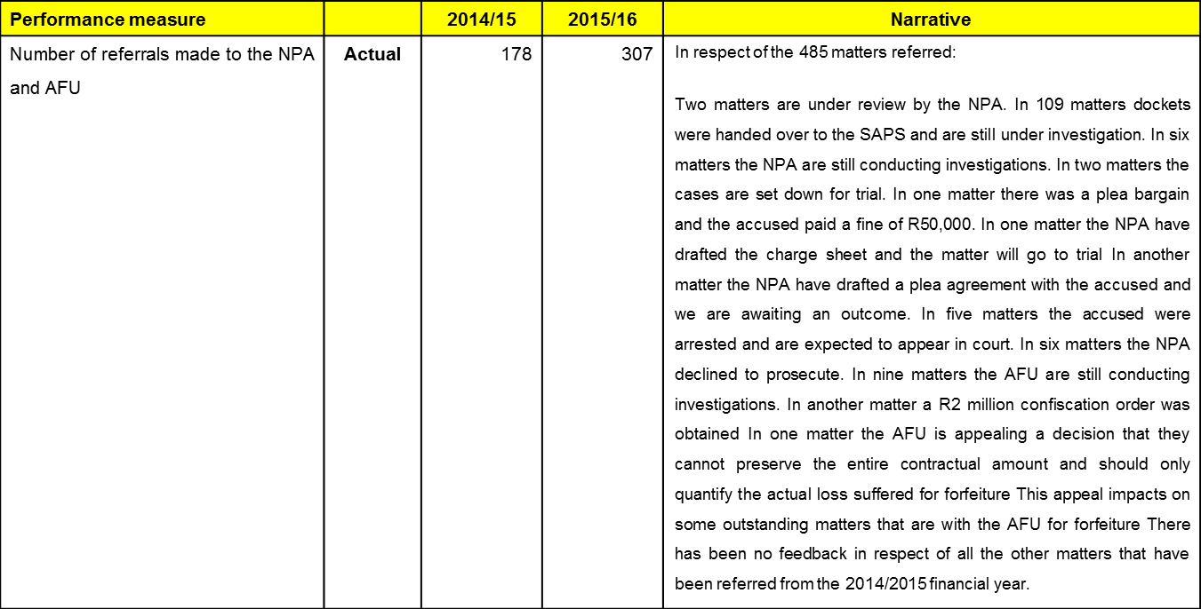
Update on Referrals made to the NPA

Slide 7
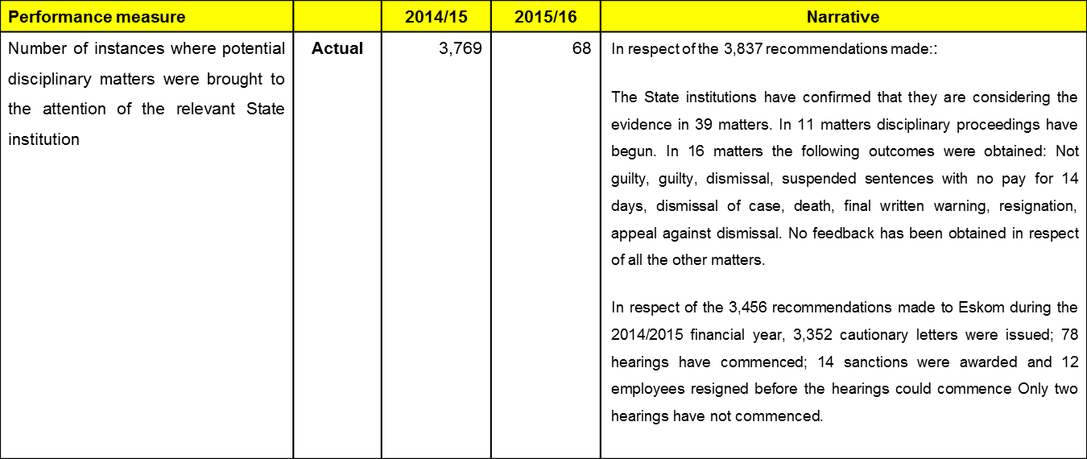
Update on Disciplinary referrals made

Slide 8
Number of Proclamations Issued
List of Proclamations Published in the 2015/2016 Financial Year
No | Proclamation No | Department / State Institution | Date Published
1 | Proc R598 of 2015 | Eastern Cape Department of Education | GG 38984 dated 10 July 2015
2 | Proc R599 of 2015 (amending R7 of 2014) | Department of Rural Development and Land Reform (formerly known as the Department of Land Affairs) in its national department, its provincial departments, its trading entities and their respective agencies (herein referred to as the DRDLR) and the State Information Technology Agency (PTY) Ltd (herein referred to as SITA | GG: 38985 dated 10 July 2015
3 | Proc R27 of 2015 (extending R38 of 2010) | Department of Public Works | GG: 39005 dated 20 July 2015
4 | Proc R40 of 2015 | Buffalo City Metropolitan Municipality | GG 39283 dated 12 October 2015
5 | Proc R44 of 2015 (amending R54 of 2014) | National Department of Public Works: Prestige Directorate: Western Cape | GG 39488 dated 10 December 2015

Slide 9
Percentage of Issued
Proclamations Finalised
Many of the proclamations issued were done in the latter part of the 2015/2016 financial year. This made it very difficult to achieve the target of 60% finalised within nine months of the date of issue.
For the 2016/2017 financial year the SIU is reporting on the number of investigations closed out under published proclamations. This will more accurately reflect the amount of work being done under a published proclamation instead of waiting for the final presidential report to be submitted.

Slide 10
Potential Value of Cash and/or Assets Recoverable (‘R)
      Acknowledgement of Debt Documents (AODs)
Proclamation R18 of 2005 (extended by R5 of 2007): National and all Provincial Department(s) of Social Development
  Two AODs to the value of R25 041 were signed.
Proclamation R53 of 2012: National Department of Rural Development and Land Reform (Land Restitution)
  33 AODs to the value of R2.6 million were signed.
Proclamation R59 of 2014: Department of Public Works: Leases
  Three AODs to the value of R213 312 were signed.
A total of 38 AOD documents were signed between 1 April 2015 and 31 March 2016 to the value of R2.8 million.

Slide 11
Potential Value of Cash and/or Assets Recoverable (‘R)
      Asset Forfeiture Unit (AFU) Preservation Orders
Proclamation R8 of 2011: National Department of Rural Development and Land Reform
  Three preservation orders were obtained from the AFU to the value of R23 million in respect of the Kwacekwane, Rhino Packhouse and Mandleni matters in KwaZulu-Natal (KZN).
Proclamation R53 of 2012: National Department of Rural Development and Land Reform (Land Restitution)
  One preservation order was obtained from the AFU to the value of R45 million in respect of the Mgai matter in KZN.
The total value of these four preservation orders is R68 million.

Slide 12
Potential Value of Cash and/or Assets Recoverable (‘R)
      Other Potential Recoveries
Proclamation R59 of 2014: Department of Public Works: Leases
  In the Free State (FS) the investigation team identified that the Department had paid for parking bays but they were never allocated by the landlord. The value of these potential recoveries is R358 123.
  In KZN the value of the potential recoveries is R1.7 million. The investigation team identified that parking bays which were paid for had not been allocated by the landlords; that the landlord was not VAT registered but had charged VAT on the rental and that the Department had made overpayments on their lease agreements.
The total value of these seven potential recoveries is R2 million.

Slide 13
Actual Value of Cash and/or Assets Recovered (‘R)
SIU AOD Enforcement Department
  The AOD Enforcement Department at the SIU collected payments from debtors to the value of R16.4 million for the 2015/2016 financial year.
Proclamation R7 of 2007 (extended by R35 of 2010 and R15 of 2012): National Department of Housing
  A final payment was made by the Polokwane Housing Association to the Department for 492 units that were not constructed at the Ga Rena Rental Village Project. The value of the payment was R29.2 million.

Slide 14
Actual Value of Cash and/or Assets Recovered (‘R)
Proclamation R43 of 2010 (extended by R49 of 2012): Department of Public Works KZN
  A final AFU order was obtained against Masakhane Properties CC to the value of R2 million. The Specialised Commercial Crime Court in KZN found that the defendants had benefitted from their criminal activities and a confiscation order in terms of Section 18(1) of the Prevention of Organised Crime Act 121 of 1998 was issued as part of the sentence.
Proclamation R54 of 2012: Department of Water Affairs
  A total of R2.2 million was recovered in respect of monies owed to the Department for the funding of the Paterson Bulk Water Project.

Slide 15
Actual Value of Cash and/or Assets Recovered (‘R)
Proclamation R59 of 2014: Department of Public Works: Leases
  A total of R2 million was recovered by the Department where the lessor was not registered as a VAT vendor and was therefore not entitled to charge the Department VAT on the lease payments.
  The total value of the actual cash and/or assets recovered was R52 million.

Slide 16
Civil Matters Instituted in Court or the Special Tribunal
  Five civil matters were instituted.
Proclamation R38 of 2010 (extended by R27 of 2015): Department of Public Works (National)
  The SIU (1st plaintiff) together with the Department (2nd plaintiff) is pursuing an action for the recovery of fees from the contractor as a consequence of an overcharge. The Plaintiffs are also seeking to recover the fees paid to the consultants arising from their failure to carry out their mandate in terms of the contract concluded between the parties. The summons was issued and served and the matter is currently being defended.

Slide 17
Civil Matters Instituted in Court or the Special Tribunal
Proclamation R38 of 2010 (extended by R27 of 2015): Department of Public Works (National)
  Legal proceedings have been instituted for the recovery of payments of R82 million on the grounds that the payment was illegal because it was contrary to the Public Finance Management Act (PFMA). The plaintiff was unjustly enriched and the respondent was unjustly impoverished because the plaintiff rendered no performance as quid pro quo for the payment of this amount.
Proclamation R38 of 2010 (extended by R27 of 2015): Department of Public Works (National)
  An application was lodged in the High Court to set aside a lease agreement for non-compliance with SCM procedures and/or the fraudulent award of a tender. A settlement agreement was reached and the contract has been declared void ab initio. The value of the agreement is R139.4 million.

Slide 18
Civil Matters Instituted in Court or the Special Tribunal
Proclamation R21 of 2012: National Limpopo Intervention
  The SIU instituted civil action to become a fourth Defendant to the civil proceedings currently pending between Sankhyaa Learning Private Limited and the Limpopo Department of Education, a former MEC for the Department and the Minister of Basic Education, which will afford the SIU the opportunity to:
    Support the Department in defending the claim made by Sankhyaa; Introduce additional grounds of defence and relevant evidence in defending the Department and the State against the claim made by Sankhyaa; Potentially institute a counter claim against Sankhyaa in which the SIU requests a Declaration of invalidity of the contract that had been concluded between Sankhyaa and the Department, along with a claim for relief that is considered to be just and equitable by the court (which could include an order for the repayment to the Department or the State of certain monies previously paid by the Department to Sankhyaa); and Intervene in any potential settlement negotiations between Sankhyaa and the Department, where the interest of the State may not be served by such settlement proposals.

Slide 19
Civil Matters Instituted in Court or the Special Tribunal
Proclamation R53 of 2014 (amended by R15 of 2015): State Information Technology Agency (SITA)
  The SIU instituted civil action to have a contract awarded to iFirm to the value of R265 million set aside. The reason for setting aside the contract is non-compliance with SITA’s procurement system as well as non-compliance with Section 217 of the Constitution.

Slide 20
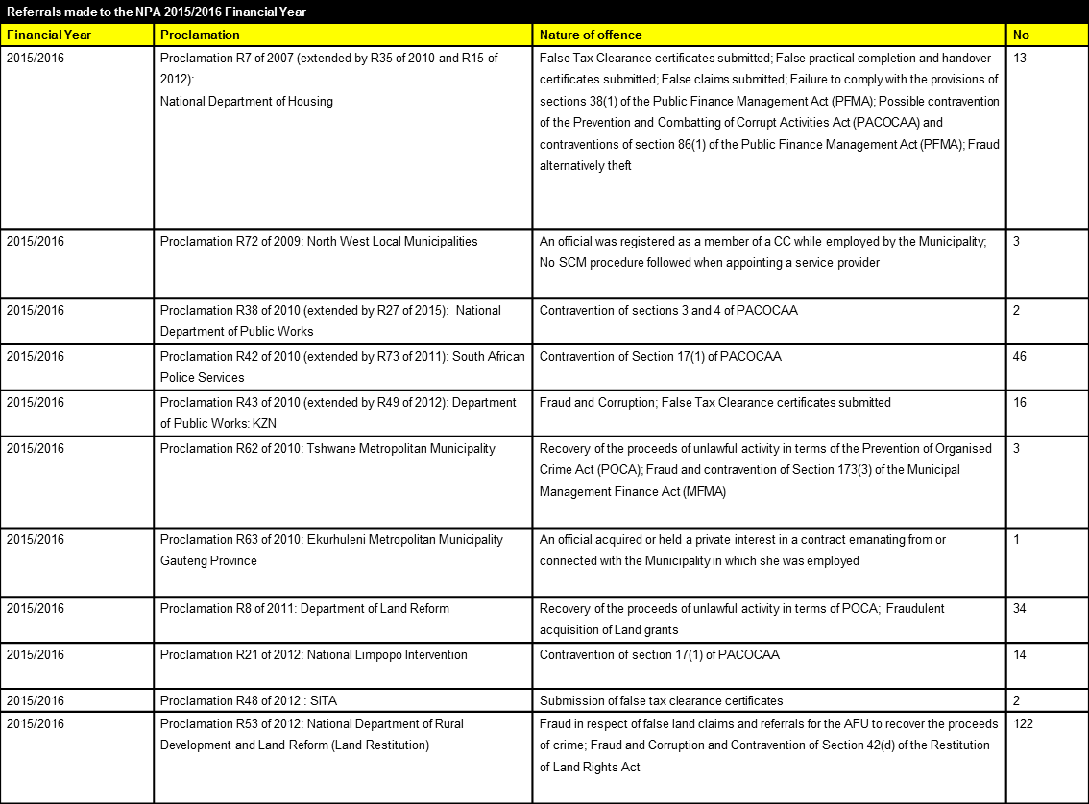
NPA Referrals

Slide 21
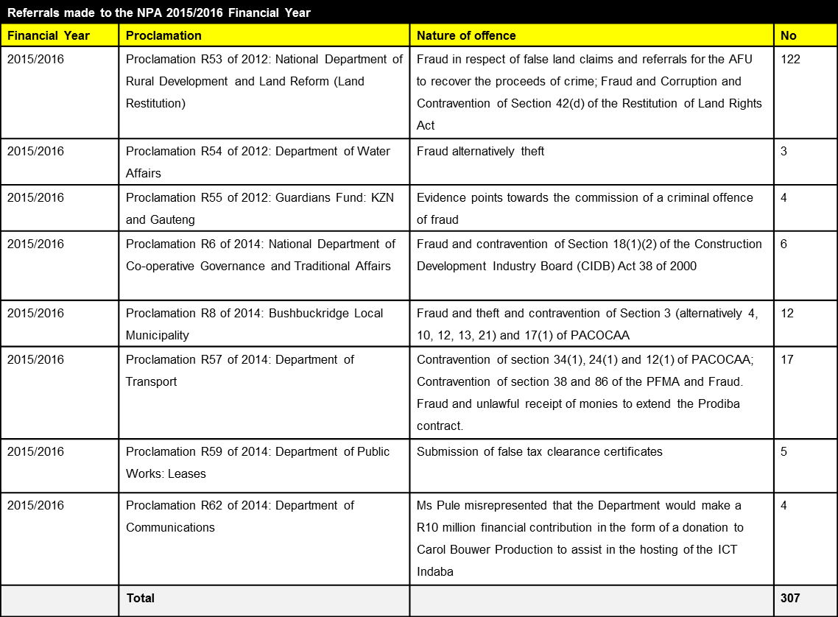
NPA Referrals

Slide 22
NPA Referrals: Proposed Measures
The measures considered to improve the follow-up with the National Directorate of Public Prosecutions (“NDPP”) and Directorate for Priority Crime Investigations (“DPCI”):
Draft Memorandum of Understanding (“MoU”) has been prepared and discussed
MoU to include the creation of a monitoring and reporting committee constituted by the SIU, NDPP and DPCI members to track progress of cases

Slide 23
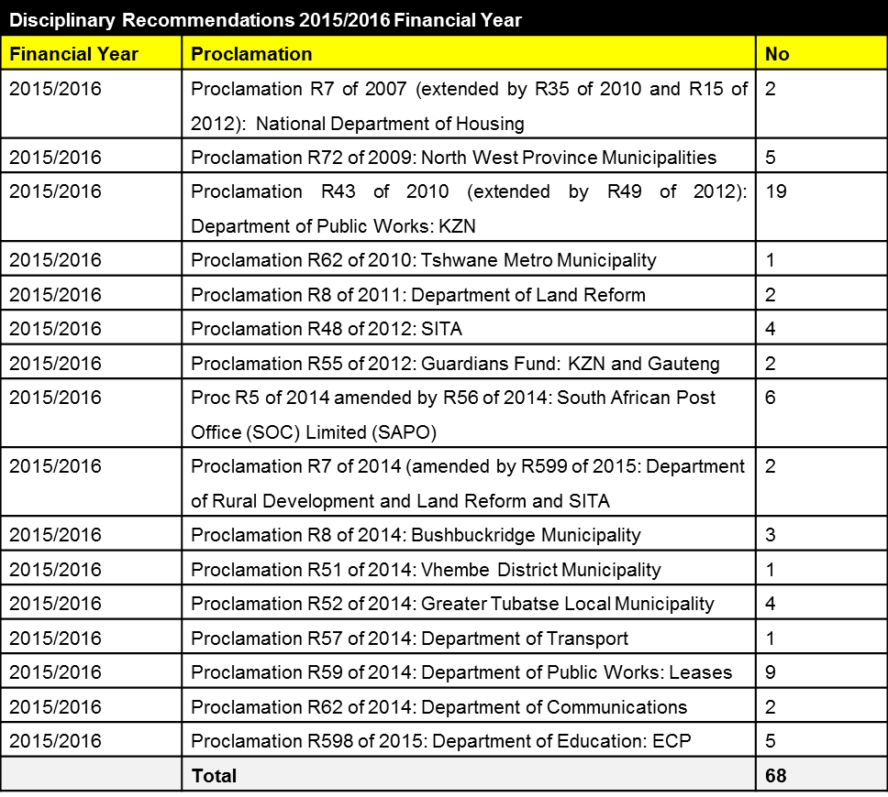
Disciplinary Recommendations

Slide 24
Disciplinary Recommendations:
Proposed Measures
The measures to be considered to enforce action on the referrals made to the State Institutions:
Internal Audit Departments to include these in their audit plans;
External auditors to include these in their audit scope;
Where State Institutions have internal Monitoring and Evaluations (“M&E”) departments, the latter to include in their M&E plans;
Department of Monitoring and Evaluation (“M&E”) to include in their M&E plan
Send copies of referrals to DPSA (since late last year we are sending copies of the disciplinary referrals to the Presidency )

Slide 25
Proclamations: Final Reports Submitted
No. | PROCLAMATION NUMBER | DEPARTMENT/STATE INSTITUTION | DATE REPORT SUBMITTED
1. | Proc R37 of 2010 | Department of Education, Eastern Cape Province | 1 July 2015
2. | Proc R43 of 2010 extended by R49 of 2012 | DPW, KwaZulu-Natal (KZN) Province | 1 July 2015
3. | Proc R34 of 2011 | The former Department of Roads and Transport, Eastern Cape Province | 1 July 2015
4. | Proc R58 of 2011 | Kopanong Local Municipality, Free State Province | 1 July 2015
5 | Proc R16 of 2012 | Former Department of Local Government and Housing: Mpumalanga Province, and its successor in title – the Department of Cooperative Governance and Traditional Affairs: Mpumalanga Province, in its Water for All Project | 1 July 2015
6 | Proc R48 of 2012 | SITA | 1 July 2015
7 | Proc R55 of 2012 | The Guardians Fund components of the KZN and Gauteng offices of the Master of the High Court of the Department of Justice and Constitutional Development | 1 July 2015
8 | Proc R65 of 2012 | Public Service Sector Education and Training Authority (PSETA) | 1 July 2015
9 | Proc R5 of 2014 amended by R56 of 2014 | South African Post Office (SOC) Limited (SAPO) | 1 July 2015
10 | Proc R74 of 2002 | Department of Finance of the Mpumalanga Province | 2 October 2015

Slide 26
Proclamations: Final Reports Submitted
No. | PROCLAMATION NUMBER | DEPARTMENT/STATE INSTITUTION | DATE REPORT SUBMITTED
11. | Proc R76 of 2002 | Uthungulu District Municipality situated in the KZN Province | 2 October 2015
12. | Proc R9 of 2004 amended by R49 of 2006 | Umzinyathi Regional Council (which was succeeded by Amajuba and Umzinyathi District Municipalities), the Uthungulu District Municipality and the Umtshezi Local Municipality in the KZN Province | 2 October 2015
13. | Proc R7 of 2007 extended by R35 of 2010 and R15 of 2012 | National Department of Housing; All Provincial Departments of Housing; The former Housing Development Boards and Corporations; Local Authorities and their agents | 2 October 2015
14. | Proc R22 of 2007 | Mpumalanga Economic Empowerment Corporation Limited (MEEC) | 2 October 2015
15. | Proc R37 of 2007 | Free State Provincial Department of Finance; Free State Provincial Treasury (Moral Regeneration Movement) | 2 October 2015
16. | Proc R40 of 2007 | Maluti-a-Phofung Local Municipality: Free State Province | 2 October 2015
17. | Proc R45 of 2007 | Department of Transport: KZN Province (Administrative Cost Centres: Merebank, Port Shepstone & Stanger) | 2 October 2015
18. | Proc R36 of 2008 | Department of Health: Eastern Cape Province | 2 October 2015
19. | Proc R2 of 2009 extended by R14 of 2012 | Department of Education: Mpumalanga Province | 2 October 2015
20. | Proc R33 of 2011 | Midvaal Local Municipality: Gauteng Province | 02 October 2015

Slide 27
2. UPDATE ON INVESTIGATIONS

Slide 28
2016/2017 YTD Performance Information
All targets shown in the table below reflect Annual Targets and Performance Information (Quarter 1 and Quarter 2) against these annual targets:
Estimate for National Expenditure Financial Report - 2016/2017 Financial Year
SIU Business Operations | ACTUAL PERFORMANCE |  |  | ESTIMATED PERFORMANCE
Core Mandate Combatting Corruption | 2013/2014 | 2014/2015 | 2015/2016 | 2016/2017
Key Performance Indicator | Strategic Objective: To increase impact of SIU's forensic services in the public sector by completing investigations successfully |  |  | Quarter 1 | Quarter 2 | YTD Actuals | Annual Target
The number of investigations closed out | 0 | 0 | Baseline established | 8 | 6 | 14 | 800
The number of reports submitted to the Presidency | 0 | 0 | Baseline established | - | - | - | 5
The value of money and/or assets potentially recoverable | R261m | R844m | R73m | 14,007,440 | 7,006,315 | 21,013,755 | 240,000,000
The actual value of money and/or assets recovered | R75.8m | R145m | R52m | 3,153,242 | 426,769 | 3,580,010 | 140,000,000
The value of potential loss prevented | 0 | 0 | Baseline established | - | 83,470,380 | 83,470,380 | 18,000,000
The value of contract(s) and/or administrative decision(s) / action(s) set aside or deemed invalid | 0 | 0 | Baseline established | - | 756,000,000 | 756,000,000 | 600,000,000
The value of matters in respect of which evidence was referred for the institution or defence/opposition of civil proceedings (including arbitration or counter civil proceedings) | 0 | 0 | Baseline established | 2,016,564,558 | 484,000,000 | 2,500,564,558 | 1,200,000,000
The number of referrals made to the relevant Prosecuting Authority | Baseline established | 171 | 307 | 18 | 1 | 19 | 60
The number of referrals made for disciplinary, executive and/or administrative action | Baseline established | 3,769 | 68 | 8 | 1 | 9 | 75
The number of SIU member(s) participating in Joint Operation(s) or seconded to assist State Institutions | 0 | 0 | Baseline established | 14 | - | 14 | 30

Slide 29
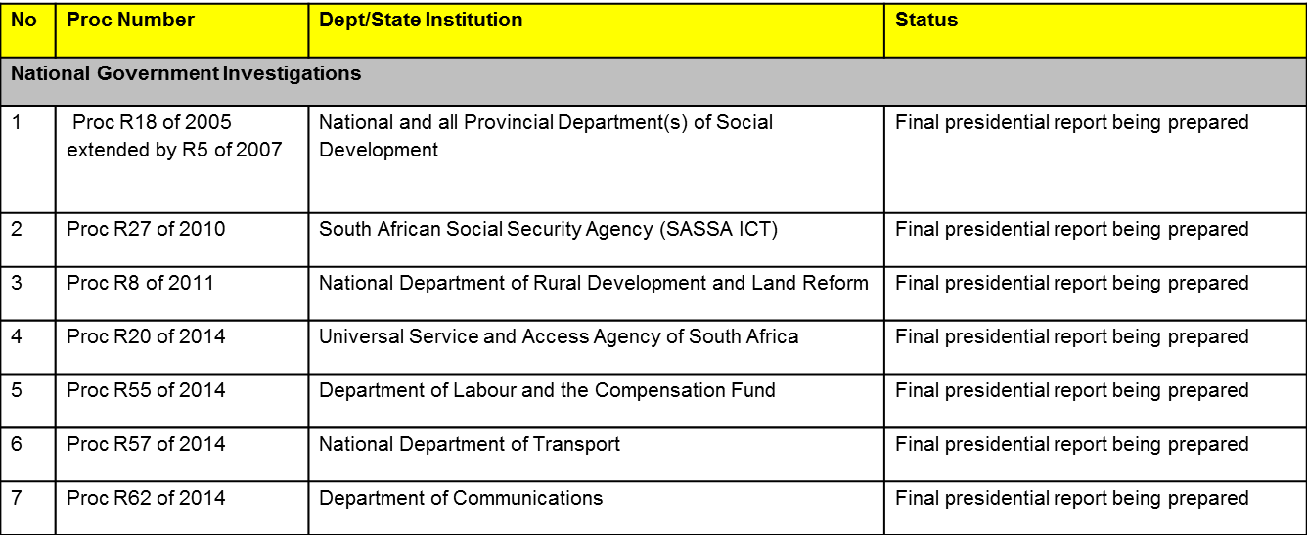
Proclamations: Final Reports Prepared
18 final reports are being prepared. The list is shown per sphere of government. It is anticipated that all these final reports will be submitted during this financial year.

Slide 30
Proclamations: Final Reports Prepared

Slide 31
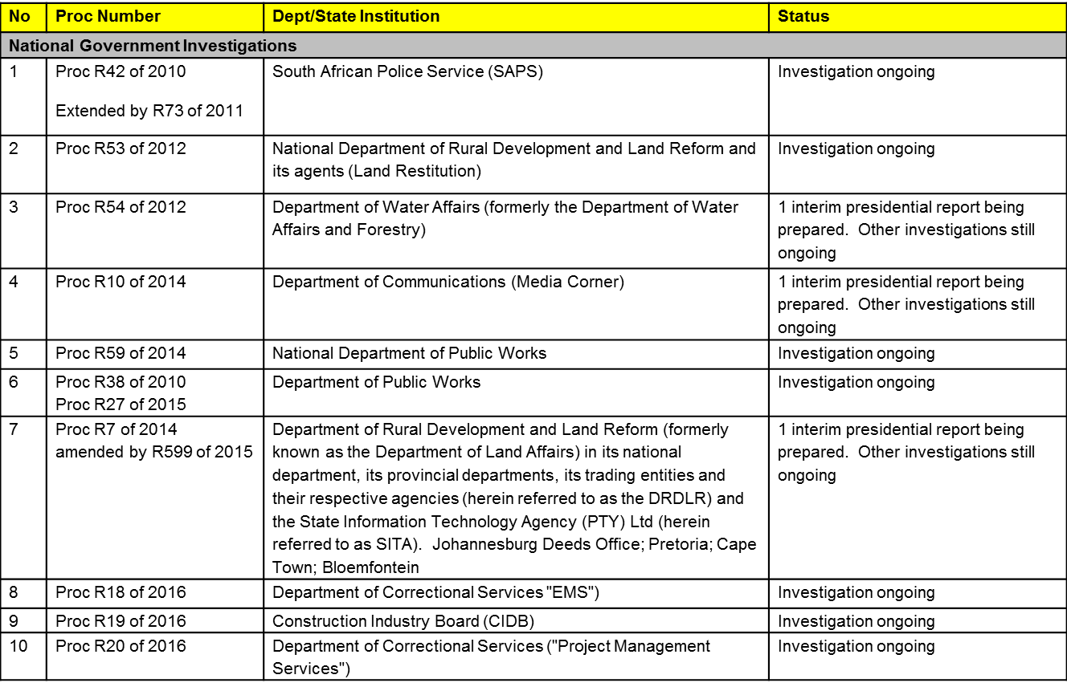
Proclamations: Active Investigations
There are 20 proclamations where the investigations are still ongoing

Slide 32
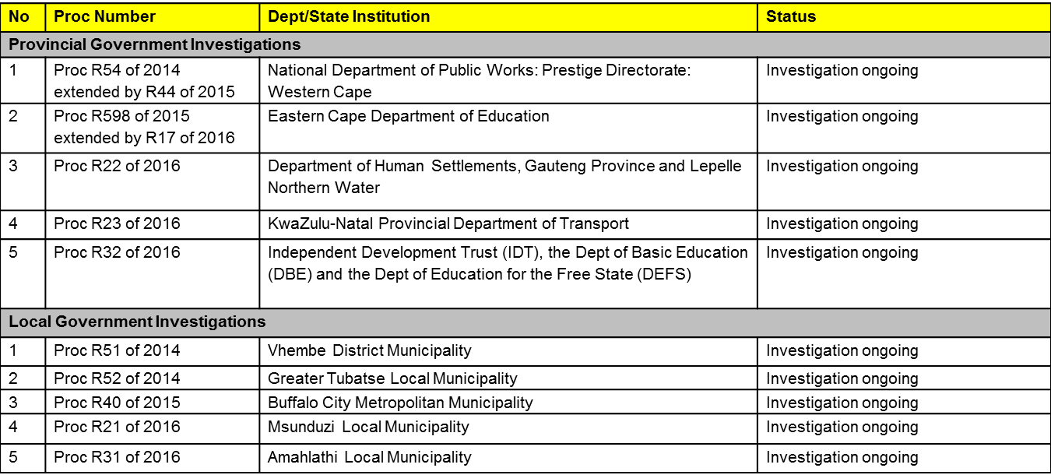
Proclamations: Active Investigations

Slide 33
3. CIVIL MATTERS

Slide 34
Summary of Civil Matters
The SIU is seeking a declaration of the invalidity of contracts where after just and equitable relief will be pursued
Summary of Civil Matters
No | Proc Number | Dept/State Institution | Civil Matter Description | Value
1 | R59 of 2013 | National Dept of Public Works: Prestige Project: Nkandla KwaZulu-Natal | SIU vs Makahanya (Nkandla). This is an action against the principal agent on the project that seeks to recover R155 million based on his negligent approval of such payments, the over-designing of security related installations. Makahanya was appointed as the principal agent in the Nkandla construction project. It was established that his appointment was contrary to the SCM prescripts and accordingly fell foul of the constitutional requirements as set out in section 217. Makhanya further approved payments in a manner that resulted in a loss to the Department. | R155 million
2 | R5 of 2014 amended by R56 of 2014 | South African Post Office (“SAPO”) | Application to Review a Decision to award a Lease (Eco Point) to Centurion Vision Development (Pty) Ltd and to set aside the resulting 10 year Lease Agreement valued at approximately R 493 million (with a further Option to Purchase Eco Point at between on or before 16h00 on 30 April 2015 for an amount of R 526 million (Vat Excluded) or at any time thereafter for an amount of R 778 million (Vat Excluded)), including all Addenda thereto. | R778 million
3 | R5 of 2014 amended by R56 of 2014 | SAPO | The Applicants request the court to order Centurion Vision Development to refund to the SAPO all payments made by them in respect of or ancillary to the “invalid” Lease Agreement. This claim could be as high as R 244 million as at the end of May 2016, already, but it will increase every month that the Post Office continues to pay rental on Eco Point (the Post Office pays a monthly rental of approximately R 4.5 million, which escalates by 9% on an annual basis). In essence, this submission is based on the natural consequences of a contract being declared invalid or void ab initio. | To be determined

Slide 35
Summary of Civil Matters
Summary of Civil Matters
No | Proc Number | Dept/State Institution | Civil Matter Description | Value
4 | R20 of 2014 | Universal Service and Access Agency Of South Africa (USAASA) | Application to review a Decision to appoint and to set aside the appointment of Mr Zami Nkosi as the Chief Executive Office (“CEO”) of the Universal Service and Access Agency of South Africa (“USAASA”). The SIU submits that the appointment is unlawful for one or more reasons | R1.9m
5 | R62 of 2014 | Dept of Communications | The SIU has instructed the State Attorney to brief Counsel to consider the prospects of recovery of the loss from the accountable person. | R693 875
6 | R21 of 2012 | Limpopo Province Intervention: Provincial Treasury; Health and Social Development; Roads and Transport; Education and Public Works | Sankhyaa Learning Private Limited instituted action proceedings via summons against the Limpopo Department of Education and 2 Others in which Sankhyaa is claiming R 85.5 million, with interest calculated at 18% per annum. As such, Sankhyaa is effectively claiming approximately R 120 million from the Department (including interests). The Department is defending the case and filed a plea and counterclaim in which the Department submits that the contract is invalid for non-compliance with the prescripts regulating public sector procurement (i.e. no tender process was followed). Since the SIU learned that Sankhyaa was trying to reach a compromise or settlement with the Premier of the Province or the MEC of the Department, and at the request of the senior counsel representing the Department in the case, the SIU applied in terms of Rule 17 for intervention, which if granted would effectively make the SIU a 4th Defendant in the case and allow the SIU to file papers to defend the case, even if the Department should decide to settle the case. | R85.5m

Slide 36
Summary of Civil Matters
Summary of Civil Matters
No | Proc Number | Dept/State Institution | Civil Matter Description | Value
7 | R53 of 2014 amended by R15 of 2015 | State Information Technology Agency (“SITA”) | The iFirm contract of R302m was investigated and the matter is in court in order to declare the contract invalid and to set the contract aside. A court date is awaited. | R302m
8 | R10 of 2014 | Dept of Communications (Media Corner) | Application to review a Decision to award a tender to Media Corner and to set aside the resulting contract (with an all-inclusive contract value of approximately R 752 million) between the Department of Telecommunications and Postal Services (formerly known as the Department of Communications) and Media Corner, plus: (a) a prayer for Media Corner to repay to the Department R 12 783 368 in respect of monthly retainer fees that were paid by the Department to Media Corner during a period where the contract was suspended; (b) a prayer instructing Media Corner to provide to the Applicants all documents relevant to all payments made to Media Corner (e.g. invoices and invoices from sub-contractors etc.) in respect of the following three payments: R 15 million, R 15 473 311.31 and R 15 million; and (c) a prayer instructing Media Corner to repay to the Department all discounts, commission and profits taken by Media Corner | R752m
9 | R59 of 2014 | National Dept of Public Works | Misrepresentation by DPW official which led to a longer lease being awarded. | R12m
10 | R38 of 2010 extended by R27 of 2015 | National Dept of Public Works | SIU has been requested to investigate allegations of irregularities in the award of the renovations contract (SCM process) for this building, which is currently occupied by DPW. This contract was awarded in February 2009, and was completed in February 2012. During the period of the contract, 38 Variation Orders were approved to the value of R253 000 613.82. | To be determined
11 | R38 of 2010 extended by R27 of 2015 | National Dept of Public Works | Empangeni Ramp – Application to recover overpayments and damages based on negligence/fraud. | R11.6m

Slide 37
Summary of Civil Matters
Summary of Civil Matters
No | Proc Number | Dept/State Institution | Civil Matter Description | Value
12 | R38 of 2010 extended by R27 of 2015 | National Dept of Public Works | Lebombo Border Post – Counsel was requested to seek a declaratory order setting aside the contract awarded on the basis that the award was in violation of the Constitution. The prayer for relief also seeks to recover R103m which it is alleged amounts to an overpayment. | R1.9bn
13 | R38 of 2010 extended by R27 of 2015 | National Dept of Public Works | Skilpadshek Border Post – The action seeks to recover R50.8m that was an overpayment to the contractor. The matter is set for trial for 31 Oct 2016 to 11 Nov 2016. | R50.8m
14 | R38 of 2010 extended by R27 of 2015 | National Dept of Public Works | The SIU established that the Department was being charged for more parking bays then were being provided. The building was in the interim sold to a new landlord. The SIU has approached the new landlord with a view to recovering the overpayments that he would be responsible for and to have the lease agreement rectified to indicate the correct position as regards what is being supplied. Negotiations are ongoing and presently looking positive. | To be determined
15 | R38 of 2010 extended by R27 of 2015 | National Dept of Public Works | Union Building - Assisting the Department in defending an action brought by the Plaintiff for the recovery of outstanding amounts due for work allegedly completed. | R54m
16 | R38 of 2010 extended by R27 of 2015 | National Dept of Public Works | Mr Mia - This is an action that was instituted by DPW seeking the cancellation of 4 leases concluded with Mia and or his associated companies together with a claim for damages. Pleadings have closed and a trial date has been applied for. | R8m

Slide 38
Summary of Civil Matters
Summary of Civil Matters
No | Proc Number | Dept/State Institution | Civil Matter Description | Value
17 | R38 of 2010 extended by R27 of 2015 | National Dept of Public Works | The landlord continued to receive rental payments from the Department after the lease had been cancelled and the Department had vacated the premises. SIU is awaiting the appointment of Counsel. | R9m
18 | R38 of 2010 extended by R27 of 2015 | National Dept of Public Works | The procurement of a lease by the Department contrary to Section 217 of the Constitution. Application to set aside the lease. Draft papers are being settled. | To be determined
19 | R38 of 2010 extended by R27 of 2015 | National Dept of Public Works | The procurement of a lease by the Department contrary to Section 217 of the Constitution. Application to set aside the lease. Draft papers are being settled. | R609m
20 | R7 of 2014 amended by R599 of 2015 | Dept of Rural Development and Land Reform and the SITA | Application to Review a Decision to award a tender (RFB 653/2008 – The provision of e-Cadastre for the Department) to Gijima and to set aside the resulting contract(s) valued at approximately R 364 910 166.08, including all Addenda thereto. The application is based on an error that was made by the SITA during the bid evaluation and bid adjudication stages of the tender process, which resulted in the award being made to the incorrect service provider. | R364m

Slide 39
4. HUMAN RESOURCES

Slide 40
HUMAN RESOURCES
Total staff complement as at 31 March 2016: 534
  Permanent: 528
  Fixed term contract: 6
  Operations staff: 419
  Business support staff: 115
Employment Equity | Race
 | African | Coloured | Indian | White | Total Gender
Gender |  |  |  |  |  | Percentage
Female | 151 | 11 | 27 | 69 | 259 | 48%
Male | 162 | 24 | 30 | 60 | 276 | 52%
Total Race | 313 | 35 | 57 | 129 | 534
Percentage | 59% | 6% | 11% | 24%

Slide 41
HUMAN RESOURCES
Employment Equity | African |  | Coloured |  | Indian |  | White |  | Total | Percentage
Gender | Female | Male | Female | Male | Female | Male | Female | Male
Senior Management | 3 | 4 | 0 | 2 | 2 | 2 | 2 | 8 | 23 | 4.30
Professionally Qualified | 19 | 53 | 1 | 14 | 5 | 17 | 30 | 44 | 183 | 34.27
Skilled Technical | 37 | 77 | 5 | 8 | 13 | 11 | 27 | 5 | 183 | 34.27
Semi-Skilled | 80 | 28 | 5 | 0 | 7 | 0 | 10 | 3 | 133 | 24.91
Unskilled | 12 | 0 | 0 | 0 | 0 | 0 | 0 | 0 | 12 | 2.25
Total | 151 | 162 | 11 | 24 | 27 | 30 | 69 | 60 | 534
Percentage | 28.28 | 30.34 | 2.05 | 4.50 | 5.06 | 5.61 | 12.93 | 11.23 |  | 100%

Slide 42
5. FINANCIAL OVERVIEW

Slide 43
Financial Results Overview:
Financial Position
Description | 2015/16 R’000 | 2014/15 R’000 | Variance %
Income
Grant Income ( N1) | 304 458 | 296 813 | 3%
CARA Funds (N2) | 4 148 | 5 136 | -19%
Project Income ( N3) | 174 044 | 226 912 | -23%
Interest & Other Income( N4) | 6 971 | 5 155 | 35%
Other Income (N5) | 5 095 | 0 | 100%
Total Income | 494 716 | 534 016
Expenditure
Employee cost (N6) | (300 863) | (275 748) | 9%
Travel and Accommodation(N7) | (11 134) | (8 649) | 28%
Other expenses(N8) | (132 801) | (177 861) | -25%
Total Expenses | (444 798) | (462 258)
Surplus | 49 918 | 71 758

Slide 44
Financial Results Overview:
Notes to Financial Position
N1: Grant income is determined by National Treasury.
N2: CARA Funds decreased due to the fact that there were no specialists costs in the 2015/16 financial year whereas the 2014/15 financial year included specialists. Funds relating to the specialist for ACTT initiatives were returned to the Dept. of Justice at the end of the 2014/15 Financial Year.
N3: Project income is driven by the number of proclamations active. Lesser proclamations were active in 2015/16 as compared to 2014/15.
N4: Interest income is income earned on positive bank balances.
N5: Other Income: This relates to the rental paid on behalf of the SIU for the East London Offices. This is a new disclosure requirement in terms amendments to GRAP 23.
N6: Employee costs increases is driven by performance and cost of living adjustments.
N7: Travel and accommodation costs are driven by the work done in projects.
N8: Other expenses: These relate to costs decreased.

Slide 45
Financial Results Overview:
Actual vs. Budget
Description | Budget R’000 | Actual R’000 | Variance
Income
Government Grant | 304 458 | 304 458 | 0.00
Project Income | 189 730 | 178 192 | (11 538)
Interest earned | 4 800 | 6 930 | 2 130
Other Income | 0 | 5 136 | 5 136
 | 498 988 | 494 716 | (4 272)
Expenditure
Employee costs | (315 930) | (300 863) | (15 066)
Travelling & Accommodation | (18 241) | (11 134) | (7 107)
Direct Operational costs | (11 876) | (1 254) | (10 622)
Administration costs | (152 941) | (131 547) | (21 394)
 | (498 988) | (444 798) | (54 190)
Assets | 147 217 | 12 291 | 134 926
Accounting Surplus |  | 49 918
Cash Retention |  | 120 918

Slide 46

Financial Results Overview :
Notes to Budget vs. Expenditure
Receipts and Payments:
The SIU’s project income is based on recovery of fees and services from state institutions that it investigates under proclamations.
The unit had anticipated 12 new proclamations for the year, given that 12 were received in the prior year.
Only 5 proclamations were received and 3 were amendments of existing proclamations and the 2 new proclamations were for East London Region.
The ability to accurately predict and budget for the new proclamations given the nature and durations of the proclamations differs vastly, is an extremely difficult exercise.
The same reason for variances in project income applies to specialists, travel and accommodation and direct operational costs.
Travel and accommodation in particular, is affected by the maturity of the matters and the remaining number of ongoing matters.
Assets:
A substantial part of the budget was earmarked to be spent on rental of premises that went out on tender, which did not materialise.
SIU placed an order for a new fleet of vehicles after the old fleet was sold. The fleet was not delivered at financial year end.
Cash Surplus:
Application for retention of surplus was approved by National Treasury.

Slide 47
Audit Outcomes for 2015/16 financial year
  No emphasis of matter reported in the 2015/16 Financial Year.
  The SIU has developed an action plan to clear the audit findings as raised by the Auditor General during the audit and is currently progressing positively against the end of financial year deadline.
 | 2015/16 | 2014/15 | 2013/14 | 2012/13
Type of Opinion | Unqualified | Unqualified | Unqualified | Unqualified
Number of emphasis of matter | 0 | 1 | 1 | 1

Slide 48
Irregular expenditure
Description | 2015/16 | 2014/15
Service provider used without proper documentation and following proper SCM procedures | 0 | 2 589 830
Proper SCM Processes not followed when extending the lapsed contract( Nelspruit Lease) | 614 205 | 1 149 987
No proper deviation in place for deviating from normal SCM processes( Travel Management) | 345 392 | 360 343
Service Provider used without following proper SCM process ( Insurance for movable assets) | 948 037 | 0
Service provider used without following proper SCM processes( Reference Checks) | 382 465 | 0
Service provider used without following proper SCM processes( Courier Services) | 196 755 | 0
Promoted employees paid before written approval by Head of the Unit | 20 393 | 0
Incorrect awarding of points to bidders based on old regulation and SCM policy | 0 | 716 491
Service provider offering specialist services on a project continued to work on the project beyond contracted amount without prior authorisation | 0 | 590 422
Service provider offering specialist services on a project continued to work on the project beyond the contracted amount without prior authorisation | 0 | 93 336
2015/16 Total | 2 507 247 | 5 500 000

Slide 49
Irregular Expenditure…cont.
SIU has reported irregular expenditure of R 2.5m for the 2015/16 financial year as compared to R 5.5m in 2014/15 financial year.
All the items above relates to irregular expenditure as opposed to fruitless and wasteful or unauthorised expenditure.
The SIU is in a process of regularising all contracts that are considered to be irregular to ensure that irregular expenditure is not incurred anymore.

Slide 50
Fruitless and wasteful expenditure
  SARS: During February 2015, SIU ran two payrolls with the second run being after the February month end. This resulted in employees tax for this period being paid after the required due date.
  Traffic Fines: these costs were incurred by SIU members and had to be settled by the SIU when the unit was trying to renew the annual vehicle licences. The cost will be recovered from the members.
2015/16 financial year | Amount
Interest payment to SARS for late payment of PAYE | 4 690
Payment of traffic fines incurred by employees | 4 090
2015/16 Total | 8 780

Slide 51
DEBTORS ANALYSIS
Description | 2015/16 R’000 | 2014/15 R’000
Trade Debtors | 374 389 | 374 964
Less: Provision for impairment | (233 480) | (170 567)
Net Trade Debtors | 140 909 | 204 397

Slide 52
6. Key Operational Challenges

Slide 53
Key Operational Challenges
  Non-achievement of targets as per the APP and Strategic Plan. SIU has improved on the Performance Targets and refined its Key Performance Indicators.
  Low Proclamation Inflow – Measures have been considered to improve business development initiatives and stakeholder relations. These include an MoU with the National Treasury (Office of the Chief Procurement Officer), DoJ and the Presidency, legislative changes and a centralised approach to expedite the motivations. For example 9 new proclamations have been received in the first two quarters of the financial year 2016/17
  Setting up the Special Tribunal – Consultation process with the Office of the Chief Justice has started.
  Poor turnaround time of implementation of remedial actions by the NPA. We have engaged the NDPP and we have drafted an MoU which includes and monitoring structure.
  Feedback from State Institutions regarding the implementation of referred disciplinary actions and systemic recommendations. SIU will receive feedback from the Presidency.

Slide 54
Key Operational Challenges
  Non-payment by State Institutions who are under investigation. Solution includes engagement with National Treasury, and more regular updates to State Institutions on the progress of the investigations.
  Shortage in specialist resources such as Senior Forensic Lawyers. Recruitment process has been finalised.
  Ineffective collaboration with other law enforcement entities - Measures include targeted meetings with relevant stakeholders to ensure practical co-operation and protocols to regulate relationships.
  Current legislative framework does not provide for pre-proclamation phase investigations which are often required to develop new opportunities. Draft amendments to the SIU Act have been prepared to address this matter

Slide 55
Principles to Improve
Turnaround Times
Previously, proclamations were generic and wide in ambit. The new strategy is to obtain proclamations as specific as possible, where matters will only be investigated that relate directly to the allegations that have been received. However, some proclamations consists of a large number of sub-investigations. Proclamation R59 of 2014 includes the procurement and administration of 2,162 leases at the Department of Public Works (“DPW”);
For multi-year proclamations (investigations) the decision has been made to submit interim reports to the Presidency;
The SIU has introduced project reviews which are aimed at fast tracking the finalisation of investigations.

Slide 56
7. SITUATIONAL ANALYSIS

Slide 57
SIU contributing to Government winning the battle, and the WAR against Corruption!
Top of Mind and
first port of call
across all spheres
of Government?
Are we:
Making an
Impact
that matter?
at risk to remain
Relevant ?
An Employer of Choice,
placing our people first!
Measuring UP on
“performance”
against the
Global Scale?
SIU
Doing the BASICS
Right (first time)?
What is the
Public & Media
Perception?
A trusted
Team Player,
fostering a cohesive
Multi Agency approach?
Delivering Quality
Professional Services,
Cost “Effectively” ?

Slide 58
Measures to combat corruption (NDP)
Measures to strengthen South Africa’s anti-corruption arsenal
Adequate funding
Competent, skilled institutions like the Public Protector and Special Investigating Unit need to be adequately funded and staffed and free from external interference. While thousands of cases are investigated, few get to court. Specialised teams of prosecutors and special courts should be established.
Central oversight
Government’s procurement policies blur the line in matters of corruption, and the state procurement system has become overly bureaucratised. The emphasis on compliance by box-ticking makes the system costly, burdensome, ineffective and prone to fraud. We propose greater central oversight over large and long-term tenders, making it illegal for public servants to operate certain types of businesses and making individuals liable for losses in proven cases of corruption.
Societal factors
The country has barely begun to tackle societal factors that contribute to corruption. South Africa’s history of state-sponsored patronage further blurs ethical standards. International experience shows that with political will and sustained application of the right strategies, corruption can be significantly reduced and public trust restored.
In addition to political will, corruption has to be fought on three fronts: deterrence, prevention and education.
  Deterrence helps people understand that they are likely to get caught and punished.
  Prevention is about systems (information, audit and so on) that make it hard to engage in corrupt acts.
  The social dimensions of corruption need to be tackled by focusing on values, through education.

Slide 59
The Public Service Commission’s
Diagnostic Report.
Released in June 2011, the report identified a failure to implement policies and an absence of broad partnerships as the main reasons for slow progress, and set out nine primary challenges
  Too few people work
  The quality of school education is low
  Infrastructure is poorly located, inadequate
  and under-maintained
  Spatial divides hobble inclusive development
  The economy is unsustainably resource intensive
  The public health system cannot meet demand or sustain quality
  Public services are uneven and often of poor quality
  Corruption levels are high, and ever
  increasing …
  South Africa remains a divided society.
Critical actions
Steps by the state to professionalise the public service, strengthen accountability, improve coordination and prosecute corruption
Fighting corruption requires an anti-corruption system that is well-resourced, operates freely from political interference and has the support of citizens.
The Commission proposes the following:
Strengthen the multi-agency anti-corruption system
Strengthen the protection of whistle-blowers
Greater central oversight over the awarding of large tenders or tenders with long duration
Empower the tender compliance monitoring office to investigate corruption and the value for money of tenders.

Slide 61
AGSA – MFMA audit report 2015/16
Irregular expenditure has doubled since 2010-11
To R14,75 billion, incurred by an increasing number
of municipalities, due to continued non-compliance with SCM legislation
Improvement in the ability of municipalities to detect and disclose irregular expenditure
Fruitless and wasteful expenditure in 2014-15 was more than R1 billion higher than in 2010-11 at R1,34 billion, again incurred by an increasing number of municipalities.
In 2010-11, 73% of the irregular expenditure was identified during the audit,
While in 2014-15 municipalities identified 69% of the irregular expenditure, some using consultants to determine the full extent of irregular expenditure.
Municipalities in North West, Mpumalanga, Eastern Cape and Limpopo were the main contributors to the significant increase in irregular expenditure over the past five years.

Slide 62
AGSA Audit Report PFMA 2014-15
Could not audit awards with a value of R1 330 million at 32 auditees (7% - not provided evidence that awards according to SCM legislation).
Encountered similar limitations at 10 of these 32 auditees (31%) in the previous year,
A total of 254 (89%) of the 287 auditees also incurred irregular expenditure in the previous year. (219 of these auditees incurred such expenditure - past 3 years).
Should serve as a red flag to oversight structures that we could also not perform any alternative audit procedures to obtain reasonable assurance that the expenditure in respect of these awards was not irregular.
The main contributors to the irregular expenditure in 2014-15 were: 2014-15 2013-14
R million R million
• Roads and Transport (Gauteng) R1 942 R1 990
• Human Settlements (Gauteng) R1 928 R1 044
• Health (Mpumalanga) R1 919 R 818
• South African National Roads Agency R1 606 R1 541
• Education (Gauteng) R1 246 R1 772
• Education (Limpopo) R 994 R2 209
• Human Settlements (Free State) R 982 R 858
• Health (KwaZulu-Natal) R 839 R1 220 .
A total of 99 auditees (2013-14: 76 auditees) disclosed in their financial statements that they still have to investigate all transactions for the financial year to determine the full extent of their irregular expenditure. This means the irregular expenditure value for 2014-15 could be higher after these investigations are completed
Notes:
The reasons for the reduction in irregular expenditure in these provinces included the implementation of consequence management, management’s commitment to implementing internal controls and to addressing the previous year’s findings through action plans, the use of checklists for procurement and the centralisation of supplier databases. However, in Mpumalanga irregular expenditure, more than doubled.

Slide 63
8. OVERVIEW OF IMPROVEMENT FOCUS AREAS

Slide 64
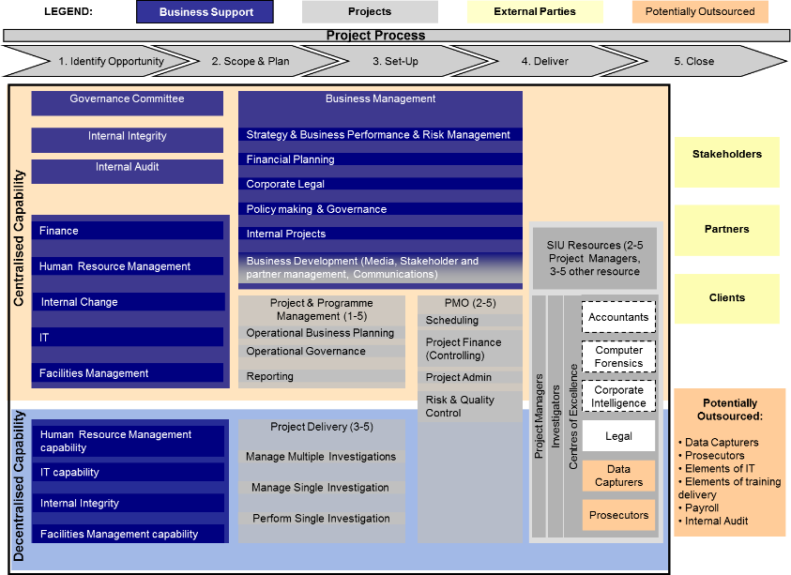
Improvement Focus Areas
In the 3rd quarter 2006 the SIU embarked on a comprehensive Organisational Assessment and Development Support Programme (OADSP), necessitated by the need to modernise and equip the organisation to achieve higher levels of operational efficiency.
The project outcome was well received, setting course towards a refined strategic intent, underpinned by a “world class” operating model and streamlined organisational structure.
NOT FULLY IMPLEMENTED !!

Slide 65

Improvement Focus Areas
Initiate an Organisational Culture Blueprint,
via participation of all staff and management.
Draft a suitable policy governing
change of organizational structure
Contribute to the finalization
where necessary of the
remuneration policy
Conduct relevant job grading
training to grading committee
Develop a remuneration
strategy by conducting
salary benchmarking
Review SIU Strategic Intent
Review the existing operating
model and structure
Develop operating processes
Align Strategic Objectives
Annual Performance Plan
Operational Plans
Procurement Plans
Risk Management Plans
Realign budgets
Stabilise all business support
functions, e.g. HR, IT, SCM.
Stabilise all core business
functions.
Establish new Business
Intelligence function
Acquire Data analytics
capability and tools
Conduct research wrt global best
practices to combat and
prevent corruption
Define new function for
Measurement and Evaluation
Develop cascading personal
and organisational Performance Measures
Process Maturity Ownership, and
continuous maturity improvement
ERP Systems Specification
Systems Selection for:
PMO, Finance, ERM, SCM, HCM, ECM and EDMS.

Slide 66
Observations . . .
The SIU will experience an increase in demand for specialist forensic investigative and civil litigation expertise and services.
Turn around time for investigations require urgent attention
The SIU’s ability to respond is heavily constrained by challenges, brought about by leadership attrition.
Challenge to set realistic and definitive key performance indicators
The organisation suffered corporate memory loss, brought about by leadership and management attrition, without corrective action.
There are various public sector agencies that have a particular legal or policy role to play in combatting corruption.
Apparent overlaps in mandate, together with various investigative units popping up

Slide 67
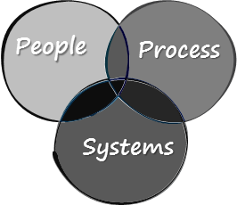
Observations continued . . .
Our people feel that people issues are “neglected”, organisational culture is not conducive to become a high performing business….
The SIU is in dire need for an intervention, to bring about rapid organisational review and rejuvenation. This will commence in November 2016
Currently reactive with regards to containing Corruption, pro-active corruption prevention is required. Public awareness and education is required
We don’t thoroughly comprehend the extent of Corruption, and the gearing required to be able to make a
meaningful impact.
The Basic elements of the business are not bedded down, hence not providing a foundation for operational
excellence…

Slide 68
THANK YOU
Adv. JL Mothibi
Head of Special Investigating Unit

