Slide 1
Rhino Conservation Lab Outcomes
Portfolio Committee on Environmental Affairs
18 October 2016

Slide 2
Rhino conservation is one of the work stream under the Biodiversity Lab – an effort to unlock the potential of South Africa’s Biodiversity
Context
Biodiversity Lab
  Departments Tourism and Environmental Affairs jointly decided to use ‘implementation lab’ methodology unlock the value of South Africa’s Biodiversity
  The Rhino Lab was added as a work stream, acknowledging the key role the rhino plays in the wildlife economy and SA’s tourism industry
  Rhino Conservation implementation plans will benefit from delivery unit infrastructure of wider Biodiversity effort
Marine & Coastal Tourism
Bio-prospecting
Wildlife
Rhino Conservation
Insert page by Duko after this one

Slide 3

South Africa has shown that it can save the rhino, and although poaching is a complex problem, multi-stakeholder solutions will yield results
Number of White Rhinos in RSA
South Africa has saved the White Rhino from its low of ≈ 20 in 1895
20,000
20,430
15,000
10,000
5,000
20
93
487
1895
1900
1910
1920
1930
1940
1950
1960
1970
1980
1990
2000
2010
Critical stakeholders
International smuggling to alleged consumers outside South Africa
Rhino poaching is a complex, multi-stakeholder problem
Private sector ownership of 25-35%
of RSA rhinos
NGOs with national and international multi-million dollar budgets to save the rhino
Interdepartmental cooperation lead to stabilization of Rhino killings by the end of 2015
Sample of existing initiatives (not necessarily recommended by the Lab)
Solutions are out there, but require an integrated approach to be successful
  MoU with Mozambique and other key countries
  Interdepartmental cooperation
  Improved anti-poaching units
  Improved intelligence gathering and analysis
International and Regional Cooperation Demand management
Compulsory (Security - Law enforcement)
  Demand management (focus on reducing demand for illegal wildlife products
  Considered legalisation of trade
  Focus on breeding to increase numbers
  Range expansion
Management of Rhino Populations
  Surrounding community education to prevent poaching
  Maximizing socio-economic potential of parks for surrounding communities
Long Term Sustainability Measures
SOURCE: CITES population estimates; Save the Rhino Annual Reports; DEA reports

Slide 4


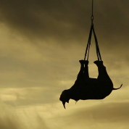


We developed work streams based on Cabinet decisions emanating from the Committee of Inquiry process: 5 pillars of rhino conservation
RHINO CONSERVATION
A
B
C
D
E
Community empowerment
Responsive legislation
Security (anti-poaching and anti-trafficking)
Demand management
Management of Rhino populations

Slide 5
Aspiration
“A robust integrated approach by all stakeholders to secure meta population of rhino in South Africa through effective reduction in the number of rhino killed through poaching by 11.1%, resulting in increase in the population at 2% p.a. through 2020”

Slide 6




































To do this work, more than 70 people from more than
20 organizations, representing ~5,600¹ hours of work, working together in the Rhino lab
1
NOT EXHAUSTIVE
1 Average of 50 people for 14 days, working 8 hours a day

Slide 7

The Lab methodology is facilitating unlocking solutions to
Rhino conservation
Description
Objective
Participants
  15-25 cross cutting stakeholders
  Sufficient seniority to make decisions
  Break down silos
  Design implementation plans
Leadership
  Government leaders frequently engaged in the lab
  Provide ‘live’ guidance
  Debottleneck processes
  Sign off on outputs
Timeline
  3 weeks, continuous fulltime process
    High level aspirations to detailed implementation plans
  Fast, actionable results
Venue
  Off-site,
    Work streams in different rooms; same site
  Work towards common goal
  Focus collectively without ‘day job distractions’
Working
style
  Intense problem solving,
  Non-hierarchical and collaborative
  Avoid non-productive discussion
  Extract high quality input
End
products
  “3-feet” level implementation plan with required budget identified for realizing initiatives
  Improve chances of implementation
Notes:
Participants
Smaller groups , more active and inclusive engagements
Leadership
Regular syndications and escalations to promote approach for departmental buy-in and secure commitment at highest level
Timeline
3 weeks fulltime process with 2.5 weeks of active participation from all role players.
Short timeframe – prevents decision fatigue and promotes fast , actionable results
Venue
Away from the daily office activities
Working style
Veeeeery intense!
Check in , check out
End products
DETAILED ACTIONABLE IMPLEMENTATION PLANS

Slide 8
The Rhino Lab has the potential to be a turning point…
New level of collaboration between Private Sector, NGOs, Academia and Government
Unprecedented approach and level of ownership from SAPS and the security cluster
Detailed and costed implementation plans with a high level of accountability
Approximately 50 Highly ambitious initiatives along dimensions Community, Legislation, Demand Management, Management of Rhino populations and Enforcement

Slide 9





A total of 44 initiatives have been developed in the Rhino Lab
4
INITIATIVES – FULL OVERVIEW
A,S
B
C
Law Enforcement
Community Engagement
Demand Management
  Anti-poaching
  APU capabilities: improved standardization and use of best practices
  Protection: more mobile footprint in the park, emphasis on perimeter protection
  Reactive elements: ramp up of APUs in provinces, increased support for APUs in SANParks
  Proactive elements: improved intelligence, transnational cooperation, and use of technology
  Improved governance via community facilitators
  Enhance the community ranger model with a national career and roll-out plan for the community ranger model
  Conduct stock take on existing economic community empowerment programs to intelligently consolidate and re-allocate resources
  Develop and roll-out a broader restorative justice programme with SAPS and other partners
  Launch a community empowerment plan and champions
  Undertake peer reviewed research, with credible funding mechanism, on consumer markets and forms of demand and supply based on government direction and link this to demand management initiatives
  Continue and expand investigation of the potential of alternative options to address national demand, increase benefits and disrupt illicit supply chain (e.g. trade, exporting live rhino, synthetic rhino horn)
  Develop targeted messages for an information campaign as part of a communication strategy relating to the status and management of rhino to address incorrect perceptions that lead to speculation that drives exaggerated prices of rhino horn
A
  SAPS
  Prosecution: improved collaboration to treat problem as organised transnational crime
  Detection: increased capabilities in forensics and intelligence
  Collaboration: law enforcement cooperation with transit and consumer states
S
D
E
Management of Rhino populations
Responsive Legislation
  Guidelines for land use, e.g., intensive breeding operations
  Securing and growing key rhino populations, by funding their owners
  Improved regulatory environment, e.g., increase usage of standing permits
  Improved best practice sharing across all stake-holders
  Expanded RMG status reporting for white rhino and continued for black rhino
  List of applied research priorities identified by RMG
  Rhino horn stockpile management with reference to centralization and a tracking system for rhino horn stockpiles to address auditing and security concerns
  Amend as appropriate National legislation to provide for effective regulation of domestic trade in
  Rhino horn
  Draft policy that provides financial security incentives for rhino conservation and ownership
  Initiate a policy and legislative development process including a review of constitutional mandate to move towards national consolidation of all forms of wildlife regulation
  Finalize and implement the electronic national integrated permit system that enables uniformity in capturing of data and information management

Slide 10
Of all the initiatives, 11 are ‘quick wins’ that can be implemented and achieve results in the next 12 months
4
INITIATIVES OVERVIEW – QUICK WINS
Initiative
Outcome
Enforcement
  Finalise Park Ranger Qualification (QCTO) curriculum and roll-out to the provinces
  Expand the sourcing equipment for provincial APUs (including US excess non-lethal military stock)
  Provide access to Health & Wellness programmes for APUs, or work with SAPS to leverage existing programmes
  Improved APU capabilities (including in Provinces)
  Readiness for APU programme expansion to all Provincial protected areas
  Training of SANPARKS and provincial Health and Wellness officers by SAPS
A,S
Community Engagement
  Recruit and deploy first batch of community facilitators in one of the identified hotspots
  Recruit and deploy ~300 community rangers in one of the identified hotspots
  Stock take of existing community programs
  First set of conflicts being resolved, improved perception among communities
  ~300 people in targeted communities employed, improved security
  Reallocation of funds to successful efforts
B
Demand Management
  Continue and expand investigation of the potential of alternative options to satisfy foreign consumer demand from within SA, increase benefits to SA and disrupt illicit supply chain
  Feasibility of alternative options known and recommendations made
C
Management of Rhino populations
  Secure USD >3M of funding for identified rhino key rhino populations
  Increase usage of standing permits to reduce number of individual permits required for keeping rhinos
  Improved security and thus lower poaching incidents in key rhino populations,
  Bio management interventions executed faster (e.g. <2 days), number of permits within standing permit is minimum of 5
D
Responsive Legislation
  Amend as appropriate national legislation to provide for effective regulation on domestic trade in rhino horn
  Centralisation of rhino horn stock piles
  If moratorium on domestic trade is lifted, there will be readiness in place
  Private sector led centralized rhino horn stock pile with electronic management
E

Slide 11
Overall budget
INITIATIVES – BUDGET
PRELIMINARY COSTING
R Million
Average cost per year
Million Rand
Cost of implementing initiatives by financial year
Million Rand
454
Law En-forcement
SAPS
379
Anti
-Poaching
36
Community Empower-ment
25
19.0
13.0
20.0
23.0
34.0
43.0
Demand Manage-ment
23
0
47.9
47.0
43.4
0
0
Biological Manage-ment
7
43.5
0.1
0.1
0.2
0.1
0.2
Responsive Legislation
3
3.2
12.1
0.1
0.1
0
0
2016/17
2017/18
2018/19
2019/20
2020/21
2021/22
TotalCost/year
434
410
512
516
463
501
473

Slide 12
Implementation of the Rhino Conservation Lab initiatives will be tracked by a Delivery Unit structure
DU activities
Implementing teams activities
Problem solving and implementation support
Implement reforms
  Directly with initiative owners to find solutions to challenges
  Provide additional resources and expertise to move project forward
  Escalate issues timeously for prompt resolution and sign-offs
  Structure and assign teams to ensure successful implementation
  Escalate roadblocks to DU to ensure corrective measures can be implemented in time
Project monitoring
Data gathering and consolidation
  Ensure accountability and transparency across project
  Get data directly from project manager to update reports
  Hold intitiative owners responsible for execution as per 3ft plans
  Collect and consolidate data timeously for reports
  Populate data using templates issued by DU to ensure reports can be easily prepared in time
Special projects
Monitor contractors
  Projects issued at the discretion of top leadership (e.g., DG or Minister)
  Normally targeted at resolving specific issued that are more research oriented in nature
  Serve as the effective project manager, monitoring line-by-line
  Ensure that expectations are met as outlined by timelines and scope issued by DU

Slide 13
Appendix 1 - Contents
  Enforcement
    Anti-poaching
    Anti-trafficking
  Community Empowerment
  Demand Management
  Responsive Legislation
  Management of Rhino populations

Slide 14
Contents
  Enforcement
    Anti-poaching
    Anti-trafficking
  Community Empowerment
  Demand Management
  Responsive Legislation
  Management of Rhino populations

Slide 15
Anti-Poaching – 22 initiatives (All initiatives to be implemented in compliance with legislative requirements)
5
INITIATIVES OVERVIEW – ANTI-POACHING
A
Anti-poaching unit
capabilities
Protection
Re-active elements
Pro-active elements
A1
Appoint a sub-committee of working group 4 members, to implement and facilitate the standardization of documents, procedures and guidelines comprising of SANParks, and provincial conservation bodies
A7
  Follow a zoning approach to ensure allocation of resources to the highest risk geographies
A15
  Establish an APU for each government protected area with rhino population and use KNP and Umfolozi as operating models and examples
A18
  Develop virtual project office to explore and develop appropriate environmental asset management technologies and share recommendations with conservation community (including IP management)
A8
  Identify and apply appropriate sensor based technologies
A9
For selected servitudes:
  Apply appropriate electronic surveillance based technologies
  Escalate the need for (temporary) restrictions
  Implement sporadic control points
A16
A2
  Benchmark and adjust APU rural allowance, OSD possibilities and overtime compensation
  Implement employee health and wellness programme at all protected areas with APUs, or leverage the SAPS programmes where possible
A19
  Finalise protocol process for “Re-instatement of joint cross border protocol between Mozambique and South Africa as part of the further development and management of the GLTP”
A3
  Finalise Park Ranger Qualification (QCTO) curriculum and create capacity to implement roll-out to the provinces
A10
A17
  Issue SAPS instruction (with NPA input) governing the investigation process following fatalities that occur in the line of duty of EMI law enforcement officials, and separate instructions for other departments operating in anti-poaching enforcements
  Task community working groups with effective information sharing between parks and communities
A20
  Form APU liaison office at DEA Enforcement
A4
  Expand the sourcing equipment for provincial APUs (including US excess non-lethal military stock)
A11
  Develop a scalable access control package that includes: trained and integrity tested officials; canine systems; technological applications
A21
  Develop legal agreements / processes to enable rangers (government/private) to undertake anti-poaching operations across the different protected areas (national and transnational)
A5
Roll out integrity management across all APUs and classify APUs as essential services
A12
  Utilise semi-permanent/ limited mobile self-contained 'mini bases' in accordance with the grading of security requirements
A6
Start Community Ranger pilot as extension of Environmental Monitors to improve enforcement relationship with surrounding communities
A22
  Work with security cluster (incl. SAPS) in context of NISCWT to gather, analyse and share intelligence in a wider anti-trafficking approach
A13
  Centralise horn stockpiles at current SANParks facilities (improve security where required) and also make provision for regional stockpiles (risk assessment to be done)
A14
  Roll out CMORE (field intelligence system) at national scale

Slide 16
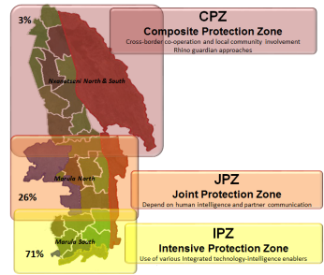
Follow a zoning approach to ensure allocation of resources to the highest risk geographies
5A
INITIATIVE DEEP DIVES – ANTI-POACHING
A7
The zoning approach has allowed KNP to focus its resources on <25% of its surface area, containing 70% of its rhinos
Several other parks across SA will benefit from the same prioritization approach
Madikwe
Poaching only in extreme North and South ends
Pilanesberg
~90% of poaching occurred in Northern ‘Wilderness’ section
Great Fish (EC)
All poaching occurred North of the Great Fish river
Across protected areas, ~60-70% of poaching occurs within ~2km of road

Slide 17
Provincial parks are not resourced for effective poaching control
5A
INITIATIVE DEEP DIVES – ANTI-POACHING
A15
Mpumalanga example
Vacancy rate
Filled posts / authorised posts
Area coverage
Hectares / filled posts
Loskop
58%
Loskop
1,513
Mtethomusha
54%
Mtethomusha
2,130
Songimvelo
38%
Songimvelo
651
Manyeleti
33%
Manyeleti
866

Slide 18
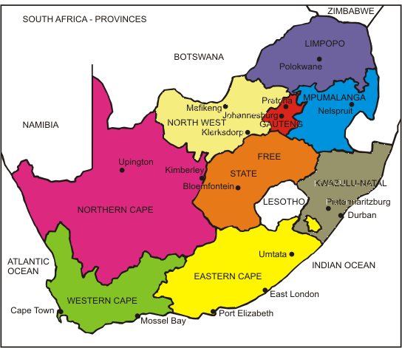
  Establish an APU for each government protected area with rhino populations and use KNP and Umfolozi as operating models and examples
5A
INITIATIVE DEEP DIVES – ANTI-POACHING
A15
Small PA
Medium PA
Large PA
GAP ANALYSIS TO BE COMPLETED
26 Protected areas (ex. KNP) with rhinos currently have no or insufficient APU capacity¹
Minimum APU capacity proposed
Small PA
  8 APU rangers
Medium PA
  16 APU rangers
Large PA
  24 APU rangers
  3 dogs
  3 dog handlers
1 Excluding 7 National Parks (excluding KNP)

Slide 19
Provide access to (psychiatric) Health & Wellness programmes for APUs, or work with SAPS to leverage existing programmes
5A
INITIATIVE DEEP DIVES – ANTI-POACHING
A16
Number of contacts with poachers in KNP alone
  Recent findings suggest that at any given point, at least 12 officials in KNP need counseling
  Adequate counseling is not available for most APUs across the provinces
Jan
Feb
Mar
Apr
May
Jun
Jul

Slide 20

  Formation of an APU liaison office in DEA Enforcement
INITIATIVE DEEP DIVES – ANTI-POACHING
A21
  Standardize tactics, techniques and procedures
  Communicate information to the various APUs through the information / communication management system currently used in SANParks
  Disseminate information relevant to current operations
  Coordinate training and rotation programmes where necessary

Slide 21
Contents
  Enforcement
    Anti-poaching
    Anti-trafficking
  Community Empowerment
  Demand Management
  Responsive Legislation
  Management of Rhino populations

Slide 22

Context and Role of Rhino Lab
INITIATIVE DEEP DIVES – ANTI-TRAFFICKING
S
  Committee of Inquiry set up to investigate the feasibility of proposing a legal trade in rhino horn at COP17
  Recommendations linked to enforcement
    Development of an integrated enforcement strategy
    Increase capacity to undertake enforcement
    Review MOUs to provide enhanced law enforcement co-operation and joint investigations with transit and consumer states
  SAPS formulated draft strategy (NISCWT) prior to Rhino Lab
  Lab is assisting to align the NISCWT implementation plan
  with the outcomes of the Rhino Lab and define financial
  implications of the NISCWT

Slide 23
National Integrated Strategy to Combat Wildlife Trafficking in
South Africa (NISCWT)
INITIATIVE DEEP DIVES – ANTI-TRAFFICKING
S
Vision
A well-resourced and implemented integrated, multidisciplinary and consolidated law enforcement approach to break the illicit value chain of wildlife trafficking in SA and beyond
Initial focus (but then expand)
  Rhinoceros
  Elephants
  Abalone
  Cycad
Mission Strategy
To focus and direct law enforcement’s ability, supported by the whole of government and society, to address the threat wildlife trafficking poses to national security and biodiversity

Slide 24
The NISCWT strategy addresses wildlife trafficking as a transnational organised crime, and significantly ramps up capacity and collaboration to detect and prosecute
INITIATIVE DEEP DIVES – ANTI-TRAFFICKING
S
1
Prosecution
2
Detection
3
Collaboration
Improving law enforcement, supported by the whole of government and society, to effectively investigate, prosecute and adjudicate wildlife trafficking as a form of transnational organised crime
Increasing the government’s ability to detect, prevent and combat wildlife trafficking in South Africa and beyond
Increasing national, regional and international law enforcement collaboration and cooperation on combating wildlife trafficking

Slide 25

Each of the objectives in NISCWT was unpacked in sub-objectives, with detailed and costed implementation plans behind them
INITIATIVE DEEP DIVES – ANTI-TRAFFICKING
S
1
Prosecution
  Adequately resource the law enforcement initiatives outlined in the NISCWT
  Increase effectiveness and coordination of intelligence collection and analysis on wildlife trafficking
  Improve law enforcement capacity to investigate wildlife trafficking
  Increase anti-corruption investigations linked to wildlife trafficking
  Enhance resources to investigate financial crimes linked to wildlife trafficking
  Enhance forensic capacity linked to wildlife trafficking investigations
  Increase the government’s ability to detect the involvement of foreign diplomats in wildlife trafficking in South Africa
  Appropriately charge offenders in relation to these types of crimes and focus investigations on dealing with wildlife trafficking as a serious organised crime
  Establish specialised prosecution and court capacity to focus on wildlife trafficking
  Prioritise wildlife trafficking crime statistics into the national crime statistics
  The SAPS to enhance cooperation and collaboration with non-governmental organisations and private security structures
  Government to consolidate all law enforcement investigation and intelligence initiatives regarding the combating of wildlife trafficking in South Africa (long-term strategy)
2
Detection
  Significantly reduce the risk of wildlife-related corruption
  Increase resources for security at South Africa’s land, air and sea borders
  Increase focus on transport routes, informal and private landing strips and illegal border crossing points linked to wildlife trafficking
  Increased crime prevention initiatives in and around communities adjacent or linked to poaching hotspots as part of law enforcement activities:
  Improve detection and prevention of wildlife trafficking through ports
  Consolidate and increase wildlife compliance and enforcement
3
Collaboration
  Diplomatic position on wildlife trafficking to reflect the issue as a national security priority
  Strengthen law enforcement cooperation with relevant countries
  Benchmark global best practices regarding wildlife trafficking investigations/prevention
  The SAPS to play a key role in regional and international wildlife trafficking combating initiatives

Slide 26





The success of NISCWT will be measured by several key KPIs over time
INITIATIVE DEEP DIVES – ANTI-TRAFFICKING
S
Overall goal
  Percentage decrease in rhinos poached
Arrests
  Number of people arrested and convicted for wildlife trafficking charges
Corruption
  Number of people arrested and convicted for wildlife trafficking related corruption charges
Seizures
  Volume of illicit wildlife products seized
Efficiency
  Average time from incident to start of court case
Forfeitures
  Rand value of seized assets in wildlife trafficking cases
Community
  Rand value of seized assets returned to park surrounding communities

Slide 27
Contents
  Enforcement
  Community Empowerment
  Demand Management
  Responsive Legislation
  Management of Rhino populations

Slide 28
Community empowerment has shortlisted 5 initiatives to increase the participation and economic benefits of communities from conservation
5B
INITIATIVE DEEP DIVES – COMMUNITY EMPOWERMENT
B
Alleviate most pressing challenges for communities to reduce hostility and create a positive bond
Increase economic participation for adjacent communities
Make adjacent communities a partner in conservation
1
Improved governance via community facilitators
2
Enhance the community rhino ambassador model with a national career and roll-out plan
3
Conduct stock take on existing economic community empowerment programs to catalyse new projects and training programmes
4
Develop and roll-out a broader restorative justice program with SAPS and other partners
5
Launch a community empower-ment plan and champions

Slide 29
The lab developed a proposal for the end-state local governance mechanism
5B
INITIATIVE DEEP DIVES – COMMUNITY EMPOWERMENT
B1
Communities
Authorities
Community structures
What it is:
External body/team reporting to DEA, DRDLR, DSD, COGTA mandated to improve lives of communities in conservation areas
Local government
Tribal authorities
Alignment with existing structures, where feasible
Conservation and parks
Communal Property Association
Governance
Facilitator
Private sector
Provincial and national government
The process:
  Mechanism for raising issues
  Facilitator will build relationships, select relevant subset of stakeholders per issue and convenes meetings to address issues
  Conducts broad engagement with all stakeholders
  Anonymous community participation
NGOs
Law
Enforcement

Slide 30
Example: To achieve security, a participation regarding land claims of neighboring communities needs to be facilitated
5B
INITIATIVE DEEP DIVES – COMMUNITY EMPOWERMENT
B1
Status quo
Desired state
Neighboring communities needs to buy-in to support security efforts
TA
TA
0%
10%
Reserve
Community facilitator convenes, facilitates and finds an amicable solution
TA
0%
0%
TA
TA
10%
10%
TA
100%
Land claims
70%
CPA
CPA
Government comes with a project but causes conflict by talking to subset of people
Government comes in and facilitator guides whom to engage with to reduce conflict

Slide 31
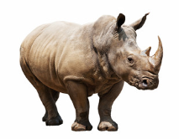
Community-based ambassadors have proven to be a model to empower communities economically and increase buy-in
5B
INITIATIVE DEEP DIVES – COMMUNITY EMPOWERMENT
B2
Existing community ambassador models…
…and come with several advantages
  KZN¹ 400 “rhino ambassadors”
  Black Mambas 37 covering Limpopo area
  K2C 27 rhino ambassadors covering Mpumalanga area
  Kids in park in KNP
  Honorary Rangers
  Create awareness and role models
  Advocacy and lobbying for protection of Rhino
  Expose communities to positive sides of law enforcement officials (including APU rangers)
  Job creation and improved livelihood
  Increased support rates of arrests
  Skill building for community members
  Decrease involvement in poaching activities from local community
  Creating of a sense of ownership towards conservation
  Enabling communities to sustainable use of natural resources
…are showing impact…¹
Rhino loss rate: GRU Reserves
Animals poached per month per 100 000ha
2.34
2016 0% up to date
1.16
1.21
2013
2014
2015
1 Kruger
2 Canyon Impact study of the Rhino ambassadors programme

Slide 32
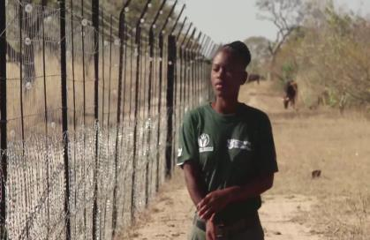
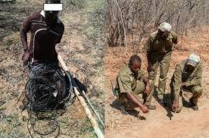
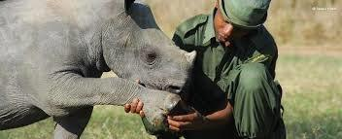
5B
INITIATIVE DEEP DIVES – COMMUNITY EMPOWERMENT
B2
Community rhino ambassadors take on many important activities in preventing poaching
Community rhino ambassador activities
  Community education & awareness
  Identify & advocate community basic needs
  Boundary patrol
  Removal of snares
  Patrolling the inside boundary
  Coordinate environmental events

Slide 33
Contents
  Enforcement
  Community Empowerment
  Demand Management
  Responsive Legislation
  Management of Rhino populations

Slide 34
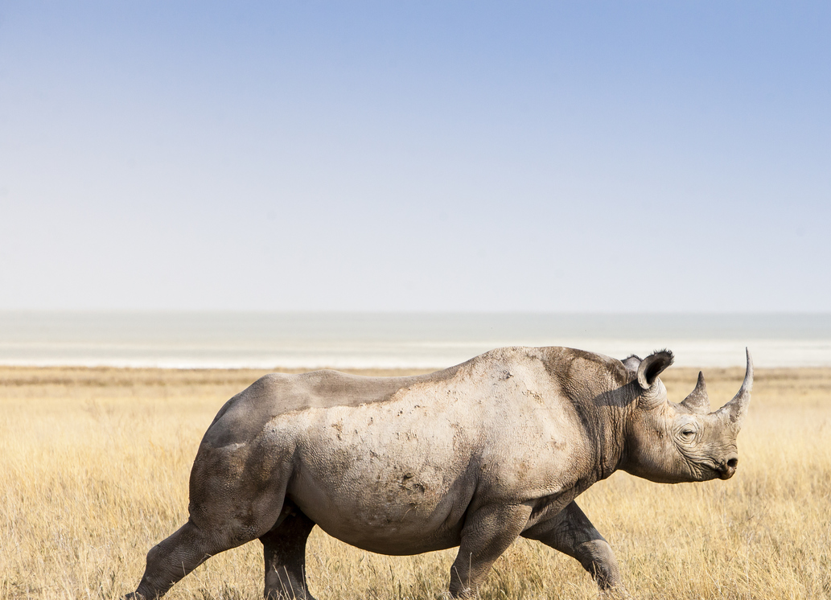
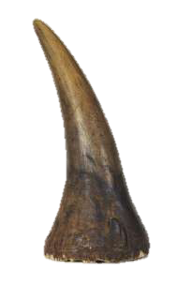
Demand management
INITIATIVE DEEP DIVES – DEMAND MANAGEMENT
C
We have focused on 3 key initiatives
Consumer markets
Alternative options to satisfy foreign consumer demand from within South Africa
Targeted messaging
It is imperative that we ensure the demand for rhino horn does not result in decline of rhino

Slide 35
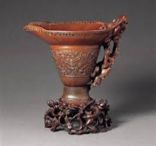
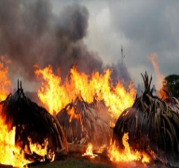


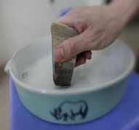



Priority research areas
5C
INITIATIVE DEEP DIVES – DEMAND MANAGEMENT
C1
Consumer Markets
Stockpile destruction
Campaign Success
Price of Rhino Horn
“Kenya burns vast piles of elephant tusks” – Reuters

Slide 36
There is urgent need to undertake research on crucial questions affecting our approach to demand management
5C
INITIATIVE DEEP DIVES – DEMAND MANAGEMENT
C1
The top 3 Inquiries to make will form the basis to build future research on
Rationale for Inquiry
Use of Insights
What are the profiles of different segments of buyers of rhino horn in consumer states?
  To understand the underlying reasons behind purchase choices
  To determine the correct sustainable approach to take in demand management
  Social cultural considerations and behavior modification campaigns
  Inform legislation including prohibitions and regulated market
1
What is the impact of large scale stock pile destruction on demand in consumer states?
  To understand the relationship between destruction and the market forces
  To determine the messaging in large scale stock pile destruction
  To determine the impact on poaching in range states
  Inform policy on destruction of stock piles and conservation
2
What are the successful demand management/ reduction campaign elements?
  Lack of knowledge of the outcomes of campaigns
  To learn best practice and lessons in messaging
  To adapt in communication strategy
  Make appropriate finance and auditing decisions for campaigns
3
What is the current horn price (at different points in the value chain) currently and under different scenarios
  Lack of understanding of syndicate dynamics
  Understanding of potential benefits of trade scenarios
  Inform prosecution/ anti-trafficking operations
  Provide insights for private and public trade initiatives
4

Slide 37

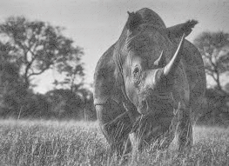
An appointed task team will look into alternative options to satisfy foreign consumer demand from within SA
INITIATIVE DEEP DIVES – DEMAND MANAGEMENT
C2
PRELIMINARY
And what are the possible outcomes under each option..
Timeline
Option
Areas to investigate
Possible outcomes
Trade
  Open market for traditional Asian medicines and clinics
  Open market for sell of rhino horn artisanal materials
  Sale of rhino for non-commercial purposes
  Consumers travel to SA for use of rhino horn
  Consumers obtaining import permits from their country of origin and export permits from SA
Recommendations on the viable routes and requirements to drive it such as legislation for implementation
Export live rhino in large volumes
  Establishment of captive breeding facilities in consumer states
  Production of rhino horn in consumer states for use in consumer states
  Rhino horn is supplied from multiple sources not just Africa range states
  Rhino owners export live rhino to trade in countries where trade is legal
Synthetic Horn
  Role of synthetic rhino horn in substitution for rhino horn
  Relieves demand pressure for authentic rhino horn
  Reduction in the price of rhino horn
  Law enforcement challenges

Slide 38


A targeted message is needed to change the perceptions on rhino horn in the various audiences
INITIATIVE DEEP DIVES – DEMAND MANAGEMENT
C3
Requires additional information
Should be replaced
What's written
Number of rhinos
Number poached
Price of horn high
Millions of users
Rhino going extinct
What's heard
There is money
in it
Price will increase!
Invest at any cost
There is a product
It’s easy to get horn
There is a market
Supply chain
Producers:
On the ground
poachers
Consumers:
Asian horn users
What should
be added/ written
Well managed rhino pops
Poachers caught, sentenced, assets forfeited
IPZ heavily guard, technology, dogs
Do not use illegal medicine
Rhino will not go extinct
What we want to be heard
It’s not easy to get horn
Not worth the risk
Stay out of IPZ
Sustainable legal
medicine
Not a good investment

Slide 39
Contents
  Enforcement
  Community Empowerment
  Demand Management
  Responsive Legislation
  Management of Rhino populations

Slide 40
Responsive Legislation
INITIATIVE DEEP DIVES – RESPONSIVE LEGISLATION
E
We have focused on 4 key initiatives
Centralisation of rhino horn stockpile management
Providing for effective legislation on domestic rhino horn trade
A consolidated national wildlife legislation
The National Electronic Integrated permit system
We will use existing laws optimally and prepare for future scenarios

Slide 41

Rhino horn stockpiles are stored in various places which has brought challenges
5E
INITIATIVE DEEP DIVES – RESPONSIVE LEGISLATION
E1
Confidential
x
  Safety of rhino horn in storage facilities is compromised as facilities is not specific for rhino horn
  Security risks to owners and staff i.e. armed attacks
  Audit challenges experienced all over the country
  Permit compliance and monitoring issues
  Expensive security costs (on individual owners)
  According to the survey conducted by PROA 60% of the owners are in favour of the centralised point
  Providers no longer want
  rhino stock piles due to
  nature of care required e.g. complain of smell
x
x
x
x
Bank
Private
vault
Private security
Home
Total

Slide 42
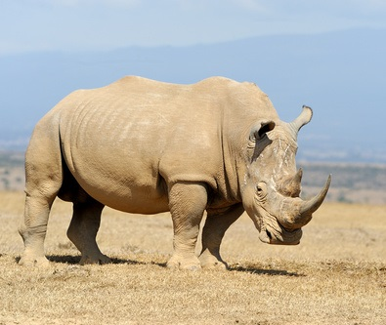
There are significant advantages to private centralised horn stockpiles, including auditability and security
5E
Private
INITIATIVE DEEP DIVES – RESPONSIVE LEGISLATION
E1
Govt
SAFE AND SPECIFIC TO RHINO
AUDIT
ELECTRONIC DATA
COST EFFECTIVE
PRIVATE
CENTRALISED RHINO HORN
STORAGE

Slide 43
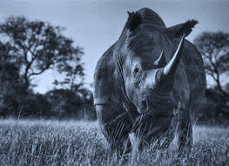
To ensure no leaks, we would regulate around the following areas and other emerging areas
INITIATIVE DEEP DIVES – RESPONSIVE LEGISLATION
E2
Foreigner transaction
  Import permits will have to be issued in home country before export permit is issued in SA
  Additional requirement for transactions involving foreigners
  Regulation limiting the number of rhino horns to be exported for personal effect
1
State of Rhino horn for sale
  Prohibit the creation of powder and trade in shaving (exclusion for dehorning and micro chipping, export of these is always prohibited)
  Include Diceros bicornis michaeli (need to amend AIS regulations to remove this species from the AIS list)
  Inspection of rhino horn to be traded
2
Movement of rhino horn
  Prescribing the port of entry and exit e.g., OR Tambo – for control purpose
  Compliance monitoring of movement of rhino horn
  Collaboration with Home Affairs on regulation on persons crossing with rhino horn
3

Slide 44
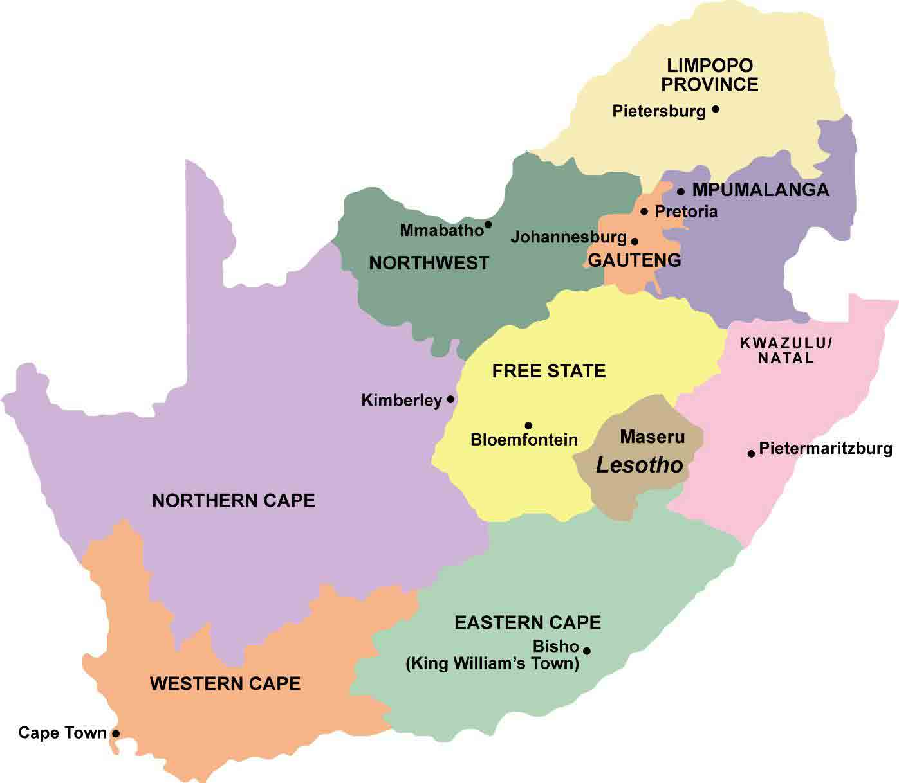
National consolidation of wildlife regulation is necessary for cohesion in implementation of regulation
INITIATIVE DEEP DIVES – RESPONSIVE LEGISLATION
E3
Currently
  Lack of cohesion between provinces and between provinces and national government
  Difficulty in implementing a national integrated permit system
  Conflict between enforcement and owners
  Corruption through cracks in the system
  Cumbersome compliance
1
A permit is not needed to move game from one farm to the other
A permit required to move game from one farm to the other
=
Free State
Gauteng
2
A permit is not required to purchase rhino horn
A permit is required to purchase rhino horn
=
Gauteng
National
3
A permit is not required to hunt on a game farm with adequate enclosure
A permit & hunting license is required to hunt on a game farm with adequate enclosure
A permit is required to hunt on a game farm with adequate enclosure
=
=
North West
KZN
National

Slide 45

To achieve national consolidation in wildlife regulation
INITIATIVE DEEP DIVES – RESPONSIVE LEGISLATION
E3
Look at best practice experience from past harmonisation
Make amendments to existing legislature
1. Harmonised all EIA legislation - All environmental authorisation are dealt with in terms of NEMA: EIA provisions
2. Gauteng has harmonised the nature conservation Bill with national legislation
  Conduct comprehensive analysis on the potential conflict between provincial legislation and national legislation
  Amend NEMBA to include enabling provisions contained in provincial legislation and to empower MECs to make regulations, where required
  Develop a national legislations and provinces to repeal their existing legislation
This process needs political buy in, capacity and financial resourcing

Slide 46
The National integrated permit system is being developed but lacks infrastructure and biometric resourcing
INITIATIVE DEEP DIVES – RESPONSIVE LEGISLATION
E4
Capabilities
Impact
1
2
  Reports will be readily available for all including parliamentary questions, media enquiries and audit reports (CITES annual report)
  Single system that saves on cost and time of information seeking
  Standardised permits
  Faster tracking of a permit application
  It will assist with effective law enforcement
  Efficiency in audit trail and linked to the wildlife permit system
  It will save on the environmental footprint i.e. less paper and environmental friendly
Online system with real time data reflection
Adaptable system that links the provinces and national system
3
4
Infrastructure and biometric system for implementation
Large back up storage space

Slide 47
Contents
  Enforcement
  Community Empowerment
  Demand Management
  Responsive Legislation
  Management of Rhino populations

Slide 48


6 initiatives for Management of Rhino populations
D
Facilitation of BMP
implementation by RMG
Enabling needed
implementation by DEA
Information needed
implementation by RMG and DEA
Grow numbers to off-set poaching in short term
Maximise rhino and persistence in long term
Maximize sustainability across social, economic, environmental objectives
Maximise sustainability across social, economic, environmental objectives
1
Guidelines for land use, e.g., Captive breeding operations
2
Securing and growing rhino “key rhino populations” by funding holders of key populations
3
Improved regulatory environment, e.g., increase usage of standing permits
4
Improved best practice sharing across all stake-holders
5
Expanded RMG status reporting for white rhino and continued for black rhino
6
List of applied research priorities identified by RMG

Slide 49
Different land use classifications exist, especially intensive and wild operations have to play a key role in White Rhino conservation efforts
D1
Not preferred
Detailed in next page
Intensive operations
Zoo Pen
Paddocks
Wild
Avg. size
<0.1 km²
<1-10 km²
<10-100 km²
~10-19,485 km²
# of rhinos
2-5
~20
Up to 1400¹
5-8800²
% of population
67%
23%³
0%
0%
10%
Artificial selection
Supplementary feed
Veterinary care
Key messages:
Do not put all effort on just one management model
Acknowledge different benefits of different land uses
Optimise usage of different land-uses in the short term to boost numbers and provide insurance policies
Priority is long term conservation in the wild environment
1 1400 2 16488 3 Private 23% / State 67%

Slide 50
The lab has identified top 20 key populations / reserves that conserve 80% of South African and 56% of the world’s rhinos
5D
INITIATIVE DEEP DIVES – BIOLOGICAL MANAGEMENT
D2
Identified key rhino populations
Black
White
Overlap between populations and reserves results in ~20 key rhino populations
  These players will
    Maximise “bang for the buck” in terms of conservation impact
    Should be prioritised to be supported
    Suffer from exploding cost and limited monetisation potential
Number of operations with species
  13
  18
+
Private
  220
  2,850
Public
  1,150
  12,000
Share in rhino population
South Africa
Africa
Black
White
  72%
  81%
  26%
  73%
1 1 The properties selected were either IUCN SSC AfRSG-rated Key black rhino populations >50, and/or Key white rhino populations >100 or Key white rhino populations >50 that also had black rhino reserve and >100 rhinos in total.
2 These 20 key reserves conserve 71%, 67% and 100% of the country’s D.b.minor, D.b.bicornis and D.b.michaeli metapopulations respectively. Globally these populations conserve 51% of Africa’s D.b.minor

Slide 51



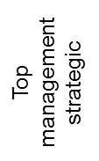








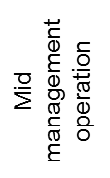



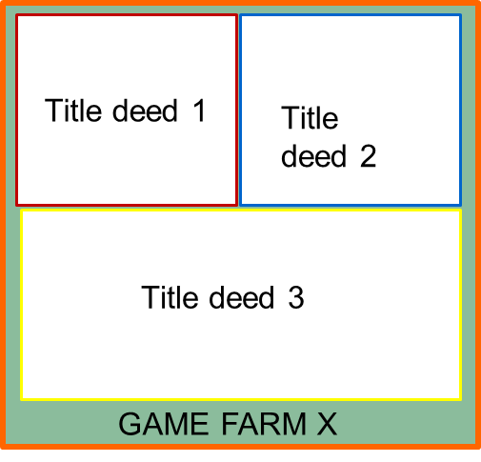

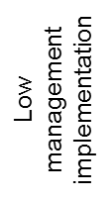



Implementing BMPs and protecting key rhino populations have several challenges
D3
Improve regulatory environment
D4
Share best practices
Attendance of key meetings is variable
18
permits required for “normal rhino management and translocation
Variable dissemination within the “state” vertical
Varying communication platforms to front line staff
Room for better engagement with the private sector and communities
  Upgrade websites to informative portals for effective and correct permitting
  Implement TOPS Standing Permits efficiently across all provinces
  Secure rhino information and protect the integrity of government
  Stimulate compulsory Rhino information flow and analyses between stakeholders
  Minister letter about meeting importance
  Matching funding for travel budget to ensure attendance
  Dissemination guidelines from proceedings
  Establish rhino management extension officers
  Establish a rhino forum for all stakeholders

Slide 52
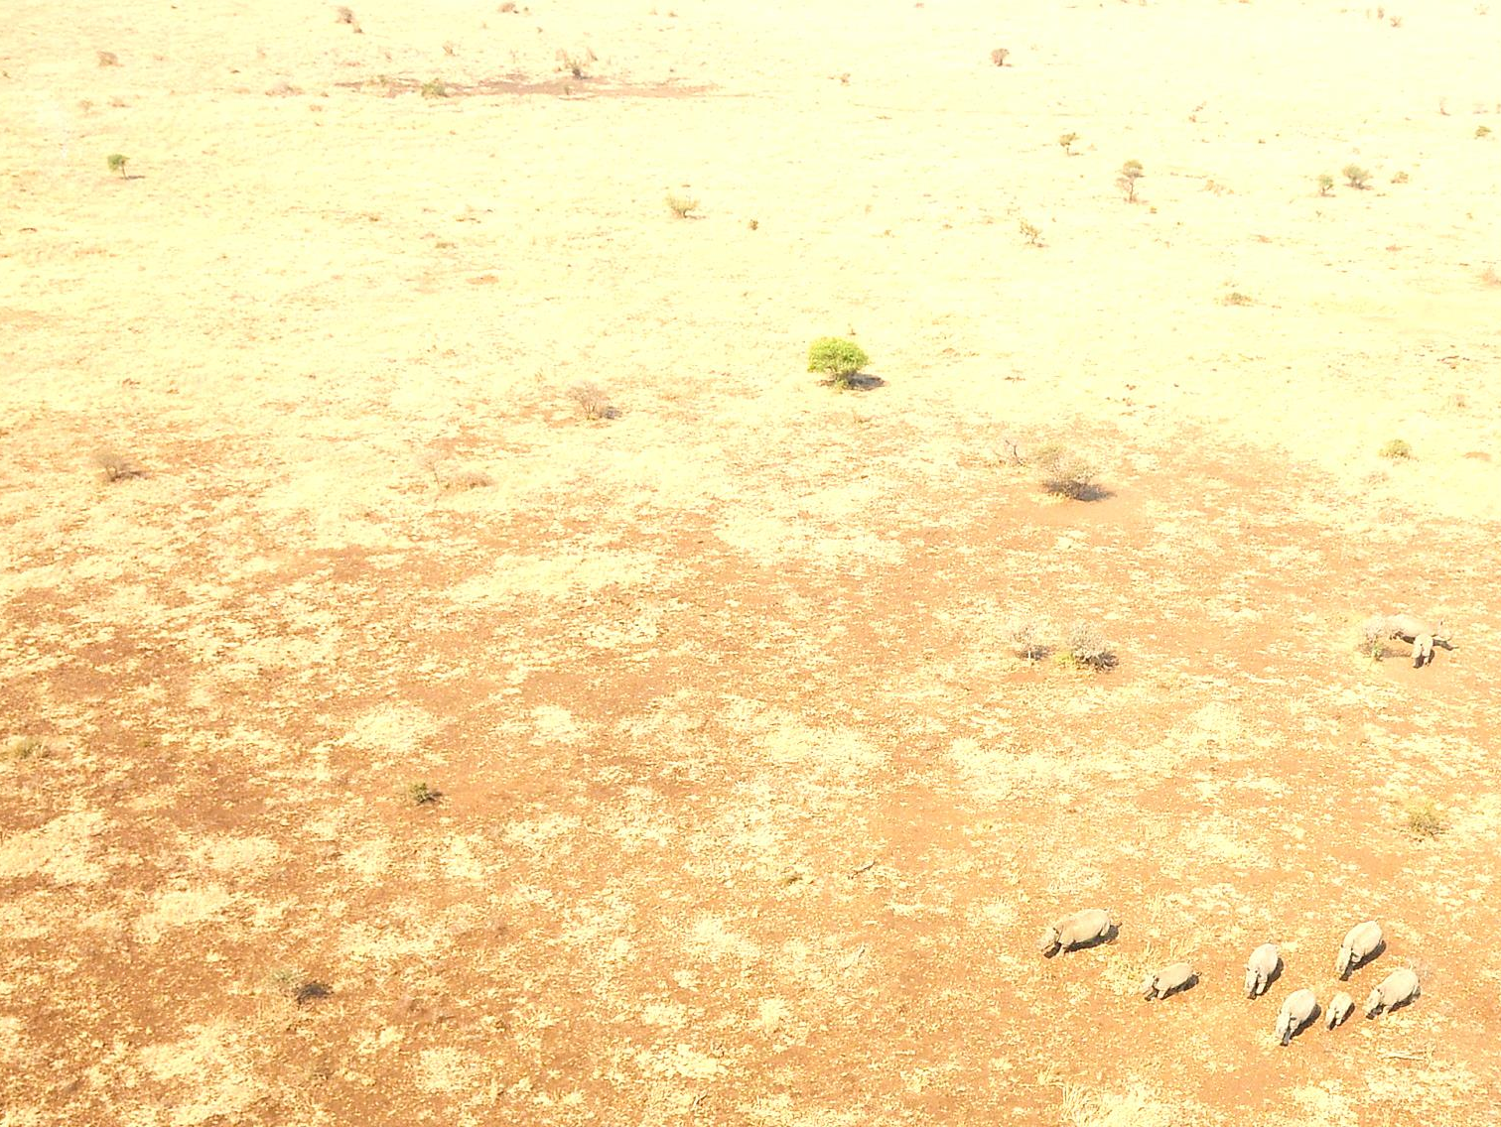
Getting smart with information we collate and what we learn
D5
Expand RMG Status Reporting
Focus areas
Challenges
Activity
  White rhinos
  No standardized white rhino reporting
  Establish white rhino RMG Reporting Format
  Black rhinos
  Declining quality in data collection and reporting
  Improve annual black rhino RMG Reporting using possible simplified formats
D6
Applied Research
Focus areas
Challenges
Emerging priorities
  Biological techniques
  Several techniques achieve the same outcome.
  Effective release of orphans
  Well-being of rhinos after intervention
  Assessment techniques
  Risks associated with management
  Risk vary between type of intervention and the scale at which that is done.
  Disease risks and vectors
  Risks of domestication
  Social risks of introducing black rhinos
  Effects of scale
  Different land-uses of rhinos provide different challenges and opportunities for sustainability
  Contributions of land-uses to sustainability
  Understanding rhinos dynamics and responses
  Rhinos respond to Management of Rhino populations –consequences of some interventions unknown
  Dynamics in semi-extensive and extensive areas
  Evaluate response to Management of Rhino populations
  Understanding rhinos as drivers of systems
  Rhinos play key roles as ecological engineers and how society enjoy and use them.

Slide 53
THANK YOU

