Slide 1
1st QUARTERLY PERFORMANCE REPORT 2016/17 PRESENTED BY THE SECRETARY GENERAL MS MEMME SEJOSENGWE
www.judiciary.org.za

Slide 2
PRESENTATION OUTLINE
PURPOSE OF THE PRESENTATION
MANDATE OF THE DEPARTMENT
VISION, MISSION AND VALUES
OVERVIEW OF Q1 (2016/17) PERFORMANCE
PERFORMANCE PER PROGRAMME
PROGRAMME 1: ADMINISTRATION
PROGRAMME 2: JUDICIAL SUPPORT AND COURT ADMINISTRATION
PROGRAMME 3: JUDICIAL EDUCATION AND RESEARCH
STATISTICAL INFORMATION
FINANCIAL PERFORMANCE REPORT
CONCLUSION
www.judiciary.org.za

Slide 3
PURPOSE OF PRESENTATION
The purpose of the presentation is:
To present the 1st quarterly performance report (non financial and financial performance information) to the Portfolio Committee.
www.judiciary.org.za

Slide 4
MANDATE OF THE DEPARTMENT
The mandate of the Office of the Chief Justice (OCJ) is to support the Chief Justice in executing administrative and judicial powers and duties as Head of the Judiciary and Head of the Constitutional Court.
Functions:
To provide and coordinate legal and administrative support to the Chief Justice;
To provide communication and relationship management services and inter-governmental and international coordination;
To develop courts administration policy, norms and standards;
To support the development of Judicial policy, norms and standards;
www.judiciary.org.za

Slide 5
MANDATE Continues……….
To support the Judicial function of the Superior Courts;
To render administrative support to the Superior Courts;
To support the Judicial Service Commission in the execution of its mandate;
To support South African Judicial Education Institute in the execution of its mandate; and
To administer Judges’ Remuneration and Conditions of Employment Act
www.judiciary.org.za

Slide 6
MANDATE Continues……….
Superior Courts Act, 2013
CJ exercise responsibility over the administration of judicial functions of all courts.
Judges President to assume responsibility over coordination of judicial functions of all courts within each province.
South African Judicial Education Institute Act, 2008 - The Chief Justice is the Chairperson of the SAJEI Council. SAJEI was established to provide judicial education to all Judicial Officers. The responsibility for the training of Magistrates has been transferred from Justice College to SAJEI since January 2012.
www.judiciary.org.za

Slide 7
MANDATE Continues……….
Judicial Service Commission Act, 1994 – The Chief Justice is the Chairperson of the Judicial Service Commission which inter alia is responsible for the recommendation of candidates for judicial appointment and dealing with complaints lodged against Judges.
Judges’ Remuneration and Conditions of Employment Act 47 of 2001- provides for the remuneration and conditions of employment for all Judges.
Public Finance Management Act, 1999
Public Service Act & Regulations
www.judiciary.org.za

Slide 8
VISION, MISSION AND VALUES
Vision
A single, transformed and independent Judicial system that guarantees access to justice for all
Mission
To provide support to the Judicial system to ensure effective and efficient court administration services
Values
- Respect and protection of the Constitution
- Honesty and integrity
- Openness and transparency
- Professionalism and excellence
www.judiciary.org.za

Slide 9
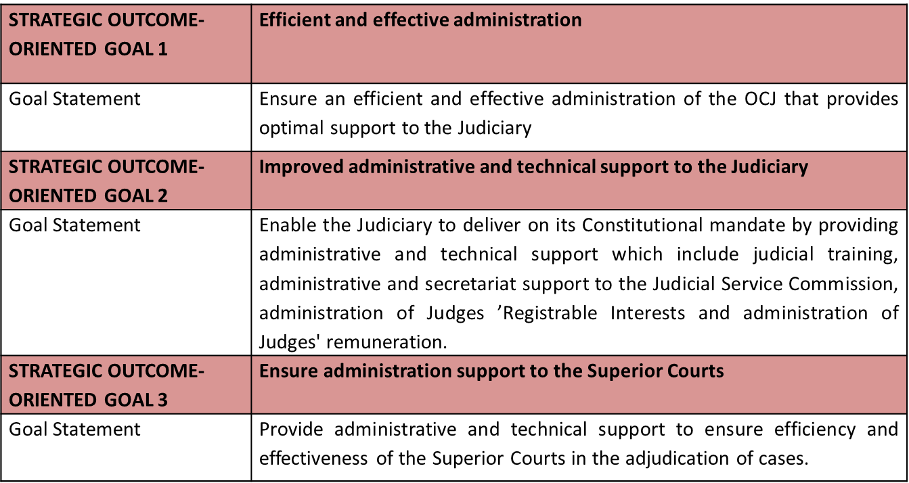
OCJ STRATEGIC GOALS
www.judiciary.org.za

Slide 10
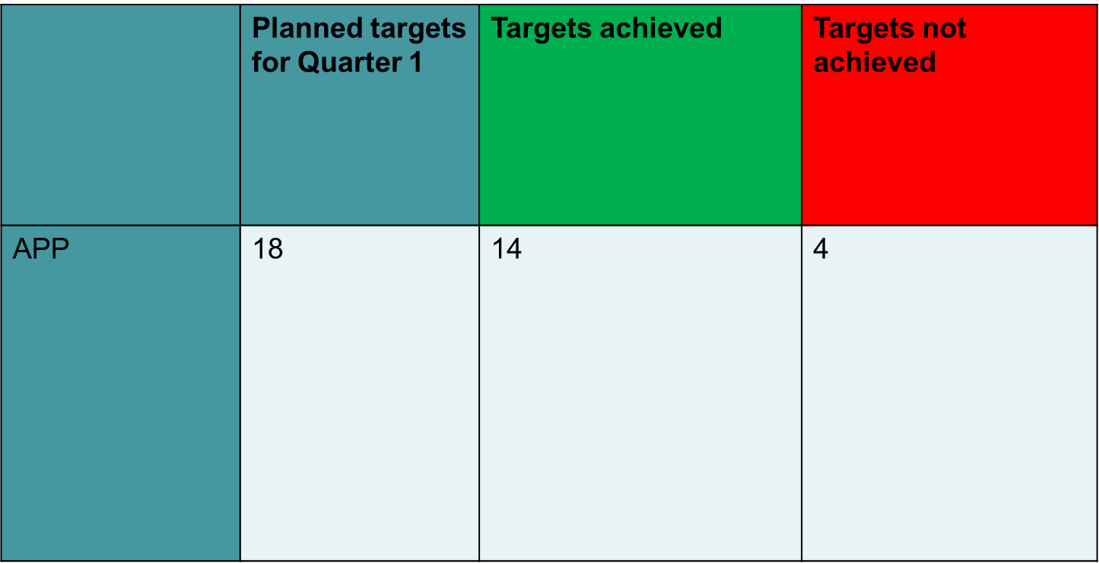
OVERVIEW OF QUARTER 1 PERFORMANCE:2016/17
www.judiciary.org.za

Slide 12
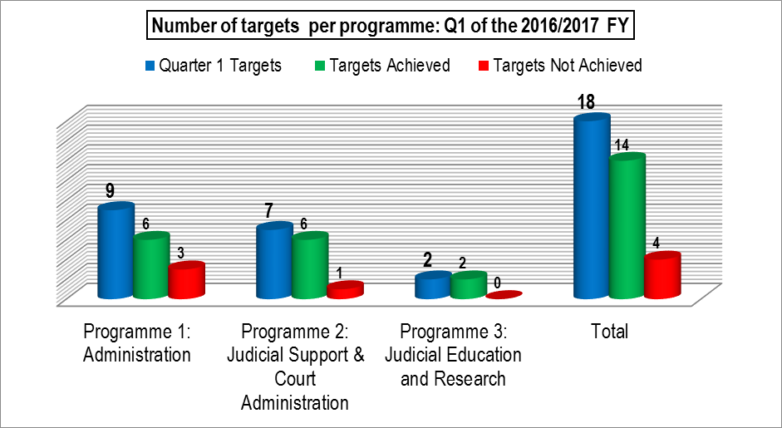
OVERVIEW OF QUARTER 1 PERFORMANCE:2016/17
www.judiciary.org.za

Slide 13
PERFORMANCE PER PROGRAMME
PROGRAMME 1: ADMINISTARTION
www.judiciary.org.za

Slide 14
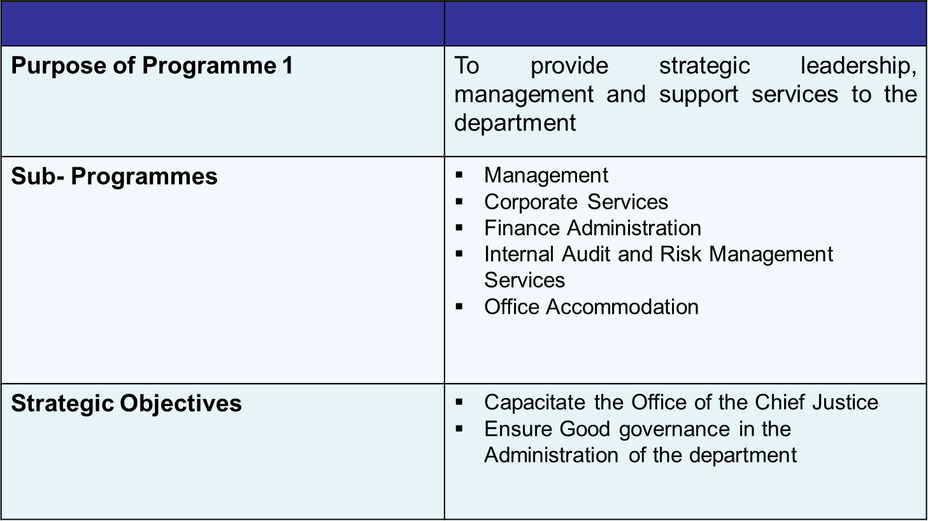
PROGRAMME 1: ADMINISTRATION
www.judiciary.org.za

Slide 15
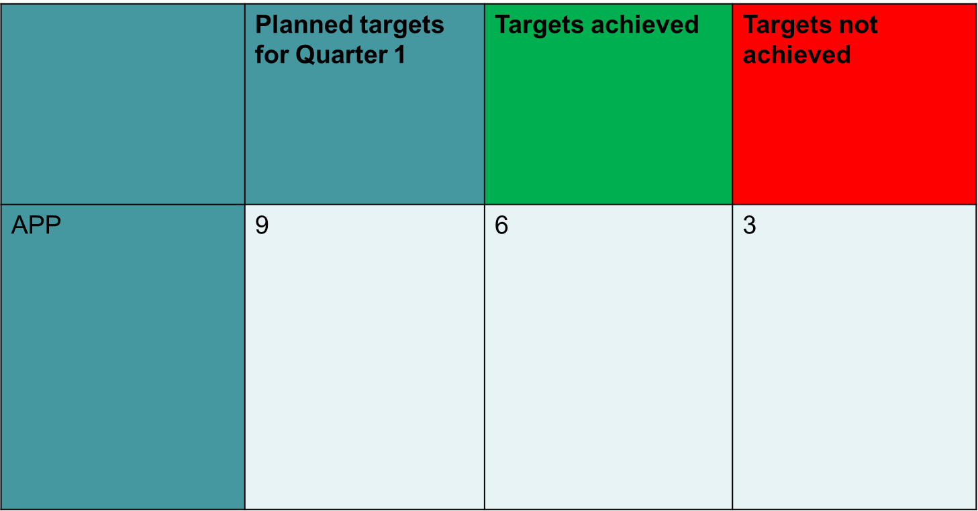
PERFORMANCE OF PROGRAMME 1: ADMINISTRATION
www.judiciary.org.za

Slide 16
PERFORMANCE OF PROGRAMME 1: ADMINISTRATION
www.judiciary.org.za

Slide 17
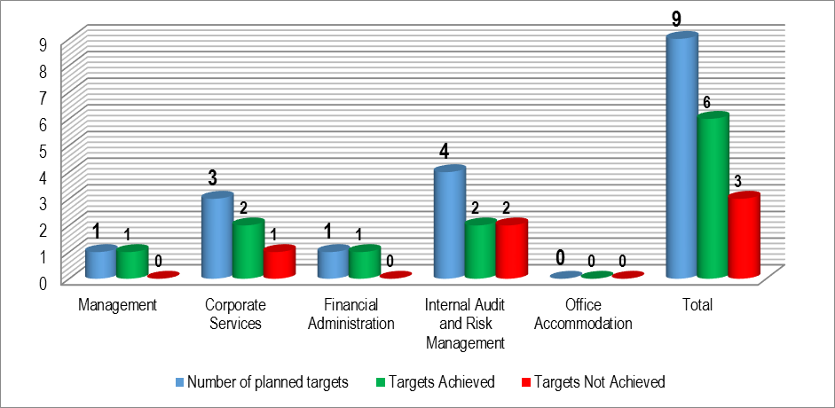
PERFORMANCE PER SUB-PROGRAMME
www.judiciary.org.za

Slide 18
PROGRAMME 1: ADMINISTRATION PERFORMANCE INFORMATION
Performance Indicators | Targets for 2016/17 as per Annual Performance Plan (APP) | Quarter 1 |  |  | Comments
 |  | Progress
 |  | Quarter 1 Target as per APP | Quarter 1 output – preliminary | Deviation (Actual) | Status | Reason for Deviation | Planned Action
Sub-Programme 1: Management
Annual Performance Plan compliant with the National Treasury prescripts tabled within prescribed timelines | OCJ Annual Performance Plan (2017/18) tabled in Parliament as per National Treasury timelines | Develop draft Annual Performance Plan (2017/18) compliant with the prescripts | Draft Annual Performance Plan (2017/18) compliant with the prescripts developed | N/A |  | N/A | N/A
Sub-Programme 2: Corporate Services
Percentage of funded vacant posts filled | 90% | 20% | 17% | 3% |  | Some of the candidates that were made offers in quarter 1 could only start in quarter 2. Namely: Supreme Court of Appeal (4); National Office (5); and Eastern Cape (2). | Close monitoring of the recruitment process will be done to fast track the filling of posts.
ICT Master Systems Plan developed and implemented over the MTEF | Master Systems Plan implementation initiated (critical systems) | Tender requirements (Terms of Reference) developed and tender advertised for infrastructure upgrades | Business Case and Terms of Reference developed, and tender not advertised | Tender not advertised |  | The process to advertise the tender was withdrawn and instead the SITA RFQ process for transversal contracts was followed in line with the SITA prescripts | N/A
www.judiciary.org.za

Slide 19
PROGRAMME 1: ADMINISTRATION PERFORMANCE INFORMATION (CONT….)
Performance Indicators | Targets for 2016/17 as per Annual Performance Plan (APP) | Quarter 1 Target as per APP | Quarter 1 output – preliminary | Deviation (Actual) | Status | Reason for Deviation | Planned Action
ICT Master Systems Plan developed and implemented over the MTEF | Master Systems Plan implementation initiated (critical systems) | Business requirements specifications developed for critical systems | Business requirements specifications developed | N/A |  | N/A | N/A
Sub-Programme 3: Financial Administration
Number of compliant financial performance reports submitted within the prescribed timelines | 12 | 3 | 3 | 0 |  | N/A | N/A
Number of asset registers produced in line with the prescripts | 2 | N/A | N/A | N/A | N/A | N/A | N/A
Sub-Programme 4: Internal Audit & Risk Management
Combined assurance plan developed and implemented | Combined assurance plan developed | Combined assurance framework developed | Combined Assurance Framework developed | N/A |  | N/A | N/A
Number of strategic and operational risk registers developed and updated | 8 | 2 | 2 | 0 |  | N/A | N/A
www.judiciary.org.za

Slide 20
PROGRAMME 1: ADMINISTRATION PERFORMANCE INFORMATION (CONT….)
Performance Indicators | Targets for 2016/17 as per Annual Performance Plan (APP) | Quarter 1 Target as per APP | Quarter 1 output – preliminary | Deviation (Actual) | Status | Reason for Deviation | Planned Action
Percentage of audit findings (internal and external) addressed | 80% | 65% | 49% | 16% |  | Inadequate internal controls. | Operations Committee (OPSCO) to work with unit Heads to address outstanding action plans and Internal Audit unit to conduct follow up audit to provide assurance.
Percentage of reported fraud cases investigated | 100% | 100% | 83% | 17% |  | Unavailability of suspects and witnesses to conduct interviews within the prescribed investigation period; and inadequate capacity within the Forensic unit. | The Forensic Investigators continually try to improve on the management of witnesses and suspects in order to expedite the interview processes to take statement timeously; and recruitment of one Forensic Investigator underway.
Unqualified audit outcome | Unqualified audit outcome | N/A | N/A | N/A | N/A | N/A | N/A
www.judiciary.org.za

Slide 21
PERFORMANCE PER PROGRAMME
PROGRAMME 2: JUDICIAL SUPPORT AND COURT ADMINISTRATION
www.judiciary.org.za

Slide 22
PROGRAMME 2: JUDICIAL SUPPORT AND COURT ADMINISTRATION
Purpose of Programme 2 | To provide judicial support and court administration services to the Superior Courts, including secretariat and administrative support services to the Judicial Service Commission (JSC)
Sub- Programmes | Administration of Superior Courts Judicial Service Commission Constitutional Court Supreme Court of Appeal High Courts Specialised Courts
Strategic Objectives | Ensure the effective and efficient administration of the Superior Courts and Judicial service commission
www.judiciary.org.za

Slide 23
PERFORMANCE OF PROGRAMME 2: JUDICIAL SUPPORT AND COURT ADMINISTRATION
 | Planned targets for Quarter 1 | Targets achieved | Targets not achieved
APP | 7 | 6 | 1
www.judiciary.org.za

Slide 25
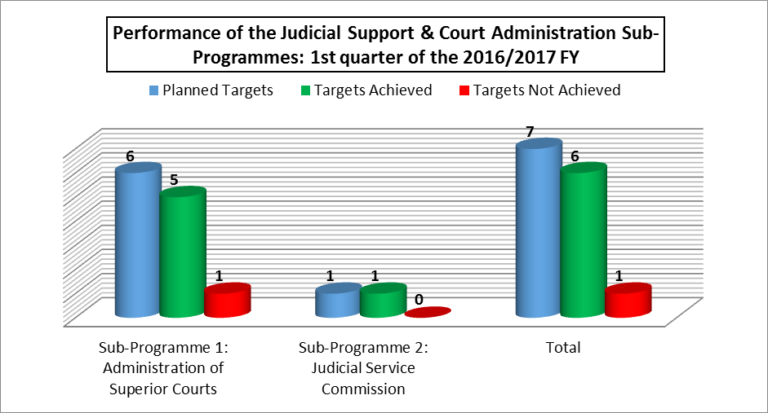
PERFORMANCE PER SUB-PROGRAMMES
www.judiciary.org.za

Slide 26
PROGRAMME 2: JUDICIAL SUPPORT AND COURT ADMINISTRATION PERFORMANCE INFORMATION
Performance Indicators | Targets for 2016/17 as per Annual Performance Plan (APP) | Quarter 1 |  |  | Comments
 |  | Progress
 |  | Quarter 1 Target as per APP | Quarter 1 output – preliminary | Deviation (Actual) | Status | Reason for Deviation | Planned Action
Sub-Programme 1: Administration of Superior Courts
Percentage of compliance with quasi-judicial targets | 65% | 65% | 73% (15596/21157) | -8% |  | Improved control measures were put in place to ensure that quasi-judicial functions are speedily dealt with. | N/A
Number of Superior Courts performance monitoring reports produced | 5 | 1 | 1 | 0 |  | N/A | N/A
Percentage of default judgments finalised by Registrars | 65% | 65% | 80% (12491/15535) | -15% |  | Improved control measures were put in place to ensure that quasi-judicial functions are speedily dealt with. | N/A
www.judiciary.org.za

Slide 27
PROGRAMME 2: JUDICIAL SUPPORT AND COURT ADMINISTRATION PERFORMANCE INFORMATION (CONT……)
Performance Indicators | Targets for 2016/17 as per Annual Performance Plan (APP) | Quarter 1 Target as per APP | Quarter 1 output – preliminary | Deviation (Actual) | Status | Reason for Deviation | Planned Action
Percentage of taxations of legal costs finalised | 65% | 65% | 82% (4715/5760) | -17% |  | Improved control measures were put in place to ensure that quasi-judicial functions are speedily dealt with. | N/A
Number of training workshops on case management conducted for Registrars, Statisticians and Clerks | 4 | 1 | 1 | 0 |  | N/A | N/A
Percentage of warrants of release delivered within one day of the release granted | 100% | 100% | 85% (23/27) | 15% |  | The Circuit Courts were unable to bring the files back to the Main Court and have the warrant delivered in time. | The warrant will be faxed to the Main Court immediately after been granted.
Sub-Programme 2: Judicial Service Commission
Number of reports on judicial appointments and complaints produced | 3 | 1 | 1 | 0 |  | N/A | N/A
www.judiciary.org.za

Slide 28
PERFORMANCE PER PROGRAMME
PROGRAMME 3: JUDICIAL EDUCATION AND RESEARCH
www.judiciary.org.za

Slide 29
PROGRAMME 3: JUDICIAL EDUCATION AND RESEARCH
Purpose of Programme 3 | To provide education programmes to Judicial Officers, including policy development and research services for the optimal administration of justice
Sub- Programmes | South African Judicial Education Institute (SAJEI) Judicial Policy and Research
Strategic Objectives | Enhance judicial skills of serving and aspiring Judicial officers to perform optimally
www.judiciary.org.za

Slide 30
PROGRAMME 3: JUDICIAL EDUCATION AND RESEARCH
 | Planned targets for Quarter 1 | Targets achieved | Targets not achieved
APP | 2 | 2 | 0
www.judiciary.org.za

Slide 32
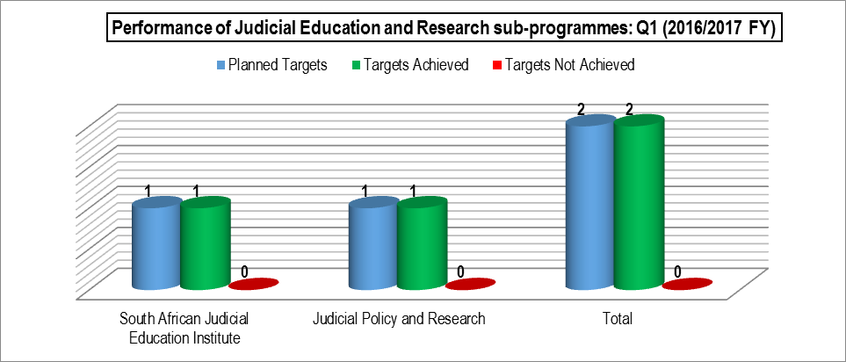
PERFORMANCE PER SUB-PROGRAMMES
www.judiciary.org.za

Slide 33
PROGRAMME 3: JUDICIAL EDUCATION AND RESEARCH PERFORMANCE INFORMATION
Performance Indicators | Targets for 2016/17 as per Annual Performance Plan (APP) | Quarter 1 |  |  | Comments
 |  | Progress
 |  | Quarter 1 Target as per APP | Quarter 1 output – preliminary | Deviation (Actual) | Status | Reason for Deviation | Planned Action
Sub-Programme 1: South African Judicial Education Institute (SAJEI)
Number of judicial education courses conducted | 70 | 5 | 9 | -4 |  | Results of Stakeholder Engagement sessions with Leadership of Lower Court Judiciary | N/A
M and E framework for judicial education and training developed and implemented | M&E Framework approved | - | N/A | N/A | N/A | N/A | N/A
Sub-Programme 2: Judicial Policy and Research
Percentage of legal advisory opinions on policy development and research services provided within 15 days of receipt | 80% | 80% | 100% | -20% |  | All legal advisory opinions were finalised within 15 days of request. | N/A
www.judiciary.org.za

Slide 34
STATISTICAL INFORMATION
Programme 2 &3
www.judiciary.org.za

Slide 35
STATISTICAL INFORMATION
No | Performance Indicator | 2016/17 Annual Target | Quarter 1 Target as per APP | Quarter 1 output -Preliminary | Deviation
PROGRAMME 2: JUDICIAL SUPPORT AND COURT ADMINISTRATION
Sub-Programme 3: Constitutional Court
1 | Percentage of cases finalised | 80% | 80% | 31% (49/159) | 49%
Sub-Programme 4: Supreme Court of Appeal
2 | Percentage of cases finalised | 80% | 80% | 83% (59/71) | -3%
Sub-Programme 5: High Courts
3 | Number of cases in the High Courts which are on the roll for more than 12 months | 156 | - | N/A | N/A
4 | Percentage of criminal cases finalised with verdict | 64% | 64% | 43% (420/976) | 21%
5 | Percentage of civil cases finalised | 54% | 54% | 66% (25930/39175) | -12%
6 | Percentage of reserved judgments finalised in all Superior Courts | 70% | 70% | 75% (845/1126) | -5%
www.judiciary.org.za

Slide 36
STATISTICAL INFORMATION (continues……..)
No | Performance Indicator | 2016/17 Annual Target | Quarter 1 Target as per APP | Quarter 1 output -Preliminary | Deviation
Sub-Programme 6: Specialised Courts
7 | Percentage of labour cases finalised | 54% | 54% | 56% (956/1709) | -2%
8 | Percentage of land claims cases finalised | 54% | 54% | 67% (35/52) | -13%
9 | Percentage of electoral cases finalised | 90% | 90% | 100% (3/3) | -10%
10 | Percentage of competition appeal cases finalised | 72% | 72% | 100% (2/2) | -28%
PROGRAMME 3: JUDICIAL EDUCATION AND RESEARCH
Sub-Programme 2: Judicial Policy and Research
11 | Percentage of disclosures for serving Judges' Registrable Interests submitted by 31 March | 100% | 100% | 93% | 7%
12 | Percentage of disclosures for newly appointed Judges' Registrable Interests submitted within 30 days of appointment (if any) | 100% | 100% | 0% | 100%
www.judiciary.org.za

Slide 37
FINANCIAL PERFORMANCE REPORT: QUARTER 1
www.judiciary.org.za

Slide 38
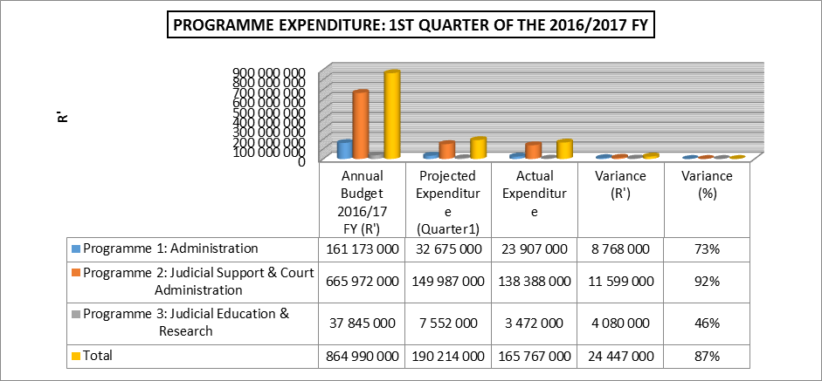
QUARTER 1 EXPENDITURE PER PROGRAMME
www.judiciary.org.za

Slide 39
REASONS FOR UNDERSPENDING PER PROGRAMME
Programme 1 | Compensation of Employees (R6.7m): Funded vacancies not filled because of the relocation of National Office to the new building. During the first quarter, most of the appointments were made. However the majority of these incumbents will only resume duty in Q2 Goods and Services (R2.0m): Non-commencement of the office rental of the National Office building.
Programme 2 | Goods and Services G-Fleet invoices paid but not yet reflected on BAS (R8.0m) Telkom bills for Superior Courts which are being paid by DoJ &CD and not yet claimed from OCJ. These claims are received on a quarterly basis and the first one is due in July (R3.4m)
Programme 3 | Compensation of Employees (R0.8m): Funded vacancies not filled because of the relocation of National Office to the new building. During the first quarter, most of the appointments were made. However the majority of these incumbents will only resume duty in Q2. Goods and Services (R3.0m): Outstanding invoices for the training programmes conducted.
www.judiciary.org.za

Slide 40
CONCLUSION
As at the end of the 1st quarter of 2016/2017 financial year the OCJ achieved 78% of its planned targets.
To address the challenges that the department was faced with during the first quarter, various control measures have been put in place to ensure improved performance and effective administrative support to the Judiciary.
Human resources capacity was a challenge during the Q1 which contributed to non-achievement of some of the planned quarterly targets.
All funded vacant positions will be filled as a matter of urgency in the next quarters of the 2016/2017 financial year to address capacity constraints.
www.judiciary.org.za

Slide 41
THANK U
www.judiciary.org.za

