Slide 1
Department of
Cooperative Governance
Briefing to the Portfolio Committee on the 2015/16 NDMC Annual Report
18 October 2016
1

Slide 2
PRESENTATION LAYOUT
Part 1: NDMC 2015/16 Annual Report
Part 2: Submission of the NDMC 2015/16 Annual Report to Parliament
Part 3: Distribution of the NDMC 2015/16 Annual Report to provincial and municipal disaster management centres
2
Notes:
The Department of Cooperative Governance with this presentation presents the 2015/16 annual report of the National Disaster Management Centre (NDMC) in compliance with Section 24 (1) of the Disaster Management Act, 2002 (Act No. 57 of 2002) – DMA.

Slide 3
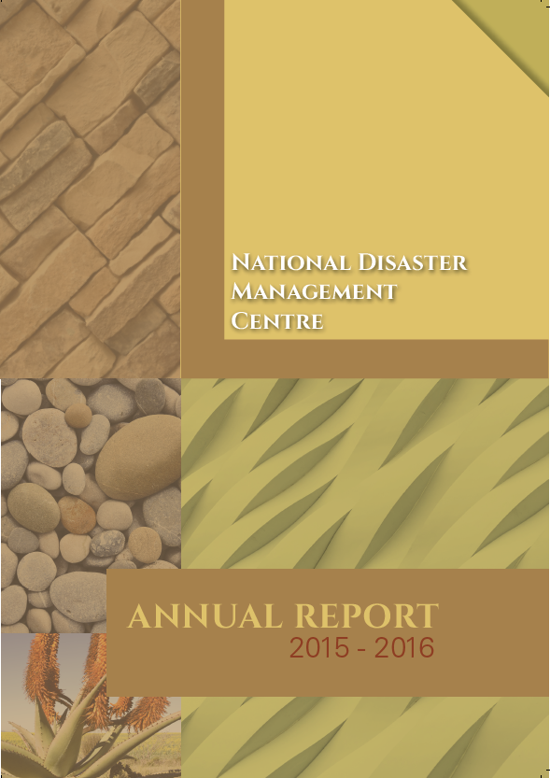
Part 1: NDMC 2015/16 Annual Report
Legislative obligation
Overview of the foreword by the Minister
Overview by the Head: NDMC
Overview of Chapter 1
Overview of Chapter 2
Overview of Chapter 3
Overview of Chapter 4
Overview of Chapter 5
Overview of Chapter 6
Overview of Chapter 7
3

Slide 4
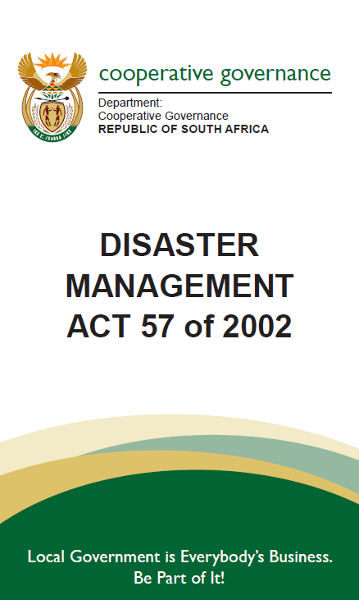
LEGISLATIVE OBLIGATION
Section 24 Reporting
[Heading substituted by s. 10 (a) of Act 16 of 2015 (wef 1 May 2016).]
(1) The National Centre must submit a report annually to the Minister on-
(a) its activities during the year;
(b) the results of its monitoring of prevention and mitigation initiatives;
(c) disasters that occurred during the year in each province;
(d) the classification, magnitude and severity of these disasters;
(e) the effects they had;
(f) particular problems that were experienced-
(i) in dealing with these disasters; and
(ii) generally in implementing this Act and the national disaster management framework;
(g) the way in which these problems were addressed and any recommendations the National Centre wishes to make in this regard;
(h) progress with the preparation and regular updating in terms of sections 25, 38, 39, 52 and 53 of disaster management plans and strategies by organs of state involved in disaster management; and
(i) an evaluation of the implementation of such plans and strategies.
(2) ….
4

Slide 5
OVERVIEW OF THE FOREWORD BY THE MINISTER
The foreword by the Minister of Cooperative Governance and Traditional Affairs emphasize governments commitment to realise the disaster management policy set out in the White Paper on Disaster Management through amongst other things the,
Amendments made to the Disaster Management Act, 2002,
2015 commemoration of the International Day for Disaster Risk Reduction,
Integrated Urban Development Framework, and
Coordinated response to disasters such as the drought gripping the country and other smaller incidents.
5

Slide 6
OVERVIEW BY THE HEAD: NDMC
The overview by the Head: NDMC presents the high level strategic achievements for the year under review which include,
Summarising the implications of the Disaster Management Amendment Act, 2015 assented to by the President during December 2015.
Discussing the commemoration of the International Day for Disaster Reduction which focussed on traditional, indigenous and local knowledge and the way they complement modern science and add to individuals’ and societies’ resilience.
Discussing how the Integrated Urban Development Framework presents a significant opportunity for disaster management to work with local organs of state to increase the resilience of urban communities.
6

Slide 7
OVERVIEW BY THE HEAD: NDMC (cont.)
Discussing the application of the back-to-basics concept in disaster management, the effect of good governance on disaster management policy implementation and how the NDMC is working with other branches of the DCoG to realise the functioning of all municipalities.
Summarising the drought coordination undertaken by the NDMC in governments’ response to the drought gripping the country, and
Giving a brief overview of the international engagements the NDMC undertook during the year under review.
7

Slide 8
OVERVIEW OF CHAPTER 1
Chapter one provides general information about the NDMC by unpacking the,
Purpose of the branch
Legislative mandate
Strategic overview
2015/16 strategic objective
2015/16 branch objectives
Organisational structure, and
Expenditure trends
8

Slide 9
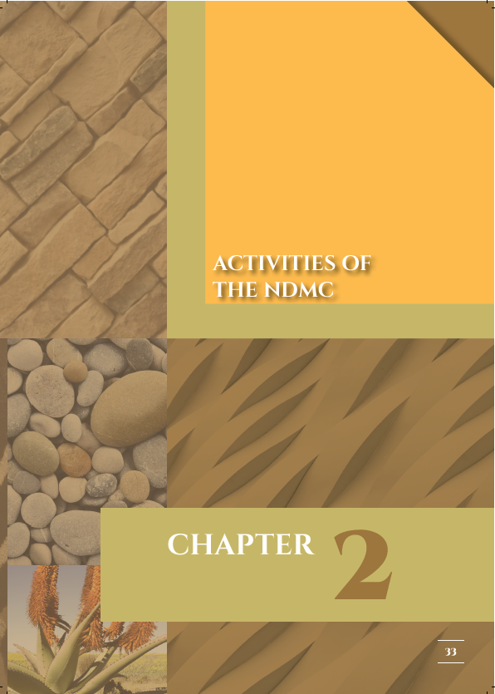
OVERVIEW OF CHAPTER 2
Chapter two provides details of the activities of the NDMC undertaken by the,
Chief Directorate: Legislation and Policy Management
Directorate: Policy Development and Regulatory Frameworks
Directorate: Fire Services
Chief Directorate: Disaster Risk Reduction, Capacity Building and Intervention
Directorate: Disaster Risk and Reduction and Planning
Directorate: Disaster Risk management, Education, Training, Awareness and Research
Chief Directorate: Integrated Provincial Disaster Management Support, Monitoring and Evaluation Systems
Directorate: Disaster Management Monitoring and Evaluation
Chief Directorate: Information Technology, Intelligence and Information Management Systems
Directorate: Early Warnings and Capability Management Systems
9

Slide 10
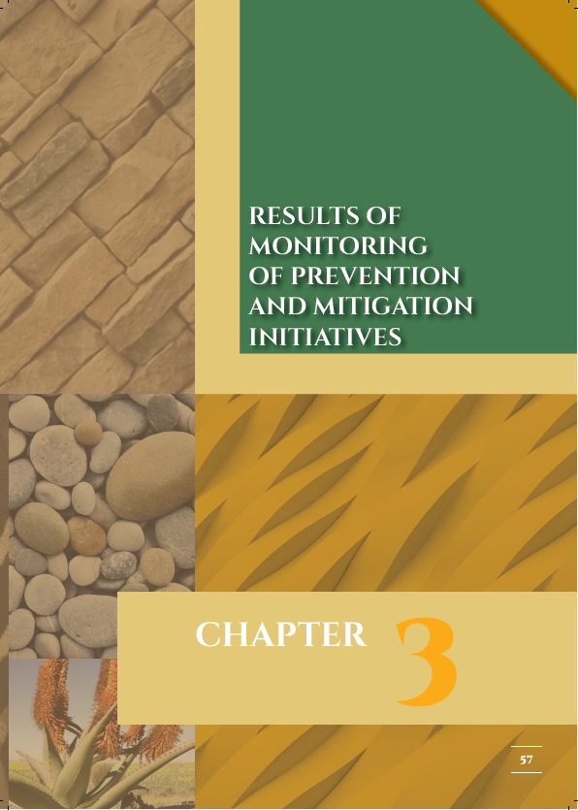
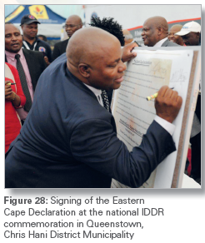
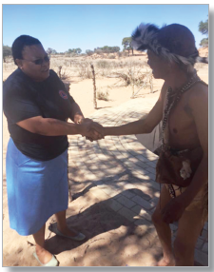
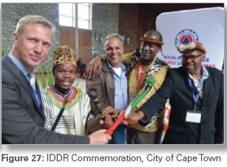
OVERVIEW OF CHAPTER 3
Chapter three provides an overview of the results of monitoring of prevention and mitigation initiatives undertaken by disaster management stakeholders across the country
10

Slide 11
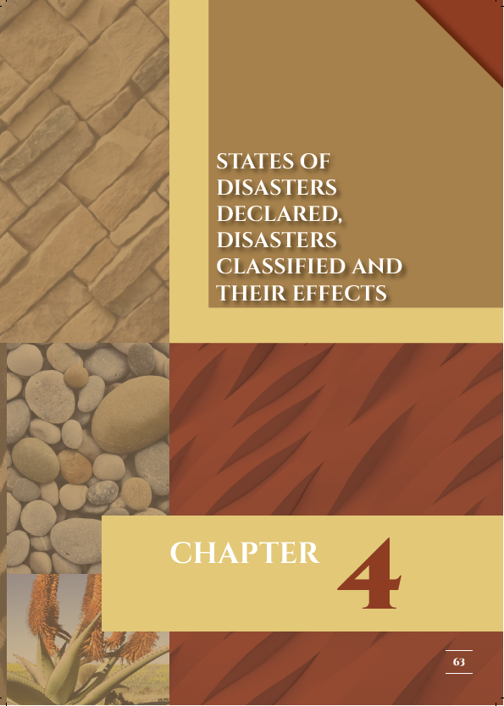
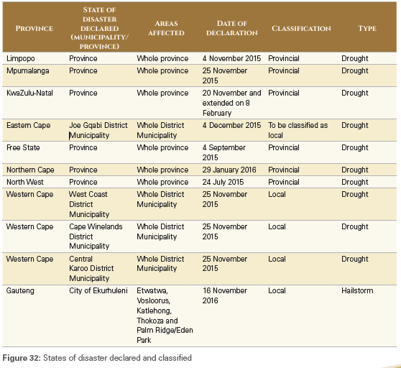
OVERVIEW OF CHAPTER 4
Chapter four provides details of states of disasters declared, disasters classified and their effects.
11

Slide 12
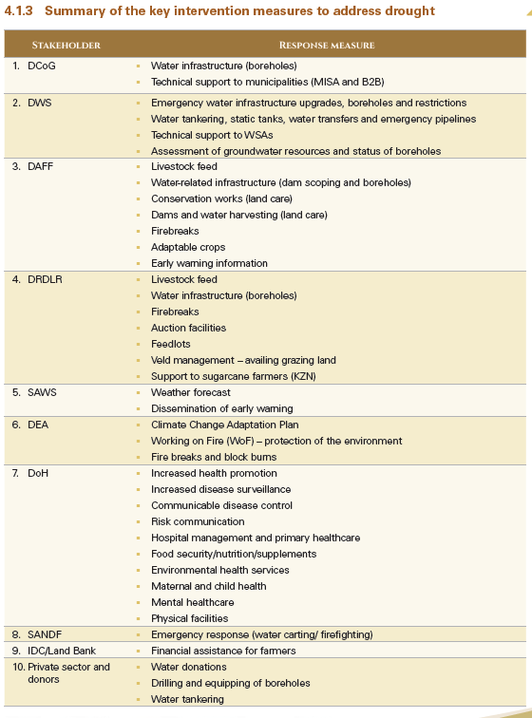
OVERVIEW OF CHAPTER 4 (Cont.)
12

Slide 13
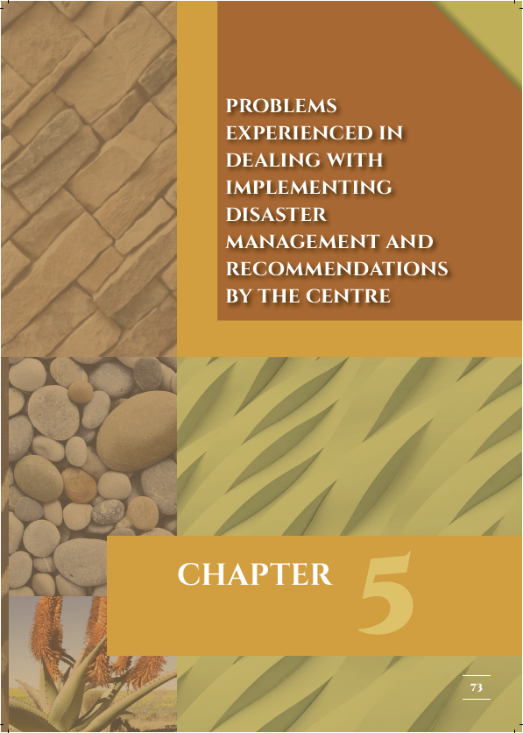
OVERVIEW OF CHAPTER 5
Chapter five reflects on some legislative compliance issues and challenges faced by organs of state across the spheres of government in implementing the disaster management legislation which includes details of the,
Annual reports received from
PDMC’s, MDMC’s, national organs of state and other entities, and provincial organs of state
Functionality of the Disaster Management Advisory Forums
Lack of implementation of disaster risk reduction by stakeholders
Non-implementation of prescripts to respond disaster occurrences by other organ of state
Public advocacy and awareness programmes not prioritised and funded, and
Challenges identified from provincial quarterly reports
13

Slide 14
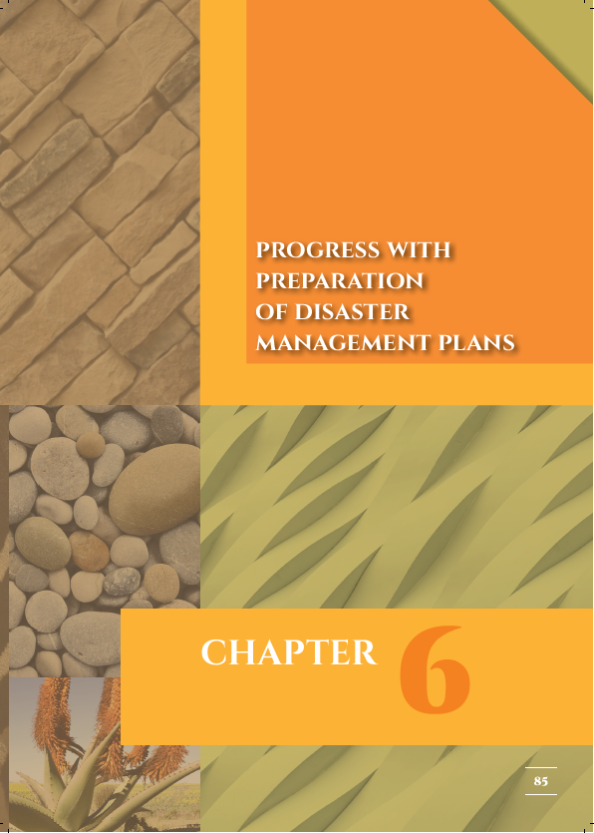
OVERVIEW OF CHAPTER 6
Chapter six provides a list of the disaster management plans submitted to the NDMC and sector drought response plans facilitated and submitted by sectors
14

Slide 15
OVERVIEW OF CHAPTER 7
Chapter seven reflects on the national coordination of disaster management across the three spheres of government which includes details of the,
Structure of National Disaster Management Coordination
Intergovernmental Committee on Disaster Management
National Disaster Management Advisory Forum
National Joint Drought Coordination Committee
Coastal PDMC’s Forum
Participation in Intergovernmental and other Coordinating Structures
15

Slide 16
Part 2: Submission of the NDMC 2015/16 Annual Report to Parliament
Legislative obligation
Tabling of Annual Reports
Submission report
16

Slide 17
LEGISLATIVE OBLIGATION
Section 24 Reporting
[Heading substituted by s. 10 (a) of Act 16 of 2015 (wef 1 May 2016).]
(1) ….
(2) The Minister must submit the report to Parliament within 30 days after receipt of the report from the National Centre.
(3) ….
17

Slide 18
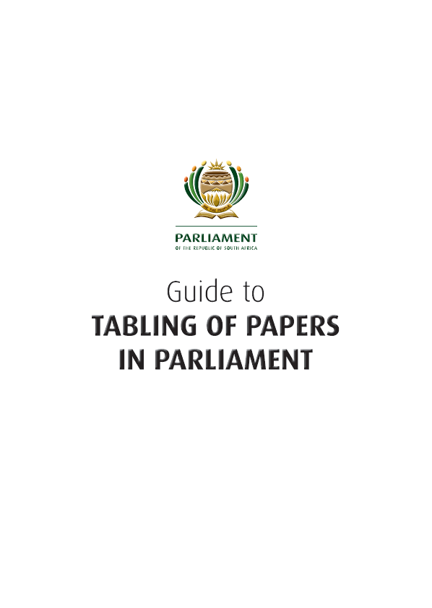
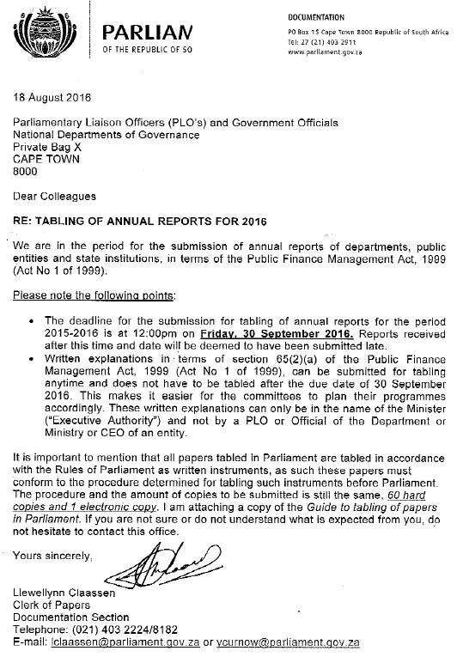
Tabling of Annual Reports
18

Slide 19
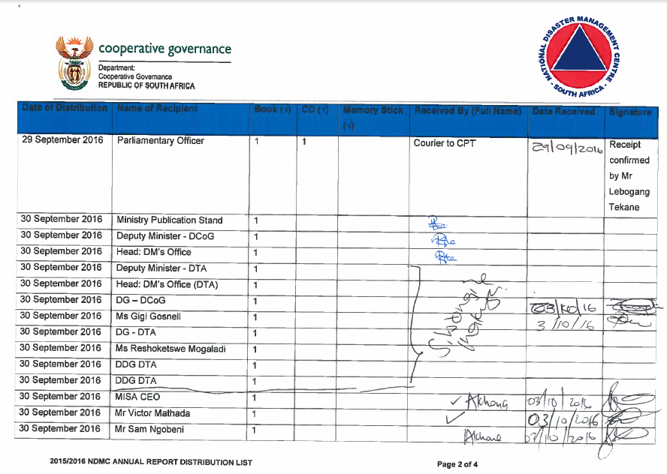
SUBMISSION REPORT
The report was submitted ito the rules of Parliament for tabling papers on
29 September 2016
19

Slide 20
Part 3: Distribution of the NDMC 2015/16 Annual Report to provincial and municipal disaster management centres
Legislative obligation
Distribution report
20

Slide 21
LEGISLATIVE OBLIGATION
Section 24 Reporting
[Heading substituted by s. 10 (a) of Act 16 of 2015 (wef 1 May 2016).]
(1) ….
(2) ….
(3) The National Centre must, at the same time that its report is submitted to the Minister in terms of subsection (1), submit a copy of that report to each provincial and municipal disaster management centre.
21

Slide 22
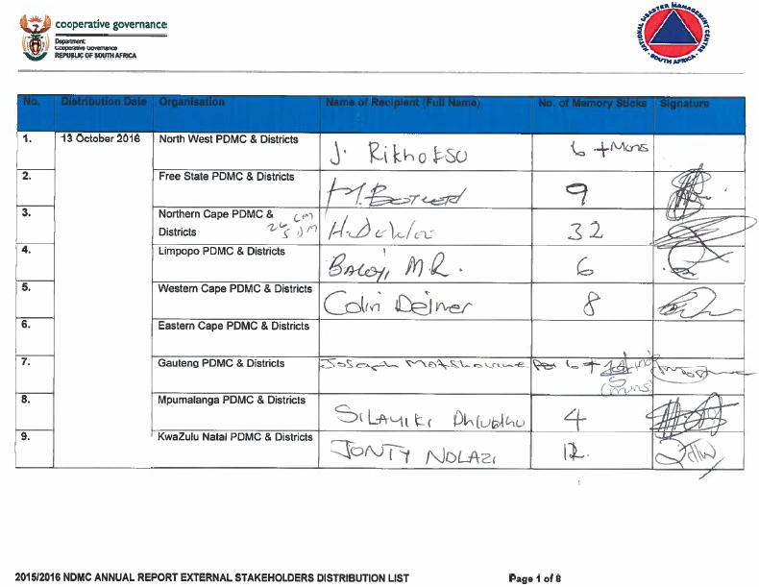
DISTRIBUTION REPORT
The report is being distributed to stakeholders during October 2016
22

Slide 23
Thank you!
23

