Slide 1
Biodiversity and Tourism Lab
PORTFOLIO COMMITTEE BRIEFING
18 OCTOBER 2016

Slide 2
The lab is a collaboration between Tourism and DEA to advance the economic potential of South Africa’s natural resources
Context
  The 2014 Ocean’s Economy Lab and 2015 National Biodiversity Economy Strategy described opportunities to implement initiatives for growth of SA’s Biodiversity Economy
  Tourism and DEA jointly decided to use the implementation lab methodology to create detailed implementation plans to achieve that growth
  The Lab was convened from 10 April to 13 May
The Department of Tourism and Department of Environmental Affairs and have taken the initiative to conduct an ‘implementation lab’ on how South Africa’s biodiversity can be used for transformation purposes
Marine & Coastal Tourism
Bioprospecting
Wildlife

Slide 3
The Lab contributes to the Government’s 9 point plan
1
Revitalising agriculture and the agro-processing
value chain
Adding value to our mineral wealth (advancing
beneficiation and support to the engineering and
metals value chain)
2
The output of the Lab contributes to points 1, 4, 5 and 6 of the Government’s 9 Point Plan
3
More effective implementation of a higher impact
Industrial Policy Action Plan
4
Unlocking the potential of small, medium and micro enterprises, cooperatives and township enterprises
5
Operation Phakisa (Oceans Economy, Mining, Health, Tourism, Basic Education, etc)
6
Encouraging private sector investment
7
Resolving the energy challenge
8
Moderating workplace conflict
State reform and boosting the role of state-owned companies, information and communications technology infrastructure or broadband roll-out, water, sanitation and transport infrastructure
9

Slide 4
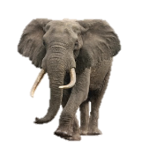
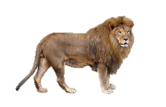
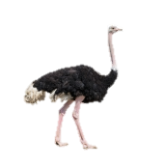
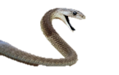
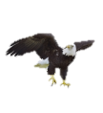
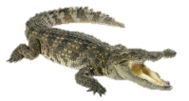
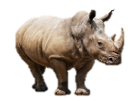
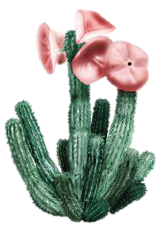
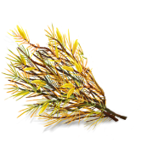
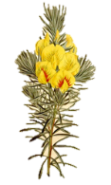

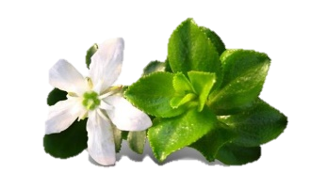


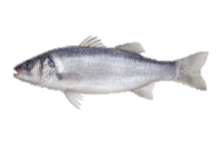
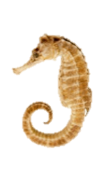
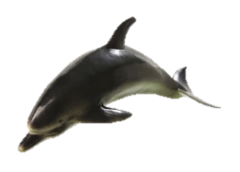
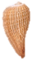
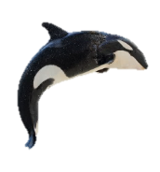
South Africa is the 3rd most biodiverse country in the world
  7% of the world’s reptiles, birds and mammals
  10% of the
  world’s plants
  South Africa
  2% of the
  world’s land area
  15% of the world’s coastal marine species

Slide 5



















































In line with Operation Phakisa methodology there was wide stakeholder engagement
GOWAR
ENTERPRISES

Slide 6
The Lab has produced 29 initiatives and several recommendations to address the key challenges experienced by the streams
Wildlife
C&M Tourism
Bioprospecting
  Actively facilitate transformation of the sector through land access and support programmes for new entrants
  Drive growth through unlocking demand, and promoting ‘value’ and products (e.g. game meat)
  Create an enabling environment for the wildlife sector
  Address the reputational and conservational risks of the sector
  Identify and elevate events, routes and attractions along the coastline
  Support high potential projects by unlocking roadblocks that are delaying implementation
  Promote SA as a coastal and marine tourism
  Enhance skills and SMME creation
  Streamline and coordinate permitting
  Increase supply through mass cultivation and sustainable harvesting
  Increase demand and local value addition through better coordination of stakeholders harnessing existing initiatives and addressing the innovation chasm
  Simplify the regulatory environment to enhance growth
  Transform the sector through direct involvement of communities and TK holders
  15 initiatives
  9 initiatives
  5 initiatives

Slide 7
WILDLIFE STREAM OUTCOMES

Slide 8
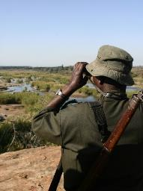
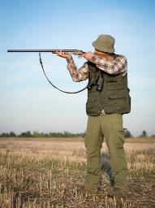
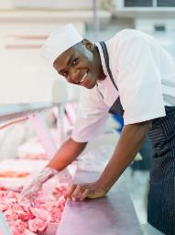
The wildlife sector comprises 3 sub-sectors
Wildlife ranching
Wildlife activities
Wildlife products
  Primary activities:
    Breeding
    Live sale
  Primary activities:
    Wildlife Viewing
    Trophy Hunting
    Biltong Hunting
  Primary activities:
    Game Meat Processing
    Skin and Hide Production
    Other products (e.g. curios and decorations)
  Secondary contributors:
    Live captures
    Translocation Services
    Veterinary Services
    Fencing and maintenance
  Secondary contributors:
    Accommodation
    Transport
    Equipment & Supplies (Arms, Ammunition etc.)
    Taxidermy
  Secondary contributors:
    Packaging and Transportation

Slide 9
The Wildlife Economy faces several challenges preventing growth and transformation happen at full potential
I
Barriers to transformation
II
Risk of future growth stagnation
III
Unsupportive enabling environment
  Insufficient access, ownership and inefficient utilization of land
  Lack of infrastructure development support for entrepreneurs
  Lack of access to ‘startup’ game
  Lack of organized governance amongst community and emerging entrepreneurs
  Lack of technical skills, oversight, business support and effective business and partnership models
  Lack of access to finance and incentives for transformation
  Insufficient government endorsement for hunting as a tourism activity
  Untapped black consumer potential
  Insufficient societal value given to wildlife resources and understanding of the sustainable use concept
  Insufficient awareness and capitalisation of the value of mixed wildlife/livestock interfaces
  Insufficient mechanism addressing and containing risks and threats to the ecological resource base in further growing the biodiversity economy
  Insufficient interdepartmental coordination and understanding of the benefits of the bio-economy
  Insufficient knowledgebase (research and access)
  Gaps in industry standards (and compliance)
  Excessive and inefficient permitting
  Unsupportive legislative regime
    Misalignment of SPLUMA and PDALFB (Land use)
    NEMBA lacking in enabling provisions
    Misalignment of provincial and/or national hunting legislation
  Lack of sufficient collaboration platform for the industry
  Lack of capacity (human and financial) to effectively manage and harness the potential of wildlife resources
  Lack of a formal game meat industry

Slide 10
The Wildlife Economy Lab developed detailed plans for 15 initiatives and a further 6 recommendations
Recommendations¹
Driving growth through promoting ‘value’ and products
Creating an enabling environment for the wildlife sector
Facilitating transformation
1
Identify and prioritize 10m Ha for transformation of wildlife economy
7
Formalize SA game meat market and create a network of game meat processing facilities
9
Create an enabling legislative environment through the amendment of NEMBA
2
Establish, develop and support new wildlife ranching entrants including business set up support, infrastructure and game ownership programmes
8
Implement a campaign that drives participative transformation and consumer growth for wildlife related activities and products
10
Develop and implement wildlife industry standards
11
Develop and Implement a national wildlife economy certification scheme
3
Increase capacity and support for (at least) 300 CPA’s, trusts and traditional authorities
12
Develop and implement an electronic wildlife permitting system and centralised database
4
Create supply chain linkages and capacitate 4,000 SMMEs (new and existing) to locally capture the value of ancillary goods and services to the wildlife economy
13
“Re-position” the Wildlife Forum as an efficient interdepartmental/ industry collaboration and co-ordination platform to promote the benefits of the Wildlife Economy
ii
Promote sustainable use as a foundation for conservation and growth of biodiversity economy
5
Operationalise 11 biodiversity economy nodes, that enhance the economic potential of Protected and non Protected Areas
14
Develop an integrated knowledge/
evidence generating and sharing platform to support the wildlife economy
iii
Develop a strategic marketing campaign and value proposition for mixed game and livestock systems
6
Empower 4,000 emerging entrepreneurs and farmers through focused capacity building programmes
15
Leverage protected areas to unlock economic potential
iv
Establish mechanisms to allow for holistic and integrated management of animal health and conflict issues at the livestock-wildlife interface
i
Develop a toolkit of effective wildlife business, stewardship and partnership models
vi
Develop, upskill and resource extension services to facilitate the growth of the wildlife economy
v
Develop an appropriate mechanism to manage and mitigate risk
1 Recommendations will be included with high level activities, but these will not have 3ft plans

Slide 11
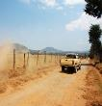
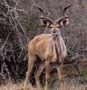
          This initiative proposes to triple the number of projects receiving support from the Working for Wildlife programme
2
Working for Wildlife Program
Working for Wildlife
Today’s scope
Expansion
Projects per year
The R25 million includes basic infrastructure, capture, translocation, skills development and mentorship, veterinary and extension.
Infrastructure support
Game donations and expanded infrastructure
  Skills development
  Planning
  Project management
  Implementation
  Game loans and donations
  Translocation
  Capture
  Extension and veterinary
  Land rehabilitation
~10
Today
2030
Estimated funds required
per project
R10m
R25m

Slide 12
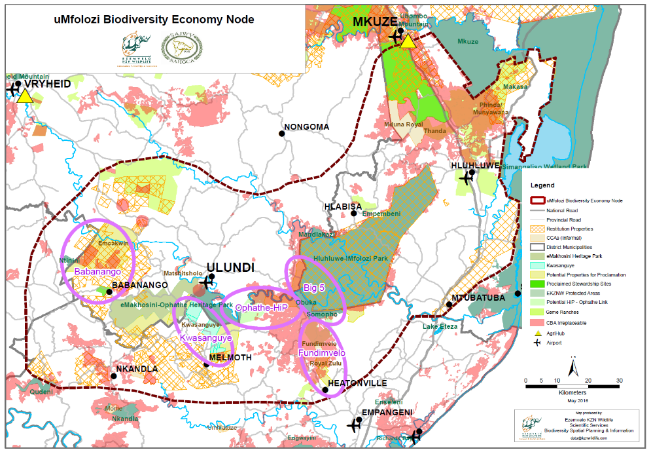
5
The launch of 11 biodiversity economy nodes across the country will accelerate growth of the wildlife economy
15
Existing nodes
Process to operationalize a node
Use land audit data to identify high land-use capability and low risk from competitive land uses
Appoint node champions to facilitate alignment and strategic focus of public and private sector interventions
Conduct socio-economic study to identify high impact interventions and investment opportunities
Conduct strategic environmental assessment (reduce regulatory impediments)
Facilitate PPC partnerships and mentorship programmes
Develop operational plan for the node
Coordinate implementation and support
Nodes would be set up under DEA Biodiversity, and will promote the following activities
  Pooling resources for infrastructural development and game donations (Initiative 2)
  Assisting communities to become engagement ready (Initiative 3)
  Enabling market access and connecting to local SMME (Initiative 4)
  Creating supply chain linkages (Initiative 7)
  Developing sustainability certification (12)
  Promoting partnerships between Protected Areas, private sector and communities (Initiative 15)

Slide 13

26 high potential node locations have been already identified across the country; these will require further consultation
5
Province
Location
Potential node locations
Eastern Cape
Greater Camdeboe Node
Greater Mount Zebra Node
Greater Amatole Node
Greater Pondoland
Greater Addo
Greater Tsitsikama
Free State
Greater Maloti-Drakensberg TFCA
Gauteng
Greater Wesrand
Dinokeng
Kwa-Zulu Natal
Hluhluwe Node
Mkahnyakude
Limpopo
Greater Makuleke
Greater Letaba
Greater Legalametsi
Greater Entabeni
Greater Masebe
Mpumalanga
Mpumalanga Nodes
Barberton Node
North West
Marico District Node
Greater Madikwe
Greater Brits Node
Greater Dellareyville Node
Northern Cape
Melkbosrand (Augrabies)
Richtersveld
Knomani San (Kgalagadi)
Western Cape
Western Coast Node

Slide 14

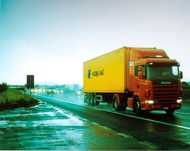
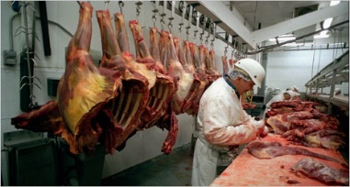
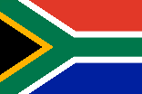
By 2021, 110 processing facilities will create 2,500 jobs, and generate ~R1.6 billion in revenue
7
Finalise Legal Framework
Model
Impact
2021
Ranch 1
  18.5K tons of meat
  ~R1.6 billion in revenue
  ~1,700 direct jobs
  ~800 peripheral jobs
Transport
Processing plant
Formalise Supply Chain
Ranch 2
Ranch 3
Brand and promote
R 490 million Investment
Private/Public sector/DTI & IDC fund contribution
72%
6%
22%
SA GAME MEAT

Slide 15
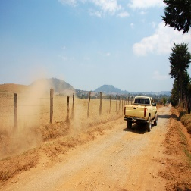
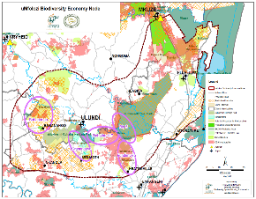
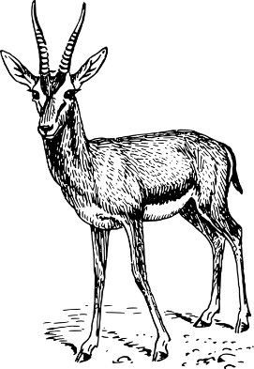
The lab has set the following short- to mid-term targets for these initiatives
Initiative:
Year
Target
1
Identify and prioritize 10m Ha for transformation of wildlife economy
2018
10m ha land mapped and prioritised
Establish, develop and support new wildlife ranching entrants through infrastructure support and game donation programmes
60 projects completed (90 000 heads of game)
2
2020
Nodes
5
Operationalise 11 biodiversity economy nodes (BENs)
2021
11 BENs established
7
Formalize SA game meat market and create a network of game meat processing facilities
2,500 jobs created
18,5K tons of game meat
2021
11
Develop and Implement a national wildlife economy certification scheme
2019
Scheme established

Slide 16







The new Wildlife Economy Support Programme (WESP) will harness and coordinate existing support mechanisms to empower new entrants in the industry
Support package
Primary delivery mechanism
WSU partner
  Recap and Development Program, EPIP, DSBD, The DTI
Business set-up support
  DEA:EPIP, DRDLR:Recap and Dev, Private Sector
Infrastructure support
  Donations, loans, fence dropping (in context of national protocol for game donations)
Coordinated under new
Wildlife Support Programme
  Prov Authorities
  Private sector
Game loans/ donations
Agricultural support & veterinary services
  Stewardship/ Extension services
  Prov Authorities
  Mentorship programmes
  Partnership building
  DTI support with (among others) access to market
Ranching skills and market access

Slide 17

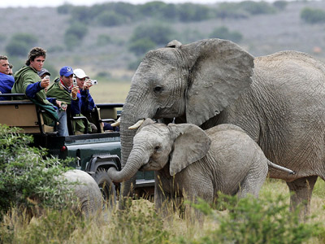
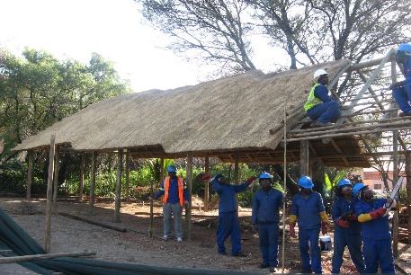
SANPARKS ROLE IN BIODIVERSITY ECONOMY
Focal areas
  Ecotourism
  Game donation/loan
  Technical support
  Product development and marketing
  Value chain support for SMMEs
Key Initiatives
  Initiative 2 – Wildlife Support Programme
  Initiative 4 – Create Supply Chain Linkages
  Initiative 5 – Establish Biodiversity Economy Nodes
  Initiative 6 – Capacity Building Emerging Entrepreneurs And Farmers
  Initiative15 – Unlocking the economic potential of protected areas

Slide 18


Contents
  Bioprospecting detail

Slide 19



Key initiatives to drive growth in the Bioprospecting Economy
How do we increase the supply?
  Promote a mass cultivation drive of 25 plant species of strategic importance and increase cultivation by 500 hectares per annum
1
  Define management plans to ensure sustainable wild harvesting of 7 high value plant species to safeguard long term supply
2
Transformation is a cross cutting essential
Develop cultivation sites focusing on communal and restituted land, poverty nodes and rural development needs
Develop entrepreneurial and agricultural skills incubators as well as provide operational support programs
Develop species and site based cultivation business plans for SMMEs and communities
Fund skills development programs for wild harvesters specifically for vulnerable groups

Slide 20




The Lab has identified 25 plant species for mass cultivation and 7 plant species for continued sustainable wild harvesting
2
Criteria
~20 000 species
Indigenous species
  Only indigenous biological resources are eligible
1
Market demand
  Permit applications (number and quantity of resource)
  Domestic market retail demand
  International exports
  Syndication with biotraders
2
Other criteria
  High levels of wild harvesting
  Ineligibility for cultivation due to long lead times to yield a crop e.g. slow growing trees)
3
25 spp for cultivation & 7 spp for sustainable wild harvesting

Slide 21
























Top 25 species for cultivation
INITIATIVES - CULTIVATION
1
Hoodia gordonii
(Hoodia)
Agathosma
betulina (Buchu)
Aspalathus
(Rooibos)
Buchu crenulata
(Buchu)
Bulbine
frutescens
(Burn Jelly)
Cyclopia
intermedia
(Honeybush)
Cyclopia
genistoides
(Honeybush)
Eriosema
kraussianum
(Bangalala)
Harpagophytum
procumbens
(Devil’s claw)
Helichrysum
odoratissimum
(Golden everlasting)
Hypoxis
hemerocallidea
(African potato )
Kigelia africana
(Sausage tree)
Lobostemon
fruticosus
(Lobostemon)
Pelargonium
reniforme
(Kidney leaved
pelargonium)
Pelargonium
sidoides
(Kalwerbossie)
Sceletium
tortuosum
(Kanna)
Siphonochilus
aethopicus
(Wild Ginger)
Sutherlandia
frutescens (Cancer
bush, balloon pea)
Trichilia emetic
(Mafura – oil)
Tylosema
esculentum
(Marama bean - oil)
Warburgia
salutaris
(Pepperbark tree)
Ximenia
americana (Sour
plum – fruit and oil)
X. caffra (Sour
plum – fruit and oil)
Xysmalobium
undulatum
(Uzara)
Lippia
javanica

Slide 22


Slide 23


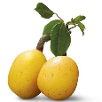




Top 7 species earmarked for sustainable harvesting
INITIATIVES – SUSTAINABLE WILD HARVESTING
2
Aloe ferox
Adansonia
digitata
Baobab
Sclerocarya
birrea
Marula
Cyclopia
intermedia
Honeybush
Cyclopia
genistoides
Honeybush
Agathosma
betulina
Buchu
Harpagophytum
procumbens
Devil’s claws

Slide 24
Contents
  Coastal and Marine Tourism

Slide 25

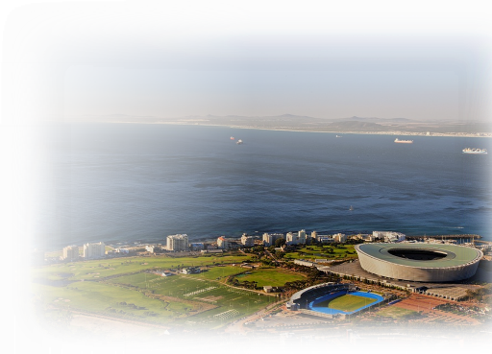
With the 3rd longest coastline in Africa (2,798 km), CMT has untapped potential to contribute to South Africa’s development and transformation
SA Coastline 50 Km Buffer
  South Africa has ~15% of the global marine species diversity with 10,000 species of marine animals and plants
  Highly diverse coast with 23 marine protected areas across the provinces and 7 national parks
  3 South African beaches achieving world ranking status¹
  ~15% of beaches with blue flag status (39 out of 200 accessible beaches)
  Several events, routes and attractions along the coast not always fully exploited (e.g. <20% of Eastern Cape beaches with tourism related economic activity)
SA Coastline 10 Km Buffer
SA Coastal Provinces
Kwa-Zulu
Natal
Northern Cape
Eastern Cape
Western Cape
1 CNN best beaches ranking
SOURCE: South Africa; World Fact book, 100 world’s best beaches 2013, CNN World’s 100 Best Beaches, National Biodiversity Assessment 2011, Provincial asset and activity register

Slide 26
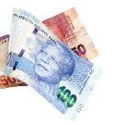


The Lab¹ estimates the Coastal and Marine sector could reach R43.3 billion contribution to GDP and approximately double the number of jobs by 2030
GDP contribution¹
Job creation¹
Key assumptions
R bn
000 jobs
  GDP contribution is calculated from ratios established from the total sector output, or total revenue, using a ratio of GDP to output
  Job creation (in number of jobs) is estimated by using ratios of average compensation of employees in the tourism sectors and dividing it into job creation which is calculated from the sector output, or total revenue, using a ration of compensation of employees to output
9²% p.a.
+4% p.a.
43,3
116,0
64,4
11,9
2015
2030
2015
2030
1 The estimations are from an economic model developed in the lab. In view of the limited baseline data, ratios were established based on total tourism sector contribution and assumptions were made which may require refinement post lab. The real growth of the coastal and marine sector is 4%. This nominal growth illustrates growth including 5% inflation rate. GDP contribution is both direct and indirect contribution

Slide 27
The lab aspires for South Africa to be ranked amongst the top 20 destinations globally, and to grow up to 9% annually
Aspiration
To deliver by 2030 a uniquely South African, world class coastal and marine experience where South Africa is ranked within the top 20 tourism destinations, showing a 9%¹ growth rate p.a. contributing to an inclusive and sustainable tourism economy
Objectives
1
Economic growth
  GDP growth of 9%¹ from R11.9 billion to R43.3 billion
  Increase jobs by 52,000 from 64,000 to 116,000
2
Transformation
  Create employment for a skilled and capable workforce
  Increase HDI participation and ownership
3
Sustainability
  To conserve the coastal natural resources to meet key sustainability indicators that drive conservation
1 The Lab aspires for a real growth of 4%. To be refined post lab

Slide 28

The tourism value chain is complex, with multiple stakeholders participating
Where do I want to go?
How do I get there?
Where will I stay?
What will I see and do?
  Travel channels; National, international and local travel agents and tour operator
  Self-planned trips
  International and national air carriers
  Ground transportation services
  Cruise lines
  Luxury, large and small hotels
  Village accom-modations
  Beach activities
  Activities (water based)
  Events
  Cultural experiences
  Retail

Slide 29
We have identified challenges to growth along the C&M tourist journey
Where do I want to go?
How do I get there?
Where will I stay?
What will I see and do?
i
iii
iv
v
  Perceptions of South Africa as an inland/wildlife tourist destination: poor awareness of South Africa coastal and marine tourism offerings
  Access and cost to coastal destinations can be challenging
    Insufficient number and frequency of flights and distance from airports
    Private car or shuttle required for many beaches, parks and attractions
    Cost of travelling equal or above to other to other competing destinations
  Accommodation mix
    Balance towards 3-4 star hotels offerings, with only 5% of 5 star hotels to compete with other African beach destinations
    Unique SA lodging like village stays and cultural experiences not developed or promoted at a sufficient scale
  C&M activities, routes and C&M/ terrestrial combos not sufficiently organized and / or marketed to targeted segments.
  Inadequate integrated information to facilitate exploration of activities, routes and packages
vi
ii
  Perceptions around lack of safety
    Number of incidents along the coastline
    Water safety (e.g., wave energy, pollution and dangerous species
Enabling environment
vii
ix
x
  Restrictive visa requirements, in particular for high growth markets
  Inadequate skills
    Poor customer service
    Low levels of entrepreneurial mindset and skills
    Low levels of transformation on managerial and entrepreneurial positions
  Difficult balance between economic development and environmental sustainability
viii
  Excessive, lengthy and costly permitting difficulty new entrants in the C&M tourism activities business

Slide 30
The C&M tourism initiatives developed address the identified market segments and enabling environment (1/2)
Proposed initiatives
1
Marketing: Integrate CMT into SA’s brand pillars and increase the share of space of CMT on the internet
2
Safety and Security: Increase security measures (e.g. EPWP) in coastal cities, beach areas and coastal attractions, while increasing and sustaining international accreditation standards for water quality, safety and environmental responsibilities
Regulations and permitting: Review legislative framework and incentives to increase participation of HDIs, integrate/coordinate permitting application processes and approvals for events, and coordinate processes to reduce the timelines for developers
3
4
Skills and transformation: Establish a National Customer Service Index and service excellence programme, and develop targeted intervention for scarce skills (e.g. cruise) and entrepreneurship in coastal areas
5
Sustainability/ spatial planning: Create a central data repository (socio-economic and environmental information) and develop decision making tools for sustainable use of CM resources
Cultural/Spiritual
Identify and elevate events that would attract domestic and international tourist, with a special focus on off-peak season
Unify and market together attractions and individual routes across the coastline to provide a variety of experiences and stimulate entrepreneurial opportunities
Unlock the challenges affecting selected capital intensive projects with great potential for economic development, and develop a framework to deal with future opportunities
Identify and market attractions along the coastline that are not well known but have potential attract visitors
BLeisure
Adventure
Lifestyle
Beach
Market segments/themes
6
7
8
9
Events
Routes
Infrastructural
developments
Hidden
Gems

Slide 31
The initiatives developed address the identified market segments and enabling environment (2/2)
Proposed initiatives
Marketing
1
  Integrate CMT into Deep Blue Plus campaign, Promote events and packages, Identify CMT brand influencers/ ambassadors
Safety and Security
2
  Increased security presence on the beaches (EPWP, MK reservists), Online security rating system, International safety accreditation
3
Regulations
and permitting
  Integrated permitting system, Inter-governmental coordinating committee, Scaling up BBBEE in CMT
Skills and
transformation
4
  Maritime Youth Development programmes, Customer Service Index, Lilizela Awards, School awareness programmes, Industry round table, Incentive programmes
Sustainability/
spatial Planning
5
  Baseline data establishment, Spatial planning and asset registers, Socio-economic and environmental impact assessments
Cultural
  National Heritage Festival
  Monwabisi recreational node
BLeisure
  Nonoti Resort
Adventure
  Durban City marathon
  Volvo Ocean race
  Diamond Coast Triathlon
  Alexander Bay airport
Indi-Atlantic route
Lifestyle
  Ports St Johns waterfront
  Cruise terminals and cruise liner
Beach
  Blue flag beaches
Market segments/themes
8
6
Infrastructural
developments
Events
7
Routes

Slide 32
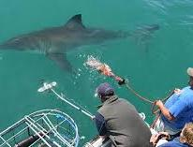
The goal of regulation initiative is to create an institutional support to unlock growth in C&M tourism (2/2)
PROPOSED INITIATIVES: INSTITUTIONAL SUPPORT, REGULATION AND PERMITTING
3
The challenge
C&M lab proposal for marine activities and events
Coastal and Marine Tourism- PANZA
DAFF
VMS and GPS coordination
Local government
Traditional
Chiefs
Launching site lease
DRDLR
Inter govt.
coordinating
committee
CIPC
Business area operation site license
  Requirements for whale watching or a shark cage diving permit
    R53,300¹ obtain at least 8 separate permits from
    6 different government offices and wait up to 365 days²
Registration for tour guides
Tourism office
DEA
SAMSA⁴
Issues permit for vehicle on coastal zone, permits for marine activity
Skipper and vessel license
The committee will reduce number of separate permits applied and application waiting time to <90 days. This will increase issued permits to >70
Responsibilities
  The committee will;
    Coordinate the permit application process
    Be responsible for implementing the BBBEE Act
    Review and amend restrictive legislation
1 Initial fee R8,300 , annual fee R12,000-R36,000, launch permit R2,000-R5,000, vessel permit R1,200-R4,000 2 For a new permit
3 Mean days are 126.3. Suitability based on sea, weather conditions and availability of whales
4 SAMSA- South African Maritime Safety Authority, DAFF – Department of Agriculture, Forestry and Fisheries, CIPC – Companies and Intellectual Property Commission.

Slide 33
We would like to link and promote existing provincial tourism routes, events and attraction to form South Africa’s Indi-Atlantic Route (1/2)
PROPOSED ROUTES INITIATIVE: INDI-ATLANTIC ROUTE
7
Limpopo
  The national Indi- Atlantic route links a variety of attractions and activities that are found in existing and established routes across different coastal regions namely ;
    Diamond Coast
    West Coast
    Coastal route
    Garden route
    Eastern Cape coastal tour
    South Coast experience
    East 3 route
  The route unifies the coastline while celebrating its’ diversity in pristine beaches, marine activities and cultural experiences
North West
Gauteng
To Swaziland
and
Mozambique
Mpumalanga
East 3 Route
Free State
KwaZulu-Natal
Northern Cape
Diamond Coast
South Coast
Experience
Eastern Cape
Eastern Cape
Coastal Tour
Garden Route
West Coast
Western Cape
Location associated with Initiatives
Coastal
Route
SA Indi-Atlantic route
Proposed Blue Flag Beaches
SA Provinces
South Africa
Individual route names

Slide 34















The Indi-Atlantic route unifies the coastline while celebrating the diverse CMT activities available (2/2)
PROPOSED ROUTES INITIATIVE: INDI- ATLANTIC ROUTE
Location associated with Initiatives
7
SA Indi-Atlantic Route
Proposed Blue Flag Beaches
Phakisa MPAs with tourist activities
Priority Small Harbours Development
Limpopo
Number of Home stay accommodations:
8 in KZN
65 in EC
<5 in WC
Cruise Terminals (work in progress)
BBWW activities
Mpumalanga
Shark cage diving
To Swaziland
and
Mozambique
Cycling
North West
Gauteng
Horse riding
Snorkeling
East 3 Route
Diamond sea experience
Alexander
Bay Airport
Free State
KwaZulu-Natal
Name Culture
Northern Cape
Shipwrecks
South Coast
Experience
4x4
Diamond Coast
Flowers
Eastern Cape
Location associated with Initiatives:
Nonoti Beach Resorts
Durban City Marathon
Durban Cruise
Port St Johns Beach Development
Port Elizabeth Cruise
Monwabisi Recreational Node
Cape Town Cruise
Volvo Ocean Race
Eastern Cape
Coastal Route
West Coast
Western Cape
Garden Route
Coastal
Route
Priority Small Harbours Development:
NC - Boegoebaai
EC - Port St Johns
KZN - Hibberdene

Slide 35
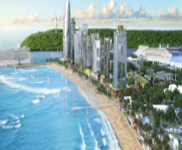
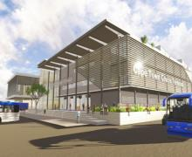


The lab recognizes major ongoing projects that will contribute to the growth of the coastal and marine sector
  These are major infrastructural projects that have potential to significantly contribute to the economic growth and job creation aspirations of the sector. They have clear business plans, funding secured and diverse stakeholder participation/ agreement. As a lab, we recognize these projects that already have strong momentum with minimal challenges and have prioritized other infrastructure projects that had challenges that the lab platform would unlock
Baakens Valley Precinct
Durban Point
Cape Town Cruise Terminal
iSimangaliso accommodation mix development
The development will include the rehabilitation of the Baakens River which will be linked to the waterfront development. There will be water sport activities and leisure facilities provided.
The project involves the development of luxury accommodation, tourist facilities and a cruise terminal.
The port will accommodate the current and future passenger vessel fleet. It is also envisaged that the upgraded facility will house value-added retail and hospitality services
43 accommodation facilities across the wetland with cabins, tented camps, lodges and self-catering units
R2.3 billion investment
Potential to create 4200 jobs
SOURCE: Department of Tourism land claims study

Slide 36
With the 9 detailed initiatives, the Lab intends to reach its aspirations through 2030
How the Lab intends to reach the Aspirations
  Events
  Routes
  New infrastructure
  Cruise
  Improved marketing
  Enabling legislation
  Skills
9% GDP contribution growth through 2030
GDP growth through 2030
9%
Inflation
5%
Implementation of initiatives
4%
Increase employment to 116,000
Job growth through 2030
116,044
Baseline employment
64,435
  Coastal route
  Monwabisi node
  Alexander Airport
  National Heritage festival
Blue Flag beaches
2,200
Cruise liner
500
Expansion of activities
48,909

Slide 37

Contents
  Introduction to iTrack
  User guide

Slide 38



iTrack is a simple and intuitive digital tool accessible from computers, tablet PCs and smartphones
Core value propositions of iTrack are…
Smartphone and tablet PC friendly
Extreme simplicity and intuitiveness
  Web-based easy to set-up tool accessible from anywhere in the world
  Accessible using computers, smartphones and tablet PCs
  Simple and intuitive interface with minimum but sufficient information to manage teams
  Requires only basic computer skills to use
Low infrastructure barrier
  Requires only 3G internet of 10-15mins/ day—friendly for emerging countries
  Accessible using Google Chrome and Safari

Slide 39


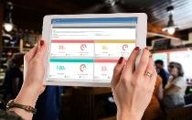

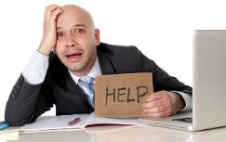
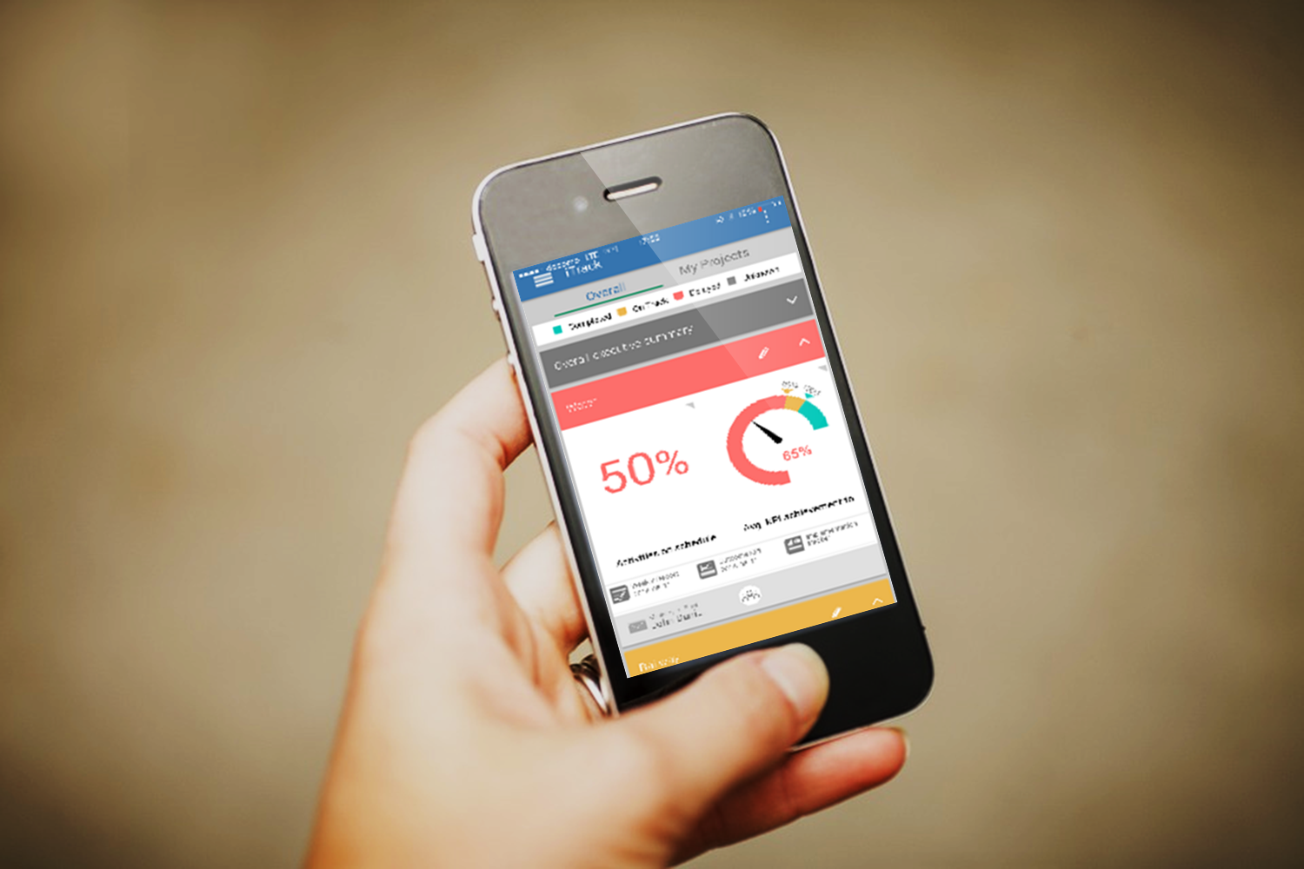
iTrack helps Delivery Units to work in a more sophisticated and efficient way
…iTrack will reduce time consuming work and improve efficiency of DUs
Time consuming work for traditional DUs to track and report progress…

Slide 40
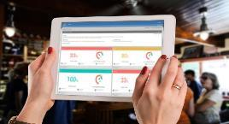
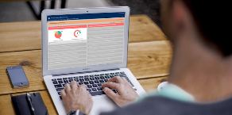
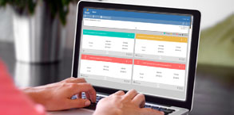


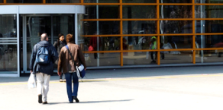
iTrack tracks both activities and KPIs and provides unique use cases for different stakeholders involved in the project
Leadership
Delivery Unit
Implementing agents
  Understand overall progress of the project by activity and KPI progress
  Communicate with DU and implementing agents– instant e-mail functionality
  Identify bottlenecks of implementation with easy to understand color coding
  Summarize and com-municate overall impact to the leadership team on a real-time basis
  Find list of necessary activities
  Update progress of activities real time to the DU and the leadership
  Easily communicate issues with the DU

Slide 41
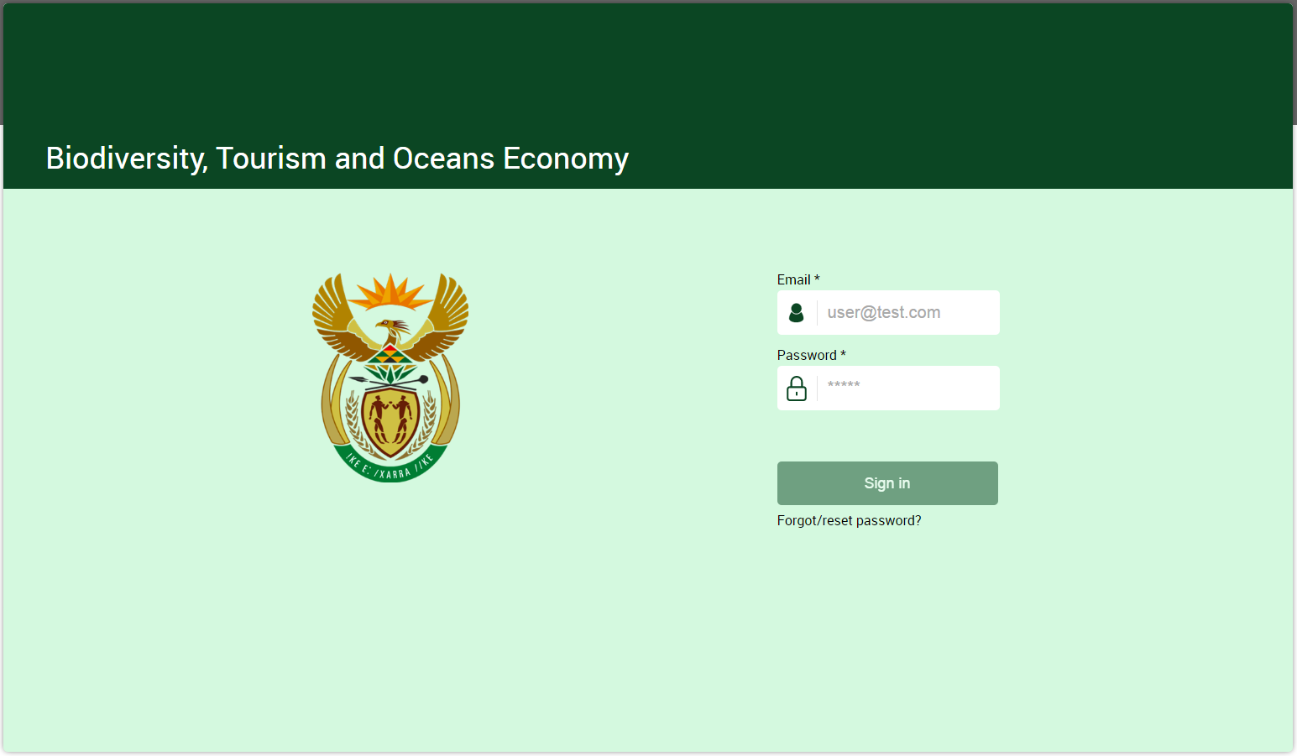
i-Track Log In

