Slide 1
SOUTH AFRICAN TOURISM
ORGANISATION
AL PERFORMANCE RESULTS
2015/16
Portfolio Committee on Tourism
14 October 2016
Slide no. 1

Slide 2
Contents
Strategic Overview
Governance and Organisational Structures
Auditor General’s Report
Situational Analysis
2015/16 Audited Performance Information
Governance Information
Human Resource Management
Audited Statement of Financial Performance for 2015/16
Slide no. 2

Slide 3
Strategic Overview
Slide no. 3

Slide 4
Vision
Mission
For South Africa to be one of the preferred tourist destinations in the world and to maximise the economic potential of the tourism industry for the benefit of our country and its people.
To develop and implement a world-class tourism marketing strategy for South Africa. In pursuance of this, South African Tourism will:
Develop and implement domestic, regional and international marketing strategies informed by research, information and knowledge-sharing;
Develop and implement a business events strategy;
Implement and maintain a recognisable, credible and globally benchmarked system of quality assurance;
Facilitate strategic alignment of provinces and industry, in support of the marketing of tourism;
Continuously align efforts to support tourism growth; and
Ensure the efficient utilisation of resources in order to deliver against the tourism strategy.
Slide no.4
Annual Report Page 22

Slide 5
Organisational Values
Our values are:
Showing respect and recognition for our people;
Acting with integrity;
Caring for our employees;
Exercising responsibility and accepting accountability for the outcomes of our actions; and
Pushing the boundaries of excellence in everything we do.
Slide no. 5
Annual Report Page 22

Slide 6
Legislative Framework and Governance
NO | LEGISLATIVE FRAMEWORK | BRIEF DESCRIPTION APPLICABLE TO SOUTH AFRICAN TOURISM
1. | South African Tourism established in terms of the Tourism Act (No. 3 of 2014) | Establishes the governance and accountability of South African Tourism to the South African Tourism Board appointed by the Minister: To provide for the continued existence of the South African Tourism Board; To establish a National Convention Bureau to market South Africa as business tourism destination; and To provide for the establishment of the Tourism Grading Council of South Africa.
2. | Public Finance Management Act (PFMA) | Established in terms of the Tourism Act (No. 3 of 2014) and listed as a Schedule 3a Public Entity (PFMA). Promotes transparency, accountability and sound management of the revenue, expenditure, assets and liabilities of the institutions to which this Act applies.
3. | National Treasury Regulations and related Practice Notes | Regulates financial, non-financial as well as fiscal matters.
4. | Reserve Bank Regulations | Relates to the management of international payments, the opening of foreign bank accounts and the transfer of funds.
Slide no. 6
Annual Report Page 23 - 24

Slide 7
Legislative Framework and Governance (cont.)
NO | LEGISLATIVE FRAMEWORK | BRIEF DESCRIPTION APPLICABLE TO SOUTH AFRICAN TOURISM
5. | National Tourism Sector Strategy (NTSS) | Sector strategy aligned with the priorities of the Medium Term Strategic Framework (MTSF): Growing tourism beyond 2020; Aligning with the government’s priorities of job creation and contribution to GDP; and Growing the domestic tourism market and positioning SA as tourism and business events destination.
6. | National Development Plan (NDP) | Chapter 3 identifies tourism as one of development pillars for economic growth.
Slide no.7
Annual Report Page 23 - 24

Slide 8
Governance and Organisational
Structure
Slide no. 8

Slide 9
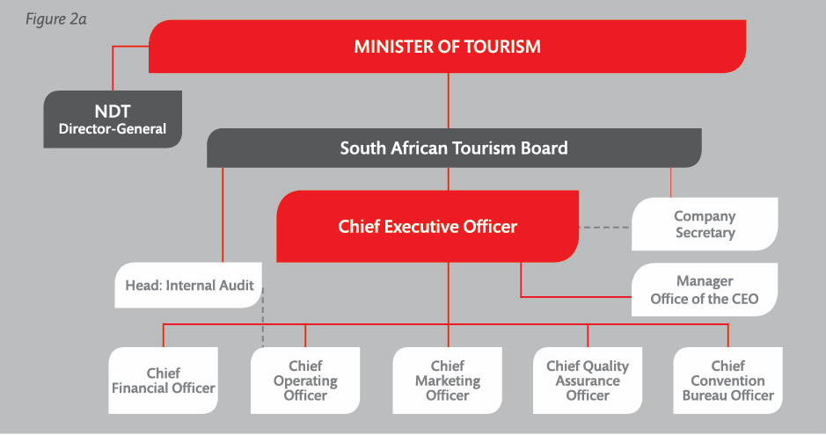
Organisational Structure
Slide no.9
Annual Report Page 24

Slide 10
Auditor General’s Report
Slide no. 10

Slide 11
Auditor-General’s Report
SA Tourism received its 15th unqualified audit report in 2015/16.
The Auditor General certified that:
- the financial statements were free from material misstatements;
- no instances of material non-compliance to specific matters in key legislations were found; and
- no significant deficiencies were found in internal controls.
Predetermined Strategic Objectives | Usefulness | Reliability
Strategic Objective 1 Contribute to the growth of International tourist arrivals in South Africa. | Unqualified | Unqualified
Strategic Objective 2 Contribute to the growth of domestic tourists in South Africa | Unqualified | Unqualified
Strategic Objective 3 Grow Tourism Revenue | Unqualified | Unqualified
Strategic Objective 4 Improve Brand Awareness of South Africa as a tourist destination | Unqualified | Unqualified
Annual Report page 105 – 107
Slide no. 11

Slide 12
Organisational Environment
Slide no. 12

Slide 13
Organisational Environment
The 2015/16 organisational environment performance was commendable, particularly in light of the following changes:
- areas of concern in the organisation highlighted in the Ministerial Review Report;
- a constrained regulatory and compliance environment posed by the PFMA and international laws;
- A change of leadership in the Board resulting in the composition of a new Board and Chairperson with new ideas and direction for the entity;
- The resignation of the CEO bringing about a period of transition for the organisation.
Annual Report Page 31 - 32

Slide 14
Funding
South African Tourism, as a global organisation with operations in about 13 international markets, has experienced approximately R350 million in currency losses in the past five years due to the depreciation of the rand against major currencies.
This has substantially reduced South African Tourism’s marketing budget in real terms. This loss of marketing budget has resulted in a drop in total overseas awareness of South Africa as a leisure destination. This awareness is measured through South African Tourism’s annual brand tracker study. In 2015 this stood at 78%, compared to 80% in 2014.
The cost of doing business abroad has also increased substantially, with the ratio between the marketing and overheads budget skewed to 65:35 – an unfavourable position, given the target of 70:30.
As part of South African Tourism’s intention to reduce overheads, and improve efficiency and return on investment, it will continue to reprioritise its market portfolio as well as its marketing operations through the hub model.
Over and above the grant allocation from the government, South African Tourism received R123 million of its budget from the Tourism Marketing South Africa (TOMSA) levy allocated through the TBCSA. This accounted for 10% of the budget as a contribution from the private sector.
This partnership increases South African Tourism’s ability to market South Africa internationally.
The TGCSA’s expanded mandate, although it was included in the TGCSA strategy, remained unfunded in the year under review
Annual Report Page 32

Slide 15
  Key Policy Developments and Legislative Changes
The functions of the TGCSA, as outlined in Chapter 4 of the Tourism Act (Act No. 3 of 2014), have been assigned by the Minister of Tourism to the South African Tourism Board.
Policy reviews are expected to address policy gaps and the expanded mandate of the TGCSA.
Annual Report Page 32

Slide 16
Performance Information by Objective
Slide no. 16

Slide 17
Performance Information for 2015/16
Strategic Objective | Performance Indicator | Actual Achievement 2014/2015 | Planned Target 2015/2016 | Actual Achievement 2015/2016 | Deviation from Planned Target to Actual Achievement for 2015/2016 | Comment on Deviation
Contribute to the growth of international tourist arrivals in South Africa | Number of international tourist arrivals achieved | 15 403 266 (foreign visitor arrivals) | 10 977 407 | 8 903 773 | -18.9% | All markets showed a decline except for the Middle East, with a notable decrease from Central and South America (-22.7%) and Australasia (-10%). The main reasons were: - Lack of forward bookings arising from the aftermath of the Ebola outbreak in some parts of West Africa; - Visa processing capacity constraints; and - Lack of understanding of the visa requirements and associated perceptions that South Africa is not safe for children. Global issues that affected arrivals: - Negative news about global safety and security; - Some of South Africa’s source markets were in recession; and - Competition from in-country domestic or regional travel.
Annual Report Page 35 - 55

Slide 18
Performance Information for 2015/16
Strategic Objective | Performance Indicator | Actual Achievement 2014/2015 | Planned Target 2015/2016 | Actual Achievement 2015/2016 | Deviation from Planned Target to Actual Achievement for 2014/2015 | Comment on Deviation
Contribute to the growth of domestic tourism in South Africa | Number of holiday trips achieved | 2 776 000 | 2 841 209 | 2 700 000 | -5% | The target has not been achieved due to South Africa’s poor economic growth, and due to many South Africans not having a culture of taking holiday trips. The domestic driver remained visiting friends and relatives (VFR).
Annual Report Page 35 - 55

Slide 19
Performance Information for 2015/16
Strategic Objective | Performance Indicator | Actual Achievement 2014/2015 | Planned Target 2015/2016 | Actual Achievement 2015/2016 | Deviation from Planned Target to Actual Achievement for 2015/2016 | Comment on Deviation
Grow tourism revenue | Total revenue achieved (billion rand) | R119.18 billion | R107.4 billion | R91.7 billion | -14.6%
 | TTFDS (billion rand) | New KPI | R83.1 billion | R68.1 billion | -18.1% | In spite of the target not being met, the TTFDS increased by 6.2% year on year. Tourism revenue is derived from tourist arrivals, therefore the decline in arrivals affected revenue.
 | TDDS (billion rand) | New KPI | R24.3 billion | R23.6 billion | -2.8% | The target was not achieved despite the average spend per trip having increased from R950 to R960. This was due to the country’s poor economic performance, high unemployment and declining disposable income.
Slide no. 19
Annual Report Page 35 - 55
Slide no. 19

Slide 20
Performance Information for 2015/16
Strategic Objective | Performance Indicator | Actual Achievement 2014/2015 | Planned Target 2015/2016 | Actual Achievement 2015/2016 | Deviation from Planned Target to Actual Achievement for 2015/2016 | Comment on Deviation
Improve brand awareness of South Africa as a tourist destination | Brand awareness achieved (%) | 80% | 80% | 78% | -2% | The target was not achieved due to a substantial reduction in the marketing and advertising budget, thus affecting brand visibility globally and in-market as well as compromising brand building and awareness.
Provide quality assurance for tourism products | Number of graded accommodation establishment members achieved | 5 369 | 6 493 | 5 230 | -19.5% | The annual performance is 19.5% below target due to the cost versus the value of grading and business closures as a result of the unfavourable economic climate.
Increase number of business events in South Africa | Number of business events achieved in South Africa | New KPI | 87 | 108 | +24.1% | The target was exceeded due to improved business events infrastructure as well as improved sales strategies.
Slide no. 20
Annual Report Page 35 -55

Slide 21
Strategies to Overcome Areas of Underperformance
Slide no. 21

Slide 22
Strategies to Overcome Areas of Under-performance
KEY PERFORMANCE INDICATOR | MITIGATION STRATEGIES
Number of international tourist arrivals achieved | Future performance is expected to grow due to the following: Amendment of the immigration regulations; Better alignment with industry, cities and provincial tourism agencies; Improved airlift strategy; and Implementation of the South African Tourism enhanced growth strategy. South African Tourism will begin implementing its enhanced growth strategy to increase travellers by five million within five years. This figure targets an increase in the number of tourist arrivals and domestic holiday trips. The following initiatives are planned: Undertaking the sixth review of the leisure tourism market portfolio in 2016/17 and implementing it from 2017/18 to 2019/20, coupled with an investment model to maximise return on investment; Undertaking a domestic target market segment refresh exercise to inform a more robust domestic marketing strategy; and Embarking on programmes that will seek to create a culture of travel.
Total revenue achieved
Number of holiday trips
Number of graded establishments | A policy review will be undertaken to address possible policy amendments and updates, to enable South African Tourism to implement the expanded mandate of the Tourism Grading Council. As part of the policy review, South African Tourism will seek to create and implement a revised business model and value proposition in order to attract more establishments to become graded, and strengthen capabilities to improve client servicing and retention. An integrated and targeted marketing and communications strategy will be implemented.
Annual Report Page 60

Slide 23
Performance Information by Activity
Slide no. 23

Slide 24
Leisure Marketing Overview in 2015
Slide no. 24

Slide 25
Tourist arrivals to South Africa from January to December 2015 declined by 6.8% compared to the previous year. There were declines from all regions, with the exception of the Middle East and Indian Ocean Islands.
Europe
1,317,291 arrivals
3.5% down from 2014
North America
353,450 arrivals
4.4% down from 2014
Middle East
53,338 arrivals
1.4% up from 2014
Asia
251,682 arrivals
6.7% down from 2014
Central & South America
50,304 arrivals
22.7% down from 2014
Australasia
118,923 arrivals
10% down from 2014
AFRICA
6,722,800 arrivals
7.4% down from 2014
Indian Ocean Islands
GRAND TOTAL
8,903,773 arrivals
6.8% down from 2014
23,314 arrivals
5.5% up from 2014
Note : Tourist arrivals figures shown above for January-December 2015
Source: Stats SA Tourism & Migration release December 2015, SAT analysis

Slide 26
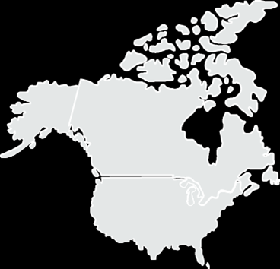
Key Highlights – United States of America
BIG THING TO BE DONE
Create talkability around SA which builds distinctive image as a fun, welcoming and exciting holiday destination, by showcasing rich, memorable and shareable “safari PLUS” experiences that will inspire.
CAMPAIGN HIGHLIGHTS
The “What’s Your BIG 5?” campaign which showcased the value-for-money proposition with strategic year-long partnerships with Budget Travel Magazine, media powerhouse The New York Times, and digital partner Adara to drive readers to deals pages.
PR VALUE
STRATEGIC MEDIA PARTNERSHIP VALUE
R2.5 billion
Strategic media partnerships with Conde Nast Traveler, Forbes, and Smithsonian, as well as hosting of 34 top journalists continued to bear fruit.
TRADE ACTIVITY
More than 100 key trade were hosted. Workshops educating trade on the destination were held.
Entered into training partnerships with Virtuoso, Ensemble, Signature, TTE, GTM and Travel Leaders, SAA Road
Show and USTOA.
Annual Report Page 36 - 49
Slide no. 26

Slide 27
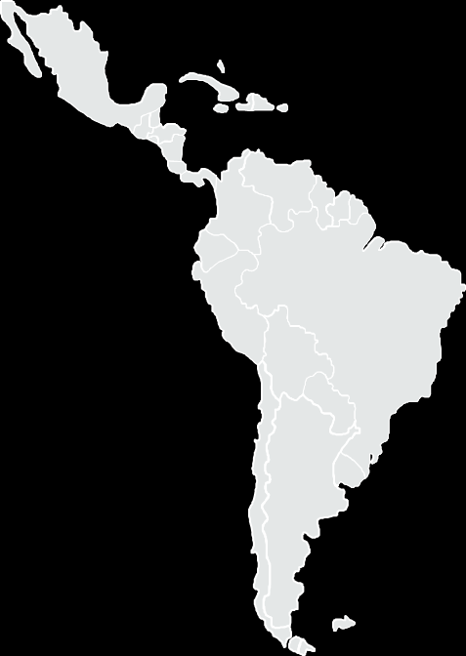
Key Highlights - Brazil
BIG THING TO BE DONE
To inspire travellers considering South Africa to take a holiday by demonstrating the wide variety of world class, value for money experiences in a fun and easy to do way.
CAMPAIGN HIGHLIGHTS
The Ordinarily Extraordinary conversion campaign was reinvigorated, the highly successful Meet South Africa TV creative was showcased across the country and the second year of the “Meet SA Week” linking the SAA Workshop, the South African Tourism Ubuntu trade awards and the ABAV travel trade show in Sao Paulo delivered great value for PR and trade.
PR VALUE
R 48.1 million
ADVERTISING VALUE
R 3.9 million
TRADE ACTIVITY
Key JMAs signed for this fiscal are JMAs signed with CVC, Decolar, Queensberry, Submarino, Be Happy and SAA. A total of 12 JMAs with tour operators were signed. The majority of JMAs focused on training and educating the travel trade about South Africa.
Slide no. 27
Annual Report Page 36 - 49

Slide 28
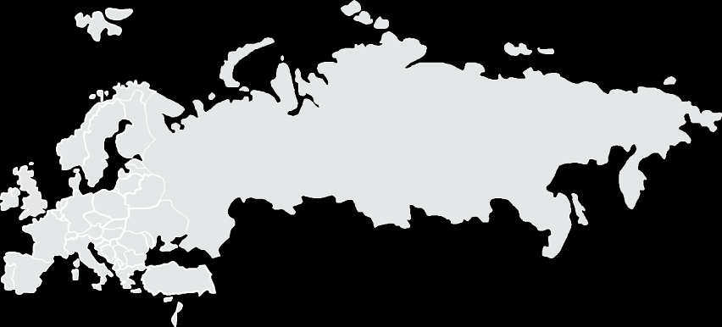
Key Highlights - Europe
FRANCE
BIG THING TO BE DONE
Promote South Africa as a leisure destination that delivers on adventure.
CAMPAIGN HIGHLIGHTS
Ongoing #MeetSouthAfrica campaigns positioned SA as a top of mind destination through a complete cross-media plan. A meeting box to connected French to South African people in real time, with a travel module video generator platform and a powerful digital media plan.
PR VALUE
THE TOTAL PR VALUE
R5.3 million
TRADE ACTIVITY
French trade sell South Africa as a value for money and enriching destination.
Slide 28
Annual Report Page 36 - 49

Slide 29
Key Highlights - Europe
NETHERLANDS
BIG THING TO BE DONE
Inspire Dutch travellers with a variety of fun experiences, welcoming South African locals, develop word of mouth and genuine content that informs and demonstrates South Africa as a value for money destination.
CAMPAIGN HIGHLIGHTS
The consumer campaign, “Your South Africa”, showcased a diverse South Africa open to different types of travellers. The campaign gave tourists the opportunity to tell their own South African stories.
PR VALUE
PR AND AD VALUE OF ALL ARTICLES AND PUBLICATIONS
R184.1 million
TRADE ACTIVITY
Tools empowered the trade to innovatively package and sell South Africa in a more inspiring way. Word of mouth campaigns informed the trade on new experiences. 12 Dutch JMAs (+1 Belgian JMA) were concluded.
SWITZERLAND
BIG THING TO BE DONE
Key activities undertaken were selected on the basis of potential conversion opportunities through the trade.
CAMPAIGN HIGHLIGHTS
No campaigns run in the market. As a tactical market, South African Tourism worked with the media to create awareness of the country.
TRADE ACTIVITY
Three JMA’s signed to continue the beneficial partnerships with members of the trade. Trade training done by SIPPO workshops. 40 members of the trade hosted in South Africa to expose them to the destination and its varied offerings.
Slide no. 29
Annual Report Page 36 - 49

Slide 30
Key Highlights - Europe
GERMANY
BIG THING TO BE DONE
Showcase a South Africa that offers a variety of authentic, immersive and life-enriching experiences for the German traveller
CAMPAIGN HIGHLIGHTS
South African Tourism outpaced competitors with National Big Screen campaign starring market Influencers and movie stars. “THE BEST DAY IN SA” - The biggest movie as well as outdoor and social campaign for South Africa in the country.
PR VALUE
BRAND CAMPAIGN GENERATED AD VALUE
R510.4 million
TRADE ACTIVITY
Trained the trade to uniquely package niche and authentic South African experiences to suit the German traveller. Our Partners make us fly! The Big Screen #DeinSuedafrika campaign was interlinked with sales at every step.
RUSSIA
BIG THING TO BE DONE
Due to the economy being in recession, there was a decline in all outbound travel from this market. The South Africa’s visa regulations impacted negatively on arrivals. Activities needed to be selected in order to circumvent the issues and make an impression on the market.
CAMPAIGN HIGHLIGHTS
As an investment market, no campaigns (trade or consumer) were undertaken. South African Tourism in conjunction with the Embassy held media and trade educationals.
TRADE ACTIVITY
South African Tourism attended and showcased at the Moscow International Trade and Travel Exhibition (MITT). The organisation also partnered with South African tour operator, Follow Me to Africa, well established in the market.
Slide no. 30
Annual Report Page 36 - 49

Slide 31
Key Highlights – United Kingdom
BIG THING TO BE DONE
Inspire targeted British travellers, to experience new fun, safe, friendly and value for money holiday destinations.
CAMPAIGN HIGHLIGHTS
Bear Grylls Survival Race activation showcased the adventure experiences. The Oculus Rift 360 content showcased different experiences.
PR/AD VALUE
THE TOTAL PR VALUE
R22.3 million
TRADE ACTIVITY
South African Tourism held roadshows in Glasgow, Manchester and London. Training events with SATOA and JMA partners enabled South African Tourism to educate trade on how to sell South
Slide no. 31
Annual Report Page 36 - 49

Slide 32
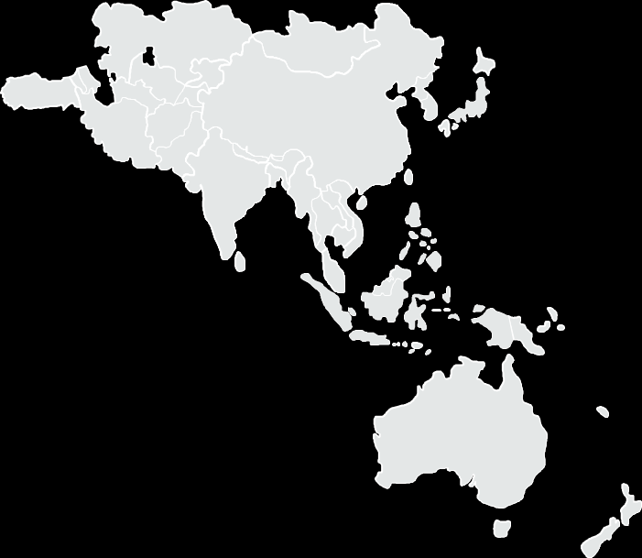
Key Highlights - Asia And Australasia
INDIA
BIG THING TO BE DONE
To position South Africa as a preferred holiday destination for family bonding time by showcasing wildlife, scenic beauty and adventure experiences.
HIGHLIGHTS
The Learn SA Roadshow and the SA Trade
Roadshow once again delivered phenomenal return on investment, focusing on training the trade on the depth and breadth of experiences and value for money on offer in South Africa. Media campaigns and the partnering with Cricket South Africa and Jonty Rhodes provided great opportunities to reach targeted consumers showcasing South Africa as a welcoming holiday destination.
PR VALUE
R13.6 million
TRADE ACTIVITY
Close to 2000 members of the trade were trained on Learn SA as well as the online programme, SA Specialists. Trade roadshows and hostings were held
Slide no.32
Annual Report Page 36 - 49

Slide 33
Key Highlights - Asia And Australasia
CHINA
BIG THING TO BE DONE
Make South Africa appealing to jetsetters and worldly travellers to be their first choice in “non-traditional” destinations; showcase South African icons and present an authentic way to interact with the country.
CAMPAIGN HIGHLIGHTS
South African Tourism Weibo launched a campaign “Be a Bit Wild” with the famous outdoor brand – “North Face” promoting South Africa as an outdoor adventure destination. The China office partnered with National Geographic Traveler, the JD Finance online, the Robb Report Partnership and celebrated the “Year of China in South Africa” with media roadshows.
PR/AD VALUE
R1.2 billion
ADVERTISING VALUE
R37.3 million
TRADE ACTIVITY
Signed JMAs with six trade partners in Beijing, Shanghai, Guangzhou and Shenzhen, including: Caissa, Huayuan Tours, Ctrip, Shanghai JinJiang Tours, GZL International Travel Service and One Tour. South Africa Specialist training programs, online promotions through social media networks, trade seminars and workshops, consumer events and other marketing initiatives were held.
JAPAN
BIG THING TO BE DONE
Provide the Japanese trade with a range of fresh itineraries which promote the variety and VFM aspects of South Africa that can be sold confidently and easily.
CAMPAIGN HIGHLIGHTS
As part of the ‘Meet South Africa’ in-country campaign, South African Tourism Japan undertook a series of “My South Africa Story” promotions on the largest travel blog/tour booking site in Japan.
PR/AD VALUE
R5.9 billion
TRADE ACTIVITY
Two JMAs were signed with key trade partners; Club Tourism and Hankyu Travel International to help grow their customers purchasing tours to South Africa through a series of consumer seminars and other event platforms, as well as tour promotions through special landing pages on the South African Tourism local website. Annual Trade Workshops were organised in Osaka and Tokyo to provide the Japanese travel trade with information positioning South Africa as an attractive, friendly and welcoming destination, bringing South Africa emotionally closer to the Japanese trade.
Slide no.33
Annual Report Page 36 - 49

Slide 34
Key Highlights - Asia And Australasia
AUSTRALIA
BIG THING TO BE DONE
Showcase South Africa as a fun, friendly and easy to do holiday destination through personal interactions with our people, adventure activities and safari experiences. Planting and amplifying positive messages and stories on South Africa using relevant, credible opinion leaders and information platforms, dispelled negative perceptions on safety and security.
CAMPAIGN HIGHLIGHTS
Drive positive impact with conservation. South African Tourism partnered with National Geographic Live events, with acclaimed wildlife photographer Steve Winter (specialising in big cats), sharing his gripping tales live on stage in “My Nine Lives” – including documenting leopards in South Africa’s Sabi Sands, across 5 cities in Australia and New Zealand during July/ August. Oceanographer Brian Skerry relayed his experiences in search of sharks in South Africa in “Ocean Wild” during October. An on-site activation delivered a virtual holiday to South Africa via Oculus Rift. Worked with Adventure World to promote travel deals on site.
PR VALUE
R 257.8 million
ADVERTISING VALUE
R 92.6 million
TRADE ACTIVITY
A key trade initiative involved partnering with travel retailer, Helloworld and their South African wholesaler, Bench International, in running a national deal driven campaign, Hello South Africa. Sponsored the Onshow Africa Showcase
training 600 travel agents across 5 cities in ANZ, partnered with Qantas and Consolidated Travel for an airline sales incentive. Increased sign ups to the SA Specialist online training program by partnering with renowned
Australian presenter, Andrew Daddo.
Slide no. 34
Annual Report Page 36 - 49

Slide 35
Key Highlights - Watch-list Markets
    As part of our ongoing efforts to improve brand awareness, we hosted media events and visits to South Africa in return for editorial coverage.
    Through such efforts, we have achieved extensive coverage in publications such as Iberia Airlines’ global magazine, which services markets beyond our normal reach.
    The key activities in Sweden, Denmark and Austria during the year under review included a trade landscape analysis through our participation in the On Show Roadshow in the Nordic countries, and a trade seminar focused on selling South Africa as a destination in Linz, Austria.
    We also hosted trade and media representatives, and signed one joint marketing agreement (JMA), all of which contributed to ensuring that conversion was enabled within the allocated watch-list budget.
Slide no. 35
Annual Report Page 36 - 49

Slide 36
Key Highlights - Watch-list Markets
    South African Tourism continued to focus on amplifying the importance of creating mutually beneficial partnerships for marketing the country in areas that sit outside of our core focus markets.
    We continued to equip South African embassies with the support they needed to position the destination prominently, to aid brand awareness and to positively impact on conversion. To this end, our DIRCO (Department of International Relations and Co-operation) stakeholder relations remain core to the functioning of this unit and our organisation as a whole.
    South African Tourism participated in the NDT and DIRCO economic diplomacy workshops, which are an integral part of delivering on our mandate.
    We continued to seek profitable partnerships by negotiating joint marketing initiatives with trade players in Argentina, Norway and Spain to help our drive on the trade front and instil confidence in selling South Africa.
    We embarked on a successful digital visibility drive across four markets, aimed at enticing consumers.
Slide no.36
Annual Report Page 36 - 49

Slide 37
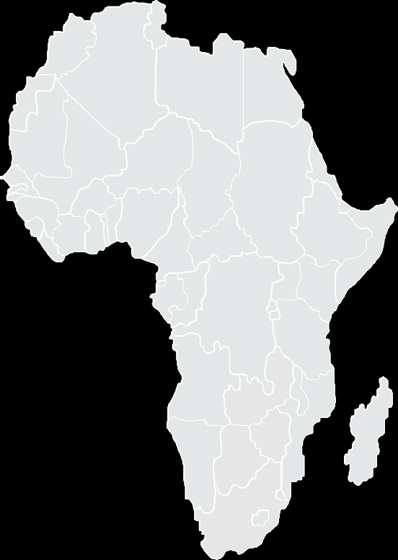
Key Highlights - Africa
  Partnership with DStv afforded the opportunity to buy media spots, as well as showcase South Africa, through a variety of media platforms including TV, radio and social media, and an influencer campaign that on the Star Gist TV programme.
  In Nigeria and Ghana 17 billboards were erected in Lagos, Abuja, Port Harcourt and Accra, showcasing different leisure experiences.
  Various lifestyle events were promoted and used to enhance the hosting experience, as events are key drivers to travel from the African continent.
  For 2015 saw a leveraging on events such as the Durban July, Masters Polo series, Standard Bank Joy of Jazz Festival, Joburg Shopping Festival and INDABA 2015.
  A joint marketing agreement (JMA) in West Africa was used to collaborate on a number of activities aimed at promoting and selling South Africa’s leisure and business experiences through various travel entities and non-travel companies.
  SA Tourism received their first trade association award – Best Trade Partner Training – from the National Association of Nigeria Travel Agencies (NANTA).
  The organisation exhibited at travel shows such as Swahili in Tanzania, Magical Kenya in Kenya, BITUR in Angola and AKWAABA in Nigeria to showcase the South African brand, building awareness and giving South African products and service providers an opportunity to interact with the trade and consumers.
  In April 2016, the Africa land markets became part of the Africa air markets and these will now be classified
  as land hubs within the Africa hub strategy.
Slide no. 37
Annual Report Page 36 - 49

Slide 38
Key Highlights – South Africa
BIG THINGS TO BE DONE
To drive demand for more frequent domestic short breaks in both the priority and secondary segments of our Domestic market. To educate, partner and encourage conversion with trade using JMA’s by demonstrating the profitability and value of domestic travel through affordable local packages. To embark on programmes which seek to create a culture of travel amongst South Africans who have no culture of travel.
CAMPAIGN HIGHLIGHTS
The Million New Experiences are a Sho't Left Away campaign was designed to drive more frequency amongst the segments that do travel and also to build a culture of holiday travel in South Africa. The Shot’left website was the first responsive country site implemented for South Africa.
PR VALUE
Strategic Media Partnership value R56 million
Secured strategic media partnerships with reality television show, The Ultimate Braai Master on E-TV, Expresso Breakfast Show and Independent Media. Won an "Orchid" award for our Tourism Month campaign with Limpopo being the host province.
TRADE ACTIVITY
South African Tourism contracted six partnership and joint marketing agreements, resulting in the training of 1581 travel trade on how to package and sell South Africa domestically aligned to the consumer insights research and promoted the Deals Dashboard for industry to load special discounted packages and deals.
Slide no. 38
Annual Report Page 36 - 49

Slide 39
TOURISM GRADING COUNCIL OF SOUTH AFRICA
Slide no.39

Slide 40
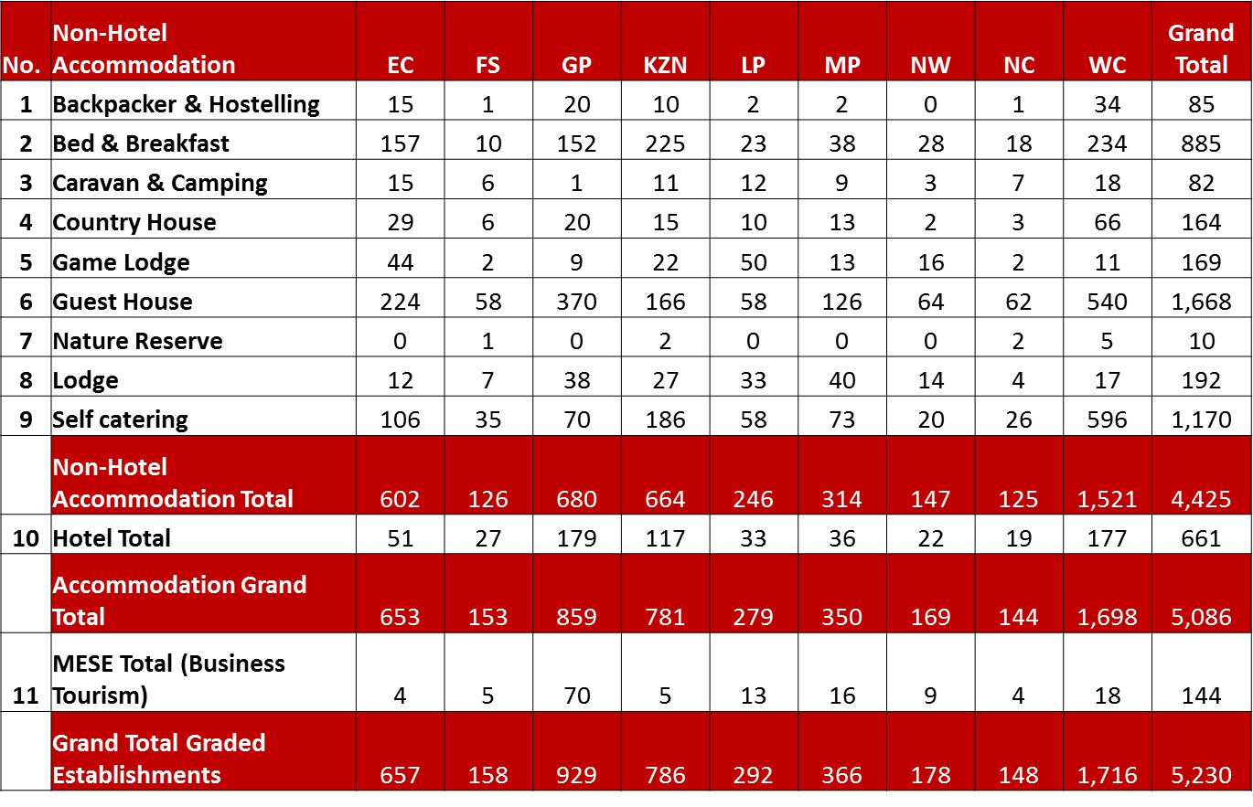

TGCSA Performance
In the year under review, the TGCSA did not meet its annual target of 6 493 graded establishments by the end of March 2016, but there was considerable growth in new establishments joining the system as well as in the number of graded rooms. In the 5 230 graded properties achieved, 755 were new and 4 475 of them were renewals.
Total number of graded rooms as at 31 March 2016
Slide no.40

Slide 41
TGCSA Performance
93% of the graded establishments were registered on the Basket of Benefits platform by the end of the financial year. The Basket of Benefits is a comprehensive offering to graded establishments that provides them with various value-added benefits, tailor-made to meet their specific needs. These benefits are negotiated at discounted rates using the buying power of the membership base of the TGCSA.
The TGCSA has successfully piloted the Tourism Analytics Programme (TAP) to integrate guest reviews from key online travel review websites such as TripAdvisor, Bookings.com and Trivago into the TGCSA’s grading system. It can now access guest reviews from a plethora of travel review websites on all tourism products. This integration of the reviews into our star grading system also provides an opportunity for a credible and transparent adjudication of our national recognition awards programme, the Lilizela Tourism Awards.
In 2016/17, the TGCSA will continue to review the policies related to grading, refine the grading value proposition and review the grading criteria.
Other initiatives include:
- Driving a category-specific Basket of Benefits offering to drive retention;
- Implementing a consumer campaign that will increase demand and awareness for graded establishments;
- Effecting trade-focused online advertising to broaden the base of graded
establishments; and
- Reviewing stakeholder engagement with applicable associations
such as the National Accommodation Association of South Africa.
Slide no.41
Annual Report Page 50 - 51

Slide 42
SOUTH AFRICAN NATIONAL CONVENTION BUREAU
Slide no.42

Slide 43
Business Events and Meetings Market Portfolio
The prioritised markets for business events and meetings are in major decision-making centres where the headquarters of international associations are located. These priority markets (shown below) were identified in terms of:
- Geographic locations or centres where decisions about the staging of major international business events are taken;
- Priority targets within those markets; and
- South Africa’s potential to attract delegates to the country.
Annual Report Page 52 - 53

Slide 44
2015-2016 DELIVERABLES
Trade Shows
Create a “marketing platform” for local business events industry players through trade shows
Bidding Support
Provide support to regional and/or city convention bureaus (CBs) in bidding for key business events
Building Attendance
On-Site Support
PR, Media and Advertising
Increase awareness about South Africa as a business events destination
Lead Development
Generate maximum delegate attendance at business events
Develop a co-ordinated approach to generate leads for business events
Capacity Building/ Research
Create a more professional environment in which more business events will come to South Africa
Strategic Goal: Increase the size of SA’s business events industry
Annual Report Page 52 - 53

Slide 45
BID SUBMISSION ANALYSIS 2015-2016
53 Submissions
4 Incentives/ 50 Association - Meetings
Number of Conference Days: 242
Number of Delegates: 86 192
Estimated Economic Impact: R1.27 billion
BID SUBMISSIONS CITY BREAKDOWN
Cape Town | 27
Durban | 13
Johannesburg | 3
Port Elizabeth | 1
Tshwane | 2
Incentives | 4
National Expressions of Interest | 3
SUBMISSION ANALYSIS
Bids Won | 3
Awaiting Outcome | 47
Lost Bids | 3
Total Bids Submitted | 53
Annual Report Page 52 - 53

Slide 46
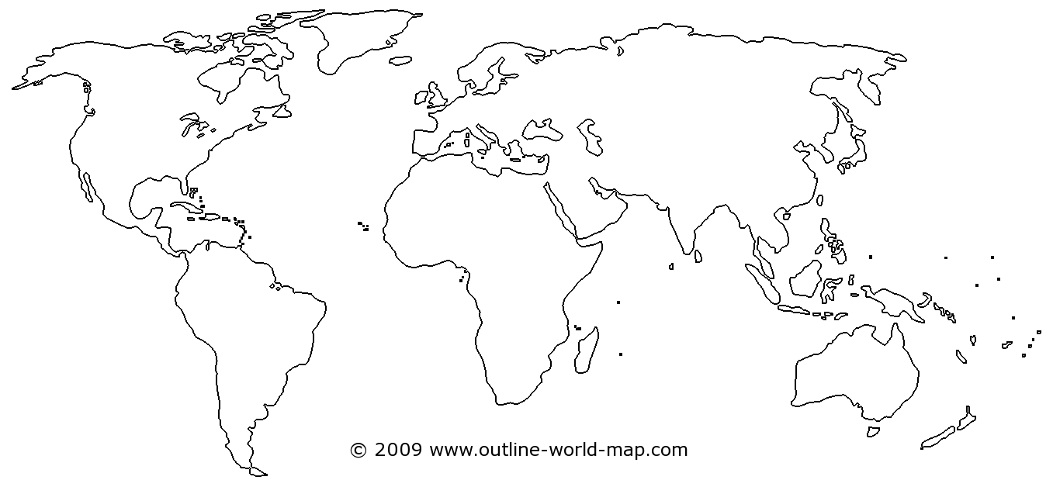
DELEGATE BOOSTING ACTIVATIONS
Target: 35 Activations 2015-2016
38 Activations
DELEGATES REACHED: 115 000

Slide 47



ON-SITE EVENT SERVICES
Target: 30 Activations 2015-2016
34 Activations
DELEGATES REACHED: 40 000

Slide 48
Governance Information
Slide no. 48

Slide 49
South African Tourism Board
In accordance with the Tourism Act, the Minister of Tourism appoints members serving on the Board for a period of three years and consists of nine Non-Executive Directors and includes a representative from the National Department of Tourism.
The Board members fulfil their roles, duties and functions with due regard to the fiduciary responsibilities bestowed on them in line with the Tourism Act and the King III Report on Corporate Governance.
The Board meets quarterly, or more frequently if circumstance require it to do so. The members provide oversight to the executive management by ensuring that all material matters are subject to Board approval. The Board meetings were well attended in the year under review.
A Board effectiveness evaluation is conducted by the Board on an annual basis.
For the period under review South African Tourism had two Boards, with the first Board’s term ending 31 May 2015. The current Board was appointed by the Minister with effect from 1 June 2015 for a period of three years.
Annual Report Page 65 - 82

Slide 50
Board Tenure ended 31 May 2015
 | Special Board Meeting | Board Meeting
NAME | 21 April 2015 | 29 May 2015
Zweli Mntambo (Chairperson) | P | P
Siza Mzimela (Deputy Chairperson ) | P | P
Ayanda Ntsaluba | O | O
Graham Wood | P | O
Dirk van Schalkwyk | O | P
Kananelo Makhetha | P | P
Thebe Ikalafeng | O | P
Tumi Makgabo | P | O
Monwabisi Kalawe | O | O
Miller Matola | O | O

Slide 51
Newly Appointed Board from 1 June 2015
 | Board Induction |  |  | Blue Skies Session | Board Lekgotla | Special Board Meeting | Board Meeting | Board Meeting | Board Meeting | Board Meeting
NAME | 5-Jun-15 | 3-Jul-15 | 4-Mar-16 | 22- Jul- 15 | 23-25 AUGUST 2015 | 26- Oct- 15 | 9- Nov- 15 | 2- Dec- 15 | 12- Feb- 16 | 16- Mar- 16
Zweli Mntambo (Chairperson resigned on 22 October 2015) | P |  |  | P | P
Tanya Abrahamse (Deputy Chairperson appointed acting chairperson on 27 October 2015) | P |  |  | P | P | P | P | P | P | P
Ayanda Ntsaluba | P |  |  | P | P | P | P | O | P | O
Graham Wood | P |  |  | P | P | P | O | P | P | O
Thebe Ikalafeng | P |  |  | P | P | P | P | P | P | P
Chichi Maponya |  | P |  | P | P | O | O | P | O | P
Oregan Hoskins |  | P |  | O | P | O | P | P | P | P
Monhla Hlahla (resigned on 04 January 2016) | P |  |  | P | P | O | P | P
Michelle Constant | P |  |  | O | P | P | P | P | P | P
Colin Bell | P |  |  | P | P | P | P | P | P | P
Amor Malan | P |  |  | P | P | P | O | P | P | P
Judy Nwokedi |  |  | P | P | P | O | P | P | O | P
Mmaditonki Setwaba | P |  |  | P | P | P | P | P | P | P
Iraj Abedian (resigned on 27 July 2015) | P |  |  | P
Yacoob Abba Omar (appointed on 19 November 2015) |  |  | P |  |  |  |  | P | P | P

Slide 52
Board Remuneration For the period 1 April 2015 to 31 May 2015
Name |  | Flights | Accommodation | Car-hire | Remuneration | Total
Zweli Mntambo (Chairperson) | Resigned 22 October 2015 | - | - | - |  | -
Sizakele Mzimela (Deputy Chairperson) |  | - | - | - | - | -
Kananelo Makhetha |  | 4 406.67 |  |  |  | 4 406.67
Ayanda Ntsaluba |  | - | - | - | - | -
Tumi Makgabo |  | 42 677.72 | - | - | - | 42 677.72
Dirk Van Schalkwyk |  | - | - | - | - | -
Graham Wood |  | 4 705.65 | 1 300.00 | - | - | 6 005.65
Thebe Ikalafeng |  | - | - | - | - | -
Miller Matola |  | - | - | - | - | -
Monwabisi Kalawe |  | - | - | - | - | -
 |  | 51 790.04 | 1 300.00 |  |  | 53 090.04

Slide 53
Board Remuneration For the period 1 June 2015 to 31 March 2016
Name |  | Flights | Accommodation | Car-hire | Remuneration | Total
Zwelibanzi Mntambo (Chairperson | Resigned 22 October 2015 | 40 505.99 | 4 548.85 | 5 616.92 | 31 888.00 | 82 559.76
Tanya Abrahamse (Deputy Chairperson) |  | 79 946.30 | 1 300.00 | 505.98 | - | 81 752.28
Ayanda Ntsaluba |  |  |  |  | 35 120.00 | 35 120.00
Graham Wood |  | 179 231.22 | 28 388.61 | 6 680.98 | 32 144.00 | 246 444.81
Thebe Ikalafeng |  | 97 860.04 | 11 080.16 | 6 382.74 | 47 408.00 | 162 730.94
Chichi Maponya |  | 5 490.58 | 1300.00 | 588.00 | 25 256.00 | 32 634.58
Oregan Hoskins |  | 17 051.90 | 5200.00 | 1946.48 | 32 144.00 | 56 342.38
Monhla Hlahla | Resigned 4 January 2016 |  |  |  | 28 232.00 | 28 232.00
Michelle Constant |  |  |  |  | 44 244.00 | 44 244.00
Colin Bell |  | 24 504.09 | 3 900.00 | 2 487.95 | 32 144.00 | 63 036.04
Amor Malan |  |  |  | 15 774.00 | 32 144.00 | 47 918.00
Judy Nwokedi | Appointed 11 May 2015 | 92 144.88 | 2 600.00 | 1 215.04 | 16 752.00 | 112 711.92
Mmaditonki Setwaba |  |  |  |  | - | -
Iraj Abedian | Resigned 27 July 2015 |  |  |  | 4 592.00 | 4 592.00
Yacoob Abba Omar | Appointed 19 November 2015 |  |  |  | 18 368.00 | 18 368.00
 |  | 536 735.00 | 58 317.62 | 41 198.09 | 380 436.00 | 1 016 686.71

Slide 54
Report from the Audit and Risk Committee
In line with the PFMA and the King III Report on Corporate Governance, the Internal Audit Unit provides the Audit and Risk Committee and management with the assurance that the internal controls are appropriate and effective.
A formal risk assessment was conducted during the period under review and the top 10 strategic risks affecting the business were identified.
There were no matters reported that indicated any material deficiencies in the systems of internal control or any deviations thereof.
In line with the statutory requirements and Audit Standards, the independence of the Internal Audit Unit has been assessed.
Annual Report Page 88

Slide 55
Human Resource Management
Slide no. 55

Slide 56
Human Resource Information
The Board-approved structure has 202 positions versus our head count of 173 positions.
South African Tourism works towards maintaining a vacancy rate of below 16.76%.
South African Tourism converted its employees (excluding executives and country managers) from fixed-term contracts to permanent employment with effect from 1 April 2015.
This was in an effort to ensure business continuity, minimise the depletion of institutional memory, increase staff retention and create a sense of belonging among employees.
At the end of March 2016 a staff turnover rate of 11.5% was recorded as a result of employee resignations, an increase on the previous year’s turnover for the same period of 5.85%.
In the year under review, South African Tourism also saw the departure of the CEO, Mr Thulani Nzima.
Annual Report Page 95 - 96

Slide 57
South African Tourism Employment Equity Statistics
The employment equity (EE) figures are based on the South African employees at head office and South African country managers based in-country.
While international offices have the promotion of diversity in their labour laws, EE targets do not bind them and South Africa’s EE legislation does not affect them.
For the period of under review, the EE targets for South African Tourism were determined in consideration of EE legislation, and the economically active population (EAP) profile for Gauteng as a guideline.
In South Africa, 67.63% of South African Tourism staff are locally recruited. The figures below are based on the South African employees at the Head Office and South African country managers based in-country offices.
Annual Report Page 97

Slide 58
AUDITED STATEMENT OF FINANCIAL PERFORMANCE FOR 2015/16
Slide no. 58

Slide 59
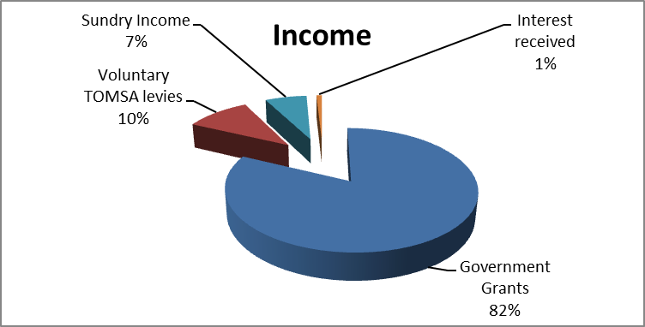
Financial Performance in 2015/16
The two main sources of income for South African Tourism are income from the NDT (R977.7 million) and the TBCSA (R123.2 million). These two revenue streams contribute 92% to South African Tourism’s total income.
The remaining 8% derives from interest income (R11.9 million), grading income
(R18.4 million) and sundry income of R81.5 million.
Sundry income comprises income from exhibitions such as INDABA and Meetings Africa.
Slide no.59
Annual Report Page 108 - 145

Slide 60
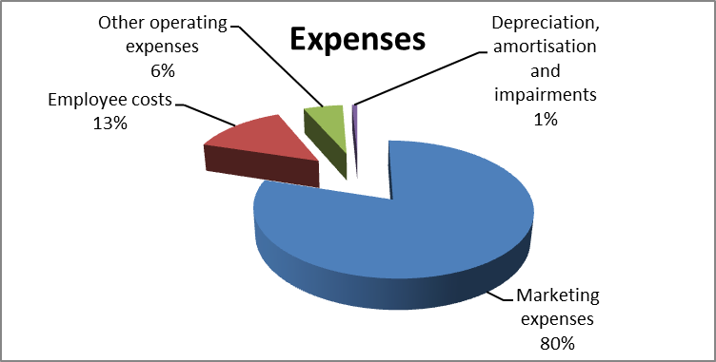
Financial Performance in 2015/16
An audited amount of R982 million was spent on marketing expenses during the 2015/16 financial year. This represents South African Tourism’s highest cost. The balance of R100 million received during the financial year for domestic marketing.
Employee costs made up 13% of total expenses, including salaries and cost-of-living allowances for locally recruited international staff members.
Slide no.60
Annual Report Page 108 - 145

Slide 61
Financial Performance against Budget in 2015/16
Objective | Budget | Actual Expenditure | (Over) / Under Expenditure
 | R'000 | R'000 | R'000
Administration | 117 385 | 125 040 | (7 655)
Contribute to the growth of international tourist arrivals in South Africa | 312 149 | 323 991 | (11 842)
Increase domestic tourism in South Africa | 143 800 | 144 390 | (590)
Increase tourism trended revenue contribution to the economy | 312 149 | 323 991 | (11 842)
Marketing Increase South Africa brand awareness* | 205 947 | 246 619 | (40 672)
Provide quality assurance for tourism products | 48 425 | 34 528 | 13 897
Increase business events | 33 700 | 57 613 | (23 913)
Total | 1 173 555 | 1 256 172 | (82 617)
*South African Tourism’s global media budget is included in this figure and includes global media platforms such as CNN, BBC and National Geographic
Slide no. 61

Slide 62
Audited Financial Performance in 2015/16
South African Tourism is proud of maintaining its clean audit status as reported by the Auditor-General.
The audited financial results show an operating deficit of R46.7 million, which was fully offset by unrealised exchange foreign gains of R62.3 million.
The audited surplus for the financial year was R15.7 million.
Slide no. 62
Annual Report Page 108 - 145

Slide 63
THANK YOU
Slide no.63

