Slide 1
SA Post Office Annual Results for the year ended 31 March 2016

Slide 2
Overview for the year ending 31 March 2016
SA Post Office has been through another challenging year
Revenues declined by R513 million to R4,8 billion
Non payment of suppliers resulted in declining service levels and closure of post office branches
Postal Services contributes 70% of overall revenue, while operational capacity remains largely fixed
Revenue diversification efforts delayed to the 2016/17 financial year
Cost containment measures resulted in reduced operating cost (by R489 million to R5,8 billion)
Net loss of R1.1 billion reduced by R383 million
1,423 employees left SAPO during the financial year, with loss of some key skill
Audit report qualified
2 prior year qualifications resolved
Management and the Board is addressing remaining qualification areas
Performance contracts of executives include resolving audit issues

Slide 3
Statement of Comprehensive Income

Slide 4
Statement of Financial Position
Accumulated loss of R1,1 billion
Shares of R492 million issued increasing share capital to R693 million
Unrecognised fair value of property portfolio R1.37 billion, so SAPO is solvent
No additional going concern guarantees required for the 2016/17 financial year
Current liabilities include loan of R1 billion acquired in 2016 (refinanced after year end)
Postbank depositors funds of R4,8 billion, Postbank cash and investments of R6,9 billion

Slide 5
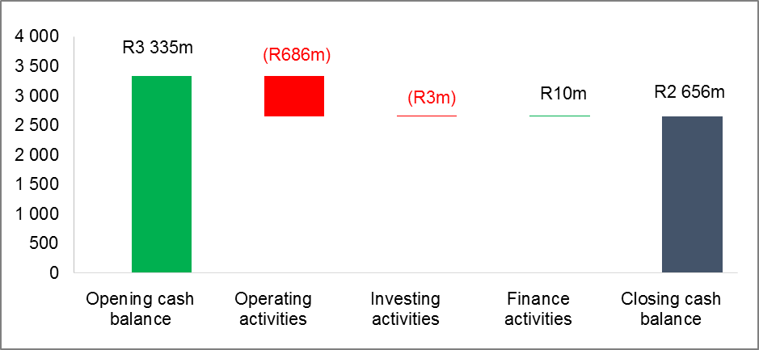
Statement of Cash Flows
Operations utilized cash of R686 million due poor revenue performance
Capital expenditure of R46 million
Loans of R1 billion raised during the year

Slide 6
Annual Performance Indicators
Strategic Objectives | Number of KPIs | KPIs Achieved |  |  |  | KPIs Not Achieved
 |  | Q1 | Q2 | Q3 | Q4 | Q1 | Q2 | Q3 | Q4
Deliver sustainable developmental obligations funded from reserved market | 1 | 0 | 1 | 1 | 1 | 1 | 0 | 0 | 0
Create a commercially viable business from the unreserved markets | 2 | - | - | - | 0 | - | - | - | 2
Achieve operational efficiency and effectiveness | 5 | 1 | 1 | 1 | 1 | 4 | 4 | 4 | 4
Achieve leadership stability that ensures continuity and accountability | 4 | 0 | 0 | 0 | 0 | 4 | 4 | 4 | 4
Achieve labour stability and improve labour relations | 3 | 1 | 1 | 1 | 0 | 1 | 1 | 1 | 3
Achieve financial sustainability | 10 | 6 | 6 | 5 | 3 | 3 | 3 | 4 | 7
Improve the customer experience to achieve customer loyalty | 1 | - | - | - | 0 | - | - | - | 1
Grow Government business to levels of 50-55% of SAPO revenue per annum | 1 | 0 | 0 | 0 | 0 | 1 | 1 | 1 | 1
Facilitate the corporatisation of Postbank | 1 | 0 | 0 | 0 | 0 | 1 | 1 | 1 | 1
Increase access of financial services to the unbanked | 1 | 0 | 1 | 0 | 0 | 1 | 0 | 1 | 1
Ethical leadership | 1 | - | - | - | 0 | - | - | - | 1
Environmental sustainability | 2 | 1 | 2 | 2 | 2 | 1 | 0 | 0 | 0
Legal compliance | 2 | 0 | 0 | 0 | 0 | 2 | 2 | 2 | 2
Effective risk management and governance | 2 | 0 | 0 | 0 | 0 | 2 | 2 | 2 | 2
Effective stakeholder management | 2 | 1 | 1 | 1 | 1 | 0 | 0 | 0 | 1
Total number | 38 | 10 | 13 | 11 | 8 | 21 | 18 | 20 | 30
% of KPIs Achieved/Not Achieved |  | 32.3% | 41.9% | 35.4% | 21.1% | 67.7% | 58.1% | 64.6% | 78.9%
Note: Total of 38 KPIs were identified for the year in the Corporate Plan. However 7 KPIs have targets measured and reported on, only at year end. Therefore only 31 KPIs have been measured and reported on, in the 1st, 2nd and 3rd quarters.

Slide 7
Challenges in achieving performance targets
Slow revenue recoveries and funding gap casued overall low achievement of 21% on the key performance indicators
SAPO faced tough trading conditions during the 2015/16 year with lower revenues to meet operating expenditure
Delay of funding hampered the payment of critical suppliers resulting in the disruption of operations and sales
Conclusion of the term loans was crucial to enable the implementation of the Corporate Plan and performance targets.
Additional term loans of R2.7bn were finalised in July 2016

Slide 8
Post year end progress
Subsequent to the year-end:
signed a joint agreement with the recognised trade unions to settle historic wage issues and conditions of employment
R650 million capital injection was received on 1 April 2016 from National Treasury
Raised additional debt funding of R2,7 billion to pay for past liabilities, fund continuing losses and invest in capital projects (supported by government guarantees)
South African Reserve Bank approved SAPO’s section 12 first-level application to establish a bank and obtain a banking license
Courier Freight Group subsidiary being divisionalised to rationalize courier offering to market
Customer engagement breakfast meetings held in Gauteng, Western Cape and KZN

Slide 9
Revenue plans and initiatives
Established centralised Commercial Division responsible for the revenue performance and customer engagement optimisation
Key activities underway:
Consolidation of all commercial related functions to ensure accountability and focus
Development of solutions for different markets
Drive and accelerate focus on Motor Vehicle License (MVL) renewals
More focus on infringement notices through agencies (such as RTIA, RTMC, JMPD, TMPD, SANRAL and E-Tolls)
Revenue strategy supported by robust marketing plans and activities
Will focus on claw back of legislated reserved area mail from courier companies to partially fund costs associated with the USO

Slide 10
Audit report – action plans
2 qualifications from prior year addressed (intangible assets, liabilities)
Qualifications in the areas of property, plant and equipment, site restoration provision, deferred tax and income tax, heritage assets, provision for site restoration, contingencies, related parties, amortisation of intangible assets, irregular expenditure, fruitless and wasteful expenditure
Full financial statements being prepared for half year to September 2016, 9 months to December, with focused actions to resolve qualification areas by year end
Financial Misconduct Committee reviews potentially irregular or fruitless and wasteful expenditure identified and recommends actions to be taken, including implementation of preventative controls, communications to business
Additional finance skills are being sourced to assist to resolve audit findings
Executive team currently focusing on resolving audit findings, included in performance contracts

Slide 11
SA Post Office Performance objectives for the year ended 31 March 2016

