Slide 1
NPC Plenary
Background presentation for plenary discussion on economy

Slide 2
Overview
Introduction
Background
Nine challenges identified in diagnostic
Specific challenges identified in economy diagnostic paper

Slide 3
Introduction
Why the urgency of NPC economic discussion?
Growing concern of the state of the economy relative to the targets set in the Plan
Although facing tough global economic condition impacting economic growth negatively there is a perception that this is exacerbated by internal factors. If only global factors then the economy should be growing at above current levels.
Internal factors hampering growth include
Poor governance in particular of SOE’s
Decreasing trust between government and private sector
Lagged/ slow implementation of NDP

Slide 4
Purpose
There has been many views on the state of the economy, but none from the Commission
Our relevance is in question
Need to find convergence of views amongst Commissioners
Key deliverable
A common position of the Commission on the state of the South African economy
This is important to focus the planning and deliberations

Slide 5
Background(1/2)
Why the need for a long-term plan?
A long-term plan serves a number of purposes.
It sets a desired destination and maps out a way of arriving at the desired destination.
It is also meant to direct the activities of different actors in society towards a common goal.

Slide 6
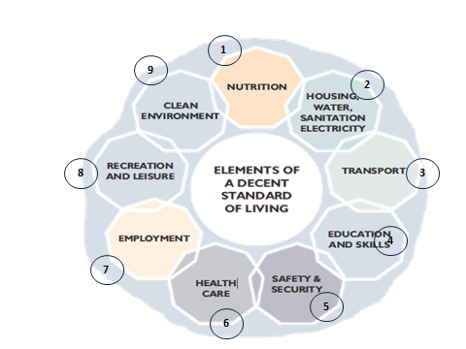
Background (2/2)
The Plan outlines goals to be achieved by 2030 in furtherance of the vision in the Constitution. The key objective of the Plan is to eliminate poverty and significantly reduce inequality. More broadly, the Plan is about ensuring that all South Africans attain a decent standard of living.

Slide 7
Challenges identified in diagnostic

Slide 8
Specific economy challenges identified (1/6)
Real per capita income is increasing but growth is unequal and too slow to solve poverty
Poverty and inequality are largely driven by high unemployment
Real per capita income has increased by 2% p.a. since 2001. At that rate, it was estimated (in 2010) that it would take South Africa about 35 years to reach Poland’s income level
The proportion of people below the poverty line has dropped from 53% in 1995 to 48% in 2008, but was still very high
Share of income for the poorest 40% has remained stable since 1994 – but comes from social grants, rather than income and remittances

Slide 9
Specific economy challenges identified(2/6)
Product markets are uncompetitive due to history of isolation and siege mentality of the apartheid economy.
This leads to high profit margins but low investment and innovation. It also stifles new firm entry. Uncompetitive labour markets keep new entrants out, with workers and capital sharing in the high profits.
This leads to low employment and skews the economy towards skills intensive, high productivity sectors.
Low savings mean that we are reliant on foreign capital inflows, which reinforce the oligopolistic nature of the economy.
Capital chases high returns and also leads to high dividend outflows.
Low skills profile and pattern of growth pushes up skills premiums, leading to labour market mismatch and high wage inequality.

Slide 10
Specific economy challenges identified(3/6)
Persistent unemployment is being driven by several factors
Growth in the labour force has outstripped employment creation
Many of these workers also lack skills in line with the needs of a modernising economy
Almost 60% of all unemployed have never worked
We have under-invested in infrastructure for over a generation
Development was being held back by too little investment in new infrastructure, and a failure to maintain existing infrastructure

Slide 11
Specific economy challenges identified(4/6)
SA will need much more effective institutions
Modernising infrastructure is complex, involving high costs while also helping shift towards a more labour-absorbing, knowledge-intensive economy
Big distances within SA and between SA and our trading partners add to costs, given weak African infrastructure networks
Thus SA needs a highly efficient logistics system, requiring more investment (including private money) and a political understanding of the need for super-efficiency
We need a level of coordination within government and amongst SOEs that we’ve not achieved to date
Given our low savings rate, capital is scarce – SA has to be careful what and how it builds

Slide 12
Specific economy challenges identified(5/6)
SA’s society and economy need a more sustainable growth path
SA’s economy is highly resource intensive and we use resources inefficiently
As a result we are starting to face some critical resource constraints (e.g. water)
We need to become less resource intensive – but we also need to balance this against job creation, economic growth and energy and food security
SA needs to simplify its policy, law and regulation processes and make them more effective
South Africa’s legal system, financial regulators and competition authorities score highly in global indices
However, on other fronts performance is poor
Policy is often seen to be ad hoc and discretion-based (thus giving rise to corruption)
Regulatory impact assessments are rare
Laws and policies are rarely costed or piloted, leading to high compliance costs
Institutional capacity to implement is seldom factored in

Slide 13
Specific economy challenges identified(6/6)
Reversing the effects of spatial apartheid will be a central challenge in the decades ahead
The poorest live either in former homelands or in cities far from where the jobs are
We fail to coordinate delivery of household infrastructure between provinces, municipalities and national government
We can either move people to where the jobs are or move the jobs to where the people are

Slide 14
Economy performance and forecast assumptions at time of writing plan (1/2)
Since 1994 the South African economy grew at 3.2% a year on average from 1994 to 2012.
GDP per capita growth averaged less than 1% per year between 1994 and 2002. It averaged 2% from 2003 to 2011.
Greater levels of trust between government and private sector.
Stable macroeconomic environment and positive capital flows

Slide 15
Economy performance and forecast assumptions at time of writing plan (2/2)
Assumption that commodity boom will continue based on belief that Chinese growth will continue and that major economies USA and Europe have overcome the financial crisis.
Government revenue and spending was still growing in real terms. Assumed enough fiscal space to implement proposed policies
Overall employment was still growing. Over the past 20 years employment (both formal and informal) has grown from 9.5 million in 1994 to 16 million at the end of 2015
Real growth of the economy (in 2010 constant prices), from a GDP of R1.6 trillion in 1994 to just over R3.0 trillion in 2015.

Slide 16
Opportunities for growth identified in plan
A thriving and growing region
A young population
A stable and robust democracy
Large and sophisticated private sector
Deep capital markets
Highly integrated and open economy
Significant comparative advantages in terms of resources, location, land area, natural beauty

Slide 17
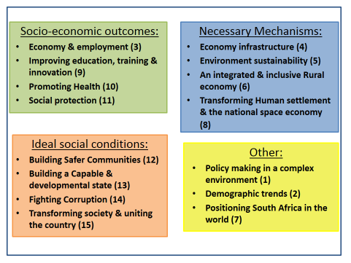
The plan in brief

Slide 18
Pillars of the NDP
Mobilisation of all South Africans around a programme to eliminate poverty and reduce inequality.
Active engagement of citizens in their own development.
Expansion of the economy through the promotion of exports, the creation of more jobs, and making growth inclusive.
Building of key capabilities.
Fostering of strong leadership throughout society and ensuring that leaders work together to solve problems.

Slide 19
Underlying approach of the NDP(1/2)
Deliver effective social wage to the poor
Especially better quality education and training
Grow labour intensive sectors such as mining, agriculture, agro-processing and tourism
Support advanced sectors to expand, especially into Africa
Manufacturing, business services, IT enabled services
Invest in infrastructure to support these three goals

Slide 20
Underlying approach of the NDP(2/2)
The NDP on macroeconomic policy
Sound fiscal and monetary policy a necessary condition for sustainable growth
Support for counter-cyclical fiscal policy
Support for floating exchange rate and flexible inflation targeting
A warning about the need for higher exports and about the negative effect that excessive periods of over-valuation have on the real sectors ability to export

Slide 21
Matters to note
While the broad thrust of the NDP has been widely accepted, the chapter on economy and employment has raised the most controversy and debate.
The previous Commission questioned whether the plan adequately addresses the question of economic transformation defined as:
Ownership of economic assets;
Access to economic opportunities (jobs, professions, management, business opportunities, capital, markets etc);
Income and wealth distribution, as well as access to public goods;
The other critique has centred around the labour market proposals leading to rejection of the plan and/or parts thereof by COSATU, and/or parts thereof

Slide 22
Issues for consideration/Conclusion
Going forward the commission need to consider
Unresolved matters which is not adequately addressed or not addressed in the plan
Do a review/ a critique of current implementation of the plan. Whether the MTSF deals with implementation adequately and how is the rest of society implementing the plan.
Commission need to have a focused deliberation on proposals which will aid an economic turnaround

Slide 23
Thank You

