Slide 1

Statistics, A conduit of Trust
Statistics a Conduit of Trust
Dr Pali Lehohla
Statistician-General
Pali Lehohla
Statistician-General

Slide 2
Contents
Statistical development
Governance
Key Achievements
Risks
Value add
Financial standing and impact
Impact on strategy

Slide 3
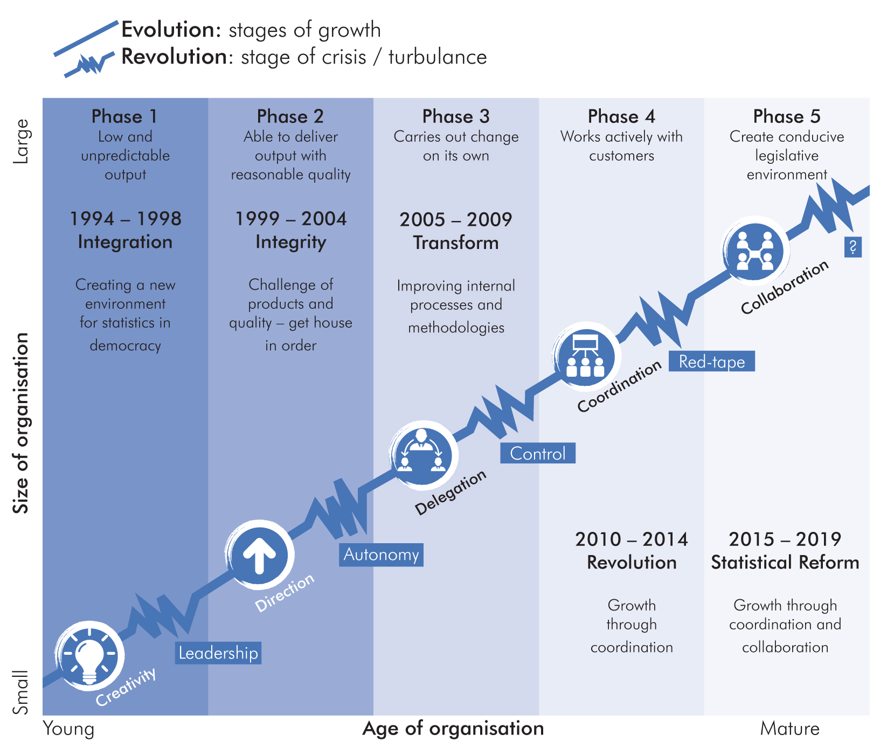
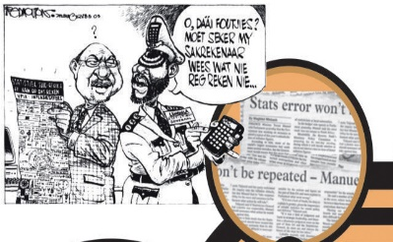

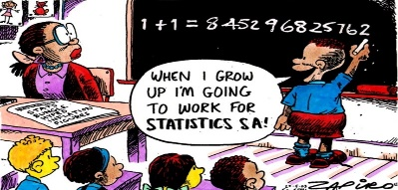
Statistical development over the past 22 years

Slide 4
2006/07
2007/08
Unqualified
Governance
and audit trail
(over the past 10 years)
Unqualified
2008/09
2009/10
Unqualified
Unqualified
2010/11
2011/12
Unqualified
Qualified
2012/13
2013/14
Unqualified
Clean
2014/15
2015/16
Clean
Clean

Slide 5

2015/16
2016/17
Citizen Satisfaction Survey (KZN) |  | Planning for National CSS
Community Survey | In Progress
GDP(E) | In progress
Integrative planning tools | In progress
Digital work place | Delivered in CSS | Delivered in CS
New Building | In progress
Legislative reform | In progress | In progress
Delivery
of key projects

Slide 6
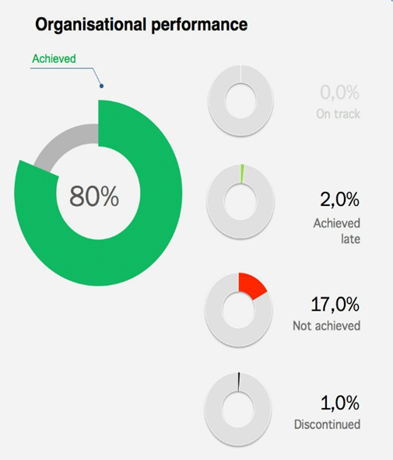
Delivery
2015/16
98%
spending
8,8
vacancy
rate
40,7%
female in
SMS posts
1,2%
staff with
disabilities

Slide 7
Targets not achieved as at 30 March 2016:
Partially achieved: 23 targets (2%)
High impact targets not achieved: 7 targets (<1%)
Targets
not achieved in 2015/16
Key reasons for not achieving targets:
Reprioritised resources towards community survey
ICT environment challenges

Slide 8
Trade and Industry statistics
Published monthly, quarterly, annual and periodic releases on 9 industries in the economy
Measuring changes in the
Economy
Price Stability
Published monthly CPI and PPIs
Government Financial Statistics
Published quarterly and annual statistics on municipalities, provincial & national government; capital expenditure; extra budgetary accounts; higher education institutions
Private Financial Statistics
Published quarterly and annual financial statistics on the private sector covering 9 industries in the economy
National Accounts Statistics
Published quarterly and annual GDP; flash GDP

Slide 9
Poverty and Inequality
Statistical information on living conditions, poverty and inequality
Measuring changes in Society
Labour Statistics
Published quarterly and annual statistics on labour market dynamics
Health and Vital Statistics
Published monthly, quarterly and annual statistics on vital events such as births, deaths, marriages and divorces, and international tourism
Social Statistics
Published annual statistics on housing, service delivery, education, crime, domestic tourism
Population Statistics
Published annual statistics on population dynamics including mid-year population estimates, migration, mortality rates

Slide 10


Methodology & Standards
Implemented new methodology for Community Survey for better efficiency
Informatics
Piloted digital data collection (CSS KZN) and Community Survey
Stakeholder focus
Dissemination focus on increased use; Municipalities and schools
Frames
Digital positioning of dwellings
SARS collaboration for up-to-date business register
Increasing
Trust in Statistics

Slide 11
Financial Management and Administration
4/5 unqualified audits in the past 5 years
Facilities management
Finalising New Building: Moved in 2016
Corporate Governance
Monitor strategic risks; Fraud prevention and Compliance
Human Resource Management and Administration
Vacancy rate: 9%; 59 staff members trained at Masters level (CRUISE); 234 Interns appointed
Management and accountability
Well established strategic, programme and project management
Capable
Organisation

Slide 12
African Statistical Development
International
Statistical development
AU: Technology and Financing strategies
CRVS support to African countries
Young African Statistician Conference
Indicators for Agenda 2063
Global Statistical Development
Indicators for SDGs
Won the bid to host UN World Data forum

Slide 13
Reputational Risk
Risks
In the system
Earned the status: Statistics, a conduit of trust
Sustaining and managing this reputation
Sustained delivery of quality products
Transparency in what we do
Financial Risk
Sustained delivery of quality products
Better efficiency through innovation
Funding emerging measurement priorities

Slide 14
IES
GDP(E)
Position of Stats SA
Funded from savings in CoE
Risk: cannot reweight & rebase CPI
CPI will become irrelevant over time
Adverse impact on: Inflation rate, Economic growth, poverty line and indicators

Slide 15
Statistical Coordination & partnerships
Growth through
Coordination
e.g.
Agriculture
Census (EC)
CSS
Administrative
records
Collection, processing, analysis, dissemination
National processing centre
Statistical information frame for the State
Risk: Incoherent policy decisions & outcomes

Slide 16
Spatial information frame
Statistical
Geography
Constitutional Judgement:
Addresses for all
Investment: Allocation of addresses
Outcome: Integrated spatial information frame
Value add: Integrated GIS for the state
Risk: Duplication of GIS effort
Impact: Incoherent Spatial planning & development

Slide 17
Statistical tools
Value add
through research and integration
e.g. SAM, GAF, ZIPf
Integrated policy research and analysis
Investment: Statistical expertise for increased knowledge and insight in planning, policy development and monitoring policy outcomes
Value add:
Identify inefficiencies in the system
Risk: Incoherent policy decisions & outcomes

Slide 18
Statistical geography
Statistical coordination mechanisms
Legislative
reform
Data revolution
State wide statistical service
Institutional arrangements and protocols

Slide 19
FINANCIAL
performance:
Growth trends
Community
Survey
New Building

Slide 20
FINANCIAL
Performance:
Expenditure per programme

Slide 21
FINANCIAL
performance:
Expenditure per economic classification

Slide 22
Legislative reform
Driving statistical reform; strengthening statistical coordination
Key
Strategic priorities
Policy, statistics and decision-making
Planning tools (SAM, GAF, SUT); integrated and spatial statistics
Economic statistics subsystem
GDP(Expenditure); Environmental economic statistics, trade statistics
Innovation and Modernisation programme
Using technology as a strategic enabler in the statistics value chain
Social statistics subsystem
Continuous population survey; CRVS; Planning for Census 2021
Data revolution
Hosting the World Data Forum; Use of alternative data sources
International statistical development
SDGs; African Agenda 2063

Slide 23

Invitation

Slide 24
THANK YOU

