Slide 1
Annual Report 2015 / 2016 Portfolio Committee on Public Service and Administration

Slide 2
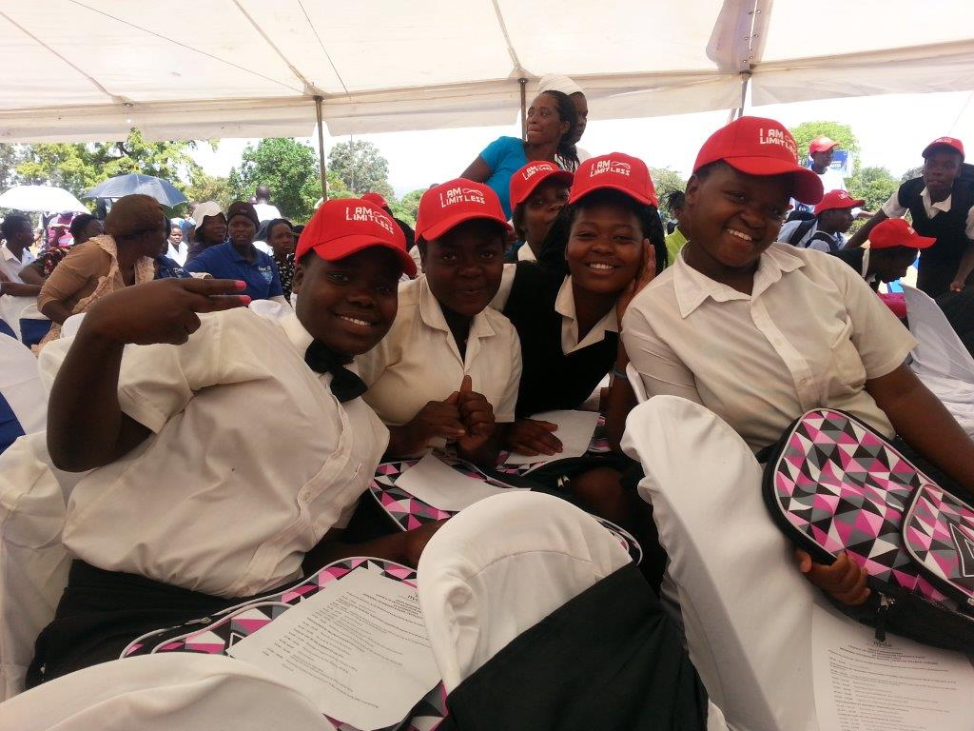
Agenda
Introduction
Performance against predetermined objectives
Financial information
Human Resources information
Legislative developments
Audit report

Slide 3
Introductory video

Slide 4
SITUATIONAL ANALYSIS
The NYDA has achieved its second clean audit opinion from the Auditor General of South Africa.
The NYDA has achieved its highest performance in history of 96% achievement of all Key Performance Indicators approved by Parliament.
The NYDA successfully concluded its organizational realignment and culture change programme resulting in a reduction of 92 positions and the overall monetary reduction of the salary bill by 25%.
Progress has been made in respect of legislative developments with the development of the Youth Employment Plan, Integrated Youth Development Strategy, National Youth Service Coordination Framework and amendment of NYDA Act.

Slide 5
PERFORMANCE AGAINST PREDETERMINED OBJECTIVES

Slide 6
KEY PROGRAMMATIC AREAS
Key Programmatic Area | Description
Economic Participation | To enhance the participation of young people in the economy through targeted and integrated programmes.
Education & Skills Development | To promote, facilitate and provide education & training opportunities to young people to enhance their socio-economic wellbeing.
Health & Wellbeing | To improve the health and wellbeing of young people to allow them to productively lead fulfilling socio-economic lives associated with a responsible and sustainable nation.
Research and Policy | To Develop a body of knowledge and best practice in the youth development sector to inform and influence policy development, planning and implementation.
Governance | Ensures that NYDA operations comply with applicable legislation and regulations governing a schedule 3A institution.

Slide 7
SUMMARY OF PERFORMANCE
 | 2010/11 | 2011/12 | 2012/13 | 2013/14 | 2014/15 | 2015/16
No of KPA’s | 8 | 7 | 10 | 5 | 5 | 5
No of KPI’s | 49 | 70 | 55 | 28 | 26 | 26
No. of KPI’s Achieved | 42 | 63 | 47 | 24 | 24 | 25
Performance Achievement | 85% | 90% | 85% | 86% | 93% | 96%

Slide 8
ECONOMIC PARTCIPATION
PROGRAMME AREA 1: ECONOMIC PARTICIPATION
STRATEGIC OBJECTIVE | KEY PERFORMANCE INDICATOR | 2015/2016 TARGET | YTD ACHIEVEMENT | REASON FOR VARIANCE
To enhance the participation of young people in the economy | Number of youth owned enterprises and youth receiving NYDA grant funding | 572 youth owned enterprises and youth | 673 youth owned enterprises and youth | The annual target was met and exceeded because there are disbursements that were carried over from the previous financial year.
 | Number of young aspiring and established entrepreneurs supported through NYDA Business Development Support services | 51 208 young aspiring and established entrepreneurs | 63 042 young aspiring and established entrepreneurs | The annual target was met and exceeded because of the partnership with Primestars on youth entrepreneurship awareness
 | Number of communities provided with community development facilitation support | 66 communities | 72 communities | The annual target was met and exceeded because of partnerships that were created though the Rural Development Request for Proposal
 | Number of jobs created and sustained through grant funding, cooperatives and business development services | 2,887 jobs created and sustained | 3672 jobs created and sustained | The annual target was met and exceeded because the jobs are linked to the disbursements that were carried over from the previous financial year and the rural development RFP’s

Slide 9
EDUCATION AND SKILLS DEVELOPMENT
PROGRAMME AREA 2: EDUCATION AND SKILLS
STRATEGIC OBJECTIVE | KEY PERFORMANCE INDICATOR | 2015/2016 TARGET | YTD ACHIEVEMENT | REASON FOR VARIANCE
To facilitate and implement education opportunities in order to improve the quality education attainment for the youth | Number of young people enrolled in the NYDA Matric (Grade 12) re-write programme | 3 675 young people | 4736 | The annual target was met and exceeded because there was a contingency pool to mediate for drop-outs
 | Number of youth supported through the scholarship programme (Solomon Mahlangu Scholarship Programme) | 400 youth | 406 | The annual target was met and exceeded because of the contingency to mediate for drops-outs or students finding other scholarships funders
 | Number of young people supported through individual and group career guidance interventions | 808 500 young people | 1 079 139 young people | The annual target was met and exceeded because of demand; great interest from young people/many requests from district DoBE’s
To facilitate and implement skills programmes | Number of young people participating in structured YouthBuild programmes | 2 000 young people | 2136 young people | The annual target was met and exceeded because the NSS EPWP partnership enabled NYS to exceed targets
 | Number of young people enrolled in NYS Volunteer programmes | 12 000 young people | 14 907 young people | The annual target was met and exceeded because there were unexpected requests for support from youth led NPOs which enabled NYS to exceed targets
 | Number of young people supported through life skills programme, the job preparedness and job placement programme | 55 650 young people supported through life skills programme, the job preparedness programme and job placement programme | 61 392 young people supported through life skills programme, the job preparedness programme and job placement programme | The annual target was met and exceeded because the programme is demand driven; high clients’ demand for the interventions

Slide 10
HEALTH AND WELLBEING
PROGRAMME AREA 3: HEALTH AND WELLBEING
STRATEGIC OBJECTIVE | KEY PERFORMANCE INDICATOR | 2015/2016 TARGET | YTD ACHIEVEMENT | REASON FOR VARIANCE
To facilitate access to health and well-being programmes | Number of young people accessing programmes and interventions designed to improve health and well-being | 5 775 young people | 6769 young people | The annual target was met and exceeded because there were partnerships which were created with several organisations
To provide health and well-being interventions to young people | Number of youth participating in campaigns and special projects implemented | 200 000 youth | 241 000 youth | The annual target was met and exceeded because of the partnership with SAB on underage drinking helped us to meet this target

Slide 11
RESEARCH AND POLICY
PROGRAMME AREA 5: POLICY AND RESEARCH
STRATEGIC OBJECTIVE | KEY PERFORMANCE INDICATOR | 2015/2016 TARGET | YTD ACHIEVEMENT | REASON FOR VARIANCE
To create and produce information and knowledge for better youth development planning and decision making | Number of new youth development research and evaluations products and policy reviews/developments produced by the NYDA | 44 youth development research and evaluations products and policy reviews/developments produced by the NYDA | 47 youth | The annual target was met and exceeded because quite a number of NYDA staff members submitted knowledge brief articles for publication
 | Develop National Youth Employment Plan 2030 | Final National Youth Employment Plan 2030 approved by the NYDA and submitted to the Presidency | Final National Youth Employment Plan 2030 approved by the NYDA and submitted to Presidency. | Annual target met and there is no variance
To provide access to information and create awareness on youth development programmes | Number of young people receiving information on youth development through NYDA access points | 1 200 000 young people | 1 592 203 young people | The annual target was met and exceeded because the number of partnerships with local municipalities has led to an increase in Municipal IDP roadshows and similar events that we get invited to. This in turn has led to us reaching more young people with our information provisions services.

Slide 12
RESEARCH AND POLICY continued…
To Lobby Key Stakeholders to support and implement youth development programmes | Number of organs of state and private sector companies lobbied resulting in the establishment of youth directorates and implementation of youth programmes | 50 organs of state and private sector companies lobbied resulting in the establishment of youth directorates and implementation of youth programmes | 59 organs of state and private sector companies lobbied resulting in the establishment of youth directorates and implementation of youth programmes | The annual target was met and exceeded because partnerships with Local Municipalities for Local Youth Offices has created a great platform for the NYDA to establish relationships and has also activated other organs of state to have interest in working with the NYDA
To create a platform for youth to participate and benefit from democratic processes | Number of youth participating in youth development related dialogue sessions | 10 800 young people | 11 570 young people | The annual target was met exceeded due to the partnerships with internal and external stakeholders
To mobilise and leverage financial resources from 3rd parties | Value of funds committed to support youth development programmes | R90 million | R107 896 883 | The annual target were met and exceeded because some funders were requested certain amounts but the scope of the project got extended and provided extra funding that increased value of funds committed.

Slide 13
GOVERNANCE
PROGRAMME AREA 6: GOVERNANCE
STRATEGIC OBJECTIVE | KEY PERFORMANCE INDICATOR | 2015/2016 TARGET | YTD ACHIEVEMENT | REASON FOR VARIANCE
To establish a credible, efficient and effective organisation | Efficient and effective IT systems to support youth development | Review NYDA IT Systems Architecture and Roadmap Implementation -Implementation of Phase 3 of the roadmap | - IT strategy roadmap submitted - Progress reports submitted - Phase 1 (roadmap) requirements specifications submitted - Phase 2 (roadmap) requirement specifications submitted - Close out report for phase 3 submitted and it covered: -Data governance -Implement IT service continuity management -Implement platform standardization -Implement future business requirements | Annual target not achieved because: Data governance – Information data security management policy approved by Board, but not yet fully operational. Implement IT service continuity management – Business continuity management strategy approved by Board, but not yet fully operational. Implement platform standardization – BYOD policy not provided Implement future business requirements – Mobile application is at 85% progress
Review of identified policies, guidelines and processes for increased efficiency | Implementation of Phase 2 roadmap | Phase 2 Roadmap developed and approved 6 policies, 1 plan, 6 frameworks, 1 strategy | Annual target met and there is no variance | Review of identified policies, guidelines and processes for increased efficiency

Slide 14
GOVERNANCE continued…
Number of staff who received training and capacity building to enhance staff performance | 367 employees trained | 368 employees trained | The annual target was met and exceeded due to the approved policies, Corporate Services had to train all the NYDA staff on the policies and selected staff on bursaries therefore some staff had to be trained more than once.
Number of information dissemination access points operationalised | 30 information dissemination access points operationalised | 34 information dissemination access points operationalised | The annual target was met and exceeded because great interest shown from Municipalities to assist the NYDA with ensuring that its mandate of mainstreaming youth development is implemented and adopted.
Compliance to policies and legislations for good governance | Dashboard reports as prepared by internal audit have acceptable levels of compliance to policies and legislation | Quarter 1 level of adherence is 71.4% (30) above the set target or acceptance rate of 70%. The 1st quarter target was met and exceeded by 1.4%. Quarter 2 level of adherence is 71.4 (30) above the set or acceptable rate of 70%. The 2nd quarter target has been achieved and exceeded by 1.42% Quarter 3 level of adherence is 71.4% (30) above the set target or acceptance rate of 70%. 3rd quarter target met and exceeded by 1.42% Quarter 4 level of adherence is 74% (31) above the set target or acceptance rate of 70%. The target has been achieved and exceeded by 4% | Annual target met

Slide 15
Financial information

Slide 16
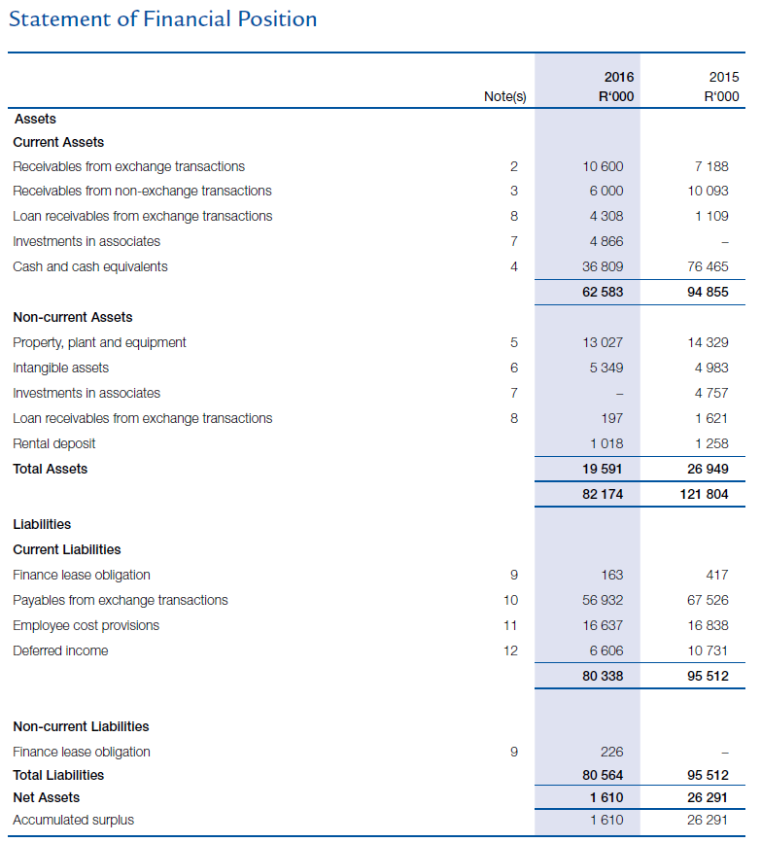
STATEMENT OF FINANCIAL POSITION

Slide 17
LIQUIDITY POSITION
Description | Amount (‘R)
Cash and cash equivalents | R36 809 000
Receivables | R25 774 000
Total cash and receivables | R62 583 000
External liabilities | R56 932 000
Employee liabilities | R6 534 000
Total liabilities | R63 466 000
Liquidity position | (R883 000)

Slide 18
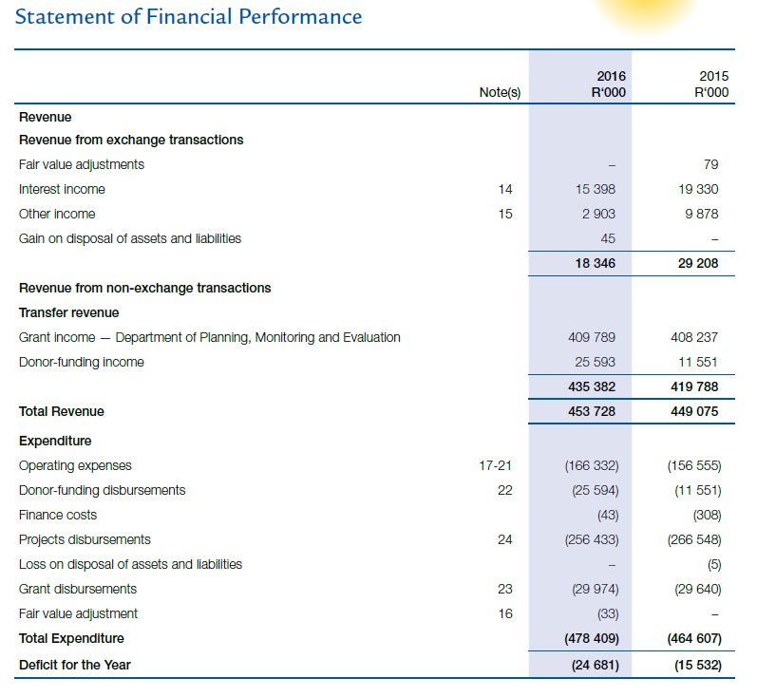
STATEMENT OF FINANCIAL PERFORMANCE

Slide 19
Adjusted deficit
Description | Amount (‘R)
Net deficit | (R24 681 000)
Depreciation & amortization (non-cash) | R5 738 000
Prior year retained earnings utilized to fund restructuring | R13 843 000
Loan repayments | R5 100 000
Adjusted deficit | -

Slide 20
PROJECT DISBURSEMENTS

Slide 21
Irregular and fruitless and wasteful expenditure
Description | 2011 / 2012 | 2012 / 2013 | 2013/ 2014 | 2014 / 2015 | 2015 / 2016
Irregular expenditure | R133 million | R62 million | R16 million | R580 000 | R74 000
Fruitless and wasteful | R1.6 million | R1.1 million | R456 000 | R266 000 | R3 000

Slide 22
HUMAN RESOURCES OVERVIEW

Slide 23
RESTRUCTURING PROCESS
The NYDA implemented a corporate realignment and culture change programme aimed at correcting the numerous legacy human resources challenges that the Agency faced including a high salary bill.
The restructuring programme was concluded in December 2015 and is one of the few successful restructuring programmes ever implemented in the public service.
The programme saw the number of positions reduce from 565 to 473, while the overall salary bill was reduced by 25% from R189 million, to R145 million. Overall, 91 staff members exited the entity through the restructuring programme.

Slide 24
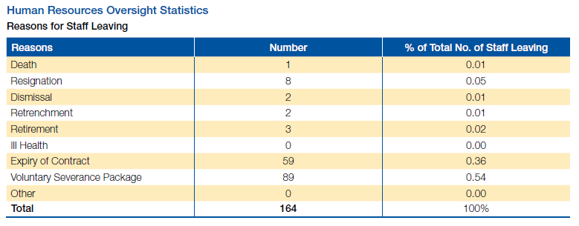
REASONS FOR STAFF LEAVING

Slide 25
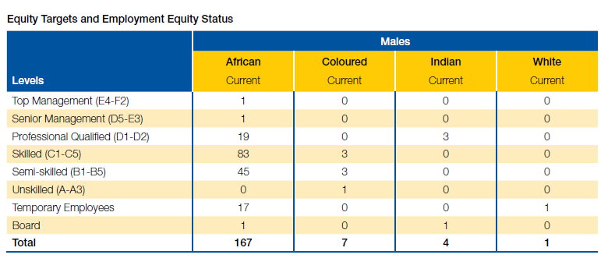
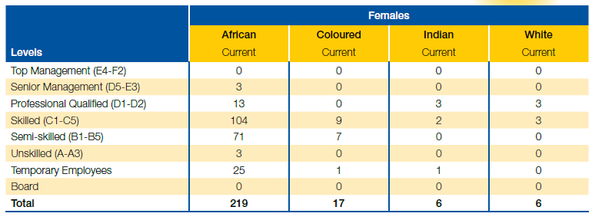
EMPLOYMENT EQUITY STATUS

Slide 26
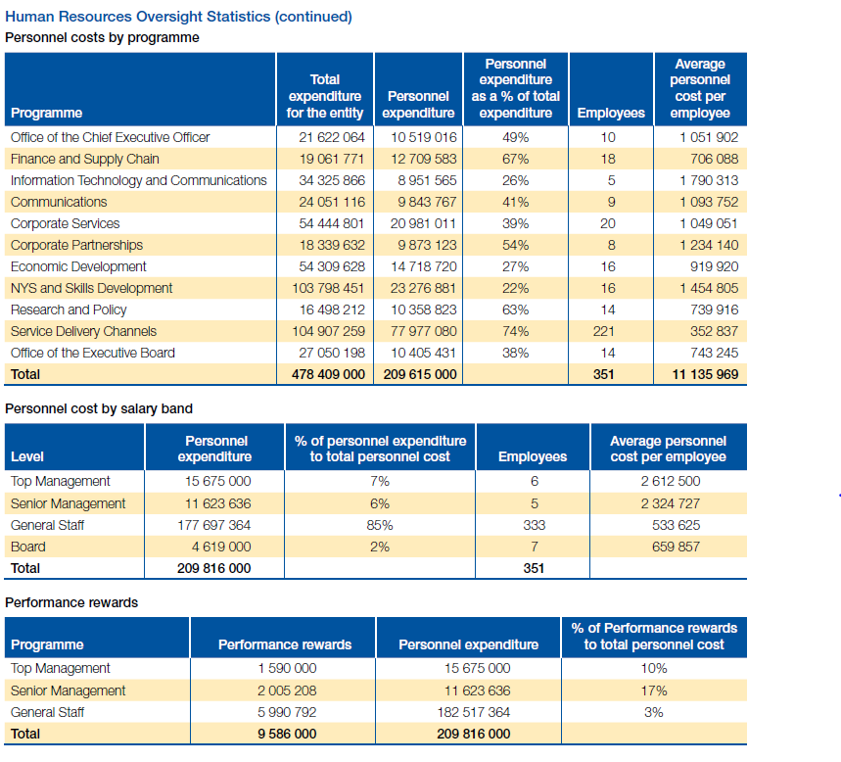
PERSONNEL COSTS

Slide 27
SALARY COSTS COMPARISON
 | 2011 / 2012 Audited (‘R) | 2012 / 2013 Audited (‘R) | 2013 / 2014 Audited (‘R) | 2014 / 2015 Audited (‘R) | 2015 / 2016 Budgeted (‘R)
Allocation | R374 722 | R385 843 | R392 710 | R408 237 | R409 789
Employee costs | R150 607 | R162 258 | R168 456 | R176 476 | R209 615
Percentage | 40% | 42% | 43% | 43% | 51%
 | Projected 2016 / 2017 | Projected 2017 / 2018
Allocation | R405 766 | R437 178
Employee costs | R145 000 | R153 700
Percentage | 35% | 35%

Slide 28
Legislative context

Slide 29
Legislative context
The NYDA Act amendment process is being undertaken by the Youth Desk in DPME. The following processes have been undertaken to date:
A technical committee has been appointed comprising of:
NYDA, DPME, Presidency, DPSA, COGTA, National Treasury
Four versions of the bill have been proposed and submitted to the State Law Advisors. In the proposed changes the function of research and policy is transferred from NYDA to Youth Desk in DPME. The gap identified is that the current Act does have sufficient youth development presence in provinces and therefore limits the reach of the NYDA.
Technical Committee is analyzing the differential provincial models that are being proposed for youth development. Section 18 of Bill is the area of focus for the provincial model.
Consultations with National Treasury in respect of the funding of the provincial models proposed.
Final proposed bill to be presented to the Deputy Minister in the next two weeks.
Roadmap from there onwards is the following:
Consultations with provinces
Presentation to Cabinet
Tabling in Parliament

Slide 30
Legislative context continued
The Integrated Youth Development Strategy and Youth Employment Plan have been crafted and submitted to the Department of Planning, Monitoring and Evaluation. The policy basis for both these documents is the National Youth Policy 2020.
The consultations with Provinces has already been concluded.
The documents must be presented to NEDLAC, Government Clusters and finally approved by Cabinet.
The National Youth Service Coordination Framework has been crafted and presented to the Deputy Minister. The forthcoming process is for the document to sit before Cabinet.

Slide 31
Audit report

Slide 32
AUDIT REPORT
Second successive clean audit report for the NYDA.
“Clean” represents:
Unqualified opinion on the annual financial statements.
Unqualified opinion on the annual performance report.
No material findings in terms of compliance with laws and regulations.
No material deficiencies in terms of the areas of governance, leadership and financial and performance management.

Slide 33
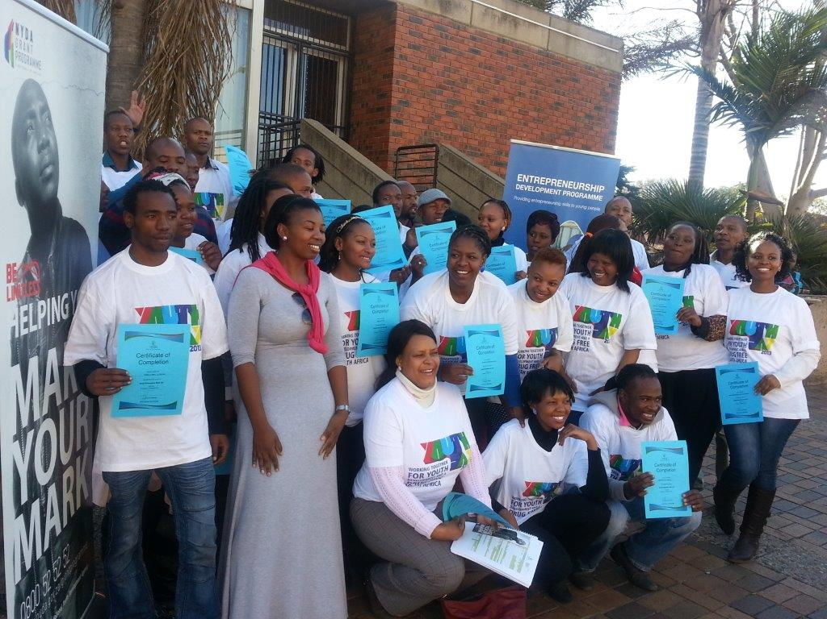
QUESTIONS

