Slide 1
Presentation to Portfolio Committee on Sport and Recreation
12 October 2016

Slide 2
Final Team Size – Olympic Games
Athletes – 137
Officials (Coaches/Managers) – 51
Medical Team – 14
GTM – 7
Number of Sports – 14

Slide 3
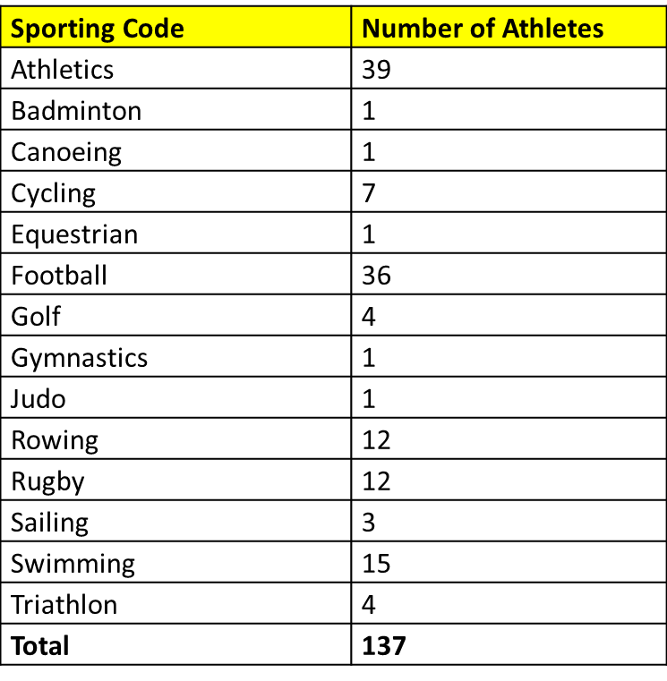
Number of athletes/sport code

Slide 4
Final Team Size – Paralympic Games
Athletes – 45
Officials (Coaches/Managers) – 22
Medical Team – 7
GTM – 7
Number of Sports – 10

Slide 5
Number of athletes/sport code
Sporting Code | Number of Athletes
Aquatics | 6
Archery | 1
Athletics | 19
Canoeing | 1
Cycling | 6
Equestrian | 1
Powerlifting | 1
Rowing | 6
Shooting | 1
Wheelchair tennis | 4

Slide 6
Preparation
Selection Policies
General Selection and Eligibility Criteria
Sport Specific Policies
Continental Qualification Slots
Publication of policies

Slide 7
Other Key policies
MOU between SASCOC and NFs
Spokespersons Policy
IOC Rules and Regulations
Prevention of the Manipulation of Competitions
  Betting in sport
  Taking bribes
Use of a Participant’s image for advertising purposes during the Rio 2016 Olympic Games
  IOC’s Rule 40 of the Olympic Charter

Slide 8
Preparation
One-on-one meetings with NFs
One-on-one meetings with athletes/coaches (OPEX)
Presentations to the General Assembly
Global camp
Medical Screening
Doping Control
Code Managers Meeting

Slide 9
Pre-Departure Holding Camp
Held from 21 – 23 July 2016
Finalise outstanding matters – admin, clothing, medical
Team send-off dinner – 22 July 2016
Team departure for Rio – staggered

Slide 10
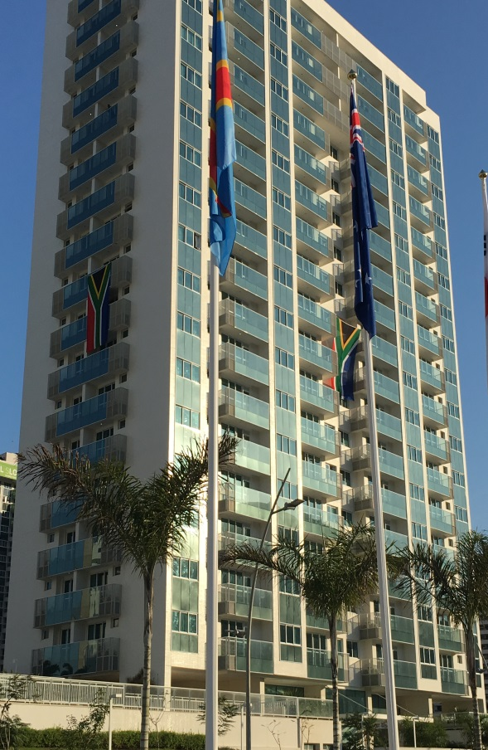
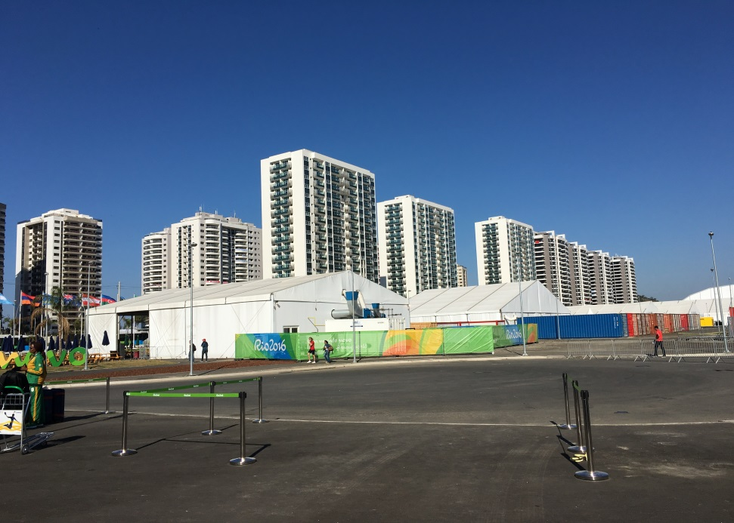
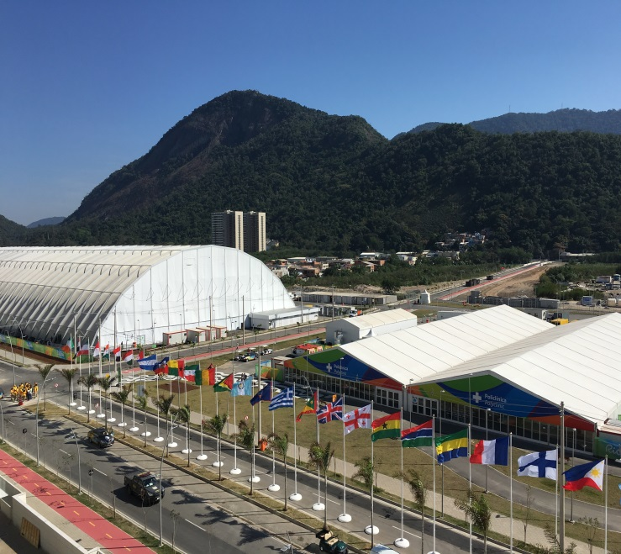
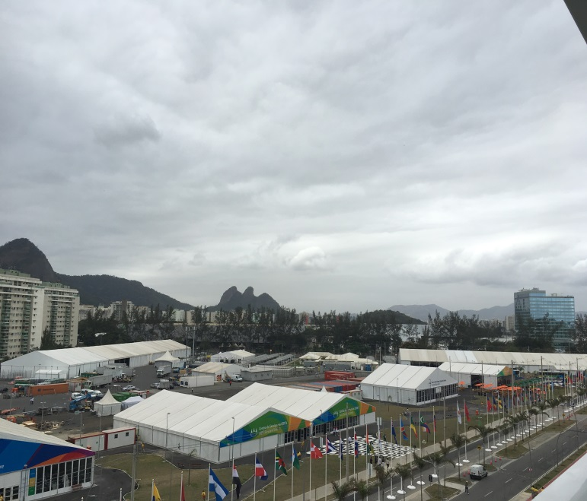
Games Village

Slide 11
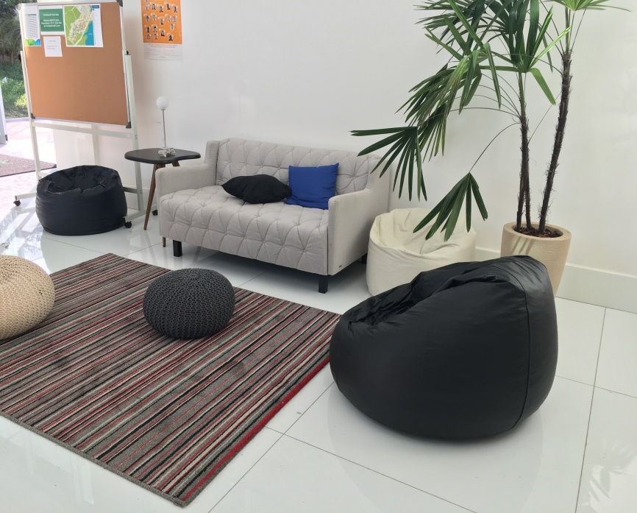
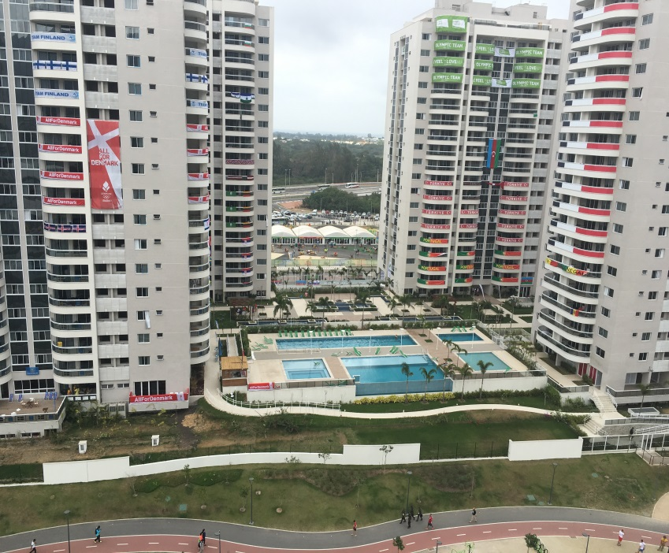
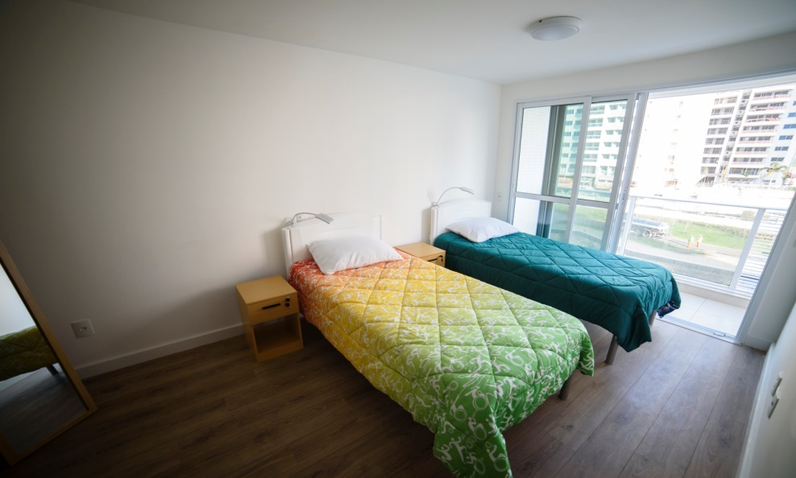
Games Village

Slide 12
Team SA Performances
Performance objective – 10 medals
Medals achieved – 10
  Athletics – 4
  Rowing – 1
  Swimming – 3
  Rugby 7’s – 1
  Triathlon – 1

Slide 13
Team SA Performances – Olympics

Slide 14
Team SA Performances – Paralympics
Sport | Athletes Name | Discipline | Medal
ATHLETICS | Hilton Langenhoven | T12 Long Jump | Gold
 | Charl du Toit | T37 100m and 400m | 2 x Gold
 | Reinhardt Hamman | F38 Javelin | Gold
 | Dyan Buis | T38 400M | Gold
SWIMMING | Kevin Paul | SB9 100m Breaststroke | Gold
CYCLING | Ernst van Dyk | H5 Road Race | Gold
ATHLETICS | Hilton Langenhoven | T12 200M | Silver
 | Ilse Hayes | T13 100m and 400m | 2 x Silver
 | Anrune Liebenberg | T47 400M | Silver
 | Ntando Mahlangu | T42 200m | Silver
 | Jonathan Ntutu | T12 100m | Silver
ATHLETICS | Fanie van der Merwe | T37 100m | Bronze
 | Zanele Situ | F54 Javelin | Bronze
 | Tyrone Pillay | F42 Shot Put | Bronze
 | Dyan Buis | F38 Long Jump | Bronze

Slide 15
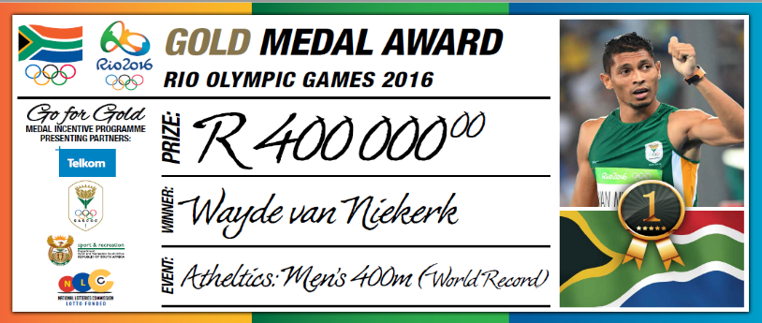
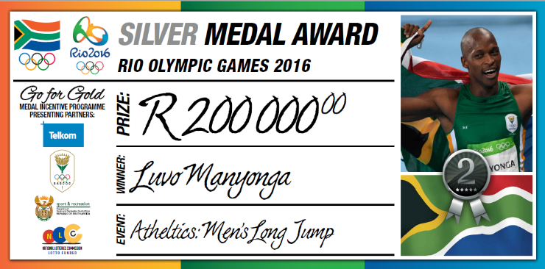
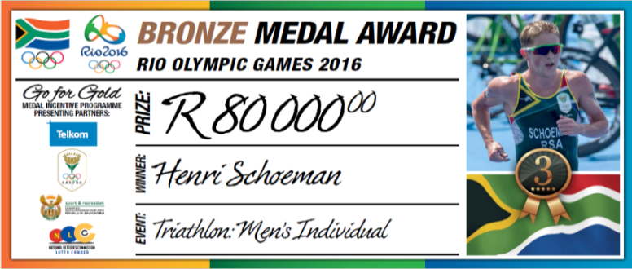
Medal Incentives from SASCOC
Athlete Coach
Gold: R500 000 R400 000 R100 000
Silver: R250 000 R200 000 R 50 000
Bronze: R100 000 R 80 000 R 20 000

Slide 16
Procurement of Team SA Attire
Clothing for the team was sponsored by 361°, a sports manufacturing company from China who has the contract to sponsor all our Team SA clothing until 2020
In the 4 year cycle, we deliver Team SA to 14 multi-coded Games around the World

Slide 17
Multi-coded Games
2017 World Games – Poland
2017 Commonwealth Youth Games- Bahamas
2018 Winter Olympic Games – Pyeongchang
2018 Winter Paralympic Games – Pyeongchang
2018 Commonwealth Games – Gold Coast, Australia
2018 African Youth Games – Algeria
2018 Youth Olympic Games – Buenos Aires, Argentina
2018 AUSC Region 5 U/20 Youth Games – Botswana
2019 African Games
2019 Inaugural ANOC World Beach Games, San Diego, USA
2020 Winter Youth Olympic Games – Lausanne, Switzerland
2020 Summer Olympic Games – Tokyo
2020 Summer Paralympic Games – Tokyo
2020 AUSC Region 5 U/20 Youth Games – Lesotho

Slide 18
Funding from SRSA
2016/2017 |  |  |  | SRSA
SRSA - Admin Grant for SASCOC |  |  |  | 1 734 600
Olympic Preparations |  |  |  | 2 605 700
Paralympic Preparation |  |  |  | 2 605 700
Olympic Games |  |  |  | 3 000 000
Paralympic Games |  |  |  | 2 000 000
Region V Games (Participation Fees) |  |  |  | 3 000 000
Coaching |  |  |  | 2 400 000
 |  |  |  | 17 346 000
Actual Spent up until 30 September 2016 |  |  |  | R
Olympic Games |  |  |  | 26 300 000
Paralympic Games |  |  |  | 15 800 000
Region V Games |  |  |  | 60 000
Coaching |  |  |  | 800 000
 |  |  |  | 42 960 000

Slide 19
SASCOC Mandate in the NSRP
Winning nation
Talent identification and development
Athlete and coach support programme
Domestic competitions
International competitions
Recognition system
Enabling environment
Clubs
Sports Councils (Confederations)
Athletes’ Commission
Coaches’ Commission
Administrators and Technical Officials’ Commission
Academy system

Slide 20
SASCOC Mandate in the NSRP
Transversal issues
Code of Conduct
Geo-political sports boundaries
Amateur vs Professional sport

Slide 21
Way forward
Debrief with the NFs – in process
Proposed selection policy for next quadrennial presented at AGM on 27 August 2016
Selection policy working group to meet end October/beginning Nov 2016
OPEX and National Academy Support to continue

Slide 22
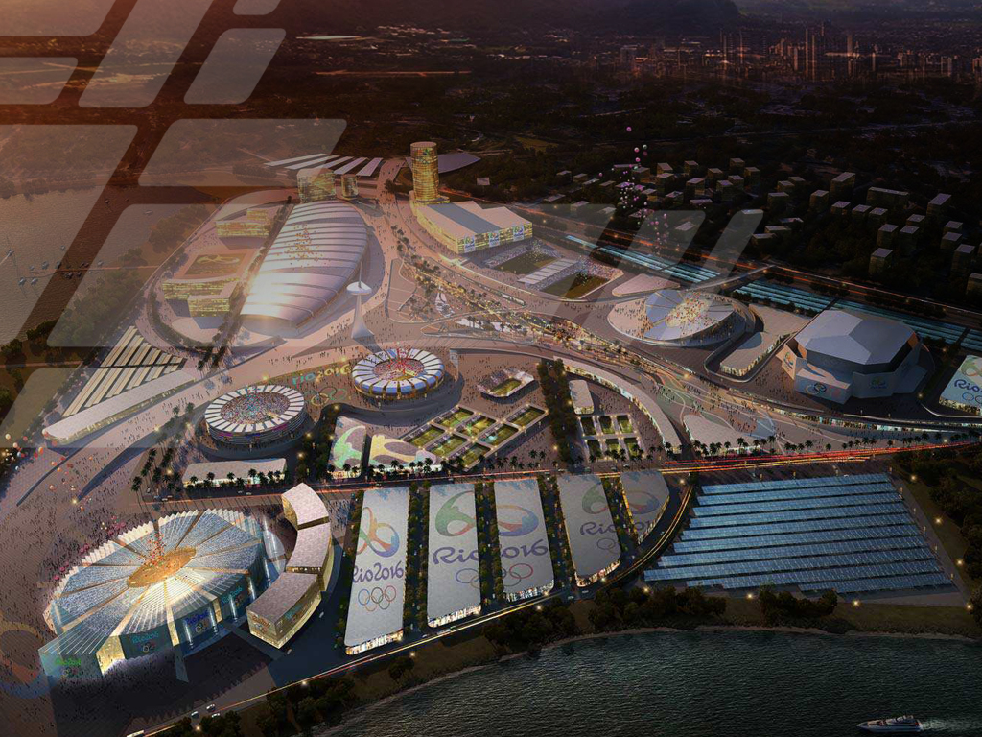
Thank you
Notes:
TITLE SLIDE

