Slide 1
PRESENTATION OF THE ANNUAL REPORT (2015/2016) TO THE PORTFOLIO COMMITTEE ON SOCIAL DEVELOPMENT 12 OCTOBER 2016

Slide 2
PURPOSE
To present the 2015/2016 Annual Report to the Portfolio Committee on Social Development for consideration.

Slide 3
NDA MANDATE
Vision
An active civil society for sustainable poverty eradication
NDA ACT
Mission
To contribute to poverty eradication and the elimination of its causes.
Primary Mandate
Values
Integrity with Dignity, Empowerment for Accountability, Responsibility with Transparency, Excellence and Partnering
Carrying out programmes and projects aimed at meeting development needs of the poor
Strengthening the institutional capacity of other civil society organisations involved in direct service provision to the poor communities
To contribute towards the eradication of poverty and its causes by granting funds to civil society organisations for the purpose of:-

Slide 4
NDA MANDATE
NDA ACT
Secondary Mandate
Debating development policy
Acting as conduit for funding from Government, foreign government and other national and international donors for development work carried-out by CSOs ”
Undertaking research and publication aimed at proving basis for development policy
Promote consultation, dialogue and sharing of development experience between the CSOs and relevance organs of state through

Slide 5
ORGANISATIONAL STRUCTURE

Slide 6
NDA STRATEGIC PROGRAMME AREAS
The programmes implemented in the year under review are briefly described as follows:
Programme 1: Resource Mobilisation for CSOs – focused on creating an enabling environment for CSOs, inclusive of cooperatives to grant funding.
Programme 2: Capacity Building for CSOs - focused on building capacities of CSOs and cooperatives across the country to improve the quality of service delivered and their sustainability.
Programme 3: Civil society mobilisation and advocacy – focused on mobilising, facilitating and re-organising available resources to support the CSO sector.
Programme 4: Research and Knowledge Management - focused on conducting research and evaluative studies that can be used to inform national policy debates and enhancement of CSOs programmes and projects.
Programme 5: Governance and Administration - focused on promoting and maintaining organisational excellence and sustainability through effective and efficient administration.

Slide 7
STRATEGIC OBJECTIVES
To mobilise R160m to enable CSOs/Cooperatives to implement development programmes by 2017/18.
To build the capacity of CSOs through training, mentorship and incubation to 13000 CSOs by 2017/18.
To promote active citizenry through consultation, dialogues and sharing of development experience between CSO’s and relevant organs of state in all 52 district municipalities by 2017/18.
To undertake 4 action research and policy publications that informs policy development and good practice by 2017/18.
To strengthen the internal capacity, systems and processes to improve operation efficiency and effectiveness by 2017/18.

Slide 8
PROGRAMME PERFORMANCE

Slide 9
PROGRAMME 1: RESOURCE MOBILISATION FOR CIVIL SOCIETY ORGANISATIONS
Strategic Objective: To mobilise R160m to enable CSOs/ Cooperatives to implement development programmes by 2017/18
No. | Performance indicator | Planned target 2015/2016 | Actual achievement 2015/2016 | Deviation from planned target
1. | Value of resources mobilised from alternative sources in cash and in kind for supporting CSOs and Cooperative programmes | R120m | R67,3m | (R52,7m)
2. | Number of civil society organisations (CSOs) and Cooperatives funded through grants | 150 | 154 | 4
3. | Number of households supported through Mikondzo programme | 1050 | 896 | (154)
4. | Number of beneficiaries from CSOs and Cooperative which have received grant funding | 1800 | 3 321 | 1 521

Slide 10
PROGRAMME 2: CAPACITY BUILDING FOR CIVIL SOCIETY ORGANISATIONS
Strategic Objective: To build the capacity of CSOs through training, mentorship and incubation to 13000 CSOs by 2017/18
No. | Performance indicator | Planned target 2015/2016 | Actual achievement 2015/2016 | Deviation from planned target
1. | Number of civil society organisations (CSOs) trained, mentored and incubated | 2 000 | 2 687 | 687
2. | Number of staff members of CSOs trained, mentored and incubated | 4 000 | 5 044 | 1 044
3. | Number of CSOs capacitated in Mikondzo | 600 | 2 002 | 1 402

Slide 11
PROGRAMME 3: CIVIL SOCIETY MOBILISATION AND ADVOCACY
Strategic Objective: To promote active citizenry through consultation, dialogues and sharing of development experience between CSO’s and relevant organs of state in all 52 district municipalities by 2017/18
No. | Performance indicator | Planned target 2015/2016 | Actual achievement 2015/2016 | Deviation from planned target
1. | Number of consultations with social partners on CSOs participation on national development programmes | 9 | 10 | 1
2. | Number of dialogues and information sharing with CSOs on promotion of the NDP | 10 | 9 | (1)

Slide 12
PROGRAMME 4: RESEARCH AND KNOWLEDGE MANAGEMENT
Strategic Objective: To undertake 4 action research and policy publications that informs policy development and good practice by 2017/18
No. | Performance indicator | Planned target 2015/2016 | Actual achievement 2015/2016 | Deviation from planned target
1. | Number of action research conducted | 2 | 1 | (1)
2. | Number of policy engagements with government and CSOs sector held | 3 | 3 | 0
3. | Number of publications on research and evaluation produced | 14 | 19 | 5

Slide 13
PROGRAMME 5: GOVERNANCE AND ADMINISTRATION
Strategic Objective: To strengthen the internal capacity, systems and processes to improve operation efficiency and effectiveness by 2017/18
No. | Performance indicator | Planned target 2015/2016 | Actual achievement 2015/2016 | Deviation from planned target
1. | Percent (%) achievement of organisational targets as set in the 2015/16 Annual Performance Plan | 80% | 73% | (7%)
2. | Percent (%) of positive rating on NDA brand recognition achieved | 70% | 95.5% | 25.5%
3. | Unqualified audit opinion | Unqualified audit opinion | Unqualified audit opinion | 0
4. | New NDA business plan and model finalised | New NDA business model | New NDA business model | 0

Slide 14
AUDITED FINANCIAL STATEMENTS FOR THE YEAR ENDED 31 MARCH 2016

Slide 15
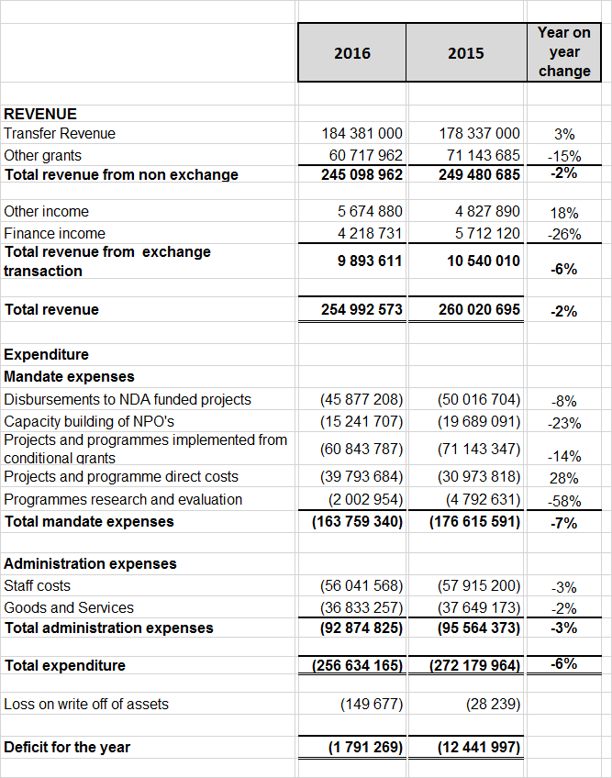
STATEMENT OF FINANCIAL PERFORMANCE FOR YEAR ENDED 31 MARCH 2016

Slide 16
NOTES TO STATEMENT OF FINANCIAL PERFORMANCE
INTRODUCTION
The NDA continues to operate under stringent financial constraints due to financial allocation increasing at 3% year on year while CPI averaged 6.5%. The resources are decreasing in real term.
Key organisational expenses such as rentals of offices and employment costs increased by 9% and 7% respectively in the previous financial year.
The public entity is reporting a deficit of R 1,7m in 2016 versus deficit of R12,4m in 2015.
The reported deficits are accounting deficits not cash deficits. These deficits are attributable to timing difference between the recognition of revenue and expenditure related to funded projects.

Slide 17
NOTES TO STATEMENT OF FINANCIAL PERFORMANCE
REVENUE
Revenue is made up of three sources of funding as indicated in the table below.
Revenue decreased by 6% year on year from R260 million in 2015 to R255 million in 2016
The main contributor to the reduction in revenue of R5 million is attributable to reduction in conditional grants received from other government departments.
 | 2016 | % | 2015 | %
Allocation | R184 381 000 | 72% | R178 337 000 | 68%
Conditional grants | R 60 717 962 | 24% | R 71 143 685 | 27%
Other Income | R 9 893 611 | 4% | R 10 540 010 | 5%
 | R254 992 573 | 100% | R260 020 695 | 100%

Slide 18
NOTES TO STATEMENT OF FINANCIAL PERFORMANCE
TOTAL EXPENDITURE
The total spend of R256.7 million represents a spending of 90% of total
annual budget.
R163.7 million from the total annual spend of R256.7 million was on mandate
64% of total annual budget was spent on mandate expenses and the
remaining 36% was on administration and support.
 | 2016 | % of total expenditure | 2015 | % of total expenditure
Mandate | R163 759 340 | 64% | R176 615 929 | 65%
Administration | R 92 874 825 | 36% | R 95 564 373 | 35%
Loss on disposal of assets | R 149 677 | 0% | R 282 390 | 0%
 | R256 783 842 | 100% | R272 462 692 | 100%

Slide 19
NOTES TO STATEMENT OF FINANCIAL PERFORMANCE
MANDATE EXPENDITURE ( R 163 million : 2016 R 176 million: 2015)
Disbursements decreased by 12.6% year on year due to shift in emphasis from grant funding to capacity building.
Capacity building decreased by 14.3% due to efficiency savings and reduction in funds mobilized from other government departments.
Reduction in research is due to planned studies that did not materialize in 2016.
Mandate Expenses | 2016 | 2015 | % CHANGE
Disbursement to projects | R66 248 183 | R75 789 533 | 12.6%
Programme costs | R39 793 684 | R30 973 818 | 20%
Capacity building | R55 714 519 | R65 059 950 | 14.3%
Research programme | R 2 002 954 | R 4 792 631 | 58%
 | R163 759 340 | R176 615 929 | 7.3%

Slide 20
NOTES TO STATEMENT OF FINANCIAL PERFORMANCE
ADMINISTRATION EXPENSES
The organisation continues to implement cost containment measures due to budgetary constraints.
Administration expenses were 6% below the previous year mainly due to savings from unfilled vacant posts and efficiency savings on the overheads.

Slide 21
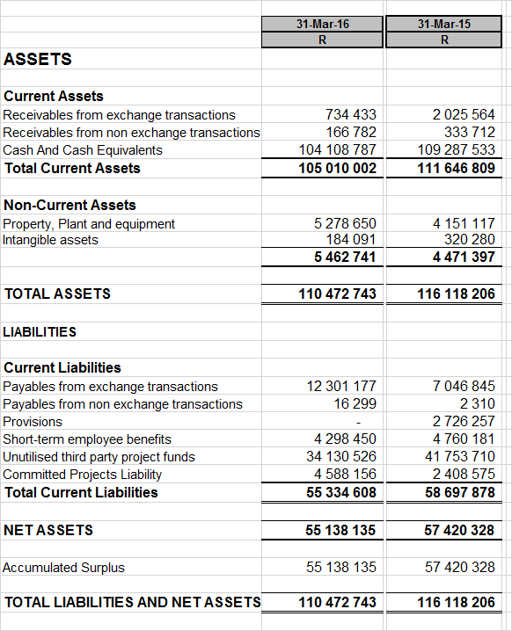
STATEMENT OF FINANCIAL POSITION AS AT 31 MARCH 2016

Slide 22
NOTES TO THE STATEMENT OF FINANCIAL POSITION (BALANCE SHEET)
KEY BALANCE SHEET PERFOMANCE
Current Assets
The entity has total current assets of R105 million in 2016, with cash balances making up 99% of total current assets
Cash balances are committed as follows:
 | Amounts
Third party funds | R34 130 526
Other current liabilities | R21 204 082
Project commitments | R32 256 490
Project evaluations committed | R 1 047 300
Savings | R15 470 388
 | R104 108 787

Slide 23
NOTES TO THE STATEMENT OF FINANCIAL POSITION (BALANCE SHEET)
KEY BALANCE SHEET PERFOMANCE
Current Assets liabilities
Total liabilities are made up as follows:
 | Amount | %
Unutilized third party funds | R34 130 526 | 62%
Payables (Funds due to creditors) | R12 317 476 | 22%
Employee benefits (leave provision & 13th cheque) | R 4 298 450 | 8%
Provision for project payment | R 4 588 156 | 8%
 | R55 334 608 | 100%

Slide 24
RECOMMENDATION
It is recommended that the Portfolio Committee considers the
Annual Report of NDA for the financial year 2015/2016

Slide 25
Thank you
THANK YOU

