Slide 1
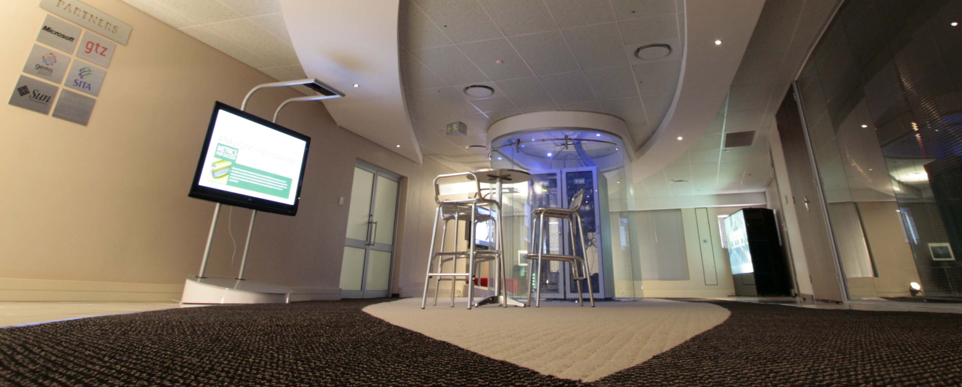
Presentation to Portfolio Committee
OCTOBER 2016
CENTRE FOR PUBLIC SERVICE INNOVATION
2015/16 ANNUAL REPORT
&
BUDGET VOTE REPORT

Slide 2
OVERVIEW
Executive Summary
Audit Outcome
Overview of the Organisation’s Performance in the 2015/16 Financial year
Achievements against Strategic Objectives
Expenditure outcome
Observations and findings from Portfolio Committee Report on Budget Vote

Slide 3
EXECUTIVE SUMMARY
This is the report on the organisation’s progress with regards to the achievement of the Annual Targets on the organisation’s 2015/2016 Annual Performance Plan (APP) as at 31 March 2016.
The report has been compiled by the Executive members of the CPSI based on the analysis of the progress from the work streams and endorsed by the Audit and Risk Committee.
The CPSI’s 2015/16 Annual Report has been audited by the Auditor General and tabled in Parliament on 01 September 2016

Slide 4
AUDIT OUTCOME
The CPSI has achieved a clean audit outcome in it’s first year of being audited as a stand-alone entity.
The Auditor General (AG) has found that the CPSI’s financial statements present fairly, in all material respects, the financial position of the organisation as at 31 March 2016 and its financial performance.
After assessing the reliability of the reported performance information to determine whether it was valid, accurate and complete the AG did not identify any material findings on the usefulness and reliability of the reported performance information.
The AG also considered internal control relevant to the audit of the financial statements, performance report and compliance with legislation and did not identify any significant deficiencies in internal control.

Slide 5
Overview of the Organisation’s Performance for 2015/16
Description | No of Annual Targets | Annual Targets Achieved | Annual Targets Not Achieved
Programme 1 Administration | 9 | 9 | 0
Programme 2 Public Sector Innovation | 17 | 17 | 0
Total | 26 | 26 | 0
During the 2015/16 Financial year the CPSI had 26 Targets, of which 9 were in Programme 1 and 17 in Programme 2.
As at the end of March 2016 100% of the targets, as per the 2015/16 Annual Performance Plan, were achieved.

Slide 6
ACHIEVEMENTS AGAINST STRATEGIC OBJECTIVES Programme 1: Administration
The CPSI successfully implemented effective, efficient and transparent financial management and internal control systems that comply with Sections 39 and 40 of the PFMA, read with Chapters 17 and 18 of the Treasury Regulations in terms of budget management and reporting responsibilities respectively.
Successfully established structures, systems and processes in order to comply with all the statutory requirements as set out in the Public Service Act, Public Service Regulations, Public Finance Management Act and all other applicable legislations.
Successfully implemented Transversal Systems i.e. Basic Accounting System (BAS), Logistical Information System (LOGIS) and Personnel Administration System (PERSAL). Identified CPSI officials were trained by National Treasury to operate these systems, and the necessary controls were introduced to ensure sound financial management.
During the year under review the CPSI operated in line with the approved Financial and HR Delegations. The 15 new policies were also developed and approved

Slide 7
ACHIEVEMENTS AGAINST STRATEGIC OBJECTIVES Programme 2: Public Sector Innovation
Piloting with service owners, demonstration to public servants, and facilitation of replications, in identified sectors, of innovative models and solutions that improve service delivery
Piloting:
The CPSI has partnered with SAPS and The Innovation Hub to find a solution that would improve SAPS response times to incidents of crime in informal settlements. The proposed solution, identified through a rigorous selection process, namely the Memeza Household and Community Alarm, was selected for piloting in Diepsloot, Gauteng.
Phase one of the pilot, funded by the CPSI was completed with very positive results which led to the installation of a further 560 units as part of the second phase of the pilot, with the support of private sector funders.
The solution already contributed to the reduction of crime in the pilot community and resulted in a number of arrests. Seven jobs were created in the community for, amongst others, installers and one SMME empowered. The further rollout of this project has the potential to generate additional job opportunities.
Additional funding has also been solicited from the Tirelo Bosha Grant Facility for the further expansion of the project to the Gauteng Social and Education sectors.
Due to its success in improving the response time by the police during criminal attacks on citizens, this project was recognised by the Premier of Gauteng in his 2016 State of the Province Address, for support towards its roll-out in other areas and sectors.
Notes:
The details of the targets not achieved will be discussed in more detail in the next slides.

Slide 8
ACHIEVEMENTS AGAINST STRATEGIC OBJECTIVES Programme 2: Public Sector Innovation Cont….
Piloting with service owners, demonstration to public servants, and facilitation of replications, in identified sectors, of innovative models and solutions that improve service delivery conti…..
Piloting:
An Energy Efficiency Model has been developed and phase 1 of the pilot project was initiated at Helen Joseph Hospital. The pilot project is focusing on retrofitting (replacement of equipment and consumables with energy saving alternatives) and behavioural changes to achieve at least a 25% reduction in energy consumption annually.
In partnership with the private sector, we were able to expand the E-learning project, a commitment from the 2014/15 APP in Mthatha in the Eastern Cape by 30 equipping 3 schools with computer laboratories to the value of about R1.0 million.
Notes:
The details of the targets not achieved will be discussed in more detail in the next slides.

Slide 9
ACHIEVEMENTS AGAINST STRATEGIC OBJECTIVES Programme 2: Public Sector Innovation Cont….
Piloting with service owners, demonstration to public servants, and facilitation of replications, in identified sectors, of innovative models and solutions that improve service delivery conti…..
Replication:
Two CPSI award winning projects were identified, facilitated and supported for replication.
The “Saving Blood Saving Lives solution” from Edendale Hospital which has saved the hospital over R 13.25 mil since 2013 through efficient use of blood and blood products to eliminate wastage is now being replicated at Bertha Gxowa Hospital.
Dietetics Project: Another award winning project which focuses on vulnerable children to reduce malnutrition and the number of malnourished children admitted to health institutions in Limpopo. The projected is being scaled-up in other Districts in Limpopo. In addition the National Department of Health has committed to donating equipment to this Project
.
Notes:
The details of the targets not achieved will be discussed in more detail in the next slides.

Slide 10
ACHIEVEMENTS AGAINST STRATEGIC OBJECTIVES Programme 2: Public Sector Innovation Cont….
Promoting a culture of innovation in the public sector to enhance service delivery through sustaining and managing knowledge programmes, products and platforms
13th CPSI Public Sector Innovation Awards: The objective of the programme is to celebrate successes of individuals and teams while importantly serving as a critical mechanism for identifying service delivery innovations for the replication programme.
93 entries were received to the 13th CPSI Public Sector Innovation Awards, project verification and adjudication was done. The Awards Ceremony was held in October where the Minister awarded 20 Public Sector Innovative Solutions.
8 CPSI Awards finalists innovation projects were entered into AAPAM Innovation Management Awards Programme. One of the entered projects, MomConnect, was awarded Silver.

Slide 11
ACHIEVEMENTS AGAINST STRATEGIC OBJECTIVES Programme 2: Public Sector Innovation Cont….
Promoting a culture of innovation in the public sector to enhance service delivery through sustaining and managing knowledge programmes, products and platforms conti…..
The UNPAN SADC Regional Workshop was hosted in June 2015 in Johannesburg and attended by representatives from 10 SADC countries, Malawi, the DRC, Seychelles, Lesotho, Tanzania, Namibia, Mozambique, Mauritius, Botswana and Swaziland. (Outcome 11: Create a better South Africa, a better Africa and a better world)
Sector Specific Innovation Workshops were held for Home Affairs, Correctional Services and Health to build internal innovation capacity and to entrench the culture of innovation in those sectors. The Multi-Media Innovation Centre was integral to these workshops as a tool to interrogate own challenges and processes.
A Foresight Exchange Forum for development in Africa was hosted in partnership with the UNDP in order to assist member states to integrate innovation in the implementation of their National long term plans. . (Outcome 11: Create a better South Africa, a better Africa and a better world)

Slide 12
ACHIEVEMENTS AGAINST STRATEGIC OBJECTIVES Programme 2: Public Sector Innovation Cont….
Promoting a culture of innovation in the public sector to enhance service delivery through sustaining and managing knowledge programmes, products and platforms conti…..
9th Public Sector Innovation Conference: Successfully hosted the 9th Public Sector Innovation Conference as a critical platform for cross-sectoral sharing of innovative ideas and solutions. Ministerial support from Ministers Pandor and Gigaba
Published 2 editions of Ideas that Work: The South African Public Sector Innovation Journal with innovation case studies and other insights for dissemination throughout the public sector.
333 visitors used the Multi-Media Innovation Centre to interrogate own challenges and processes to infuse innovation during the period under review. The visitors included amongst others, City of Tshwane, NSG, City of Johannesburg, Technology Innovation Agency, National Treasury, Civilian Secretariat of Police, The UNDP, SAHRC, SALGA.
As the Online Regional Centre (ORC) for SADC, CPSI uploaded 1497 documents to the UNPAN Portal. During the year under review CPSI was one of the top three performing ORCs in all categories.

Slide 13
ACHIEVEMENTS AGAINST STRATEGIC OBJECTIVES Programme 2: Public Sector Innovation Cont….
Development of case studies of selected service delivery innovations, for dissemination through the CPSI’s knowledge platforms and products :
Six Case studies on possible solutions for service delivery challenges were developed and disseminated through our Journal Ideas that Work: The South African Public Sector Innovation Journal
Notes:
The details of the targets not achieved will be discussed in more detail in the next slides.

Slide 14
Expenditure outcome

Slide 15
Expenditure outcome

Slide 16
Expenditure outcome conti…

Slide 17
Observations and findings from Portfolio Committee Report on Budget Vote
Intensify and enhance innovation towards contributing in building an efficient, effective and development-oriented public service
All CPSI projects and engagements are about efficient, effective and development-oriented public service.
The annual CPSI Innovation conference is used as platform for engagements where participants debate innovation for service delivery improvement.
Establishing innovation units
CPSI facilitate the establishment of Innovation structures in Correctional Services, Bertha Gxowa Hospital (Innovation Hub)and collaborated with Cities of Tshwane, Johannesburg and Cape Town.
Continued engagements with Hospital CEO to take innovation to the coal face.
Involvement with the UNDP to facilitate broader Innovation practices.

Slide 18
THANK YOU!

