Slide 1
ANNUAL REPORT OF THE DEPARTMENT OF BASIC EDUCATION 2015/16 FINANCIAL YEAR
Portfolio Committee on Basic Education
11 October 2016

Slide 2
PRESENTATION OUTLINE
PART A Overview of the Service Delivery Environment and Context
PART B Programme Performance
PART C Annual Financial Statements

Slide 3
PURPOSE
To report on the achievements of the Department of Basic Education for the 2015/16 financial year.
To report on the performance of the department against the planned targets of the pre-determined objectives in the Annual Performance Plan for the financial year 2015/16.
To report on the Department’s expenditure for the financial year 2015/16.

Slide 4
PART A
OVERVIEW OF THE SERVICE DELIVERY ENVIRONMENT AND
CONTEXT

Slide 5
OVERVIEW OF THE SERVICE DELIVERY ENVIRONMENT AND CONTEXT
Legislative Mandate
The National Education Policy Act (Act 27 of 1996) (NEPA) inscribes into law the policies for the national system of education, the legislative and monitoring responsibilities of the Minister of Education, as well as the formal relations between national and provincial authorities.
DBE’s Statutory role is to :
Formulate policy, norms and standards; and
monitor and evaluate policy implementation and impact.

Slide 6
PERFORMANCE DELIVERY ENVIRONMENT 2015/16
The delivery environment required a model of provision which requires:
the National Department of Basic Education to focus on technical leadership, oversight, and the setting and maintenance of norms; and standards in the basic education concurrent function.
There are factors that influence the plans and activities of the Department of Basic Education. Such plans are covered in the government mandates namely the National Development Plan (NDP), 2014-2019 Medium Term Strategic Framework (MTSF), Action Plan to 2019: Towards the Realisation of Schooling 2030.
Department’s Strategic Outcome Oriented goals per programme are linked to the six priority areas of the 2014 -2019 Medium Term Strategic Framework, and they exist under the following priorities .

Slide 7
PERFORMANCE DELIVERY ENVIRONMENT 2015/16
Improved quality of teaching and learning through development, supply and effective utilisation of teachers;
Improving assessment for learning to ensure quality and efficiency in academic achievement;
Expanded access to Early Childhood Development and improvement of the quality of Grade R, with support for pre-Grade R provision;
Strengthening accountability and improving management at the school, community and district levels; and
Partnerships for education reform and improved quality.

Slide 8
ACHIEVEMENTS OF 2015/16
The following are amongst the major achievements of the Department of Basic Education in the financial year 2015/16:
Conducted mentoring programme aimed at supporting Districts and Circuit Managers in identified districts, to improve management practices for effective support to schools.
10 216 newly qualified educators entered the schools in South Africa.
The 2015 National Senior Certificate (NSC) pass rate of 70.7% with 455 825 candidates passing the NSC examinations. This represents an increase of 51 952 candidate from those who passed in 2014.
Implemented the Early Grade Reading Assessment (EGRA) in 1000 schools nationally, in all official languages in Grade 1-3.
Implemented the National Curriculum Framework for Children from Birth to Four Years.

Slide 9
ACHIEVEMENTS OF 2015/16
Technical Vocational and Technical Occupational Streams were introduced in this financial year to cater for learners who have aptitude for technical and vocational education or who could benefit from applied knowledge beyond what is offered in the National Curriculum Statement.
Undertaken to strengthen ICT in education, including creating a content repository for free, offline, static and interactive digital educational resources to support teaching and learning.
School enrichment programmes gained traction with the Moot Court win in The Hague.
The National School Nutrition Programme (NSNP) reaching an average of 9 630 590 learners.

Slide 10
PART B
PROGRAMME PERFOMANCE

Slide 11
PROGRAMMES OF THE DBE
The ANNUAL PERFORMANCE PLAN summarises the priorities of the DBE as aligned to the Delivery Agreement of OUTCOME 1: Improving the quality of Basic Education and the Action Plan to 2019: Towards the Realisation of Schooling 2030.
The activities of the DBE have been structured into five programmes as elaborated in the Annual Performance Plan:
PROGRAMME 1: ADMINISTRATION
PROGRAMME 2: CURRICULUM POLICY, SUPPORT AND MONITORING
PROGRAMME 3: TEACHERS, EDUCATION HUMAN RESOURCES AND INSTITUTIONAL DEVELOPMENT
PROGRAMME 4: PLANNING, INFORMATION AND ASSESSMENT
PROGRAMME 5: EDUCATIONAL ENRICHMENT SERVICES

Slide 12
STATUS BAR FOR INDICATORS
Programme | No. of indicators per programme | Q4 Not achieved | Q4 Partially achieved | Q4 Fully achieved
One | 4 | 0 | 0 | 4
Two | 9 | 1 | 0 | 8
Three | 7 | 2 | 1 | 4
Four | 9 | 0 | 0 | 8 (1)*
Five | 2 | 0 | 0 | 2
Total distribution according to status | 31 | 3 | 1 | 27
Percentage distribution | 100% | 10.3% | 3.1% | 87.1%
* The ANA Indicator was not measured
Where 50% of the target has not been achieved, the status will be reflected as red.
Where 50% or more of the target has been realised, supported by credible evidence, the status will be reflected as amber.
Green will be reflected when the target has been fully achieved.

Slide 13
PROGRAMME 1: ADMINISTRATION
The purpose of Programme 1 is to provide strategic and administrative support services

Slide 14
PROGRAMME 1- OUTPUTS
PERFORMANCE INDICATORS | TARGET FOR 20115/16 AS PER APP | ACTUAL OUTPUT FOR 2015/16 | STATUS
Number of staff development opportunities offered to officials in the DBE | 15 | 24
Number of internships implemented in the Department | 65 | 66
Signed Financial Disclosure forms for all DBE SMS members submitted by due date every year. | All SMS members | All SMS members submitted by due date.
Signed Performance Agreements by all DBE SMS members submitted by due date every year. | All SMS submitted by due date | All SMS members submitted by due date.

Slide 15
PROGRAMME 1
Human Resource Management and Development
A total number of 22 training programmes training 214 officials were arranged by the Department in 2015/16 financial year.
The Department recruited 66 interns of whom 43 were funded from the Department’s vote, while the other 23 were funded through ETDP SETA.
The Department had 49 bursary holders of whom 18 were registered in the 2015/16 financial year and 31 were existing bursary holders.
Labour Relations
The Department reports to the Department of Public Service and Administration (DPSA) on the management of grievances and disputes as well as on issues regarding the bargaining council.
Grievances meetings In 2015/16, 164 grievance meetings (consultations) were held during the reporting period.
Disciplinary Hearings: 2 disciplinary hearings were held during the 2015/16 financial year. These hearings involved an SMS member as well as a Chief Education Specialist (CES).
Both cases were finalised within the 60-day prescribed period. A final written warning was imposed as a sanction in each case.

Slide 16
PROGRAMME 1 …cont.
Legal Services :
As at the end of the financial year, the Minister received forty four (44) correspondences. Matters raised range from concerns, to queries, dissatisfaction, and unfair treatment to enquiries.
The department processed the following:
twenty (20) litigations against the Department were handled,
two (2) of which have been finalized and eighteen (18) of these cases are still ongoing.
Legal opinions on three (3) matters were provided.
Legislative Services :
For the period under review, the Legislative Services has processed ten (10) pieces of legislation.
Media Liaison:
A total of seventy two (72) interviews were conducted during the year under review.
Publications: There are currently 18,024 followers on Facebook; 37,000 followers on Twitter and approximately 3,000 messages were received through the information e-mail system.

Slide 17
PROGRAMME 1 …cont.
Internal Audit:
The Internal Audit, Risk Management and Forensics Investigations Directorate completed two (2) approved audit reports and one (1) audit verification report as per DPME requirement.
International Relations:
The Department continues to have relations with other countries through Co-operation Agreements and Memoranda of Agreements.
Co-operation Agreement are with China: The Chinese Embassy and the Chinese Culture and International Education Exchange Centre (CCIEEC) donated a Planetarium which was launched by the Minister of Basic Education, Minister Angie Motshekga on 7 March 2016 at the Sci-Bono Discovery Centre.
Co-operation Agreement with Cuba: The Deputy Minister of Basic Education, Mr EM Surty, MP, accompanied the Deputy President Mr C Ramaphosa, on an official visit to Cuba on 21 to 26 October 2015.
Memorandum of Understanding with the French Embassy: The Department, together with the French Institute is co-ordinating the National Nutrition Week/So Chef as well as French language co-operation.

Slide 18
PROGRAMME 1 …cont.
Japan International Cooperation Agency Engagements (JICA): The Department welcomed a new volunteer from the Japan International Cooperation Agency (JICA) on 9 July 2015.
The Department hosted three (3) international delegations for the year under review, being Nigerian Delegation Study Tour, Norwegian and Swaziland Delegations.
Strategic Planning, Coordination and Research
Planning and Reporting :
The revised Strategic Plan and the Annual Performance Plan were tabled in Parliament on 11 March 2016.
The Department analysed and provided feedback on the draft Annual Performance Plans of all Provincial Education Departments and Public Entities (Umalusi and SACE) to ensure compliance with the planning frameworks and alignment to the sector plan in their quarterly reports.
The reports were compiled, consolidated, edited and submitted to the Department of Planning, Monitoring and Evaluation (DPME) and National Treasury, Parliament. Cabinet and other Government Departments on their outcomes.

Slide 19
PROGRAMME 1 …cont.
DBE MPAT scores were received after end of financial year according to its cycle. The MPAT scoring above level two has improved from 54% in 2014/15 to 66 % in 2015/16.
This means that the Department is compliant with the basic legal/regulatory requirements from level 2 upwards.
Co-ordination and Secretarial Support
During the 2015/16 financial year, a total number of sixty-two (62) meetings were held.
Research Monitoring and Evaluation:
Three evaluations were conducted namely; Curriculum and Assessments Statements (CAPS) implementation evaluation, Funza Lushaka Implementation Evaluation and National School Nutrition Programme (NSNP) implementation evaluation.
The monitoring of the sector was done through the finalisation of a report on General Household Survey (GHS) focusing on schooling.
The Department has co-ordinated the District Managers Capacity Building Workshops that were facilitated by the University of Stellenbosch, with financial support from UNICEF in February and March 2016.

Slide 20
PROGRAMME 2: CURRICULUM POLICY, SUPPORT AND MONITORING
The purpose of Programme 2 is to develop curriculum and assessment policy and support, monitor and evaluate curriculum implementation

Slide 21
PROGRAMME 2- OUTPUTS
PERFORMANCE INDICATORS | TARGET FOR 2015/16 AS PER APP | ACTUAL OUTPUT FOR 2015/16 | DEVIATION FROM PLANNED TARGET | Status
Percentage of qualifying public schools with workbooks for Grade R learners. | 97-100% | 100% 16 291 schools received/ 16291 schools ordered | _
Percentage of Grade R practitioners with NQF level 6. | 20% | 19% 2 576 NQF L6 Practitioners / 13 664 Gr R Practitioner | -1%
Percentage of Grade R practitioners with NQF level 4 and 5. | 50% | 79% 10 739 NQF L4&5 practitioners/ 13 664 total Grade R practitioners | +29%
Percentage of public schools with Home language workbooks for learners in Grade 1-6. | 97-100% | 100%: 17930 schools received / 17930 schools ordered | _

Slide 22
PROGRAMME 2 - OUTPUTS
PERFORMANCE INDICATORS | TARGET FOR 2015/16 AS PER APP | ACTUAL OUTPUT FOR 2015/16 | DEVIATION FROM PLANNED TARGET | Status
Percentage of public schools with Mathematics workbooks from learners in Grade 1-9 | 97-100% | 100% 23 680 books received / 23 680 books ordered | _
Number of learners completing the Kha Ri Gude programme. | 430 441 | 298 317 | -132 124
Percentage of learners who obtain a National Senior Certificate. | 76% | 72.1% 465 956 learners passed/ 646 020 learners wrote | -3.9%
Number of teachers trained in multi-grade teaching. | 500 | 1108 | +608
Percentage of public schools with Mathematics workbooks from learners in Grade 1-9 | 97-100% | 100% 23 680 books received/ 23 680 books ordered | _

Slide 23
PROGRAMME 2
Reading Promotion and Library Information Services
The Sector Plan for Reading Promotion and Library and Information Services was launched in May 2015 and the 1000 Schools Library Project in July 2015.
The Early Grade Reading Assessment (EGRA) was implemented successful in 1000 schools nationally in all the official languages in Grades 1 to 3.
Multi-Grade and Rural Education
The implementation of the toolkit started with the training of both subject advisors and teachers.
Rural Education: The Minister has approved the establishment of a Research Team that will focus on the development of the Rural Education Policy.
A Concept Document has been developed, which outlines how to develop the policy, as well as the roles and responsibilities of all the role players.
Incremental Introduction of African Languages (IIAL): In 2015, the Sector implemented the Incremental Introduction of African Languages (IIAL) pilot in Grade 1 classes in 264 schools across all nine provinces.

Slide 24
PROGRAMME 2 …cont.
Training was conducted for 156 officials from all 9 provinces, on Curriculum Differentiation and Policy on Screening, identification, Assessment and Support (SIAIS).
198 intermediate phase and Grade 9 and 10 teachers and Deaf teaching assistants were trained in CAPS for SASL.
A policy framework and learning programmes to support learners with severe and profound intellectual disability was developed and consulted on at the Ministerial round table in November 2015.
Early Childhood Development (ECD)
A total of 150 phase 1 centres were provided with EDC Lego Resources to support curriculum implementation.
Implementation of NCF for Children from Birth to 4 years is underway and the Department has developed a monitoring tool which was tested in 2 ECD sites in Limpopo.
A total of 100 000 copies of the NCF for children was printed and distributed to registered ECD sites.
A total of 5 898 practitioners at level 4,5 and 6 were trained.
A total of 3 558 job opportunities were created in 2015/16.

Slide 25
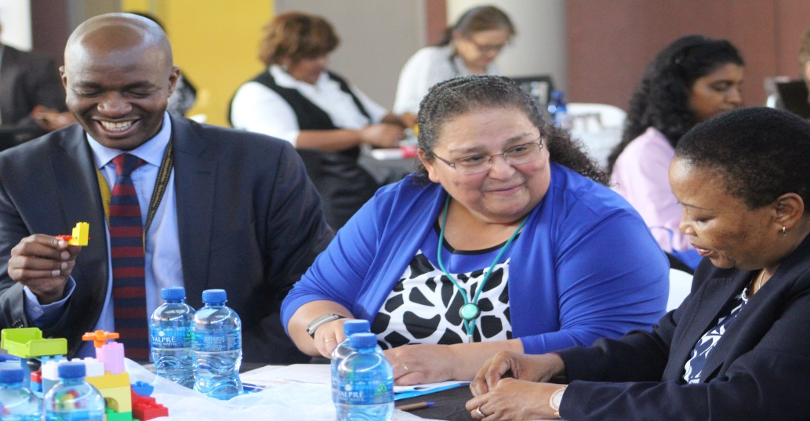
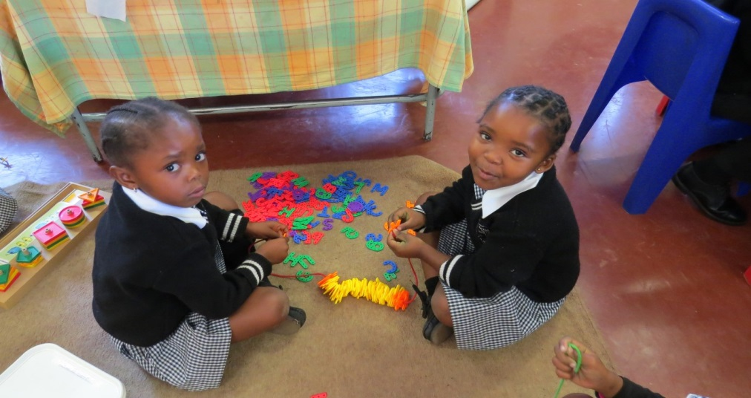
ECD LEGO RESOURCE SUPPORT

Slide 26
PROGRAMME 2 …cont.
LTSM
The Grade R workbooks, Grades 1-6 Home Languages, Grades 1-6 English First Additional Language, Grades 1-3 Life Skills and Grades 1-9 Mathematics workbooks were printed and delivered to all public schools.
The Department has completed delivery of Volume 2 of Grades 1 to 9 workbooks, delivery is at 100%.
In addition to these, the printing and delivery of Grades R-9 volume one (1) Braille workbooks to twenty two (22) Special Schools has also been completed.
Maths Science and Technology (MST)
The following goods and services were procured and delivered to improve Maths, Science and Technology during the period:
A total of 595 schools were supplied with information, communication and Technology (ICT) resources such as laptops, tablets and software for Maths, Science and Technology to support curriculum and teaching methodology at FET level.

Slide 27
PROGRAMME 2 …cont.
A total of 802 workshops were supplied with equipment, tools and machinery for Technology subjects to support curriculum and practical teaching methodology at FET level.
A total of 136 Physical Science laboratories in Mpumalanga were supplied with consumables and subject-related apparatus to support curriculum and practical teaching methodology at FET level.
A total of 17,824 learners were funded to participate in Maths and Science Olympiads including coaching and revision camps to improve learner preparedness for the NSC examinations.
CAPS for Technical Schools
A Guideline for Technical Schools was developed and distributed to schools to strengthen implementation of the CAPS for Technical subjects in Grade 10 in 2016.

Slide 28
PROGRAMME 2 … cont.
Implementation of the CAPS for Technical Schools in 2016 at Grade 10 was achieved and the following activities were put in place during the 2015/16 period:
Delivering 3,611 units of CAPS documents to 385 schools at all provinces;
A total of 228 and 203 subject advisors and 563 and 467 teachers were trained on Technical Maths and Science respectively; and
Training of 1660 teachers and subject advisors on technical specialisation in 5 different skills training centres was offered.
Signed an MoU with TEACH SA to deploy Maths and Science Teachers in rural areas.
Focus Schools
The establishment of Focus Schools augurs well for the sector in its quest to introduce the Three Stream Model of Basic Education.
The Three Stream Model calls for the introduction of educational programmes that enforce and encourage the acquisition of skills in selected subjects. The Focus Schools are all geared towards the application of skills.
The call to publish the Norms and Standards was signed by the Minister on 02 April 2016 and will be published as a Gazette for public comments.

Slide 29
PROGRAMME 2 …cont.
Information Communication Technology (ICT)
Digital Content
The Department has set up free offline static and interactive digital educational resources including interactive workbooks, videos lessons, worksheets and state-owned core e-textbooks.
Developed 14 Interactive DBE workbooks for Literacy Grade R, Mathematics Grade 1 – 3 and English FAL Grade 1, 2 and 4.
The Department developed digital textbooks (e-textbooks) for Grade 10 Technical Mathematics and Science Learner Book and Teacher Guide in English and Afrikaans and distributed 1 575 offline digital content packs.
Developed, printed and delivered 40,000 Grade 10 Technical Mathematics textbooks to all schools taking the subject.
The Department started an awareness campaign to advocate dedicated educational channel broadcasting.
Connectivity
884 Schools, with own TV sets, across the country were provided with OVHD Decoders and Dishes to access the Educational TV channel broadcasting on OVHD platform, channel 201.

Slide 30
PROGRAMME 2 …cont.
A total of 1544 schools were provided with connectivity through the Universal Service and Access Obligation (USAO), hence benefiting about 1, 0006, 051 learners nationally.
The schools are provided through this USAO with connectivity, devices digital content and teacher training are vetted and declared to be e-ready before provisioning.
Operation Phakisa
The initial phase of the Operation Phakisa started with a mini lab process called the Soft Start on the 22 June -3 July 2015.
A full lab on ICT in Education was conducted from 6 September to 2 October 2015.
The lab identified areas of challenge which were tackled in 5 work streams namely:
Digital Content and Curriculum;
Teacher Professional development;
e-Administration;
Provisioning of ICT equipment and technical support; and
Connectivity .

Slide 31
PROGRAMME 2
The work done was subjected to interrogation by the “Lions’ Den” which was the validation session where the plans were subjected to interrogation and critique by experts from government and industry.
The lab was concluded with a launch by the President on 2 October 2015.
Kha Ri Gude
The Minister attended eight (8) road shows that were conducted in all nine provinces. The advocacy led to the recruitment of 41 642 volunteers.
The Campaign registered 329, 641 learners for the 2015 Kha Ri Gude Campaign.
The LTSM in the form of workbooks, LAPs and stationery, as well as the administrative documents (attendance registers) and reporting formats were distributed to learners and volunteers at the learning sites across provinces.
Kha Ri Gude classes took place from 1 September 2015 to 29 February 2016 for sighted learners and from 1 September to 30 April 2015 for the disability sector.
Of the learners that registered, 298 317 completed the classes and submitted their LAPs.
To date 4 217 373 of the 4.7 million learners have completed the programme

Slide 32
NUMBER OF LEARNERS WHO BENEFITTED FROM KHA RI GUDE PROGRAMME
Learners |  | 2008 | 2009 | 2010 | 2011 | 2012 | 2013 | 2014 | 2015 | TOTAL
Disability | Blind | 9 535 | 230 | 590 | 804 | 1 159 | 1 945 | 2 032 | 2 668 | 18 963
 | Deaf | 3 033 | 805 | 894 | 880 | 1 561 | 1 494 | 1 082 | 802 | 10 551
Non-disabled |  | 369 294 | 632 968 | 609 797 | 637 765 | 597 444 | 562 925 | 432 908 | 350 381 | 4 193 482
Total |  | 381 862 | 634 003 | 611 281 | 639 449 | 600 164 | 566 364 | 436 022 | 353 851 | 4 222 996

Slide 33
NUMBER OF JOB OPPORTUNITIES CREATED
Volunteers |  | 2008 | 2009 | 2010 | 2011 | 2012 | 2013 | 2014 | 2015 | TOTAL
Disability | Blind | 90 | 234 | 236 | 365 | 570 | 818 | 948 | 1 227 | 4488
 | Deaf | 48 | 156 | 165 | 225 | 318 | 418 | 342 | 305 | 1977
Non-disabled |  | 35 045 | 39 113 | 37 860 | 40 176 | 40 376 | 42 013 | 44 329 | 40 943 | 319 855
Total |  | 35 183 | 39 503 | 38 261 | 40 766 | 41 264 | 43 249 | 45 619 | 42 475 | 326 320

Slide 34
JOB OPPORTUNITIES FOR FEMALES
Gender | 2008 | 2009 | 2010 | 2011 | 2012 | 2013 | 2014 | 2015 | TOTAL
Female | 29 063 | 34 202 | 33 599 | 35 718 | 35 976 | 37 424 | 38 740 | 35 646 | 280 368
Total % | 83 | 87 | 88 | 88 | 87 | 87 | 93 | 84 | 87

Slide 35
JOB OPPORTUNITIES FOR YOUTH
Youth Volunteer | 2008 | 2009 | 2010 | 2011 | 2012 | 2013 | 2014 | 2015 | TOTAL
Total | 21 599 | 22 562 | 22 048 | 23 976 | 24 667 | 25 423 | 28 984 | 26 630 | 195 889

Slide 36
STATISTICS FOR GRADUATIONS
Province | Number of Graduates | Venue | Date | Attended by
Mumalanga | 620 | Witbank, Ackerville Sports Ground | 23 June 2015 | Minister
KwaZulu- Natal | 1263 | Nongoma | 26 June 2015 | Minister
Free State | 700 | Phutgaditjaba Community Centre | 28 June 2015 | Minister
Limpopo | 1000 | Giyani | 29 June 2015 | Minister
Gauteng | 962 | Kliptown, JHB | 30 June 2015 | Minister
Eastern Cape | 970 | Mthatha, 2010 Stadium | 1 July 2015 | Minister
North-West | 698 | Lerome Village | 3 July 2015 | Deputy Minister
Northern Cape | 1176 | Kimberley Community Centre | 8 July 2015 | Minister
Limpopo | 1500 | Tubatse, Burgersfort | 1 August 2015 | Minister
KwaZulu- Natal | 930 | Community Centre | 2 August 2015 | Minister
KwaZulu- Natal | 200 | Durban City Hall | 15 June 2016 | Deputy Minister
KwaZulu- Natal | 600 | Ulundi, Old Legislature | 16 June 2016 | DBE Officials
North-West | 836 | Mokgalwane Community Hall | 28 June 2016 | DBE Officials
North-West | 900 | Taung | 28 July 2016 | Deputy Minister
North-West | 700 | Orkney | 29 July 2016 | DBE Officials

Slide 37
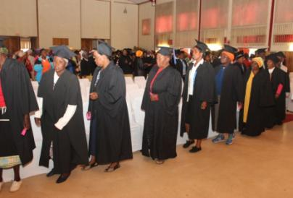
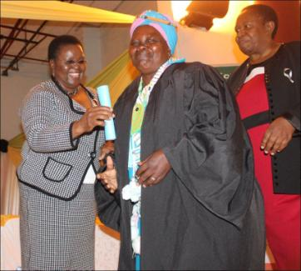
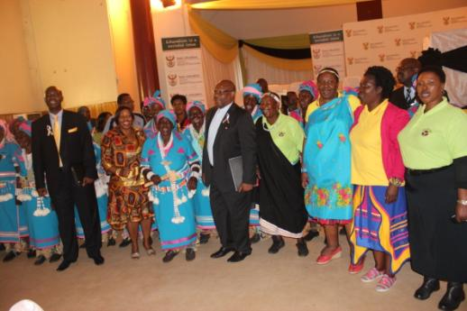
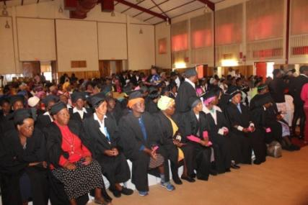
CEREMONY -Limpopo
Tzaneen- Nkowankowa:
7 000
People
attended

Slide 38
PROGRAMME 3 : TEACHERS, EDUCATION HUMAN RESOURCES AND INSTITUTIONAL DEVELOPMENT
The purpose of Programme 3 is to promote quality teaching and institutional performance through the effective supply, development and utilisation of human resources

Slide 39
PROGRAMME 3 -OUTPUTS
PERFORMANCE INDICATORS | TARGET FOR 2015/16 AS PER APP | ACTUAL OUTPUT FOR 2015/16 | DEVIATION FROM PLANNED TARGET | Status
Number of Funza Lushaka bursaries awarded to students enrolled for initial teacher education. | 13 000 | 13 980 | +980
Percentage of Funza Lushaka bursary holders placed within six months of their graduation. | 85% | 87% 4 110 placed in 6 months/ 4 723 eligible for placement | +2%
Number of qualified teachers aged 30 and below, entering the public service as teachers during the financial year. | 8 600 | 12 976 | +4 376
Percentage of principals appointed based on competency assessment processes. | 75% of advertised posts. | 7% 103 principals appointed/ 1 435 posts advertised | -68%

Slide 40
PROGRAMME 3 - OUTPUTS
PERFORMANCE INDICATORS | TARGET FOR 2015/16 AS PER APP | ACTUAL OUTPUT FOR 2015/16 | DEVIATION FROM PLANNED TARGET | Status
Number of teachers who have written the Self-Diagnostic Assessments for English First Additional Language(EFAL) and Mathematics. | EFAL: 20 000 Maths: 20 000 | EFAL:487 Maths: 653 | EFAL: -19 513 Maths: -19 347
Percentage of SGBs that meet minimum criteria in terms of effectiveness (in sampled schools) | 70% of sampled SGBs | 84% of sampled SGBs 1683 SGBs meeting requirements/2000 sampled schools | +14%
Number of public schools supported by external moderators to monitor the utilisation of findings of school profiles to improve leaner performance. | 6 000 | 5 517 | -483

Slide 41
PROGRAMME 3
Human Resource Planning , Provisioning and Monitoring
During this financial year, 10 216 young and qualified educators were recorded in the PERSAL system as at end of March 2016, 1616 above the annual target of 8 600.
The final figure increased to 12 976 after taking into account delayed appointments or appointments that actually occurred before the end the financial year but were captured after the end of the financial year.
The Department experienced a loss of 1 381 young and qualified educators who left the system.
A total number of 82% of those had been appointed in temporary posts (52%) and substitute posts (30%).
As this number is lower than the number entering the system, it suggests that the majority of the young educators entering the system are appointed for at least a period of one year.
In 2015, 4 723 Funza Lushaka bursary recipient graduates were eligible for placement. A total of 4 110 (87%) graduates were placed within six months of graduation.
The overall placement rate, including those appointed after six of graduation in all provinces ranged between 81% and 100% with the national average at 94%.

Slide 42
PROGRAMME 3
Number of Qualified Educators Aged 30 and Below Entering the
Public Service as Teachers for the First time
Province | Quarter 1 | Quarter 2 | Quarter 3 | Quarter 4 (preliminary) | Total
Eastern Cape | 268 | 131 | 41 | 2 | 442
Free State | 245 | 280 | 53 | 231 | 809
Gauteng | 778 | 689 | 127 | 960 | 2 554
Kwazulu-Natal | 725 | 751 | 81 | 94 | 1 651
Limpopo | 299 | 386 | 54 | 117 | 856
Mpumalanga | 159 | 141 | 50 | 145 | 495
North West | 227 | 158 | 39 | 661 | 1 085
Northern Cape | 44 | 68 | 11 | 310 | 433
Western Cape | 268 | 763 | 54 | 806 | 1 891
TOTAL | 3 013 | 3 367 | 510 | 3326 | 10 216

Slide 43
PROGRAMME 3 …cont
Labour Relations
The investigation into the selling of posts has been completed and a report has been sent to the Minister’s office with a request for the extension of time for the forensic investigations.
On 31 August 2015, two weeks before ANA 2015 was to be implemented, the South African Democratic Teachers Union (SADTU) issued a press statement following its National Executive Committee (NEC) meeting essentially announcing that SADTU members would not administer ANA.
Funza Lushaka Bursary Programme
In 2015/16 under review 13 980 students were awarded with Funza Lushaka bursary.
The Department has placed 94% of Funza Lushaka bursary holders in teaching positions.
A total of 4 110 (87%) graduates were placed within six months of graduation. The overall placement rate in all provinces ranged between 81% and 100% with the national average at 94%.
The North West and Northern Cape were able to place all their allocated graduates.
Funza Lushaka recruitment in 2015/16 also focused on school-going youth in Grade 12 attending Quintile 1-3 schools and out-of-school youth from rural and disadvantaged communities, total of 1 074 applicants were recruited for the next cohorts of bursars.

Slide 44
PROGRAMME 3
Placement of Funza Lushaka Bursary Scheme Beneficiaries
PED | Placed | Unplaced | Total Allocation | Placement %
Eastern Cape | 426 | 63 | 489 | 87%
Free State | 331 | 3 | 334 | 99%
Gauteng | 880 | 40 | 920 | 96%
KwaZulu-Natal | 1 010 | 100 | 1 110 | 91%
Limpopo | 336 | 10 | 346 | 97%
Mpumalanga | 239 | 2 | 241 | 99%
North West | 190 | 0 | 190 | 100%
Northern Cape | 657 | 0 | 657 | 100%
Western Cape | 355 | 81 | 436 | 81%
TOTAL | 4 424 | 299 | 4 723 | 94%

Slide 45
PROGRAMME 3 …cont.
Human Resource Development
Developed draft training materials for the training of Circuit Managers and school principals on financial management in collaboration with the Suid Afrikaanse-Onderwysers Unie (SAOU) were developed.
The amended guidelines aimed at improving the participation of parents in educational matters titled Practical Guidelines.
Integrated Quality Management System
During the 2015/16 period, Provincial Education Departments (PEDs) provided the DBE with progress reports on the functionality of the IQMS.
The reports produced show that a total of 341 326 educators were evaluated nationally in terms of the IQMS.
DBE monitored the quality of performance management of school- based educators by visiting six (6) provinces (Gauteng, KwaZulu-Natal, Eastern Cape, Mpumalanga, Free State and North West).
Good practices were shared with provinces, challenges in the provinces were noted.
In order to strengthen IQMS implementation in KwaZulu-Natal, the DBE conducted a training programme with 88 Provincial Training Team (PTT) members to enable cascading of training in schools in all districts in the province.

Slide 46
PROGRAMME 3 …cont.
Whole School Evaluation (WSE)
During the 2015/16 period, WSE focussed on the implementation of External Evaluations and School Self-Evaluations (SSE) in the sector, using standard evaluating criteria.
Data received from Provincial Education Departments indicated 493 schools were externally evaluated, which constitutes 303 primary, 155 secondary, 29 combined and 9 special schools.
Full external evaluations conducted in the Western Cape,142 and Gauteng, 90 amounted to 48% of the schools evaluated nationally.
The Department monitored the quality of WSE work of the supervisors during the period under review. In this regard, five provincial oversight visits were undertaken in 33 schools: 5 in KwaZulu-Natal, 2 in Northern Cape, 10 in Mpumalanga, 10 in North West and 6 in the Western Cape.
The Department implemented an online SSE instrument in more than 225 schools countrywide, which was found to be very ideal by the schools who implemented the evaluation.

Slide 47
PROGRAMME 3 …cont.
Continuing Professional Teacher Development (CPTD)
National Teaching Awards (NTA) and World Teachers’ Day Celebration: The NTA winners were recognised on 27 February 2016 at the Gala event held at the Gallagher Conference Centre, and the event was addressed by the Deputy President of the Republic of South Africa Mr Cyril Ramaphosa.
Acknowledging dedication and excellence in the teaching profession.
The Department’s collaboration with SACE has continued to make progress in the registration of all categories of educators and ensuring that those that have signed up participate in continuing professional teacher development activities and programmes.
The total number of educators that have been registered and signed in the database 129 014 as at the end of the 2015/16 financial year.
The reports show that 33 160 educators (all levels/categories) were participating in CPTD activities and programmes.
A wide range of CPTD programmes (800 in total) have been made available to teachers to choose from to address their professional development needs.
240 Advisors and 35 000 teachers in EFAL through the collaboration with British Council.
.

Slide 48
PROGRAMME 3 …cont.
Education Management and Governance Development (EMGD)
The Policy on the South African Standard for Principalship was promulgated on 18 March 2016.
The policy will serve as the base for the implementation of the NDP requirements such as informing appointment of appropriately qualified and competent principals, the implementation of an entry qualification for principals and the introduction of competency assessment to determine their suitability and identify the areas in which they would need development and support as in other senior management positions.
The National Core Training Team (NCTT) coordinators, which included EMGD, Teacher Development, financial managers and Circuit Managers, were trained in financial management from 2 to 4 February 2016.
This was followed by the training of 1 130 Circuit Managers in March 2016 by SAOU to prepare them to cascade the training to school principals during the July holidays.
1 018 principals were trained in Limpopo and Northern Cape. The training was endorsed by SACE.
The Sector is expected to improve monitoring of school effectiveness and accountability through individual performance and school governance.

Slide 49
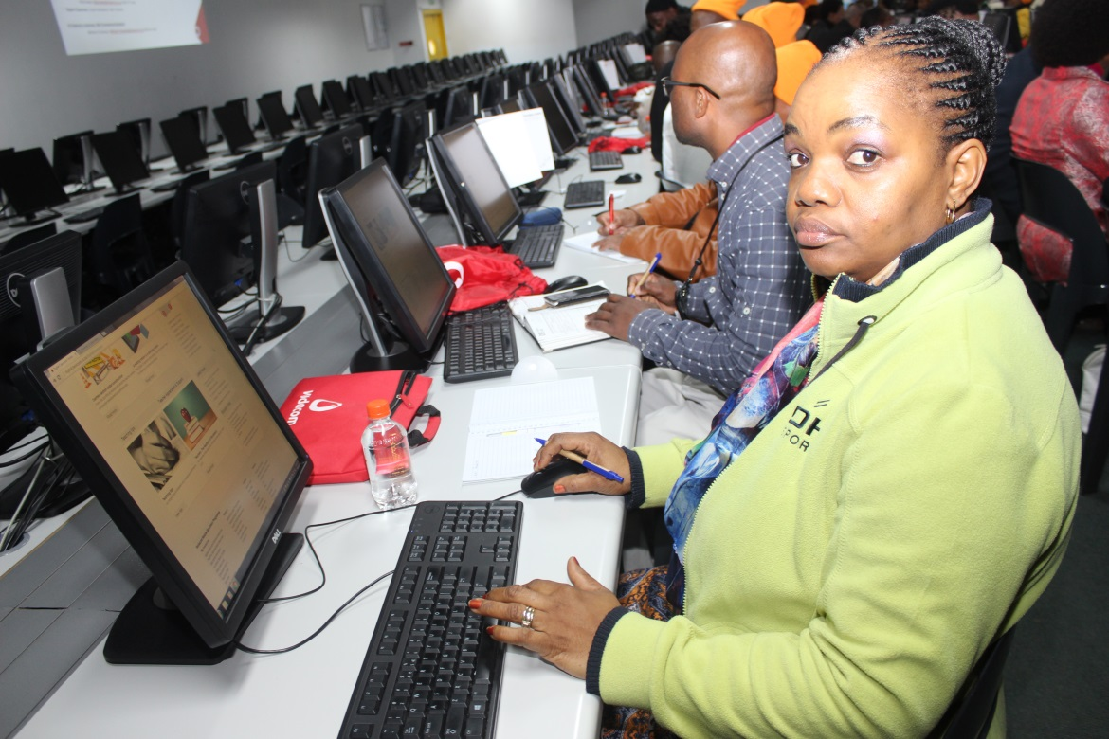
TEACHER TRAINING

Slide 50
PROGRAMME 3 …cont.
A total of 2 000 schools were sampled in all the provinces to determine the functionality of their school governing bodies.
In terms of the analysis, 1683 schools were found to have functional school governing bodies, constituting 84,15% of the sampled schools.
Teacher Development Implementation
For the year under review, the Department embarked on the training of Mathematics, Science and Technology HODs and teachers with the focus on content and pedagogy.
A total of 10 530 classroom-based educators received three to four full days’ training.
The Mathematics 1+4 Model benefitted greatly through this training.
In preparation for the Grade 10 Technical subjects implementation in 2016, 451 Mathematics and Science Subject Advisors, 525 Technical Mathematics teachers and 516 Technical Science teachers were trained using the CAPS documents as well as the NTT-developed manuals.
A total of 200, Grades 11 and 12 Mathematics and Physical Science teachers were trained in ICT integration skills as well as matric revision techniques. Further training of through a collaboration with NECT 410 Grade 11 and 12 Mathematics and Physical Science teachers was conducted in Eastern Cape, KwaZulu-Natal and Limpopo.

Slide 51
PROGRAMME 4: PLANNING, INFORMATION AND ASSESSMENT
The purpose of Programme 4 is to promote quality and effective service delivery in the basic education system through planning, implementation and assessment

Slide 52
PROGRAMME 4 - OUTPUTS
PERFORMANCE INDICATORS | TARGET FOR 2015/16 AS PER APP | ACTUAL OUTPUT FOR 2015/16 | VARIANCE | Status
Valid and reliable data on learner results of performance in ANA. | National ANA report Diagnostic report Annual ANA district report | None | 3 reports
Valid and reliable data on learner results of performance in NSC. | (4) Four National Exam reports on learner performance in Grade 12: Technical report Detailed schools statistics report Diagnostic report in selected subjects; and Report o schools statistics indicating 3 year performance in selected subjects. | (4) Four reports produced: a. Diagnostic report b. School Performance Report c. School Subject Report d. Technical Report | None
Percentage of schools provided with sanitation facilities. | 99% | 99% | None

Slide 53
PROGRAMME 4 -OUTPUTS
PERFORMANCE INDICATORS | TARGET FOR 2015/16 AS PER APP | ACTUAL OUTPUT FOR 2015/16 | VARIANCE | STATUS
Percentage of schools provided with water. | 98% | 99% | __
Percentage of schools provided with electricity. | 96% | 96% | __
Percentage of public schools that use the schools administration and management systems to electronically provide data to the national learner tracking system. | 60% | 88% | +28.4%

Slide 54
PROGRAMME 4- OUTPUTS
PERFORMANCE INDICATORS | TARGET FOR 2015/16 AS PER APP | ACTUAL OUTPUT FOR 2015/16 | VARIANCE | Status
Number of officials from districts that achieved less than 65% in the NSC participating in mentoring programme. | 24 | 36 | +12
Percentage of principals rating the support of district offices as satisfactory. | 60% | 69.3% | +9.3%
Percentage of district managers assessed against development criteria. | 65% | 78% | +0.4%

Slide 55
PROGRAMME 4
Examinations and Assessment
National Senior Certificate (NSC)
The DBE has agreed with teacher unions that there is a need to reform the current model of assessments and the Department is confident that together with the Unions a model for National Assessment will be developed that is acceptable to all parties.
The 2015 NSC examination was written by 644 536 full-time candidates and 91 063 part-time candidates across 6 767 examination centres.
Supplementary Examinations were written by 114 690 full candidates and 816 part time candidates .
This has now taken the 2015 NSC results from 70.7% pass to 72% pass rate.
Total of 130 national marking guideline standardization meetings which were held on 26 October 2015 to 27 November 2015 prior to the commencement of marking of the NSC examination.

Slide 56
PROGRAMME 4 …cont.
Annual National Assessment (ANA)
The task team set up to undertake the remodelling of ANA held monthly meetings from September to December of 2015 to finalise the preliminary ground work on the re-design process.
Of schools that wrote in 2015, only 200 have submitted their learner schedules. This is an insignificant number to analyse.
A total of 57 participants comprising Departmental officials, union officials, provincial officials, and academic experts attended the first working group session that took place on 25-29 January 2016.
Participants reviewed the gaps, inadequacies and deficiencies in the current ANAs, and also took note of the benefits that may have accrued.
International Assessments
The Southern and Eastern Africa Consortium for Monitoring Educational Quality (SACMEQ) IV study was collected from a random sample of 298 schools with 7 046 learners participating across all nine provinces.
The SACMEQ IV analysis and learner achievement results are in the final stages of verification by the SACMEQ co-ordinating Centre (SCC).

Slide 57
PROGRAMME 4 …cont.
The South Africa country report will be released to the public in June 2016.
The Trends in International Mathematics and Science Study (TIMSS) and TIMSS-Numeracy (TIMSS-N) studies have been completed and final data sets were submitted to the International Association for Educational Assessment (IEA).
The TIMSS study will report on learner achievement trends in Grade 9 and the TIMSS-N will report on Grade 5.
Educational Management information systems (EMIS)
EMIS has the responsibility to develop and maintain an integrated education information system for the management of education.
The integrated information system is accomplished through acquisition, processing, dissemination and reporting of quality education data.
98.2 % of ordinary schools comprising 92.57% learners were uploaded to Learner Unit Record Information and Tracking System (LURITS)

Slide 58
PROGRAMME 4 …cont.
Physical Planning
School furniture by the end of February 2016 only 570 026 units of furniture were delivered which is 52% of the total units to be delivered.
The delivery is at 52% due to delay in procurement in other provinces such as Limpopo and Mpumalanga.
The learner transport by end of February 2016, 386 448 learners were transported, which translates to 104% against the target.
Replacement of inappropriate schools: in 2015/16 financial year 163 schools had been completed.
211 schools in the EC with low learner enrolment are under rationalisation process by the Eastern Cape Provincial Education Department and have not been awarded to Implementing Agents (IAs).
Sanitation: 412 schools have been provided with sanitation facilities.
Water: 605 schools have been have been provided with water.
Electricity: 294 schools have been provided with electricity.

Slide 59
PROGRAMME 4 …cont.
ASIDI FROM THE START OF THE PROJECT
 | Projects Allocated |  | Number of Projects Completed
Sub-Programme | Baseline | Revised | 2012/13 | 2013/14 | 2014/15 | 2015/16 | Jul-16 | Total
Inappropriate Schools | 510 | 293 | 17 | 36 | 59 | 51 | 7 | 170
Water | 1120 | 959 | 154 | 61 | 309 | 81 | 10 | 615
Sanitation | 741 | 585 | 185 | 77 | 131 | 21 | 8 | 418
Electricity | 916 | 535 | 137 | 101 | 39 | 17 | 12 | 306

Slide 60
STATISTICS OF EMPLOYMENT ASIDI 2013-16
32 786 Job Opportunities created since inception of the programme till to date.
Below Youth, Women and Disabled persons employed in the project in percentage.

Slide 61
PROGRAMME 4 …cont.
Financial Planning, Economic Analysis and Provincial Budget Monitoring
The Minister published the no-fee schools lists for 2015 to ensure adherence to the National Norms and Standards for School Funding (NNSSF) policy.
A telephonic survey was conducted with selected schools to monitor progress by PEDs regarding the transfer and utilisation of school funding.
During the 2015/16 financial year, the following analyses were done:
PEDs’ Medium Term Expenditure Framework (MTEF) budgets - to provide a snapshot of the budgetary situation in the current MTEF against the previous MTEF cycle.
Provincial APPs - to ensure planning for the service delivery outcomes against allocated budgets for an MTEF, and more specifically a financial year, were realistic.
Quarterly Performance Reports of the PEDs - to gauge the progress of selected indicators towards the achievement of the annual targets. This showed the link between the financial and non-financial data.

Slide 62
PROGRAMME 4 …cont.
Quality Learning and Teaching Campaign (QLTC)
The QLTC’s primary mandate is to ensure that education becomes a societal matter and that communities play a pivotal role in the attainment of quality learning and teaching.
QLTC continued to be integral in realising the Drop All and Read Campaign.
The Quality Coordinating Team members were part in these training programmes empowering the newly elected SGB in strengthening the functionality of QLTC at school level
District level planning and implementation support
Guidelines on Standard Routines and Operations in education districts were developed. This will standardise the work of district directors as well as ensure predictability in what they do.
A Draft Recruitment and Selection Criteria Guideline for district officials was also developed to strengthen the recruitment and appointment of the right people in the right roles.
Vacancies in district offices are tracked quarterly to monitor the timely filling of vacancies.

Slide 63
PROGRAMME 4 …cont.
Monitoring of the basic tools of trade for districts and circuits in line with the Minimum Resource Package was strengthened with a marked improvement in the resourcing of districts country-wide.
Draft norms and standards for staffing education districts have been developed and costed to strengthen the implementation of the Policy on the Organisation, Roles and Responsibilities of Education Districts.
A capability building program for District Directors, Data Specialists in districts and District Support Staff is being rolled out. Already 60 officials from 30 districts have participated in training focused on data management, analysis, reporting and utilization .
National workshops and on-site visits to support and strengthen district operations to deliver on their mandate have been conducted country-wide.
National Education Excellence Awards to recognise and celebrate districts and schools for excellent performance and consistent improvement in the system were successfully organised and excellence celebrated in districts and schools from across the country.

Slide 64
PROGRAMME 4 …cont.
School level Planning
For the 2015/16 financial year School Improvement Support Co-ordinators (SISCO) worked with a total of 187 Circuit Managers to assist them to develop specific interventions to support schools
In this process the SISCO team supported a total of 5 517 schools, working with and through districts and circuits.
During the year under review, School Improvement Support Coordinators also participated in the pre-closure School Readiness Monitoring exercise, where 1 734 schools were supported.
In addition, School Improvement Support Co-ordinators were also utilised to support 45 selected underperforming schools in the Eastern Cape, KwaZulu-Natal and Limpopo, and to monitor the 2015 NSC examinations.
From the beginning of November 2015, School Improvement Support Coordinators were also utilised for the audit of school furniture in the Eastern Cape to help the province comply with a court order. By the end of March 2016 the team had audited a total of 980 schools.

Slide 65
PROGRAMME 4 …cont.
PROVINCIAL MONITORING
The DBE Call Centre
The Call Centre successfully resolved 8 716 cases that were received through the toll free line between 1 April 2015 and March 2016.
There were 2 412 in the first quarter; 2 527 in the second quarter; 1 694 in the third quarter and 2 083 in the fourth quarter.
Follow up calls were made to members of the public and they were asked to rate the service from the DBE Call Centre. 71% rated it as good; 26 said it was satisfactory and only 3% rated it as poor.
The Presidential Hotline
The Department managed the successful resolution of cases that were referred from the Presidential Hotline.
The highest resolution rate was 100% obtained in May and June 2015 while the lowest was 99.45% obtained in January and February 2016.

Slide 66
PROGRAMME 4 …cont.
A telephonic survey that was conducted by the Presidency to determine the level of satisfaction for the DBE’s customers showed that the DBE rendered quality service to its clientele and it exceeded the 70% target set by the Presidency.
This performance is in line with the Minister’s theme for enhanced quality and improved efficiency. The table below shows the resolution rate of the DBE.
Working with the Provincial Education Departments (PEDs)
The provincial support strategies implemented during the year yielded results. Three provincial education departments (PEDs) – Eastern Cape (EC), KwaZulu-Natal (KZN) and North West (NW) – whose performance had been below the required 90% benchmark set by the Presidency, improved.
The resolution rate for EC improved from 57.55% in February 2015 to 74.51% in February 2016. KZN and NW improved from 66.17% to 74.87% and 71.14% to 77.14% respectively.
The remaining six (6) PEDs have been consistent in achieving the required 90% benchmark.

Slide 67
PROGRAMME 4 …cont.
Website enquiries
The department received a total of 678 enquiries via email and these were all resolved. There are no outstanding enquiries.
Walk-ins
A total of 65 cases were resolved in consultation with the PEDs. The Department has developed strategies to resolve persistent problems reported through the Call Centre and is receiving increasing levels of support from PEDs.
Customer Relations Management
The Call Centre successfully resolved 8716 cases that were received through the toll free line between 1 April 2015 and March 2016.
Working jointly with PEDs to resolve 70% of the cases that were reported to the DBE. These were related to challenges regarding the admission of learners; complaints about ill-treatment of learners by teachers; payment of pension benefits; complaints related to mismanagement of funds in schools and infrastructure.

Slide 68
PROGRAMME 4 …cont.
School Readiness Assessments for 2016
A total of 931 schools from 50 education districts in the country that is Eastern Cape 55, Free State 34, Gauteng 138, KZN 255, Limpopo 198, Mpumalanga 82, North West 80, Northern Cape 16 and Western Cape 73.
In general schools were ready for the start of the 2016 academic year. However, a total number of 788 schools were identified as having challenges in one of the areas, admissions and learner registration, planning, availability of teachers, LTSM including workbooks and infrastructure particularly school furniture and ablution facilities.
THE NATIONAL EDUCATION EVALUATION AND DEVELOPMENT UNIT (NEEDU)
NEEDU analyses and identifies methods and strategies for achieving equity and equality in the provision of quality education, evaluates the manner in which the national Department and the provincial education departments (including districts) support, monitor and evaluate schools, and evaluates the state of schools in general and the quality of school leadership, teaching and learning in particular.

Slide 69
PROGRAMME 4 …cont.
27 districts and 176 special schools were evaluated in 10 areas.
10 areas of operation, were namely learner access, curriculum programmes, teacher quality and support, monitoring of learning, learner support, assessing learners and use of data, school governance, availability and use of learning and teaching support materials (LTSM) and assistive devices, time management, and non-teaching staff.
NEEDU examined and analysed evidence collected through interviews and document analysis from the districts to establish how the districts had put systems in place to realise the vision of Education White Paper 6—Special Needs Education (2001), particularly, “the development of an inclusive education and training system that will uncover and address barriers to learning, and recognise and accommodate the diverse range of learning needs”.

Slide 70
PROGRAMME 5 : EDUCATIONAL ENRICHMENT SERVICES
The purpose of Programme 5 is to develop policies and programmes to improve the quality of learning in schools

Slide 71
PROGRAMME 5- OUTPUTS
PERFORMANCE INDICATORS | TARGET FOR 2015/16 AS PER APP | ACTUAL OUTPUT FOR 2015/16 | DEVIATION FROM PLANNED TARGET | STATUS
Number of educators, officials and learners participating in DBE organised activities on social cohesion, nation building, citizenship, rights & responsibilities and constitutional values. | 5000 | 5 843 | +843
Number of schools that provide nutritious meals. | 19 800 | Q1: 21200 Q2: 16 493 Q3: 21 203 Q4: 21 219 Average: 20 029 | +229

Slide 72
PROGRAMME 5 …cont.
Care and Support
National School Nutrition Programme (NSNP)
For the 2015/16 financial year, the programme provided daily nutritious meals to 21 177 Quintile 1 – 3 primary, secondary and special schools nationally, reaching an average of 9 630 590 learners.
NSNP officials visited a total of 299 schools in all the nine (9) provinces.
A further observation during the monitoring was that the programme was generally effectively implemented.
Good practices observed were the general hygiene practices such as learners washing their hands before their meals; food preparation areas being kept clean; as well as the cleanliness and protective clothing of volunteer food handlers (VFHs). Storerooms were also well kept and in cases where there were no shelves, foodstuff was placed on pallets and not on the floor as was the practice in the past.
There were challenges common to most schools visited, such as the issue of gas storage, cylinders were supposed to be placed outside in a locked cage and lack of storage
Deworming was further rolled out in the nine provinces.
The deworming implementation in 101 schools was closely monitored by the Department.

Slide 73
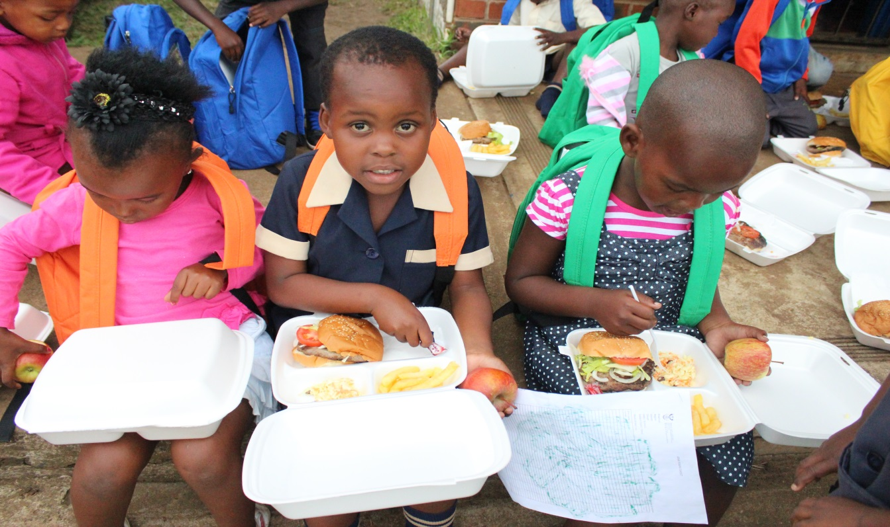
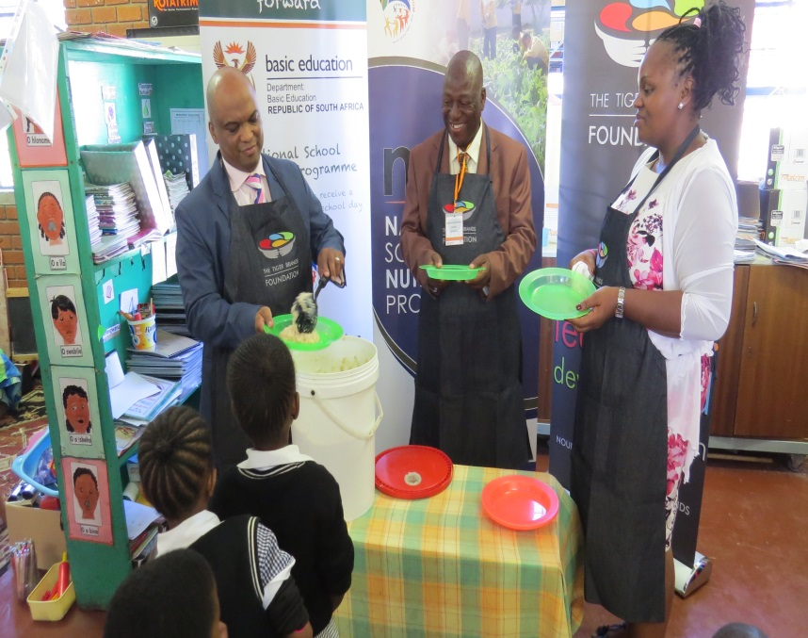
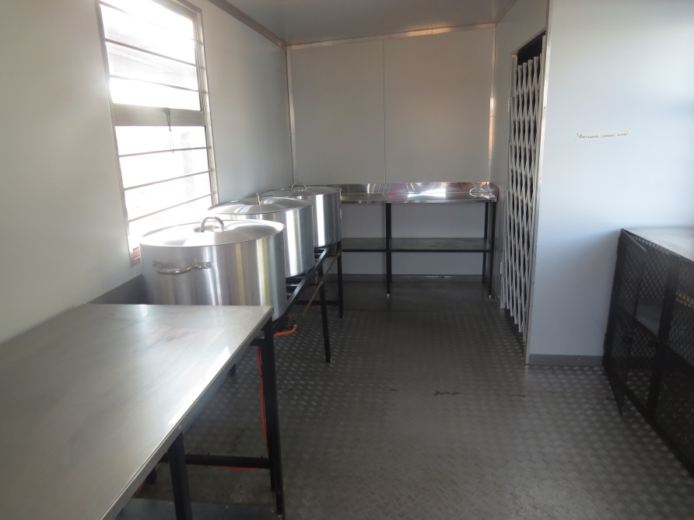
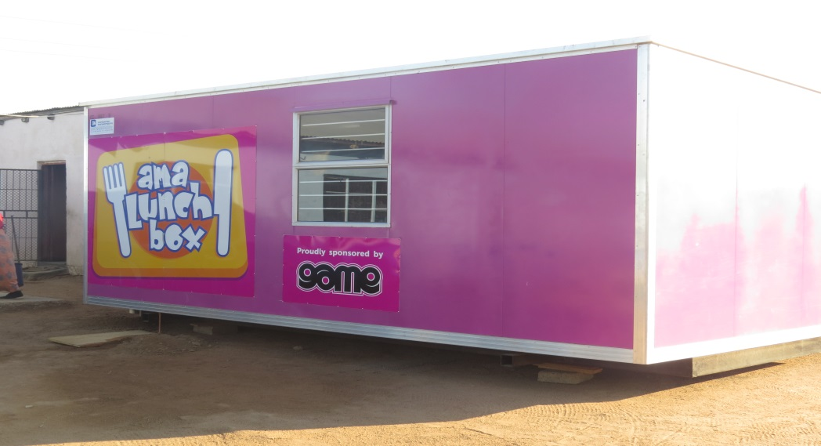
NATIONAL SCHOOL FEEDING PROGRAMME

Slide 74
PROGRAMME 5 …cont.
The National School Deworming Programme launch was held on 16 February 2016 at Zimasa Primary School, Langa, in Cape Town.
Health Promotion
The World Health Organisation (WHO) implemented the Post Introduction Evaluation (PIE) in provinces on the Human Papillomavirus vaccination on 10-17 October.
A total of 229 554 Grade 4 girls received the Human Papillomavirus (HPV) vaccination.
Altogether, a total of 1 111 705 learners received health services.
Safety
During the period under review, progress was made regarding a number of policies , that is:
Draft Charter on Harmful Religious Practices.
The draft National Strategy on the Implementation of the Prevention and Management of Bullying (Homophobic and Cyber Bullying) in Schools has been submitted to the Minister for consideration.

Slide 75
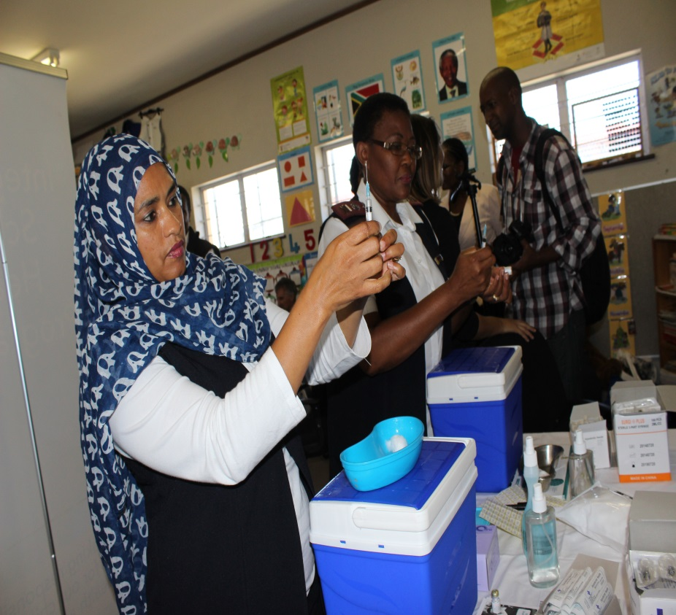
HUMAN PAPILOMAVIRUS VACCINATION

Slide 76
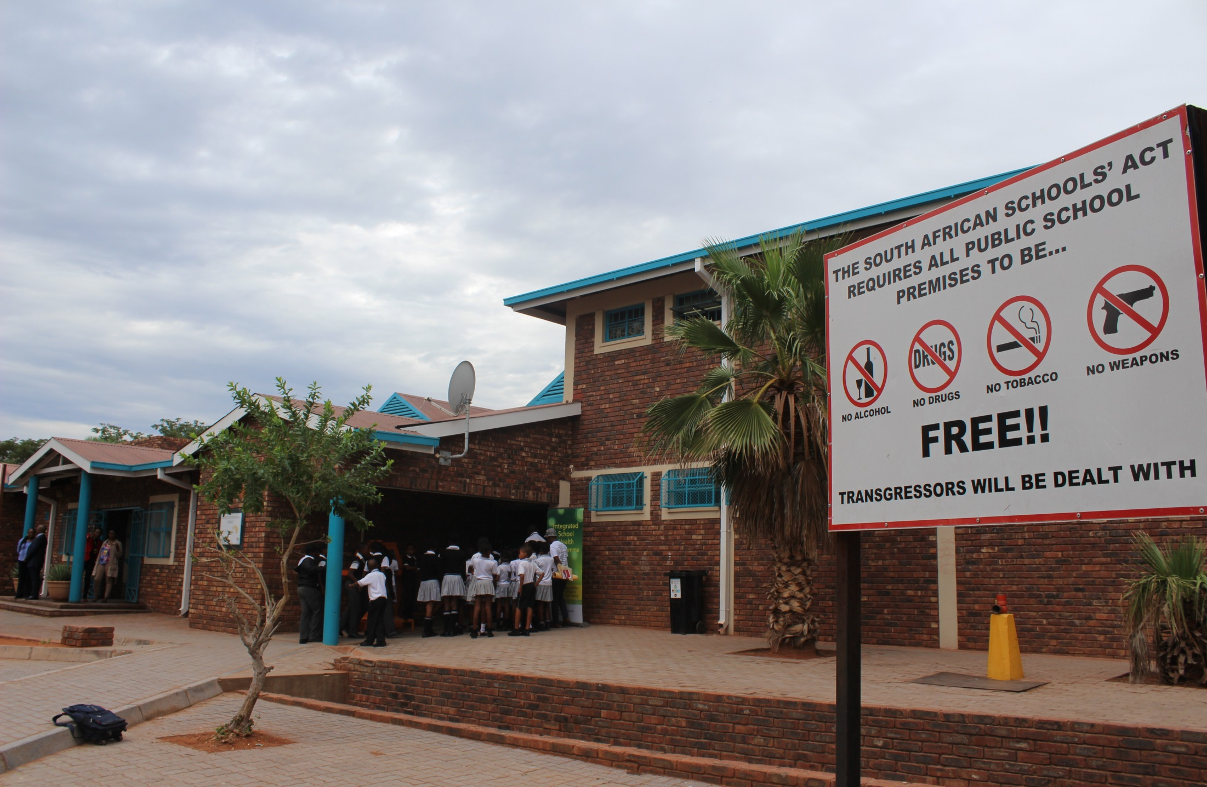
SCHOOL SAFETY

Slide 77
PROGRAMME 5 …cont.
Revised DBE/SAPS Collaborative Partnership Protocol has been developed and submitted for approval.
National Strategy on the Use of Alcohol and Illegal Substances Amongst Learners In South African Schools as well as The Guidelines for Drug Testing And Doping : terms of reference of both policies were drafted and submitted to UNICEF for the appointment of a consultant to operationalize the implementation of the Strategy.
ENRICHMENT AND SPORT IN EDUCATION
South African Schools Choral Eisteddford (SASCE)
All provincial SASCE championships were successfully held in May – June 2015. The national championship was successfully held from 30 June to 02 July 2015 at the Rhema Ministries, Randburg under the theme “Celebrating 60 Years of the Freedom Charter Through Music”.
A total of 6 722 learners participated.

Slide 78
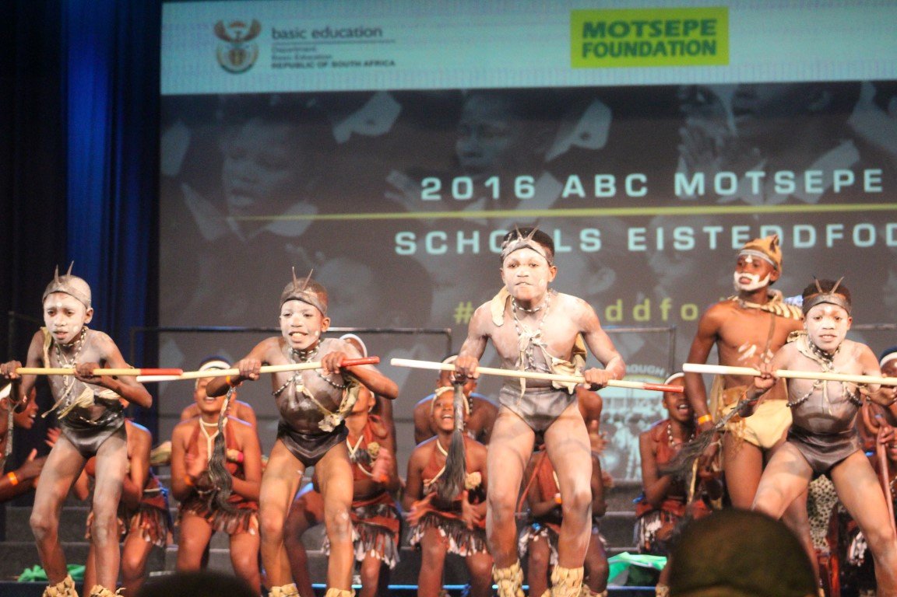
SASCE

Slide 79
PROGRAMME 5 …cont.
Moot Court
The programme started with an estimated number of 1 069 learners participated in the Fifth National Schools Moot Court Competition, which featured essay writing for workshops, provincial rounds and national rounds.
On 22 January 2016, the South African team scooped 1st PLACE at the 3rd International Moot Court Award at The Hague City, Netherlands.
The team consisted of eight learners from Gauteng, KwaZulu-Natal and the Western Cape
The hypothetical Problem statement was on the prosecution for aiding and abetting against the civilians war crimes.
There were twelve (12) other countries that participated in the competition.
The iNkosi Albert Luthuli Oral History Programme
A total number of 64 learners and 13 educators took part in the 2015 national finals.

Slide 80
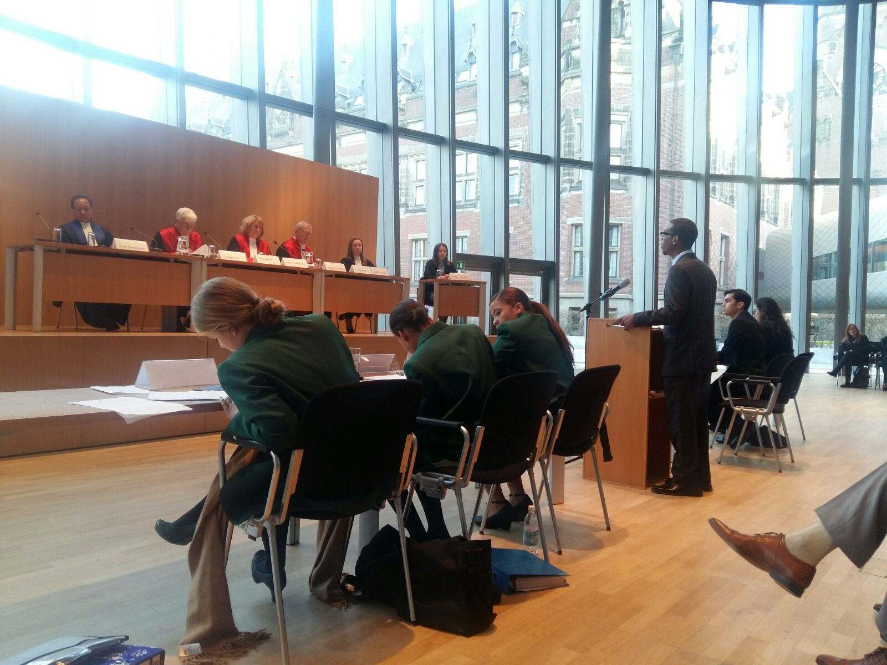
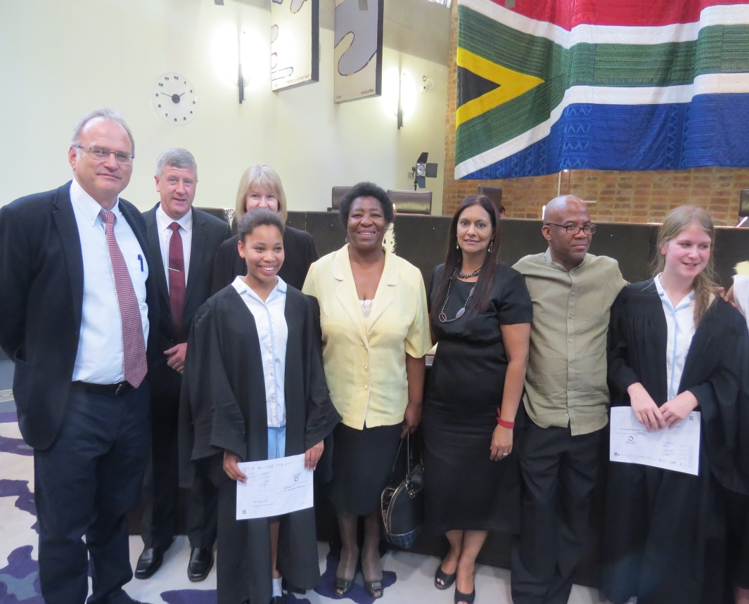
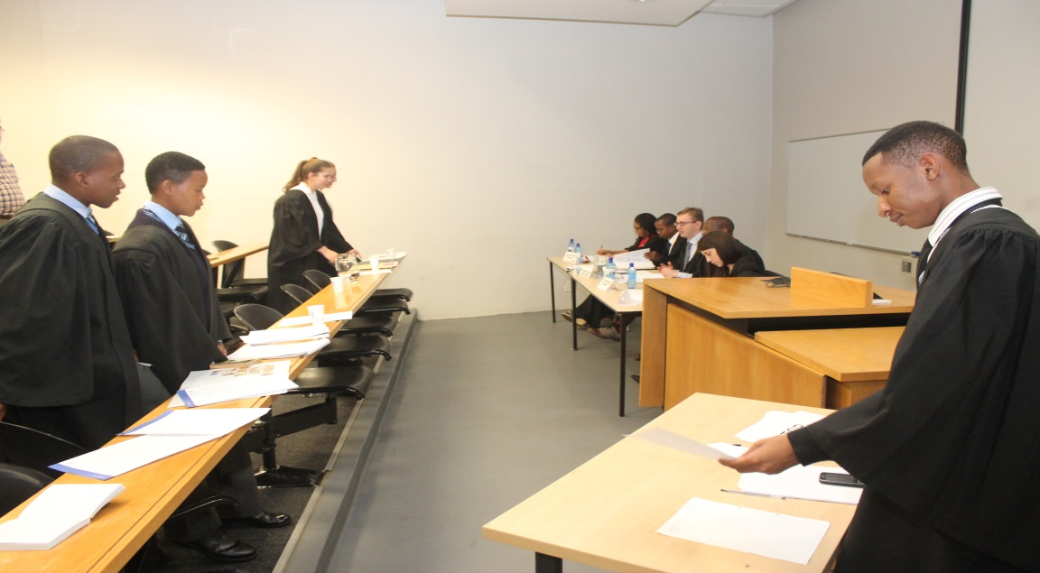
MOOT COURT

Slide 81
PROGRAMME 5 …cont.
School Sports
The SA Schools National Championships were held on 10–16 December 2015 in Pretoria. All the provinces participated in the 16 priority codes, including the indigenous game codes.
The games were preceded by the Transnet and Rural Farm Schools Championships and the Kay Motsepe Schools Cup Championships in October 2015.
The National Athletics Championships for Primary Schools were held on 10–12 March 2016 in Port Elizabeth, where a total of 886 learners participated and for Secondary Schools , they were held on 16–19 March 2016 in Bloemfontein. A total of 1 742 learners, including LSEN, participated.
Bill of Rights Activities
A total number of 2329 learners from Mpumalanga, Eastern Cape and Gauteng participated in engagement sessions on education, career guidance, the commemoration of Youth day (16 June), active citizenry and national identity.

Slide 82
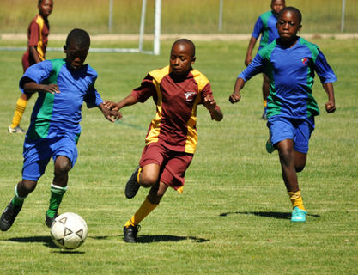
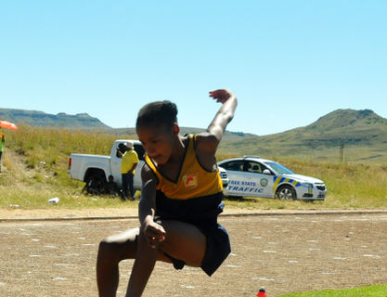
SCHOOL SPORT

Slide 83
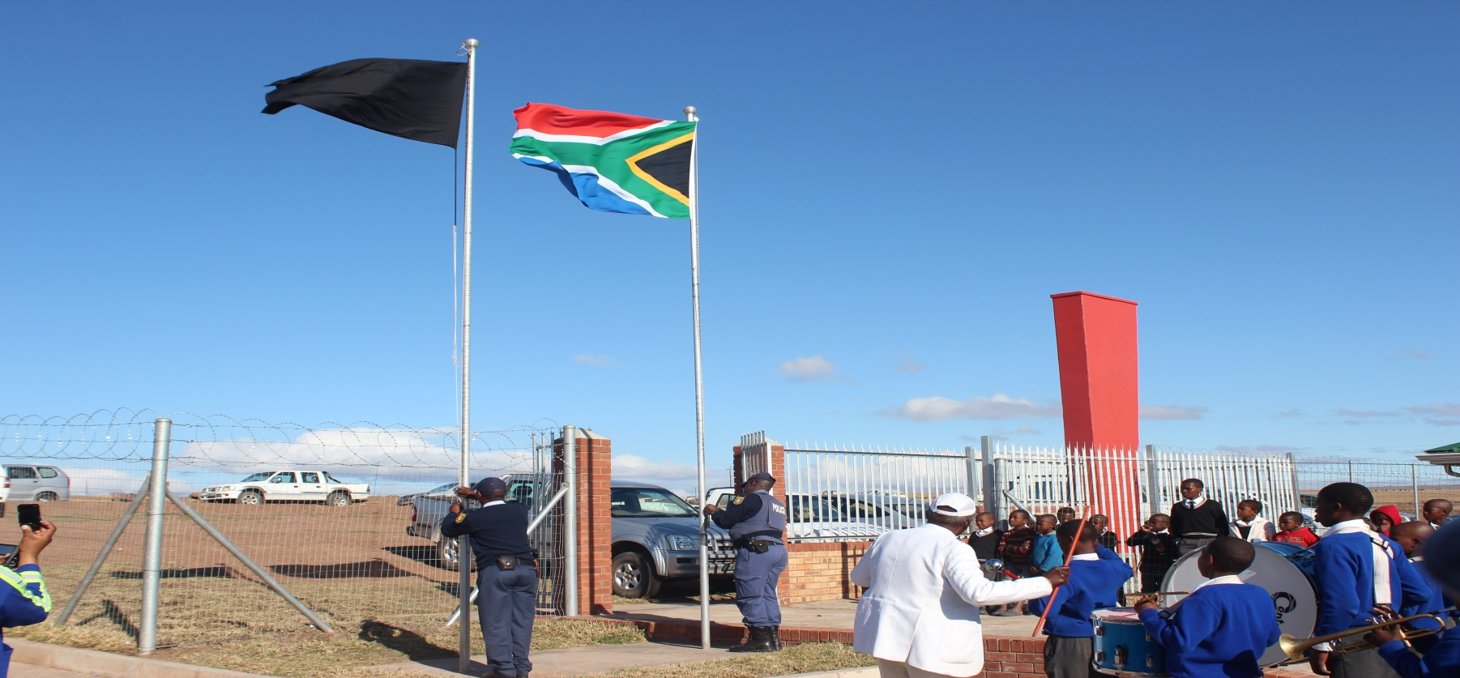
PROGRAMME 5 …cont.
National Flags
99 schools in North West and 77 schools in Northern Cape have been identified as provinces that need the National Flags and flag poles.
322 National Flags were installed in schools in the Eastern Cape.
This is a programme implemented in schools through the Department of Arts and Culture.

Slide 84
AREAS OF UNDER-PERFORMANCE
Indicator | Reasons for Under-performance | Remedial Action | Time Frame | Responsibility
Number of learners completing the Kha Ri Gude programme. | Due to the start of teaching in September. The completed LAPs were still being collected in May. Number of learners completed the LAPs that we collected in July 2016 were reported since they were already evaluated by SAQA . | Set a target that is informed by the trends regarding the completion rates in the past three years. For 2016/17 the indicator reports on number of learners enrolled. | Next reporting cycle | Programme 2: Branch C
Percentage of learners who obtained a National Senior Certificate | There was an increase in high order questions across all subjects to drive quality. | Conduct a School Based Assessment workshops with special focus on cognitive levels as per the CAPS requirements. | July 2016 | Programme 2 : Branch C

Slide 85
AREAS OF UNDER-PERFORMANCE
Indicator | Reasons for Under-performance | Remedial Action | Time Frame | Responsibility
Percentage of principals appointed based on competency assessment processes. | Underperformance was due to 8 provinces not implementing competency assessments in appointing principals. The affected provinces could not introduce competency assessment due to the delays in consultation processes with unions. | Discussion to be elevated to the National ELRC to have an agreement. Failure to reach agreement will result in declaration of policy in this regard. | December 2016. | Programme 3: Branch T
Number of public schools supported by external moderators to monitor the utilisation of findings of school profiles to improve leaner performance. | Underperformance was due to the tour of the 9 provinces on findings of the school profiles overlapping to the first quarter. The actual monitoring process started in the 2nd quarter. | The monitoring will started at the beginning of the financial year so that the schools that were allocated to be monitored in the first quarter covered. | Next reporting cycle | Programme 3 Branch DCMS

Slide 86
AREAS OF UNDER-PERFORMANCE
Indicator | Reasons for Under-performance | Remedial Action | Time Frame | Responsibility
Number of teachers who have written the Self-Diagnostic Assessments for English First Additional Language(EFAL) and Mathematics. | A lack of an appropriate platform as well as the required funding prevented the DBE and Provinces from undertaking the tests. The target set was too high and the DBE could not acquire the required amounts to undertake the tests. | For the current year, the target has been reduced for both EFAL and Mathematics. A tender is currently in progress to appoint a suitable service provider to provide the test items and the platform to conduct the tests. Money in this regard has been sourced from the EU Funding. Engagements are also being held with the ETDP SETA to use some of the Provincial funding to test the teachers. | December 2016 | Programme 3: Branch T

Slide 87
PART C
ANNUAL FINANCIAL STATEMENTS

Slide 88
ALLOCATION AGAINST ACTUAL EXPENDITURE PER PROGRAMME FOR THE 2015/16 FINANCIAL YEAR
Programmes | 2015/16 |  |  | Expenditure as % of Appropriation
 | Appropriation | Actual Expenditure | Variance
 | R’000 | R’000 | R’000
Administration | 386 645 | 386 475 | 170 | 100.0%
Curriculum Policy, Support and Monitoring | 1 837 965 | 1 797 740 | 40 225 | 97.8%
Teachers, Education Human Resources Development and Institutional Development | 1 164 017 | 1 163 548 | 469 | 100.0%
Planning, Information and Assessment | 11 959 764 | 11 511 906 | 447 858 | 96.3%
Educational Enrichment Services | 5 938 035 | 5 936 456 | 1 579 | 100.0%
Total | 21 286 426 | 20 796 125 | 490 301 | 97.7%

Slide 89
REASONS FOR DEVIATIONS
Programme1: Administration | Underspent: R170 thousand
There were no material variances on this programme.
Programme 2: Curriculum Policy, Support and Monitoring | Underspent: R40.225 million
The under-spending on this programme is mainly on the EPWP Grant due to the delays in capturing the required data into the EPWP electronic system. The major problem was EPWP changed the reporting system, capturing in the new electronic system was a challenge as this system was not included in the original plan and the agreement signed by both the Director-general of DBE and Public Works.
Programme 3: Teachers, Education Human Resources Development and Institutional Development | Underspent: R469 thousand
There were no material variances on this programme.

Slide 90
REASONS FOR DEVIATIONS
Programme 4: Planning, Information and Assessment | Underspent: R447.858 million
The under-spending on this programme is mainly on the ASIDI programme. The process of consultation on rationalisation of schools took longer than anticipated and it impacted on the spending trends for the ASIDI project.
Programme 5: Educational Enrichment Services | Underspent: R1.579 million
There were no material variances on this programme.

Slide 91
Challenges and Mitigation Measures
Challenges | Mitigation Measures
Programme 2: Curriculum Policy, Support and Monitoring The under-spending on this programme is mainly on EPWP Grant for Kha Ri Gude. The under-spending on the grant was due to delays in finalising the calculation and late submission of data in the EPWP electronic system. The major problem was the delay in submitting the certified ID Copies to EPWP. | The Department held meetings with EPWP unit of the Department of Public Works. Both Department’s agreed on amendment of the application form for volunteers to meet the categories required by the EPWP electronic system and the Department to assign a dedicated Deputy Director to work fulltime on data submission into the EPWP electronic system.
Programme 4: Planning, Information and Assessment The under-spending on this programme is mainly on the ASIDI programme. The process of consultation on rationalisation of schools took longer than anticipated and impacted on the spending trends for the ASIDI project. | The consultation on rationalisation of schools has been completed in some areas.

Slide 92
ALLOCATION AGAINST ACTUAL EXPENDITURE FOR THE 2015/16 FINANCIAL YEAR
Economic Classifications | 2015/16 |  |  | Expenditure as % of Appropriation
 | Appropriation | Actual Expenditure | Variance
 | R’000 | R’000 | R’000
^{CURRENT PAYMENTS}
Compensation of Employees | 439 640 | 439 472 | 168 | 100.0%
Goods and Services | 2 037 526 | 2 102 316 | (64 790) | 103.2%
Interest on rent and land | 47 524 | 47 524 | 0 | 100.0%
^{TRANSFERS AND SUBSIDIES} | 16 813 584 | 16 818 562 | (4 978) | 100.0%
Provinces and Municipalities | 15 631 771 | 15 631 771 | 0 | 100.0%
Departmental agencies and accounts | 1 103 789 | 1 104 391 | (417) | 100.0%
Foreign government and international organisations | 16 478 | 20 998 | (4 520) | 127.4%
Non profit institutions | 60 055 | 60 055 | 0 | 100.00%
Households | 1 306 | 1 347 | (41) | 103.1%
^{PAYMENTS FOR CAPITAL ASSETS} | 1 947 645 | 1 387 737 | 559 908 | 71.3%
Building and other fixed structures | 1 932 786 | 1 374 762 | 558 024 | 71.1%
Machinery and Equipment | 14 779 | 12 795 | 1 804 | 87.8%
Software and other tangible assets | 80 | 0 | 80 | 0%
^{PAYMENTS FOR FINANCIAL ASSETS} | 507 | 514 | (7) | 101.4%
Total | 21 286 426 | 20 796 125 | 490 301 | 97.7%

Slide 93
DEVIATIONS AND MITIGATION MEASURES
DEVIATIONS | MITIGATION MEASURES
Goods and Services: The over spending on this item is due to the procurement and provision of school furniture for non ASIDI schools that was not budgeted for under the ASIDI allocation. | The Department will ensure that during the adjustment, budget funds are shifted from the capital budget to cover the remaining commitments on this item.
Transfer and subsidies: The over expenditure on this item is due to the transfers to foreign/international organisations which are made in Dollars and EUROs. At the time of the transfer the exchange rate was higher than projected. | The Department will in future estimate the exchange rate based on the value of the rand at the time of receipt of these invoices and request National Treasury approval to increase the amounts to be transferred to these organisations.
Payments for Capital Assets: The under-spending on this item is mainly in respect of the ASIDI project. The under-spending was due to the rationalisation of schools. The process of consultation for the mergers of schools took longer than anticipated. | The consultation on rationalisation of schools has been completed in some areas.

Slide 94
SECTOR AUDIT OUTCOMES – 2015/16
Auditee | Outcomes (2015/16) |  |  | Outcomes (2014/15) |  |  | Movement
 | Audit Opinion | PDOs | Non-compliance with laws and regulations | Audit Opinion | PDOs | Non-compliance with laws and regulations
Eastern Cape | Qualified | Yes | Yes | Qualified | Yes | Yes
Free State | Qualified | Yes | Yes | Unqualified with findings | Yes | Yes
Gauteng | Unqualified with findings | No | Yes | Unqualified with findings | No | Yes
KwaZulu-Natal | Unqualified with findings | Yes | Yes | Unqualified with findings | Yes | Yes
Limpopo | Disclaimer | Yes | Yes | Disclaimer | Yes | Yes
Mpumalanga | Qualified | Yes | Yes | Qualified | No | Yes
Northern Cape | Unqualified with findings | Yes | Yes | Unqualified with findings | Yes | Yes
North West | Unqualified with findings | Yes | Yes | Unqualified with findings | Yes | Yes
Western Cape | Unqualified without findings | No | No | Unqualified without findings | No | No
Basic Education | Unqualified with findings | Yes | Yes | Unqualified with findings | Yes | Yes

Slide 95
AUDITOR-GENERAL REPORT
Unqualified audit opinion with matter of emphasis
National text books cataloguing process
The audit revealed deficiencies in the process of establishing national catalogues of text books to be procured by provincial education departments for distribution to schools. The Department did not comply with certain aspects of the supply chain requirements as prescribed by the National Treasury in the Treasury Regulations. This was due to lack of tracking and monitoring of compliance with Treasury Regulations during this process.
Additional Matters
Expenditure management
The accounting officer did not take effective steps to prevent irregular expenditure amounting to R599 million, in contravention of section 38(1)(c)(ii) of the PFMA and treasury regulation 9.1.1.
The accounting officer did not take effective steps to prevent unauthorised expenditure amounting to R153 million, in contravention of section 38(1)(c)(ii) of the PFMA and treasury regulation 9.1.1.
The accounting officer did not take effective steps to prevent fruitless and wasteful expenditure amounting to R44 million, in contravention of section 38(1)(c)(ii) of the PFMA and treasury regulation 9.1.1.

Slide 96
ADDITIONAL MATTERS
Consequence management
Effective and appropriate disciplinary steps were not taken against officials who made and permitted irregular and unauthorised expenditure at the time, as required by section 38(1)(h)(iii) of the PFMA and treasury regulation 9.1.3, as it was not investigated during the year under review.
Procurement and contract management
Fourteen contracts were awarded to bidders where preferential points were not allocated and/or calculated according to the requirements of the Preferential Procurement Policy Framework Act and its regulations.
Memorandums of agreements with implementing agents were not amended or extended through approval by a delegated official, in contravention of the department’s delegation of authority issued in terms of section 44 of the PFMA. The total value of the payments made in the current financial year to the implementing agents after expiry of their memorandums of agreements amounted to R219 834 000 and it has been disclosed as irregular expenditure.
Annual Financial Statements
Material misstatements of immovable tangible capital assets, accruals and commitments identified by the auditors in the submitted financial statements were subsequently corrected and the supporting records provided, resulting in the financial statements receiving an unqualified audit opinion.

Slide 97
STEPS TAKEN TO PREVENT RECCURENCE
FINDINGS OF AGSA | RECOMMENDATIONS BY AGSA | REMEDIAL ACTION
National text books cataloguing process |  | The Department wrote to National Treasury requesting approval to deviate from the normal procurement process since cataloguing cannot be done through the normal SCM process.
Irregular Expenditure Fruitless and Wasteful Expenditure Unauthorised Expenditure Consequence management | Enforce daily management disciplines. Identify and create appropriate capacity Improve coordination between the various departments and principal actors. Manage consequences Monitor and evaluate processes. | Meetings were held with all Implementing Agencies to inform them about following all Government Supply Chain Management (SCM) processes. Should any Implementing Agency found not to have followed the SCM processes, the Department has the right to terminate the Memorandum of Understanding with the IA. Where fruitless and wasteful expenditure could be confirmed, deductions have already been made from the volunteers. Other cases are still under investigation to ascertain that they are indeed fruitless and wasteful expenditure. Once confirmed, deductions will be effected immediately.

Slide 98
STEPS TAKEN TO PREVENT RECCURENCE
FINDINGS | RECOMMENDATIONS BY AGSA | MITIGATION MEASURES
Annual Financial Statements |  | During the training of volunteer supervisors and coordinators, a presentation was made on the matter. Should any volunteer be found to be affected by the matter, their contract will be terminated with immediate effect. Officials affected by any form of irregularity, have been issued with warning letters. Immovable tangible capital assets - The capital asset table is updated quarterly. Accruals - The implementing agents will submit accruals on their official letterhead confirming completeness and correctness. Commitments – Copies of contracts are being collected from the implementing agents to verify the commitment amounts.

Slide 99
RECOMMENDATIONS
To request the Portfolio Committee to:
accept the Annual Report outputs of the Department of Basic Education against planned targets of the pre-determined objectives in the Annual Performance Plan of 2015/16.
accept the Annual Financial Statement of the Department of Basic Education for the financial year 2015/16.

