Slide 1
Briefing to the Telecommunications and Postal Services Portfolio Committee
Audit outcomes of the portfolio for the 2015-16 financial year

Slide 2
PFMA
2015-16
1
1
The AGSA’s promise and focus
2

Slide 3
Role of the AGSA in the BRRR process
Reputation promise
PFMA
2015-16
The Auditor-General of South Africa (AGSA) has a constitutional mandate and, as the supreme audit institution (SAI) of South Africa, exists to strengthen our country’s democracy by enabling oversight, accountability and governance in the public sector through auditing, thereby building public confidence
Our role as the AGSA is to reflect on the audit work performed to assist the portfolio committee in its oversight role of assessing the performance of the entities taking into consideration the objective of the committee to produce a BRRR

Slide 4
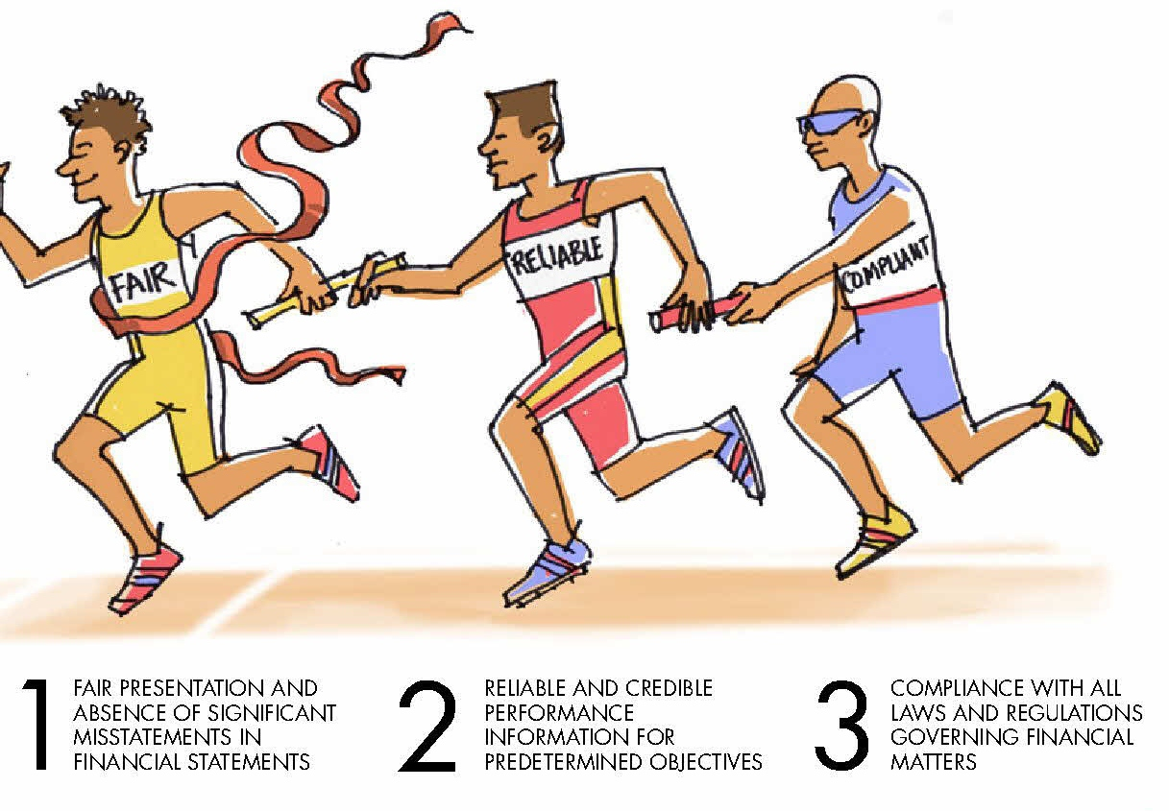
Our annual audits examine three areas
PFMA
2015-16
1
2
3
FAIR PRESENTATION AND RELIABILITY OF FINANCIAL STATEMENTS
RELIABLE AND CREDIBLE PERFORMANCE INFORMATION FOR PREDETERMINED OBJECTIVES
COMPLIANCE WITH KEY LEGISLATION ON FINANCIAL AND PERFORMANCE MANAGEMENT

Slide 5
Unqualified opinion with no findings (clean audit)
Financially unqualified opinion with findings
PFMA
2015-16
Auditee:
produced credible and reliable financial statements that are free of material misstatements
reported in a useful and reliable manner on performance as measured against predetermined objectives in the annual performance plan (APP)
complied with key legislation in conducting their day-to-day operations to achieve their mandate
Auditee produced financial statements without material misstatements or could correct the material misstatements, but struggled in one or more area to:
align their performance reports to the predetermined objectives they committed to in their APPs
set clear performance indicators and targets to measure their performance against their predetermined objectives
report reliably on whether they achieved their performance targets
determine the legislation that they should comply with and implement the required policies, procedures and controls to ensure compliance

Slide 6
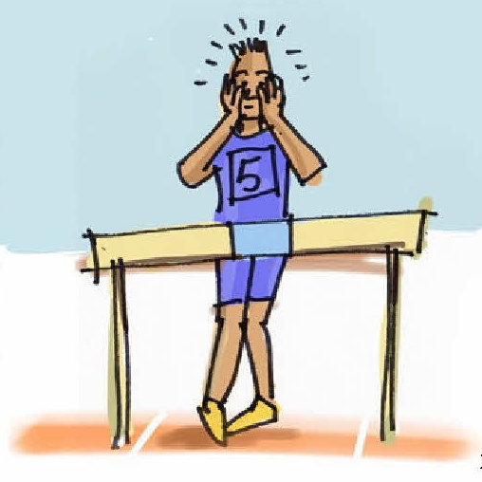
Qualified opinion
Auditee:
had the same challenges as those with unqualified opinions with findings but, in addition, they could not produce credible and reliable financial statements
had material misstatements on specific areas in their financial statements, which could not be corrected before the financial statements were published.
PFMA
2015-16
Adverse opinion
Auditee:
had the same challenges as those with qualified opinions but, in addition, they had so many material misstatements in their financial statements that we disagreed with almost all the amounts and disclosures in the financial statements
Disclaimed opinion
Auditee:
had the same challenges as those with qualified opinions but, in addition, they could not provide us with evidence for most of the amounts and disclosures reported in the financial statements, and we were unable to conclude or express an opinion on the credibility of their financial statements

Slide 7
PFMA
2015-16
The 2015-16 audit outcomes and key messages
2
2

Slide 8
Audit outcomes over three years – Telecommunication and Postal Services portfolio
PFMA
2015-16
Unqualified with no findings
Unqualified with findings
Qualified with findings
8 auditees
8 auditees
8 auditees

Slide 9
Key messages
PFMA
2015-16
Portfolio’s 2015-16 audit outcomes were stagnant
Number of compliance findings increased in 2015-16
Key positions remain vacant or suspended, with the following positions filled in an acting capacity:
One director-general (DTPS)
One chief executive officer (Nemisa)
Four chief financial officer (Usaasa, Nemisa, Sentech and Sapo)
Two chairpersons of the board (Usaasa and Sita)
One chief operations officer (Sapo)

Slide 10
PFMA
2015-16
Performance management linked to programmes or objectives tested
3
3

Slide 11
Regression in the quality of performance information
PFMA
2015-16
Usefulness of annual performance information
Reliability of performance information
With no material findings
With material findings
---------------------------------------------------

Slide 12
Most common material findings on usefulness and reliability
PFMA
2015-16
Usefulness
The most common findings on the usefulness of information were the following:
Indicators not well defined
Indicators not verifiable
Targets not specific and measurable
Reliability
The most common findings on reliability of information were the following:
Reported information not complete
Reported information not valid
Reported information not accurate
Regressed

Slide 13
PFMA
2015-16
4
4
Compliance

Slide 14
Compliance with legislation
PFMA
2015-16
With no material compliance findings
With material compliance findings
8 auditees
8 auditees

Slide 15
Regression in compliance with legislation and quality of financial statements
Figure 1: Findings on compliance with
key legislation – all auditees
Figure 2: Findings on compliance with key SCM legislation – all auditees
Figure 3: Quality of submitted financial statements
Material misstatements in submitted annual financial statements
5 auditees (62%) [2014-15: 5 (62%)] avoided qualifications by correcting material misstatements during the audit process
75% (5)
50% (4)
2015-16
Prevention of unauthorised, irregular and/ or fruitless and wasteful expenditure
Outcome if NOT corrected
Outcome after corrections
75% (6)
25% (2)
Management of procurement and/or contracts
38% (3)
2014-15
25% (2)
Outcome if NOT corrected
Outcome after corrections
Consequence management
13% (1)
0% (0)
2015-16 | 2014-15
With no material misstatements | With material misstatements
PFMA
2015-16

Slide 16
Unauthorised, irregular and fruitless and wasteful expenditure
PFMA
2015-16
Definition
UIF amounts incurred by entities in portfolio
Investigations of UIF expenditure
Expenditure not in accordance with the budget vote/ overspending of budget or programme
3 auditees (75%) [2014-15: 2 (50%)] lodged investigations to determine the root cause and consequences of UIF incurred
2015-16
8 Entities
Expenditure in vain, which could have been avoided if reasonable steps had been taken. No value for money!
2014-15
Expenditure in contravention of key legislation; goods delivered but prescribed processes not followed
8 Entities
2015-16 | 2014-15
Investigated
Not investigated

Slide 17
PFMA
2015-16
Key controls, assurance providers, top three root causes and proposed recommendations
5
5

Slide 18
Regression in controls
PFMA
2015-16
Leadership
Good
Of concern
Intervention required
Financial and performance management
Improved
Regressed
Governance

Slide 19
Improvement in assurance provided by key role players
PFMA
2015-16
First level of assurance
Management/leadership
Second level of assurance
Internal independent assurance and oversight
Third level of assurance
External independent assurance and oversight
Provides assurance
Provides some assurance
Accounting officers/ authorities
Audit committees
Senior management
Executive authorities
Internal audit
units
Portfolio
Committee
Improved
Stagnant or little progress
Regressed

Slide 20
Follow up on commitments by the minister
PFMA
2015-16
Ensuring performance agreements are signed
Ensure stability within the staff at department, thereby increasing stability in public entity
Fill all vacant key positions in the department
Clarify the role (space) of each entity as there is an overlap of functions and responsibilities
Consider the budget for the Nemisa/iNeSI merger, as its lack adds to uncertainty about their future reasons for existence/mandate
Closely monitoring the Sapo situation
Filling key vacancies in the portfolio
Implementing consequence management
Tracking of irregular and fruitless and wasteful expenditure in the portfolio
Tracking of Sapo going concern
Tracking of DTT project
Implemented
In progress
New

Slide 21
Top root causes
PFMA
2015-16
Slow response in improving key controls and addressing risk areas
2015-16
2014-15
Instability or vacancies in key positions or key officials lacking competencies
Inadequate consequences for poor performance and transgressions

Slide 22
Key recommendation for improvement
PFMA
2015-16
Auditees that submitted financial statements of poor quality for auditing should strengthen their processes and controls ,to create and sustain a control environment that supports reliable reporting
We recommend that the following best practices be implemented by all auditees to prevent material misstatements and non -compliance with legislation:
Leadership should prioritise filling all vacant managerial and key official positions that have remained vacant for extended periods
Leadership should develop a training programme to ensure that all staff are up to date with the requirements of their jobs and relevant legislation
Implement an effective performance management system, which ensures that consequence management is implemented
Auditees should implement daily and monthly processing and reconciling controls over the areas where material misstatements were identified in the submitted financial statements
The information for the secondary financial information should not be prepared only when compiling the year-end financial statements, but regularly, and reviewed monthly
Auditees should identify the root cause of the material misstatements identified during the audit and ensure that adequate and immediate action is taken to address them
Notes:
These are the line items most commonly qualified.
The number of qualifications on PPE reduced from 44% to 36% of auditees.
The number of qualifications on receivables reduced from 33% to 25% of auditees.

Slide 23
Actions required from the oversight structures
PFMA
2015-16
Oversee and follow up on filling key vacancies in the portfolio (quarterly interactions portfolio to report on their vacancy rates)
Senior management, political leadership and oversight structures should continue to pay close attention to supply chain management transgressions. Investigate the incidents of non-compliance, take appropriate corrective steps and implement consequence management
Oversee key projects, reporting on the milestones of the projects
Monitor Financial viability or health of entities within the portfolio
Continue to have the portfolio account for their performance quarterly
Monitor quarterly progress reports to determine whether the SAPO is resolving the outstanding qualification matters
23

Slide 24
Entities included in the portfolio but not audited by the AGSA: PAA (section 4(3) audit entities
PFMA
2015-16
Three-year audit outcome of auditees within the telecommunications portfolio that are not audited by the AGSA in terms of PAA section 4(3):
Auditee | Two-year trend | Audit outcomes
 |  | 2015-16 |  |  | 2014-15
 |  | AFS | AoPO | Compliance | AFS | AoPO | Compliance
BroadBand Infraco |  |  | a | a |  | a | r
Sentech |  |  | a | a |  | a | a
Unqualified with no findings
Improved
a
No material findings
Stagnant
r
Material findings

Slide 25
Questions
PFMA
2015-16

