Slide 1

CONDITIONAL GRANTS AND FETSA TLALA FOOD PRODUCTION PROGRAMME:
PRESENTATION TO THE PORTFOLIO COMMITTEE ON AGRICULTURE, FORESTRY AND FISHERIES
22 September 2016
Parliament, Cape Town

Slide 2
OUTLINE
INTRODUCTION
LandCare
CASP PROJECTS
EXTENSION RECOVERY PLAN
CASP TRAINING
ILIMA-LETSEMA
FETSA TLALA

Slide 3
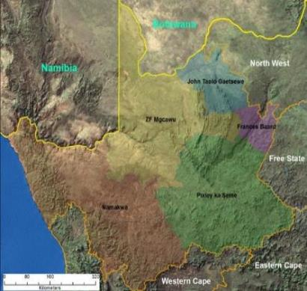
PROVINCIAL PROFILE
Northern Cape in a nutshell
Provincial Analysis
The Northern Cape is a Semi-Arid Province which occupies over 30% of South African land mass.
67% - Animal Production land use
1% - Crop production mainly under Irrigation
3% - World Production of Raisins
2.1% - Agricultural Households
(of RSA)
Biggest Irrigation scheme in Sub-Saharan Africa (Vaalharts Irrigation Scheme)
Biggest Wine Cellar Group
Population Analysis
2,1%
Of the South African Population
30%
1.2m
67%
2.1%
4

Slide 4
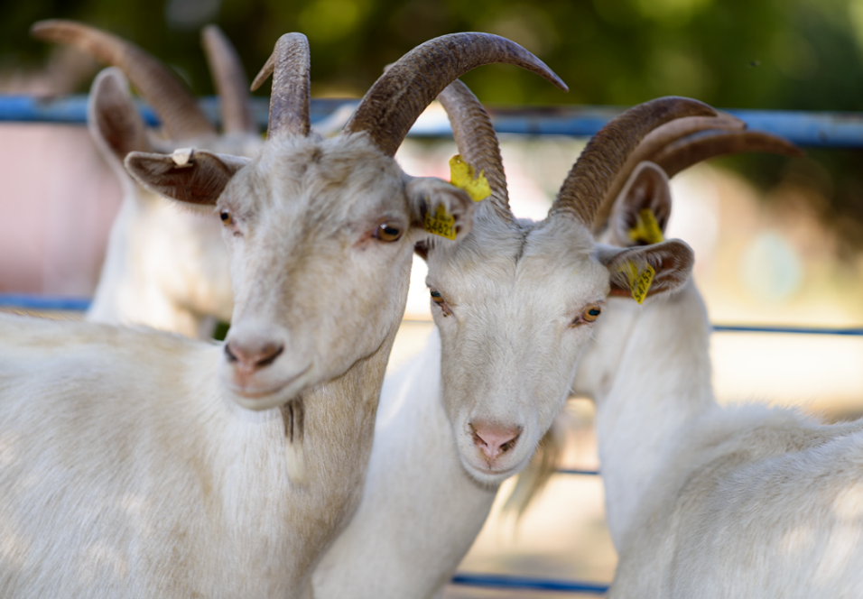
Make up of NC Agric
Region | Area under irrigation | Main crops | Irrigation method
Vaalharts | 32 000ha | Summer grains, Winter Cereals, Groundnuts, Lucerne, Pecan nuts | Centre Pivot and drip
Middle Orange | 44 000ha | Summer Grains, Winter Cereals, Lucerne and Cotton | Centre Pivot
Lower Orange | 38 000ha | Wine, dry and table grapes and Lucerne | Flood, drip and micro

Slide 5
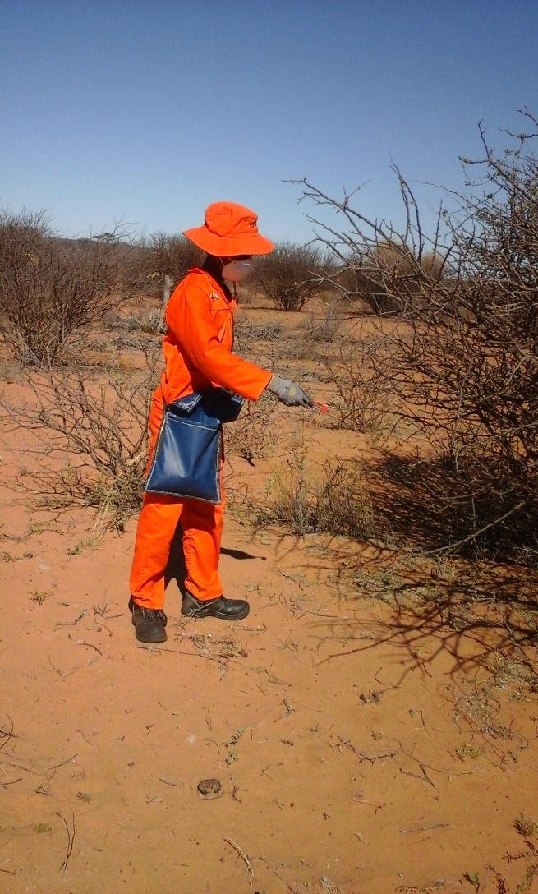
LANDCARE
LANDCARE
LANDCARE

Slide 6

Focus areas
VeldCare
SoilCare
Watercare
JuniorCare
Conservation agriculture
6

Slide 7
LandCare Projects
2016/17
PROJECT | LOCAL MUNICIPALITY | PROJECT SCOPE | BUDGET R’000 | WORK OPPORTUNIES
Frances Baard VeldCare Project | Magareng & Dikgatlong | Bush control of acacia mellifera on 2 000ha of rangeland | 1 000 | 30
JTG VeldCare Project | Joe Morolong | Veld enhancement program (Re-Vegetation), Fencing (20km), Bush Control of acacia mellifera and eradication of Gnidia Burchelli at Lokaleng, Magonate, Bothitong and Danoon (Kuruman) | 2 316 | 120
ZF Mgcawu VeldCare Project | Khara Hais | Chemical Control of 1 000ha of Rhigozum trichotomu | 800 | 10
Pixley Ka Seme SoilCare project | Ubuntu | Veld enhancement aimed at rehabilitating degraded soils using a variety of soil rehabilitation techniques | 1 000 | 38
National LandCare Conference 2016 | Provincial | Hosting of the 7th Biennial National LandCare conference and Districts LandCare awareness days | 4 000
LandCare Administration | Provincial | A contingency project administrative fund and funding of the Kalahari Namib Project | 204
Total |  |  | 9 320

Slide 8
LandCare Projects
2016/17

Slide 9

LANDCARE PROJECT NON-FINANCIAL PROGRESS
2016/17
DISTRICT | PROJECT | BUDGET R’000 | TYPE OF SUPPORT | PROGRESS
Pixley ka Seme | Pixley Ka Seme SoilCare (Site 1 Richmond | R1 000 | Veld enhancement and soil erosion control program | 210ha of rangeland rehabilitated
Frances Baard | Frances Baard Bush Control (Majeng and Honderdoring) | R1 000 | Chemical control of 1 000ha of acacia mellifera (Land Rehabilitation) | Funds re-allocated
Pixley ka Seme | Niekerkshoop Prosposis control | R200 | Control of prosopis re-growth onn previously mechanically controlled 250ha | Work to commence in the 3rd quarter

Slide 10

LANDCARE PROJECT NON-FINANCIAL PROGRESS
2016/17
DISTRICT | PROJECT | BUDGET R’000 | TYPE OF SUPPORT | PROGRESS
John Taolo Gaetsewe | JTG VeldCare site 1 Bothitong & Danoon), Site 2: Magonate & Site 3: Lokaleng | R3 116 | Control 700ha of Gnidia burchelli, 200ha acacia mellifera, fencing and reseeding of 316ha | 670ha of Gnidia burchelli controlled
ZF Mgcawu | Z.F Mgcawu VeldCare Site Miranda | R800 | Control 700ha of Rhigozum trichotomum | Project to commence in the 3rd quarter
Provincial | NC LandCare awareness | R4 000 | 7th Biennial National LandCare conference | Venues, accommodation, transport and promotional material procured

Slide 11
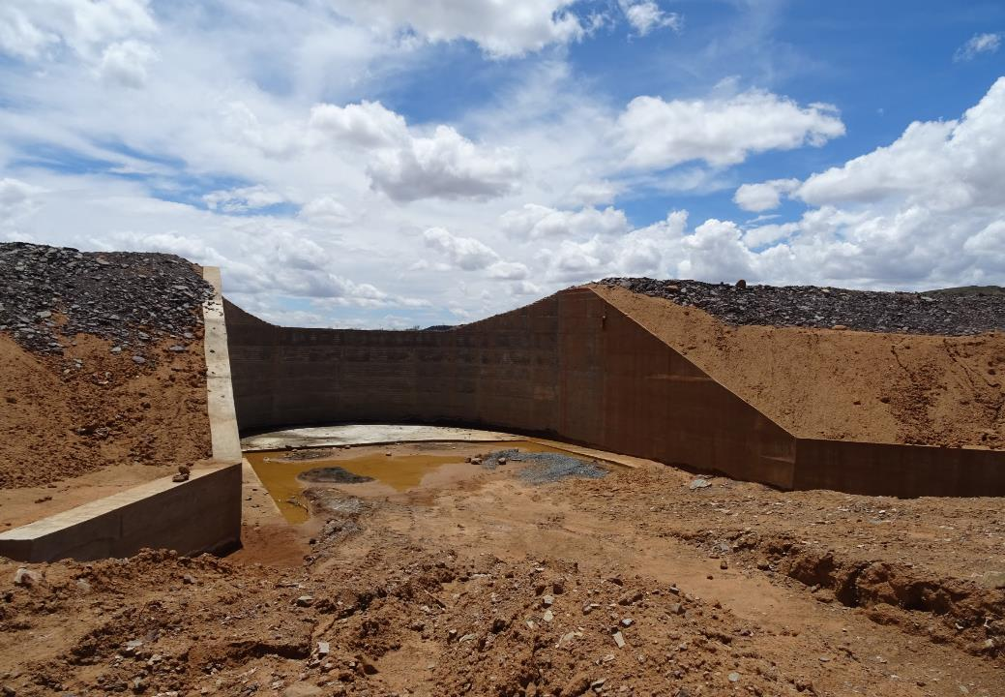

Slide 12
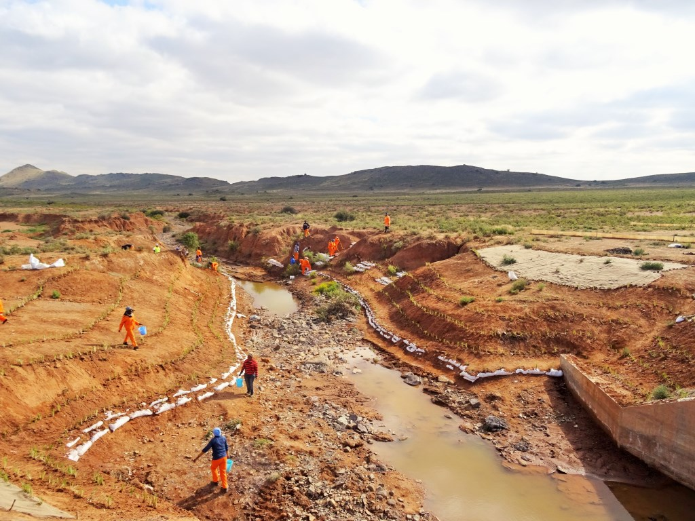

NC LandCare in the last 2 years
449 green jobs created.
12139ha protected/rehabilitated.
R2,5m spent on wages.
Training out sourced: R 225,000.00
R305,000.00 spent on protective clothing & branding.
Man hours…….
12

Slide 13
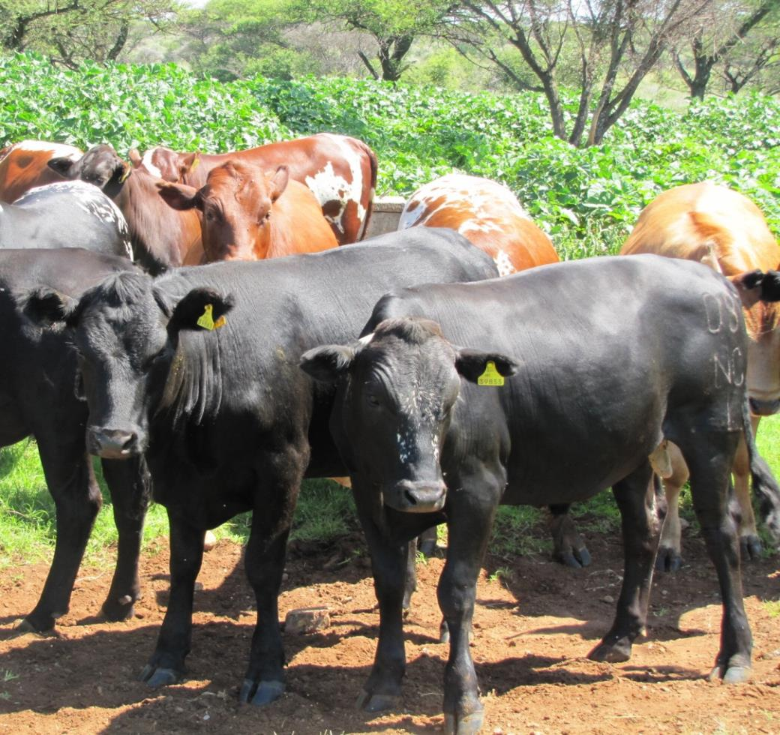
CASP
CASP

Slide 14
CASP BUDGET
2016/17
CASP PILLARS | OUTPUT | BUDGET ’000
On and Off farm infrastructure | CASP Projects | R 92 570
Training; Capacity Building | Farmer and Farm worker training & mentorship programmes | R 3 000
Marketing & Business Development | Marketing and business development support: Hanover abattoir, Moringa feasibility studies; Hopetown piggery EIA and electricity connection; Petrusville tannery electricity connection; Boegoberg feasibility study | R 2 135
Technical; Advisory & Regulatory Services | Extension Recovery Plan | R 28 122
Information & Knowledge Management | Research & Development | R 1 500
Financing Mechanisms | Farmer credit facility
 | Administration | R 1 037
TOTAL CASP BUDGET |  | R 128 364

Slide 15
Extension Recovery Plan
PILLARS | BUDGET | EXPENDITURE Q1
1. Ensure accountability & visibility of Extension (3%) | R 843 660 | R 1 038 396
2. Promote professionalism and improve the image of extension (2%) | R 562 440 | R 99 587
3. Recruitment of Personnel (60%) | R 16 873 200 | R 5 294 360
4. Re-skilling & Re-orientation of extension (5%) | R 1 406 100 | R 137 520
5. Provision of ICT infrastructure & other resources (30%) | R 8 436 600 | R 2 624 158
TOTAL | R 28 122 000 | R 9 194 021
Notes:
3%

Slide 16
CASP Training 2016/17
Budget allocated
Pillar | Activity | Output no. | Beneficiary no. | Cost (R’000)
Training and Capacity Building | Courses in small stock production, veldt management, crop production & financial management, etc. | 75 events | 1200 | R900
 | Farmers days | 100 | 650 | R650 Equitable share
 | Demonstration tours to experimental farms | 5 tours | 75 | 250 Equitable share
 | Mentorship | 1 | 93 | R2100
Total |  |  | 2018 | R3000

Slide 17
CASP PROJECTS PER DISTRICT
DISTRICT | NO. OF PROJECTS | BUDGET R’000
FRANCES BAARD | 4 | 14 200
JOHN TAOLO GAETSEWE | 3 | 21 970
NAMAKWA | 8 | 33 400
PIXLEY KA SEME | 6 | 15 000
ZF MGCAWU | 4 | 8 000
TOTAL | 25 | 92 570

Slide 18
CASP Projects
2016/17

Slide 19
BENEFICIARIES SUPPORTED
PROVINCE: NORTHERN CAPE | APAP Commodities |  | Targeted Beneficiaries | Beneficiaries supported this quarter | Adult |  |  | Youth |  |  | Total
 |  | No. of Projects |  |  | Male | Female | Disabled | Male | Female | Disabled
 | Wine
 | Fruit | 4 | 253 | 239 | 137 | 102 |  | 18 | 17 |  | 239
 | Vegetables | 2 | 45 | 4 | 2 | 2 | 1 | 2 |  | 1 | 4
 | Red Meat | 13 | 4119 | 2184 | 1783 | 401 | 1 | 158 | 20 |  | 2184
 | Poultry | 1 | 4 | 0 |  |  |  |  |  |  | 0
 | Grains (Maize & Wheat) | 4 | 1060 | 1020 | 720 | 300 |  | 100 | 50 |  | 1020
 | Wool | 1 | 48 | 0
 | Soya Beans
 | Aquaculture
 | Fisheries
 | Forestry
 | Other commodities
TOTAL |  | 25 | 5529 | 3447 | 2642 | 805 | 2 | 278 | 87 | 1 | 3447

Slide 20
FARMERS SUPPORTED
District | Farmers supported with infrastructure and inputs |  |  |  |  | Total | Farmers accessing markets |  |  | Total
 | Category | Newly supported |  | Existing
 |  | Male | Female | Male | Female |  | Male |  | Female
FRANCES BAARD | Subsistence |  |  |  |  | 0
 | Smallholder |  |  |  |  | 0
 | Black Commercial |  |  | 21 | 9 | 30 | 21 | 9 |  | 60
JOHN TAOLO GAETSEWE | Subsistence |  |  | 407 | 127 | 534 | 407 | 127 |  | 1068
 | Smallholder |  |  | 873 | 153 | 1026 | 873 | 153 |  | 2052
 | Black Commercial |  |  | 75 | 14 | 89 | 75 | 14 |  | 178
NAMAKWA | Subsistence |  |  |  |  | 0 |  |  |  | 0
 | Smallholder |  |  | 505 | 136 | 641 | 505 | 136 |  | 1282
 | Black Commercial |  |  |  |  | 0 |  |  |  | 0
PIXLEY KA SEME | Subsistence |  |  |  |  | 0 |  |  |  | 0
 | Smallholder |  |  | 42 | 9 | 51 | 42 | 9 |  | 102
 | Black Commercial |  |  |  |  | 0 |  |  |  | 0
ZF MGCAWU | Subsistence |  |  |  |  | 0
 | Smallholder |  |  |  |  | 0
 | Black Commercial |  |  |  |  | 0
Total |  |  |  | 1923 | 448 | 2371 | 1923 | 448 |  | 4742

Slide 21
HECTARES PLANTED
Maize | Planned No. of Hectares | No. of Hectares planted |  |  |  | Total
 |  | Quarter 1 | Quarter 2 | Quarter 3 | Quarter 4
 | 35
Wheat | Planned No. of Hectares | No. of Hectares planted |  |  |  | Total
 |  | Quarter 1 | Quarter 2 | Quarter 3 | Quarter 4
 | 150 | 150 |  |  |  | 150
Soyabeans | Planned No. of Hectares | No. of Hectares planted |  |  |  | Total
 |  | Quarter 1 | Quarter 2 | Quarter 3 | Quarter 4
Fruit | Planned No. of Hectares | No. of Hectares planted |  |  |  | Total
 |  | Quarter 1 | Quarter 2 | Quarter 3 | Quarter 4
 | 65
Vegetables | Planned No. of Hectares | No. of Hectares planted |  |  |  | Total
 |  | Quarter 1 | Quarter 2 | Quarter 3 | Quarter 4
 | 0,45 | 0,45 |  |  |  | 0.45
Wine grapes | Planned No. of Hectares | No. of Hectares planted |  |  |  | Total
 |  | Quarter 1 | Quarter 2 | Quarter 3 | Quarter 4
Sugarcane | Planned No. of Hectares | No. of Hectares planted |  |  |  | Total
 |  | Quarter 1 | Quarter 2 | Quarter 3 | Quarter 4
Aquaculture | Planned No. of Animals | No. of Animals / Sold |  |  |  | Total
 |  | Quarter 1 | Quarter 2 | Quarter 3 | Quarter 4
Oats | Planned No. of Hectares | No. of Hectares planted |  |  |  | Total
 |  | Quarter 1 | Quarter 2 | Quarter 3 | Quarter 4
 | 50 | 50 |  |  |  | 50
Barley | Planned No. of Hectares | No. of Hectares planted |  |  |  | Total
 |  | Quarter 1 | Quarter 2 | Quarter 3 | Quarter 4
 | 50
Rye | Planned No. of Hectares | No. of Hectares planted |  |  |  | Total
 |  | Quarter 1 | Quarter 2 | Quarter 3 | Quarter 4
 | 50
TOTAL | 400,45 | 200,45 |  |  |  | 200,45

Slide 22
Q1 CASP Training 2016/17
A total of 13 training courses were conducted
In total 259 beneficiaries were trained
Training was conducted by:
  extension practitioners
  economics unit
  external service providers
The courses were mainly non-credit bearing

Slide 23
Non Credit Bearing Training Conducted Q1
Name of Training | District | Total beneficiaries | Male | Female | Youth
Basic HACCP training | ZF Mgcawu | 22 | 11 | 11 | 8
Lucerne production | ZF Mgcawu | 13 | 4 | 9 | 6
Financial record keeping | ZF Mgcawu | 9 | 5 | 4 | 3
Fence construction | Pixley ka Seme | 20 | 14 | 6 | 8
Dongas rehabilitation techniques | Pixley ka Seme | 32 | 15 | 17 | 20
Cooperatives and marketing | Frances Baard | 16 | 12 | 4 | 4
Irrigation scheduling | Frances Baard | 24 | 11 | 13 | 13
Cattle production | Frances Baard | 23 | 16 | 7 | 7
Vaccinate and dehorning of animal | Frances Baard | 2 | 1 | 1 | 1

Slide 24
Non Credit Bearing Training Conducted Q1
Name of Training | District | Total beneficiaries | Male | Female | Youth
Cattle production (x2) | John Taolo Gaetsewe | 27 | 15 | 12 | 11
Small stock training | John Taolo Gaetsewe | 12 | 9 | 3 | 0
Vegetable production (x2) | John Taolo Gaetsewe | 29 | 7 | 22 | 9
Safe handling of chemicals | John Taolo Gaetsewe | 26 | 12 | 14 | 2
Broiler management | John Taolo Gaetsewe | 4 | 0 | 4 | 2
Total |  | 259 | 132 | 127 | 95

Slide 25
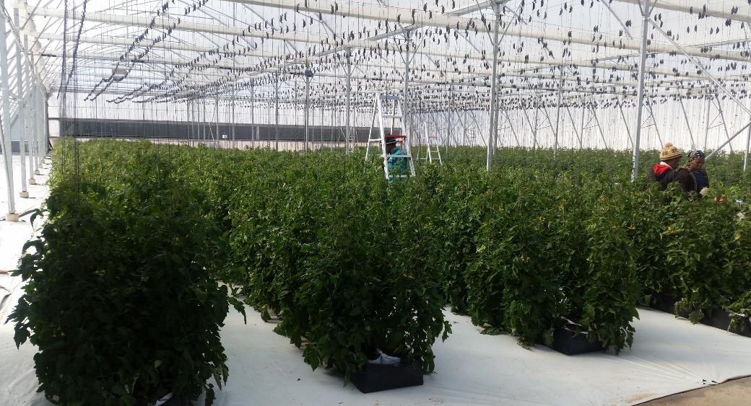
ILIMA-LETSEMA 2016/17

Slide 26
PROJECTS PER DISTRICT
DISTRICT | NO. OF PROJECTS | BUDGET R’000
FRANCES BAARD | 2 | 18 000
JOHN TAOLO GAETSEWE | 1 | 6 500
NAMAKWA | 1 | 2 000
PIXLEY KA SEME | 3 | 9 100
ZF MGCAWU | 7 | 19 450
TOTAL | 14 | 55 050

Slide 27
Ilima / Letsema
2016/17

Slide 28
COMMODITIES SUPPORTED
COMMODITIES | NUMBER OF PROJECTS PER COMMODITY | BUDGET (R’000)
Irrigation Schemes | 1 | 13 000 .00
Wine | 4 | 13 150 .00
Fruit | 3 | 6 300 .00
Vegetables | 1 | 6 500 .00
Maize & Wheat | 2 | 10 000 .00
Fisheries | 1 | 2 900 .00
Piggery | 1 | 1 200 .00
Rooibos Tea | 1 | 2 000 .00
TOTAL | 14 | 55 050 .00

Slide 29
BENEFICIARIES SUPPORTED
PROVINCE: NORTHERN CAPE | APAP Commodities |  | Targeted Beneficiaries | Supported Beneficiaries supported this quarter | Adult |  |  | Youth
 |  | No. of Projects |  |  | Male | Female | Disabled | Male | Female | Disabled
 | Irrigation Schemes | 1 | 39 | 39 | 34 | 5
 | Wine | 4 | 1281 | 1281 | 604 | 677
 | Fruit | 3 | 1562 | 1562 | 750 | 812
 | Vegetables | 1 | 84
 | Red Meat
 | Poultry
 | Grains (Maize & Wheat) | 2 | 226 | 128 | 107 | 21
 | Wool
 | Soya Beans
 | Aquaculture
 | Fisheries | 1 | 0
 | Piggery | 1 | 14
 | Rooibos Tea | 1 | 85
 | Forestry
TOTAL |  | 14 | 3291 | 3010 | 1495 | 1515

Slide 30
FARMERS SUPPORTED
District | Farmers supported with infrastructure and inputs |  |  |  |  |  | Total | Farmers accessing markets |  | Total
 | Category | Newly supported |  | Existing
 |  | Male | Female | Male | Female |  |  | Male | Female
FRANCES BAARD | Subsistence
 | Smallholder |  |  | 2 | 4 |  | 6 | 2 | 4 | 6
 | Black Commercial |  |  | 20 | 1 |  | 21 | 20 | 1 | 21
JOHN TAOLO GAETSEWE | Subsistence
 | Smallholder
 | Black Commercial
NAMAKWA | Subsistence
 | Smallholder
 | Black Commercial
PIXLEY KA SEME | Subsistence
 | Smallholder |  |  | 107 | 21 |  | 128 | 107 | 21 | 128
 | Black Commercial
ZF MGCAWU | Subsistence
 | Smallholder |  |  | 38 | 28 |  | 66 | 38 | 28 | 66
 | Black Commercial
Total |  |  |  | 167 | 54 |  | 221 | 167 | 54 | 221

Slide 31
HECTARES PLANTED
Maize | Planned No. of Hectares | No. of Hectares planted |  |  |  | Total
 |  | Quarter 1 | Quarter 2 | Quarter 3 | Quarter 4
 | 400
Wheat | Planned No. of Hectares | No. of Hectares planted |  |  |  | Total
 |  | Quarter 1 | Quarter 2 | Quarter 3 | Quarter 4
 | 400 | 400 |  |  |  | 400
Soyabeans | Planned No. of Hectares | No. of Hectares planted |  |  |  | Total
 |  | Quarter 1 | Quarter 2 | Quarter 3 | Quarter 4
Fruit | Planned No. of Hectares | No. of Hectares planted |  |  |  | Total
 |  | Quarter 1 | Quarter 2 | Quarter 3 | Quarter 4
 | 17
Vegetables | Planned No. of Hectares | No. of Hectares planted |  |  |  | Total
 |  | Quarter 1 | Quarter 2 | Quarter 3 | Quarter 4
 | 0,6 | 0,3 |  |  |  | 0,3
Wine grapes | Planned No. of Hectares | No. of Hectares planted |  |  |  | Total
 |  | Quarter 1 | Quarter 2 | Quarter 3 | Quarter 4
 | 9,03
Rooibos Tea | Planned No. of Hectares | No. of Hectares planted |  |  |  | Total
 |  | Quarter 1 | Quarter 2 | Quarter 3 | Quarter 4
 | 150
Aquaculture | Planned No. of Animals | No. of Animals / Sold |  |  |  | Total
 |  | Quarter 1 | Quarter 2 | Quarter 3 | Quarter 4
TOTAL | 976,63 | 400,3 |  |  |  | 400,3

Slide 32
FETSA TLALA PROJECTS PLANTED
2015/16
Crop | Total Hectors | District | No. of Projects
Maize | 579 | Frances Baard | 15
 | 78 | Pixley ka Seme | 5
Wheat | 579 | Frances Baard | 15
 | 78 | Pixley ka Seme | 5
 | 83 | Namakwa | 1
Oats | 41 | Namakwa | 1

Slide 33
FETSA TLALA PRODUCTION PLAN 2016/17
Crop | Total Hectors | District | No. of Projects
Maize | 300 | Frances Baard | 15
 | 35 | Namakwa | 1
 | 100 | Pixley ka Seme | 4
Wheat | 90 | Namakwa | 1
 | 300 | Frances Baard | 15
 | 100 | Pixley ka Seme | 4
Dry Beans | 11 | Namakwa | 1
Oats | 50 | Namakwa | 1

Slide 34
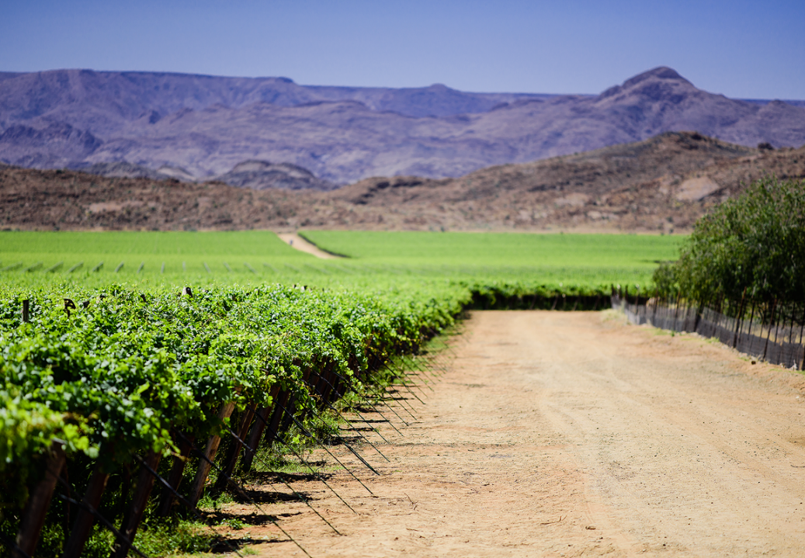
HIGH IMPACT
VALUE-CHAIN PROJECTS
HIGH IMPACT PROJECTS
ROOIBOS DEVELOPMENT
NAMAKWA IRRIGATION DEVELOPMENT
VAALHARTS REVITALIZATION SCHEME
18

Slide 35
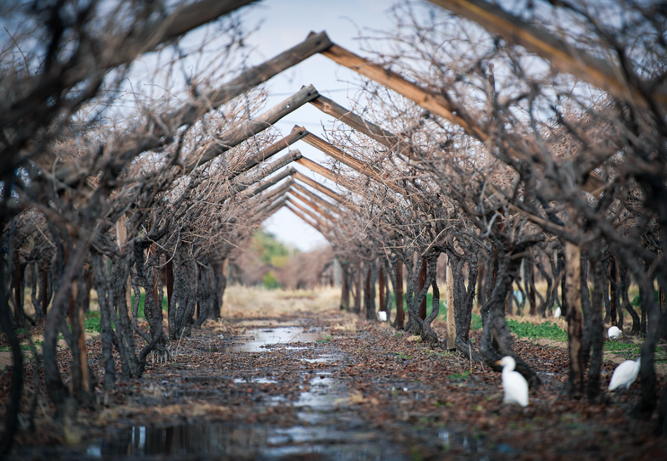
NAMAKWA IRRIGATION DEVELOPMENT
NDP: Expansion of Irrigated Land
Develop 3 200 Ha of high potential arable land.
2 000 Ha already has existing water licenses. 1 200 Ha new water rights to be sought. Land belongs to emerging farmers or municipalities
11 Localities along the Lower Orange River. Onseepkans is the Anchor of the Namakwa Irrigation Development
High Value crops targeted such as Raisins, wine and table grapes, Dates and where possible, Pecan nuts.
Project costs over 10 years is R1.6 billion. Funded through Conditional Grants
26

Slide 36
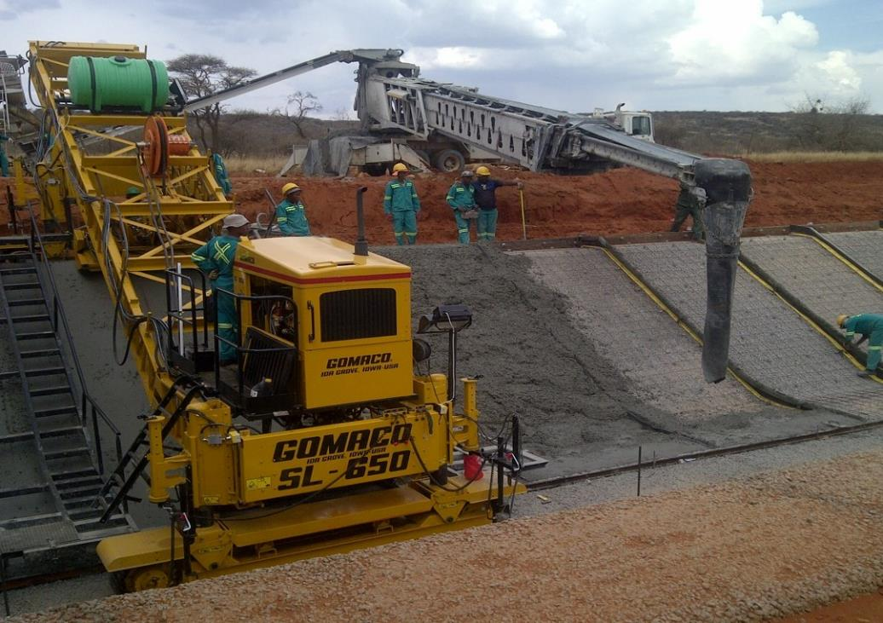
VAALHARTS REVITALISATION SCHEME
SIP 11 Project / NDP Expansion of Irrigated Agriculture
32 000 Ha of arable land, which makes it one of the biggest irrigation schemes in Sub-Saharan Africa
Bulk Irrigation infrastructure is 60 years and this results in about 30% water loss due to leaking canals
Revitalization of the infrastructure can increase Maize production by 5.7% and Wheat by 5.6% in the Northern Cape
Over 30% of Vaalharts is now under Pecan nuts Production and this industry is growing at a phenomenal rate. Main market is China
29

Slide 37
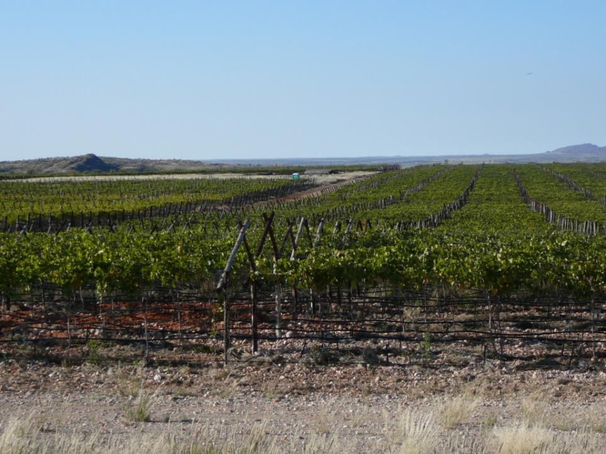
NORTHERN CAPE VINEYARD DEVELOPMENT SCHEME

Slide 38
Land under production
Name of Project | Villard Blanc | Cheninblanc/Colombar | Raisins | Future developments (Ha)
Realeboga | 6 | 5.73 |  | 22 ha raisins
Sanddraai | 12,4 | 0 | 3,6 | 0
Middel -Eiland | 8.5 | 0 |  | 0
Valley Junction | 10 | 0 |  | 10 ha wine
Blocuso | 18 | 12 | 9 | 170 ha wine and raisins
Riemvasmaak | 0 | 0 | 0 | 40 ha export grapes
Silver Moon | 0 | 0 | 16 | 9 ha raisins
Eksteenkuil | 8.5 | 0 | 32,8 | 18.70 ha raisins
Lemoendraai | 0 | 16 | 0 | 13 ha wine and 20 ha raisins
Nomalangha | 0 | 0 | (70) | 70 ha to be replanted
Silvermoon | 0 | 0 | 16 | 8.4ha raisins
Pella | 0 | 0 | 0 | 60ha to be developed
Coboop | 0 | 0 | 0 | 49ha to be developed
Total | 76.4 | 33,73 | 77.4 | 369.47 to be developed 187.53 developed

Slide 39
EXPENDITURE
REPORT

Slide 40
C-Grant Expenditure Summary as at 15 September 2016

Slide 41
C-Grant Expenditure Summary as at 15 September 2016

Slide 42
C-Grant Expenditure Summary as at 15 September 2016

Slide 43
C-Grant Expenditure Trend as at 15 September 2016

Slide 44
CASP Expenditure per District as at 15 September 2016

Slide 45
Ilima/Letsema Expenditure per District as at 15 September 2016

Slide 46
LandCare Expenditure per District as at 15 September 2016

Slide 47
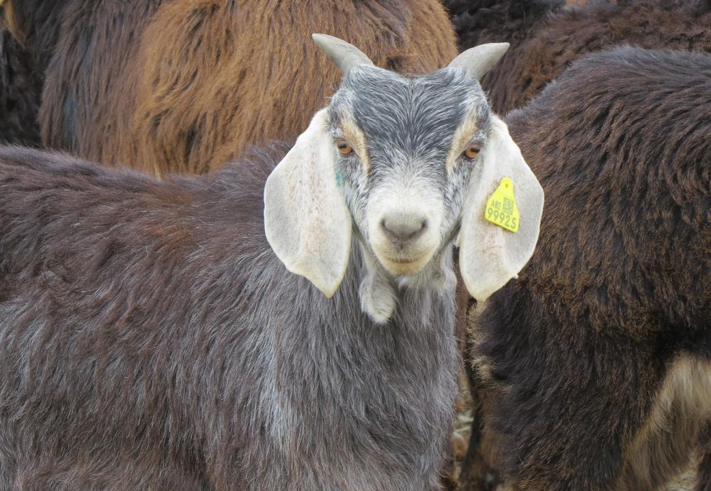
THANK YOU

