Slide 1
PRESENTATION TO PORTFOLIO COMMITTEE ON AGRICULTURE,FORESTRY AND FISHERIES
CONDITIONAL GRANTS AND EQUITABLE SHARE PLANS AND PROGRESS
PROVINCE:LIMPOPO
PRESENTER: NOWATA JETHRO
21 SEPTEMBER 2016

Slide 2
Presentation outline
Overview of the province
Food Security Status in the past 5 years
National Development Plan
Nine Point Plan
Key Agricultural Development Zones
Commodities Produced in Limpopo
Highlights
Agri-Park
Planned Activities
Investment per Commodity
Major commodities and progress
Programme Allocation in 2016/17
Job Creation
Capacity Building
Extension Recovery Program
Colleges of Agriculture
Disaster
Fetsa Tlala Readiness
Land Care and EPWP
Drought Status

Slide 3
Overview of the Province
Total agricultural land available for agricultural production is 11 321 million
Size of the area under irrigation 163 080,20ha (SIQ 2011)
Dominated by citrus, subtropical fruit and vegetable as well as variety of nuts.
Limpopo has approximately 88% of the population living in non-urban areas (StatsSA 2015 General Household Survey report, released in June 2016)
Limpopo is among provinces with the highest % of households relying on grants, at 59,8%, more than the national average of 46,2%.
Limpopo province has the highest percentage of people involved in agriculture, at 43,8%. The national average is 16,9%.

Slide 4
Food Security Status over past 5 years
Qualitative and quantitative data have been gathered in the province of Limpopo across 5 different districts in 2011.
In the same year findings showed that 52% of the sampled households were severely food insecure while 32% is living off less than 1$US a day.
In 2015 the number of households involve in agricultural activities were 71% in order to improve livelihood.
Grain production was the most popular agricultural activity across the four Livelihood Zones (74.7%).
Livestock production was second most popular agricultural activity practiced by households from the selected Livelihood Zones, with 26.5%.
Poultry production was the third popular agricultural activity in two zones practiced by 14.25% of the households.
Fruit and vegetable production was the third most popular agricultural activity in one zone, practiced by 25.3% of the households.
The province will continue to implement programs like Fetsa Tlala and Aquaculture to improve livelihood and income of the rural communities.

Slide 5
National Development Plan (NDP)
Targets (Nationally):
1 million jobs - Job increase of 500 000 by 2019 (100 000/annum) and 1 million by 2030
2 million ha of strategically located land acquired by 2019
1 million ha of under-utilized land in communal areas and land reform projects put in production
Provide support to 80 000 new smallholder producers by 2019
Food security for all by 2030 – Reduction of households vulnerable to food insecurity by 9.5% by 2019

Slide 6
Nine Point Plan (SONA 2015)
Resolving Energy challenges.
Revitalizing the Agriculture and Agro Processing value chain (RAAVC) - Agri-parks adopted as a model for implementation.
Advancing beneficiation and adding value to mineral wealth.
Effective Implementation of Industrial Policy Action Plan(IPAP).
Moderating workplace conflict.
Encouraging Private Sector Investment.
Cross cutting areas to reform, boost and diversify the economy (i.e Water and Sanitation infrastructure).
Unlocking the potential of SMME, Co-operatives, Township and Rural Enterprise potential.
Growing Ocean Economy and Tourism & Aquaculture “Operation Phakisha”

Slide 7
Identified Key Agricultural Development Zone
Prior to the Agri-Parks concept, the LDARD had already started work at identified Key Agricultural Development Zones (ADZ), confirmed by Agri-Parks development focus
Priska development in Mopani District, supporting horticulture development (variety of cash-crops and fruit production)
Nwanedi development in Vhembe District, supporting vegetables, mainly tomato.
Lower and Upper Lepelle river in Sekhukhune District supporting mainly grain production
Red meat zone development in Waterberg district
Potato belt development in Capricorn District,
Aquaculture development targeting rural communities with in-land water sources, focusing on Sekhukhune and Vhembe.
Poultry cluster – provincial focus, with specific focus on Sekhukhune and Capricorn

Slide 8
COMMODITIES PRODUCED IN LIMPOPO
Horticulture
Citrus
Subtropical fruit
Avocadoes
Bananas
Litchi
Mangoes
Nuts
Macadamia Nuts
Vegetables
Tomatoes
Potatoes
Onions
Industrial crops
Tea
Cotton
Tobacco
Field Crops
Grains
Maize
Sorghum
Wheat
Canola
Oil and protein seeds
Sunflower
Groundnuts
Dry Beans
Soybean
Livestock
Red meat
Beef
Game/Venison
Dairy
White meat
Poultry (Broiler and Egg Production)
Pork
Fish (Aquaculture system)
Forestry

Slide 9
LDARD’s contribution (MTSF targets)
Strategic Objective / Programme | Target for 2014-19 MTSF
2. Agro-processing and value adding support | 13 facilities (2 x seed processing, 2 x vegetable processing & value adding), 1 x fruit processing , 2 x potato value adding, 1 x maize mill, 1x feed mill, 1 x dairy, 1x feedlot, 1x abattoir)
3. Support employment creation through upstream and down stream activities | 25 000 Job opportunities created through: Primary production Agro processing Irrigation expansion EPWP
4. Support agribusinesses (agricultural cooperatives and agricultural enterprises) on finance and market access | 600 agribusinesses supported to access commodity markets 250 agribusinesses supported to access agricultural finance
5. Strengthen support to reduce the impact of animal diseases, pests outbreak natural disasters on livestock and horticulture industries | Increase resources in terms of ICT and human capital

Slide 10
LDARD’s contribution (MTSF targets)
Strategic Objective / Programme | Target for 2014-19 MTSF
1. Increased smallholder agricultural production (Crops and livestock) to contribute to food security and employment creation | Expansion of irrigated agriculture, supplemented by dry-land production – provision of infrastructure, production inputs, mechanisation support, etc. Facilitate conversion of 200 000 hectares of under-utilised land in communal areas and land reform projects into productive units, including revitalization of small scale irrigation schemes (RESIS)
 | 5 000 tons of Seeds varieties produced under dry-land and processed.
 | Provision of1860 livestock breeding material to farmers
 | Supply of 92000 fish breeding stock (fingerlings) to farmers
 | Strengthen support to broiler producers to operationalise broiler houses in Sekhukhune and Capricorn districts

Slide 11
APAP and MTSF; Nine Point Plan progress
Strategic Objective / Programme | Provincial Target for 2014-19 Electoral Cycle | Progress from 2014/15 to 1 quarter 2016/17
Create opportunities for rural communities to participate fully in the economy through initiatives like Fetsa Tlala. | 5 (Development of ADZ covering Nwanedi, GRASP, Upper and Lower Lepelle canal, Mogalakwena Red Meat and Potato belt | Identified strategic location to ensure production from grain to vegetable production Cleared more than 2600 hectares of land in the Sekhukhune to ensure production takes-off. Established two Aquaculture development projects as source of protein to rural communities. Installed and completed 40 irrigation projects to increase production. Started with the 17km Priska canal to ensure flow of water.
Expansion of irrigated | Complete mainly 05 irrigation schemes to cover 1300ha and complete 17km Priska canal | Mogalatjane (139ha) irrigation scheme at 90% completion Matsika (90ha) 70% completion Nwanedi Phase (280ha) 1 50% completion Tshikonelo (90ha) irrigation scheme tender awarded Elandskraal (200ha) through DRDLR
Agriculture, supplemented by dry-land production.

Slide 12
APAP and MTSF; Nine Point Plan progress
Strategic Objective / Programme | Provincial Target for 2014-19 Electoral Cycle | Progress from 2014/15 to 1 quarter 2016/17
Integration of the | 5 (All ADZ). To be complimented by also five Agri-parks | Infrastructure development is progressing in all ADZ i.e. Nwanedi, GRASP-Prisca; Potato belt; Red Meat cluster and Upper and Lower Lepelle.
rural areas, achieved through successful
Infrastructure development, job creation and poverty alleviation.
Trade, Agribusiness Development and Support: 10 community milling facilities | 3 seed processing facilities established 10 community milling facilities 05 packing facilities | Seed processing facility already completed at Madzivhandila College Sekgosese Community Mill is at 80% completion Three packing facilities completed (Vhuawelo; Raletjena and Solly Boerdery One on advert (Nwanedi) One on Planning (Masalal)

Slide 13
APAP and MTSF; Nine Point Plan progress
Strategic Objective / Programme | Provincial Target for 2014-19 Electoral Cycle | Progress from 2014/15 to 1 quarter 2016/17
Facilitate conversion of 200 000 hectares of under-utilised land in communal areas and land reform projects into productive units, including revitalization of small scale irrigation schemes (RESIS) | • 200 000 ha | 51840 ha were put under production covering grain and cash-crop Red meat area ensure development of more than 31000 ha. Agri-Park development has a potential to trigger more land.
Supply of 92 000 fish breeding stock to farmers | • 92 000 | In 2014/15 - 6000 delivered to Mrs Mathobo and Phetwane) In 2015/16 20 000 fish breeding stock were delivered to two projects (Phetwane and Tlading Hyper)

Slide 14
Highlights
The Department has since 2014/15 to date put more than 51840ha under production of which 391ha were under irrigated land.
Assisted 72 projects with irrigation water at a cost of R87.8 million @ average cost of R106 094/ha. This intervention has assisted farmers to access different markets e.g. Mccain – all potato producers; Tiger brand – all Nwanedi farmers and Kopano Disable; woolworths – GRASP farmers, PnP - Vhuawelo etc.
Adopted development approach that focuses on the priority commodities of the province ensuring that rural communities participate in the economy.
Partnering with different funders over the years e.g. Anglo Platinum at Mapela Red Meat Cluster; Job Fund, Department of Small Business at Nwanedi; World vision at Sekgosese Milling; Ba-Phalaborwa foundation (Mining foundation) Waterbok Irrigation Project.

Slide 15
Highlights continues
Nwanedi Agricultural Development now called Nwanedi Agricultural Agri-Park Development is unlocking market opportunities for more than 200 farmers.
The development initiated has attracted R58 million over three years from Job Fund and R7.6 million from Department of Trade and Industry.
Nwanedi Incubation program has increased production from 30tons to 60tons per ha. Employment opportunities has increased from 03 to 09 permanent employees per farmer.
This (Nwanedi) project has already created more than 562 job opportunities during installation of irrigation systems and 187 during production.

Slide 16
Agri-Park: Development Approach
Primary production is being developed and increased mainly to support agri-parks
Production infrastructure is being developed in more comprehensive manner (targeting cluster support, support production logistics system developed i.e. mechanization, production inputs etc.
Improved knowledge and skills of farmers along value chain
Ownership is instilled within farming communities through participatory approach model – farmers are taking part in the planning processes, implementation of certain activities like fencing, debushing are carried out by farmers etc.

Slide 17
Agri-Park
Agri-Park name | Prioritised Commodities | Current cobined budget 2016/17 R'000 | Progress
Capricorn: Poopedi | Potato and Onion Poultry | 61 700 | Completed Raletjena Packing facility a total of R7.8 million was spent (R4.3m LDARD and R3.5m DRDLR) and ; Development of potato irrigation projects on going at different stages
Sekhukhune: Groblersdal | Poultry, Grains | 65 400 | PMU will be appointed by DRDLR to conduct a feasibility study as well as the detailed planning of a broiler abattoir; Irrigation projects in progress
Mopani: Tzaneen | Subtropical Fruit and Vegetables | 53 800 | Fencing tender for hub advertised; infrastructure for primary production in progress
Vhembe: Nwanedi | Avocado and Vegetables | 99 600 | Pack house on tender; Bid for Agri-hub and FPSU fencing on advert
Waterberg: Modimolle | Livestock: Red meet | 28 300 | Livestock infrastructure in progress
Total |  | 308 800

Slide 18
Planned Activities aligned to APAP
Commodity | Total Allocation | Planned projects | Planned jobs | No. of Farmers targeted | Progress
 | R’000 (conditional grant and Eq Share)
Grains | 34 625 | 34 | 3095 | 10359 | Completed production plans for 2016/17
Vegetables | 68 752 | 40 | 5 526 | 3815 | 02 projects at 76%-99% completion, one project at advert , 04 - retention and 03 planning for 2017/18 implementation. 01 on advert
Red Meat | 32 072 | 18 | 198 | 757 | Recruitment for EPWP labour is completed for both Modimolle and Mogalakwena. Currently generating official purchase orders for fencing 130km boarder fence; Water develop to relief drought affected communities is also progressing.
Poultry | 12 875 | 24 | 135 | 87 | 01 project - practically completed and 02 - bid-evaluation for repairing. The remaining 5 ECBH are on hold due to market related issue. Awaits Lebowakgomo abattoir operation.
Fruits | 14 730 | 8 | 952 | 301 | 02- bid awarded; 01 completed; 02 construction.
Table Grapes | 1 400 | 1 | 52 | 10 | Bid- evaluation stage
Aquaculture | 20 684 | 3 | 102 | 373 | Fish processing facility is at 50% completion stage and Turf fish Hatchery is at tender stage.
Dairy | 2 101 | 1 | 15 | 68
Bee | 396 | 1 | 2 | 1
Total | 187 635 | 130 | 10 077 | 15 771

Slide 19
Investment per commodity

Slide 20
Major commodities and progress
Cash crop main high value crops (Tomatoes and Baby Vegetables
Two main areas: Nwanedi and Mopani
The two areas cover : 273 farmers
Phase 1 extend of land in hectares: 4 140 ha
Main objectives: improved infrastructure primary and secondary and create Coordinated production and market supply system through cluster approach:
Just between 2014/15 to date 30 farmers all women received irrigation infrastructure and all have started with production each creating between 9 to 12 jobs from only 02 to 03 jobs. Production increased also from 30 to 60 tons.
The flow of water has also improved at Mopani Prisca canal
Potato Development
Target area is Capricorn District covering part of Blouberg, Molemole and Polokwane Local Municipalities
The main objective is to graduate ten (10 small producers to commercial level by 2018/19) and currently the province has only 05 producers compared to 95 white commercial producers.
Completed four irrigation projects and production has started on three 03 projects i.e. (Maiwashe; Maroon Trading and Maseka;
One project on advert and two planning in this current financial year.
Completed two packing facilities (Raletjena (CASP & DRDLR) and Solly’s Boerdery (BEE fund and CASP to develop ablution facilities)

Slide 21
Programme allocations in 2016/17
Programme | Total Allocation | Transfer in Q1 | Expenditure in Q1 | % Spent per transfer | % Spent from total Allocation
 | R'000 | R'000 | R'000
CASP | 260 576 | 56 782 | 43 794 | 77 | 17
ILIMA/LETSEMA | 63 876 | 12 775 | 1 501 | 12 | 0
LAND CARE | 10 438 | 1 044 | 399 | 38 | 0
EPWP | 4 476 | 1 119 | 64 | 6 | 0
Conditional Grants Total | 339 366 | 71 720 | 45 758 | 64 | 17
EQUITABLE SHARE | 21 136 | - | 1 463 | - | 7
Total | 360 502 | 71 720 | 47 221 |  | 13

Slide 22
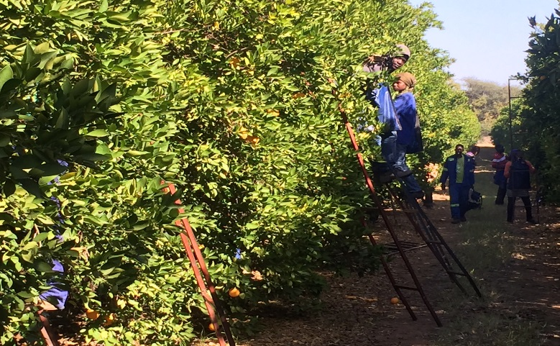
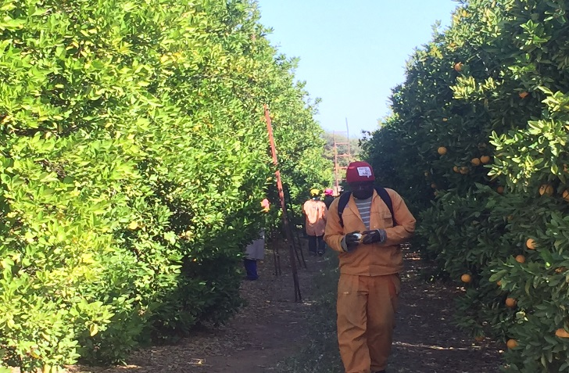
Jobs Created Quarter 01 of 2016/17
PROVINCE | Annual Targets | Number of Employees |  | Total | Permanent |  | Total | Temporary/ Seasonal |  | Total | Youth employed |  | Total | disabled employed |  | Total
COMMODITY |  | Male | Female |  | Male | Female |  | Male | Female |  | Male | Female |  | Male | Female
Fruits | 1004 | 74 | 200 | 274 | 44 | 83 | 127 | 30 | 117 | 147 | 22 | 35 | 57 | 0 | 0 | 0
Vegetables | 5526 | 48 | 31 | 79 | 157 | 101 | 16 | 41 | 22 | 63 | 32 | 17 | 49 | 0 | 0 | 0
Livestock | 348 | 24 | 18 | 42 | 5 | 11 | 16 | 19 | 7 | 26 | 13 | 2 | 15 | 0 | 0 | 0
Grain | 3095 | 21 | 5 | 26 | 3 | 2 | 5 | 18 | 3 | 21 | 11 | 2 | 13 | 0 | 0 | 0
Aqua&Apiculture | 104 | 3 | 3 | 6 | 0 | 0 | 0 | 3 | 3 | 6 | 2 | 1 | 3 | 0 | 0 | 0
Total | 10077 | 170 | 257 | 674 | 209 | 202 | 164 | 111 | 152 | 263 | 80 | 57 | 137 | 0 | 0 | 0

Slide 23
Capacity Building
Progarm | Allocation R'000 | Targets Q1 | Transfe in Quarter 1 | Expenditure Q 1 | Progress Made
Farmers Training | 9 083 | 150 | 1 998 |  | 224 farmers training
Mentorship | 6 056 |  | 1 332
Total | 15 139 | 150 | 3 331 | - | -
Training during quarter 01: concentrated on marketing - assisting the beneficiaries to create effective and efficient market systems so as to reduce transport costs by initiating bulk cluster production systems.
Invoices were processed in July 2016 outside quarter 1 period.
Mentorship was not provided during the period under review and to date the Department has recommended 17 companies to provide mentorship to projects.

Slide 24
Extension Recovery Program
Grant outputs | Total annual targets | Q1 Target | Quarter 1 Progress
Improved skills and Knowledge of Extension Officers through Human Resource Development Pillar | 612 | 100 | 62 Officials were re-skilled on different programs –(35 poultry; 14 irrigation evaluation; 13 Project Management)
Information Communication Technology Pillar | 305 | 305 | No ICT tools were procured as planned. The procurement under way and will be completed by the end of September. Registered and increase in the usage of smart pen by 19.7 as compared to the same period in 2015.
Image and professionalism | 06 conferences; 100 officials attending professional bodies conferences and seminars |  | No target during quarter 01 but 05 Officials attended SASAE conference between 5-8June 2016
Improved Extension visibility and accountability | Maintaining 679 communication tools; procuring protective clothing for 500 officials and 25 sign boards | Maintenance of 679 communication tools; 500 protective clothing & 25 sign boards | Maintenance is continuing on a monthly basis; 500 protective clothing were procured and distributed and 25 sign boards to be procured in quarter 3.
Recruitment | Maintaining salaries of 121 officials | 121 officials | Achieved monthly

Slide 25
Colleges of Agriculture
Two colleges of Agriculture in the Province namely Tompi Seleka and Madzivhandila College
2016/17 CASP budget: R17,2m.
CASP expenditure at quarter 01 was: 18%(R3,1m)
Equitable share budget is: R9,7 million
Total R 26,9m
CASP Non Financials
CASP – three (03) main projects (Madzi Cluster @ 58% completion; Tompi Cluster 2 @ 53% and Cluster 4 @ 62%.
Piggery project for vocational training at Madzivhandila was completed.
Equitable share budget will be used to construct Academic Structure. The bid was advertised and closed on the 17 July 2016.

Slide 26
Disaster
Total number of project = 43
Program Value: R15.5m
Expenditure: 08% (R1.3m)
01%-25%: 18 projects – R9.6m
26%-50%: 15 projects – R4,1m
76%-100%: 10 projects completed – R1.3m

Slide 27
Fetsa Tlala readiness 2016/17
Standard operative procedure has been approved to guide the implementation of the mechanization Support program
Contract has been concluded with Landin to service and repair all tractors.
Out of 480ha targeted in Quarter 01 only 43 hectares were ploughed and planted as a results of incomplete projects in the identified areas like Mogalatjane and dam levels - restrictions
All tractors are in good condition except only three tractors with Landin for repairs out of 72.
Fertilizers procured and delivered = 37 tons
Seeds procured and delivered = 16.2 tons
Potato seeds = 3.1 tons – already planted
Chemicals procured and delivered = 160 litres
Delivery of production inputs is progressing

Slide 28
LANDCARE AND EPWP PROGRESS: QUARTER 1 - 2016/16
Indicators | Annual Target | Q 01: Target | Actual Output: Q 01
Number of hectares protected/rehabilitated to improve agricultural production | 13 000 ha | 2 000 ha | 2 008 ha
Kilometres of fencing constructed | 65 km | 10 km | 5 km at Khomanani LandCare
Number of Green Jobs created through EPWP | 4 000 | 800 | 807 jobs created from 14 projects out of 40 registered on the EPWP RS
Number of hectares cleared of alien invasive plants and weeds | 2 000 ha | 200 ha | 200 ha

Slide 29
CURRENT DROUGHT STATUS AND MITIGATION STRATEGIES
Limpopo Province received below normal rainfall during the previous summer, October, November and December 2015.
The situation did not improve since then.
No rainfall was received during the current spring, September 2016
Provincial farmers are continually given early warning information awareness and advisory services regarding the current drought situation.
The Province through equitable share has set aside an amount of R8m for drought relief purposes while conditional grants has supplemented with R13million
The average Dam levels is at 49.1% at 16th September 2016 as compared to 76.0% this time around, last year.
Recorded mortality to date is 31329
A total of 36213 x40kg bags were delivered
A total number of 31 boreholes were recently drilled and equipped with windmills, drinking troughs and 2 x 10 000 litres jojo tanks at cost of R7.9 million by end of quarter 1.

Slide 30
THANKS

