Slide 1
PRESENTATION TO PORTFOLIO COMMITTEE ON AGRICULTURE,FORESTRY AND FISHERIES ON CONDITIONAL GRANTS AND EQUITABLE SHARE PLANS AND PROGRESS
PRESENTER: MS T MBASSA
HEAD OF DEPARTMENT

Slide 2
Presentation Outline
Vision and Mission
Overview of the Gauteng Province
Policy Imperative: Gauteng City Region Agri Food Transformation and Development Strategy
Policy Context
High impact value chain projects
2016/17 Fetsa Tlala plans and progress – State of Readiness
Economic contribution of Agriculture in Gauteng

Slide 3
Presentation Outline (2)
Grant Purpose
Policy imperatives informing investments in 2016/17
Programme allocations in 2016/17
Planned Activities aligned to APAP
Jobs targeted
Farmer Training and Capacity building
Extension Recovery Plan
2016/17 Fetsa Tlala plans and progress
Number of households benefiting from Agricultural Food Security Initiatives

Slide 4
VISION AND MISSION
Vision
An economically transformed agricultural sector and sustainable environmental management for healthy, food secure, developed rural and urban communities in Gauteng
Mission
To radically modernise and transform agriculture, environment and rural development by:
promoting environmental protection and management,
expanding access to agricultural opportunities;
maximising food security,
up-scaling rural development,
promoting the One Health system; and
supporting sustainable livelihoods and communities

Slide 5
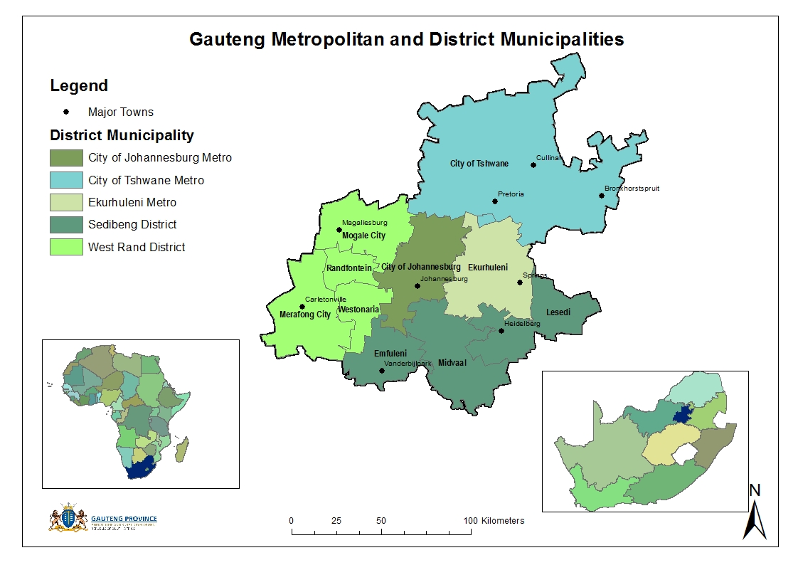
Overview of the Gauteng Province
Gauteng is the smallest province in South Africa with 1.7m ha of land surface area
It occupies only 1.4% of RSA land surface area
Population: 12.3m (23.7% - Largest % share of RSA population – Census 2011)
Gauteng has 3 of the 7 Metro Municipalities in the Country

Slide 6
Introduction and Overview
Gauteng Province continues to be the powerhouse of the South African economy.
The province occupies just 1.4% of the country’s land area and contributes 35% to national GDP.
The economy is traditionally dominated by secondary and tertiary sectors with agriculture being a relatively small sector in the province.
The larger farms in Gauteng are involved in cattle, game farming and eco-tourism while the smaller farming operations tend to be involved in nurseries, piggeries, eggs, chickens, vegetables, maize and nuts.

Slide 7
Policy Imperative: Gauteng City Region Agri Food Transformation and Development Strategy
CROSS-CUTTING ISSUES:
DEVELOPMENT FACILITATION AND COORDINATION
PILLARS & INTERVENTIONS
1
2
3
5
6
PRIMARY AGRICULTURAL PRODUCTION
FOOD
SECURITY
INDUSTRIALI-SATION OF THE AGRICULTURAL VALUE-CHAIN
4
RESEARCH, INNOVATION, DEVELOPMENT AND TECHNOLOGICAL ADVANCEMENT
STRATEGIC ECONOMIC INFRASTRUCTURE DEVELOPMENT
TRANSFORMATION
PILLARS
Improved Food Security & Nutrition
Co-ops and Enterprise Development
Communication and Stakeholder Mobilisation
Value-chain Development in Priority Sectors
Partnership Creation
Protecting the Agricultural Production Base
Investment in Strategic Economic Infrastructure
Research and Development
Promoting Entrepreneurship
Improved Safety Controls
Cluster Development
INTERVENTIONS
Innovation
and Technology Advancement
Expansion of Land Under Sustainable Agriculture
Resource Mobilisation and Funding
Promotion of AgriBEE
Market Development and Export Promotion
Improved Institutional Support
Improved Service Delivery
Agro Logistics Support
Provision of Effective Farmer Support
Skills Development and Knowledge Transfer
Leveraging Public Procurement
Agro Processing

Slide 8
Policy Context
As identified by National Development plan & New Growth Path, Agriculture remains critical for employment and food security
NDP estimates that agriculture could potentially create 1mill jobs by 2030
IPAP & APAP refers to investment in agroprocessing & agro-logistics
( bulk agricultural commodities )

Slide 9
High impact value chain projects
Agri-Parks: Gauteng have developed an Agri-parks Program which emphasize on the concept of a one stop destination for enhancing participation of all farmers. Five (5) Agri parks are established and there is a need for two more to cover all the district.
Vertical Growth Chamber farming system: As part of Modernization and Re-industrialization the GDARD has introduced the latest farming technology in the form of the Hydroponics Vertical Chamber established at Westonaria Agripark. It is commercial system for growing plants or crops vertically in a controlled environment (high intensive). The facility (30mX10mX6m) is established at West Rand and there is a need to replicate in the other Agri parks within the Province.
Isigayo grain milling plant: Land owned by WRDM was allocated for development of this project. The construction of the warehouse is in progress and almost 85% complete. Procurement of the turnkey milling plant and accessories is underway. Business plan and the approved construction plans are in place

Slide 10
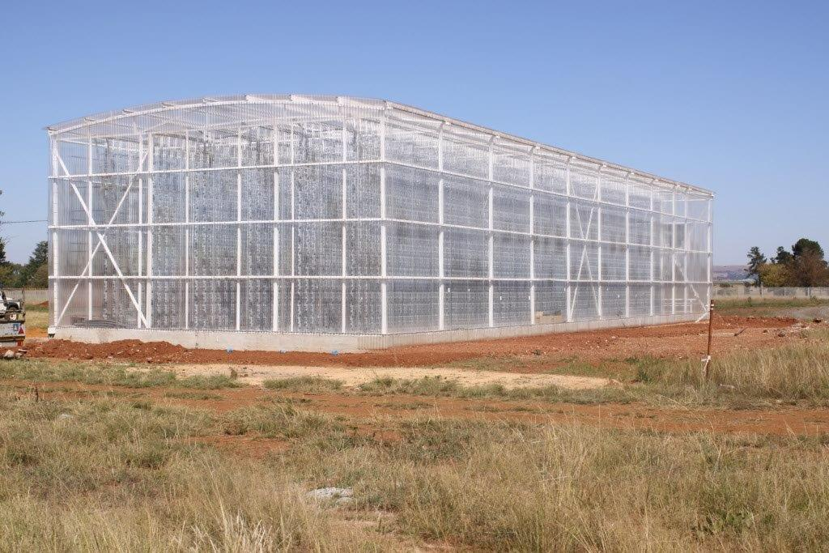
WESTONARIA AGRIPARK (VERTICAL CHAMBER)
Front-view – main entrance
Rear-view

Slide 11
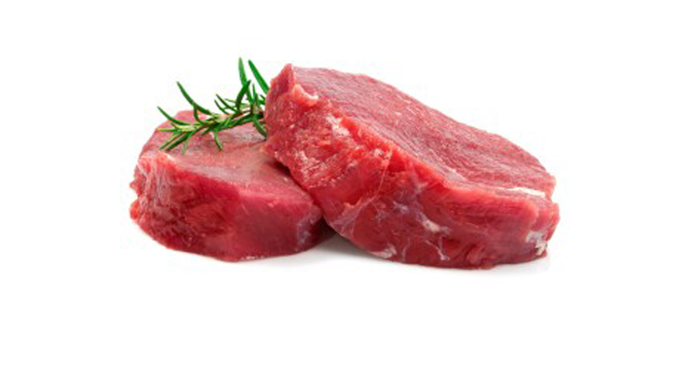
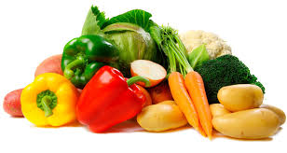
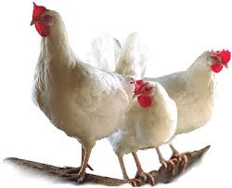
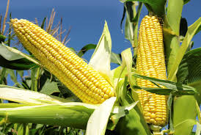
PRIORITY COMMODITIES FOR GAUTENG IN LINE WITH APAP
Horticulture Value Chain
Grains – Poultry Integrated Value Chain
(4th largest producer of Grains)
Red Meat Value Chain
Horticulture Value Chain (21% of Gauteng GVA)
Vegetables
Cut Flowers
Herbs & Essential oils
Opportunity: Proximity to large population and growing middle class – Bulking up, quality assurance and branding
59% of Gauteng Gross farm income comes from Livestock predominantly in Feedlots
Opportunity: Processing infrastructure for smallholder farmers and their integration.
- Linkage to mobile abattoirs program

Slide 12
AGRIPARKS OPERATING MODEL
Each Agripark will be a critical link between the formal markets and the smallholder farmers.
The Agripark will serve as an intermediary and a distribution facility whereby the smallholder farmers `s produce will be aggregated and graded in accordance with formal markets requirements
Management of each Agripark is to be undertaken on a private-public partnership to ensure a balance between with economic and development goals.
FORMAL MARKETS
Off-take Agreements
AGRIPARK
Shared packaging & coldroom facilities
Out-grower Model & On-site production
Smallholder farmer
Smallholder farmer
Smallholder farmer
Community
gardens

Slide 13
2016/17 Fetsa Tlala plans and progress – State of Readiness
GDARD is interacting with grain producing farmers to ensure that they are ready for the cropping season.
The lands are still very dry and not ready to be cultivated.
The first summer rains will ensure readiness to start cultivating the lands.
GDARD will support the identified crop farmers with production inputs for the coming production season.
Five (5) Agri parks are established in the Province by GDARD and there is a need for two more to cover all the district.

Slide 14
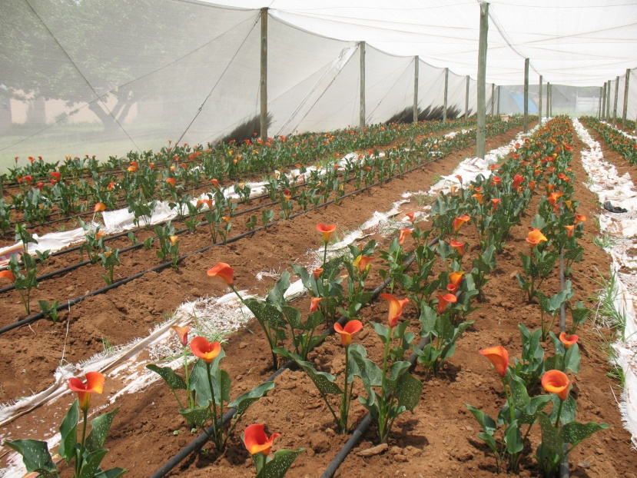
GDARD Agricultural programs
Agro-processing (pack house, milling plants, abattoirs, etc)
Agri-Parks (vegetable, flower, poultry, etc)
Maize Triangle (flag-ship project)
On-off Farm Infrastructure (piggery, poultry, under cover vegetable infrastructure, etc)
Food Security Projects (food gardens)
Research & Development
Veterinary Services
Mechanization Programme
Flower agri-park
Food garden

Slide 15
Pelusa SH YF

Slide 17
Carletonville project

Slide 18
Ten Pillars
The Gauteng Government has adopted a ten-pillar programme of radical transformation, modernisation and re- industrialisation of Gauteng over the next five to fifteen years:
1. Radical economic transformation
2. Decisive spatial transformation
3. Accelerated social transformation
4. Transformation of the state and governance
5. Modernisation of the public service
6. Modernisation of the economy
7. Modernisation of human settlements and urban development
8. Modernisation of public transport infrastructure
9. Re-industrialisation of Gauteng province and
10. Taking the lead in Africa's new industrial revolution

Slide 19
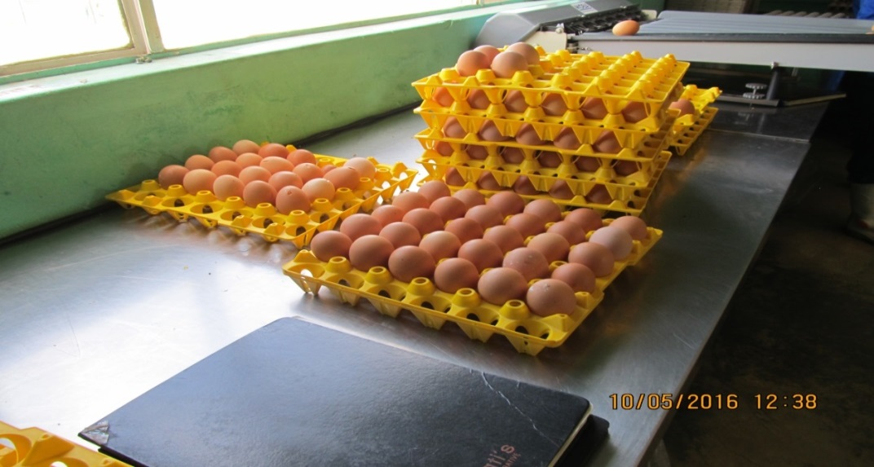
Ms Busisiwe Tshomela project

Slide 20
Grant Purpose
CASP
To provide effective agricultural support services, promote and facilitate agricultural development by targeting beneficiaries of land reform’s restitution and redistribution; and other black producers who have acquired land through private means and are engaged in value-adding enterprises domestically, or involved in export.
To address damage to infrastructure caused by floods. (since 2012)
ILIMA/LETSEMA
To assist vulnerable South African farming communities to achieve an increase in agricultural production and invest in infrastructure that unlocks agricultural production. i.e. Revitalization of irrigation schemes
LAND CARE
To enhance a sustainable conservation of natural resources through community based participatory approach, create job opportunities through expanded public works programme model (EPWP), to improve food security and well being of society as guided by six indivisible principles.

Slide 21
Pullets recently delivered: Roda Farm

Slide 22
Policy imperatives informing investments in 2016/17
Create 1 million jobs (NDP: 2030 vision)
Put 1 million hectares of unutilised land under production by 2019 (Fetsa Tlala)
Support 300 000 smallholder producers by 2019 (NGP)
Expand 1.5 million hectares under irrigation by 500 000 (NDP: 2030 Vision)
Ensure food security for all (Constitutional Mandate)
Ensure sustainable use of natural resources
Grow agricultural contribution to the GDP - driven by the Revitalization of Agriculture and Agro-processing Value Chains (RAAVC)

Slide 23
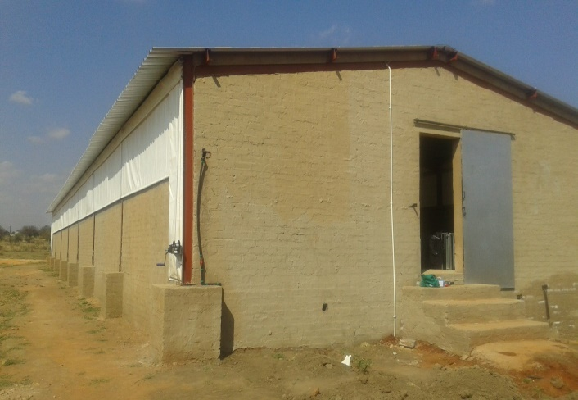
21 sow piggery structure: Seanego Project Winterveldt

Slide 24
Programme allocations in 2016/17
Programme | Total Allocation | Transfer in Q1 | Expenditure in Q1 | % Spent
 | R'000 | R'000 | R'000
EQUITABLE SHARE | 65 525 | Prov | 28 280 | 43
CASP | 70,097 | 7 008 | 6,497 | 12
ERP | 14,982 | 1 500 | 3,371 | 23
ILIMA/LETSEMA | 26,061 | 2 606 | 21,096 | 81
LAND CARE | 85,079 | 9,868 | 75,211 | 12
Total | 261 744 | 20 982 | 143 455

Slide 25
Khabothe’s farm

Slide 26
Planned Activities aligned to APAP
.
Commodity | Total Allocation R’000 (conditional grant and Eq Share) | Planned projects | Planned jobs | No. of Farmers targeted | Progress
Maize | 3 600 | 30 | 12 | 30 | Production inputs to be delivered in October 2016
Vegetables | 14 650 | 52 | 97 | 47 + 8 Co-ops | Production inputs are being delivered. Five Agri-Parks are being supported
Red meat | 1 200 | 5 | 6 | 5 | Feedlot infrastructure being supported
Poultry | 18 390 | 14 | 15 | 14 | Production inputs are being delivered, structures in process
Piggery | 16 919 | 16 | 15 | 16 | Production inputs are being delivered, structures in process
Total | 54 759 | 117 | 145 | 112 + 8 Co-ops

Slide 27
GAUTENG
4 commodities prioritized
79 projects planned covering all districts

Slide 28
Job creation
Alignment to the National Development Plan (NDP), New Growth Path(NGP) and the Agriculture Policy Action Plan (APAP)
The NDP argues the importance of commercial agriculture for job creation, which has the potential to create 250 000 direct jobs and a further 130 000 indirect jobs. The NDP identifies agricultural subsectors with the potential for long-term, sustainable expansion in production and value adding processes
The NGP seeks to shift the economy towards strong, sustained, and inclusive economic growth with an emphasis on the rebuilding of the productive sectors of the economy. Infrastructure development and agriculture, in particular, have been identified as a foundation for more jobs and addressing rural underdevelopment. The NGP set targets of increasing the smallholder sector by 300 000 households, ensuring 145 000 additional jobs in agro-processing, and upgrading conditions for 660 000 farm workers
Each completed Agri park has the potential to create 30 permanent jobs, 90 seasonal job and 60 indirect permanent jobs on farms that are supplying the Agri parks. Total 180 jobs per park will be created

Slide 29
Farmer Training and Capacity building
Programme | Allocation R’000 | Targeted Farmers | Transfer in Q1 | Expenditure in Q1 | Progress made
Farmer Training | 7 009 | 650 | 700 | 250 | Thus far a total of 71 farmers have been trained

Slide 30
Extension Recovery Plan
The total allocation for the Extension Recovery Plan is R14 982 000. The equitable share allocation is in the form of Compensation of Employees (CoE)
There are 121 extension officers in the province
Key deliverables aligned to APAP
Specialised extension support – appropriately placed with commodity organizations :
There will be no additional extension officers recruited.
121 extension officers will be trained as per the training plan developed by the province.
There will be no graduates placed in farms

Slide 31
Number of HOUSEHOLDS BENEFITING from Agricultural Food Security Initiatives
DISTRICT | Annual target | Planned Output: 1ST QUARTER 2016/17 | Actual Output: 1ST QUARTER 2016/17 | CHALLENGES/ COMMENTS
City of Tshwane | 2333 | 233 | 233 | None. Progress on track to deliver on these targets at the end of financial year.
City of Ekurhuleni | 1166 | 116 | 116
Sedibeng | 1167 | 117 | 117
City of Johannesburg | 1166 | 116 | 116
West Rand District | 1168 | 118 | 118
TOTAL | 7 000 | 700 | 700

Slide 32
Number of Hectares cultivated
DISTRICT | Annual target (Ha) | Planned Output: 1ST QUARTER 2016/17 | Actual Output: 1ST QUARTER 2016/17 | CHALLENGES/ COMMENTS
City of Tshwane | 428 | 0 | 0 | The lands are still not ready for cultivation due to lack of rains. Cultivation will commence soon after the first rains.
Sedibeng | 917 | 0 | 0
Ekurhuleni | 458 | 0 | 0
Westrand | 692 | 0 | 0
City of Joburg | 105 | 0 | 0
Total | 2600 | 0 | 0

Slide 33
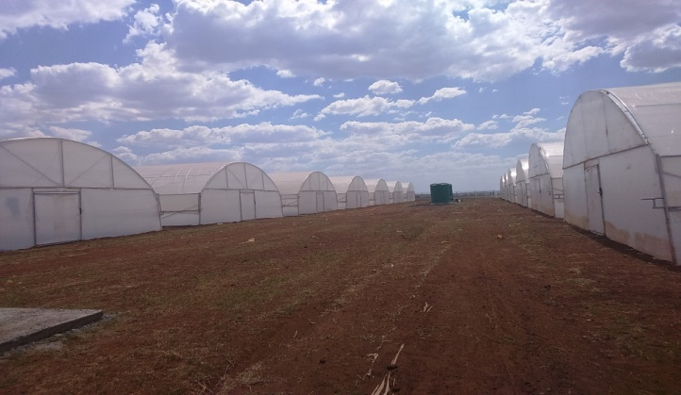
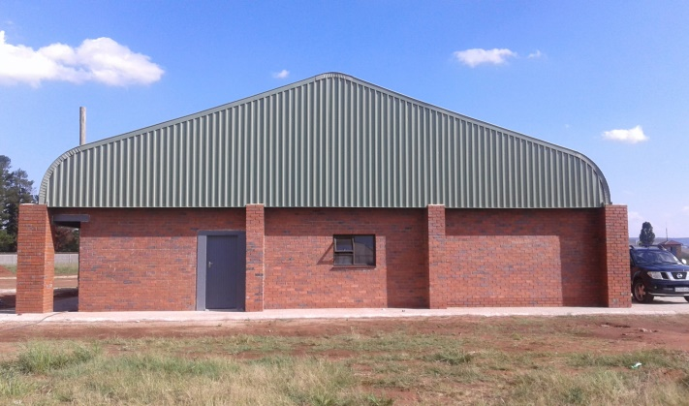
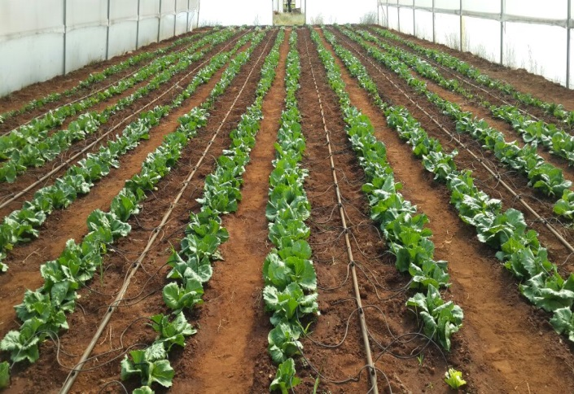
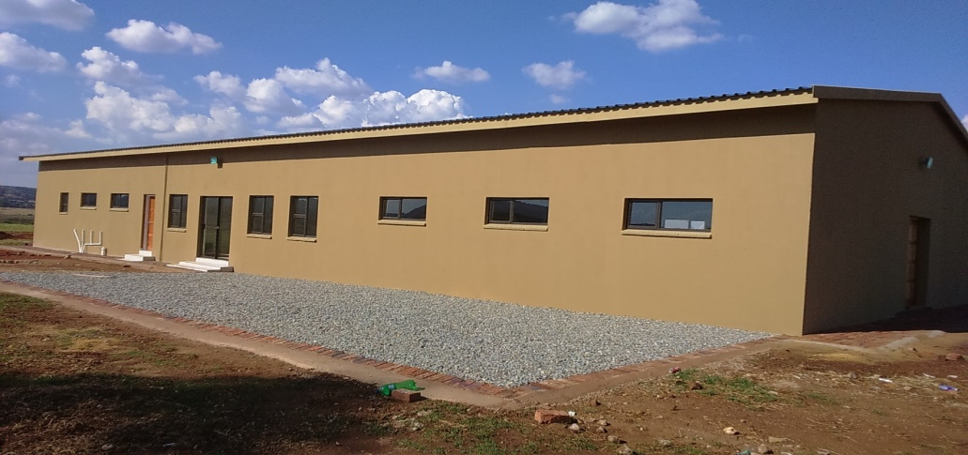
PROGRESS ON AGRIPARKS INTERVENTIONS
Westonaria Agripark: Hydroponics, Packhouse and Administration Block and Training room
Westonaria Agripark: Lettuce production
Eikenhof Agripark: Combined Offices, Ablution block and Training room

Slide 34
THANK YOU

