Slide 1
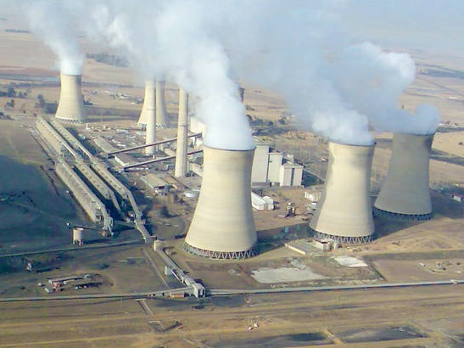
Case Studies in Renewable Energy
Eskom 2016/17 Municipal Tariffs
Presentation to DPE/DoE
11 August 2016
NCOPS presentation
21 September 2016
Confidential

Slide 2
The agenda
1
Eskom Tariffs – a regulated environment
2
The Regulatory Process
3
Tariff Development & Annual Increase Process
4
Municipal Finance Management Act (MFMA)
5
2016/17 Tariff increase
6
2016 Tabling of Eskom Tariffs in Parliament
Confidential

Slide 3
Eskom tariffs – a regulated environment
Regulatory environment in which tariffs are determined
Legislation (Acts)
The Electricity Regulation Act, 2006 (Act no 40 of 2006 as amended) or ERA
Nersa must regulate electricity prices and tariffs. Eskom may only charge a tariff determined by Nersa
Municipal Finance Management Act (MFMA); and
For Municipal tariff increases Eskom to timeously table proposed increases in Parliament in terms of MFMA
Promotion of Administrative Justice Act (PAJA)
Judicial review of an administrative action
Government Electricity Pricing Policy (EPP)
The Codes – Grid Code (Transmission) and Distribution Code
Nersa rules and guidelines

Slide 4
Eskom’s Regulatory Process
MYPD rules
NERSA determination
The RCA (based on actual revenue costs)
Forecast of Revenue, Capex, and Opex
The Multi-Year Price Determination (MYPD) Methodology is developed for the regulation of Eskom’s required revenues
This includes the forecast of revenue, operating costs, primary energy costs, depreciation, levies and taxes and return on assets (incl. capex)
It forms the basis on which the National Energy Regulator of South Africa (NERSA) will evaluate price and revenue applications received from Eskom
In terms of the MYPD methodology, NERSA awards Eskom an “allowed revenue” that is intended to allow Eskom to cover operating costs and earn a reasonable return
Determination by NERSA for five year price path
The actual determination from NERSA is for the revenue allocation for Eskom
The tariff adjustment is then subsequently calculated from this
Eskom aligns the cost base of the business to the determination
There will always be operating variances that are then dealt with in the Regulatory Clearing Account (RCA)
Audited financial statements – Actual Revenue, Opex and Capex
RCA is a balancing mechanism between what was awarded by NERSA on the basis of a forecast (MYPD), and what actually materialised (Eskom’s audited financial statements) - a backward looking mechanism
Differences will materialise if Eskom either does not achieve or exceeds the awarded revenue (due to pricing or demand factors), or incurs costs greater or lower than those which were taken into account when NERSA calculated the allowable revenue in MYPD
RCA balance could be in favour of either Eskom or NERSA (ultimately the customer). RCA is subject to approval by the regulator
Liquidation of the RCA as approved by the regulator may result in an increase or decrease in future electricity tariffs
Confidential

Slide 5
Regulatory process
Consultation
Paper on MYPD Methodology
Approved MYPD Methodology (after public hearings)
Revenue Requirement (Price application using building blocks)
Track variances via Regulatory Clearing Account
(RCA)
Tariffs
(Customer Categories)
Allowed Revenue
(translates into a % Price Increase)
Adjusted
Tariffs
MYPD process
Annual Tariff Adjustment process
Confidential

Slide 6
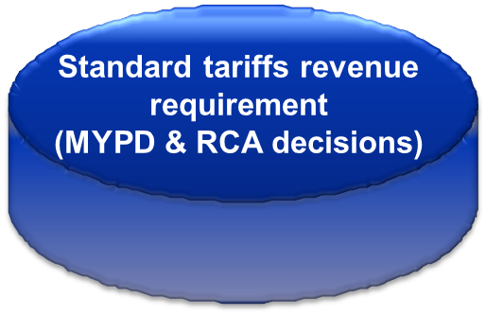
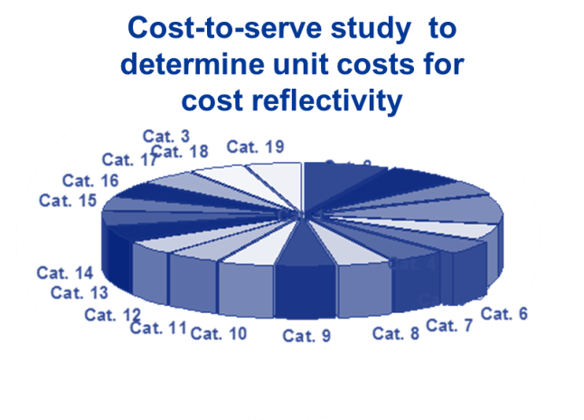
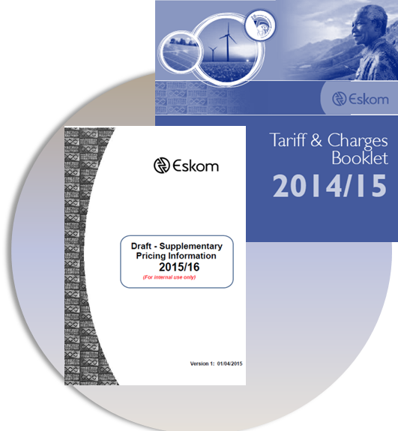
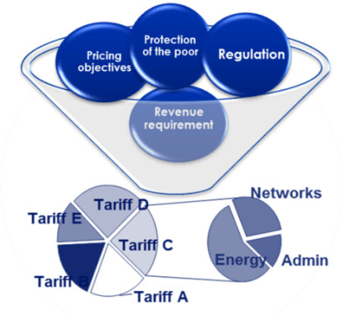
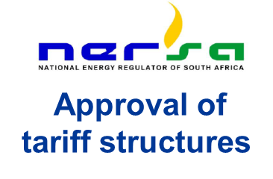
Tariff development & annual increase process

Slide 7
Understanding the annual tariff adjustment process
The annual tariff adjustment occurs each year after the MYPD decision
Purpose is to recover incremental allowed MYPD decision + RCA revenues
Compliance to the Electricity Regulation Act (ERA)
Adjust the previous year’s approved tariffs

Slide 8
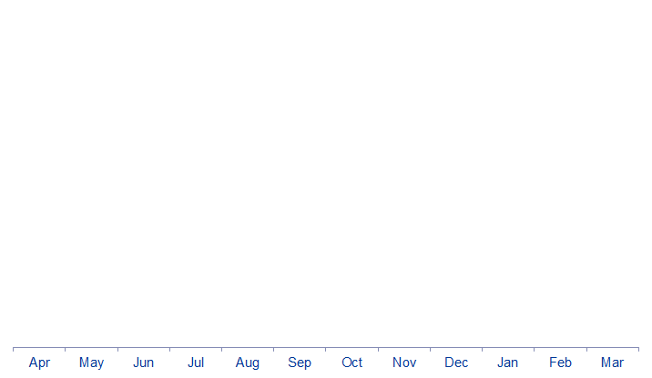
Municipal Finance Management Act (MFMA) determines the annual tariff adjustment Eskom and NERSA time-lines
MFMA creates two set of tariff rates for Eskom i.e. Eskom directly supplied and municipal tariff rates
Non-municipal
Higher tariffs over 12 months
Municipal
Higher tariffs over 9 months
1 April
non-municipal increase
1 July
municipal increase
Period available to recover the MYPD allowed annual revenues

Slide 9
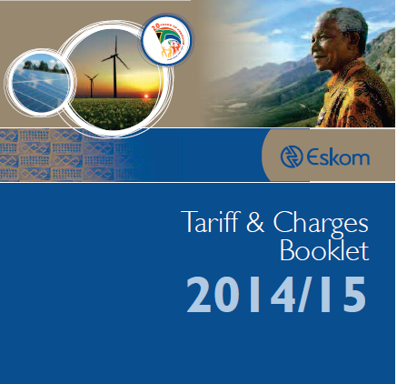
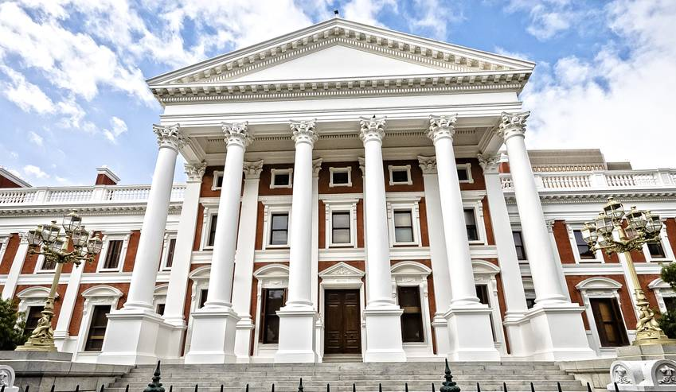
Section 42 of the MFMA requires the proposed increase for municipalities must be tabled in Parliament
1 April non-municipal implementation
1 July
municipal implementation
Table in Parliament on or before 15 March

Slide 10
Compliance to the MFMA for the 2016/17 tariff
Key comments
Submission on 14 March 2016 by Ms Lynne Brown, MP, Minister of Public Enterprises, tabled 2016/17 Eskom Schedule of Standard Prices for Municipalities.
Section 42 of the MFMA requires the proposed increase for municipalities must be tabled in Parliament by Eskom’s executive authority (the Minister of Public Enterprises) prior to implementation
The MFMA determines the annual tariff adjustment for Eskom and NERSA time-lines
It also creates two sets of tariffs - for customers directly supplied by Eskom, and a separate municipal customer tariff
On 14 March 2016, Ms Lynne Brown, MP, Minister of Public Enterprises, tabled 2016/17 Eskom Schedule of Standard Prices for Municipalities
Included in the Parliament submission were:
Purpose and clarification on the Tabled 2016/17 Eskom tariffs
Nersa decisions on Eskom tariffs
Schedule of Standard Prices for Municipalities
Confidential

Slide 11
The Nersa approved 2016/17 tariff increase tabled
 | NERSA
Total Standard Tariffs | 9.4%
Municipal – 1 July 2016 | 7.86%
Key Industrial & Urban Other Tariff Charges Affordability Subsidy | 9.4% 9.4% 8.61%
Rural | 9.4%
Homelight 20A Block 1 (0-350kWh) Block 2 (>350kWh) | 7.2% 9.0%
Homelight 60A | 9.4%
Homepower | 9.4%
On 1 March 2016, Nersa made a decision on Eskom’s RCA submission for year 2013/14 of MYPD 3, based on the variances on the qualifying criteria.
A RCA balance decision of R11 241 corresponding to an increase of 9.4%, was made.
Confidential

Slide 12
Affordability of electricity for the poor at a time of increasing prices is of great importance to Eskom
Reducing the impact for the poor can be achieved in partnership with local authorities as an estimated 60% of the South African consumers are supplied by the local authorities
Eskom together with government has in the past implemented several solutions to address affordability for their residential customers
Inclining Block Tariff addresses the needs of the poor, but has unintended consequences
Eskom supports the implementation of IBT based on a targeted approach and a sound cost-based design – prepayment customers should be the focus and not across the board to all residential customers as currently implemented

Slide 13
Free Basic Electricity (FBE)
Overview of Free Basic Electricity (FBE)
How FBE works?
In 2000, Government announced a free basic service policy.
In 2003 the Department of Energy (then Department of Minerals and Energy) developed the Electricity Basic Services Support Tariff (EBSST) Policy which was implemented in the 2003/2004 financial year
This policy prescribed an allocation of 50 kWh per month to be provided to all low income households to be funded through the local government equitable share
The obligation to identify indigents, in line with the Constitution remained with municipalities even in places where Eskom is the direct supplier of energy
The equitable share is an unconditional grant given to municipalities to assist them in providing basic services to poor households
No funding is directly provided to Eskom from national government but Eskom claims the funding for FBE from municipalities in terms of a funding agreement between Eskom and each municipality
Eskom has 1,15 million customers approved to receive FBE, with agreements signed with 243 municipalities
Local government decides who qualifies to receive FBE
From FBE Policy and the indigent policies of local government
Selection includes customers in Eskom supply areas
In Eskom areas of supply, the municipality provides the names of qualifying customers to Eskom.
Eskom has approx 1.3 mil residential customers configured to receive FBE, with agreements signed with 241 municipalities.
Eskom’s total no of residential customers = 4 million
Municipalities also provide FBE to their direct customers.
May be on a different basis, for example 100 kWh per month to all customers.
Eskom is a Service Agent to the municipality
The terms and conditions set out in a Service Level Agreement between Eskom and the municipality.
Each month Eskom invoices and recovers from the municipality the free allocations provided
At 50 kWh x FBE pre-determined “claim” rate x the number of customers
In 2000, Government announced a free basic service policy.
In 2003 the Department of Energy (then Department of Minerals and Energy) developed the Electricity Basic Services Support Tariff (EBSST) Policy which was implemented in the 2003/2004 financial year
This policy prescribed an allocation of 50 kWh per month to be provided to all low income households to be funded through the local government equitable share
The obligation to identify indigents, in line with the Constitution remained with municipalities even in places where Eskom is the direct supplier of energy
The equitable share is an unconditional grant given to municipalities to assist them in providing basic services to poor households
No funding is directly provided to Eskom from national government but Eskom claims the funding for FBE from municipalities in terms of a funding agreement between Eskom and each municipality
Eskom has 1,15 million customers approved to receive FBE, with agreements signed with 243 municipalities
Confidential

Slide 14
Cost incurred by Eskom in providing FBE
Eskom incurs costs in providing FBE i.e.,
Operational expenditure
The difference between the standard tariff and the “claim rate”
NERSA determines a c/kWh “claim rate”
Originally based on a national average for all residential tariffs
Eskom claims from a municipality at this rate for all energy provided through FBE
Since FBE has been implemented, there has always been customers that receive FBE where the claim rate is lower than the standard tariff.
Results an under-recovery of revenue for Eskom.
E.g. say the Eskom tariff is 40 c/kWh and the “claim rate” is 35 c/kWh = 5 c/kWh shortfall per kWh for the 50 kWh.
Claim rate reviewed by NERSA annually but shortfall remains

Slide 15
Challenges experienced in implementing the programmes
The national average of customers collecting FBE tokens is at 70%
In some provinces collection rate is as low as 58% due to collection sites not being easily accessible to customers in remote area and rural areas
District energy forums in certain districts are not always functional and not always well attended.
Municipalities do not always share their FBE status with Eskom and do not always request progress statistics from Eskom.
Non-adherence by municipalities to Indigent Register.
Municipalities do not always adhere to the payment arrangements with Eskom.
Challenges with FBE being provided to farm workers as the farmer generally holds the contract of supply, and this needs to be addressed.
Inconsistent approach applied by municipalities to customers outside of the policy

Slide 16
What has Eskom done to protect the poor before Inclining Block Tariffs (IBT)
Facilitating convenient access to electricity (government grants or cross-subsidies)
Already available through the national electrification program.
For Eskom customers, provision to access new connection at no charge for the Homelight 20 Amp consumers.
Lower electricity prices to specific and deserving customer categories (based on poverty levels or self-targeted tariffs). Shortfall recovered from other customers through explicit levies, surcharges or from fiscal grants.
The lower than the average price increase to the Eskom Homelight tariffs in 2008 and 2009 has resulted in significant cross-subsidies to the Homelight tariff customers.
Social grants provided directly to customers (government funding or surcharge on electricity to all customers; or a combination of both)
Currently 50 kWh per household per month is provided free by national government to the indigent through the Equitable Share Fund.
Eskom provides FBE to customers in their area of supply as an agent for the municipalities
The promotion of energy efficiency
Eskom assistance to customers to implement energy efficiency initiatives such as better insulation of homes, or the use of more energy efficient appliances and lights (CFL’s).

Slide 17
Conclusion: The 2016/17 tariffs were tabled in compliance with the MFMA
The tariff was approved by Nersa and tabled in Parliament before implementation
Eskom will continue to collaborate with stakeholders across South Africa – engaging in discussions on the future tariff frameworks.
The municipal business is a key component to Eskom’s revenues and is therefore proactively working together with them to address key issues around the tariff, as well as outstanding debt.
Affordability of electricity for the poor at a time of increasing prices is of great importance to Eskom
Confidential

