Slide 1
PROPERTY MANAGEMENT TRADING ENTITY 4th Quarter Performance of 2015/16 and 1st Quarter Performance of 2016/17 for the PMTE
Standing Committee on Appropriation
Parliament, Cape Town
15th September 2016
Office of the Director-General

Slide 2
Content
Content | Slide No.
Property Management Trading Entity (PMTE) Funding Model | 3
Revenue and Expenditure Summary – as at 31 March 2016 | 4 – 5
2016/17 1st Quarter Performance - Performance Information per programme (details in Annexure A and B) | 6 - 9
Service delivery implications from slow expenditure and implications fro the targets in the NDP | 10 – 12
Challenges around the PMTE Operationalisation | 13 - 14
Challenges with Billing System and Invoicing of Client Departments | 15
Challenges around the PMTE systems to administer financial management | 16

Slide 3
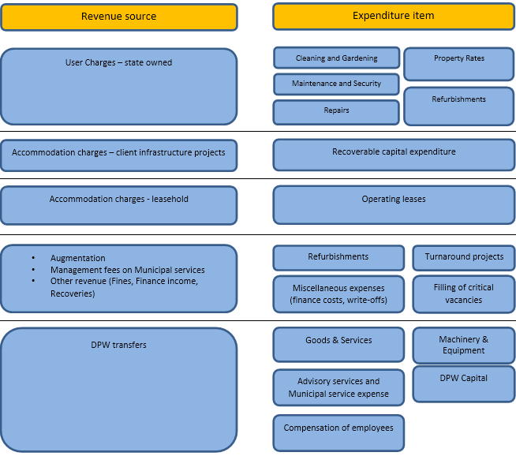
Property Management Trading Entity (PMTE) Funding Model
The diagram illustrates the different revenue streams and the various expenditure items of the PMTE.
For illustration purposes different revenue streams and expenditure items have been aligned to each other.
It does however not mean that the particular revenue item will be ring-fenced for any particular expenditure exclusively.
Revenue loses its identity when consolidated into the pool of receipts from which the various expenditure items are being financed.

Slide 4
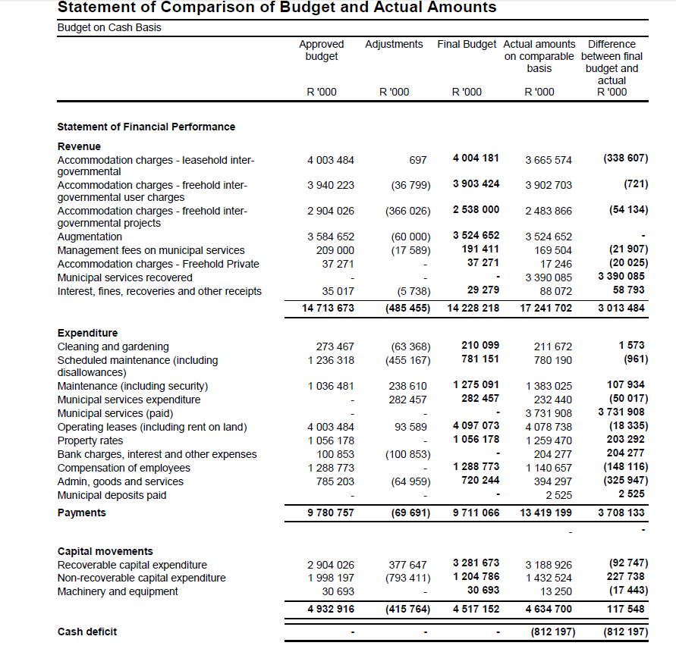
Revenue and Expenditure Summary – as at 31 March 2016

Slide 5
Revenue and Expenditure Summary – as at 31 March 2016 (cont.)
The PMTE reflected a cash deficit of R812 million as at 31 March 2016 per the 2015/16 Annual Financial Statements (AFS)
10% (R340 million) of municipal services expenditure incurred was not recovered from the client departments before year end
The Day-to-day maintenance budget was over spent by R108 million - cash flow impact of subsequent payment of previous year’s accruals
Property rates expenditure exceeded the 2015/16 allocation by R203 million resulting from the payment of validated historical municipal invoices identified through the rates verification project
Substantial 2014/15 asset related accrued expenses were incurred in 2015/16 against refurbishments resulting in the non-recoverable capital expenditure to exceed budget with R228 million
Therefore there were no slow expenditure having a service delivery impact on NDP targets (see next slide for NDP targets)

Slide 6
2016/17 1st Quarter Performance

Slide 7
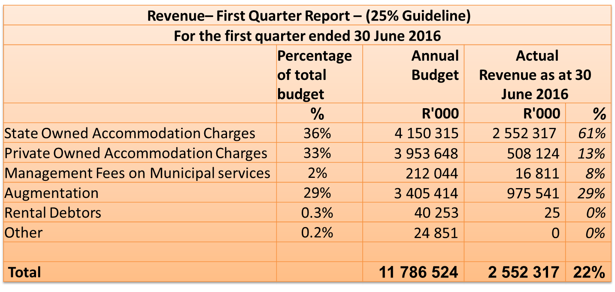
Revenue Summary – first quarter ended 30 June 2016

Slide 8
Expenditure Summary per Economic Classification - 30 June 2016
Expenditure Economic classification – First Quarter Report – (25% Guideline)
For the first quarter ended 30 June 2016
 | Percentage of total budget | Annual Budget | Actual Expenditure as at 30 June 2016
 | % | R'000 | R'000 | %
Current payments | 75% | 8 787 733 | 2 178 095 | 25%
Compensation of employees | 12% | 1 469 783 | 339 692 | 23%
Goods and services | 6% | 705 421 | 75 449 | 11%
Cleaning and Gardening | 2% | 250 657 | 59 608 | 24%
Operating Leases | 35% | 4 074 622 | 1 058 558 | 26%
Repairs | 7% | 813 611 | 207 897 | 26%
Maintenance | 10% | 1 212 660 | 359 431 | 30%
Municipal Services | 2% | 260 979 | 77 459 | 30%
Transfers and subsidies | 10% | 1 161 796 | 108 516 | 9%
Property Rates | 10% | 1 161 796 | 108 516 | 9%
Payment for capital assets | 15% | 1 836 995 | 372 782 | 20%
Machinery & equipment / intangible assets | 0.3% | 40 414 | 18 941 | 47%
Refurbishments | 9% | 1 094 172 | 247 018 | 23%
DPW Capital Infrastructure | 6% | 702 409 | 106 823 | 15%
Total |  | 11 786 524 | 2 659 393 | 23%
The PMTE 2016/17 Q1 expenditure (23%) was slightly below the guideline of 25%. Management do however not project any under expenditure at the end of the financial year.
Goods and services (11%) is in line with projections for the first quarter.
Compensation (23%) is a bit below the guideline of 25% for the first quarter. This will increase during the next quarter in line with the filled positions.
Property rates (9%) will increase during the second quarter when the Municipalities’ financial year starts.
DPW Capital (15%) will increase during the year on projects currently on site in line with reallocations made between projects in June 2016. Same principle applies for Refurbishments (23%).
Therefore there were no slow expenditure having a service delivery impact on NDP targets (see next slide for NDP targets).

Slide 9
PMTE– 2015/16 and 2016/16 Q1 % Achievement per Programme
Of the 54targets for the Quarter, 26 targets were achieved (48%)
Of the 24 targets for the Quarter, 12 targets were achieved (50%)

Slide 10
National Development Plan Targets - 2015/16
National priorities | NDP Chapter & MTSF National Outcome | MTEF Budget | Related performance indicators | 2015/16 Annual Performance
Small Harbour Development (Ocean Phakisa) | Chapter 3, 4 and 5: Outcome 6: An efficient, competitive and responsive economic infrastructure network | - | Percentage of investment decisions approved to support Operation Phakisa (mari/aquaculture projects) Percentage of investment decisions approved on proclaimed fishing harbours Audit of all state coastal reserves under the custodianship of Public Works | 82% achieved against a 60-80% target of investment decisions approved to support Operation Phakisa projects (9 of 11 operation Phakisa aquaculture related leases 100% achieved against a 60-80% of investment decisions (73 of 73) approved on proclaimed fishing harbours Infrastructure
Energy Savings | Chapter 4 and 5: Outcome 6: An efficient, competitive and responsive economic infrastructure network | R60.6 million | Reduction in kilowatt-hour (Kwh) usage achieved on energy consumption Percentage efficiency (turnaround time) for unscheduled maintenance on freehold property within 5 days | 284,4 million reduction in kilowatt-hour (Kwh) usage achieved on energy consumption against a target of 220 million KwH 5% (253 of 5553) efficiency (turnaround time) for unscheduled maintenance on freehold property within 5 days against a 65% target
Water Conservation | Chapter 4 and 5: Outcome: 6 An efficient, competitive and responsive economic infrastructure network Outcome 11: 4. Protected and enhanced environmental assets and natural resources | R6.4 million | Reduction in kilolitre –(kl) usage achieved on water consumption Number of Building Management Systems installed | 4,090,865 (kl) Reduction in kilolitre –(kl) usage achieved on water consumption against a target of 3,905,528 (kl) 2 of 3 Building Management Systems installed

Slide 11
National Development Plan Targets - 2015/16
National priorities | NDP Chapter & MTSF National Outcome | MTEF Budget | Related performance indicators | 2015/16 Annual Performance
Inclusive rural economy | Chapter 6 : Inclusive rural economy Outcome 7: Comprehensive rural development | R1.9 million | Number of Precinct development proposals produced for local/rural municipalities Number of vacant land (Land Parcels) let out towards economic development initiatives Number of schools completed within planned construction period | 2 of 2 Precinct Development Proposal completed. (Mandeni and Mount Fletcher) 849 vacant land (Land Parcels) let out towards economic development initiatives against a target of 100 No schools completed within planned construction period
Transforming Human Settlements | Chapter 8 : Transforming Human Settlements Outcome 8: Sustainable human settlements and improved quality of household life | - | Number of Precinct development proposals produced for metros and district municipalities Number of projects completed within agreed construction period | 2 of 2 Precinct Development Proposal Report completed 125 projects completed within agreed construction period against a target of 62
Providing reasonable functional accommodation that facilitates the attainment of departments’ service delivery objectives | Chapter 13 : Building a capable and developmental State Outcome 12 : An efficient and effective development-oriented Public Service | The medium term budget allocation for DPW infrastructure is R2.2 billion. The PMTE medium term budget allocation is R31.7 billion (Clients capital budget, repair and maintenance, cleaning and gardening, private leases, rates and taxes) | Number of projects completed within agreed construction period Percentage occupancy rate increased for partially occupied property | 125 projects completed within agreed construction period against a target of 62 0% occupancy rate increased for partially occupied property

Slide 12
National Development Plan Targets - 2016/17
National priorities | NDP Chapter & MTSF National Outcome | MTEF Budget | Related performance indicators
Small Harbour Development (Harbour Phakisa) | Chapter 3, 4 and 5 Outcome 6: An efficient, competitive and responsive economic infrastructure network | R20.6 million | Percentage of revenue increased through rentals of harbour related properties Percentage of DAFF certified Operation Phakisa Ocean economy leasing requests processed within agreed timeframes
Energy Savings | Chapter 4 and 5 Outcome 6: An efficient, competitive and responsive economic infrastructure network | R28 million | Reduction in energy consumption (kilowatt hours) in identified property portfolio Number of Kilowatt hours of renewable generated
Water Conservation | Chapter 4 and 5 Outcome: 6 An efficient, competitive and responsive economic infrastructure network Outcome 11: Protected and enhanced environmental assets and natural resources | R4.6 million | Reduction in water consumption (kilolitres) in identified property portfolio
Inclusive rural economy | Chapter 6 Outcome 7: Comprehensive rural development | R1.9 million | Number of User Asset Management Plans received Number of Custodian Asset Management Plans approved Number of Government Precinct Development Proposals integrated with identified municipal (urban and rural) Integrated Development Plans (IDPs)
Transforming Human Settlements | Chapter 8 Outcome 8: Sustainable human settlements and improved quality of household life | - | Number of Government Precinct Development Proposals integrated with identified municipal (urban and rural) Integrated Development Plans (IDPs) Number of sites established for development Percentage of responsive disposal requests approved within scheduled timeframes
Providing reasonable functional accommodation that facilitates the attainment of departments’ service delivery objectives | Chapter 13 Outcome 12 : An efficient and effective development-oriented Public Service | The PMTE medium term budget allocation is R31.2 billion (Clients capital budget, repair and maintenance, cleaning and gardening, private leases, rates and taxes) | Percentage of infrastructure projects completed within approved budget Percentage of infrastructure projects completed within agreed construction period Percentage reduction of identified leased-in functional accommodation within the security cluster Percentage of accommodation procured for user departments that adhere to prescribed criteria Percentage of unscheduled reported maintenance incidents resolved within prescribed time frames

Slide 13
Challenges around the PMTE Operationalisation
CHALLENGE | INTERVENTION | COMPLETION DATE
State buildings not optimised and poor condition of some buildings does not enable the User Departments to fulfil their service delivery mandates. | Current rate of utilisation 96% Maintenance Programme to improve access to, and the quality of, the State’s immovable assets developed for implementation as part of efficiency Enhancement Phase First Phase commenced – Top 300 High Impact Areas (180 day programme) Programme is linked to revenue generation intervention | Completion date of Phase 1: 31 March 2017 Ongoing
Infrastructure backlogs, non-compliance with laws/regulations and the inability to deliver projects within time, budget and quality. | Backlogs in project planning and delivery and have introduced a Monitoring and Evaluation process to measure the performance of project managers to expedite the delivery of infrastructure projects. Implementation of IDMS Provision of training, oversight and capacity to strengthen the project management function. PMO established with necessary line of sight and delegations to ensure effective coordination and control of projects. Reviewing Business Improvement Plan with focus on strengthening the professional capacity Conceptualised Efficiency Enhancement Interventions aimed at turning the Construction Project Management function around | Ongoing
Tight fiscal space | Developing Financial Model with a focus on revenue generation through various interventions | Completion: 31 March 2017

Slide 14
Challenges around the PMTE Operationalisation
CHALLENGE | INTERVENTION | COMPLETION DATE
State buildings not optimised and poor condition of some buildings does not enable the User Departments to fulfil their service delivery mandates. | Current rate of utilisation 96% Maintenance Programme to improve access to, and the quality of, the State’s immovable assets developed for implementation as part of efficiency Enhancement Phase First Phase commenced – Top 300 High Impact Areas (180 day programme) Programme is linked to revenue generation intervention | Completion date of Phase 1: 31 March 2017 Ongoing
Infrastructure backlogs, non-compliance with laws/regulations and the inability to deliver projects within time, budget and quality. | Backlogs in project planning and delivery identified Introduced Monitoring and Evaluation process to measure the performance of project managers to expedite the delivery of infrastructure projects. Implementation of IDMS Provision of training, oversight and capacity to strengthen the project management function. PMO established with necessary line of sight and delegations to ensure effective coordination and control of projects. Reviewing Business Improvement Plan with focus on strengthening the professional capacity Conceptualised Efficiency Enhancement Interventions aimed at turning the Construction Project Management function around | Ongoing
Tight fiscal space | Developing Financial Model with a focus on revenue generation through various interventions | Completion: 31 March 2017

Slide 15
Challenges with Billing System and Invoicing of Client Departments
Emerging challenge on client billing:
Exemption from NT for not charging clients based on itemised billing (User pay model) expires 31 March 2017.
CHALLENGE | MITIGATION ACTION | TIMEFRAMES
Confirmation of occupancy by clients | Confirmation of occupancy signed off by all client departments | 31 January 2016
Signing of lease contracts based on list of properties and extent | Signing of lease agreements by user departments based on list of properties and extent used | 31 March 2016
Current payment system not capable of handling new asset register and expected volume of transactions and the related billing requirement | Implementation of the asset register and leasing modules on Archibus/SAGE. | 31 October 2016
Current billing of clients not based on a fair and systematic manner. Budget devolved on outdated client occupancy | Approval of proposed tariffs by National Treasury. | 1 April 2016
Clients budgets not re-prioritised with NT, additional funding might be necessary through MTEF process | National Treasury to re-distribute clients funds to be in line with the proposed tariffs. | 1 April 2016

Slide 16
Challenges around the PMTE systems to administer financial management
Facilities Man (1 April 2017)
Lease Man (31 Oct 2016)
SAGE (Financial)
Asset Register (30 Sept 2016)
Budget Man (1 Aug 2017)
Project Man ( 1 Aug 2017)
Progress made:
SAGE X3 implemented at 80%
Billing and invoicing done manually based on actual expenditure incurred.
Asset Register: 98% of the verified data has been successfully uploaded on to the ARCHIBUS system. Users can navigate and update the data on the system
Lease Management Module:
80% of the verified data has been successfully uploaded on to the ARCHIBUS system.
User acceptance testing is currently underway, after which the regional office users will be trained
Financial system is dependent on integration of operational modules

Slide 17
Thank You

