Slide 1
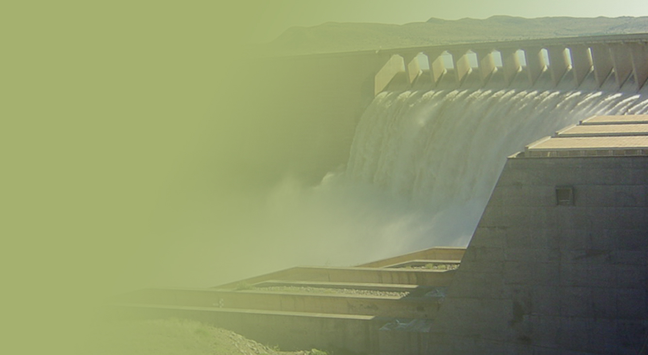
PRESENTATION TITLE
Presented by:
Name Surname
Directorate
Date
FOURTH QUARTER ANALYSIS REPORT
FOR THE
2015/16 FINANCIAL YEAR
Presented by:
Mr Sifiso Mkhize
Acting Director-General
14 September 2016

Slide 2
Preliminary fourth quarter progress report for the 2015/16 financial year
CONTENTS
Part 1: Analysis of department’s performance
Detailed analysis of Main Account
Detailed analysis of Water Trading
Part 2: Financial performance
Detailed analysis of Main Account
Detailed analysis of Water Trading

Slide 3
Analysis of annual performance
Main Account
Water Trading
Over Achieved
(>100%)
Achieved
(100%)
Partially achieved
(50 – 99%)
Not achieved
(<50%)

Slide 4
Analysis per budget programme
Partially achieved
(50 – 99%)
Not achieved
(<50%)

Slide 5
Analysis per budget programme
Partially achieved
(50 – 99%)
Not achieved
(<50%)

Slide 6
Part 2: financial performance

Slide 7
Main Account
Departmental Spending as at 31 March 2016
First Quarter Expenditure
Areas of underspending

Slide 8
Fourth Quarter Expenditure for the 2015/16 financial year

Slide 9
Areas of Over/Under-Expenditure
Budget: R15.747 billion
Actual Spending: R15.557 billion
Underspending: R189.558 million.
The under spending is mainly due to the following:
Programme 1: R1.886 million was not transferred to other organs due to outstanding documents
Programme 2: Unspent R15.629 million is as a result of unfilled funded vacant positions
Programme 3: Unspent R107.693 million is due to delays in procurement of services and contractors by IA’s.
Programme 4: Unspent R55.099 million is due to late receipt of invoices.
Programme 5: Unspent R9.249 million is due to delays in WUA invoice finalization and transfer to WRC due to the delays in finalization of memorandum of agreement

Slide 10
Provincial and Municipal Conditional Grants
Grants and Transfers to Municipalities (R'000) | 2015/16 Financial Year - 4th Quarter
 | Grant Allocation | Actual Transfer | Spent By Municipality | % Spent
Municipal Water Infrastructure Grant | 1,803,932 | 1,803,932 | 850,342 | 47%
Water Services Operating Subsidy | 452,915 | 452,915 | 152,465 | 34%
Rural Households Infrastructure Grant | 48,182 | 48,182 | 25,538 | 53%
Total | 2,305,029 | 2,305,029 | 1,028,345 | 45%
Narratives on Conditional Grants
2015/16 Financial Year – 4th Quarter
Grant Allocation: R2.305 billion
Transferred : R2.305 billion
Actual Spending by Municipalities: R1.028 billion
Variance: R1.277 billion
The significant variance between funds transferred and spent is due to the different financial years for the Department (31 March) and Municipalities (30 June). As at 30 June 2016 expenditure performance increased as follows:
Municipal Water Infrastructure Grant (MWIG) Schedule 5B: R1.571 billion
Water Services Operating Subsidy (WSOS) : R292 million

Slide 11
Water trading
Expenditure for augmentation funded projects Quarter 4: 2015/16
Reasons for variances Quarter 4: 2015/16

Slide 13
Reasons for Variance Quarter 4: 2015/16
The following projects have spent the revised allocated budget for FY 2015/16:
Mzimvubu Water Projects, GLeWAP Phase (Nwamitwa Dam) and Nooitgedacht Water
ORWRDP (Ph 2A) - De Hoop Dam
The under spending is mainly due to the delay in the appointment of PSP to do fencing and sub-surface drainage.
GLeWAP Phase (Tzaneen Dam Raising) -
The under spending is due to the delay in the appointment of a implementing Agent. Lepelle Northern Water was later appointed to do planning and finalisation of the design and permit. Geotechnical investigations still outstanding.
Water Resources Project: Raising of Clanwilliam Dam -
The under spending was due to the delays in the appointment of Environmental Control Officer (ECO) and appointment construction sub-contractors.
Development of Raising of Hazelmere Dam
The contractor that was appointed later in the financial year and was requested to accelerate the project and thus resulted in the adjusted budget spent.
Nandoni Nsami
The engineering designs and tender documents completed. The Contractor was appointed on 07 January 2016. Site handover was completed on 28 January 2016. Work on site was suspended with instruction from National Treasury.
Dam Safety Rehabilitation Programme
There are various projects under this programme which includes Vaalkop II Dam, Kalkfontein Dam Elandsdrift Barrage and Elandsdrift
Underspending was as a results of amongst others; damage to construction equipment, slow delivery of material by the supplier industrial action that lasted for a period of 2 weeks

Slide 14
Definitions: abbreviations / acronyms

Slide 15
Definitions
Abbreviation / Acronym | Description
APP | Approved Professional Person
BRICS | Brazil, Russia, India, China and South Africa
CFO | Chief Financial Officer
DEA | Department of Environmental Affairs
DM | District Municipality
DoRA | Division of Revenue Act
DWS | Department of Water and Sanitation
EC | Eastern Cape
ECO | Environmental Control Officer
EIA | Environmental Impact Assessment
EMP | Environmental Management Programme
ER | Economic regulation
FS | Free State
GLeWAP | Greater Letaba Water Augmentation Project
GTI | Geotechnical investigation
Inst. Est. | Institutional Establishment
LP | Limpopo
MP | Mpumalanga
Nat. Sanitation Serv. | National Sanitation Services
NT | National Treasury
N & S | Norms and standards
O & M | Operations and maintenance
ORWRDP | Olifants River Water Resource Development Project

Slide 16
Definitions
Abbreviation / Acronym | Description
PMO | Project Management Office
PoE | Portfolio of Evidence
PSP | Professional Service Provider
RBIG | Regional Bulk Infrastructure Grant
RHIG | Rural Household Infrastructure Grant
RHIP | Rural Household Infrastructure Programme
RID | Record of Implementation Decision
RQOs | Resource Quality Objectives
RWPS | Raw water pricing strategy
SLAs | Service Level Agreements
TCTA | Trans Caledon Tunnel Authority
Trans of Water Schemes | Transfer of Water Schemes
Water Info Mgt. | Water Information Management
WC | Western Cape
WS Mgt | Water Sector Management
WS services & sanitation regulation | Water Supply Services and Sanitation Regulation
WTE | Water Trading Entity
WTW | Water Treatment Works
WU Author & Admin | Water Use Authorisation and Administration
WU Authorisat. Enabling | Water Use Authorisation Enabling
WULATS | Water Use Licence Authorisation Tracking System
WWTW | Wastewater Treatment Works

Slide 17
END

