Slide 1
Investigations in the
steel industry
AMSA settlement in focus
Deputy Commissioner (acting): Hardin Ratshisusu
14 September 2016

Slide 2
OUTLINE
Legislative mandate
Institutions
Why focus on the steel industry
History of AMSA’s pricing of flat steel
Flat steel imports into South Africa
Cases involving AMSA
Settlement between the Commission and AMSA
Other interventions by the commission in steel
Way forward

Slide 3
LEGISLATIVE MANDATE
Purpose of the Competition Act is to maintain competition in order to:
Promote the efficiency, adaptability and development of the economy
Provide consumers with competitive prices and product choices
Promote employment and advance the social and economic welfare of South Africans
Expand opportunities for South African participation in world markets and recognise the role of foreign competition in the Republic
Ensure that small and medium-sized enterprises have an equitable opportunity to participate in the economy
Promote a greater spread of ownership, in particular to increase the ownership stakes of historically disadvantaged persons

Slide 4
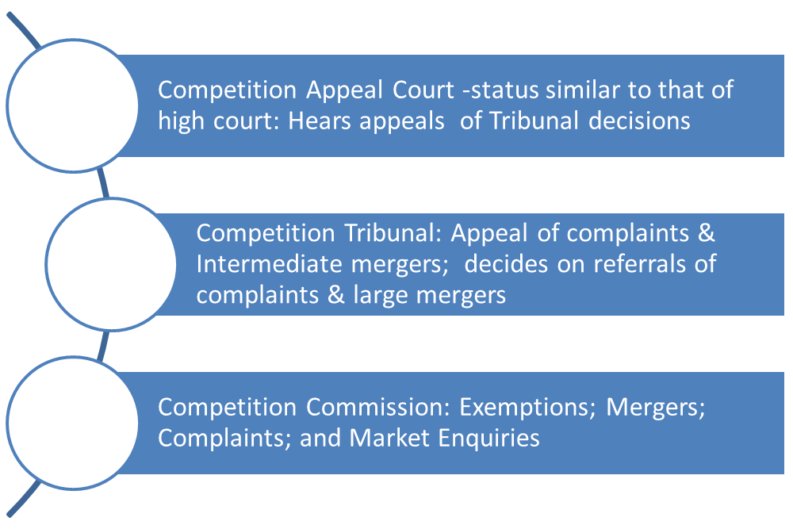
INSTITUTIONS

Slide 5
WHY FOCUS ON THE STEEL INDUSTRY?
In terms of the Commission’s prioritization framework, intermediate industrial products which include steel have been identified as a priority sector.
Steel is an essential input to ensure the success and sustainability of many strategic and key sectors of the economy.
AMSA dominates the domestic steel industry in both flat and long steel markets.
In respect of flat steel, AMSA competes with Duferco Steel Processing, Safal Steel South Africa and Highveld (which is currently under business rescue).
In long steel AMSA competes with SCAW, Highveld and Cape Gate.
71% of steel produced by AMSA is used in 3 key industrial sectors- construction; energy , mining, chemicals and water; and automotive.
Downstream beneficiation is important for widening South Africa’s manufacturing base.
A competitive primary steel industry is essential for the development of the downstream industry.

Slide 6
HISTORY OF AMSA’S PRICING OF FLAT STEEL
Prior to 2005/06 – Import Parity Pricing (IPP) model taking into account volume and settlement discounts
Investigations into allegations of excessive pricing and price discrimination
2006/08 - Basket pricing model for all products (except the automotive and packaging business)
Investigations into allegations of price fixing {flat steel and long steel} and price discrimination
2009 - Hybrid pricing model combining basket and IPP model
Investigations into allegations of price fixing {scrap metal)
2010 - IPP model with the following main references:
HRC - Russia Black Sea FOB prices
Rebar – Turkey FOB
Tribunal decision in Mittal 1
Investigations into allegations of excessive pricing {flat steel}
2013 Q4 - IPP model with China FOB prices as main reference
2014 to date - IPP model with all prices referenced to Chinese prices (currently with 10% tariff)
China IPP = Consensus price + sea freight (Durban) + Financing, Discharge and inland logistical cost (Gauteng) + local value added advantage (trade margin)

Slide 7
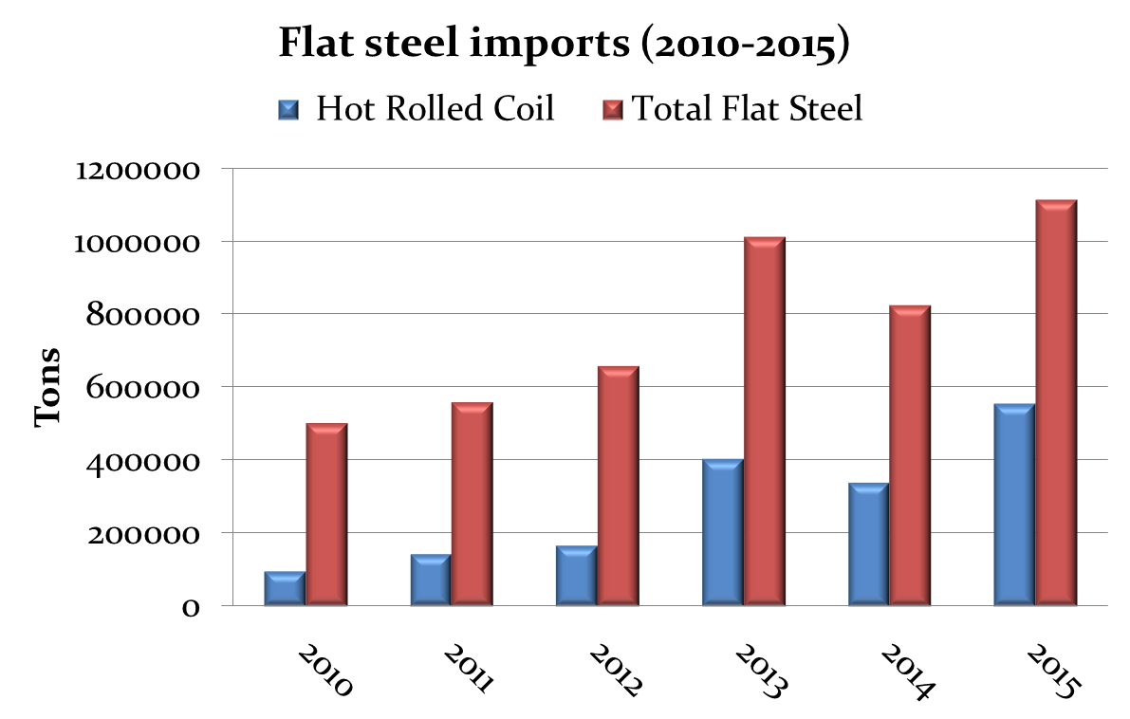
FLAT STEEL IMPORTS INTO SOUTH AFRICA
Significant surge in flat steel imports into South Africa between 2010 and 2015
HRC account for highest increase of imports of 473% (2010-2015)
Rise in HRC imports implies competitive pressure on AMSA which relies largely on HRC sales
Surge in imports triggered approval of tariffs on galvanised and colour coated
Further tariff increases proposals on other flat steel products are advanced.
Import duties of 10% have since been imposed across ten primary steel categories, including HRC.
AMSA has applied for an additional 30% safeguard duty on imports.

Slide 8
CASES INVOLVING AMSA
Collusive conduct
Type of conduct | Respondents | Description of conduct | Alleged contravention | Remaining respondents
Long steel cartel | AMSA, CISCO, Scaw and Cape Gate (Pty) Ltd. | AMSA, CISCO, Scaw and Cape Gate (Pty) Ltd (Cape Gate), being competitors in the manufacturing of long steel products, engaged in collusion by fixing prices and discounts, allocating customers and sharing commercially sensitive information through the South African Iron and Steel Institute (SAISI) and the South African Reinforced Concrete Engineers’ Association. | Price fixing and market allocation | CISCO, Highveld and Cape Gate. SCAW applied for and was granted leniency in this complaint.
Flat steel cartel | Highveld and AMSA | During the period 1999 and 2009, AMSA and Highveld had an understanding in terms of which Highveld would follow AMSA’s lead on pricing in the flat steel market. The Commission also found that AMSA and Highveld used the industry association, SAISI, to exchange commercially sensitive information, such as sales volumes. | Price fixing and market allocation | Highveld (under business rescue)

Slide 9
CASES INVOLVING AMSA (continued)
Collusive conduct
Type of conduct | Respondents | Description of conduct | Alleged contravention | Remaining respondents
Scrap metal cartel | AMSA, Highveld, Cape Gate, CISCO and Columbus Stainless Steel (Pty) Ltd and SAISI | AMSA, Columbus Steel, Cape Gate and Scaw fixed the purchase price of scrap metal. In this regard, the Commission found that these firms collectively negotiated and agreed a standard formula which was used to determine the purchase price of scrap metal as a buyers’ cartel. AMSA, Columbus Steel, Cape Gate and Scaw fixed the purchase price of scrap metal. In this regard, the Commission also found that these firms collectively negotiated and agreed a standard formula which was used to determine the purchase price of scrap metal as a buyers’ cartel. | Price fixing | Cape Gate. Columbus has settled with the Commission (the Columbus settlement was confirmed as an order of the Tribunal). SCAW applied for and was granted leniency in this complaint.

Slide 10
CASES INVOLVING AMSA (continued)
Abuse of dominance
Type of conduct | Respondents | Description of conduct | Alleged contravention | Remaining respondents
Barnes Fencing 1 complaint | AMSA | AMSA differentiated between its customers in terms of discounts offered for low carbon wire rod and that this conduct amounted to price discrimination in contravention of the Competition Act. The Commission’s investigations found that AMSA engaged in the conduct of price discrimination in contravention of the Competition Act. This complaint concerned the period 2000 to 2003. | Price discrimination | No other respondent remains as these complaints relates to unilateral conduct
Barnes Fencing 2 complaint | AMSA | In the second complaint received in December 2008, the same complainants alleged that the conduct complained of in the first complaint had continued from 2004 to 2006. | Price discrimination
Excessive pricing complaint | AMSA | AMSA allegedly charging excessive prices for its flat steel products in contravention of the Competition Act. | Excessive pricing

Slide 11
SETTLEMENT BETWEEN COMMISSION AND AMSA
On 22 August 2016, the Competition Commission filed the settlement agreement concluded between the Commission and AMSA for confirmation as an order of the Competition Tribunal.
The settlement is an omnibus settlement agreement covering the abovementioned 6 (six) complaints against AMSA.
The salient features of the settlement agreement are as follows:
Fine
AMSA has a agreed to a fine of R1.5 billion payable over 5 (five) years (plus interest after 18 months) in 5 annual installments of not less that R300 million.

Slide 12
SETTLEMENT BETWEEN COMMISSION AND AMSA (continued)
Admissions
AMSA admits that it engaged in collusion with CISCO, Scaw and Cape Gate by fixing prices and discounts, allocating customers and sharing commercially sensitive information in the market for the manufacture of long steel products.
AMSA also admits that it fixed the purchased price of scrap metal with Columbus Steel, Cape Gate and Scaw.
In respect of the flat steel complaint and the Barnes Fencing complaints, AMSA admits the conduct as alleged by the Commission but does not admit that this conduct constituted a contravention of the Competition Act.
In relation to the pricing complaint, AMSA does not admit that it acted in contravention of the Competition Act. However, it has agreed to remedies to address competition concerns arising from its pricing conduct.

Slide 13
SETTLEMENT BETWEEN COMMISSION AND AMSA (continued)
Pricing remedy
AMSA has agreed that it shall for a period of 5 years not be permitted to earn an EBIT (earnings before tax and interest) margin percentage greater than 10% on flat steel products sold in South Africa over a 12 months period linked to AMSA’s financial year.
The 10% EBIT cap is subject to variation up to a maximum of 15% if the difference between the raw material basket cost and the basket price (raw material basket spread) exceeds or is forecast to exceed USD350/t for a period of at least 3 months.
Capital Investment
AMSA has committed an additional capital expenditure of R4.5 billion over 5 years subject to its being feasible and affordable.
This settlement agreement is an important milestone in the Commission’s fight against cartels. The pricing remedy is a safeguard mechanism to constrain AMSA’s exercise of its pricing power in order to protect the downstream industries.

Slide 14
OTHER INTERVENTIONS BY THE COMMISSION IN STEEL
In addition to the six complaints forming the subject matter of the AMSA settlement, there have been interventions by the Commission in the steel market involving cartels in scrap, rebar, reinforcing mesh, mining roof bolts and wire and wire products. These interventions are summarized below:
Type of Cartel | Parties | Allegations | Penalties levied
Scrap Merchants Cartel | SA Metal and Machinery (Pty) Ltd, National Scrap Metal (Pty) Ltd, Ben Jacobs Metals (Pty) Ltd, Power Metals Recyclers (Pty) Ltd, Universal Recycling (Pty) Ltd, Scaw South Africa (Pty) Ltd (Leniency applicant), Scaw Metals Group (Pty) Ltd (Leniency applicant), Amalgamated Scrap Metals Recycling CC, Abbedac Metals (Pty) Ltd, Ben Jacobs Iron and Steel (Pty) Ltd, Cape Town Iron and Steel Works (Pty) Ltd, Ton Scrap (Pty) Ltd and The New Reclamation Group (Pty) Ltd. | Price fixing and market allocation | SA Metal and Machinery (Pty) Ltd – penalty R22 430 000.00; National Scrap Metal (Pty) Ltd – penalty R17 730 973.60; Ben Jacobs Metals (Pty) Ltd – penalty R12 773,587.55; Power Metals Recyclers (Pty) Ltd – penalty R12 773,587.55; Universal Recycling (Pty) Ltd – penalty R18 061 596.75; Amalgamated Scrap Metals Recycling CC – penalty R3 264 944.60; Abbedac Metals (Pty) Ltd – penalty R4 965 793.70; Ton Scrap (Pty) Ltd – penalty R3 500 000.00 and The New Reclamation Group (Pty) Ltd – penalty R145 972 065. Ben Jacob Ron and Steel (Pty) Ltd- penalty R2 995 922.70 (Still to be confirmed).

Slide 15
OTHER INTERVENTIONS BY THE COMMISSION IN STEEL – 2006 to date (continued)
Type of Cartel | Parties | Allegations | Penalties levied
Downstream Rebar Cartel | Aveng (Africa) Limited t/a Steeldale, and Others | Price fixing, market allocation and collusive tendering | Aveng (Africa) Limited t/a Steeldale – penalty R128 904 640. (for rebar and mesh). Reinforcing Mesh Solutions (assets transferred and is currently a shelf company) The main players in this cartel were Aveng and RMS
Reinforcing Mesh Cartel | Aveng (Africa) Limited t/a Steeldale, Capital Africa Steel (Pty) Ltd t/a Reinforcing Mesh Solutions, Vulcania Reinforcing (Pty) Ltd, BRC Mesh Reinforcing (Pty) Limited (leniency applicant) | Price fixing and market allocation | Aveng (Africa) Limited t/a Steeldale – penalty R128 904 640. (for rebar and mesh). Vulcania – penalty R5,6 million. Reinforcing Mesh Solutions – R21.6 million ( assets transferred and is currently a shelf company)
Mining roof bolts Cartel | RSC Ekusasa Mining (Pty) Limited (leniency applicant), Aveng (Africa) Limited t/a Duraset, Dywidag-Systems International (Pty) Limited and Videx Wire Products (Pty) Limited | Collusive tendering | Aveng (Africa) Limited t/a Duraset – penalty R21 900 000, Dywidag-Systems International (Pty) Limited – penalty R 1 848 301 and Videx Wire Products (Pty) Limited – R4 765 502

Slide 16
OTHER INTERVENTIONS BY THE COMMISSION IN STEEL – 2006 to date (continued)
Type of Cartel | Parties | Allegations | Penalties levied
The wire and wire products Cartel | Consolidated Wire Industry (Pty) Ltd (Leniency Applicant), Cape Gate (Pty) Ltd, The Allens Meshco Group of Companies | Price fixing, market allocation and collusive tendering | Litigation ongoing in the Competition Tribunal

Slide 17
WAY FORWARD FOR THE STEEL INDUSTRY
The Commission’s interventions in the steel sector confirm that it is a sector amenable to exploitative pricing and collusion at the primary steel production level; and collusion at the steel beneficiation level (conversion of steel into intermediate products).
The pricing remedy contained in the settlement agreement between the Commission and AMSA seeks to strike a balance between AMSA’s sustainability and the protection of the downstream industries against AMSA’s pricing power.
The Commission will continue to monitor AMSA’s pricing policy and compliance with the 10% EBIT margin cap; and the impact of the pricing remedy on the downstream industries.
The Commission will finalise the prosecution of the remaining respondents in the long steel cartel, flat steel cartel and the scrap metal cartel.
Currently, Chinese imports constrain AMSA’s pricing power.
Ultimately, what the economy needs is a globally competitive steel industry to spur economic growth.

Slide 18
THANK YOU
Contact details: Tel: 012 394 3295 e-mail: hardinr@compcom.co.za Follow the Commission on Twitter @CompComSA Follow me on Twitter @hardinratshi

