Slide 1


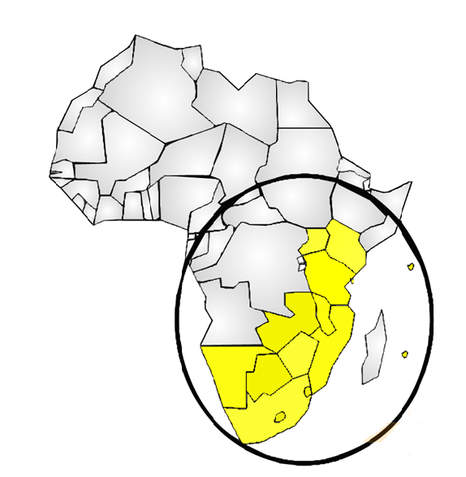
SACMEQ IV STUDY
Results
PORTFOLIO COMMITTEE ON BASIC EDUCATION
13 SEPTEMBER 2016

Slide 2
PRESENTATION OUTLINE
The SACMEQ Purpose, Mission and Model
Methodology
Key findings on South Africa’s Learner Performance
Some Factors Affecting Learner Performance
Way forward

Slide 3
The SACMEQ Purpose, Mission and Model

Slide 4
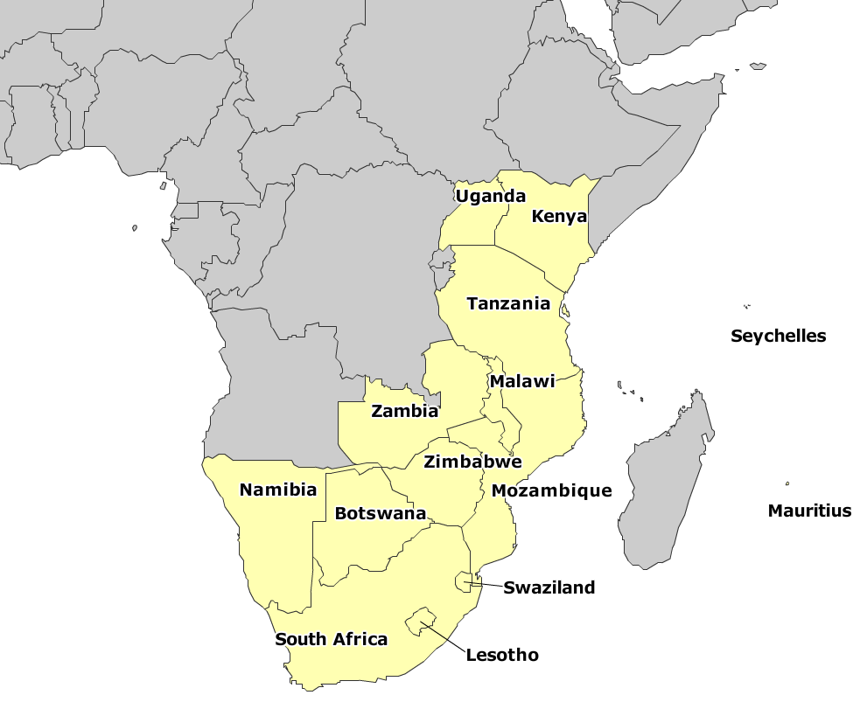
What is SACMEQ?
A network of 15 Ministries of Education

Slide 5
PURPOSE
The Southern and Eastern Africa Consortium for Monitoring Educational Quality (SACMEQ) is an African initiative in response to the targets set within the framework of the international Education for All (EFA) Campaign and UN Millennium Development Goals (Now the Sustainable Development Goals)

Slide 6
SACMEQ’S MISSION
To undertake integrated research and training that will develop the capacities of educational planners to:
  Monitor and evaluate the conditions of schooling and the quality of their own basic education systems;
  To generate research based information that can be used by decision-makers to plan for improvements in the quality of education.

Slide 7
THE CONCEPTUAL MODEL
School Characteristics
  Type, location, enrolment, resources, principal’s qualifications, parental involvement, etc.
Learner Characteristics
  Age, gender, attendance, grade repetition, SES, nutrition, siblings, home help, etc.
Teacher Characteristics
  Age, gender, qualifications, subjects, classroom resources, behaviour, in-service training, etc.
Learner achievement
Reading
Math
Health

Slide 8
METHODOLOGY

Slide 9
RESEARCH DESIGN
SACMEQ research is informed by policy concerns identified by Ministers of the SACMEQ member countries.
Reading and Mathematics test frameworks cover curriculum ‘topics’ that are common across the member systems.
Samples and sample sizes are designed to ensure that estimates are reported with 95% level of confidence.
South Africa has participated in SACMEQ II (2000) and SACMEQ III (2007) and SACMEQ IV (2013) – this provides trend data.

Slide 10
TEST INSTRUMENTS
SACMEQ uses the most modern research techniques in order to develop instruments that:
  (a) examine changes in the performance of single education systems across several time points (“Is our education system improving, staying the same, or getting worse?”), and
  (b) examine differences in the performance of different education systems at single time points (“Is our education system better, the same, or worse than other education systems like ours?”)
In the area of test construction and test scoring, item response theory (IRT) models facilitated the generation of valid comparisons of student reading and mathematics achievement across countries both within and across the SACMEQ studies.
  SACMEQ instruments are confidential and a common set of test items are purposefully used across SACMEQ studies to make valid comparisons.

Slide 11
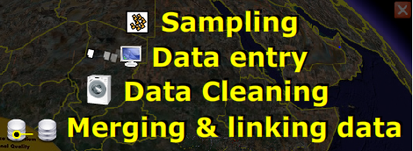
DATA PROCESSES

Slide 12
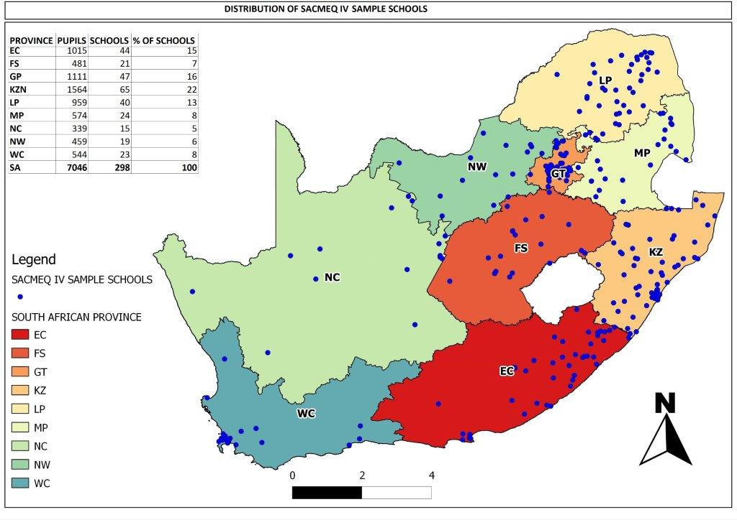
SAMPLE

Slide 13
KEY FINDINGS ON SOUTH AFRICA’S LEARNER PERFORMANCE

Slide 14
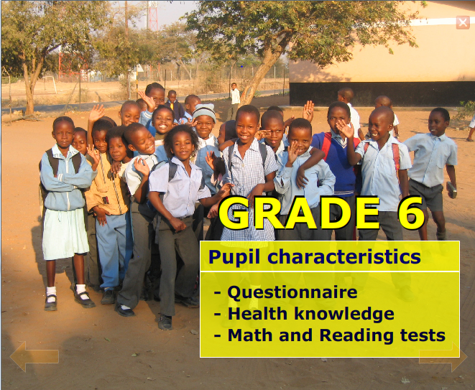

Slide 15
What was the situation and have we moved since 2007?
Significant
 | Reading score |  | Mathematics
 | 2000 | 2007 | 2000 | 2007
1. Mauritius | 536 | 574 | 585 | 623
2. Kenya | 547 | 543 | 563 | 557
3. Tanzania | 546 | 578 | 522 | 553
4. Seychelles | 582 | 575 | 554 | 551
5. Swaziland | 529 | 549 | 517 | 541
6. Botswana | 521 | 535 | 513 | 521
7. Zimbabwe | 504 | 508 | ** | 520
8. South Africa | 492 | 495 | 486 | 495
9. Zanzibar | 478 | 534 | 478 | 486
10. Mozambique | 516 | 476 | 530 | 484
11. Uganda | 482 | 479 | 506 | 482
12. Lesotho | 451 | 468 | 447 | 477
13. Namibia | 449 | 497 | 431 | 471
14. Malawi | 429 | 434 | 433 | 447
15. Zambia | 440 | 434 | 435 | 435

Slide 16
SACMEQ TRENDS
Means | Learner Reading Score |  |  |  | Learner Maths Score
Country** | SACMEQ III | SACMEQ IV | Diff | Change | S III | S IV | Diff | Change
1 | 574 | 597 | 23 |  | 623 | 694 | 71
2 | 543 | 601 | 58 |  | 557 | 651 | 94
3 | 575 | 602 | 27 |  | 551 | 630 | 79
4 | 549 | 590 | 41 |  | 541 | 609 | 68
5 | 535 | 582 | 47 |  | 521 | 598 | 77
6. SOU | 495 | 558 | 63 |  | 495 | 587 | 92
SACMEQ | 507 | 558 | 51 |  | 507 | 584 | 77
7 | 479 | 554 | 75 |  | 482 | 580 | 98
8 | 508 | 528 | 20 |  | 520 | 566 | 46
9 | 468 | 531 | 63 |  | 477 | 559 | 82
10 | 497 | 599 | 102 |  | 471 | 558 | 87
11 | 476 | 519 | 43 |  | 484 | 558 | 74
12 | 537 | 562 | 25 |  | 490 | 538 | 48
13 | 434 | 494 | 60 |  | 435 | 522 | 87
14 | 434 | 492 | 58 |  | 447 | 522 | 75

Slide 17
OVERALL PERFORMANCE:
READING AND MATHEMATICS
Across all SACMEQ countries, there was a notable improvement in the overall reading and mathematics scores of learners.
Against the SACMEQ centre point of 500 (established in SACMEQ 11), learners in South Africa for the first time achieved a mean score above the centre point with 558 in reading and 587 in mathematics.
In SACMEQ 4 (SOU (S IV)), learners showed significant improvement, with an increase by 63 points reading and 92 points in mathematics.
Only 2 other countries within SACMEQ had more significant increases than South Africa. Given the significant improvements, the South African national research team requested SACMEQ to double check the results and were subsequently reassured on their accuracy.

Slide 18
PROVINCIAL PERFORMANCE
Province | Learner reading score |  | Learner math score
 | SACMEQ III | SACMEQ IV | SACMEQ III | SACMEQ IV
Eastern Cape | 448 | 535 | 469 | 570
Free State | 491 | 563 | 492 | 584
Gauteng | 573 | 599 | 545 | 615
Kwazulu-Natal | 486 | 552 | 485 | 579
Limpopo | 425 | 519 | 447 | 554
Mpumalanga | 474 | 553 | 476 | 576
Northern Cape | 506 | 544 | 499 | 575
North West | 506 | 543 | 503 | 574
Western Cape | 583 | 630 | 566 | 673
National | 495 | 558 | 495 | 587

Slide 19
READING IMPROVEMENT
> national increase

Slide 20
MATHEMATICS IMPROVEMENT
> national increase

Slide 21
PROVINCIAL PERFORMANCE
The improvement in learner performance is more explicit at a provincial (regional) level.
In SACMEQ III, only three of our provinces - Western Cape, Gauteng and the North West province achieved scores in reading and mathematics above the SACMEQ mean score of 500, but in SACMEQ IV all provinces had scores above 500.
Provinces such as Eastern Cape and Limpopo which had low scores in SACMEQ III, had the biggest improvement margins in SACMEQ IV.
Western Cape also showed a significant increase in mathematics performance.

Slide 22
PROVINCIAL TRENDS

Slide 23
SACMEQ READING LEVELS & SA GRADE EQUIVALENTS
SACMEQ levels of competency | SA grade equivalents
1. Pre-reading | 2 and lower
2. Emergent reading | 3
3. Basic reading | 4
4. Reading for meaning | 5
5. Interpretive reading | 6
6. Inferential reading | 7
7. Analytical reading | 7+
8. Critical reading | 7++

Slide 24
LEVELS OF ACHIEVEMENT - READING
SACMEQ IV | NON READER |  | Level 3 | Level 4 | Level 5 | ADVANCED
 | Level 1 | Level 2 |  |  |  | Level 6 | Level 7 | Level 8
 | % | % | % | % | % | % | % | %
EC | 0.9 | 4 | 9.9 | 31.7 | 17.7 | 18.5 | 15 | 2.3
FS | 0 | 1.9 | 3.5 | 20.5 | 17.7 | 27 | 21 | 1.8
GP | 0 | 0.7 | 3.6 | 11.9 | 24.2 | 23 | 36.4 | 8.7
KZN | 0.5 | 2.4 | 7.3 | 27.6 | 15.9 | 18.9 | 16.4 | 5.5
LP | 0.8 | 4.3 | 12.2 | 37.7 | 21.4 | 13.8 | 10.3 | 1.3
MPU | 0 | 1.1 | 6 | 25.7 | 19.6 | 23.3 | 18.3 | 1.9
NC | 0.5 | 3.1 | 11 | 18.7 | 23.8 | 26.8 | 15.3 | 0.5
NW | 0.5 | 1.9 | 7 | 29.5 | 24 | 19.9 | 14.2 | 2.1
WC | 0.3 | 0.6 | 1.8 | 6.4 | 24.8 | 21.3 | 45.4 | 15.5
SOUTH AFRICA | 0.4 | 2.3 | 7.1 | 24.9 | 8.8 | 20.1 | 20.8 | 4.8

Slide 25
SACMEQ MATH LEVELS & SA GRADE EQUIVALENTS
SACMEQ Levels of competency | SA grade equivalents
1. Pre numeracy | 2 and lower
2. Emergent numeracy | 3
3. Basic numeracy | 4
4. Beginning numeracy | 5
5. Competent numeracy | 6
6. Mathematically – skilled | 7
7. Concrete problem-solving skills | 7+
8. Abstract problem –solving skills | 7++

Slide 26
LEVELS OF ACHIEVEMENT – MATHEMATICS
SACMEQ IV | NON NUMERATE |  | Level 3 | Level 4 | Level 5 | ADVANCED
 | Level 1 | Level 2 |  |  |  | Level 6 | Level 7 | Level 8
 | % | % | % | % | % | % | % | %
EC | 0 | 6.9 | 26.7 | 26.9 | 22.9 | 10.9 | 5.3 | 0.4
FS | 0 | 1.5 | 22.6 | 30.6 | 27.7 | 12.8 | 3.7 | 1.1
GP | 0 | 2.6 | 14.3 | 26.1 | 24.3 | 17.4 | 11.3 | 3.9
KZN | 0 | 4.9 | 23.2 | 30.4 | 24.1 | 10.5 | 5.7 | 1.2
LP | 0.8 | 7.6 | 30.2 | 31.9 | 18.4 | 7.8 | 2.8 | 0.5
MPU | 0.2 | 5 | 24.4 | 29.3 | 22.7 | 15.4 | 2.1 | 0.9
NC | 0 | 2.9 | 22 | 34.9 | 25.5 | 13 | 1.4 | 0.4
NW | 0 | 5.4 | 23.9 | 27 | 30.6 | 9.3 | 3.1 | 0.7
WC | 0 | 0.3 | 6.1 | 15.6 | 22.3 | 21.7 | 24.2 | 9.9
SOUTH AFRICA | 0.1 | 4.5 | 21.9 | 28.1 | 23.7 | 12.8 | 6.8 | 2.0

Slide 27
ADVANCED LEVELS COMPARISON
Provinces | S III Reading | S IV Reading | S III Maths | S IV Maths
 | Level 6 - 8 (%) | Level 6 - 8 (%) | Level 6 - 8 (%) | Level 6 - 8 (%)
EC | 9.3 | 36 | 4.1 | 17
FS | 23.2 | 50 | 5.5 | 18
GP | 55.1 | 68 | 17.3 | 33
KZN | 22.1 | 41 | 6.8 | 17
LP | 5.7 | 25 | 0.9 | 11
MPU | 16.5 | 44 | 3.1 | 18
NC | 28.6 | 43 | 8.4 | 15
NW | 28.9 | 36 | 10.3 | 13
WC | 57.1 | 82 | 21.1 | 56
SOUTH AFRICA | 26.4 | 46 | 8.4 | 22

Slide 28
ACHIEVEMENT: NON READERS AND NON NUMERATE
Provinces | S III - % Non Readers | S IV - % Non Readers | S III - % Non Numerate | S IV - % Non Numerate
EC | 38.6 | 4.9 | 50.3 | 6.9
FS | 22.3 | 1.9 | 38.1 | 1.5
GP | 11.6 | 0.6 | 20.5 | 2.6
KZN | 28.4 | 2.9 | 44 | 4.9
LP | 49 | 5.1 | 60.6 | 8.4
MPU | 28.4 | 1.1 | 43.8 | 5.2
NC | 21.4 | 3.6 | 37.1 | 2.9
NW | 21.9 | 2.4 | 38.1 | 5.4
WC | 5.1 | 0.9 | 15 | 0.3
South Africa | 27.2 | 2.7 | 40.2 | 4.7

Slide 29
ACHIEVEMENT LEVELS
We have made great strides in achieving at the higher Grade 6 levels
  In Reading: L6 - L8 (46%) – advanced reading skills
  In Maths: L6 - L8 (22%) – advanced math skills
And reduced the number of non readers and non numerate learners across all provinces to:
  2.7% Non readers (cannot “interpret meaning in a short and simple text”), and
  4.7% Non numerate (not able to move beyond mechanical skills)

Slide 30
ACHIEVEMENT BY SUB-GROUPS

Slide 31
SOME FACTORS AFFECTING LEARNER PERFORMANCE

Slide 32
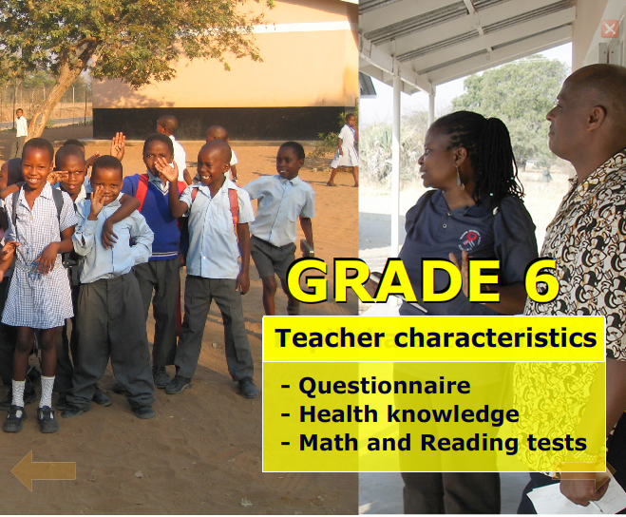

Slide 33
TEACHER TESTS
South African Grade 6 teachers participated for the first time in SACMEQ III in 2007. Their participation in the SACMEQ IV allows for comparisons to be made.
Grade 6 Language and Mathematics teachers responded to the same test items as learners with a few items pitched at a higher level of difficulty than those of learners.
Teachers who took the HIV-and-AIDS knowledge test (HAKT) and TB Knowledge test (TBKT) were those who taught mathematics, reading and life orientation at the Grade 6 level.

Slide 34
OVERALL MEAN SCORES OF TEACHERS
Provinces | Teachers
 | READING |  | MATHEMATICS
 | SACMEQ III | SACMEQ IV | SACMEQ III | SACMEQ IV
Eastern Cape | 724 | 657 | 730 | 764
Free State | 757 | 639 | 782 | 763
Gauteng | 776 | 704 | 788 | 830
Kwazulu-Natal | 758 | 660 | 765 | 729
Limpopo | 745 | 667 | 748 | 718
Mpumalanga | 754 | 660 | 700 | 779
Northern Cape | 756 | 673 | 796 | 769
North West | 758 | 687 | 767 | 703
Western Cape | 813 | 733 | 852 | 829
South Africa | 758 | 672 | 764 | 757

Slide 35
TEACHER READING SCORES BY LEVELS
Provinces | Level 6 % |  | Level 7 % |  | Level 8 %
 | SACMEQ III | SACMEQ IV | SACMEQ III | SACMEQ IV | SACMEQ III | SACMEQ IV
Eastern Cape | 0 | 20 | 36.4 | 48.5 | 62.5 | 24.6
Free State | 0 | 13.2 | 20.5 | 66 | 79.5 | 4.7
Gauteng | 0 | 19.1 | 10 | 24.4 | 87.6 | 56.5
Kwazulu-Natal | 3.6 | 25.2 | 22.4 | 31.1 | 73.9 | 32.3
Limpopo | 2 | 23.5 | 11 | 40.4 | 87.1 | 34.1
Mpumalanga | 0 | 18 | 37.8 | 56.9 | 62.2 | 19.1
Northern Cape | 0 | 0 | 10.5 | 67.8 | 87.1 | 26
North West | 0 | 0 | 19.4 | 73 | 80.6 | 27
Western Cape | 0 | 1.2 | 6.1 | 37.3 | 93.9 | 61.4
South Africa | 1.2 | 18.2 | 20.5 | 43 | 77.8 | 32.9

Slide 36
REDUCED TEACHER SCORES

Slide 37
TEACHER IN-SERVICE TRAINING

Slide 38
ATTEND EXTRA TUITION

Slide 39
ACCESS TO LTSM
Province | Percentage of learner access to learning materials
 | Sitting and Writing Place | Exercise Book, Pen, Ruler | Own Reading Textbook | Own Math Textbook | Notebooks or Workbooks
Eastern Cape | 99.5 | 90.1 | 56.2 | 57.2 | 82.5
Free State | 98.8 | 88.0 | 81.2 | 77.1 | 82.1
Gauteng | 99.2 | 90.1 | 73.0 | 64.8 | 68.4
Kwazulu-Natal | 98.9 | 90.1 | 45.4 | 50.1 | 78.9
Limpopo | 99.4 | 90.0 | 58.9 | 62.4 | 85.9
Mpumalanga | 99.0 | 89.5 | 81.4 | 86.7 | 71.4
Northern Cape | 98.0 | 77.7 | 84.2 | 79.8 | 64.7
North West | 98.5 | 92.6 | 80.3 | 80.0 | 79.5
Western Cape | 98.9 | 91.4 | 85.6 | 87.0 | 71.4
South Africa | 99.1 | 89.9 | 65.6 | 66.1 | 77.0

Slide 40
HEALTH KNOWLEDGE
HIV and AIDS Knowledge Test (HAKT):
Grade 6 Learners and Teachers
Average HAKT | 2007 (S 111) | 2013 (S IV)
Grade 6 learners | 503 | 468
Health Teachers | 799 | 773

Slide 41
HEALTH QUESTIONAIRE
PUPIL ATTITUDES TOWARDS HIV INFECTED INDIVIDUALS
AVAILABILITY OF TEXTBOOKS

Slide 42
PERFORMANCE WITHIN SACMEQ
Means | HAKT
Country** | SACMEQ III | SACMEQ IV | Diff | Change
1 | 531 | 529 | -2
2 | 509 | 520 | 11
3 | 502 | 510 | 8
4 | 465 | 504 | 39
5 | 499 | 502 | 3
6 | 489 | 500 | 11
SACMEQ | 495 | 483 | -12
7 | 501 | 482 | -19
8 | 488 | 481 | -7
9 | 488 | 478 | -10
10 | 477 | 477 | 0
11. SOU | 503 | 468 | -35
12 | 507 | 466 | -41
13 | 512 | 435 | -77
14 | 453 | 412 | -41
Key:
 | = Improvement by 10 points or more
 | = Improvement by less than 10 points
 | = Decline by 10 points or more
 | = Decline by less than 10 points
 | = No change

Slide 43
TB KNOWLEDGE - OVERALL
Province | Teacher Scores | Learner Scores
Eastern Cape | 673 | 560
Free State | 694 | 566
Gauteng | 666 | 565
KwaZulu-Natal | 667 | 555
Limpopo | 660 | 523
Mpumalanga | 668 | 549
Northern Cape | 658 | 576
Northwest | 654 | 553
Western Cape | 662 | 581
South Africa | 666 | 559

Slide 44
TB PREVENTION REQUIREMENTS AND STRATEGIES
Province | Teacher Scores | Learner Scores
Eastern Cape | 620 | 564
Free State | 634 | 558
Gauteng | 652 | 549
KwaZulu Natal | 630 | 555
Limpopo | 613 | 521
Mpumalanga | 637 | 524
Northern Cape | 630 | 567
Northwest | 647 | 550
Western Cape | 624 | 564
South Africa | 630 | 554

Slide 45
WAY FORWARD

Slide 46
The Next Steps (following official release)
The SACMEQ Report concludes with policy suggestions and recommendations within the constraints of time and budget
The Agenda for Action
Align interventions to
Action Plan 2019 and NDP
5 focus areas:
Quality of the learning environment,
Reading and Mathematics achievement levels of learners,
Gender equality and promotion,
Infrastructure and resources
Learner and teacher knowledge on HIV and AIDS and TB.
Teacher development
Share findings with PED’s:
Workshops
Release of policy briefs

Slide 47
CONCLUSION
The SACMEQ IV Study Report sheds vital information on the following important research components on the functioning of schools for Grade 6 learners and their teachers in South Africa:
  Reading (Language) competency
  Mathematics competency
  Conditions of schooling
  Health knowledge on and the impact of HIV-AIDS.
In addition, the Ministry decided as part of its national option for the SACMEQ IV project, to include an additional research component: health knowledge on and the impact of Tuberculosis. This will enable South Africa to take the lead in correlating research on HIV/AIDS and Tuberculosis on the functioning of schools.

Slide 48


