Slide 1
Industrial Parks Revitalization Programme Presented to the Select Committee on Trade and International Relations
7 September, 2016

Slide 2
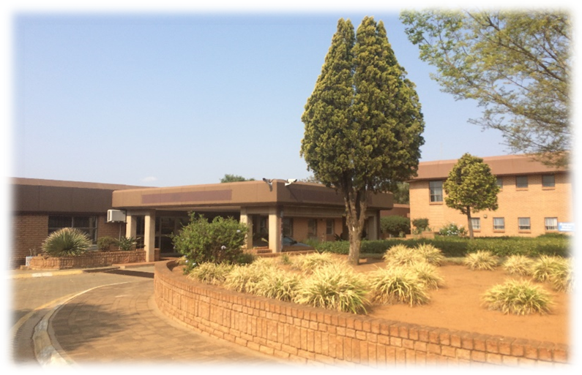
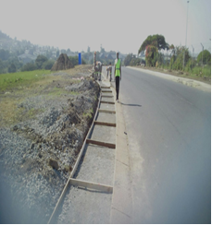
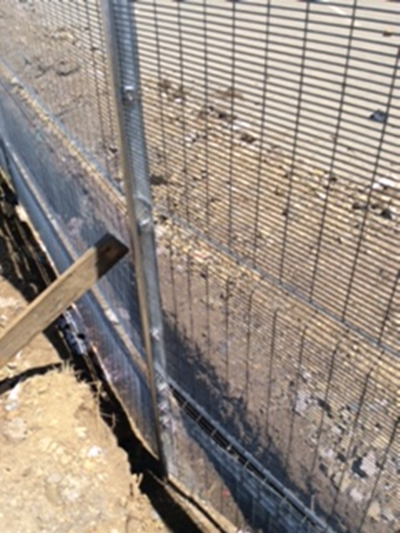
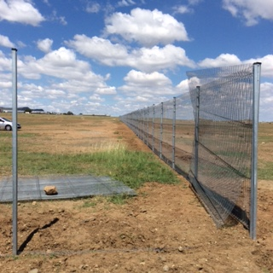
INDUSTRIAL PARK REVITALIZATION PROGRAMME

Slide 3
Introduction
the dti has responded to a call by the President to work towards full scale industrialization and inclusive growth.
A structured programme for the revitalization of industrial parks located in the old industrial areas across the country has been initiated.
The programme has identified the first ten (10) state owned industrial parks to be revitalized.
The programme focuses on both the physical infrastructure and other support requirements in line with outcome 4 and 6.
the dti has forged strategic partnerships for the implementation of the programme on a national scale.
The first phase covering six industrial parks has been initiated.

Slide 4
Purpose of the Industrial Parks Revitalization Programme
To revitalise South Africa’s old industrial parks allowing them to serve as catalysts for broader economic and industrial development in their host regions (townships and rural areas).
The Industrial Parks contribute to economic growth, diversification of economic activity, attracting investments, job creation and addressing inequality.

Slide 5
Objectives
The objectives of the Revitalization of Industrial Parks Programmes are:
To accelerate economic development in the lagging regions by attracting business investments to locate in the areas.
To support job creation in manufacturing and related sectors so as to arrest negative externalities associated with urban congestion.
To remove barriers related to infrastructure, market access and institutional and support firm level competitiveness.
To provide new opportunities and support the high growth in the townships, rural and distressed areas.
To assist regions to build, strengthen and develop strategic industrial capabilities; and
To develop sustainable industrial clusters on the back of the old industrial assets in those regions.

Slide 6
Implementation Programme
The revitalization Programme is categorized into the following phases:-
Phase 1: Security infrastructure upgrade, fencing, street lighting, top structures and critical electricity requirements
Phase 2: Engineering designs and construction of new and existing roads, bulk water supply and sewage treatment plants or industrial effluent control
Phase 3: Upgrading electricity infrastructure, and build new top structures in line with the expansion programme of the Parks.
Phase 4: Development of sustainable industrial clusters in the Parks.

Slide 7
List of Approved Industrial Parks and Value
PROVINCE | INDUSTRIAL PARK | TOTAL APPROVED BUDGET
Eastern Cape | Vulindlela Eastern Cape Development Corporation | R 22 723 571
Eastern Cape | Queenindustria Chris Hani Development Agency | R22 500 000
KwaZulu-Natal | Isithebe Ithala Bank | R 49 580 020
Free State | Botshabelo Free State Development Corporation (FDC) | R 24 462 780
North West | Babelegi North West Development Agency (NWDA) | R 49 341 028
Limpopo | Seshego Limpopo Development Agency (LEDA) | R 21 069 308
Prioritised Industrial Parks

Slide 8
PHASE 1 DELIVERABLES
Scope of work on Individual Industrial Parks
Fencing
Perimeter fencing Fencing between erven Fencing around all the sub-station and mini sub-stations Security CCTV cameras installations complete with control centres Access control – access control gates complete with boom gates Pedestrian access point - a combination of turnstiles and pedestrian gates
Street Lighting and Electrical Installations High mast lighting Intermediate street lighting Maintenance of electrical infrastructure (mini substations and substations) Site lighting; Solar powered lights fixed to 20m high mast towers including excavation for its bases
Waste Management Waste skip structures made of brick structure and plastered inside with 10m3 capacity

Slide 9
INDUSTRIAL PARKS OCCUPANCY
PROVINCE | INDUSTRIAL PARK | OCCUPANCY
Eastern Cape | Vulindlela Eastern Cape Development Corporation | 86%
Eastern Cape | Queenindustria Chris Hani Development Agency | 80%
KwaZulu-Natal | Isithebe Ithala Bank | 90%
Free State | Botshabelo Free State Development Corporation (FDC) | 87%
North West | Babelegi North West Development Agency (NWDA) | 82%
Limpopo | Seshego Limpopo Development Agency (LEDA) | 92%

Slide 10
BOTSHABELO INDUSTRIAL PARK
The Industrial Park is situated in Mangaung in the proximity of Botshabelo township.
It has an occupancy rate of about 234 282m² gross land area.
It boasts of manufacturing and services companies in Textile, Electrical, Plastic Production, Poultry and Food & Snack sectors.
It plays a critical role in contributing to the employment of the area employing over 10,000 people.
It is also serves as a hive for the development of SME’s that require business and trading infrastructure.
The first phase of the revitalization industrial Park was completed in June 2016

Slide 11
Phuthadijhaba INDUSTRIAL PARK
The Industrial Park occupies a total of 257 360m² gross land area, with approximately 67% occupancy rate.
It is one of the biggest local employers in the Textile sector, employing 1200 local people, who comprise of more than 90% women.
The park is a major economic hub of the district, with varied businesses located In the Industrial Park.

Slide 12
EKANDUSTRIAL INDUSTRIAL PARK
Ekandustrial Economic Hub is situated outside Bronkhorstspruit, 57km East of Tshwane and 79km North East of OR Tambo International Airport (ORTIA), and is also close to the N4 Highway (Maputo Corridor) linked to Mpumalanga Province via Witbank and Middleburg.
It is managed and operated by the Mpumalanga Economic Growth Agency (MEGA).
The park currently has 88% occupancy rate comprising a mix of tenants involved in manufacturing and services.
Firms in the industrial park produce plastic goods, light and heavy steel works, wood and timber products, leather processing, food and snacks processing, textile and clothing products, valves and pumps.

Slide 13
EKANDUSTRIAL INDUSTRIAL PARKS
The assessment of the Industrial Park revealed the following requirements to be covered in phase 1 of the programme:
High mast lighting
Boundary Fencing
Access control
CCTV Installations
Water Treatment Plant
Bulk Services Provisional Sums

Slide 14
BABELEGI INDUSTRIAL PARKS
Babelegi is an Industrial Park managed by the North West Development Corporation (NWDC).
It has approximately 261 developed units available for leasing, and 188 of the units are occupied by firms operating in textiles, engineering, construction, light manufacturing, warehousing and distribution.
The industrial park provides employment for residents in nearby township including Hamaanskraal.
The park is strategically located 60 kilometres from the Tshwane CBD and close to the N1.

Slide 15
BABELEGI INDUSTRIAL PARKS
Key areas that have been addressed by the upgrades Babelegi include :-
Fencing – Steel, invisible high density type to a height of 3.2meters
Pedestrian swing gates
Upgrade internal fencing
Installation of new boom gate
Install Perimeter lighting
High mast lighting upgrade and maintenance
CCTV cameras and WIFI installation
Upgrade one office at the NWDC as control room for security and CCTV cameras
Remove existing roller shutter doors and replace with new including its opening and closing mechanisms.
Maintenance of electrical infrastructures (mini substations and substations)

Slide 16
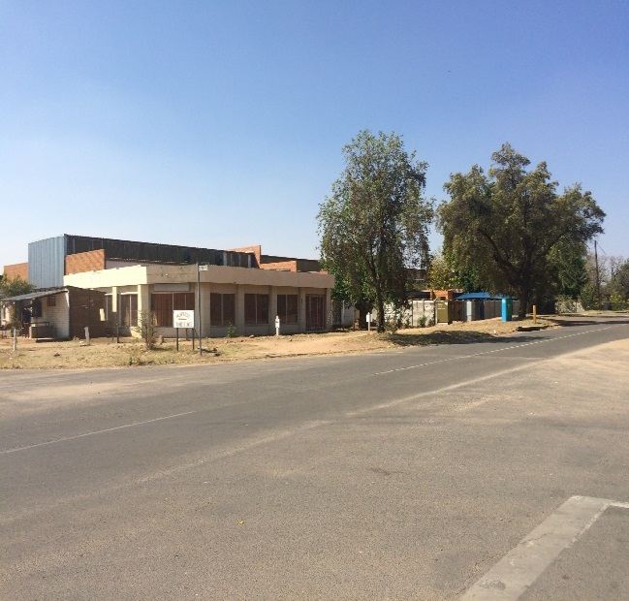
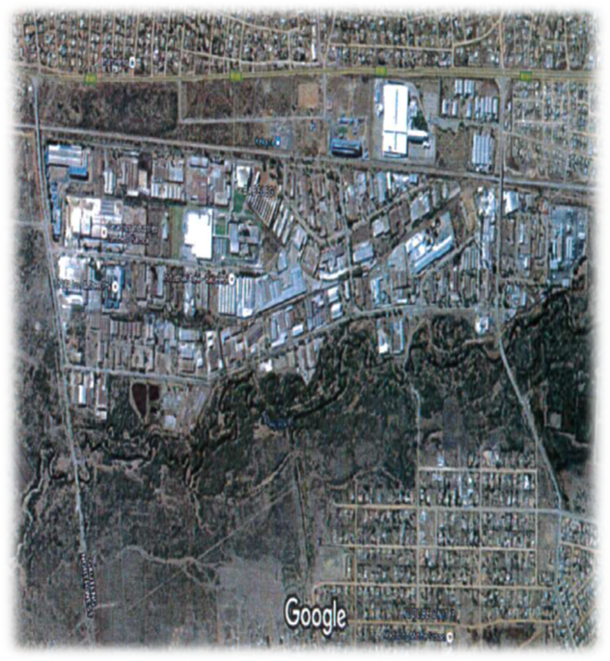
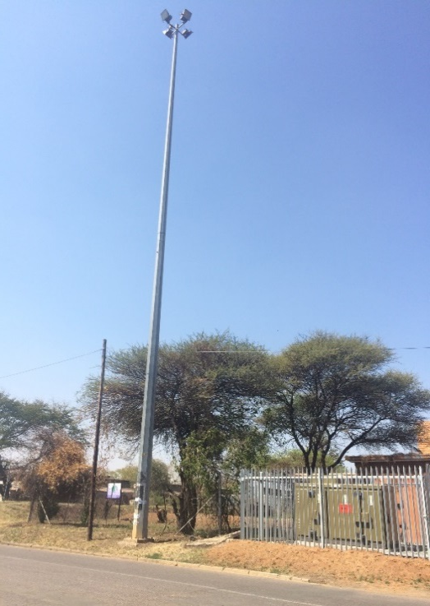
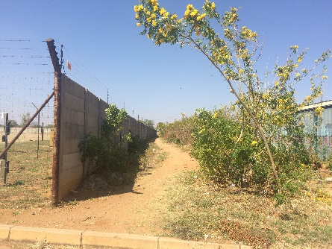
Babelegi Industrial Park - Photos

Slide 17
Ga-rankuwa INDUSTRIAL PARK
The Ga-rankuwa is also managed by the NWDC and is located 15 km west of Rosslyn Industrial Park.
The Industrial Park hosts approximately 283 developed units of which 210 of them are fully occupied by manufacturing and commercial businesses.
It has a total of 1262 stands some stands have several factory subdivisions on them allowing multi-discipline companies to operate.

Slide 18
SESHEGO INDUSTRIAL PARK
The industrial park is located in the jurisdiction of Polokwane City Municipality which is within the Capricorn District.
The Industrial Park is strategically positioned in an area which is within 11 kilometres to Polokwane City and has a direct access to the N1 highway.
Furthermore, the industrial park is located within close proximity to the Gateway International Airport and railway lines traversing the Province from the South to the North into Zimbabwe.
The first phase of rivitalization of the Industrial Park was completed and launched in July 2016

Slide 19
NKOWANKOWA INDUSTRIAL PARKS
The industrial park is situated in the Mopani District Municipality, approximately 15 kilometres from Tzaneen CBD
The Phalaborwa Corridor, which connects Tzaneen to the Maputo Corridor, and the deep-water port in Mozambique is within close reach to the Industrial Park
The industrial park has a total of 90 factories with a 76% occupancy despite it’s state.

Slide 20
ISITHEBE INDUSTRIAL PARKS
The Isithebe Industrial Estate comprises approximately 442 hectares of serviced industrial land.
Isithebe was established as an industrial growth point some forty years ago to stimulate development in the Mandeni and Sundumbili region.
To date Isithebe can be considered as a successful industrial estate given the high occupation rates, low turnover, the mix of industrial activity.
Isithebe Industrial Park is managed by Ithala Bank with their offices located on the South Eastern part of the industrial park.

Slide 21
QUEENDUSTRIAL PARK
The Industrial Park Complex is located 5KM from Queenstown Central Business District with the entrance to the park positioned on the road to Ezibeleni Township.
The extent of the land area covered by the park is in a region of ± 360ha and is linked to the railway line that links East London Harbour with the Free State and Gauteng Province and the N6 national road.
Ezibeleni Industrial Complex is owned and managed by Lukhanji Municipality, whist the adjacent Industrial Park, Queendustria has a combination of state owned and privately owned stands and factories and is managed by the Chris Hani Development Agency.
Queendustria is a mixed industrial park and boast an operational occupancy rate of 80%. It offers 555 employment opportunities to the local community.

Slide 22
VULINDLELA INDUSTRIAL PARK
Vulindlela Heights Industrial Park comprises of stand-alone units, semi-detached units and factory block units.
The tenancy matrix includes heavy and light industry, manufacturing and retail, goods and services; and private and public enterprises.
The park is occupied largely by commercial tenants varying from industrial, commercial, retail, offices, etc and had an occupancy rate of 86%
It is envisaged that the Park will form part of the greater developmental goals of the District, namely, the Wild Coast SEZ development.

Slide 23
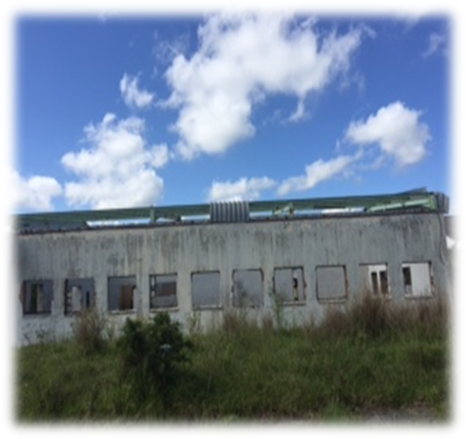
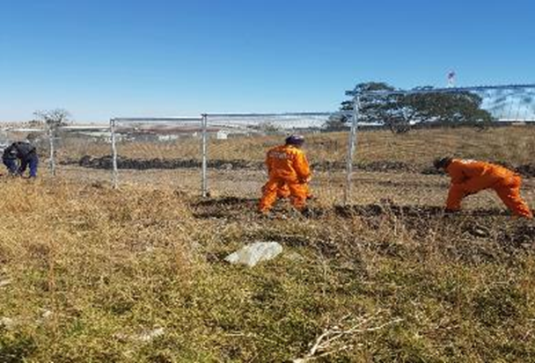
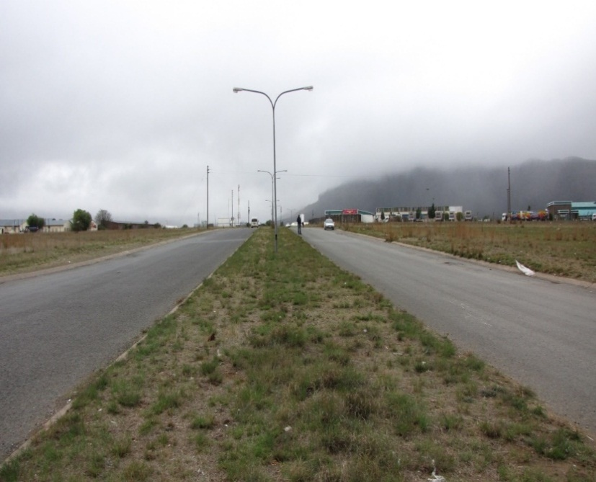
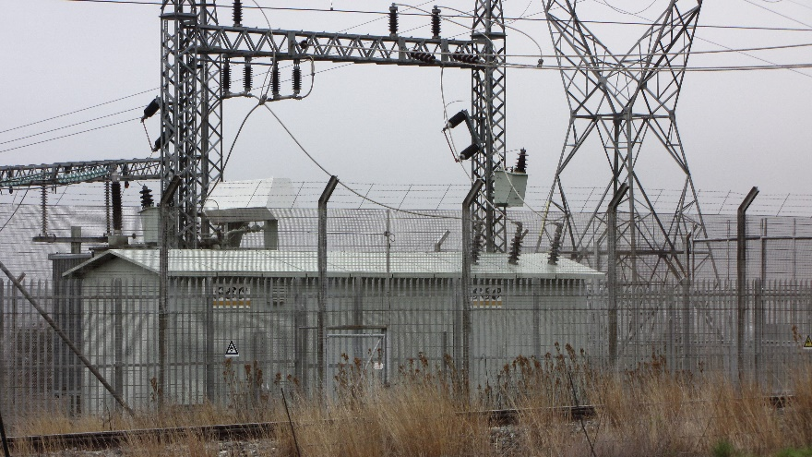
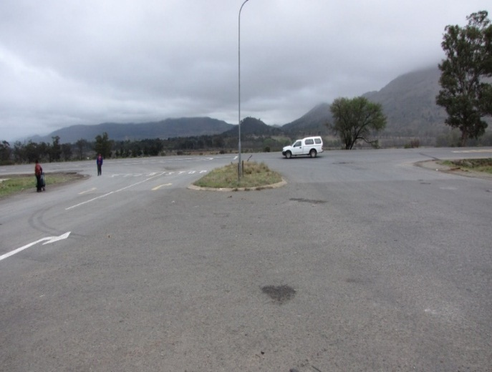
Current Status of Industrial Parks

Slide 24
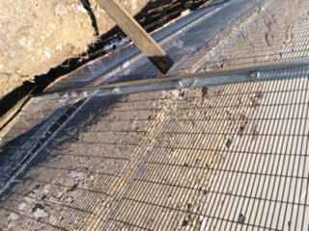
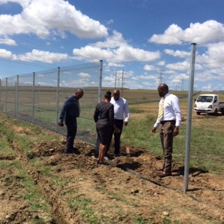

Slide 25
Stieneke Samuel
Chief Director RIC
SSamuel@thedti.gov.za
012 394 3563
071 607 4970

