Slide 1
Presentation to the Joint Session of the Portfolio Committees on Home Affairs and Telecommunications and Postal Services
06 SEPTEMBER 2016

Slide 2
BACKGROUND

Slide 3
SITA MANDATE
Objects of the Agency
    Section 6. The objects of the Agency are:
    To improve service delivery to the public through the provision of information technology, information systems and related services in a maintained information systems security environment to departments and public bodies; and
    To promote the efficiency of departments and public bodies through the use of information technology

Slide 4
SITA MANDATE
Mandated Services
    Section 7(1). To achieve its objects, the Agency
    must on behalf of a department, and may, on behalf of a public body, which so requests in terms of subsection (4) or (5) –
    provide or maintain a private telecommunications network or a value-added network service in accordance with the Telecommunications Act, 1996 (Act No. 3 of 1996);
    Section 7(2). For purposes of the Telecommunications Act, 1996, the provision of a private telecommunications network in terms of section (1)(a)(i) by the Agency on behalf of one or more departments or public bodies, must be construed as the provision of the network by the State for the purposes principally or integrally related to the operations of the State.

Slide 5
SITA MANDATE
Mandated Services
    Section 7(2). For purposes of the Telecommunications Act, 1996, the provision of a private telecommunications network in terms of section (1)(a)(i) by the Agency on behalf of one or more departments or public bodies, must be construed as the provision of the network by the State for the purposes principally or integrally related to the operations of the State.

Slide 6
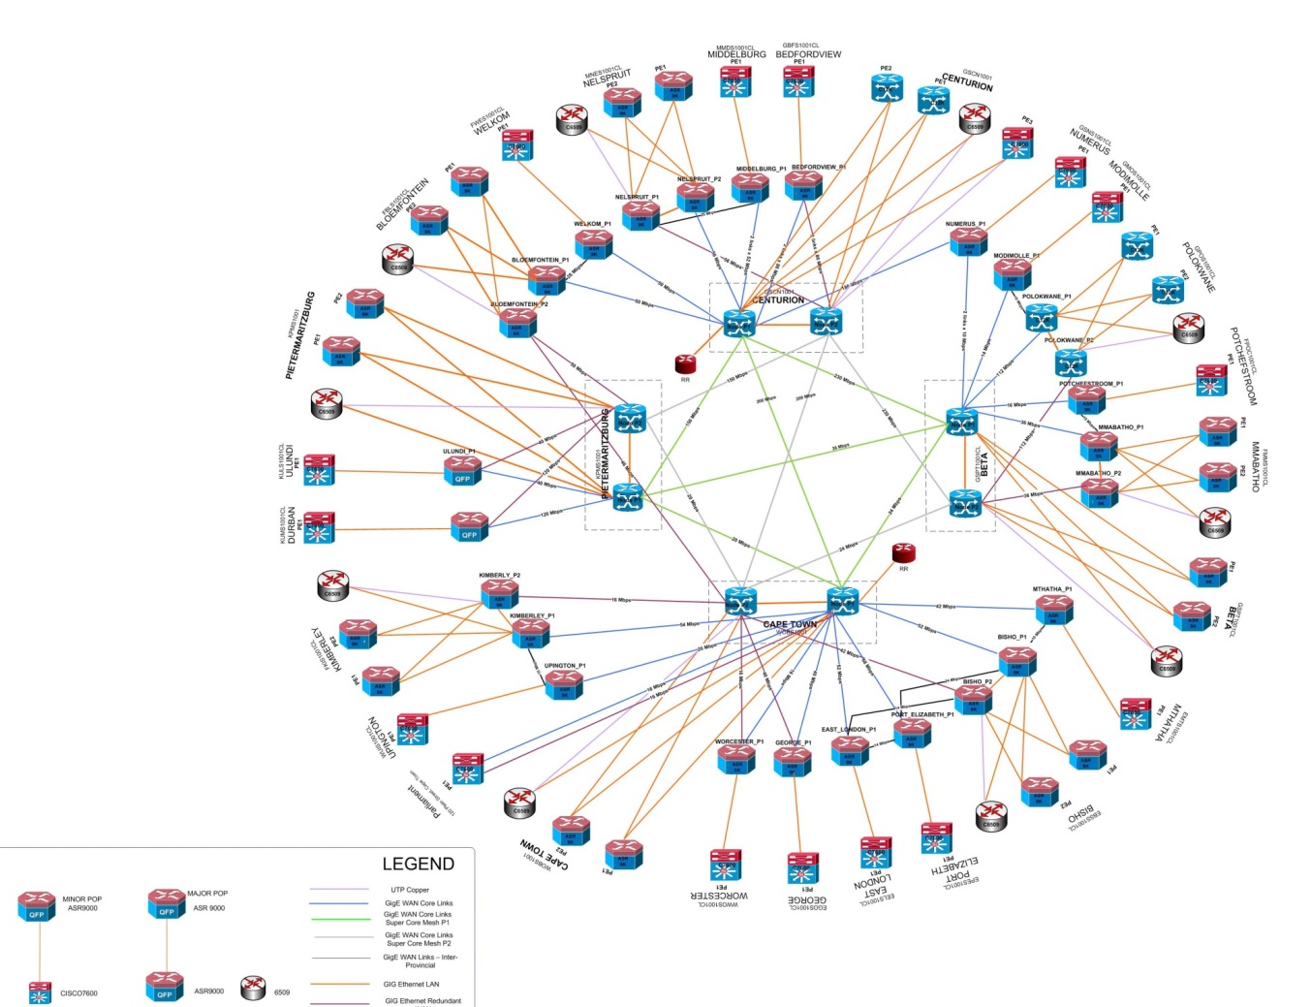
SITA NETWORK
SITA operates a dedicated core network of long distance fibre network, routing and switching equipment and security services.
SITA also employs dedicated NOC team that monitors and manages service operations.
Access links costs are passed through without markup.
No duplication.

Slide 7
SITA NETWORK
Currently almost 92% of government sites are on Telkom’s terrestrial access networks. Almost all access lines for DHA are drawn from Telkom. The banks are mostly connected on Vodacom.
The fibre infrastructure in the core network is provided by Broadband Infraco
SITA owns and operates the routers in the POPs and Switching Centers.
SITA manages the electrical and mechanical equipment in the POPs and Switching Centers.
Primary power is drawn from either Eskom or local Municipality.
SITA
NOC
DHA Office
DHA Office
SITA
Data Center
SITA POP
SITA Core
DHA Office
Terrestrial Access Network
SITA Switching
Center

Slide 8
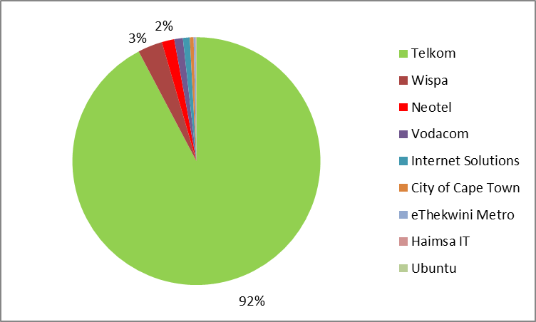
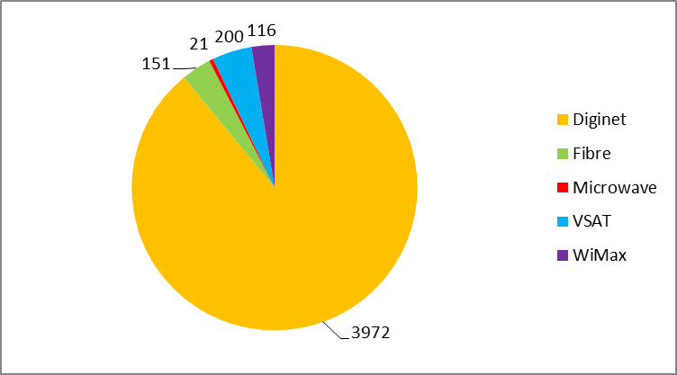
SITA ACCESS NETWORK
Most of the access networks are from Telkom and use copper infrastructure.
VSAT is generally used for mobile Government sites or sites located in rural areas where no service provider has terrestrial infrastructure .

Slide 10
CONTRACTED SERVICES

Slide 11
CONTRACTED SERVICES
Networks | Dedicated Virtual Private Network
 | Dedicated Internet
 | Remote Access
 | Common Access Point
 | VSAT
Hosting | Mainframe Hosting
 | Hosted Batch Printing
 | Server Accommodation Facilities
Unified Messaging | Wireless Access Point
LAN and Desktop | Support and Cabling

Slide 12
DEDICATED Vpn

Slide 13
DEDICATED VPN
Service Description
A dedicated VPN service provides connectivity of an individual office of the Department of Home Affairs (DHA) with the back office systems of DHA.
Service Features
The service can be provided in fully outsourced or dedicated versions. In the fully outsourced version, SITA owns and manages the routers at the office sites. In the dedicated version, DHA owns and manages the routers at the office sites. The service with DHA is a Dedicated VPN Service..
Current Service Level Agreement
Generally, a dedicated VPN service can be provided under Bronze, Silver, Gold & Platinum service levels. The current Service Level Agreement between SITA and DHA is for a Bronze service.

Slide 14
SERVICE LEVEL DEFINITIONS
Availability measures the percentage of time over a period when the service on a network link or data line per site (from the NGN to the client site) is available for usage. This is expressed as a percentage such as 99.5%, measured over a 30 day period (24x7).
Reachability measures percentage of time over a period when network equipment, excluding the link/data line, is available usage. This is expressed as a percentage such as 99.5%, measured over a 30 day period (24x7).
In terms of SLA reporting, Availability and Reachability are reported as averages of all sites per Department over a 30 day period 24 x 7 respectively. Penalties are generally stated in service level agreements to cater for situations where the performance targets are not met. Network Management Systems (NMS) are used to connect (ping) to the 403 DHA site routers with their data lines every 5 minutes to collect information to be used in the statistics.

Slide 15
SPECIFIC DHA SLA METRICS
AND TARGETS
Unit of Measure | SLA Target
Mean Time to Respond (MTTr): The time SITA or a vendor is allowed to respond to a failed network component. Normally defined as an hour but if travelling will be required an hour is added for every 100km that needs to be travelled. | 4 hours
Mean Time to Resolve (MTTR): The time taken to resolve an incident from the time that is was logged to the time it was resolved. | 16 hours
Carrier Provider Reachability: Reachability of the NGN core provider equipment (P-node). | 95%
NGN Distribution Reachability: Reachability of NGN core equipment (PE-node) | 95%
Access Links Availability: Availability of services over communication services on infrastructure, such as a data line/fibre, connection between SITA NGN equipment (PE node) and client equipment (router) at client site. | 95%
NMS Reachability: Reachability of SITA Network Management System tools. | 99.5%

Slide 16
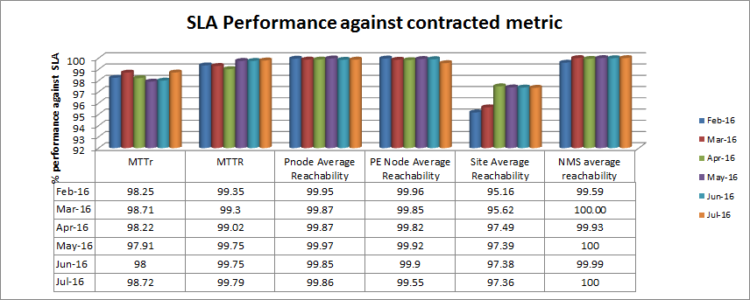
PERFORMANCE ON METRICS
SITA has met all the service metrics for the service over the period. The data is based on SITA’s NMS measurements and the agreed calculation methodology.

Slide 17
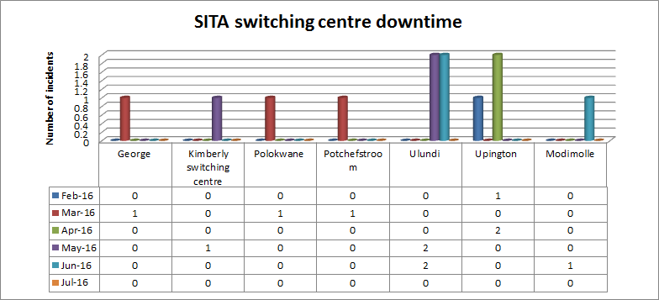
SWITCHING CENTER
PERFORMANCE

Slide 18
SWITCHING CENTER
PERFORMANCE
Switching Centre | Root cause | Mitigation
Modimolle | Generator ran out of diesel | The analysis and mitigation plans per switching center are addressed later on in the presentation.
George | Faulty municipality feed.
Upington | Power failure due to a faulty UPS.
Ulundi | Faulty switch over device from generator power into main power.
Potchefstroom | Faulty air conditioning unit.
Polokwane | Faulty air conditioning unit and UPS.
Kimberley | Faulty air conditioning unit.

Slide 19
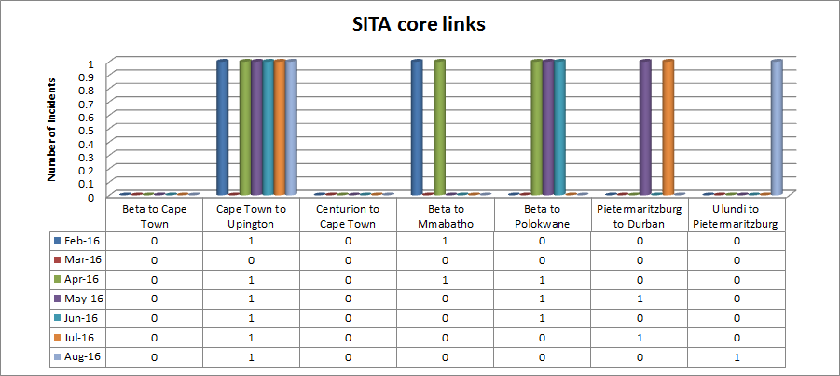
NGN CORE LINKS
PERFORMANCE

Slide 20
NGN CORE LINKS
PERFORMANCE
NGN core failures:
  08 August 2016 – 88 DHA offices countrywide were affected by SITA core configuration failure.
  18 August 2016 – 21 x DHA offices were affected by core links failure in Ulundi.
  25 August 2016 – 7 x DHA offices in Upington were affected by cable break.

Slide 21
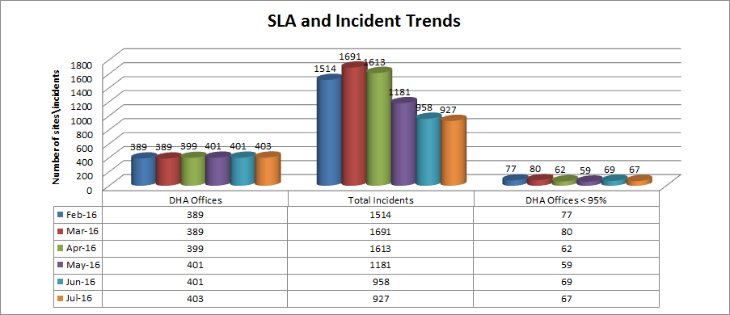
OTHER INCIDENTS
IMPACTING ON SERVICES

Slide 22
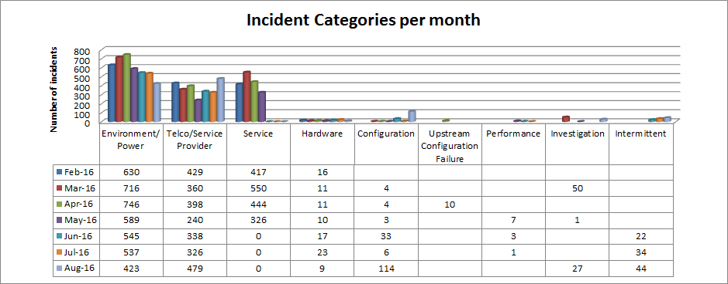
OTHER INCIDENTS
IMPACTING ON SERVICES

Slide 23
IMPACT OF TELKOM’S
INDUSTRIAL ACTION IN AUGUST 2016
Telkom informed SITA in writing on 18 August 2016 about the impact of industrial action on service delivery.
This includes instances of damage to property and sabotage.
SITA has put a process in place in instances where any SITA data lines are down, it is reported by following the normal process, and right after a reference number has been provided, it is escalated to the relevant Telkom Manager to treat it as critical services and have the fault resolved.

Slide 24
IMPACT OF TELKOM’S INDUSTRIAL
ACTION IN AUGUST 2016
Telkom cable breaks in Limpopo, KZN and Eastern Cape:
  02 - 03 August 2016 – +- 22 DHA offices in Limpopo were affected.
  16 August 2016 – 6 x DHA offices in Limpopo
  22 August 2016 – 13 x DHA offices in Ulundi and Durban were affected.
  24 August 2016 – 10 x DHA offices in Durban were affected.
  26 August 2016 – 21 DHA offices in Eastern Cape were affected
  30 August 2016 – 13 DHA offices in Modimolle were affected.

Slide 25
SERVICE IMPROVEMENT:
CORE NETWORK
The design of the NGN Core is currently being reviewed with the view to introduce more resiliency in 2017/18, with specific emphasis and consideration being put on the following:
  Convert some of the 14 minor point of presence (POP) sites into major POPs, by introducing redundancy on the core node infrastructure.
  Increase the number of Super POPs to address issues such as that of Western Cape, Eastern Cape, Northern Cape, Pietermaritzburg, Ulundi and Durban all being isolated whenever Cape Town or Pietermaritzburg experiences a service outage.

Slide 26
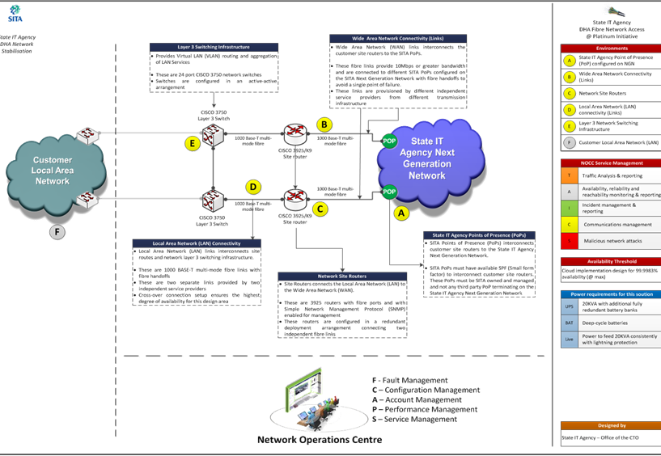
SERVICE IMPROVEMENT:
ACCESS NETWORK
SITA created a platinum solution in 2015 and went into the market to look for access network service providers.
This solution would have introduced full redundancy in the access network for all DHA sites, using two independent service providers per site, with each line on 10Mbps and fibre.
The proposal would have increased service levels from 95% to well over 99%.
It is a naturally very expensive solution that would have cost in excess of R20m per month.
The proposal was not received favourably.

Slide 27
SERVICE IMPROVEMENT:
ACCESS NETWORK
Based on preliminary analysis, this solution will cost between R500k and R800k per month.
Shared satellite bandwidth
Minimum number of sites share concurrently
1:30 sharing maximum
Minimum bandwidth per site defined
Burst allowed
NOC-to-NOC real-time coordination
Ku-band satellite
SITA
NOC
SP
NOC
Automatic or forced switch over in case of terrestrial links and/or switching center failures.
10-20Mbps
SP Local
Teleport
DHA Office
DHA Office
SITA
Data Center
SITA POP
SITA Core
DHA Office
Terrestrial Access Network
SITA Switching

Slide 28
SERVICE IMPROVEMENT:
SWITCHING CENTERS
The following actions have been taken place since April 2015
Appointing a specialist resource to direct the stabilisation and modernisation of the Switching Centre, supported by internal resources and external service providers.
Full assessment of the Switching Centres’ facility condition and fit for purpose assessment completed by June 2015.
Identification of critical items for stabilisation and modernisation and initiating projects to address immediate requirements completed March 2016.
Establishment of a full preventive maintenance contract to maintain the Switching Centres’ facility infrastructure. Award to be completed September 2016.

Slide 29
SERVICE IMPROVEMENT:
SWITCHING CENTERS
Switching Centre | Generators | UPS & Batteries | LV Distribution Boards | CRAC Units | Cooling Towers / Chiller | Fire Suppression | Environmental Alarm | Single Point of Failures
Parliamentary Switching Centre (not SITA owned) | 3rd Party | UPSs nearing End of Life Batteries will not provide 8hour site backup time | Not suitable technology | Not suitable technology | Not Applicable | Not Applicable | Not Applicable | Distribution Board
Worcester Switching Centre | 3rd Party | 3rd Party | Not suitable technology | Not suitable technology | Not Applicable | Not Applicable | Present Limited monitoring Not fully Operational | Distribution Board
Port Elizabeth Switching Centre | Mid-life | 1x nearing End of Life 1x End of Life Batteries will not provide 8hour site backup time | Mid-life | Mid-life Need repairs | Not Applicable | Mid-life | Present Limited monitoring | Distribution Board Generator
Bisho Switching Centre | Mid-life | UPSs nearing End of Life Batteries will not provide 8hour site backup time | Mid-life | Mid-life | Not Applicable | Mid-life Need repairs | Present Limited monitoring | Distribution Board Generator

Slide 30
SERVICE IMPROVEMENT:
SWITCHING CENTERS
Switching Centre | Generators | UPS & Batteries | LV Distribution Boards | CRAC Units | Cooling Towers / Chiller | Fire Suppression | Environmental Alarm | Single Point of Failures
East London Switching Centre | End of Life Need repairs | Nearing End of life UPSs 1x decommissioned Batteries will not provide 8hour site backup time Need repairs | Mid-life | End of Life | Not Applicable | Mid-life | Present Limited monitoring Need repairs | Distribution Board Generator
Mthatha Switching Centre | 3rd Party | Nearing End of Life UPSs Batteries will not provide 8hour site backup time Both battery banks decommissioned Need repairs | Mid-life | Mid-life Need repairs | Not Applicable | Mid-life Need repairs | Present Limited monitoring | Distribution Board

Slide 31
SERVICE IMPROVEMENT:
SWITCHING CENTERS
Switching Centre | Generators | UPS & Batteries | LV Distribution Boards | CRAC Units | Cooling Towers / Chiller | Fire Suppression | Environmental Alarm | Single Point of Failures
Polokwane Switching Centre | Mid-life | 1x End of Life Batteries will not provide 8hour site backup time | Mid-life | Mid-life Need repairs | Not Applicable | Near End of Life Need repairs | Present Limited monitoring | Distribution Board Generator UPS
Modimole Switching Centre | Mid-life | 1x Near End of Life Batteries will not provide 8hour site backup time | Mid-life | Not suitable technology | Not Applicable | Near End of Life Need repairs | Present Limited monitoring | Distribution Board Generator UPS
Nelspruit Switching Centre | Mid-life | 1x Near End of Life Batteries will not provide 8hour site backup time | Mid-life | Not suitable technology | Not Applicable | Near End of Life Need repairs | Present Limited monitoring | Distribution Board Generator UPS

Slide 32
SERVICE IMPROVEMENT:
SWITCHING CENTERS
Switching Centre | Generators | UPS & Batteries | LV Distribution Boards | CRAC Units | Cooling Towers / Chiller | Fire Suppression | Environmental Alarm | Single Point of Failures
Middelburg Switching Centre | Mid-life | Relative new UPSs Batteries will not provide 8hour site backup time. | Mid-life | Mid-life | Not Applicable | Mid-life | Present Limited monitoring | Distribution Board Generator
Ulundi Switching Centre | Mid-life | Relative new UPSs Batteries will not provide 8hour site backup time | Mid-life | Nearing end of life | Not Applicable | Mid-life | Present Limited monitoring | Distribution Board Generator
Durban Switching Centre | Mid-life | Relative new UPSs Batteries will not provide 8hour site backup time | Mid-Life | Mid-life | Not Applicable | Mid-life Need repairs | Present Limited monitoring | Distribution Board Generator

Slide 33
SERVICE IMPROVEMENT:
SWITCHING CENTERS
Switching Centre | Generators | UPS & Batteries | LV Distribution Boards | CRAC Units | Cooling Towers / Chiller | Fire Suppression | Environmental Alarm | Single Point of Failures
Mmabatho | 3rd Party | 3rd Party | Not suitable technology | Mix between End of Life and Mid-life units | Not Applicable | Mid-life Need repairs | Present Limited monitoring Not fully Operational | Distribution Board Generator UPS
Potchefstroom | 3rd Party | 3rd Party | Not suitable technology | Not suitable technology | Not Applicable | Not Applicable | Present Limited monitoring Not fully Operational | Distribution Board
Welkom | Mid-life | Nearing End of Life UPSs Both units not functional Batteries End of Life Will not provide 8hour site backup time | Mid-life | Mid-life Orientation concern | Not Applicable | Mid-life | Present Limited monitoring | Distribution Board Generator

Slide 34
SERVICE IMPROVEMENT:
SWITCHING CENTERS
Switching Centre* | Generators | UPS & Batteries | LV Distribution Boards | CRAC Units | Cooling Towers / Chiller | Fire Suppression | Environmental Alarm | Single Point of Failures
Upington | 3rd Party | 3rd Party | Not suitable technology | Not suitable technology | Not Applicable | Not Applicable | Present Limited monitoring Not fully Operational | Distribution Board
Kimberley | 3rd Party | 3rd Party | Not suitable technology | Not suitable technology | Not Applicable | Not Applicable | Present Limited monitoring | Distribution Board
George | Mid-life | Nearing End of Life UPSs Batteries will not provide 8hour site backup time | Mid-life | Mid-life | Not Applicable | Mid-life | Present Limited monitoring Not fully Operational | Distribution Board Generator
Bedfordview | Mid-life | Relative new UPSs Batteries will not provide 8hour site backup time | Mid-life | Mid-life | Not Applicable | Mid-life | Present Limited monitoring Not fully Operational | Distribution Board Generator
*Infrastructure assessment

Slide 35
SERVICE IMPROVEMENT:
SWITCHING CENTERS
Switching Centre* | Space for future rack growth | Space for UPS & battery backup | Type of building structure | Floor loading capacity | Window in building Data room | 3rd party occupants close to Data room | 3rd party activity risk to SITA | SITA can provide own Generator | Dedicated internal access | Dedicated site access | Site Security
Centurion Switching Centre | Yes | Yes | Brick | High | None | None | None | Yes | Yes | Yes | Sufficient
BETA Switching Centre | Yes | Yes | Brick | High | None | None | None | Yes | Yes | Yes | Sufficient
Numerus Switching Centre | Yes | Yes | Brick | High | None | None | None | Yes | Yes | Yes | Sufficient
Erasmuskloof Switching Centre | Yes | Yes | Brick | High | None | None | None | Yes | Yes | Yes | Sufficient
Pietermaritzburg Switching Centre | Yes | Yes | Brick | High | None | None | None | Yes | Yes | Yes | Sufficient
East London Switching Centre | Yes | Yes | Brick | Not applicable, on ground. | None | Office area. Could be leased by 3rd party. Currently leased by SITA. | Medium if office area is leased to 3rd party. Possible risk from adjacent office blocks. | Yes | Yes | No | In office park.
*Fit for purpose assessment

Slide 36
SERVICE IMPROVEMENT:
SWITCHING CENTERS
Switching Centre | Space for future rack growth | Space for UPS & battery backup | Type of building structure | Floor loading capacity | Window in building Data room | 3rd party occupants close to Data room | 3rd party activity risk to SITA | SITA can provide own Generator | Dedicated internal access | Dedicated site access | Site Security
Middelburg Switching Centre | Yes | Yes | Brick | Not applicable, on ground | None | Office area. Could be leased by 3rd party. Currently leased by SITA. Two shop. | Medium | Yes | Yes | Yes | Reasonable.
Port Elizabeth Switching Centre | Yes | Yes | Brick | Not applicable, on ground | None external facing | None | None | Yes | Yes | Yes | Sufficient
Parliamentary Switching Centre | Limited, but sufficient for need. | Limited | Brick | Not applicable, on ground | None | Government offices. | Medium | No | Yes | No, but it is a controlled area | High
George Switching Centre | Yes | Yes | Brick | Not applicable, on ground | None | Office area with 3rd party tenants currently | Medium | Yes | Yes | No | Reasonable.

Slide 37
SERVICE IMPROVEMENT:
SWITCHING CENTERS
Switching Centre | Space for future rack growth | Space for UPS & battery backup | Type of building structure | Floor loading capacity | Window in building Data room | 3rd party occupants close to Data room | 3rd party activity risk to SITA | SITA can provide own Generator | Dedicated internal access | Dedicated site access | Site Security
Modimole Switching Centre | Yes | Yes | Brick | Not applicable, on ground | None | Government offices | Medium | Yes | Yes | No | Sufficient
Ulundi Switching Centre | Yes | Yes | Brick | Not applicable, on ground | None | Government offices | Medium | Yes | No, through offices. | No | High
Free State Switching Centre | Yes | Yes | Brick | Investigate. | None | Government offices | Medium | Need to negotiate with landlord | Yes | No | Sufficient
Observatory Switching Centre | No | Yes | Brick | Investigate. | Yes, closed off with board. | Office area. Could be leased by 3rd party. Currently leased by SITA. | High | Yes | Yes | No | Sufficient
Worcester Switching Centre | No | Limited | Container | Limited | None | SAPS | Medium | Need to negotiate with landlord | Yes | Yes | Reasonable

Slide 38
SERVICE IMPROVEMENT:
SWITCHING CENTERS
Switching Centre | Space for future rack growth | Space for UPS & battery backup | Type of building structure | Floor loading capacity | Window in building Data room | 3rd party occupants close to Data room | 3rd party activity risk to SITA | SITA can provide own Generator | Dedicated internal access | Dedicated site access | Site Security
Polokwane Switching Centre | Yes | Yes | Brick | Not applicable, on ground. | Yes, closed off with board. | Office area. Could be leased by 3rd party. Currently leased by SITA. | High pertaining to generator. | Yes | Yes | No | Sufficient
Nelspruit Switching Centre | Yes | Yes | Brick | Investigate. | None | Office area. Leased by 3rd party. | Medium | Yes | Yes | No | Concern.
Potchefstroom Switching Centre | No | Limited | Container | Limited | None | SAPS | Medium | Need to negotiate with landlord. | Yes | No | Reasonable.
Upington Switching Centre | No | Limited | Container | Limited | None | SAPS | Medium | Need to negotiate with landlord. | Yes | No | Sufficient
Kimberly Switching Centre | No | Limited | Container | Limited | None | SAPS | Medium | Need to negotiate with landlord. | Yes | No | Reasonable.

Slide 39
SERVICE IMPROVEMENT:
SWITCHING CENTERS
Switching Centre | Space for future rack growth | Space for UPS & battery backup | Type of building structure | Floor loading capacity | Window in building Data room | 3rd party occupants close to Data room | 3rd party activity risk to SITA | SITA can provide own Generator | Dedicated internal access | Dedicated site access | Site Security
Mmabatho Switching Centre | Limited | Need to negotiate with landlord | Brick | Not applicable, on ground | None | Government offices | Medium | Need to negotiate with landlord | No | No | High
Bedfordview Switching Centre | Yes | Yes | Brick | Not applicable, on ground. | None | Office area. Leased by 3rd party | High, pertaining to generator | Yes | Yes | No | Reasonable.
Welkom Switching Centre | Yes | Yes | Brick | Investigate | Yes, closed off with board | Office area Leased by 3rd party | Medium | Yes | Yes | No | Concern to generator and aircon condensers
Bisho Switching Centre | Yes | Yes | Brick | Not applicable, on ground. | None | Government offices | Medium | Yes | Yes | No | Sufficient

Slide 40
SERVICE IMPROVEMENT:
SWITCHING CENTERS
Switching Centre | Space for future rack growth | Space for UPS & battery backup | Type of building structure | Floor loading capacity | Window in building Data room | 3rd party occupants close to Data room | 3rd party activity risk to SITA | SITA can provide own Generator | Dedicated internal access | Dedicated site access | Site Security
Mthatha Switching Centre | Yes | Limited | Brick | Investigate | None | Government offices | Medium | Need to negotiate with landlord | Yes | No | Sufficient
Durban Switching Centre | Yes | Yes | Brick | Not applicable, on ground | None | Office area. Leased by 3rd party | High to generator if it moves out of generator room | Current generator room not suitable. Need to negotiate with landlord for alternative. | Yes | No | Reasonable.

Slide 41
SERVICE IMPROVEMENT:
SWITCHING CENTERS
The following RFQ processes have been initiated to address the immediate and known stabilisation issues:
Switching Centre | Scope of Work | Status
Kimberley Switching Centre | Stabilisation of Electrical and Mechanical plant | RFQ to be published October 2016.
East London Switching Centre | Mechanical Plant Replacement | Underway. Completion February 2017.
East London Switching Centre | Electrical Plant repairs | Underway. Completion February 2017.
Welkom Switching Centre | Mechanical Plant Replacement | RFQ to be published October 2016.

Slide 42
SERVICE IMPROVEMENT:
SWITCHING CENTERS
Switching Centre | Scope of Work | Status
Welkom Switching Centre | Electrical Plant repairs | RFQ to be published October 2016.
Nelspruit Switching Centre | Electrical Plant repairs | RFQ closed August 26th 2016.
Bisho Switching Centre | Mechanical Plant major repairs | Completed.
All Switching Centres | Full scope preventive maintenance | RFQ-913JM768-2016 in award stage.
Further increase in specialist internal resources to support the Switching Centres’ facility infrastructure.
Finalisation of the ownership and specific responsibilities with regard to the Switching Centres’ facility infrastructure through processes and procedures. A management plan for the Data Centres have been submitted at SITA Executive Committee. This principle will be rolled out for Switching Centres as well.
Operational issues such as the refuel of diesel form part of the full maintenance scope of work for Switching Centres.

Slide 43
SERVICE IMPROVEMENT:
SWITCHING CENTERS
The following RFQ processes have been initiated to address the immediate and known Modernisation issues.
Switching Centre | Scope of Work | Status
Modimolle Switching centre | Mechanical plant Modernisation | RFB to be published September 2016.
Port Elizabeth Switching Centre | Uninterruptable Power System Modernisation | RFB to be published November 2016.
Mthatha Switching Centre | Provision of Generator unit | RFB to be published October 2016.
Polokwane Switching Centre | Uninterruptable Power System Modernisation | Completed.

Slide 44
DEDICATED INTERNET ACCESS

Slide 45
DEDICATED INTERNET SERVICE
The Dedicated Internet service provides Internet access to clients in their own VPNs by providing Internet connectivity.
Features:
  Flexibility of bandwidth split between local and international as per business requirements
  Mail Cleansing service
  Controlled access to internet – Firewall & Proxy service access management
Contracted SLA Metrics
Service | Service Component | Unit of Measure | Metric
Dedicated Internet | Internet Access | % Availability | 98%
Performance against SLA metrics
Jan | Feb | Mar | Apr | May | Jun | Jul
100 % | 100 % | 100 % | 100 % | 100 % | 100 % | 100 %

Slide 46
COMMON ACCESS POINT (CAP)

Slide 47
COMMON ACCESS POINT (CAP)
Provision of IP connectivity between any external network and the perimeter of the SITA core network . It is effectively a private peering point for the entire SITA core network, with access only configured to authorised services within specific VPNs.
Features:
  Controlled Connectivity between any external network and DHA network
Contracted SLA Metrics
Service | Service Component | Unit of Measure | Metric
Common Access Point | 3rd party connectivity | % Availability | 98% during business hours
Performance Against SLA Metrics
Jan | Feb | Mar | Apr | May | Jun | Jul
99.83 % | 99.69 % | 99.89 % | 99.73 % | 100 % | 100 % | 100 %

Slide 48
REMOTE ACCESS (vpnc)

Slide 49
REMOTE ACCESS SERVICE
The Remote Access (VPNC) service provides remote connectivity to the perimeter network of the SITA core network nd relevant VPNs.
Features:
  Controlled access to network resources – authorization is granular (i.e. specify source to destination)
  Security policies tailored to department's business requirements
  Secured mobility
Contracted SLA Metrics
Service | Service Component | Unit of Measure | Metric
Remote Access Services | Remote access to DHA VPN | % Availability | 98% during business hours
Performance Against SLA Metrics
Jan | Feb | Mar | Apr | May | Jun | Jul
99.99 % | 99.74 % | 99.97 % | 99.66 % | 100 % | 100 % | 100 %

Slide 50
Mainframe hosting

Slide 51
MAINFRAME HOSTING
Service Description
The Mainframe Hosting services provides capacity on mainframe technology infrastructure (hardware and software) for the processing of transversal and other client owned mainframe applications.
Service Component | Unit of Measure | SLA Metrics
System Availability | % Availability | System Availability of 98%
Database Availability | % Availability | Database Availability of 98%
Disaster Recovery (warm) | Hours Number of DR tests | Recovery Time Objective (RTO) 8 hours Two DR tests per year
MTTr / MTTR (Mean time to respond / Resolve) for all incidents and service requests | % Respond and Resolve times | 95% of calls will be responded to and/or resolved within agreed times rolled up across all priorities as follows (MTTr, MTTR) Critical (2hrs,4hrs), High ( 4hrs, 8hrs), Medium (8 hrs, 16hrs), Low (16 hrs, 24 hrs)

Slide 52
MAINFRAME HOSTING:
AVAILABILITY
Month | Systems | Database (DHA Systems) | Live Capture MQ Production * | Database (Transversals)
Feb 2016 | 100% | 100% | 100% | 100%
Mar 2016 | 100% | 100% | 100% | 100%
Apr 2016 | 100% | 100% | 99.92% | 99.80%
May 2016 | 100% | 100% | 100% | 100%
June 2016 | 100% | 100% | 100% | 100%
July 2016 | 100% | 100% | 98.33% | 100%
Target | 98% | 98% | 98% | 98%
Live Capture MQ not part of formally contracted service levels, but included because of criticality for DHA service delivery to citizens.

Slide 53
MAINFRAME HOSTING:
DISASTER RECOVERY
The first of two DR test planned for the 2016/17 year was performed on Sunday, 21 August 2016. The Recovery Time Objective (RTO) of 8 hours was achieved. Actual recovery time on the day was 4.5 hours.
DHA participated in this test and confirmed that the following was tested successfully on the following applications:
  Movement Control System (MCS)
  National Population Register (NPR) Backend
  NPR Births, Marriages and Deaths (BMD)
  QA MQ Live Capture Queues
  NPR Front office (BMD)
  PERSAL
  LOGIS

Slide 54
MAINFRAME HOSTING:
RESPONSIVENESS
Month | # of Incidents & Requests | Service Desk Call Answering | Mean Time To respond | Mean Time To Resolve
Feb 2016 | 55 | 86% | 100% | 100%
Mar 2016 | 28 | 80% | 100% | 100%
Apr 2016 | 28 | 86% | 100% | 100%
May 2016 | 29 | 97% | 100% | 100%
June 2016 | 39 | 98% | 100% | 100%
July 2016 | 74 | 96% | 100% | 100%
Target |  | 80% | 95% | 95%

Slide 55
MAINFRAME HOSTING:
INCIDENTS
Date | Description | Downtime
14 April 2016 | SITA received complaints regarding slow BAS response on 14 April 2016. An investigation into BAS transaction volumes and processor usage patterns revealed an unexplained jump of approximately 40% of the machines processor capacity required to process the BAS online workload. Performance levels were restored and significantly improved from Friday, 15 April 2016 at 14:00, through joint efforts between National Treasury and SITA. | None
18 July 2016 | Non-availability of the Live Capture MQ production environment from 07:00 to 11:00 after upgrade of IBM MQ software to V8.0. Rollback to previous version solved the problem. | 4 hours

Slide 56
MAINFRAME HOSTING:
SERVICE IMPROVEMENTS
Improvements made in past 6 months and planned
Migration of the Movement Control System (MCS) to logical partition NUC3, which also supports the National Population Register (NPR), was completed by SITA and DHA personnel on 14 April 2016. This allows for improved interoperability between the two DHA systems. Also made IBM Message Queueing (MQ) software available to MCS in support of the DHA’s modernisation initiatives.
Upgraded non-BAS mainframe on 27 April 2016 through the implementation of three additional processors as well as core memory, leading to significant improvements in response times for all clients. Applications hosted for DHA include NPR, MCS, Live Capture MQ, LOGIS and PERSAL.
Implementation of cryptographic card functionality to improve security offering on mainframe (in progress).
Planned implementation of Dynatrace to monitor MQ traffic between Live Capture server and the mainframe.

Slide 57
HOSTED BATCH PRINTING

Slide 58
HOSTED BATCH PRINTING
Service Description
Comprehensive Printing service offering ensures end-to-end delivery and back-end management of a secure printing environment and includes hardware provisioning and installation, network connectivity and access, failover capabilities, backup and restore and other professional services needed to support a dedicated printing environment.
Features:
Pre-Processing:
  (scanning, data conversion, document composition, form creation, electronic document delivery)
Printing :
  (Monochrome Printing (A4/A3), Colour printing (limited) (A4/A3), face value documents)
Post Processing
  (stapling, ring and glue binding, sorting, packaging, delivery, reconciliation of face value forms).

Slide 59
HOSTED BATCH PRINTING
Service Component | Unit of Measure | SLA Metrics
PERSAL Printing ID Printing | % target met % target met | Target 95% Hours for processing services : a) PERSAL Permanent runs : 72 Hours turnaround time b) PERSAL Supplementary runs : 48 Hours turnaround time c) PERSAL Temporary runs : 48 Hours turnaround time Target 95% Hours for processing services : a) ID Printing : 24 Hours turnaround time b) ID Report Printing : 24 Hours turnaround time

Slide 60
HOSTED BATCH PRINTING:
PERFORMANCE
 | Feb 2016 | Mar 2016 | Apr 2016 | May 2016 | Jun 2016 | Jul 2016
PERSAL Printing | 100% | 100% | 100% | 100% | 100% | 100%
ID Printing - SC318 | 97.37% | 96.28% | 94.39% | 96.22% | 92.35% | 93.41%
Due to the operational agreement for the printing of the ID documents:
The SLA target might not be met due to printing agreements to print ID documents first thing every morning for jobs submitted the previous day.
When there are more than 4 weekends in a billing cycle, chances are that the 95% target will not be met.
Jobs submitted on a Friday afternoon is only printed on a Monday morning, therefore the target is not met due to operational agreement of printing ID documents. The operational agreements has been put in place due to the secure nature of printing ID documents.

Slide 61
HOSTED BATCH PRINTING:
INCIDENTS
Date | Description | Downtime
18 August 2016 | INC14200535 NAT DHA Batch Printing. Proposal for DHA for the procurement of a new printer for the printing of the ID Documents. | None

Slide 62
HOSTED BATCH PRINTING:
SERVICE IMPROVEMENTS
Improvements proposed for 2016/2017 – Electronic Document Delivery(EDD)
EDD constitutes the Web Hosting and delivery of Electronic Documents through multiple delivery channels, email, mobile and fax;
The definition of EDD as a Cloud Computing Service;
The enterprise’s need for EDD;
Alignment of EDD high-level architecture to the Cloud Computing Reference Architecture;
A brief description of the EDD architectural building blocks;
The functionality that is required from an EDD solution.

Slide 63
UNIFIED MESSAGING (WASP)

Slide 64
UNIFIED MESSAGING
Service Definition
WASP services provides the department with a facility to engage citizens over the SMS mobile platform. Citizens can query status of the ID, Passports, Marriage status etc.
Service Description
This service enables SITA to provide the department with the capability to effectively communicate with citizens through mobile platform
    Bulk SMS - Send
    Premium SMS - Receive
    Premium SMS - Query
    Service Desk

Slide 65
UNIFIED MESSAGING
Contracted Metrics | 1 Jan 2016 – March 2016 | 1 April 2016 to date
SMS Track and Trace Notifications: 98% Message Statistics indicating delivered failed and pending messages. | 98.38% | 96.16%
SMS Track and Trace Enquiries: 98% SMS Received by SITA WASP sent through to the department’s in house system. | 100% | 100%
Functional Support/Availability: 95% WASP Platform, 95% DHA Middleware. | WASP Platform 99.99% DHA Middleware 100% | WASP Platform 98.59% DHA Middleware 100%

Slide 66
UNIFIED MESSAGING:
INCIDENTS
Incident Description | Incident Date | Resolution
WASP System Down | 2016/08/01 | Resolved
WASP System Down | 2016/06/05 | The WASP gateway was restarted, binds to Cell-C, MTN, Vodacom, Telkom Business and DHA Middleware re-established.
Proposed Service Improvement Solutions:
  The application is currently being migrated to redundant hardware that will ensure business continuity is in place.
  The redesign of the middleware is under investigation to ensure that component of the service is stable and enables the required growth in the service.

Slide 67
conclusion

Slide 68
CONCULSION
SITA acknowledges the challenging relationship it has had with DHA over the years due to poor service delivery.
SITA is investigating possible alternative solutions to provide last-mile network redundancy based on VSAT technology address connectivity challenges.
SITA has improved it working relationship and is looking forward to more improvements.

