Slide 1
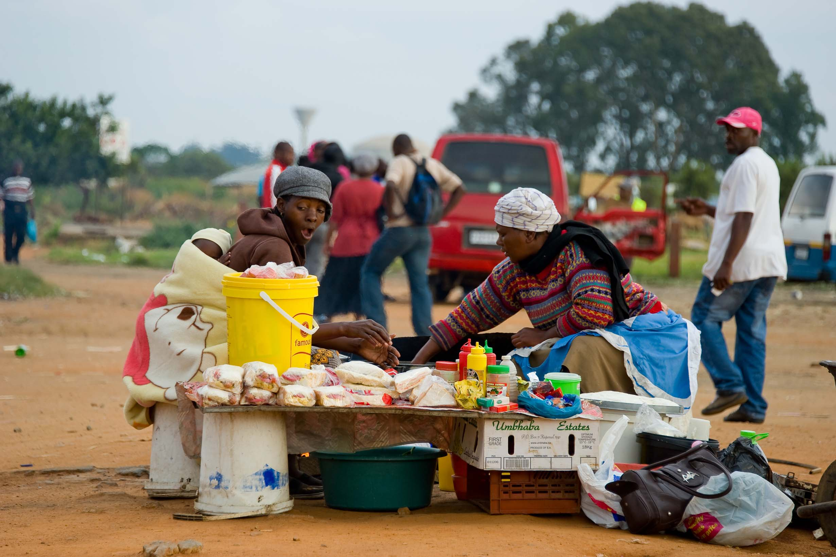
SUBMISSION OF COMMENTS ON THE ADMINISTRATIVE ADJUDICATION OF TRAFFIC OFFENCES AMENDMENT BILL 2015 September 2016

Slide 2
SA Taxi Background

Slide 3
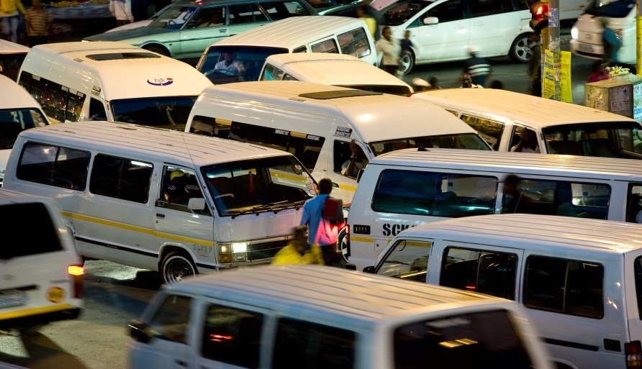
Background
SA Taxi has been in business for over 18 years
We have financed over 50 000 taxi businesses to the value of over 20 billion since inception
Currently the biggest taxi dedicated financier
Finance over 43% of all new taxi vehicles sold monthly
Largest taxi dealer in South Africa
18000 m² taxi Panel Shop (Biggest on the continent)
Approximately 25 000 (incl. zebra & bakkies) accounts on book currently
Taxi dedicated insurance portfolio of over 18000
Approaching Taxi Operators as small businesses rather than individuals

Slide 4
AARTO Submission of Comments
We support AARTO due to:
Proper Adjudication of traffic offences(improving compliance)
Corrective emphasis of the Act (Fine equal to infringement & behaviour modification)
Appropriate punishment for all parties

Slide 5
Introduction

Slide 6
Introduction
We refer to the proposed amendments to the Administrative Adjudication of Traffic Offences Amendment Bill 2015.
Our approach to the Act is as per the diagram below which is
Two Fold
Administrative Matters
Points Demerit Impact
(Behavioural Modification)
RTIA
** Kindly note that our submissions are not in opposition to the act but are rather to bring attention to the unintended consequences

Slide 7
Administrative Matters

Slide 8
Courtesy Letters
Reference:
Chapter 3 : Section 19 (1) of Act 46 of 1998
Submission:
We hope that the issuing out of courtesy letters will be in line with the prescript of the law throughout the country.
Note:
*Secured Mail vs Registered Mail
*Ref: AARTO Amendment Bill : Section 1 (d), subsection (a)
Electronic Prescription/services

Slide 9
Points Demerit Impact
(Behavioural Modification)

Slide 10
Introduction to Behavioural Modification
CHAPTER 4
Acknowledgement of weaknesses of current corrective mechanisms in Public Transport
We welcome endeavours by government to attribute responsibility on the part of those who gain out of such offences
However, we would like to draw the committees attention to the following:

Slide 11
Economic Impact on the poor
Reference:
Submission:
Chapter 4: Section 29 (d)
Chapter 4: Section 20 (5) and Section 25 of Act 46 of 1998
Noting that our government’s position is pro-poor (NDP Vision 2030), we submit that we anticipate;
This section will result in persons that are formally employed as drivers (non taxi) inability to make a living during the suspension period, which is against what the government stands for and aims to achieve in terms of employment creation
As a result of point A, employers will change current employment contracts of persons employed as drivers, to be valid only if they are able to do their jobs. We don’t believe employers would pay a suspended driver a full remuneration when they are unable to do their work (during the suspension period).
Suggestion:
* Lets think of a solution that will not be too detrimental to the family of a person employed as a driver (identified in Point A)

Slide 12
Pilot Phase Lessons Learned
Reference:
Submission:
AARTO Amendment Bill, Background & Purpose, section 1.1 & 1.2
Please share lessons learned on the pilot project implemented in the two metropolitan cities -Johannesburg & Tshwane.
Suggestion:
* Share lessons learned with all stakeholders
* Public buy in process will enable the public to understand the meticulousness of the process followed by government

Slide 13
Potential Constitutional Conflict
Reference:
Submission:
Constitutionally - penalties for similar infringements have to be consistently applicable to all infringers throughout the country regardless of geographical location.
What is the state of readiness of supporting systems, AARTO administration requirements, required resources, infrastructure and level of training & skills of law enforcers – both in rural areas and urban areas?
We believe constitutionally, South Africans cannot be penalised inconsistently for the same traffic infringements due to geographic location.
Chapter 3 Section 17(1) of Act 46 of 1998
Suggestion:
* We believe that intensive training will be critical in fully implementing the law and therefore we would like to submit to the committee that attention has to be brought to bear in an effort to become fully incorporated.
* We appeal that the committee should ensure that the act is not inconsistent with other laws. We suggest a single National Authority could provide consistency due to systems and standards applicable.

Slide 14
Potential Investment Destruction
Reference:
Submission:
Chapter 4:
*Section 25 of Act 46 of 1998
*Section 27 (1)
Access to information
Chapter 4:33 (d)
Business & Investment Risk
The demerits that would lead to the suspension of a vehicle operator card could create a risk of grinding a taxi business to a halt, irrespective of a driver. This means the operator will be unable to derive an income from taxi operations and default on their payment obligations. Businesses/Funders, financing taxi business as operating businesses could potentially be impacted if the taxi business is inoperable.
Affordability Risk
Impact to Insurance Risk tables and monthly insurance premiums
Note:
Ref: NCR (affordability)
Suggestion:
Rather than an operator card suspension, we suggest the following:
- Increase the cost of impounding
- Load penalty against the e-Natis account
- Recover the penalty through tax

Slide 15
Conclusion
The submission outlined above represents a summary of matters we believe the Parliamentary Portfolio Committee on Transport needs to take into consideration. We remain willing and available to engage and assist in the process of arriving at solutions.

Slide 16
END
Enkosi
Realeboha
Dankie
Siyabonga
Ndolivhua

