Slide 1

Gauteng Department of Human Settlements
NATIONAL PORTFOLIO COMMITTEE
ON HUMAN SETTLEMENTS
Committee Room 1, 90 Plein Street, Parliament

Slide 2
Table of Contents
HSDG allocation 2016/17 FY
Work in progress
Affordable rental-social housing
Informal Settlements Upgrading
Affordable gab market [FLISP]
Eradication of backlog in the issuing of Title Deeds
Challenges and interventions

Slide 3
HSDG 2016/17: ALLOCATION VERSUS EXPENDITURE UP TO 31 AUGUST 2016
Description | R’000 | %
DORA Allocation 2016/17 FY | 5 022 669 | 100%
Drawdowns received from NDOHS [April- August 2016] | 1 883 566 | 38%
Actual Expenditure incurred to 31 August 2016 | 1 745 172 | 93%

Slide 4
There is an upward trend in approved foundations and wall plates suggesting that more units will be completed going forward
QA Approvals Dashboard (April to July 2016)
Approved
Foundations
Approved
Wall Plate
Approved
Completed Units
Trend
Trend
Trend
1,180
1,003
1,060
1,320
Mar
Apr
May
Jun
Jul
Mar
Apr
May
Jun
Jul
Mar
Apr
May
Jun
Jul
Pending Validation Of March Carryover Figures
Source: QA Reports

Slide 5
Our WIP at the end of April stood at 4,125 including carryover balance from the last financial year
Work In Progress (WIP) Snapshot For the month of April 2016
5,008
50
136
4,125
3,305
WIP Brought Forward (FY15/16)
Approved Foundations
Rejected Foundations
Approved Wall Plates
Rejected Wall Plates
Rejected Completions
Total
Less Approved Completions For the Month
WIP
Source: QA Reports

Slide 6
Our WIP at the end of May stood at 5,770
Work In Progress (WIP) Snapshot For the month of May 2016
1,060
6,321
59
50
5,770
4,125
WIP Carried Over From Previous Month
Approved Foundations
Rejected Foundations
Approved Wall Plates
Rejected Wall Plates
Rejected Units
Total
Less Approved Completions
WIP Carried Over
Source: QA Reports

Slide 7
Our WIP estimate at the end of June stands at 6,822
Work In Progress (WIP) Snapshot For the month of June 2016
7,410
0
0
6,822
5,770
WIP Carried Over From Previous Month
Approved Foundations
Rejected Foundations
Approved Wall Plates
Rejected Wall Plates
Rejected Units
Total
Less Approved Completions
WIP Carried Over
Source: QA Reports

Slide 8
Our WIP estimate at the end of July stands at 8,499
Work In Progress (WIP) Snapshot For the month of July 2016
9,087
68
74
588
8,499
6,822
1,180
WIP Carried Over From Previous Month
Approved Foundations
Rejected Foundations
Approved Wall Plates
Rejected Wall Plates
Rejected Units
Total
Less Approved Completions
WIP Carried Over
Source: QA Reports

Slide 9
Community Residential Units (Constructed)2015-2016 FY Delivery
Region | Delivery 2015/16 FY
 | Housing Units
 | Annual Target | Delivery | Variances | %
Community residential units (CRU) Converted/Upgraded | 518 | 271 | -247 | 52%
Community residential units (CRU) Constructed | 201 | 35 | -166 | 17%

Slide 10
Social Housing Evaluation Criteria / State Of Readiness

Slide 11
Social and Rental Housing 2015-2016 FY Delivery
Region | Delivery 2015/16 FY
 | Housing Units
 | Annual Target | Delivery | Variances | %
Social & Rental Housing | 910 | 973 | 63 | 106 %

Slide 12
Social & Rental Housing Performance 2015 – 2016 FY
No | Name of Institution | Project Name | Location | No of Units | Completion date | occupational certificates
1 | Norvena Property Consortium | O'Reilly Street | Jhb CBD | 122 | completed | no
2 | Meilijian Construction and Development CC | Erf 1617 Edleen | Kempton Park | 25 | completed | yes
3 | Ninarich Trading 3 (Pty)Lltd | Betty Street Precinct | Jhb CBD | 255 | completed | yes for 158
4 | Xanado Trade or Invest 614 (Pty) Ltd | Erf 324 Princess Ext 49, Roodepoort | Roodepoort | 161 | completed | yes
5 | Kertrade 24 CC | Madison Lofts | Springs | 101 | completed | yes
6 | DNM Estates CC | Erf 517 & 518 City & Suburban | Jhb CBD | 50 | completed | yes
7 | Lukataedi (Pty) Ltd | Erf 739 Pretoria Nort | Pretoria | 38 | completed | yes
8 | Valotorque 199 CC | Erf 757 Pretoria North | Pretoria | 40 | completed | yes
9 | MUMA Property Investments (Pty) Ltd | Erf 978 Pretoria North | Pretoria | 53 | completed | no
10 | Cape Gannet Properties (Pty) Ltd | Erf 42 Kempton Park | Kempton Park | 24 | completed | no
11 | Eagle valley |  |  | 40 | completed | yes
12 | Certrum Est 130 (Pty) Ltd | Erf 564 Bertrams | Jhb CBD | 30 | completd | yes
13 | CUMO property |  | Kempton Park | 36 | completed | yes
14 | Castle Crest Properties 80 (Pty) Ltd | Erf 233 Kempton Park | Kempton Park | 26 | completed | yes
 | Total |  |  | 1001

Slide 13
2016-2017 FY Planned Target
Sub-Programme | QUARTER 1 PLANNED |  | QUARTER 1 ACTUAL
 | Planned Units | Planned Budget | Delivered | Expenditure
3. Social & Rental Housing
3.1 Institutional Subsidies | 341 | R 174 994 122 | 0 | R 140 089 000
3.2b Social Housing: Capital Grants for rental housing (Funded by NDoHS) | 70 | R 766 290 | 0 | R 0
TOTAL | 411 | R 175 760 412 | 0 | R 140 089 000 [GPF transfers]
NB: The construction of units is at various stages, with the completion of units being realised towards the 4th quarter of the financial year.

Slide 14
MTSF Analysis
 | MTSF | 2016/2017 | 2017/2018 | 2018/2019 | 2014 /2015 | 2015/2016 | 2016 /2017
3. Social & Rental Housing |  | Planned Units | Plan Units | Planned Units | Actual Units | Actual Units | Actual Units
3.1 Institutional Subsidies | 9905 | 2324 | 2434 | 2634 | 829 | 973 | 411
3.2b Social Housing: Capital Grants for rental housing (Funded by NDoH) |  | 1064 | 550 | 1094

Slide 15
Project List Per Region 2016-2017FY
 | Sub-Programme | Project Number (HSS) | Project Name/Description | Planned Units 2016-2017 | Total Annual Budget
Joburg | 3. Social & Rental Housing
Joburg | 3.2b Social Housing:Capital Grants for rental housing (Funded by NDoH) |  |  | 764 | R 111 997 409
Joburg | 3 D Pennyville (Toproot (U)) | G07020011/1 | Construction of Units | 141 | R 10 698 314
Joburg | 5 A Bertrams Social Housing Project (Blackhead PRT (PF)) | G13060007/1 B | 0 | 0 | R 25 004 572
Joburg | 5 N Fleurhof Junction Social Housing Project (Joshco (U)) (Mega) | G13020004/1 | Construction of Units | 52 | R 6 634 571
Joburg | 5 N Tsutsumani Village Social Housing Project (PRT to be appointed (PF)) | G04120045/1 P | Planning by PRT to be appointed (PF) | 0 | R 2 729 698
Joburg | Achriwaam (Kiblerpark) Social Housing Project (PRT to be appointed (PF)) | G05110014/1 P | Planning by PRT to be appointed (PF) | 0 | R 3 735 457
Joburg | Alexandra Renewal Programme - Bothlabela Remedial - Motheo (FI) | G15080003/2 | Construction of Units | 0 | R 11 000 000
Joburg | Alexandra Renewal Programme - Lombardy West - PRT to be appointed (PF) | G15080003/X02 | Planning by PRT to be appointed (PF) | 0 | R 1 500 000
Joburg | Alexandra Renewal Programme - River Park - Arengo PRT (PF) | G15080003/11 | Planning by PRT to be appointed (PF) | 0 | R 2 500 000
Joburg | Alexandra Renewal Programme - River Park - Contractor to be appointed (U) | G15080003/X01 | Construction of Units by Contractor to be appointed (U) | 180 | R 8 583 103
Joburg | Devland Ext 36 (Instratin Properties(U)) | G16070004/1 | Construction of Units | 79 | R 8 147 350
Joburg | Devland Golden Highway Social Housing - Joshco (U) | G081J | by Madulammoho Social Housing Association(U) | 100 | R 10 313 101
Joburg | Dobsonville Social Housing (Joshco (U)) | G080J | by Madulammoho Social Housing Association(U) | 100 | R 9 600 570
Joburg | Riverlea (Toproof SHI (U)) | G076 | Construction of Units | 112 | R 11 550 673

Slide 16
Project List Per Region 2016-2017FY
 | Sub-Programme | Project Number (HSS) | Project Name/Description | Planned Units 2016-2017 | Total Annual Budget
 | 3. Social & Rental Housing
 | 3.1 Institutional Subsidies |  |  | 630 | R 70 896 610
Tshwane | Akasia Place | New Project (GPF) | Social Housing | 200 | R 22 189 400
Tshwane | Chantell X39 | New Project from CoT | Social Housing | 100 | R 11 094 700
Tshwane | Erf 708 & 709Sunnyside | New Project from CoT | Social Housing | 130 | R 14 423 110
Tshwane | Timberlance | New Project from CoT | Social Housing | 100 | R 11 094 700
Tshwane | Townlands | New Project from CoT | Social Housing | 100 | R 11 094 700
Tshwane | Vermeulen Point | G07020002/1 | Feasibility Study work in progress | 0 | R 1 000 000
Tshwane | 3.2b Social Housing:Capital Grants for rental housing (Funded by NDoH) |  |  | 300 | R 33 284 100
Tshwane | Heatherly East (Nellmapius Ext. 22) | G04070012/1 | Mixed Housing Development | 300 | R 33 284 100
Tshwane | Sub-total: Social & Rental Housing |  |  | 930 | R 104 180 710

Slide 17
Project List Per Region 2016-2017FY
 | Sub-Programme | Project Number (HSS) | Project Name/Description | Planned Units 2016-2017 | Total Annual Budget
Ekurhuleni | 3.1 Institutional Subsidies |  |  | 465 | R 19 561 260
Ekurhuleni | Delville Ext. 9 Erf 948 (EMM) |  | Transfer of tranche to EMM in previous financial years for 112 units at R 11 530 797.00 | 112 | R 0
Ekurhuleni | Germiston South Erf 808(Mega Germiston)(EMM) | G15090002/1 | Transfer of tranche to EMM in previous financial years for 163 units at R 16 781 428.00. Balance to be transferred in 2016/2017 | 353 | R 19 561 260
Ekurhuleni | Sub-total: Social & Rental Housing |  |  | 465 | R 99 309 844

Slide 18
Project List – GPF 2016-2017FY
 | Sub-Programme | Project Number (HSS) | Project Name/Description | Planned Units 2016-2017 | Total Annual Budget
GPF | 3. Social & Rental Housing
GPF | 3.1 Institutional Subsidies |  | Echo Canyon Reading (Pty) Ltd | 1229 | R 136 353 863
GPF | 463 and 465 Hanny Street | G16060016/1 | Indigo Kulani Properties (Pty) Ltd | 84 | R 9 319 548
GPF | Erf 1676 Benoni | G16060007/1 | G | 60 | R 6 656 820
GPF | ERF 2682 Kempton Park | G16060014/1 | Fundzo Trading (Pty) Ltd | 50 | R 5 547 350
GPF | Ptn 15 of Erf 8489 Protea North | G16060001/1 | Hoewe 15 Doreg Landbouhoewes (Pty) Ltd | 62 | R 6 878 714
GPF | Ervens 1499& 1450, Karen Park Ext 52, Pretoria | G16060011/1 | Bixowise CC | 100 | R 11 094 700
GPF | Erf 278 Primrose Hill | G16060009/1 | Ace Pallets (Pty) Ltd | 30 | R 3 328 410
GPF | Ptn 26 of Erf 381, Vanderbijlpark Central West | G160660015/1 | NBLR Properties (Pty) Ltd | 84 | R 9 319 548
GPF | Erven 2880 and 2881 Fleurhof Ext 20 | G16060002/1 | SOA Residential village(Pty) Ltd | 76 | R 8 431 972
GPF | Erf 1532 selcourt,springs | G16060010/1 | Take shape properties 75 cc | 56 | R 6 213 032
GPF | Erf 4510 Johannesburg | G16030002/1 | Makabongwe Property Holdings (Pty) Ltd | 101 | R 11 205 647
GPF | Beverley Towers - cnr Kerk and End Street | G16060006/1 | Kesef Properties (Pty) Ltd | 64 | R 7 100 608
GPF | Ervens 343,344,345,346,347,348,387,388 and 389, New Doornfontein, Johannesburg | G16060004/1 | Ace Pallets (Pty) Ltd | 100 | R 11 094 700
GPF | Erf 6554 Germiston | G16060008/1 |  | 66 | R 7 322 502
GPF | Erf 113 Pretoria North | G16060003/1 |  | 18 | R 1 997 046
GPF | ERF 2918 Kempton Park | G16060006/1 | Inkavelihle Trading enterprise cc | 240 | R 26 627 280
GPF | Erf 953-956 Berea | G16060012/1 |  | 38 | R 4 215 986
GPF | Sub-total: Social & Rental Housing |  |  | 1 229 | R 136 353 863

Slide 19
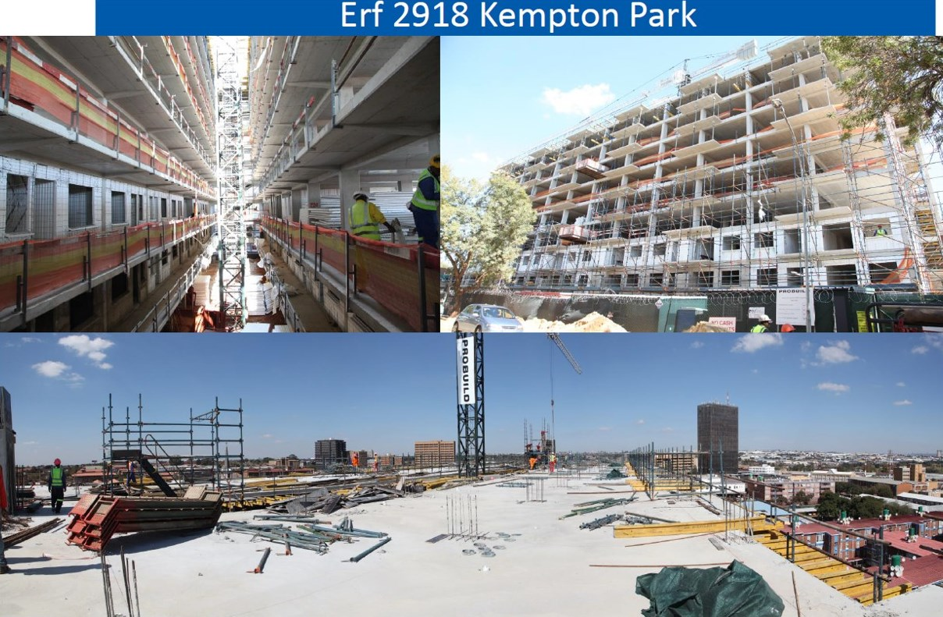

Slide 20
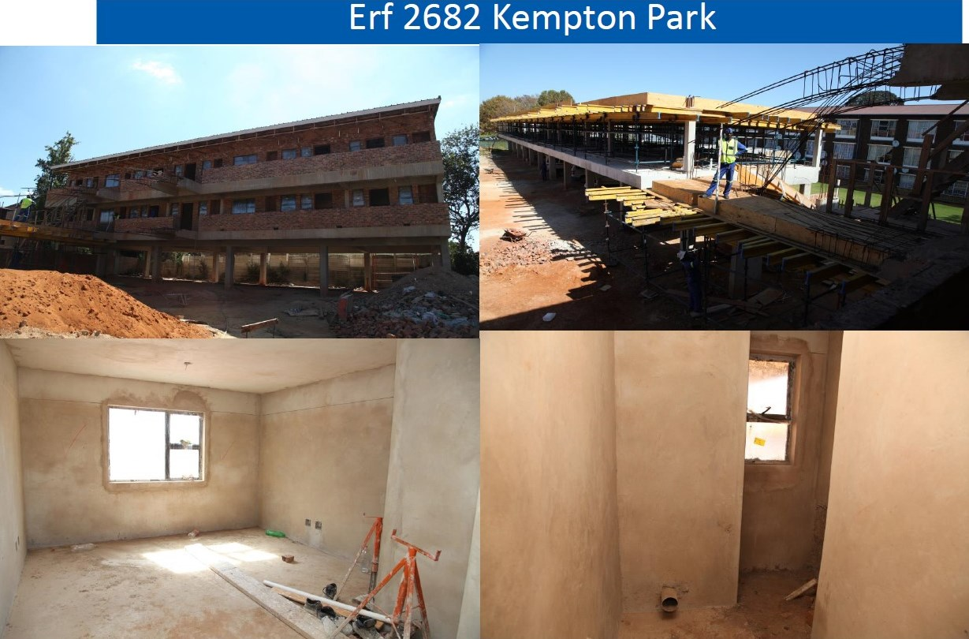

Slide 21
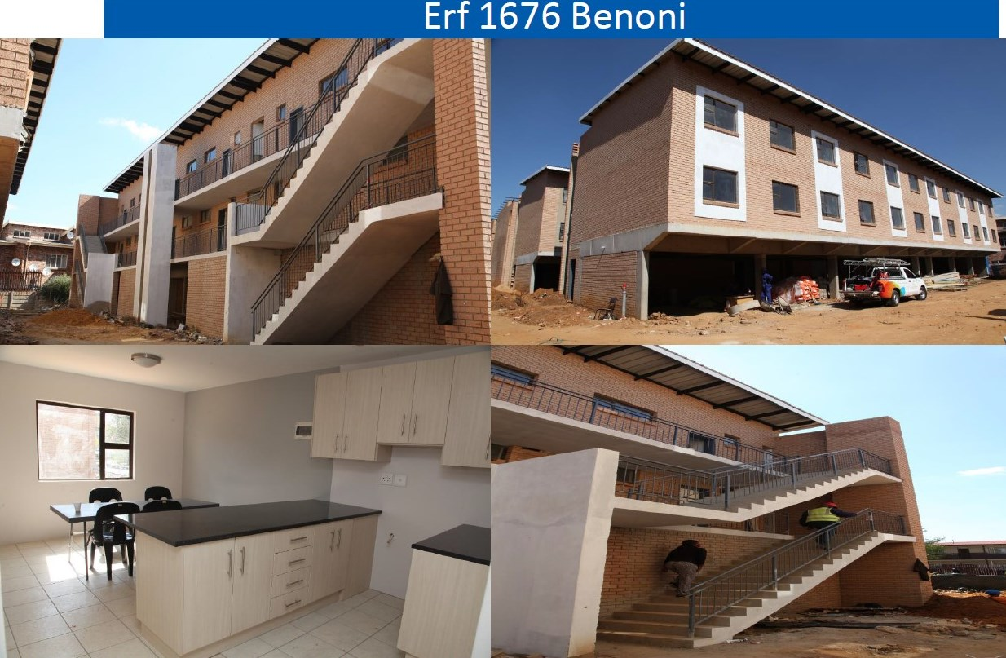

Slide 22
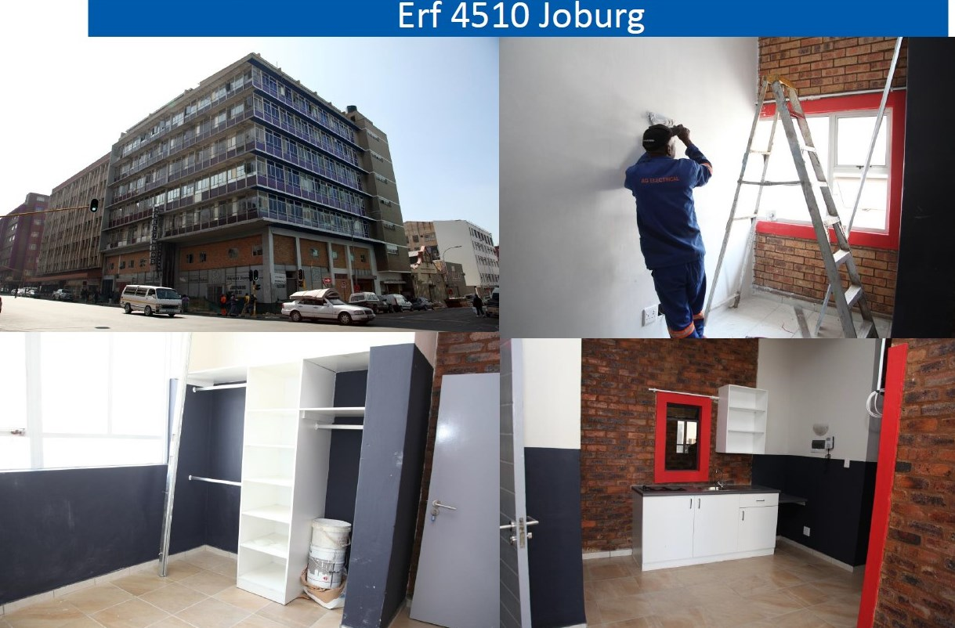

Slide 23
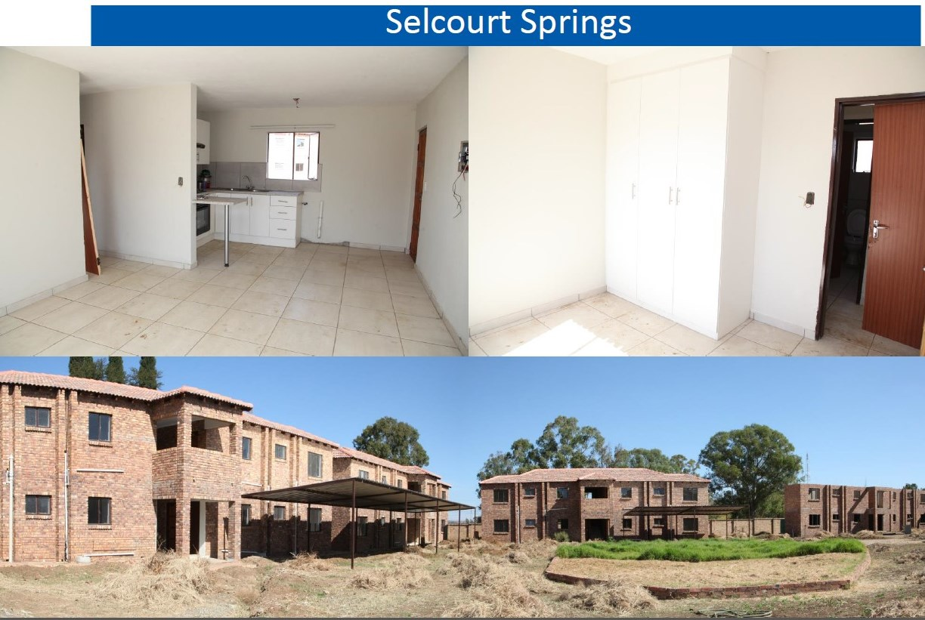

Slide 24
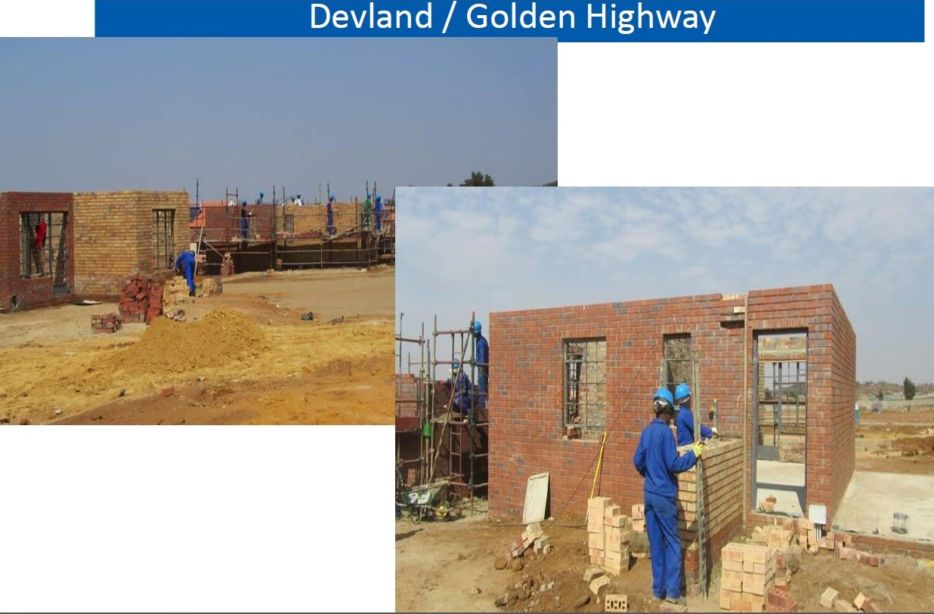

Slide 25
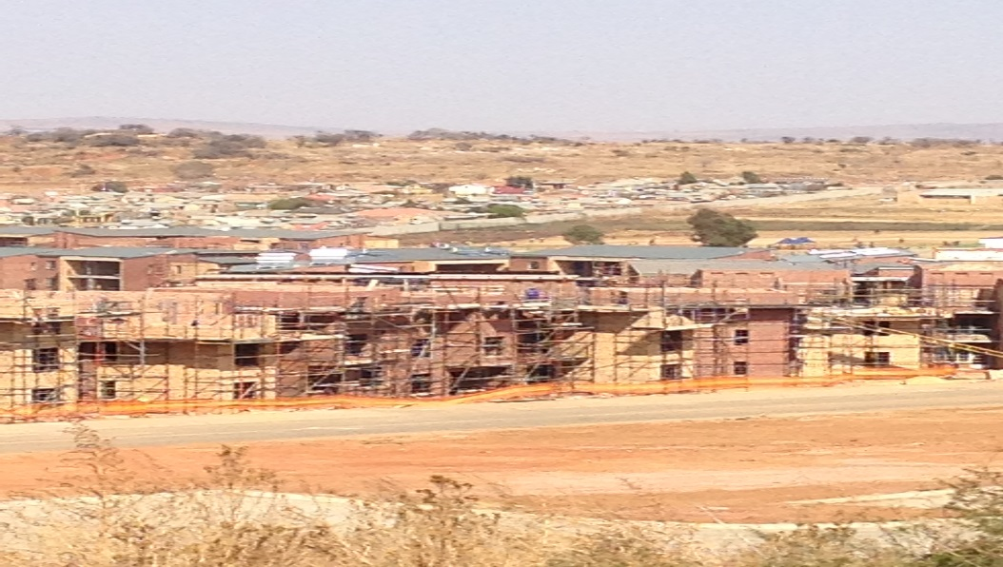
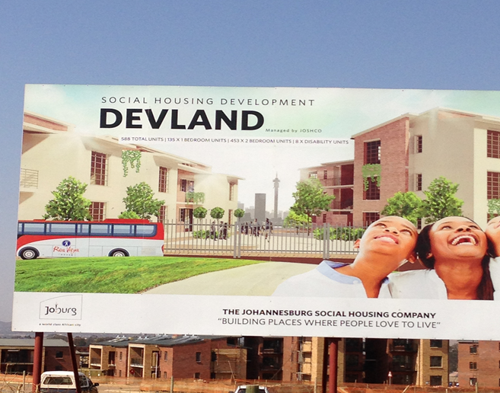
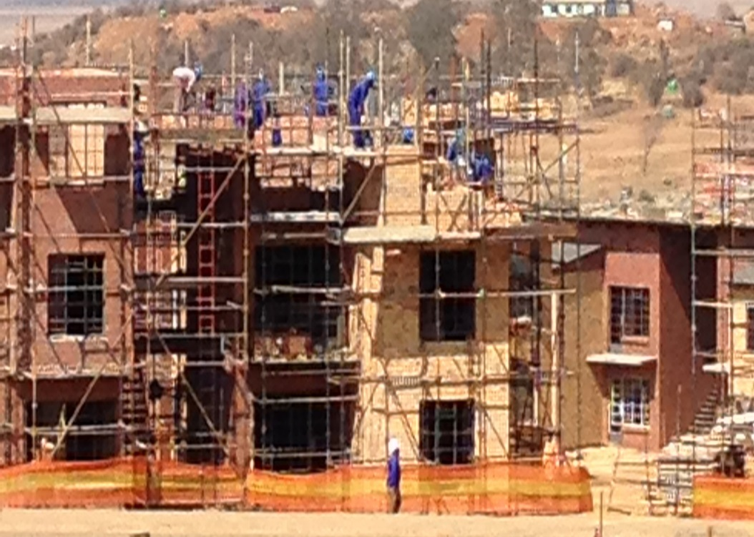
Devland /Golden Highway

Slide 26
Challenges for Social Housing
Shortage of well located land parcel
Bulk infrastructure provision is limited
Unit cost for high rise development is high – additional funding mechanism is required

Slide 27













Collaborative Approach to Social & Rental Housing
Restructuring Capital Grant (RCG), Governance, Support
HSDG – Institutional Subsidy – Monitor
DEBT /Loan – Gauteng Partnership Fund – Financial Viability
Equity – Private Stakeholder
USDG – Land, Buildings, Municipal Services , Bulk infrastructure, Property / Urban Management
SHRA
GDHS
GPF/FI
Private
Sector
Local
Gov

Slide 28
Informal Settlements
Sub-Programme | 2017/2018 |  |  | 2018/2019 |  |  | 2019/2020
 | Targets for Sites | Targets for Units | Budget | Budget | Targets for Sites | Targets for Units | Budget | Targets for Sites | Targets for Units
2. Incremental Housing Programmes | Sites | Units |  |  | Sites | Units |  | Sites | Units
2.2a IRDP :Phase 1:Planning and Services | 6 981 | 0 | R 413 324 800 | R 415 701 022 | 9760 | 0 | R 483 774 171 | 9950 | 0
2.2b IRDP :Phase 1:Planning and Services INFORMAL SETTLEMENTS | 5 378 | 0 | R 440 198 941 | R 582 779 287 | 9128 | 0 | R 818 012 785 | 13920 | 0
2.2c IRDP :Phase 2:Top Structure Construction | 0 | 3 700 | R 348 698 150 | R 498 496 843 | 0 | 4967 | R 506 963 930 | 0 | 4400
2.2d IRDP :Phase 2:Top Structure Construction INFORMAL SETTLEMENTS | 0 | 13 900 | R 1 721 757 099 | R 1 767 962 669 | 0 | 14720 | R 1 933 088 295 | 0 | 16795
2.4 Informal Settlement Upgrading | 1 530 | 4 826 | R 585 917 695 | R 598 546 754 | 1600 | 4936 | R 538 177 205 | 1000 | 4397
Sub-total: Incremental Housing Programmes | 13 889 | 22 426 | R 3 509 896 685 | R 3 863 486 575 | 20 488 | 24 623 | R 4 280 016 386 | 24 870 | 25 592
5. PRIORITY PROJECTS | 3 650 | 2 326 | R 521 102 752 | R 608 243 832 | 2 700 | 3 893 | R 455 399 935 | 2 300 | 2 600
6. PROVINCIAL SPECIFIC PROGRAMMES | 0 | 995 | R 157 272 434 | R 164 100 389 | 0 | 676 | R 214 586 160 | 0 | 990
Total Linked to Informal Settlements | 17 539 | 25 747 | R 4 188 271 871 | R 4 635 830 795 | 23 188 | 29 192 | R 4 950 002 481 | 27 170 | 29 182

Slide 29
Informal Settlements
Informal Settlement Upgrading | The programme facilitates the structured upgrading of informal settlements. It applies to in situ upgrading of informal settlements as well as where communities are to be relocated for a variety of reasons. The programme entails extensive community consultation and participation, Emergency basic services provision, permanent services provision and security of tenure.
NB. Qualifying beneficiaries are assisted and relocated in
projects linked to Integrated Residential Programme
NB. Provincial Specific and Priority Projects are linked to Informal Settlements

Slide 30
Informal Settlements – Delivery 2016/17
Sub-Programme | 2016/2017
 | QUARTER 1 TARGETS |  |  | QUARTER 1 ACTUAL DELIVERY / SPENDING
 | Targets for Sites | Targets for Units | Planned Budget | Actual sites | Actual units | Actual Expenditure
2. Incremental Housing Programmes
2.2a Integrated Residential Development Programme :Phase 1:Planning and Services | 50 | 0 | R 18 720 061 | 0 | 0 | R132 568 000
2.2b Integrated Residential Development Programme :Phase 1:Planning and Services INFORMAL SETTLEMENTS | 456 | 0 | R 48 777 724 | 0 | 0 | 0
2.2c Integrated Residential Development Programme :Phase 2:Top Structure Construction | 0 | 510 | R 56 461 970 | 0 | 8 | R186 658 000
2.2d Integrated Residential Development Programme :Phase 2:Top Structure Construction INFORMAL SETTLEMENTS | 0 | 1402 | R 278 583 293 | 0 | 1 475 | R162 252 000
2.4 Informal Settlement Upgrading | 400 | 856 | R 108 874 480 | 693 | 918 | R331 744 000
Total: Incremental Housing Programmes | 906 | 2 767 | R 511 417 528 | 693 | 2 401 | R813 222 000

Slide 31
Informal Settlements: Challenges
Challenges | Remedial Action
Untraceable beneficiaries Beneficiaries not qualifying for subsidies Non-alignment of financial years between the Province and Municipalities | Advert publication and regularize Mixed typologies that include rental stock Three years gazetting aligned to MTEF

Slide 32
FINANCE LINKED INDIVIDUAL SUBSIDY PROGRAMME [FLISP]
PROJECTS | APRIL | MAY | JUNE | Q1 | JULY | Q2 | TOTAL
Fleurhof | 10 | 38 | 41 | 89 | 27 | 27 | 116
Lehae | 4 |  | 0 | 4 |  | 0 | 4
Savannah City | 17 | 11 | 25 | 53 | 9 | 9 | 62
Mahube Valley | 0 | 0 | 3 | 3 | 1 | 1 | 4
Stredtford | 0 | 0 | 0 | 0 | 2 | 2 | 2
Open Market COJ | 11 | 18 | 22 | 51 | 36 | 36 | 87
Open Market Ekurhuleni | 12 | 19 | 7 | 38 | 6 | 6 | 44
Open Market Sedibeng | 15 | 24 | 11 | 50 | 11 | 11 | 61
Open Market Tshwane | 11 | 19 | 26 | 56 | 14 | 14 | 70
Open Market West Rand | 1 | 1 | 0 | 2 | 2 | 2 | 4
TOTAL NO. OF SUBSIDIES DISBURSED: | 81 | 130 | 135 | 346 | 108 | 108 | 454

Slide 33
FINANCE LINKED INDIVIDUAL SUBSIDY PROGRAMME [FLISP]
The NHFC has in terms implementation protocol been appoint as the implementing agent of the FLISP in the Gauteng.
Funds have in terms of this arrangement been advanced to NHFC to used for the disbursement of approved subsidies for the purchase on units in the gab market on date of registration of mortgaged bonds.
The balance of the funds still held in trust is still sufficient to cover bond registrations during the 1st quarter, hence not further advance payment to NHFC.

Slide 34
Gauteng Province: Eradication of the backlog in issuing title deeds
It should be noted that 2016/17 is the first year of implementation for the Title Deeds Restoration program and targets would be reviewed in the coming financial year should there be a need.
The Department has to date transferred 278 726 pre-1994 properties to individuals and 6441 is outstanding.
A backlog of 236 385 for post-1994 property transfers was recorded during 2015/16 financial year.
In an effort to eradicate the backlog, since 01 April 2016, ±74 000 instructions have been issued to various conveyancing firm for them to do lodgements with Deeds Offices

Slide 35
Eradication of backlog in the issuing of Title Deeds
2016-2017 FY
 | Annual Budget | Annual No. of Title Deeds | QUARTER 1 PLANNED |  | QUARTER 1 ACTUAL
 |  |  | Budget | No of Title Deeds | Expenditure | No of Title Deeds
Title Deeds post 1994 | R 48 570 200 | 26 983 | R 0 | 6 573 | R 11 113 645 | 1 787
Title Deeds pre 1994 | R 13 429 800 | 7 461 |  | 1 863 |  | 429
Total | R 62 000 000 | 34 444 | R 0 | 8 336 | R 11 113 645 | 2 216
The above illustrates the current 2016 – 2017 FY projections is based on a ring fenced budget of R62 mil, with a unit cost of R1 800 per title deed.

Slide 36
Eradication of backlog in the issuing of Title Deeds
2016-2017 FY
 | Budget | No. of Title Deeds
Title Deeds post 1994 | R 48 570 200 | 26 983
Title Deeds pre 1994 | R 13 429 800 | 7 461
Total | R 62 000 000 | 34 444
The above illustrates the current 2016 – 2017 FY projections is based on a ring fenced budget of R62 mil, with a unit cost of R1 800 per title deed.
 | 2016-2017 | 2017-2018 | 2018-2019 | 2019-2020
Budget | R 62 000 000 | R 100 000 000 | R 110 000 000 | R 120 000 000
No. of title deeds | 34 444 | 55 556 | 61 111 | 66 667
Total Budget | R 392 000 000
Total Title Deeds | 217 777
The above illustrates the projections in the outer years, in addressing the backlog of 244 000 title deeds , the department in the first draft business plan for 2017 MTEF, allocated R330 mil linked to 183 333 Title Deeds over and above the 2016 – 2017 Allocation and Projection.

Slide 37
POST -1994
TITLE DEEDS REGISTERED TO DATE
JOHANNESBURG | TSHWANE | EKURHULENI | SEDIBENG | WEST RAND | TOTAL
804 | 15997 | 2521 | 95 | 1609 | 21026
POST -1994
INSTRUCTIONS ISSUED TO CONVEYANCERS
JOHANNESBURG | TSHWANE | EKURHULENI | SEDIBENG | WEST RAND | TOTAL
5097 | 31977 | 20944 | 283 | 11646 | 69947

Slide 38
CHALLENGES | INTERVENTIONS
Disputed properties | The Department has a quasi judicial structure that deals with disputed properties although the process can take a long time depending on the complexity of the case and the number witness to be subpoenaed
2. Missing beneficiaries | The list of missing beneficiaries is advertised on local newspapers and the Department works closely with Ward Councillors
Estate matters where parents are deceased | Beneficiaries are advised to report estates of the deceased to the Master of High Court and are also referred to pro-bono lawyers where necessary. The process can take years thus delaying transfer of respective properties
4. Property invasions | Previously, the Department linked beneficiaries to stands or projects and registered properties to individuals before taking occupation. There is large number of title deeds registered to beneficiaries who never took occupation due to property invasions. The Department is to compile a database of such properties and apply for cancellation through High Court

Slide 39
CHALLENGES | INTERVENTIONS
Delays at Municipal level with regards to signing Power of Attorneys | Continuous engagement with respective municipalities to fast-track issuance of title deeds
Township registers not opened due to outstanding conditions | The Department is in a process of appointing a panel of Town Planners to address the backlog of township proclamation and registration thereafter. As a temporary measure, municipalities are engaged to relax some conditions for the purpose of lodging applications with Deeds Offices.

Slide 40
T
hank
Y
oU …

