Slide 1
DHA IT Systems Modernisation “Towards a paperless Home Affairs” SERVICE DISRUPTION DUE TO CONNECTIVITY ISSUES JOINT MEETING OF PORTFOLIO COMMITTEES OF HOME AFFAIRS AND TELECOMMUNICATIONS AND POSTAL SERVICES - 6 SEPTEMBER 2016

Slide 2
SCOPE
Legislative Mandate of SITA
Services that are rendered by SITA to DHA
DHA Modernisation Programme
Network challenges and Risks faced by DHA
Major Service Disruption - Latest Incidents
Current Incidents Management Process
Impact of Network downtimes
Interventions by DHA
Conclusion and Recommendations
High level Network architecture

Slide 3
Legislative Mandate & SITA Services to the DHA
SITA ACT prescribes mandatory and non-mandatory services;
Mandatory services as prescribed by the Act:
Provision of telecommunications network services;
Hosting of datacentres for all government systems;
Provision of transversal services of Government; i.e BAS, Persal and Logis.
Services that are rendered by SITA to DHA
Hosting Services – NPR, MCS, BAS, Persal and Logis (Production and DRS)
Housing Services – HANIS DRS, Service Manager (known as Live Capture for Smart ID and Passport)
Dedicated Virtual Private Network (VPN) and Dedicated Internet Services
WAN: Remote Access (Dial up) Services
WAN- Remote Access Services (VPNC)
SMS Track and Trace Facility
Hosted Batch Printing – Printing of Salary advices and Green ID Books

Slide 4
Service Level Agreements and Costs
Five (5) Annexures that are under Managed Infrastructure Services from SITA as per their Service Catalogue and are classified as mandatory services as per the SITA Amendment Act. All annexures expire 31st March 2018.
Annexure & Service | Cost per annum | Penalty
Annexure G: Dedicated Virtual Private Network Services. Various bandwidth ranging from 192kb to 300 Mb | R 70 million | 2.5 % of monthly billable in the month where SLA not met
Annexure H: Dedicated Internet Services | R 5 Million | 2.5 % of monthly billable in the month where SLA not met
Annexure J: WAN: Remote Access Services (Dial Up) | R 80 000.00 per annum | 2.5 % of monthly billable in the month where SLA not met
Annexure K: WAN: Remote Access Services (VPNC) | VAS | Not applicable
Annexure L: Common Access Point Services | R 1 million | 2.5 % of monthly billable in the month where SLA not met

Slide 5
DHA Modernisation
DHA services has been automated and gone online; Live Capture system does not provide for alternative manual application process for application of smart ID cards and passports; therefore service delivery is dependent on the reliable network provision.
Live Capture system for Smart ID cards and Passports is rolled out to 178 offices; and 12 Bank sites.
DHA has launched an eHome Affairs Portal which enables DHA clients to apply for both IDs and Passports online; pay through online EFT, and make appointment to visit a Bank Branch to complete their applications.
DHA has rolled out the Live capture system at the Bank Halls to complete the above process; reputational risks if the Government network will remain as unreliable.
Registration of birth, marriages and death process are in the process of automation and thus will be provided online before the end of the Financial Year.
DHA has rolled out the capturing of Biometrics at the Ports through the Enhanced Movement Control System from December 2015 as instructed by Cabinet and monitored by IMC.
The above EMCS system is currently hosted by SARS network and can not be moved into the SITA Government networks environment; since it requires high network availability.
DHA is making inroads to modernise its processes and systems and investing in robust change management, the main setback is the high frequency of network disruptions.
The main dependency for the implementation of these systems is the reliable broadband network provision.

Slide 6
Challenges experienced by DHA
Service Disruptions are caused by several factors; but mainly is the Network disruption to DHA offices.
SITA Switching centers frequent downtimes – affects multiple offices at a time.
Current network architecture that does not provide redundancies - single connections at the last mile.
Environmental conditions at the Data centres and switching centres.
Lack of required expertise to manage the hosted system (NPR) at SITA.
No single point of responsibility and accountability for the end to end network services (one part of the network (core) is managed fully by SITA and infrastructure part in the last mile is managed by network providers).

Slide 7
Major services disruptions during August 2016
Several incidents have been referred to in the letters to the Ministry of Telecommunications and Postal services; dating back from February 2015.
Network disruption as a common phenomenon has dented the image of DHA.
Some examples of the latest Major Networks downtimes encountered in the month of August.
2- 3 August – Network failure and 23 offices offline; Modemolle switching centre affected due to cable break… No immediate rerouting to other alternative network lines.
16 August - Network failure in Limpopo and 6x offices are affected for a day.
18 August - Network failure in Ulundi and Pietermaritzburg and 21 offices are affected.
22 August – Network failure in Durban and Ulundi with 13 offices affected.
25 August – Network failure at Upington Switching centre and 30 offices are affected.

Slide 8
Incident Management Process
Call Logging system and service restoration process.
Current process is a reactive mode and frustrating to DHA as a client and in the coal face of service delivery–
DHA will receive a call from the client offices experiencing system error/s.
DHA establishes that it is Network related downtime depend on the call logged.
DHA logs a call to get SITA NOC to troubleshoot and investigate.
SITA NOC checks with network providers and establish the cause of the network downtime and resolution timelines.
SITA evokes its SLA and monitors the restoration with service provider.
DHA awaits SITA and network service provider to complete the process.

Slide 9
Impact of Network Disruption
Denial of service by DHA to its clients.
Crucial Services are impacted due to network unavailability and instability.
Delays in turnaround times of issuing the enabling documents impacting the committed service standards.
Morale of employees affected while DHA is investing on change management to turn around the department.
DHA is continuously on bad spotlight due to network interruptions.
Reputational Risks to the DHA
Repeat visits by Clients

Slide 10
Interventions
Monthly SLA meetings between DHA and SITA at operational level.
Several meetings between the DG DHA and SITA CEOs.
Ministerial letters to Minister of Telecommunications and Postal Services.
Intervention and meetings between DG: DHA and DG: Telecommunications and Postal Services.
Meetings between all stakeholders as convened by Ministers : DHA, Telecommunications and Postal Services, SITA CEO and Telkom CEO.
Presentation regarding Biometrics at the Ports of Entry; eHome Affairs Portal for Smart ID cards and Passport was made to Cabinet and the issue of connectivity and request for interrupted Networks was also raised.

Slide 11
Conclusion and Recommendation
Significant investment in turning around DHA through Modernisation programme to ensure the following objectives:
Provision of efficient services.
Securing of identity processes and systems.
Enabling economic development.
Department requires a robust multi-redundancy, reliable and available network to become a backbone of e-Government services.
DHA still requests to be granted an exemption from procuring telecommunication network services from the Agency in terms of regulation 17.6.1(b) of the regulations under the SITA Act, to be able to procure such services directly from the network operators, thus enabling the Department to provide a proper service to the public.

Slide 12
Current Networks and Datacentre high level Architecture

Slide 13
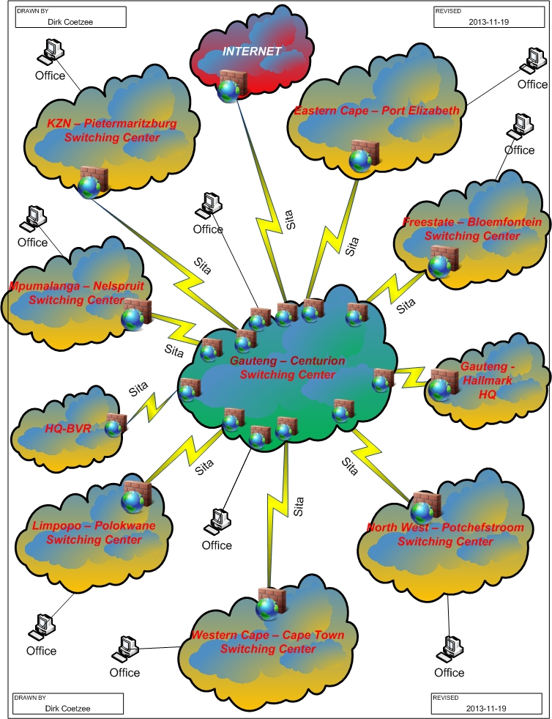
DHA connects to all its offices through the 11 Switching centres across the Provinces.
Network switching centre is also powered by the normal municipality power and the alternative power supply (UPS and Generators)
So if the switching centre loses power, or suffers a hardware problem therefore the network in that part of the country will be affected. All offices that connects through that switching centre will be down.
Infrastructure break (Cable break and Trunck failures)is also another main cause of the service delivery disruption
This is an explanation of several service interruptions i.e; switching centres technical challenges, cable break and power loss in the entire process where there is no alternative Power source.

Slide 14
Thank you
Comments/ Questions

