Slide 1
DIRCO
PRESENTATION TO THE PORTFOLIO COMMITTEE
31 AUGUST 2016
-----
The United Kingdom's exit (BREXIT)
from the European Union
and its implications

Slide 2
BACKGROUND ON BREXIT
On 23 June 2016, 52% of the UK’s electorate voted in favour of a withdrawal from the EU (Brexit).
The outcome of the referendum is a major development that holds far-reaching global implications.
The UK is the first state to withdraw from the EU in its 58 years of existence.
The outcome of the referendum was largely influenced by:
Euroscepticism, heightened by the migration crisis;
The perception that increased migration leads to decreased employment opportunities for the UK’s citizens;
The poor economic performance in Europe;
A growing resistance to the role of Brussels and its impact on the UK’s sovereignty;
Discontent of the older “blue collar” establishment in the UK;
Many younger voters did not participate in the referendum, and many analysts believe that their participation would have favoured the “Remain Vote”;
A perceived “Democratic Deficit” in which the citizens feel that they do not have an impact on the decision making processes of the EU;
Lack of communication by the EU of the benefits related to membership of the EU.

Slide 3
IMPLICATIONS OF BREXIT FOR THE UK
Political
The UK Government will have to deal with dissatisfaction in Scotland and Northern Ireland where the vote had been overwhelmingly in favour of remaining in the EU. This dissatisfaction could feed into renewed calls for the independence of Scotland and for a review of the ties between Northern Ireland and the Republic of Ireland.
Economic
The Pound reached a record low in the immediate aftermath of the referendum, coupled with a decline in the London Stock Exchange.
International credit rating agencies have cut the UK’s credit rating.
A cut in the interest rate from 0.5% to 0.25%, taking it to its lowest levels since 2009.
The UK’s Treasury stated that the economy could contract between 3% and 6% in the two years after Brexit.
The Bank of England predicts lower growth over the next two years, as well as an increase in inflation linked to a weakening Pound.
Depending on the UK’s exit agreement with the EU, it will have to withdraw from more than 5000 EU regulations, and more than 1100 trade agreements signed between the EU and third countries (including South Africa) – the continued uncertainty caused by Brexit is expected to continue impacting negatively on the UK’s economy.

Slide 4
IMPLICATIONS OF BREXIT FOR THE EU
Trade and Development Impact
The UK is the second biggest EU trade partner (after Germany), accounting for 13% of the EU’s internal trade and 15% of its imports to/from non-member countries.
The UK is the largest contributor to the EU development aid budget, representing 15% of the European Development Fund (EDF).
The UK’s absence from negotiations in the next EU budget, and its priorities post-2020, will have direct and long-term implications on the impact of EU ODA policies.
Due to the UK being the US’s largest ‘single’ market within the EU, a Brexit may negatively affect the finalization of the US-EU Mega Trade Agreement.
Levels of Integration
Brexit could have a two-fold effect on European integration:
The absence of the UK in the EU may favour the notion of moving to an ever closer Union, a concept that the UK has resisted and slowed-down in the past.
However, a Brexit may also serve as a motivation for nationalist / Eurosceptic sentiment across the continent to call for similar referendums.

Slide 5
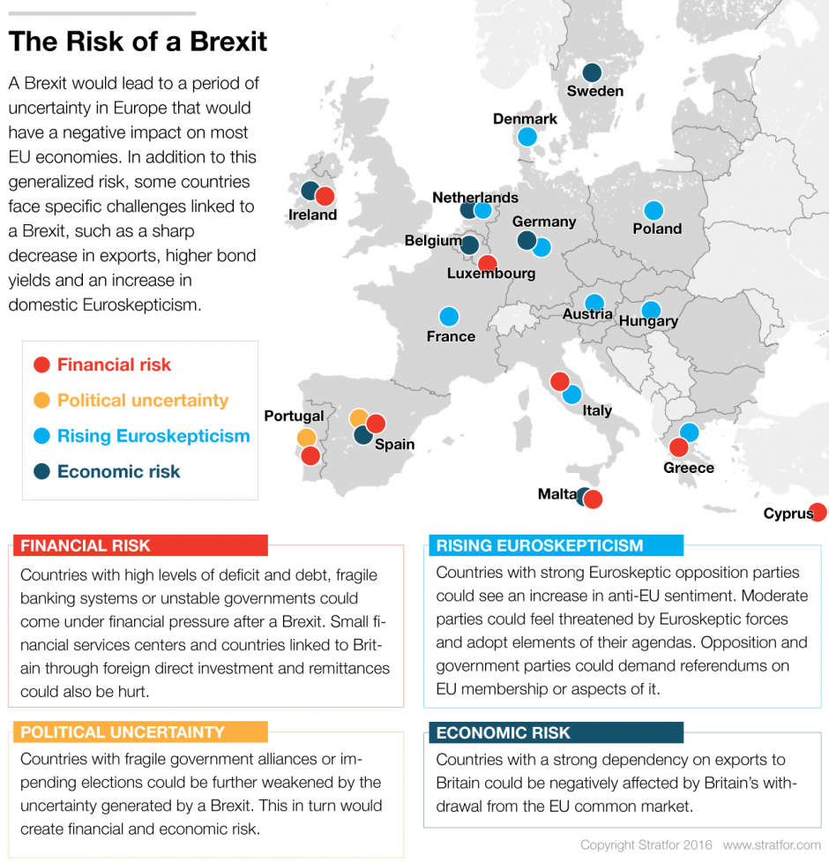

Slide 6
IMPLICATIONS OF BREXIT FOR SA
SA-UK Relations
The UK is SA’s 8th largest bilateral trading partner, and there exists extensive economic (trade and investment) relations.
During the UK’s two year withdrawal period from the EU, the Common International Trade Policy (CITP) of the EU will continue to apply to SA’s trade relations with the UK.
However, in preparation for the eventual Brexit, it will be necessary to enter into discussions with the UK on future trade relations, as the UK will cease to be a party to the Southern African Development Community’s Economic Partnership Agreement with the EU (SADC-EU EPA), which provides increased market access into the EU.
SA-EU Relations
Other than the absence of the UK, there will be no change to the framework (including the legal framework) of South Africa’s relations with the EU.
Relations will continue to take place under the SA-EU Strategic Partnership, within the legal framework provided by the Trade, Development and Cooperation Agreement (TDCA) as well as the SADC-EU EPA.

Slide 7
WAY FORWARD FOR THE UK
The procedure to withdraw membership from the EU is based on Article 50 of the Lisbon Treaty, which states that Member States who wish to leave the Union must first negotiate the terms of their exit.
This process takes up to two years and is triggered only once the country leaving invokes Article 50. Prime Minister May has been clear that the UK will not do so before the end of 2016.
If no agreement is reached within two years the exit from the EU is automatic. Alternatively the parties could agree to extend the negotiating period.
Prime Minister May has meanwhile appointed prominent “Leave-” and “Remain-Campaigners” in her new Cabinet. Boris Johnson (Leave) was appointed as the Foreign Secretary, and Mr David Davis (Leave) was put in charge of a new “Brexit” Ministry. Phillip Hammond (Remain) was appointed as Chancellor of the Exchequer.
In the interim, the UK will continue to be a full EU Member State, bound by the bloc's rules and treaties.

Slide 8
THANK YOU

