Slide 1
Presentation to the Parliamentary Portfolio Committee on Public Works – Progress report on the management of the Construction Industry Development Board 30 August 2016 by: Mr Lufuno Nevhutalu Board Chairperson

Slide 2
Presentation Outline
PART ONE – by the Chairperson
Overview
PART TWO – by the Acting CEO
Purpose
cidb Mandate
cidb Accounting Authority
Cidb Board Strategic Intent
Tripod for Transformation
Review of Board Committees
Alignment of Committees with the revised strategy
Board Emoluments

Slide 3
I. Overview
New Chairperson came on Board: March 2016 (5 months)
This followed interventions by the Minister on governance challenges in the cidb Board
Currently there is no Deputy Chairperson
The Board operates with 4 Committees which focus predominantly on statutory issues as well as the core business
Each Committee has a Committee Chairperson – these are members of the Board
The Board meets atleast four times a year
The Board as well as all its committees have approved Charters that guide and inform the terms of reference for each structure
The Committees of the Board report directly to the Board
The Board currently has an Acting Chief Executive Officer – reports directly to the Board through the Chairperson
Progress on the recruitment of a permanent CEO

Slide 4
I. Overview…..contd.
In February 2016: the Board attended a governance workshop, facilitated by KPMG. This was done is conjunction with Public Works
In March 2016: the Board hosted its National Stakeholder Forum. The theme of the forum was TRANSFORMATION
In April – May 2016: the Board conducted its performance assessment as well as that of its Committees. This was facilitated by Grant Thornton
So as to enhance its effectiveness, the assessment recommended specific review of committees for consideration by the Board
This will consequently be followed by the review of the Charters so as to align with the new terms of reference

Slide 5
I. Overview…..contd.
In June – August 2016: the Board embarked on a review of its 2015/16 – 2019/2020 Strategic Plan
Four strategic pillars were identified in terms of focus areas
Regulation
Development
Transformation
Partnerships
To deliver on the key focus areas, a High Performance Organisation was identified to underpin the revised strategy. The key focus areas will be:
Digitalised services
Sound corporate governance
Knowledgeable and influential team

Slide 6
I. Overview…..contd.
To support the revised strategy, the Board is currently embarking on an Organisational Re-design (OD)
In addition to a revised staff organogram, the following OD deliverables are expected:
Service delivery model
Skills audit
Competency framework
This will inform the competency assessments at all levels
Training strategy
Remuneration strategy
Revised Job Evaluation and job grading system
Enhanced performance management system

Slide 7
I. Overview…..contd.
From end July 2016 to current: the Board is hosting Provincial Stakeholder Liaison Meetings (PSLMs)
The meetings have been held in: Gauteng, Limpopo, Free State, North West, KwaZulu-Natal, Mpumalanga & Eastern Cape
The upcoming meetings will take place early in September: Northern Cape and Western Cape
These meetings are targeted as follows:
Contractors at all levels
Client departments and local government
The main common issues across all provinces are:
Registration
Downgrading
Late payments
Access to finance and work opportunities
Sub-contracting

Slide 8
PART TWO

Slide 9
Presentation to the Parliamentary Portfolio Committee on Public Works – cidb Highlights on Governance Matters 30 August 2016 by: Ms Hlengiwe Khumalo Acting CEO

Slide 10
I. Purpose

Slide 11
I. Purpose
To brief the Portfolio Committee on Public Works on the progress regarding governance matters of the Construction Industry Development Board (cidb)

Slide 12
II. cidb Mandate

Slide 13
II. cidb Mandate
Provide strategic leadership to construction industry stakeholders
Promote sustainable growth of the construction industry and the participation of the emerging sector
Promote improved performance and best practice of public and private sector clients, contractors and other participants in the construction delivery process
Promote uniform application of policy throughout all spheres of government and promote uniform and ethical standards, construction procurement reform, and improved procurement and delivery management – including a code of conduct
Monitoring and regulating the performance of the industry and its stakeholders, including the registration of projects and contractors

Slide 14
III. cidb Accounting Authority

Slide 15
III. cidb Accounting Authority
In line with the cidb Act No. 38 of 2000, the Minister of Public Works appoints a Board (as Accounting Authority) who is tasked with a responsibility of overseeing the operations of the entity:
The Board consists of not fewer than nine, but not more than 13 members
The Board currently has 13 members
The term of office of the cidb Board is three years
The current Board’s term officially started on 1 August 2014 and will therefore end on 31 July 2017
Board members may not serve for more than two consecutive terms, unless the Minister considers it necessary to reappoint a member (for continuity or specific expertise)
A third of the Board members must be reappointed

Slide 16
III. cidb Accounting Authority…..contd.
The current Board is structured as follows:
OUTSOURCED SECRETARIAT SERVICE
CHAIRPERSON: Lufuno Nevhutalu
COMMITTEE:
AUDIT & RISK – Lefadi Makibinyane
COMMITTEE: REMUNERATION – Sipho Mosai
COMMITTEE: SOCIAL & ETHICS – Nazreen Pandor
COMMITTEE: CORE PROGRAMMES – Chris Jiyane
MEMBERS: Natalie Skeepers; Hareesh Patel; Vuyiswa Sidzumo; Denzel Maduray; Nico Maas; Mike Makhura; Mandisa Fatyela-Lindie & Lindelwa Myataza

Slide 17
III. cidb Accounting Authority …..contd.
Out of the 13 Members of the Board, their individual terms are as follows:
Second Term: Hareesh Patel, Nico Mass & Lindelwa Myataza.
DPW Representative: Mandisa Fatyela-Lindie (2nd term)
First Term: Lufuno Nevhutalu, Lefadi Makibinyane, Sipho Mosai, Nazreen Pandor, Chris Jiyane, Natalie Skeepers, Vuyiswa Sidzumo, Mike Makhura & Denzel Maduray

Slide 18
IV. cidb Board – strategic intent

Slide 19
IV. cidb Board – Strategic intent
Values
Vision
Mission
Goals
Outcome/Output measures
Objectives
Impact/Outcome measures
S
T
R
A
T
E
G
I
E
S
I
N
I
T
I
A
T
I
V
E
S
Situational & Status Quo Analysis

Slide 20
V. Tripod for Transformation

Slide 21
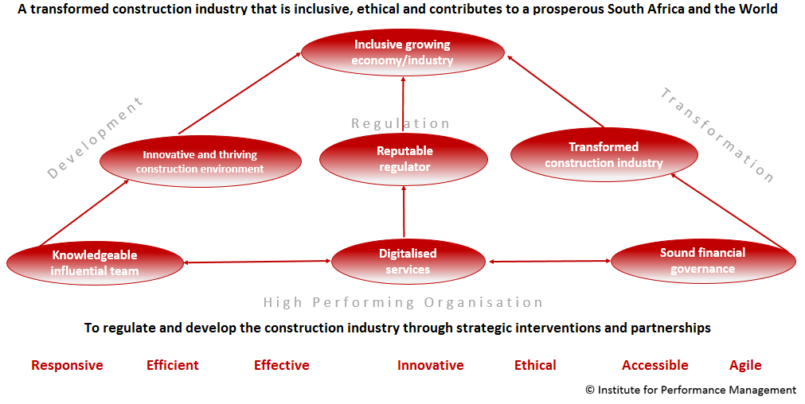
V. Tripod for Transformation
Strategic Goal : SOUND CORPORATE GOVERNANCE

Slide 22
VI. Review of Board Committees

Slide 23
VI. Review of Board Committees
The future Board will be structured as follows:
OUTSOURCED SECRETARIAT SERVICE
CHAIRPERSON: Lufuno Nevhutalu
COMMITTEE:
AUDIT , RISK & GOVERNANCE – Lefadi Makibinyane
COMMITTEE: HUMAN CAPITAL – Sipho Mosai
COMMITTEE: REGISTRATION & REGULATORY COMPLIANCE – Mike Makhura
COMMITTEE: STAKEHOLDER MANAGEMENT – Natalie Skeepers
MEMBERS: Chris Jiyane; Hareesh Patel; Vuyiswa Sidzumo; Denzel Maduray; Nico Maas, Nazreen Pandor; Mandisa Fatyela-Lindie & Lindelwa Myataza

Slide 24
VII. Alignment of Board Committees

Slide 25
VII. Alignment of Board Committees with the revised strategy
INCLUSIVE GROWING CONSTRUCTION INDUSTRY
TRANFORMATION
AUDIT , RISK & GOVERNANCE – HPO: Sound Corporate Governance
HUMAN CAPITAL – HPO: Knowledgeable & Influential Team
REGISTRATION & REGULATORY COMPLIANCE – Regulation & Development
STAKEHOLDER MANAGEMENT – Partnerships
Digitalised Services

Slide 26
VIII. Board Emoluments

Slide 27
VIII. Board Emoluments
The National Treasury rates are applicable to cidb
These are in terms of Category “S” of the National Treasury’s determination for Boards
The rates applicable are determined by the Minister of Finance. These are reviewed annually in April to cater for cost-of-living adjustments
Table: these are rates as at 1 April 2015 (not yet revised for 2016)
Category S | Rate per day | Rate per hour
Chairperson | 4 864.00 | 608.00
Vice-chairperson | 4 128.00 | 516.00
Member | 3 784.00 | 473.00

Slide 29
Thank You

