Slide 1
ENGINEERING COUNCIL OF SOUTH AFRICA PORTFOLIO COMMITTEE ON ECONOMIC DEVELOPMENT
Mr. Thabo Senooane
(Manager: Office of the CEO)
Tuesday, 30 August 2016

Slide 2
1. THE ROLE OF ECSA
Constitution of the Republic of South Africa, Section 22
Every citizen has the right to choose their trade, occupation or profession freely. The practice of a trade, occupation or profession may be regulated by law.
South Africa chose to regulate the profession
This gave rise to the Engineering Profession Act (EPA, 46 of 2000)
Registration is a tool by which we regulate the profession

Slide 3
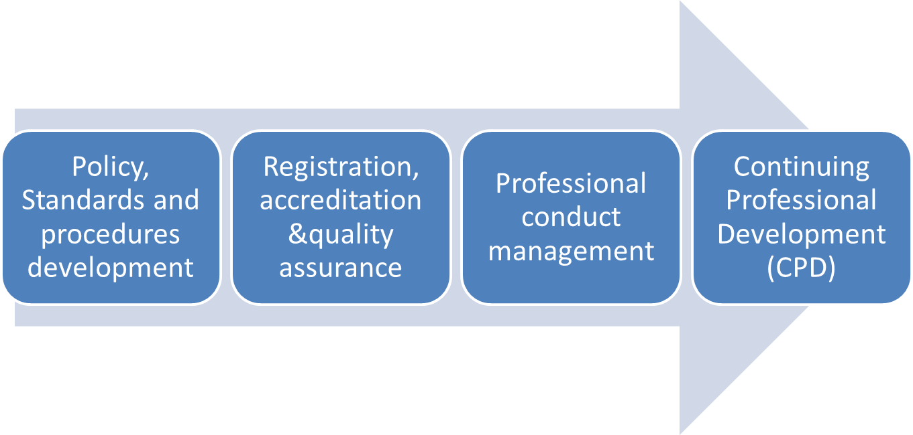
2. HOW DO WE REGULATE?

Slide 4
3. THE OTHER ROLES OF ECSA
Identification of Engineering Work (IDoEW)
Recognition of Voluntary Associations
International Benchmarking
Advise the Minister of Public Works on matters of engineering interest

Slide 5
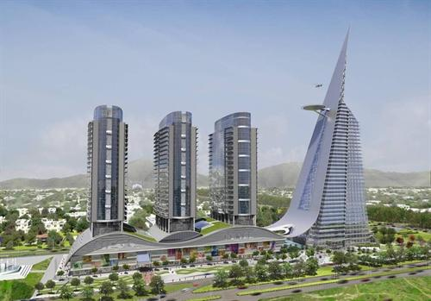
4. SOCIETAL BENEFITS

Slide 6
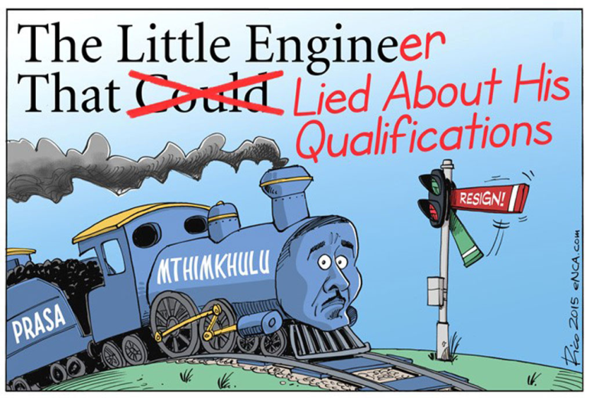
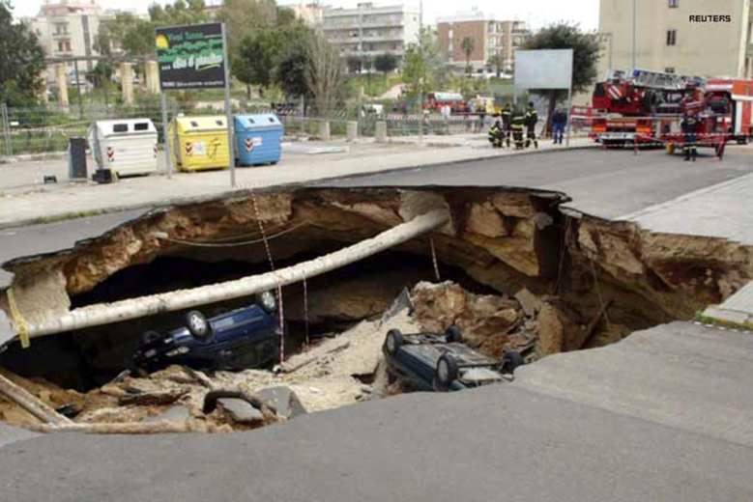
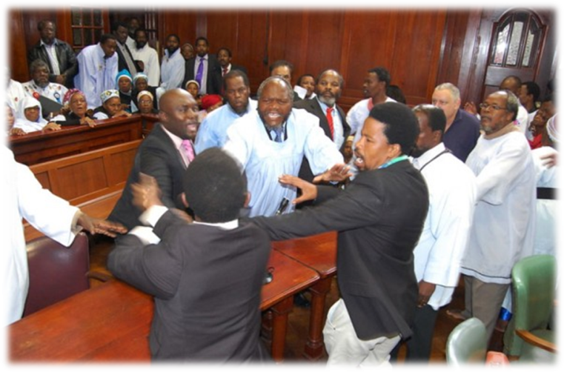
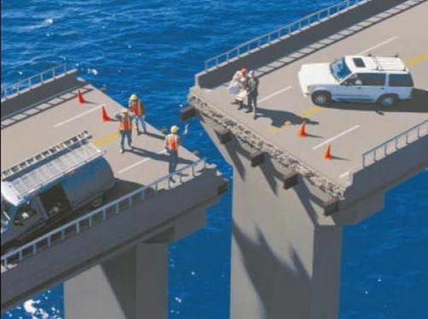
5. AND WHAT IF WE DO NOT REGULATE?
Competence
Quality
Code of Conduct
Standards

Slide 7
6. CATEGORIES OF REGISTRATION
Registered
Persons
Professional
Engineer
Technician
Specified Category
Lifting Inspectors
Technologist
Certificated Engineer
Lifting machinery Inspectors
Medical Equipment Maintainers
Fire Protection System Inspectors
Candidate
Engineer
Engineering Technologist
Certificated Engineer
Engineering Technician

Slide 8
7. ECSA ROLE ON SKILLS DEVELOPMENT
Framework development for recognition of VA’s and CPD
Effect registration renewal through CPD system
Discipline delinquent registered engineers
Audit VA’s and its membership system
Engineering Council of South Africa (ECSA)
Renewal of Registration
Set policies, standards & procedures for registration
Receive and assess applications for registration
Attend to appeals
Develop framework for Mentor Connector and C&U
Registration of Competent Persons
Recognition of Candidate Qualifications
Endorse University Engineering Programmes for/on behalf of CHE
Accredit engineering programmes
Set and review accreditation standards and procedures
Professional Practice Phase
Candidate Training Phase Towards Registration
University Studying Learning Phase
Validate CPD Courses
Offer CPD Courses
Offer expert peers to fulfill ECSA mandate:
Misconduct Management
International Obligations
Student Entry Point
Encourage qualified engineers to register with ECSA
Mobilize expert peers to assist ECSA for registration purposes:
Evaluate qualifications of applicants
Evaluate applicants’ competency for registration
Encourage Mentorship
Encourage buy-in to C & U
Registered Persons
Universities apply to ECSA for endorsement of their engineering programmes
Universities avail their programmes for accreditation
VA’s and universities avail expertise to ECSA for endorsement and accreditation
Registered Persons
University Qualifications
Voluntary Associations & Other stakeholders

Slide 9
8. ECSA PROJECTS ON SKILLS DEVELOPMENT
Accreditation of Academies
Encourage establishment of candidate schools/academies and development of guidelines
Encourage academies to fill in the gap of in-service training
Validate CPD courses
Make CPD accessible to far-flung areas
Develop a catalogue of different CPD categories
Provide licencing for institutions which offer CPD Courses
Renewal of Registration
Engeneus Programme
Promote Engineering Profession to primary and high school learners
UNESCO Africa Engineering Week
In collaboration with DST
Invite high school learners to be exposed to engineering companies and the work that they do.
Registration of Competent Persons
Recognition of Candidate Qualifications
Professional Practice Phase
Candidate Training Phase Towards Registration
School & University Studying Learning Phase
VAs to apply for validation of CPD courses
VAs to provide expert peers for validation of CPD courses
Assist professionals to keep abreast of the developments in the engineering fraternity
Student Entry Point
Sign Accords with employer bodies
Employers to assist candidates towards registration
Encourage Mentorship
Create structured programmes for candidates through 11 Exit Outcomes
Registered Persons
Sakhimfundo Trust
Assists financially needy learners who pass matric with 60% and above.
Students get tuition, accommodation, study material, in-service training stipend, etc.
Students get mentors
Registered Persons
University Qualifications

Slide 10
9. OTHER PROJECTS
Skills Summit in collaboration with DHET
The scope of work of the joint working group is focused on providing recommendations to the Department regarding the:
Introduction of a formal programme accreditation system in the FET sector
A pilot for improving quality of programmes in colleges
Improving the FET lecturer capacity in engineering studies at the colleges
Establishing a formal relationship with the Quality Councils with specific focus on Umalusi and QCTO if a formal accreditation system is to be introduced

Slide 11
9. OTHER PROJECTS (Cont)
Member of International Engineering Organisations
Membership at World Federation of Engineering Organisation (WFEO)
Membership at Federation of African Engineering Organisation (FAEO)
Membership at Southern Africa Federation of Engineering Organisation (SAFEO)

Slide 12
10. REGISTRATION STATISTICS – PROFESSIONAL
 | African |  | White |  | Indian |  | Coloured |  | Sub -Totals
Year | 2011 | 2016 | 2011 | 2016 | 2011 | 2016 | 2011 | 2016 | 2011 | 2016
Male | 814 | 1589 | 71 | 13101 | 566 | 927 | 120 | 162 | 1571 | 15779
Female | 55 | 182 | 275 | 487 | 55 | 146 | 9 | 16 | 394 | 831
Total |  |  |  |  |  |  |  |  | 1965 | 16610
Transformation Information
Registration of Professionals increased by 745 % since 2011
Professional in the black category 1619 in 2011 to 3022 in 2016
Female Professional increased from 394 to 831(Increase by 110%)

Slide 13
11. REGISTRATION STATISTICS – PROFESSIONAL ENGINEERING TECHNOLOGIST
 | African |  | White |  | Indian |  | Coloured |  | Sub -Totals
Year | 2011 | 2016 | 2011 | 2016 | 2011 | 2016 | 2011 | 2016 | 2011 | 2016
Male | 464 | 1313 | 2555 | 3191 | 304 | 438 | 132 | 209 | 3155 | 5151
Female | 171 | 245 | 27 | 73 | 24 | 41 | 8 | 12 | 230 | 371
Total |  |  |  |  |  |  |  |  | 3385 | 5522
Transformation Information
Registration of Professional Engineering Technologist increased by 63% since 2011
Professionals in the black category increased from 803 in 2011 to 2258 in 2016
Female Professionals increased from 230 in 2011 to 371 in 2016 (61.3% increase)

Slide 14
12. REGISTRATION STATISTICS – PROFESSIONAL ENGINEERING TECHNICIANS
 | African |  | White |  | Indian |  | Coloured |  | Sub -Totals
Year | 2011 | 2016 | 2011 | 2016 | 2011 | 2016 | 2011 | 2016 | 2011 | 2016
Male | 779 | 1785 | 811 | 1037 | 162 | 221 | 97 | 166 | 1849 | 3209
Female | 246 | 631 | 29 | 36 | 15 | 24 | 9 | 17 | 299 | 708
Total |  |  |  |  |  |  |  |  | 2148 | 3917
Transformation Information
Registration of Professional Engineering Technicians increased by 82% since 2011
Professional in the black category increased from 1308 in 2011 to 2844 in 2016
Female Professional increased from 299 in 2011 to 708 in 2016 (136% increase)

Slide 15
13. REGISTRATION STATISTICS – PROFESSIONAL CERTIFICATED ENGINEERS
 | African |  | White |  | Indian |  | Coloured |  | Sub -Totals
Year | 2011 | 2016 | 2011 | 2016 | 2011 | 2016 | 2011 | 2016 | 2011 | 2016
Male | 34 | 70 | 913 | 996 | 32 | 38 | 8 | 13 | 987 | 1117
Female | 0 | 2 | 1 | 3 | 0 | 1 | 0 | 0 | 1 | 6
Total |  |  |  |  |  |  |  |  | 988 | 1123
Transformation Information
Registration of Professional Certificated Engineers increased by 13.6% since 2011
Professionals in the black category increased from 74 in 2011 to 124 in 2016
Female Professionals increased from 1 in 2011 to 6 in 2016

Slide 16
14. REGISTRATION STATISTICS – CANDIDATE ENGINEERS
 | African |  | White |  | Indian |  | Coloured |  | Sub -Totals
Year | 2011 | 2016 | 2011 | 2016 | 2011 | 2016 | 2011 | 2016 | 2011 | 2016
Male | 649 | 2403 | 1456 | 3544 | 342 | 918 | 39 | 154 | 2486 | 7019
Female | 191 | 771 | 239 | 702 | 109 | 342 | 17 | 46 | 556 | 1861
Total |  |  |  |  |  |  |  |  | 3042 | 8880
Transformation Information
Registration of Candidate Engineers increased by 919% since 2011
Candidates in the black category increased from 1347 in 2011 to 4574 in 2016
Female Professionals increased from 556 in 2011 to 1801 in 2016 (134% increase)

Slide 17
15. REGISTRATION STATISTICS – CANDIDATE ENGINEERING TECHNOLOGIST
 | African |  | White |  | Indian |  | Coloured |  | Sub -Totals
Year | 2011 | 2016 | 2011 | 2016 | 2011 | 2016 | 2011 | 2016 | 2011 | 2016
Male | 549 | 2223 | 231 | 647 | 23 | 299 | 98 | 115 | 901 | 3284
Female | 171 | 721 | 27 | 58 | 24 | 65 | 8 | 35 | 230 | 879
Total |  |  |  |  |  |  |  |  | 1131 | 5163
Transformation Information
Registration of Candidate Engineering Technologist increased by 356% since 2011
Candidates in the black category increased from 873 in 2011 to 4458 in 2016
Female Professionals increased from 556 in 2011 to 1801 in 2016 (282% increase)

Slide 18
16. REGISTRATION STATISTICS – CANDIDATE ENGINEERING TECHNICIANS
 | African |  | White |  | Indian |  | Coloured |  | Sub -Totals
Year | 2011 | 2016 | 2011 | 2016 | 2011 | 2016 | 2011 | 2016 | 2011 | 2016
Male | 910 | 3742 | 291 | 621 | 125 | 297 | 31 | 137 | 1357 | 4797
Female | 370 | 1529 | 26 | 69 | 23 | 59 | 4 | 36 | 423 | 1693
Total |  |  |  |  |  |  |  |  | 1780 | 6490
Transformation Information
Registration of Candidate Engineering Technicians increased by 264% since 2011
Candidates in the black category increased from 1463 in 2011 to 5800 in 2016
Female Professionals increased from 423 in 2011 to 1693 in 2016 (300% increase)

Slide 19
17. REGISTRATION STATISTICS – CANDIDATE CERTIFICATED ENGINEERS
 | African |  | White |  | Indian |  | Coloured |  | Sub -Totals
Year | 2011 | 2016 | 2011 | 2016 | 2011 | 2016 | 2011 | 2016 | 2011 | 2016
Male | 35 | 130 | 82 | 118 | 12 | 26 | 5 | 9 | 134 | 283
Female | 1 | 6 | 1 | 1 | 0 | 0 | 0 | 0 | 2 | 7
Total |  |  |  |  |  |  |  |  | 136 | 290
Transformation Information
Registration of Candidate certificated Engineers increased by 113 % since 2011
Candidates in the black category increased from 53 in 2011 to 171 in 2016
Female Professionals increased from 2 in 2011 to 7 in 2016

Slide 20
18. OVERALL REGISTRATION STATUS QUO
Top end registered Professionals
38%
Target of 52%
Engineers
Unregistered Engineers
Economically active unregistered engineering practitioners
52%
Why?
Qualified unemployed or practicing outside engineering scope
10%

Slide 21
19. CHALLENGES
Engineering is not a well defined and protected term
Professional Registration is not compulsory in terms of the EPA (46 of 2000)
Employer bodies are not compelled to employ registered engineers

Slide 22
19. CHALLENGES (Cont)
Refusal of VA to record interviews
Registration delays due to committee go-slow
Manual Registration System

Slide 23
20. WHAT IS ECSA DOING TO IMPROVE ITS REGULATED ENVIRONMENT?
Through amendment of the EPA (46 of 2000) ECSA seeks to have compulsory registration for all engineers who participate in the public space
Through legislation ECSA must have authority over institutions that depend on professional engineering services
ECSA is planning to sign agreements with employer bodies regarding employing registered persons and facilitate registration of candidates within their employ
ECSA is encouraging all VAs to rally behind the good of the profession
Implement the Online system for ease of registration processes

Slide 24
21. CONCLUSION
ECSA AIMS TO:
Expand registration scope of registered engineers
Talk with treasury regarding policy to employ only competent engineers
Establish an objective, transparent and consistent registration system
Play a substantial socio-economic role within the confines of the ACT

Slide 25
THANK YOU!

